Slide 1
Beam Commissioning Planning
Ryoichi Miyamoto
(AD/BPOD/BP)
TAC18
17-19 October, 2018

Slide 2
Outline
"Boundary conditions"
Beam commissioning overview
  Planning
  Configuration
Summary

Slide 3
"Boundary conditions" (1)
To avoid overlaps with other presentations, this presentation doesn't cover the following subjects:
  Linac details
  Hardware commissioning and the transition from the hardware to beam commissioning
  Operations
  Reviews
  Lessons learned during the transition phase from the hardware to beam commissioning

Slide 4
"Boundary conditions" (2): linac tuning
No time to cover linac tuning.
Hadron linac beam commissioning 101:
  System verification with beam (large fraction of beam commissioning)
  Steering (low current)
  RF setting (low current)
  Matching (high current)
  Power ramp-up and scratch our heads to understand losses
Overview of the linac tuning is discussed in:
  Internal documents
    ESS-0149990: NC linac commissioning.
    ...
  Conferences, workshops, and reviews
    HB16, IPAC17
    EuCARD2 workshop on proton linac beam commissioning (https://indico.esss.lu.se/event/164/)
    Review on beam dynamics and lattice (https://indico.esss.lu.se/event/681/)
    ...
Online applications and (layout of) diagnostics devices are keys to efficient beam commissioning.

Slide 5
"Boundary conditions" (3): diagnostics
 | ISrc | LEBT | RFQ | MEBT | DTL | SPK | MBL | HBL | HEBT | A2T | DmpL | Total
FC |  | 1 |  | 1 | 2 |  |  |  |  |  |  | 4
IBS |  |  |  |  |  | 1 | 1 |  |  |  |  | 2
BCM | 1 | 1 | 1 | 2 | 5 |  | 1 | 1 | 2 | 3 | 2 | 19
FBCM |  |  |  | 1 |  |  |  |  |  |  |  | 1
FBPM |  |  |  | 1 |  |  |  |  |  |  |  | 1
Dpl |  | 1 |  |  |  |  |  |  |  |  |  | 1
BPM |  |  |  | 7 | 15 | 14 | 9 | 21 | 16 | 12 | 4 | 98
BIF |  | 2 |  | 2 |  |  |  |  |  | 1 |  | 5
IPM |  |  |  |  |  | 1 | 3 | 1 |  |  |  | 5
EMU |  | 1 |  | 1 |  |  |  |  |  |  |  | 2
LBM |  |  |  | 1 |  | 1 | 1 |  |  |  |  | 3
WS |  |  |  | 3 |  | 3 | 3 | 1 | 3 | 1 |  | 14
AptM |  |  |  |  |  |  |  |  |  | 3 | 1 | 4
Img |  |  |  |  |  |  |  |  |  | 2 | 1 | 3
nBLM |  |  |  | 4 | 42 | 26 | 2 | 2 | 2 | 4 |  | 82
icBLM |  |  |  |  | 5 | 52 | 36 | 84 | 49 | 34 | 6 | 266

Slide 6
Beam commissioning stages and schedule
Stage | Energy [MeV] | Start date (old) | Start date (TAC17) | Start date (TAC18) | Duration [weeks]
ISrc - LEBT | 0.075 | 2017-11-20 | 2018-06-28 | 2018-09-19 | 22
ISrc - DTL1 | 21 | 2018-11-05 | 2019-11-04 | 2019-11-11 | 14
ISrc - DTL4 | 74 | 2019-01-21 | 2020-04-27 | 2020-07-13 | 13
ISrc - dump (BOD) | ~570 | 2019-05-13 | 2021-02-08 | 2021-04-26 | 13
ISrc - target (BOT) | ~1370 | 2019-06-24 | 2022-06-08 | 2022-06-08
Focus now is on the ongoing ISrc-LEBT and the following NC linac stage.
Schedule is driven by deliveries and installations of components. The sequence of beam commissioning activities is laid out to fit to the allocated time.
  Little or no contingency for unexpected interventions.
  Every step has to be well prepared and executed as planned.
Beyond the ISrc-LEBT stage, we use internal and permanent beam stops and diagnostics devices. This allows us to come back to a state of the preceding stages.
  The linac includes a thorough set of permanent diagnostics devices.

Slide 7
Roles and responsibilities of "technical and scientific coordinator for commissioning"
Planning phase
  Identify required activities with beam and their dependencies.
    Focus is on linac tuning but also include components verifications with beam.
  Define a sequence of activities based on the dependencies and priorities.
    Have no authority to change the time allocated to a beam commissioning stage.
  Help to develop a procedure of each activity.
  Maintain and update the plan.
Execution phase
  When the beam is available, determine what to do based on the plan and other conditions, e.g., availability of subsystems and personnel.
    Availability of the beam itself is determined by the system owners and operations.
  Help to conduct each activity.
  Beam physics one of the primary stakeholders to permit (the shift leader) to use a new machine configuration and beam parameter envelope.
    In the control room, the shift leader is in charge of these.
  Maintain and update the plan.

Slide 8
Example of commissioning sequence (1):
ISrc-LEBT (1)

Slide 9
Example of commissioning sequence (2):
ISrc-LEBT (2)
How to prepare for each sub-step is up to the responsible person.

Slide 10
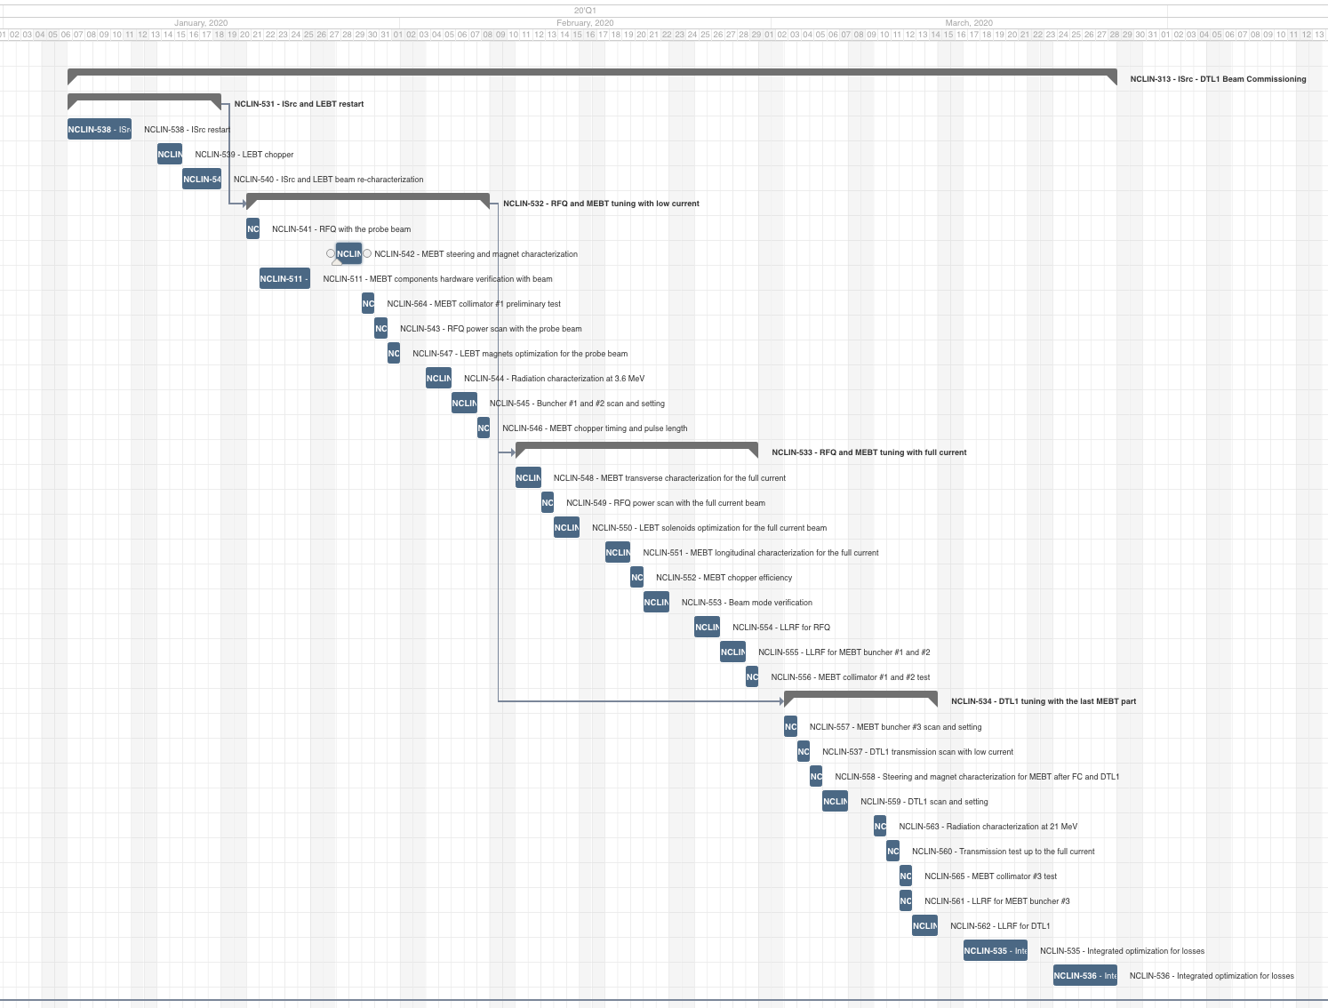
Example of commissioning sequence (3)
ISrc-DTL1 (under development!)
ISrc-LEBT restart
RFQ-MEBT low current
RFQ-MEBT high current
DTL1
ISrc-LEBT and ISrc-DTL1 are complexed due to many "chicken-egg problems".
Higher energy part required care for high beam power but more straightforward.

Slide 11
Beam modes
ISrc
< 100 mA
~3000 µs
5-2860 µs
~100 µs
LEBT
(chopper)
Mode | Current [mA] | Duration [µs] | Rep [Hz]
Probe | ~6 | ≤ 5 | ≤ 1
Fast tuning | ≤ 62.5 | ≤ 5 | ≤ 14
Slow tuning | ≤ 62.5 | ≤ 50 | ≤ 1
Long pulse verification | ≤ 62.5 | ≤ 2860 | ≤ 1/30
Production | ≤ 62.5 | 2860 | 14
6-70 mA
~0.1+20 µs
5-2860 µs
~0.1 µs
RFQ
6-63 mA
MEBT
(chopper)
6-62.5 mA
~0.01 µs
5-2860 µs
~0.01 µs
Notes:
.

Slide 12
Beam stops
Location | Type | Availability | Tuning | Long-pulse | Production
LEBT (inside tank) | FC | Permanent* | Yes | Yes | Yes
LEBT (outside tank) | FC | Temporary* | Yes | Yes | Yes
MEBT (inside tank) | FC | Permanent | Yes | -- | --
DTL2 (intertank) | FC | Permanent | Yes | -- | --
DTL4 (intertank) | FC | Permanent* | Yes | -- | --
Spokes (doublet #1) | Stop | Permanent | Yes | -- | --
Medium-β (doublet #6) | Stop | Permanent | Yes | -- | --
Dump line | Dump | Permanent | Yes | Yes | --
Target | Target | Permanent | Yes | Yes | Yes

Slide 13
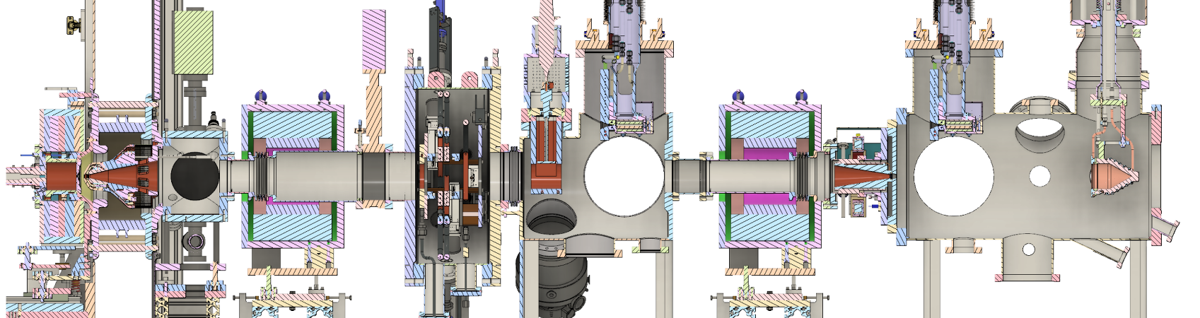
ISrc- LEBT commissioning configuration
(Plan)
BCM
- FC
- Allison (H)
- Allison (V)
- Camera (H)
- Camera (V)
- Doppler
- Camera (H)
- Camera (V)
- BCM
- Allison (V)
- Camera (H)
- Camera (V)
- FC
Source extraction
Solenoid 1 (Steerer 1)
Iris
Permanent tank
Solenoid 2
(Steerer 2)
Chopper
Collimator
Beam stop
Commissioning tank

Slide 14
ISrc- LEBT commissioning configuration
(How we started on 2018-09-19)
BCM
- FC
- Allison (H)
- Allison (V)
- Camera (H)
- Camera (V)
- Doppler
- Camera (H)
- Camera (V)
- BCM
- Allison (V)
- Camera (H)
- Camera (V)
- FC
Source extraction
Solenoid 1 (Steerer 1)
Iris
Permanent tank
Solenoid 2
(Steerer 2)
Chopper
Collimator
Beam stop
Commissioning tank

Slide 15
ISrc- LEBT commissioning configuration
(How we started on 2018-09-19)
BCM
- FC
- Allison (H)
- Allison (V)
- Camera (H)
- Camera (V)
- Doppler
- Camera (H)
- Camera (V)
- BCM
- Allison (V)
- Camera (H)
- Camera (V)
- FC
Running the real beam provides the best lesson, but...
We could have had a better platform to check and follow-up machine status and agreed beforehand on the acceptable state to start the beam. (Performance related issue was out of scope of this SRR.)
Only occasion to use an external stop and diagnostics. We could never come back to this configuration.
Only occasion, besides target, we can test the nominal beam parameters.
Source extraction
Solenoid 1 (Steerer 1)
Iris
Permanent tank
Solenoid 2
(Steerer 2)
Chopper
Collimator
Beam stop
Commissioning tank

Slide 16
NC linac commissioning configuration
(baseline)
ISrc - MEBT, DTL1
MEBT FC
DTL2 FC
DTL4 FC
RFQ
MEBT
DTL1
DTL2
DTL3
DTL4
DTL5
DTL1-4 installed but only DTL1 powered.
MEBT and DTL2 FCs at their nominal locations.
Temporary shield wall + DTL4 FC with shielding at DTL5.
Temp shield wall
ISrc - DTL4
MEBT FC
DTL2 FC
DTL4 FC
RFQ
MEBT
DTL1
DTL2
DTL3
DTL4
DTL5
DTL1-4 powered.
MEBT and DTL2 FCs at their nominal locations.
Temporary shield wall + DTL4 FC with shielding at DTL5.
Temp shield wall

Slide 17
NC linac commissioning configuration
(updated)
ISrc - MEBT, DTL1
MEBT FC
DTL2 FC
RFQ
MEBT
DTL1
DTL2
DTL3
DTL4
DTL5
DTL2-3 not installed. DTL4 installed but not powered.
DTL2 FC placed right after DTL1. (With shielding?)
Temporary shield wall at DTL5.
Temp shield wall
ISrc - DTL4
MEBT FC
DTL2 FC
DTL4 FC
RFQ
MEBT
DTL1
DTL2
DTL3
DTL4
DTL5
No change from the baseline.
Temp shield wall

Slide 18
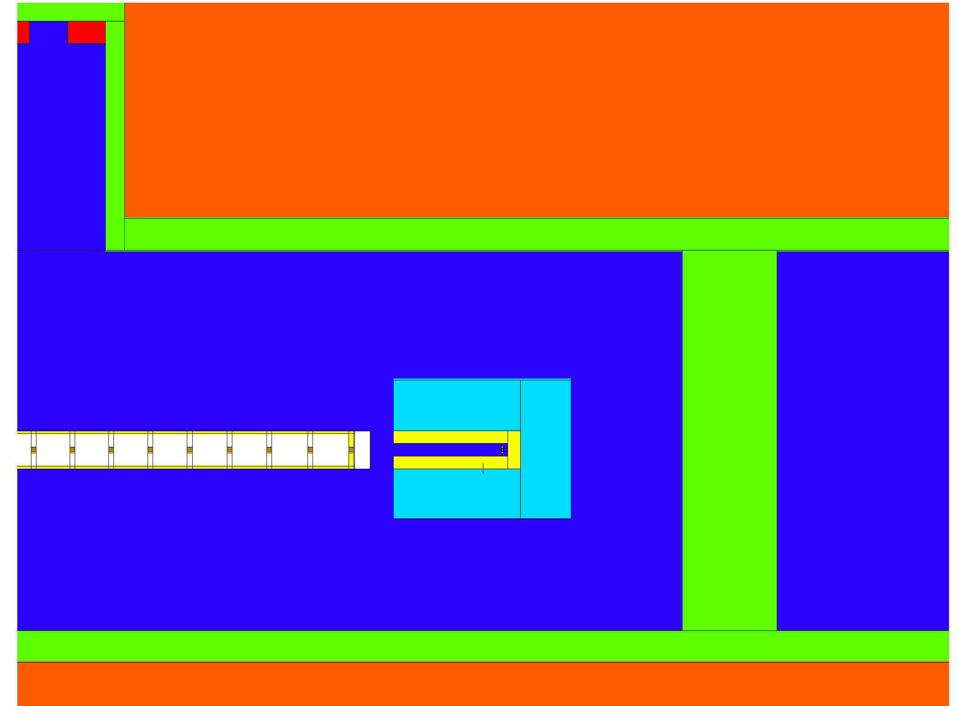
Limits during the NC linac commissioning
(ESS-0118232 under revision)
This configuration (FC shielding + wall) allows the NC linac beam and SC linac installation in parallel.
Prompt dose limit:
  3 µSv/h (supervised area)
  Averaged over 1 hour
Limits in dose and FC itself are comparable. If either is missing, the beam very limited.
Courtesy of K Batkov
FC
DTL4
FC | Energy [MeV] | Ave curr lim [µA] | Probe lim [min/hour] | Slow-tuning lim [min/hour] | Fast-tuning lim [min/hour]
DTL4 | 22 | 8.8 | -- | -- | --
 | 40 | 3.0 | -- | 57 | 41
 | 57 | 1.4 | -- | 26 | 19
 | 74 | 1.2 | -- | 23 | 16
DTL2 | 22 | 8.8E-3 | 17 | 0.1 | 0.1
 | 40 | 3.0E-3 | 6 | 0.0 | 0.0
Notes:
Updated numbers for the single layer shielding wall
- 1300 µA, DTL1
- 1.57 µA, DTL4 and 74 MeV

Slide 19
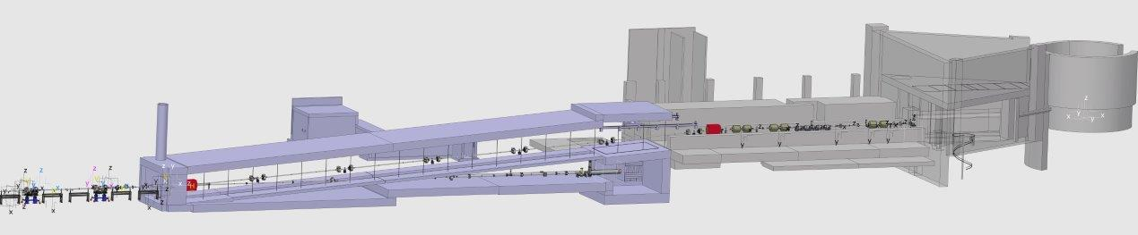
No special configuration after the NC linac commissioning
Target
Tuning dump
The beam is stopped with internal beam stops, tuning dump, or target.
  The tuning dump could bear with the 2.86 ms pulse but only at 1/30 Hz (12.5 kW).
Only available number of cryomodules change over time.

Slide 20
Summary
Status of planning beam commissioning activities and their sequence:
  For the ISrc-LEBT stage, the developed plan is being executed and also updated to adopt to situation.
  For the NC linac stage, plan is being detailed.
  For the SC linac stage (starting in ~2.5 years), due to a resource limitation, we only have very high-level plan (and studies).
The schedules of the stages beyond the ISrc-LEBT are aggressive but using internal and permanent beam stops and diagnostics allow to come back and repeat the process in any given point, later.
  On the contrary, the ISrc-LEBT stage is unique.
One lesson learned so far:
  All the reviews on ISrc and LEBT were focused on installation, testing, and safety, but performance related issues deserve more attention.
    One example is the re-design of the LEBT chopper.
  We could either expand scopes of reviews or introduce another platform.

Slide 21
Backup

Slide 22
Simple and or standard tuning
Standard linac/beamline tuning, requiring a dedicated application:
Linear optics verification
  Polarity check
  Beam based alignment
  Trajectory correction
RF phase and amplitude setting
Transverse matching with 3+ profile measurements
For beam transports and RFQ, many adjustments are done with a simple parameter(s) scan:
LEBT
  Iris verification
  Chopper verification
RFQ
  Amplitude scan
  Matching with LEBT solenoids scan
MEBT
  Chopper verification
  Collimator positioning
A2T (including dogleg)
  Achromatic condition verification
  Cross-over point verification
  Raster verification
Online beam physics application and diagnostics devices are keys to efficient beam commissioning.
Further details on tuning were presented in the past conference, workshops, and reviews.

Slide 23
Could-be-challenging tuning
(Excluding operational challenges such as protection)
ISrc optimization
  Unlike H- machines, we need to balance the current and beam quality.
Optics tuning of the non-periodic MEBT
Twiss and emittance reconstruction with a quad or cavity scan
  Space charge and beam loss require extra care.
Matching at the frequency jump
  Frequency jump at the SPK-MBL interface is the weakest point of our linac and requires a smooth matching. But, there is no nearly direct longitudinal measurement.
Beam loss mitigation
  We don't have the obvious beam loss cause of H- stripping.

Slide 24
ISrc- LEBT operations configuration
BCM
- FC
- Allison (H)
- Allison (V)
- Camera (H)
- Camera (V)
- Doppler
- Camera (H)
- Camera (V)
- BCM
Source extraction
Solenoid 1 (Steerer 1)
Iris
Permanent tank
Solenoid 2
(Steerer 2)
Chopper
Collimator

