Slide 1
High Level Readiness Reviews
J. G. Weisend II
www.europeanspallationsource.se
October 18, 2018

Slide 2
Introduction
Since 2014, The ACCSYS Project has held more than 100 formal design reviews (PDRs and CDRs)
These reviews:
  Are listed on https://confluence.esss.lu.se/display/ASTR
  Are consistent with ESS policy
  Are carried out at the component and subcomponent level
  Check that the designs will meet the requirements
  Result in reports entered into CHESS
  Generate recommendations that are tracked: https://jira.esss.lu.se/projects/ADR/issues/ADR-163?filter=allopenissues

Slide 3
Introduction
With the ACCSYS Project moving into installation and commissioning, few design reviews remain.
Instead, we are increasingly conducting higher level readiness reviews. The principal ones are:
  Installation Readiness Reviews (IRRs)
  Test Readiness Reviews (TRRs)
  Safety Readiness Reviews (SRRs)

Slide 4
Installation Readiness Reviews (IRRs)
Checks that the system or component is ready to install and all supporting systems (transport, rigging alignment etc. are also ready.
Ensures that all worker training is complete, that all permits have been issued, all required documentation done, all safety issues addressed and that the installation activity will not conflict with other work.
These reviews:
  Are listed on https://confluence.esss.lu.se/display/ASTR
  Are generally held within a month prior to the start of installation
  Are consistent with ESS policy
  Are carried out at the component and subcomponent level
  Result in reports entered into CHESS
  Generate recommendations that are tracked: https://jira.esss.lu.se/projects/ADR/issues/ADR-163?filter=allopenissues

Slide 5
Installation Readiness Reviews (IRRs)
IRRs are requested by the component’s installation manager (WP manager or designee).
IRRs are chaired by J. Weisend (Technical Components) or O. Lagerblad (Infrastructure).
Committee members include: representatives from affected work packages, area supervisor, safety, QA, alignment (if required).
Presenters at review include: installation subcontractors and WP representatives.
Complex systems such as cryoplants may have multiple IRRs.
Will make use of installation binder

Slide 6
Installation Readiness Reviews (IRRs)
IRRs Held So Far
IS – LEBT
ACCP
TMCP
TICP (Parts 1 and 2)
RFQ Water skid
HEBT Vacuum system
CDS-LTS2
IS-LEBT Safety Fence
DTL Workshop
Studs Mechanical Installation
Test Stand 3 Water Manifold

Slide 7
Installation Readiness Reviews (IRRs):
Upcoming Reviews
Technical Systems ( J. Weisend) | Infrastructure ( O. Lagerblad)
RFQ | Cable installation in the tunnel, Gallery and stubs (may be more than 1 IRR)
MEBT | RFDS in gallery, Tunnel and Stubs (may be more than 1 IRR)
DTL ( possibly more than one IRR here) | Remaining Water Installation in Gallery and Tunnel
Spoke cryomodules | All other equipment in Gallery (modulators, RF sources etc)
Medium Beta Cryomodules
High Beta cryomodules
LWUs and Warm Beam Line
CDS-EL and CDS-SPK
TMCP transfer line
RSM system

Slide 8
Test Readiness Reviews (TRRs)
May occur prior to start of manufacturing to ensure that QA inspections, component tests and FAT are appropriate. – (thus more of a manufacturing readiness review)
Willl also occur prior to the final SAT at ESS.
  In the case of some beam line components this review will be part of the Safety Readiness Review.
  In the case of the cryoplants, detailed SAT plans were reviewed at the CDR stage. A prestart up checklist is completed prior to the start of any cryoplant testing.

Slide 9
Test Readiness Reviews (TRRs)
These reviews:
  Are listed on https://confluence.esss.lu.se/display/ASTR
  Are consistent with ESS policy
  Are carried out at the component and subcomponent level
  Result in reports entered into CHESS
  Generate recommendations that are tracked: https://jira.esss.lu.se/projects/ADR/issues/ADR-163?filter=allopenissues

Slide 10
TRRs Already Held
IS – LEBT
CDS-EL
CDS-LST2
CDS-SPK (valve box)

Slide 11
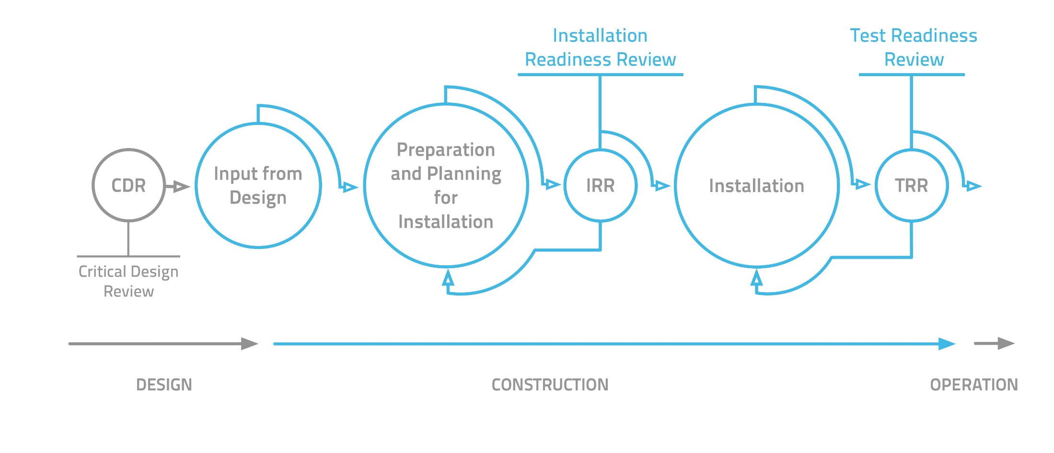
IRRs and TRRs
Installation binder IB

Slide 12
Safety Readiness Reviews
The final review before the start-up of Beam Line components. Required prior to the issurance of beam permit.
Organized by ES&H using a panel of external experts.
Reviews systems, documentation, procedures, personel training and awareness.
Includes an extensive document review, presentations, site tour and staff interviews.
SSM attends as an observer.
Final documentation, including operating procedures and training records, required at this stage.

Slide 13
From the IS – LEBT SSR Charge
This review (held July 2018) generated a list of activities that had to be completed prior to the start of operation along with recommendations that could be addressed after the start of operation.

Slide 14
Planned SRRs
IS – LEBT (Held July 2018)
Test Stand 2 (cryomodule test stand)
Normal Conducting Linac
Complete Linac (including superconducting section) to Beam Dump
Complete Linac to Target (reduced beam parameters)
Complete Linac to Target (nominal beam parameters)

Slide 15
Summary
An extensive set of design reviews have been held to date.
As ESS moves into installation and commissioning higher level readiness reviews are required.
These reviews (IRRs, TRRs and SRRs) have been developed and are important milestones in the project.
A number of the high level readiness reviews has been held to date for the accelerator and have provided both valuable recommendations and confidence that we are ready to move into the next stage of installation and commissioning.

