Slide 1
Lessons from the 1st Safety Readiness Review
Lali Tchelidze
Operations Section Leader
Accelerator Division
October 18, 2018

Slide 2
INTRODUCTION

Slide 3
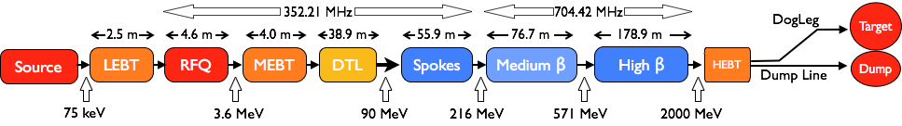
Commissioning stages
Ion source and LEBT (75 keV), beam to FC - ongoing
RFQ and MEBT (3.6 MeV), beam to FC
DTL1 (22 MeV), beam to FC
DTL2 to DTL4 (40 MeV, 57 MeV, 74 MeV), beam to FC
DTL5 and SCL, beam to Beam Dump
Full accelerator, beam to Target

Slide 4
Process to get to beam commissioning
License
Safety Readiness Review
Beam Permit
Beam commissioning/operation
Hardware testing

Slide 5
Safety Readiness Review
SRR process at ESS is equivalent of the Accelerator Readiness Review process for the national labs in the US.
The purpose of the SRR process it to review the readiness to safely commission and operate a system.
The SRR is a process by which hardware, personnel and procedures associated with commissioning and operation of the system is verified.
SRR is organized by ESH&Q using external and internal (independent) reviewers.
SRR1 (for ion source and LEBT) was performed on July 2018.

Slide 6
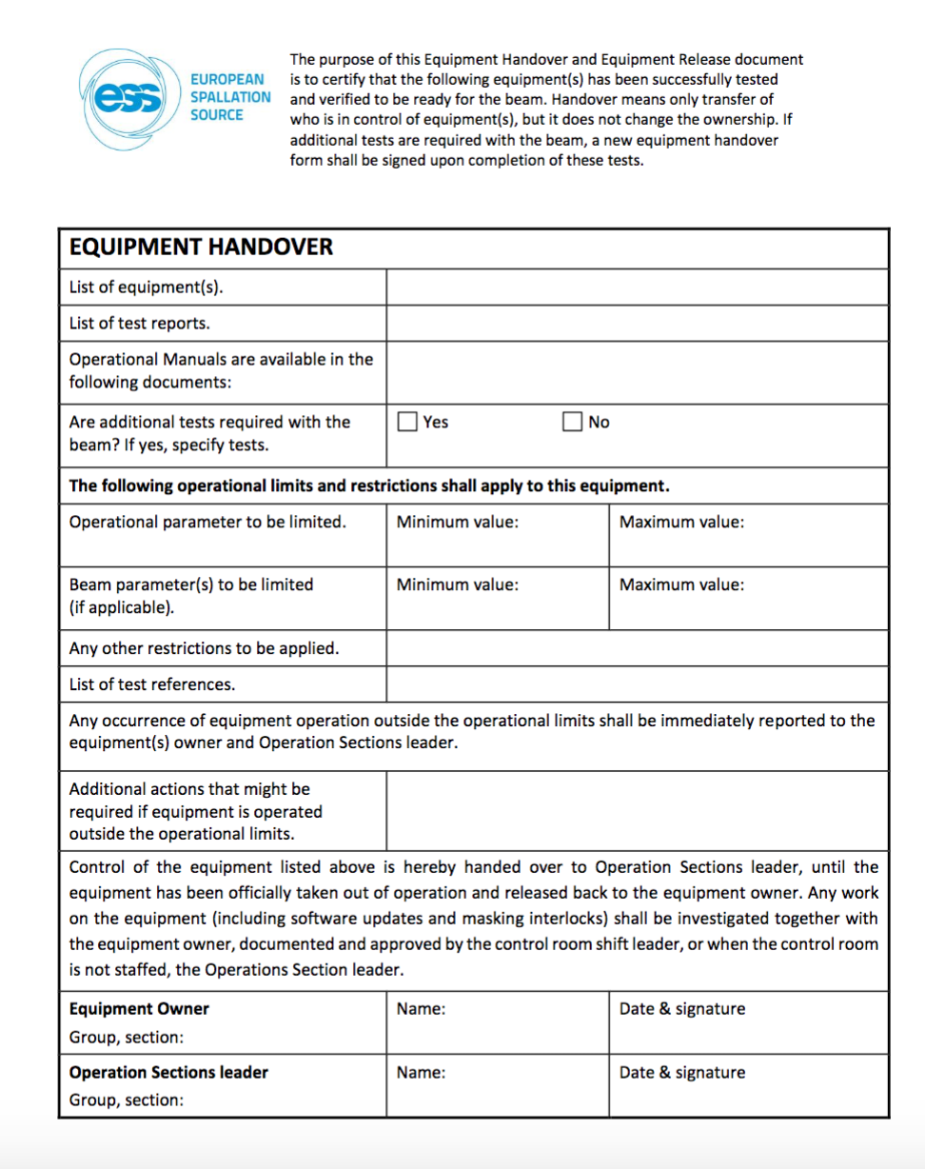
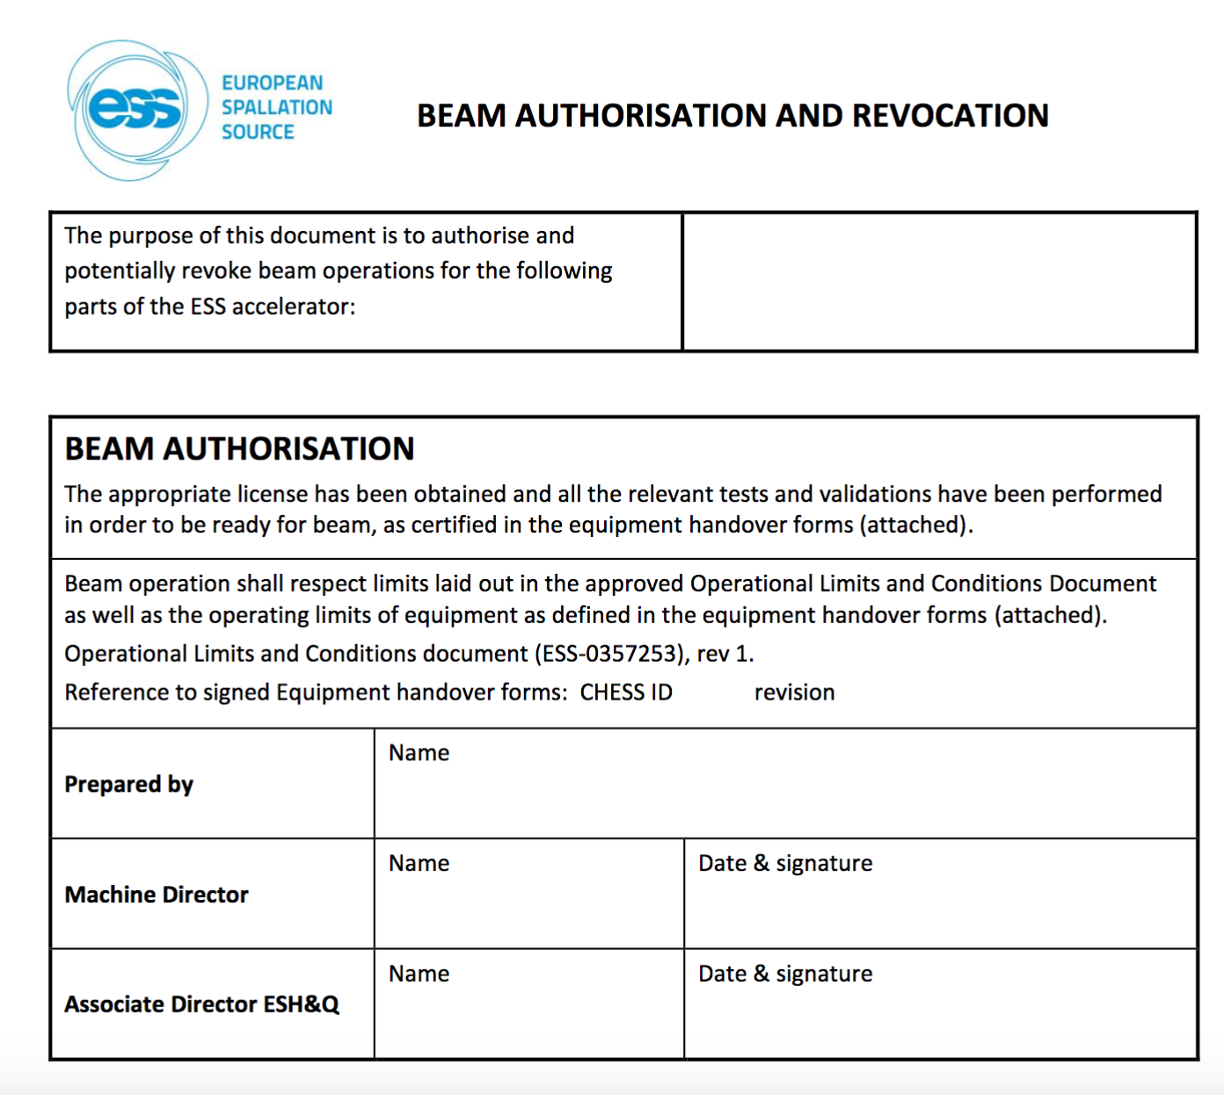
Beam Permit
Pre-start items were finished, relevant equipment was handed over to the operations section and the beam permit was signed by the laboratory management on September 19th
Final pre-requisites for beam permit are equipment handover and Operational Limits and Conditions (OLC).
SSM observed SRR and SSM came for a surveillance meeting to ESS in early September.

Slide 7
LESSONS LEARNED

Slide 8
What went well
We got beam!
We have seen a very good team spirit and high degree of involvement and commitment from system owners.
The weekly preparation and follow-up meetings were effective at getting the team together and working against the same goals.
The vacuum sub-system commissioning, documentation and testing was very good and could be used as an example for how to do system development and commissioning.
PSS0 system operating instructions and training was very good, the shift leaders have good experience as we have not had a single trip in a month.
Equipment handover and release forms, also beam permit and revocation forms were successfully introduced.
Morning standing meetings were successfully introduced and are been exercised, this enhanced coordination with the area coordinators.

Slide 9
What didn’t go well
Sorting out the ability to energize systems was extremely and inexplicably delayed.
The situation and discussions around the masking of interlocks highlighted the lack of clearly defined guidance and ownership.

Slide 10
What we should do better
Give an authority (not just downwards but also upwards) and clear mandate to a person responsible for overall coordination and strategic planning across AD and ICS.
Establish a good plan (consider dependencies, prerequisites, etc.) and allow more time to complete planned activities. For the next stage, don’t underestimate effort to re-install and re-test systems used today, as the set-up changes almost completely.
Involve ESH earlier.
Account for delays (e.g. if the electrical installation is delayed 3 weeks, move the SRR for 3 weeks).
Establish core team.
Ensure that the test results from partners are comprehensively documented.
Follow the defined test plans and if some tests need to be omitted, justify by analyzing impact on safety or machine.

Slide 11
What we should do better
Plan for longer time and more resources for commissioning activities. Base the future commissioning plan (number of people and time) on experience from this stage of commissioning.
Put stricter requirements on documentation going into commissioning.
Re-discuss and define the meaning/purpose of the equipment handover and have a staged approach. Perform handover before the SRR.
Clearly define operations role and involvement in hardware testing and beam commissioning.
Clarify the purpose and scope of the SRR, ensure that the beam readiness is included. The name is confusing.

Slide 12
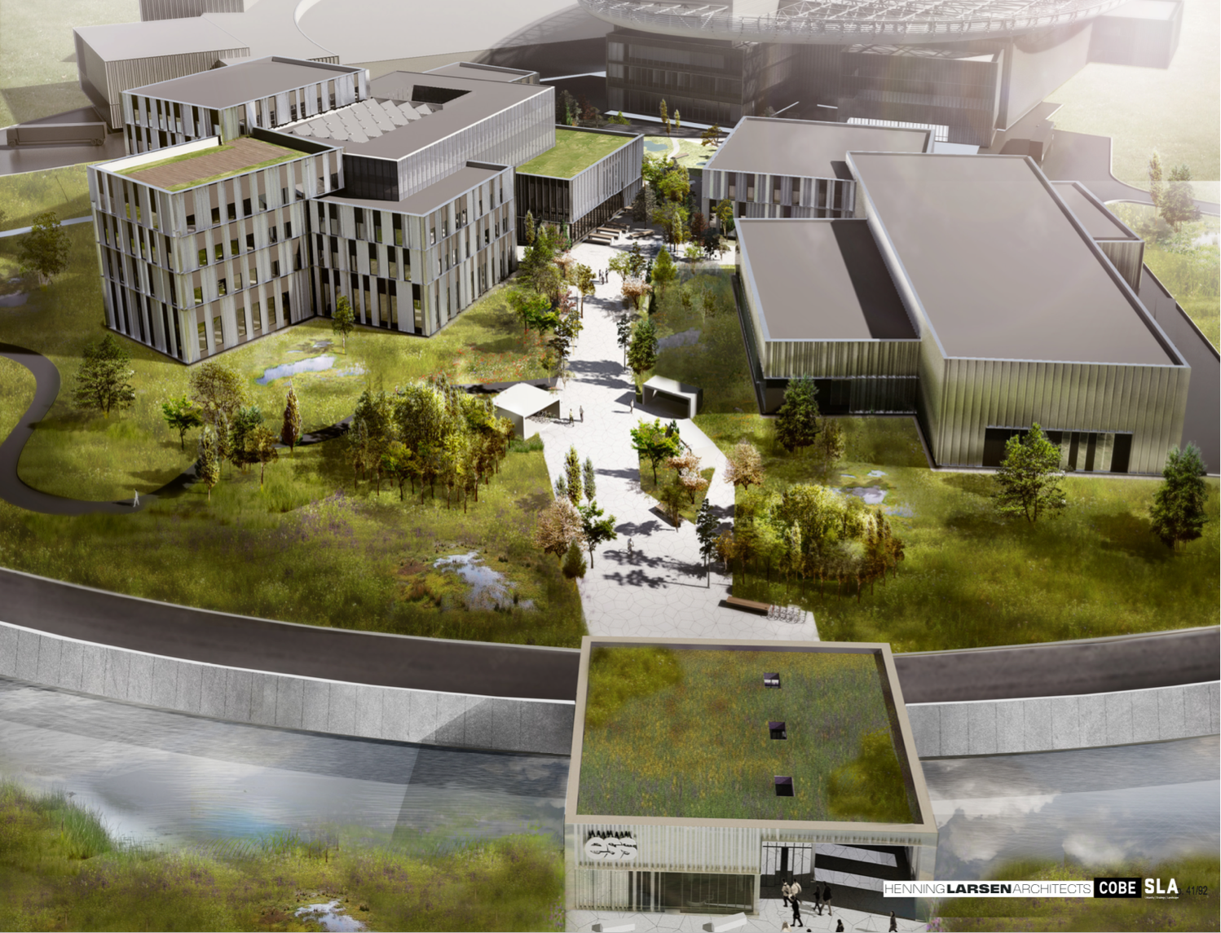


Campus
Thank you!

