Slide 1

Monolith Inner Shielding Design
Ulf Odén
WP Manager Target System
www.europeanspallationsource.se
17 October, 2018

Slide 2
Outline of the presentation
Charge question
Design requirements
Monolith Inner Shielding Design
Fatigue and fracture mechanics
  Conventional fatigue analysis
  Fracture mechanics analysis
Pipe connection
  Mock-Up
Water Channels
  Prototype
Testing of final shielding block
Conclusions

Slide 3
Charge question
Presentation of technical solution for the monolith inner (water-cooled) shielding, comparison to specified requirements (Ulf Odén, Mats Segerup) Charge question: Will the presented technical solution, for the inner water-cooled monolith shielding, be a reasonable compromise to conflicting and challenging requirements?

Slide 4
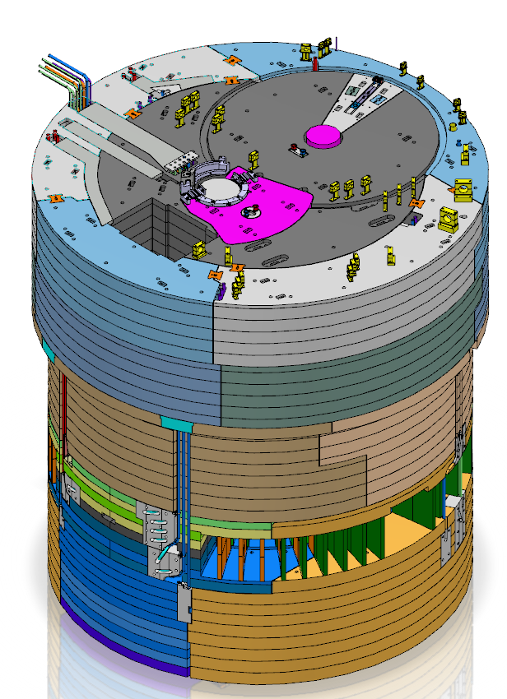
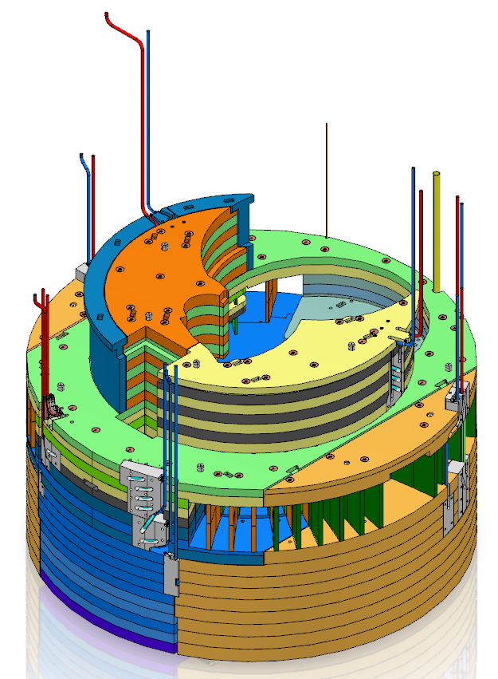
Design requirements
Maximum leakage 1g water/h
Minimum 40 year of operation

Slide 5
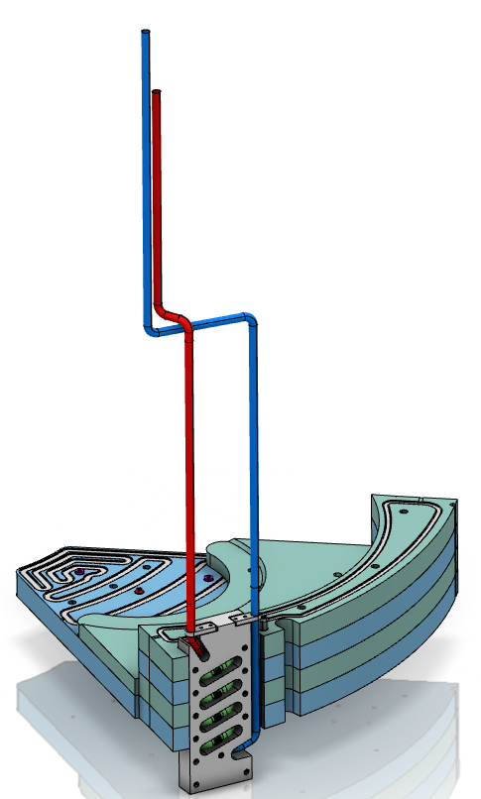
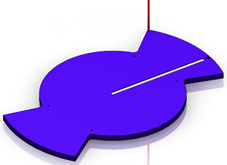
Monolith inner shielding design

Slide 6
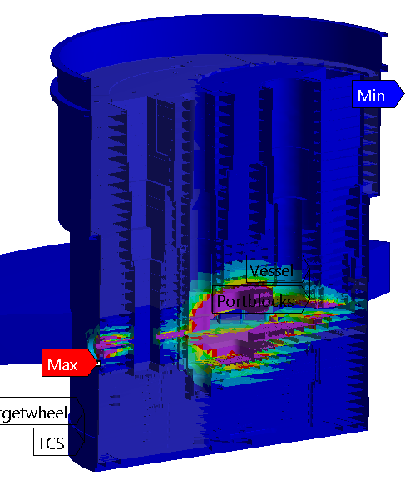
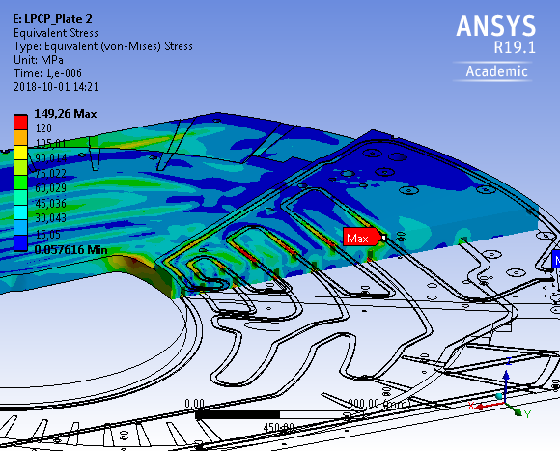
Fatigue and fracture mechanics
Heat load in the Monolith
Thermal stress in the shielding block
Max stress value 149.26 MPa

Slide 7
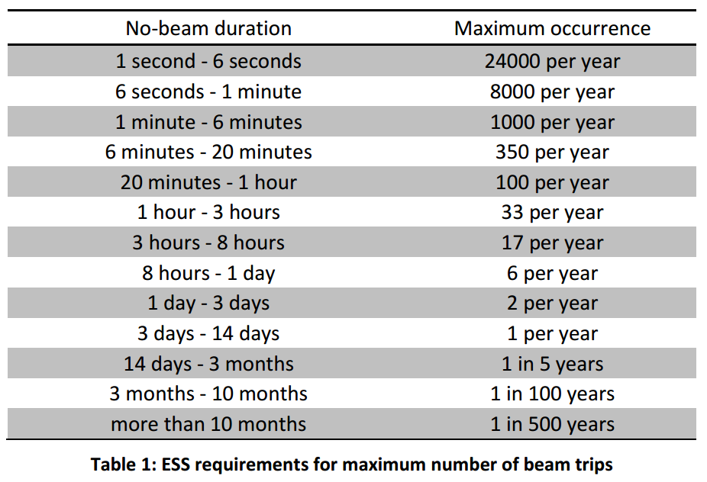
Fatigue analysis
Stationary thermal stresses are harmless.
Variations in thermal stresses may however generate fatigue and subsequent cracking. Stress variations arise from beam trips.
ESS-0008886 ESS Reliability and Availability requirements

Slide 8
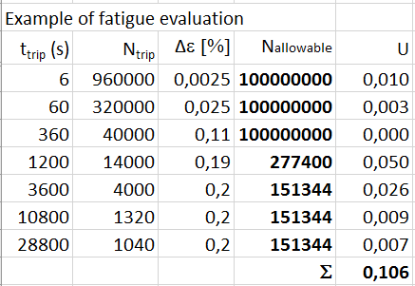
Fatigue and fracture mechanics
Conventional fatigue analysis

Slide 9
Fatigue and fracture mechanics
Fracture mechanics
  Initial finite surface crack 1 mm depth and 5 mm width is postulated,
  During the plant life, i.e. the full set of beam trips, this initial crack growths to 2.7 mm depth and 7.5 mm width,
  Hence, such an initial crack does not grow to penetrate the cover during plant life and hence leakage should not be expected,
  At final crack size (2.7 x 7.5 mm) the fracture toughness exceeds the stress intensity factor and hence no sudden rupture will occur anytime during plant life, (fracture mechanics = in air)
  This result follows from upper bound considerations of fatigue loading and is hence valid for all locations in the entire stack.

Slide 10
Fatigue and fracture mechanics
detect crack during manufacturing
  Based upon the RCC-MRx leak rate analysis procedures, we arrive at the conclusion a through-thickness crack need be 1.5 mm wide to generate leak rate 1 gr/h,
  An initial crack of 0.75 mm width will reach 1.5 mm width during plant life from fatigue loading.

Slide 11
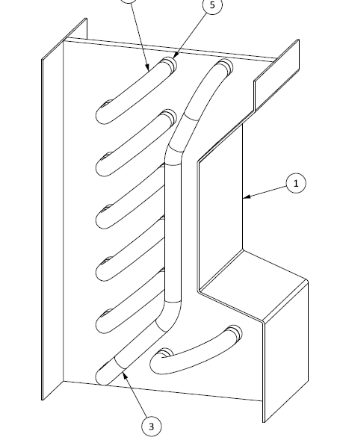
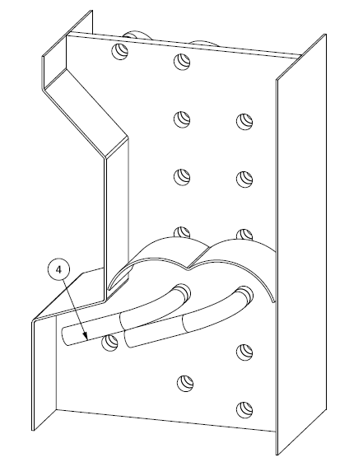
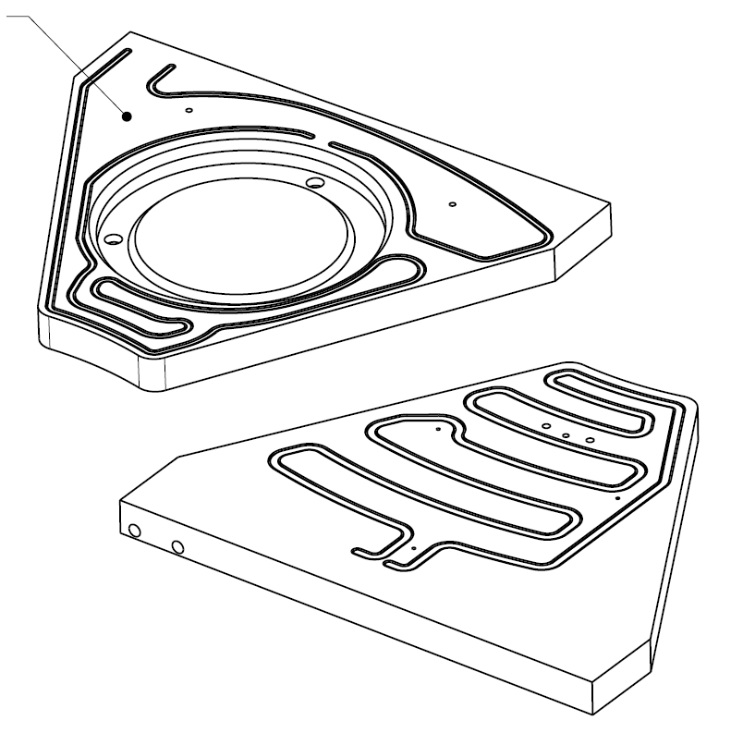
Prototype and Mock-Up
Mock-Up
Prototype

Slide 12
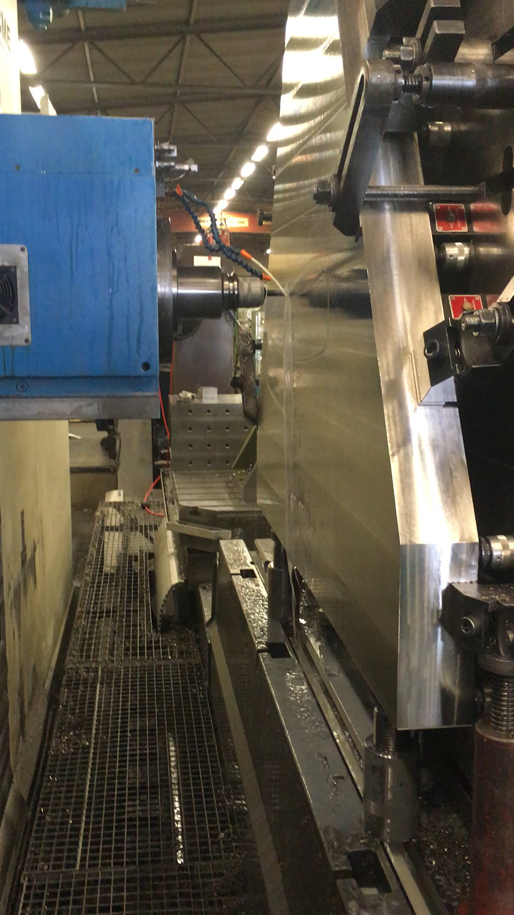
Prototype
the lid will have to hang freely in order the achieve optimized weld properties.
A fixture will be welded to the lid in order to keep the lid in place during welding.
The dimensions of both the lid and the groove has been redesigned several times.
45°
35°
Lid
2
Plate
~1,5
Lid
Plate

Slide 13
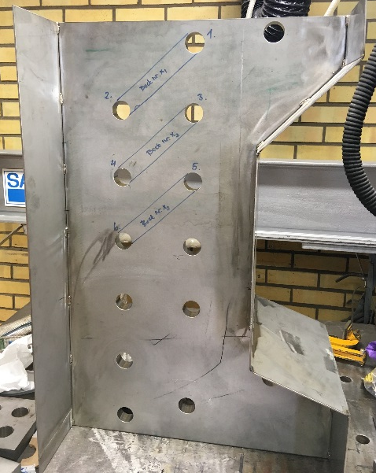
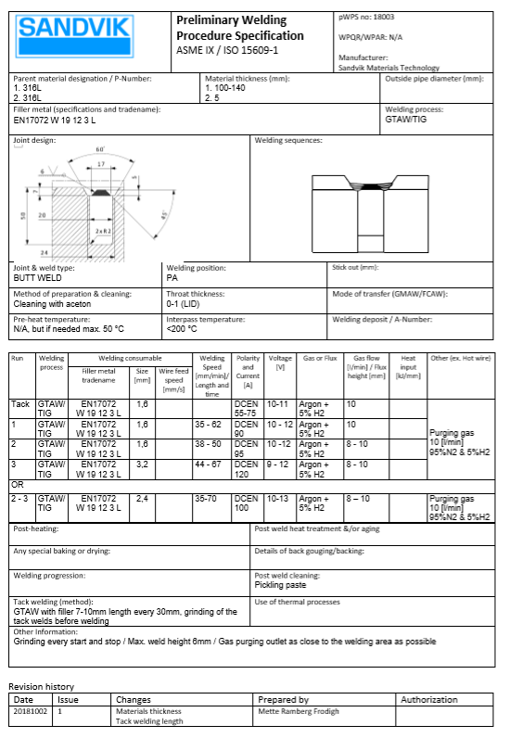
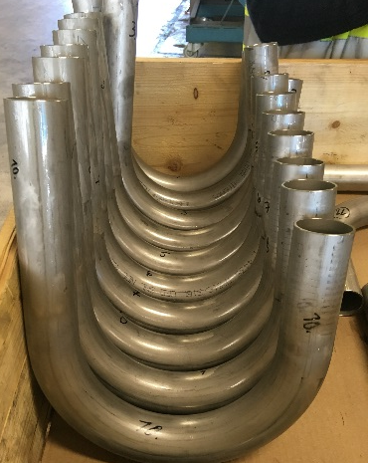
Mock-Up
Evaluate the welding using manual TIG for the grove and the orbital weld head.
Test the accessibility to perform the welding with good quality.
Create a p-WPS
Produce tube bends for the mock-up

Slide 14
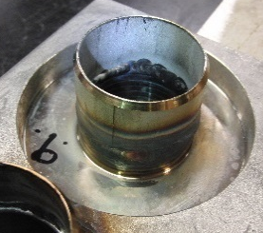
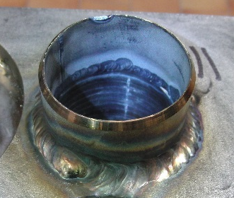
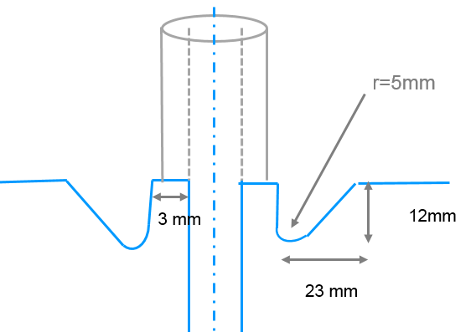
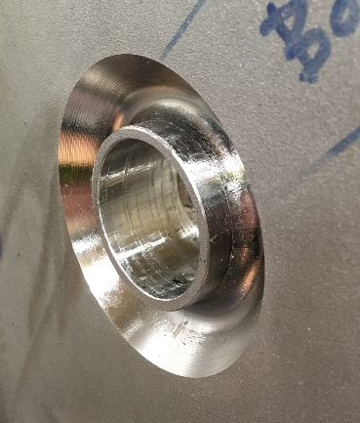
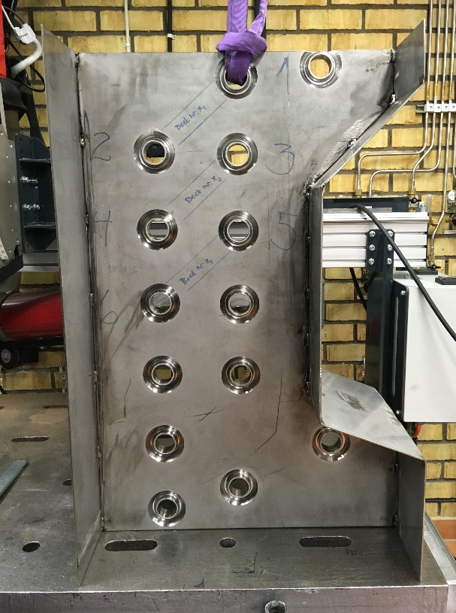
Mock-Up
Tube to Plate
Tube to “Tube”
a

Slide 15
Testing of final shielding block 1/3
Additional material testing requirements
The inclusion content is limited and tested according to ASTM E45
Each individual plate is volumetrically tested with Ultrasonic testing according to EN 10307 S3/E4
IK-corrosion test is performed
The chemical composition is restricted regarding Sulphur and Aluminium content

Slide 16
Testing of final shielding block 2/3
Additional weld inspection requirements
The root pass and the following weld layers are tested 100% with liquid penetrant test to verify that there are no cracks or imperfections between the weld layers
The internal of the cooling channels are inspected 100% with borescope to guarantee full penetration and that there are no surface penetrating defects or dangerous welding oxides
Welding procedures and testing procedures are tested on a mock-up

Slide 17
Testing of final shielding block 3/3
Final inspection requirements
Every single cooling block is pressure tested at 1.43 x design pressure
Every single cooling block is helium leak tested according to the high vacuum rules

Slide 18
Conclusions
No leaks during the life time of the facility is challenging
Conservative calculations
Welding tests in both Mock-Up and Prototype
“100%” Inspections
These three actions will make it reasonable to install shielding according to the design.

