Slide 1
Radioactive Waste Building
Lennart Stenman
Presentation for TAC 2018 10 18
www.europeanspallationsource.se
17 October, 2018

Slide 2
Requirement for the H09 (RW Building)
Handling of Low-Level and Very-Low-Level radioactive solid waste
Handling of contaminated sewage water, contaminated fire extinguish water and (activated) water from cooling circuits
Handling of spent Ion Exchange Resins (intermediate level)
Preparation of external transports
De-contaminate large vehicles (specific external requirement from the local Fire Brigade)

Slide 3
Development 2018
PDR - February
  Remarks that the “pipe-line” solution would create problem for potentially mixing contaminated water with clean water
  Questions regarding the amount of waste (general)
  Remarks that the size of the building was probably too small
CF cost reduction Working Group – April-Aug
  The Group had 8 meetings that has included all stakeholders (AD, TD, CF, ESH, ICS, NSS)
  Two sub-groups were initiated to establish solutions for :
    Yearly waste streams for the first years of operation
    Waste water (from D/E building) handling

Slide 4
Key findings – Working Group
Definition of waste water
  ”supervised area” laboratories considered always clean, directly to VA-Syd via discharge tank, an ”accident” if contaminated.
  Target area risk water does not justify pipeline – “may never occur”
Waste streams defined different for two stages:
  Build up stage 2022-2030, each stakeholder to update waste documents
  Steady state stage 2031 -2065, update documents
External and internal transports from and to H09 to be re-assessed. November JPARC visit focus on cask transports and regulations.

Slide 5
Scrubbing result of Preliminary Design H09
Tank transport for contaminated and activated water to Waste Building
Reduced building area for “build up” stage (2022-2030)
Reduce tank size in H09; same functions
reserve expansion areas
develop solution for licensed transport cask – collaboration

Slide 6
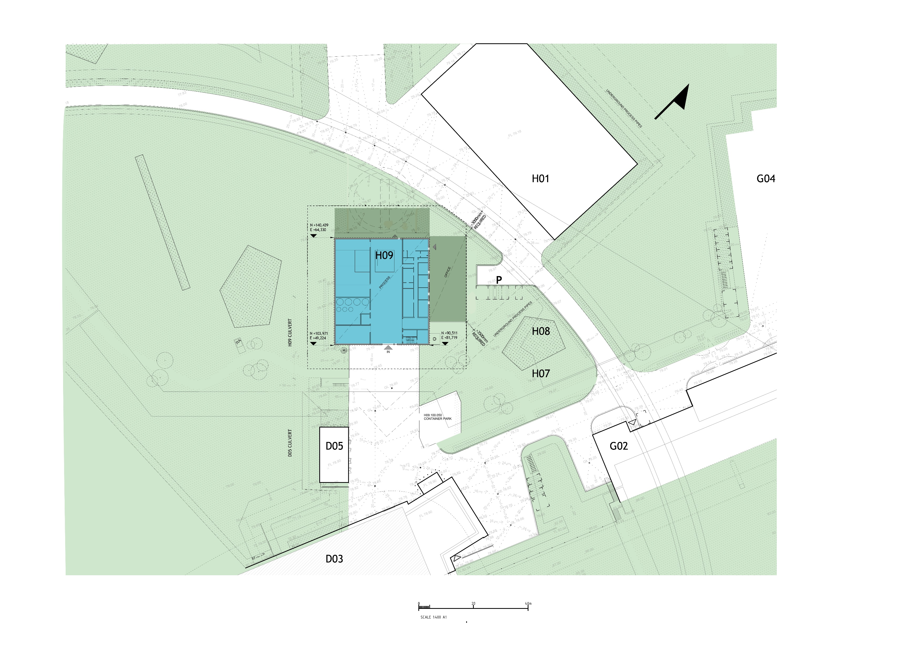
Site plan
Upgrade areas
Access line

Slide 7
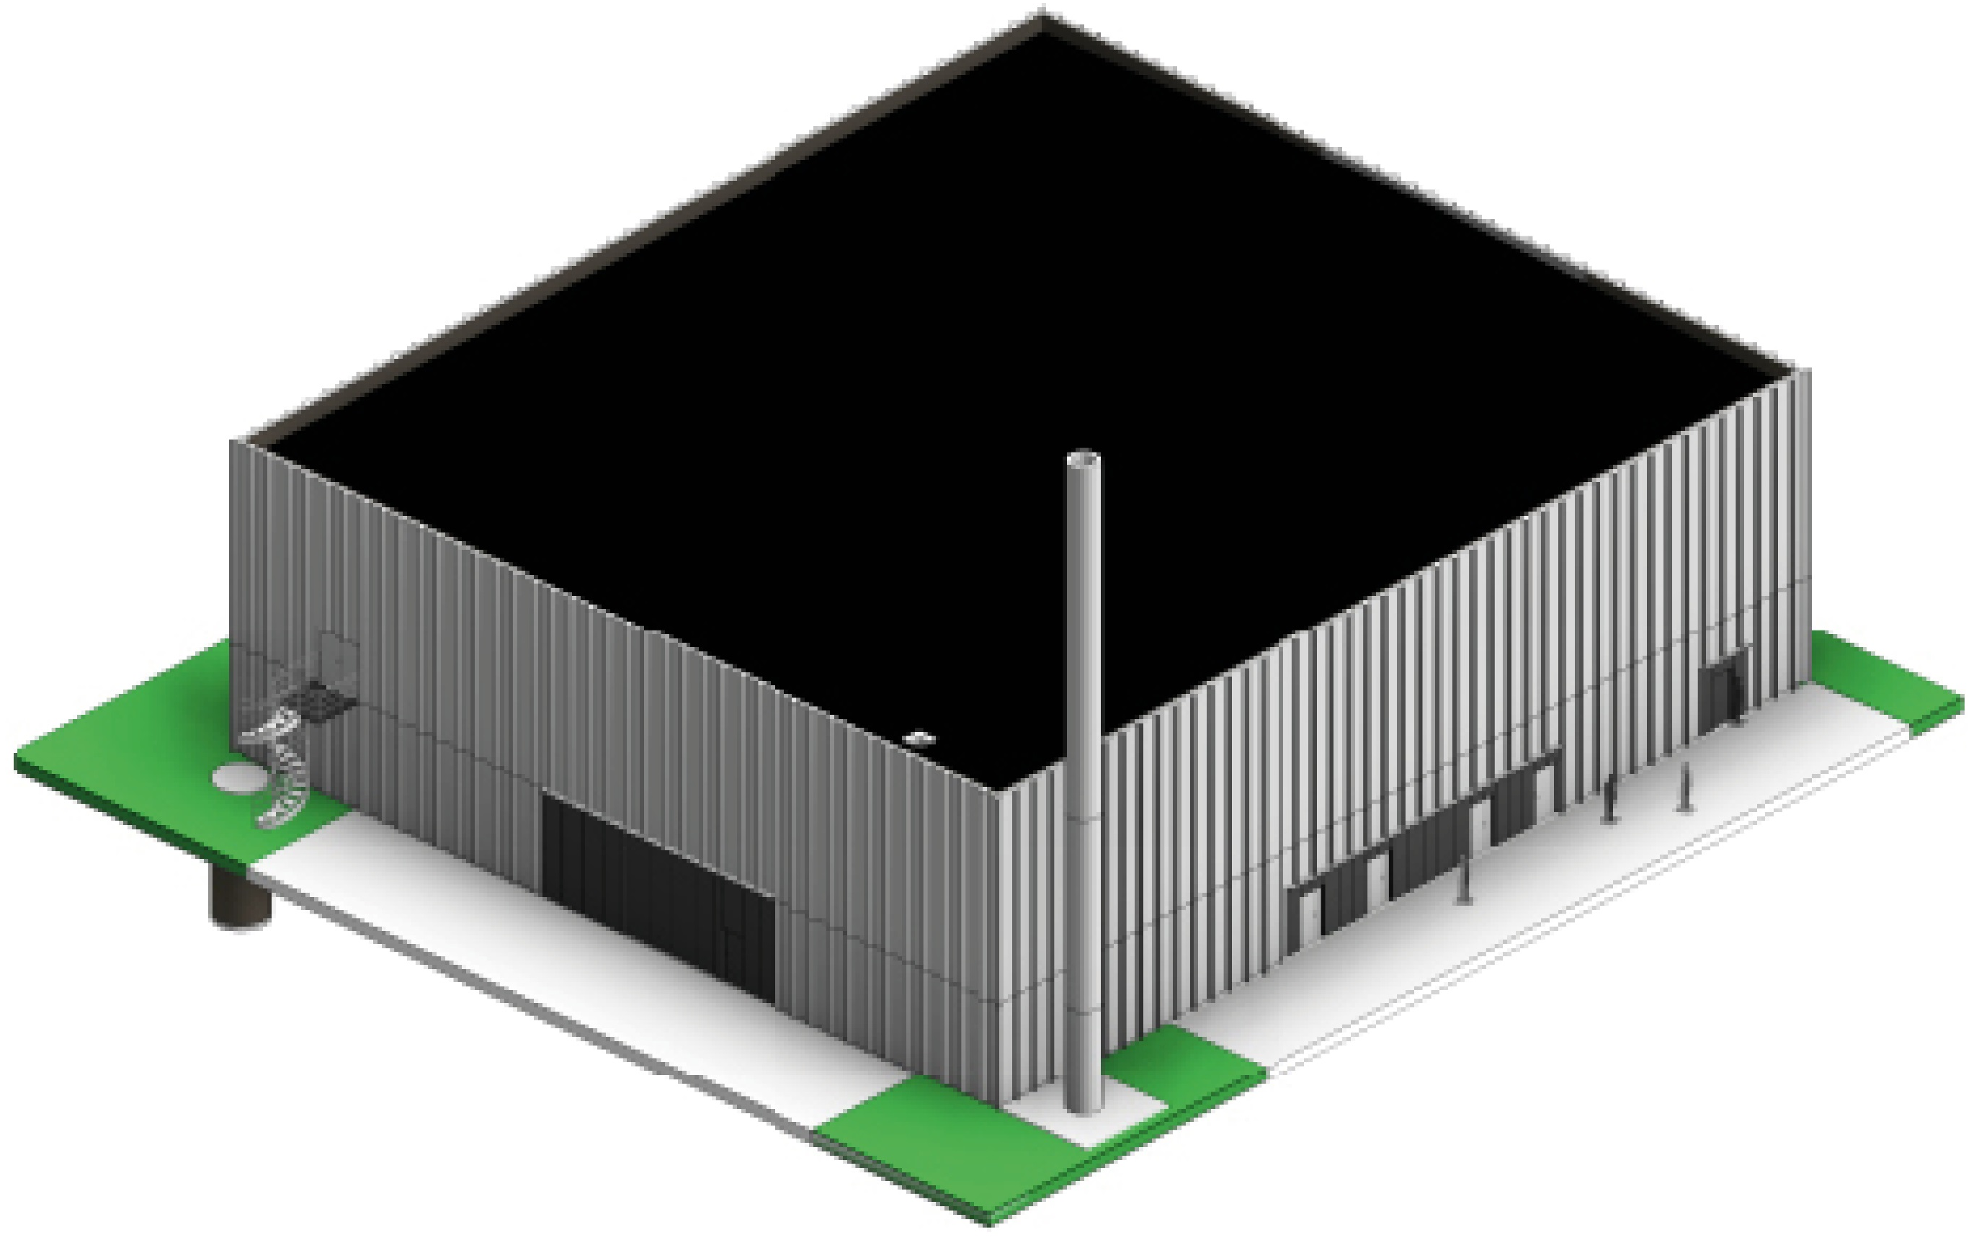
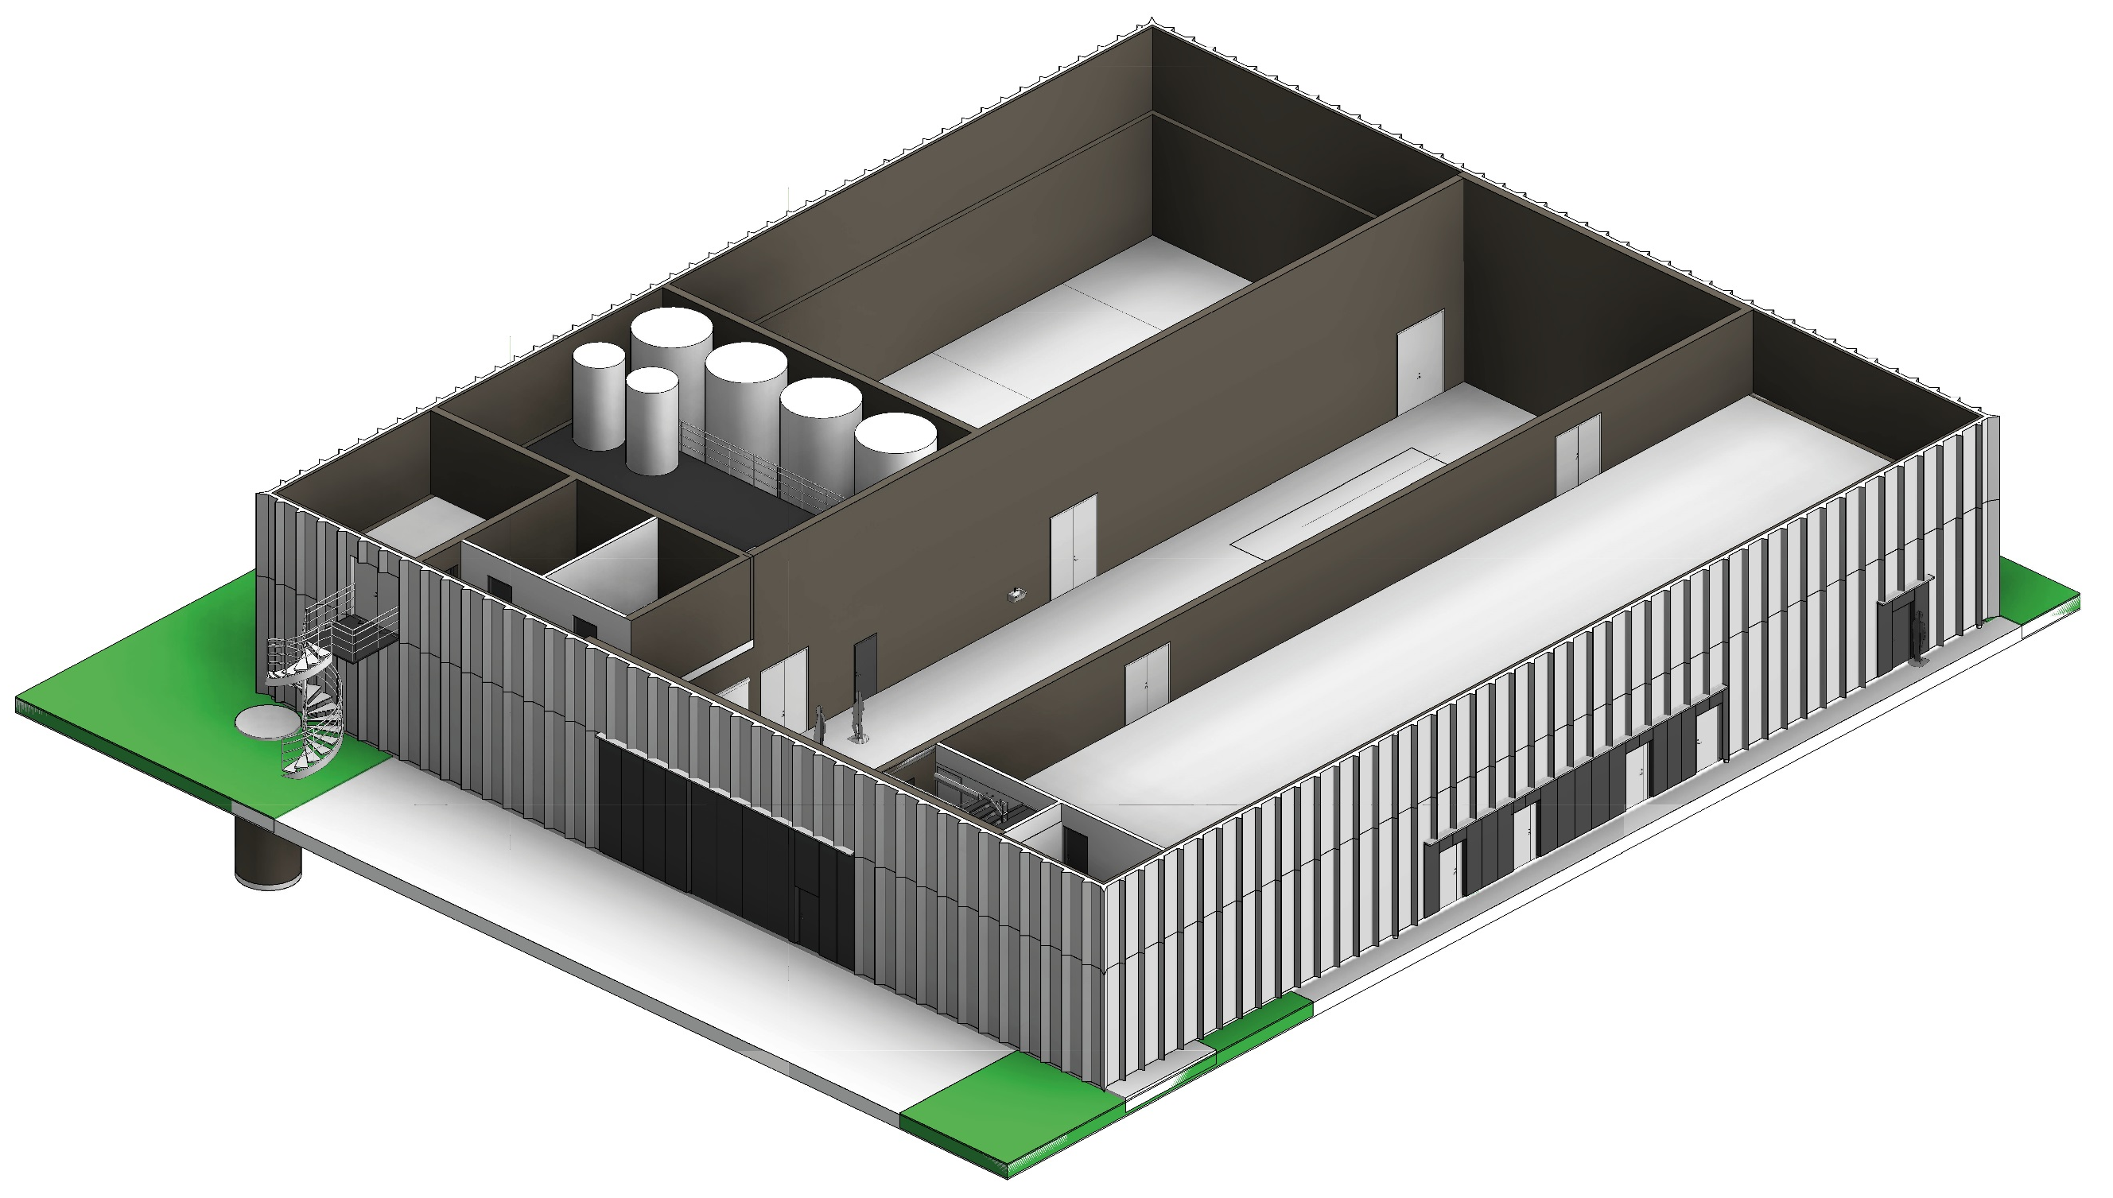
H09 view

Slide 8
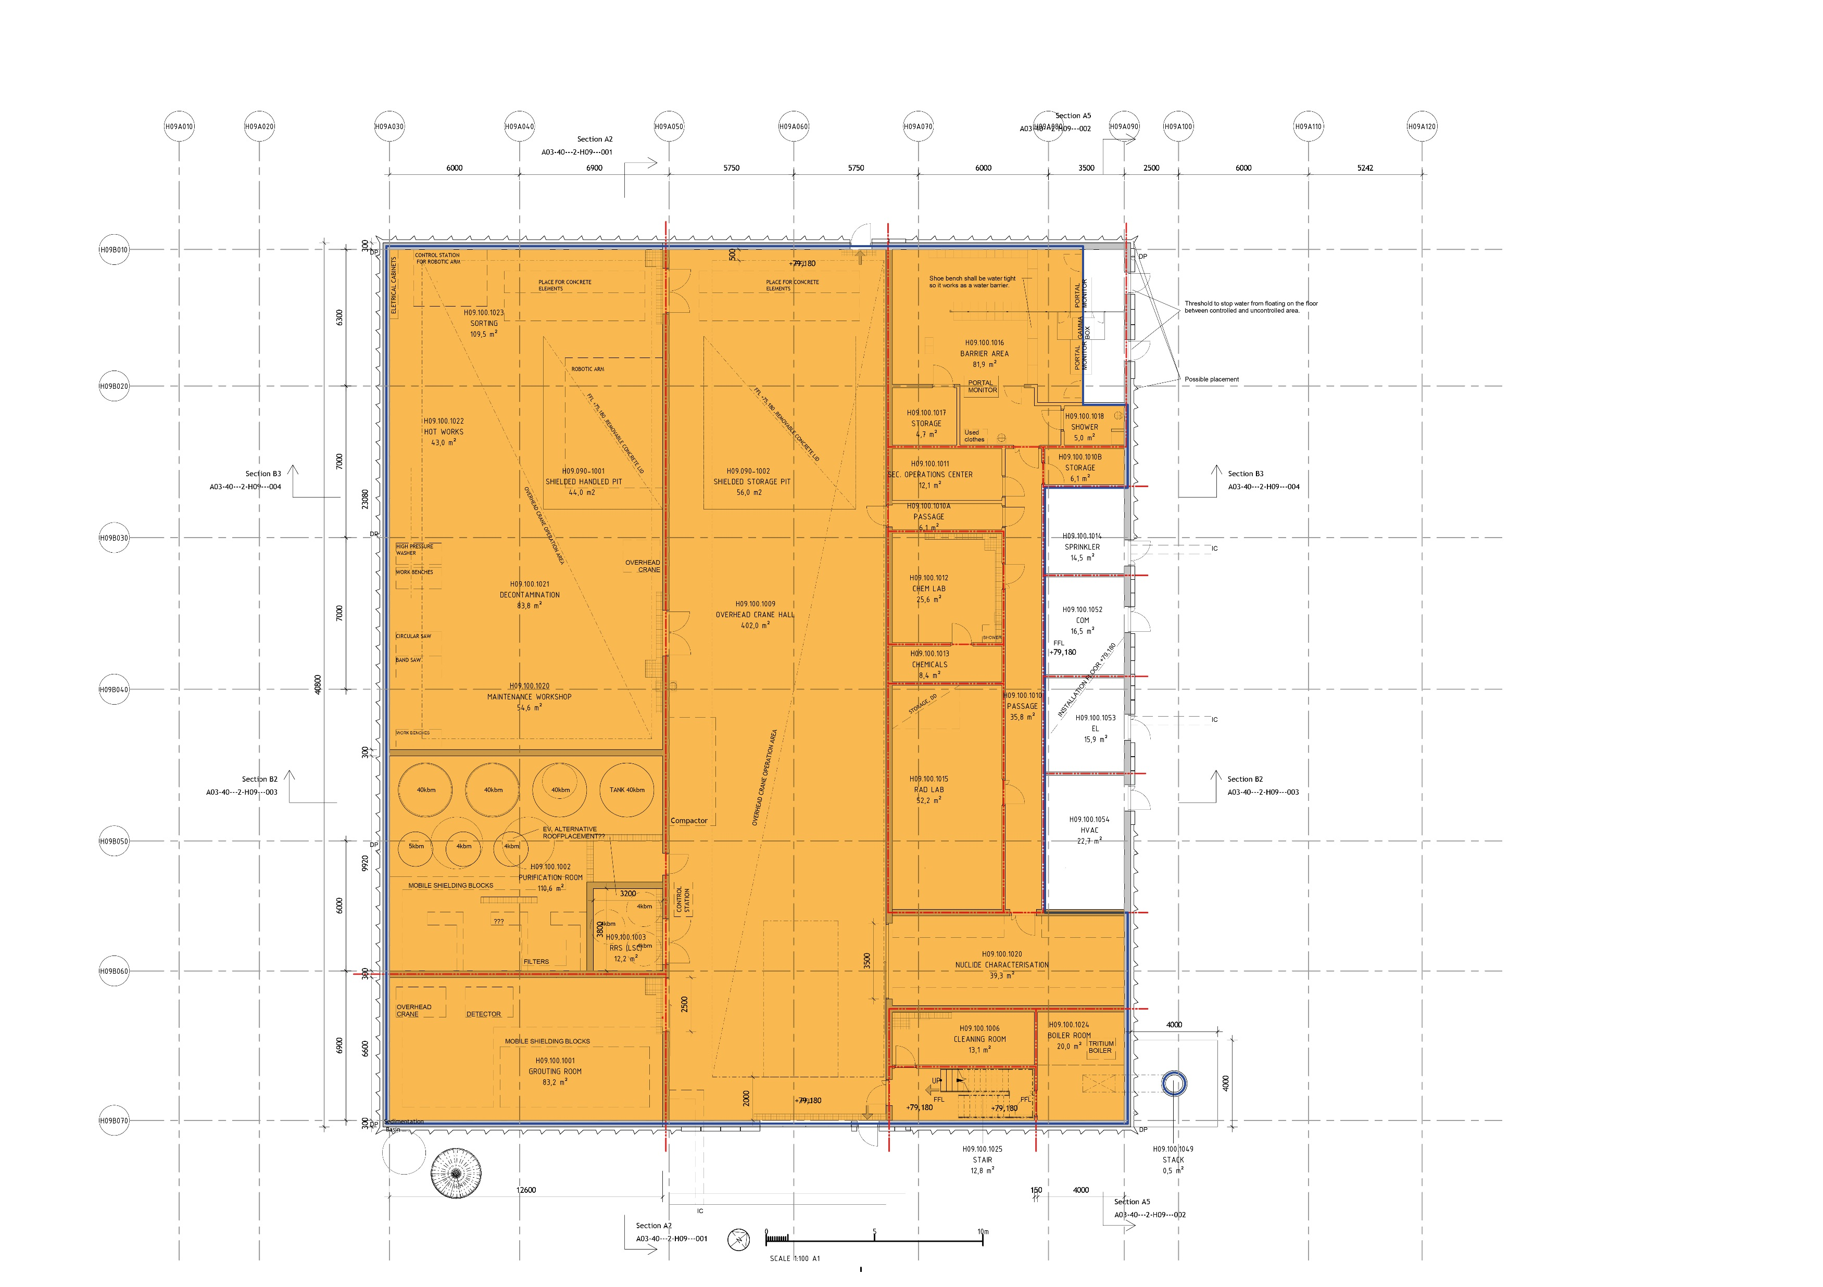
H09 Area table
Controlled

Slide 9
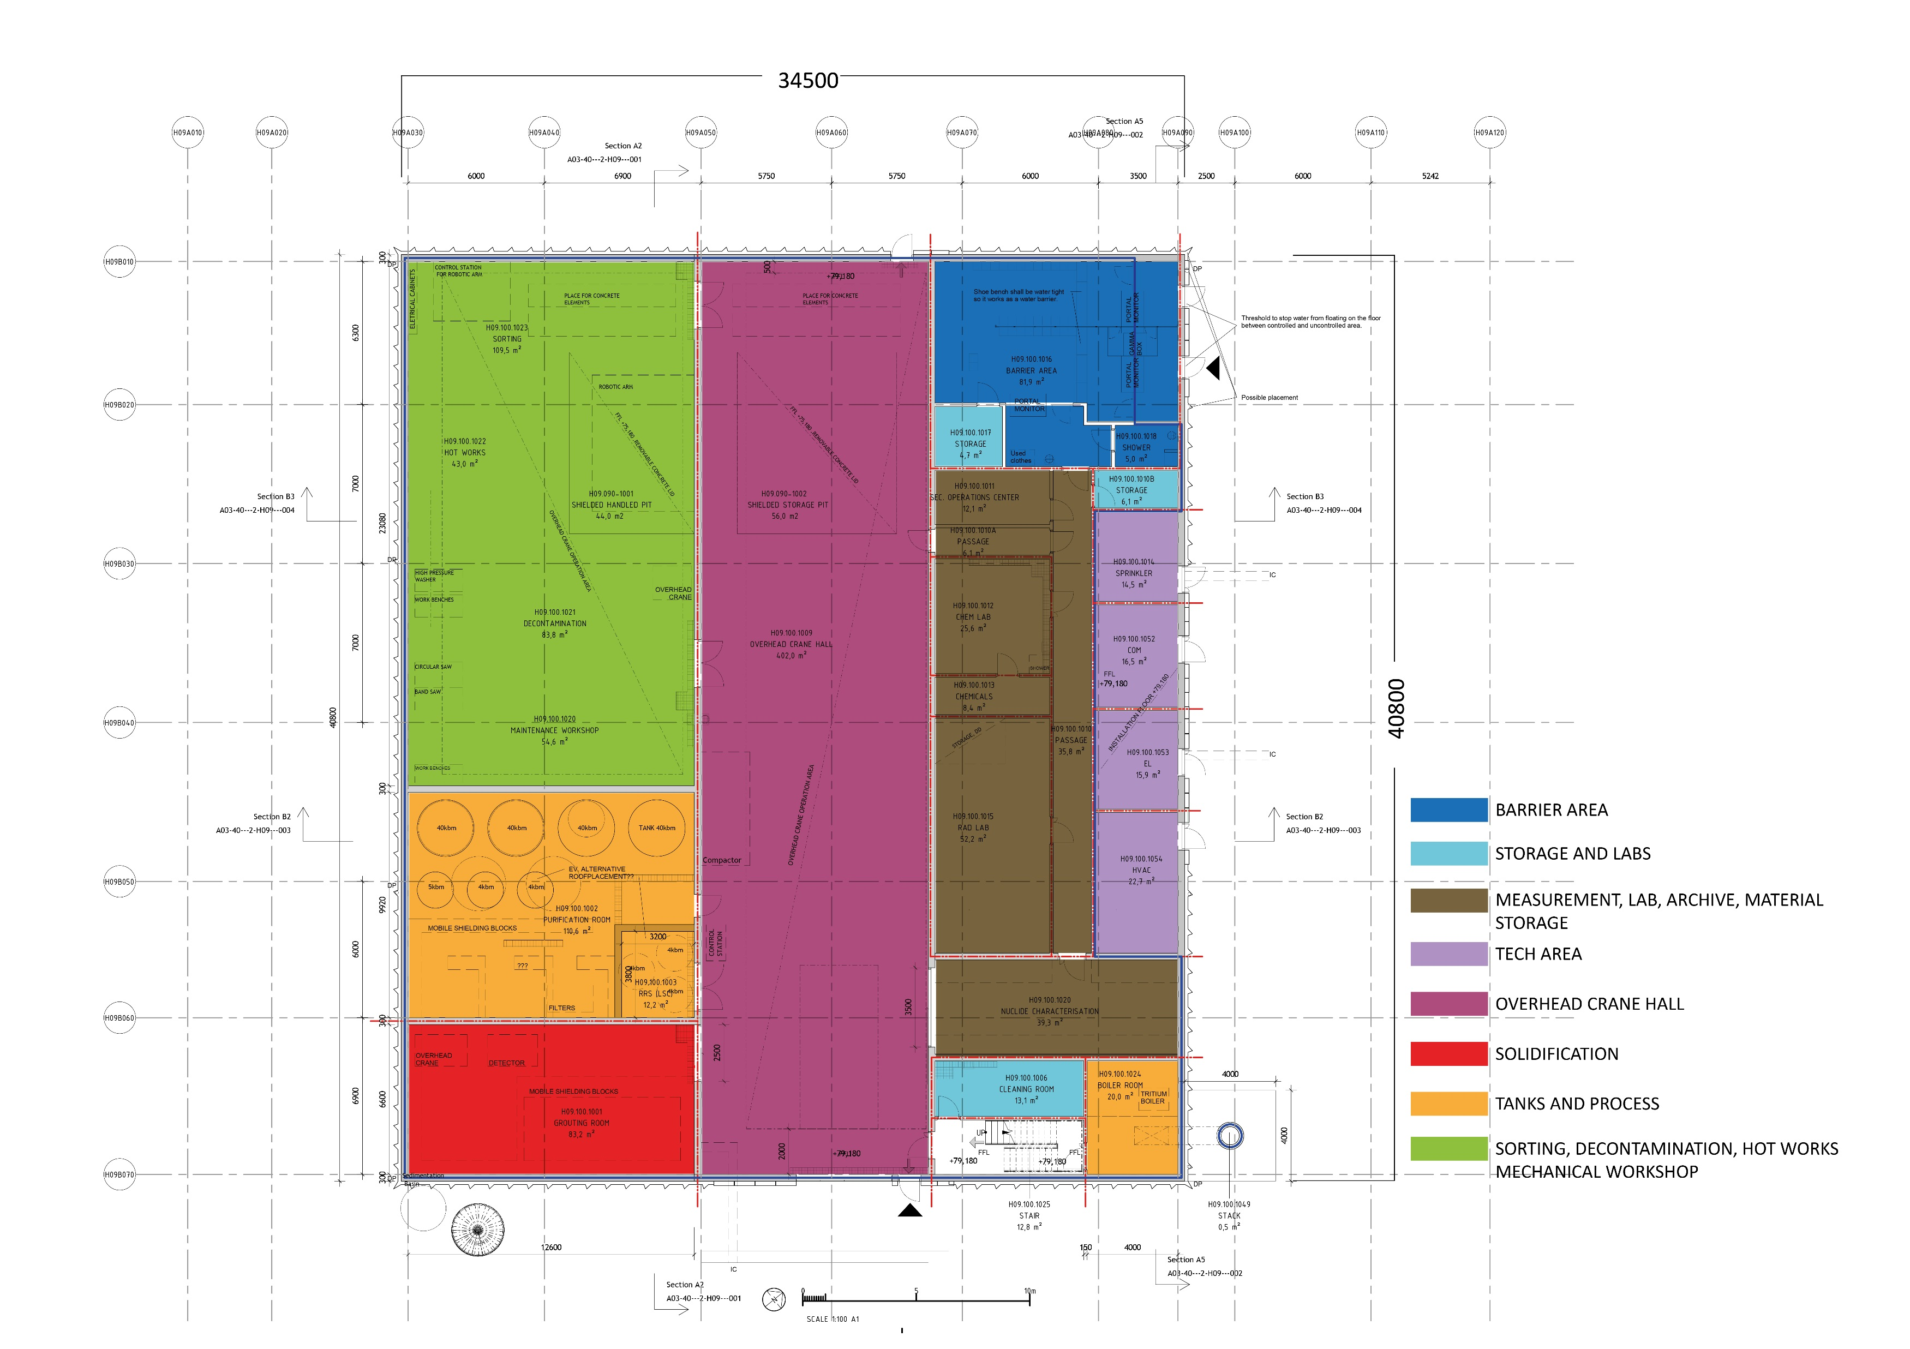
Functions

Slide 10
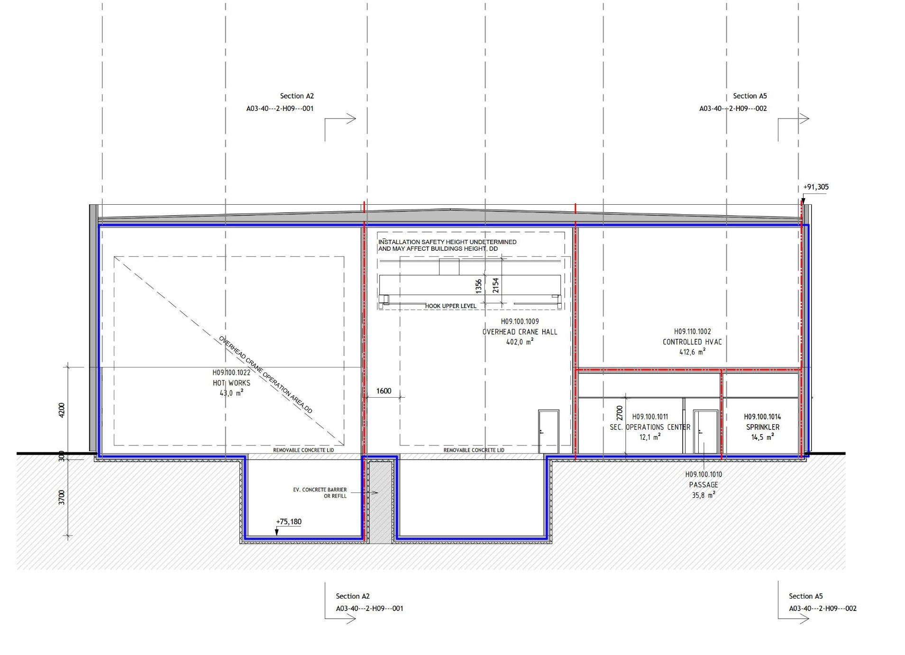
Main section
Storage and handling pits

Slide 11
H09 PDR design update
Area 1778m²
Single entrance
Loading dock operated from inside
Stack height 25 meters
Waste handling designed and installation integrated into building works
In situ concrete structure to optimize shielding
Storage pits below ground for effective shielding.
Overhead crane dimensioned for ATB 4K vessel
Number of floor levels reduced to two

Slide 12
Planned program
PDR (light) 15/9 (done)
Update PD documents complete 31/10 (ongoing)
Detailed design started 1/10 (Ongoing)
1st IFC drawings for building March 2019
Radiological type (process/vent) installation starts in January 2020,
Handover 12 months before Beam on Target (July 2021)

Slide 13
Waste water pipes removed

Slide 14
Development of transport system ongoing
Reference JPARC transport system
Internal Liquid Waste Transport and Treatment at JAEA
Treatment
Dilute
Ejection, Store
Category
Transport
Dilute
Low Level Waste
Waste Treatment bldg. No.3
Pacific Ocean
Storage Facility
Waste Pool
Dilute
evaporation
Cement Solidify
Storage Facility
Tank lorry
Waste Treatment bldg. No.2
Storage Facility
High Level Waste
Direct Solidification
Demolition and Separation
Direct Solidification
evaporation
Asphalt Solidify
Direct Waste Storing
Storage Facility

Slide 15
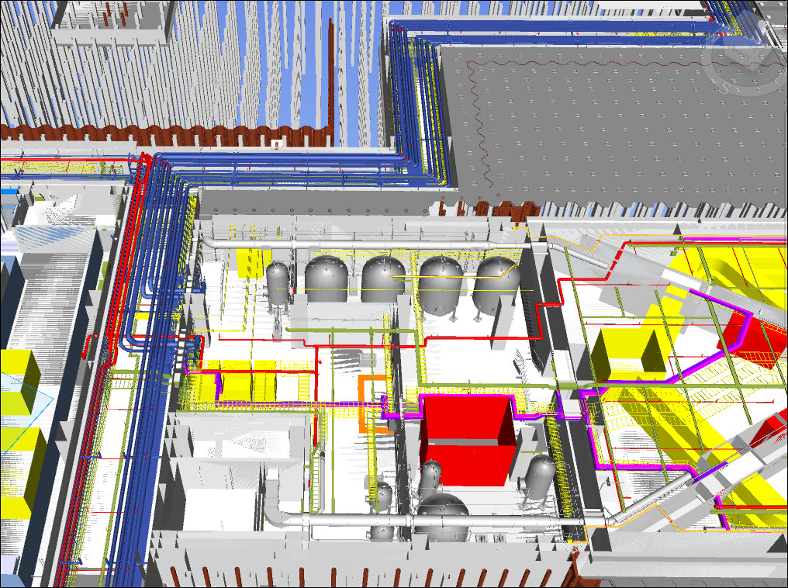
Example: D02 waste tanks – Transport through gallery investigated
D02 cooling water tanks

Slide 16
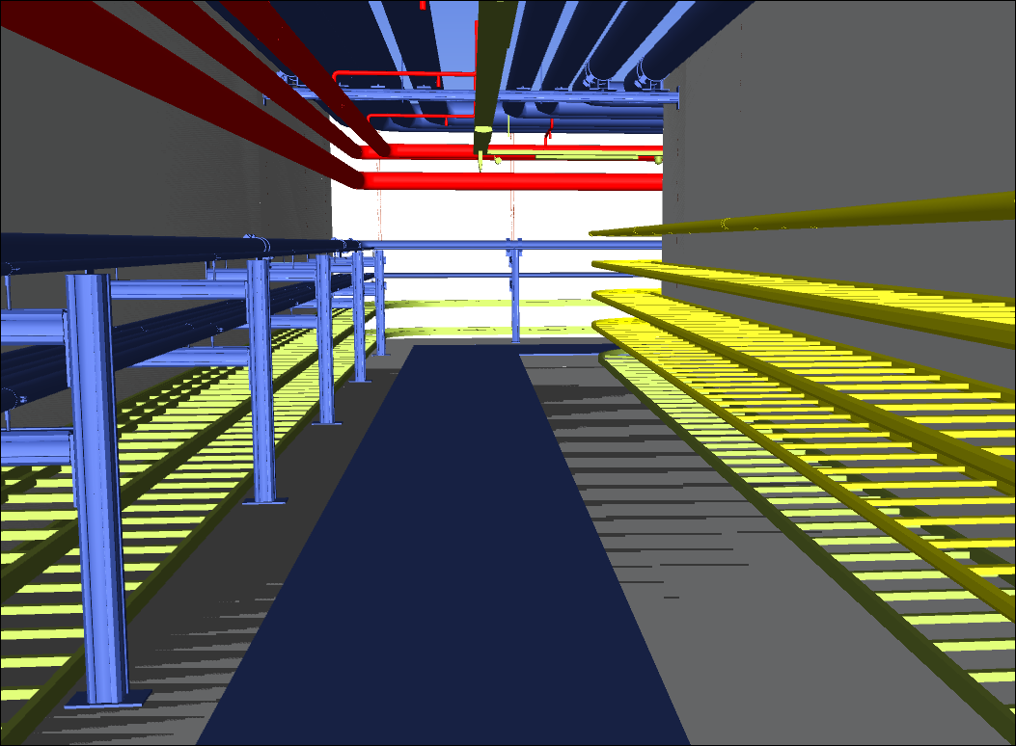
Wall-to-Wall 3600 mm
Free width 2100 mm
Free height 2100 mm

Slide 17
Waste water containers in JPARC
. J-PARC can design containers for each category by herself.
Waste Liquid is temporarily stored in Storage Tank and if the activation level is less than a level, then it is released to Pacific Ocean.
If the level is higher than a level, then it is transferred to the treatment building by the Tank Lorry.
Container needs some specification, Mechanical Strength, Air tightness etc., which depends on the type of container.
The dose rate around container is shown in Table I and around transport vehicle is shown in Table III.
Table III
Position | Dose rate
at Vehicle surface | 2 mSv/h
1m from Vehicle surface | 100 microSv/h
at Driver's seat | 20 microSv/h

Slide 18
Waste Liquid Tanks
Waste Liquid is temporarily stored in Storage Tank and if the activation level is less than a level, then it is released to Pacific Ocean.
If the level is higher than a level, then it is transferred to the treatment building by the Tank Lorry.

