Slide 1
ESS Machine Protection
Technical Advisory Committee, TAC 18
Lund, Sweden
A. Nordt
ESS Machine Protection Team
European Spallation Source ERIC, Sweden
FBIS Design Team (In-Kind-Contribution)
ZHAW, Winterthur, Switzerland
2018-10-18

Slide 2
Overview
Machine Protection Integration Strategy
Status on the Fast Beam Interlock System (FBIS)
Status on FBIS Reliability Prediction
Issues/Concerns for MP at ESS

Slide 3
Attention
The following slides are for TAC to READ
Slides will not be presented 1 by 1
Please ask questions per main topic

Slide 4
Attention
Lets discuss MPS at ESS

Slide 5
Reminder: What is Machine Protection?
MP is Happiness
  Happiness for the scientists
  Happiness for the Council
  Happiness for the staff
Time and money

Slide 6
Reminder: What is Machine Protection?
Add Availability = ”Subtract Downtime”
Short Downtime
Long Downtime
6
Courtesy of Enric Bargalló (aligned with “ESS Reliability and Availability Requirements” ESS-0064499

Slide 7
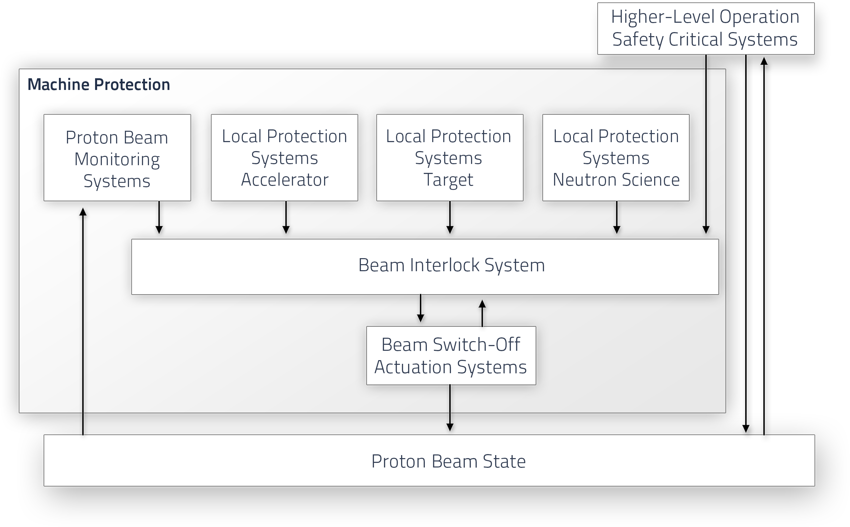
Reminder: MP-System of Systems (SoS)

Slide 8
Reminder: Local vs Global Protection

Slide 9
Short Summary:
Risk Management and Machine Protection Lifecycle
And how we integrate MP into ESS

Slide 10
Inspired by International Standards

Slide 11
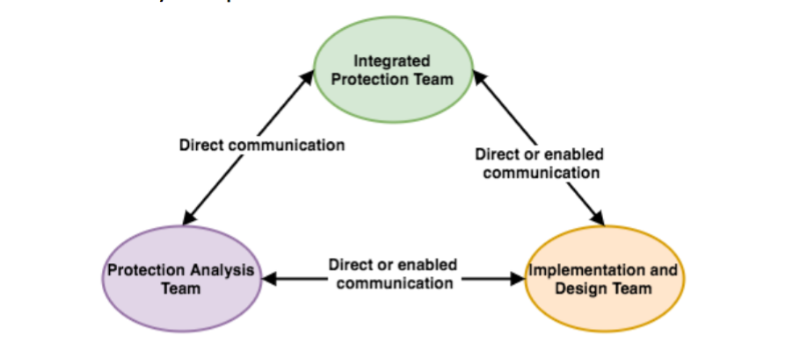
Machine Protection Lifecycle
Analysis → Enric (sick leave), Ric (resigned/off by 2018-10-31), Johannes (50%)/consultant started 2018-10-01
Integration → Szandra, Annika (10%)
Implementation and Design → Manuel (MPS-VAC, MPS-ID, MPS-Target), Stephane (FBIS, LPS Raster Magnets), David (MPS-MAG, MPS-BMAG, MPS-NSS), Viktor (El. Design and installation), Fernando (Technician), Johannes (consultant/el. design 50%), team from ZHAW (FBIS), system-owners at ESS (e.g. Rafael M. for LPS RF)

Slide 12
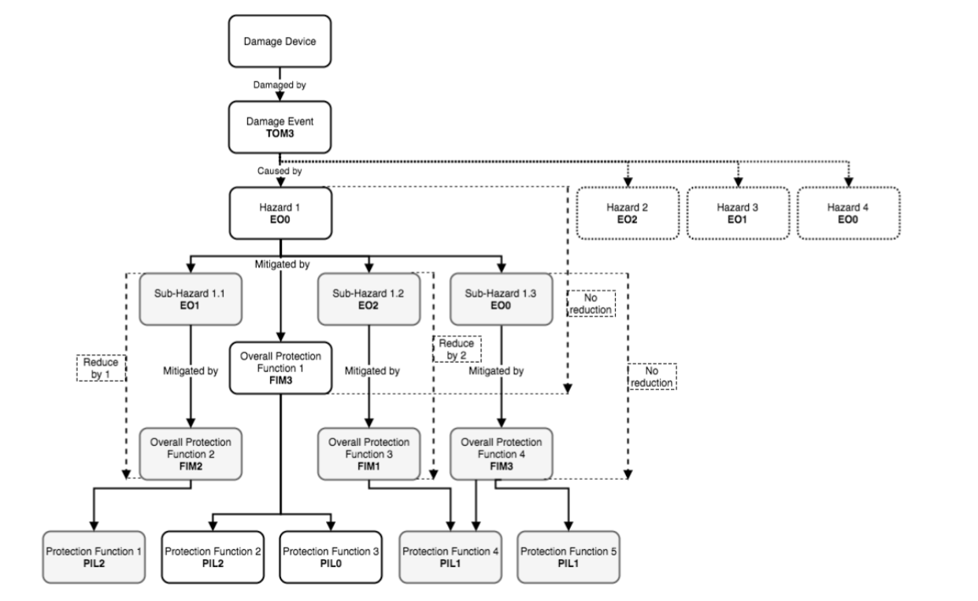
Details: How Does the Analysis Work?

Slide 13
Example: Machine Protection for Target
Proton Beam Window
Target Wheel
Moderators
  Water
  Cryogenic
Reflectors
Tuning Beam Dump

Slide 14
Analysis Example – 1041/2/3
Damage Events
Hazards
Overall Protection Functions
Protection Functions
  Sensors
  Logic Elements
  Actuators
  Protection Integrity Level
  Timing Requirements

Slide 15
What Does Machine Protection Ask for?
System information
System designs
System analyses (risk, HAZOP etc.)
System interactions
Solutions
An open mind

Slide 16
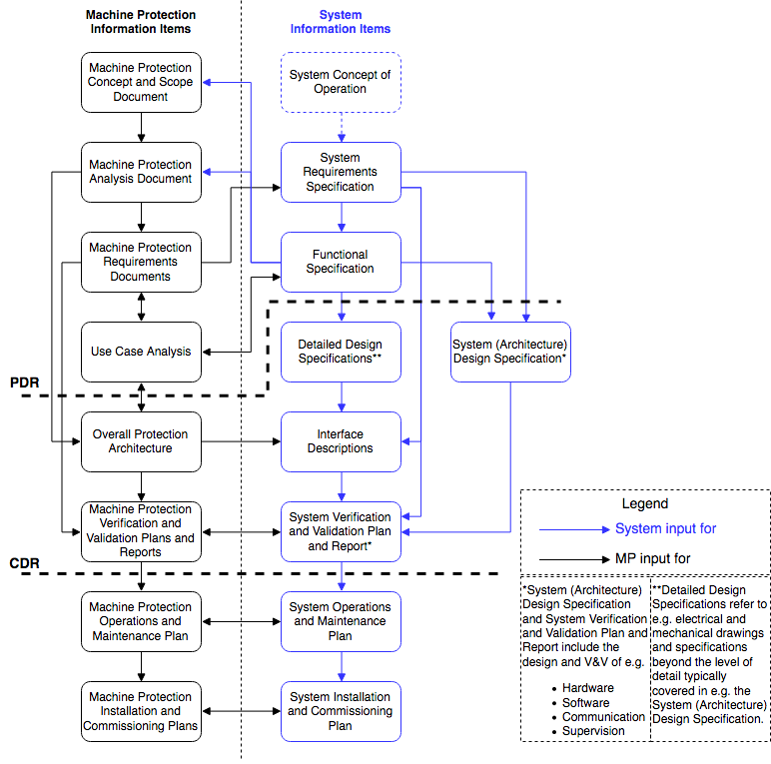
MP SoS – Information Item Structure
Question: What info do we need from whom?
The information item (document) structure is used for MP-SoS across ESS
Black information items/documents are developed and owned by the MP-SoS staff
Blue information items are owned by respective system owner
Note: The term "information item" is used to relieve some of the tension caused by the word "document"
This is compliant and in line with how the term is used in the ISO 15289 standard and is applied to the MP-SoS work

Slide 17
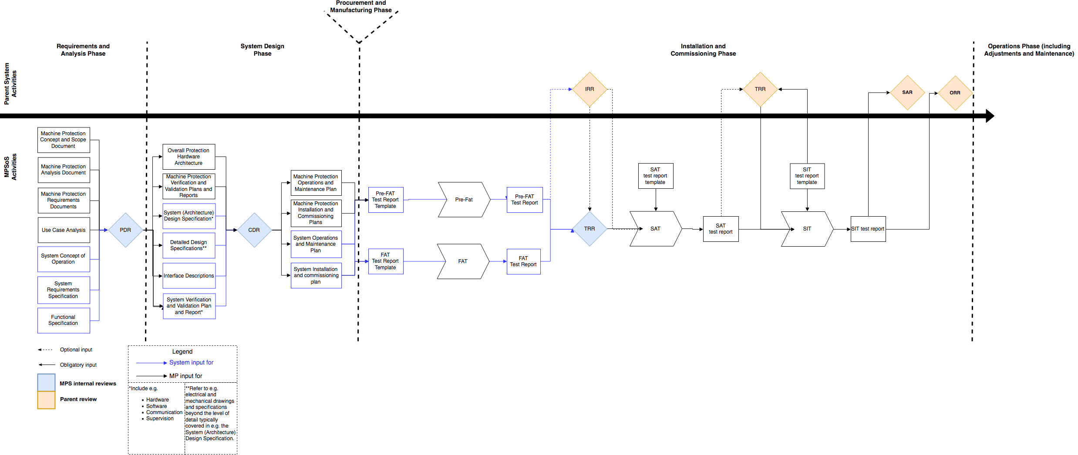
MP SoS - Lifecycle
ESS Systems Engineering Management Handbook (ESS-0093443)
adapted for Machine Protection (MP-SEMP: ESS-0057245 rev2)

Slide 18
MP SoS – Use Case Workshops
Protection requirements are derived from hazard and risk assessments
BUT: this is not enough and is a too 1 dimensional approach!
In addition we perform “use case” workshops to derive behavioral requirements for the different systems
Example use case: Change of beam destination (LEBT-FC to DTL4-FC):
Likely to happen frequently (tuning, commissioning)
Many systems required for efficient “handshaking” (avoid damage, confusion for operators, interlock deadlocks, operational impossibility)
All system stakeholders involved in workshops
Identified sequence of actions that will work
Optimized sequence
Documented

Slide 19
MP SoS – Use Case Workshops
Logic details stored in Enterprise Architect (EA)
Simulation of logic
EA model shared with ZHAW team for FBIS development (logic in VHDL)
EA model serves reliability prediction effort made by ZHAW
This kind of work is not to be underestimated (importance + effort)

Slide 20
Integration OK... BUT
Practically…
How is it all working together?
How do we want to make “good” beam?

Slide 21
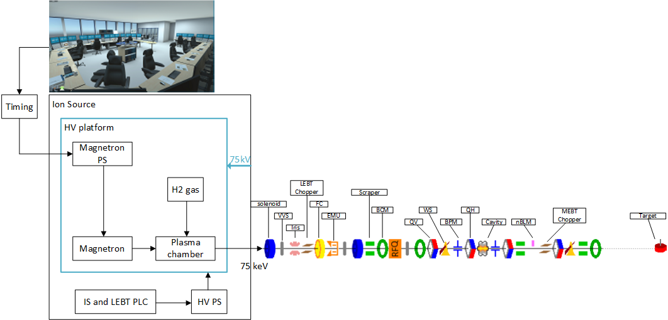

ESS Beam Production
Operators request beam from the control room
The Timing system sends event triggers to the Ion Source
Plasma is generated using H₂ gas and RF power
Beam is extracted, sent to the Target and Neutron science starts

Slide 22
Example: What if there is an issue with the target wheel?
Target needs to request a Beam stop
MPS/BIS will take care and stop beam through Actuators!
Forbid the Timing System to send the Timing triggers
Forbid feeding the Magnetron (FSU) (no RF)
Beam Interlock System

Slide 23
Example: What if there is an issue e.g. with the target wheel (out of phase)?
Target needs to request a Beam stop
MPS will take care of it using the Actuators!
Forbid the Timing System to send the Timing triggers
Forbid feeding the Magnetron (FSU) (no RF)
Stop the HV power*
Deflect Beam using the LEBT Chopper
Deflect Beam using the MEBT Chopper
*only for emergency
Beam Interlock System

Slide 24
What is the Beam Interlock System (BIS)?
A set of Machine Protection systems (MPSs) + Fast Beam Interlock System (FBIS)
These implement Global Protection Functions
MPS Vac
MPS ID
MPS Mag
MPS Trg
FBIS

Slide 25
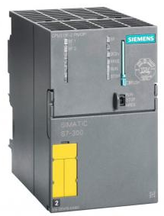
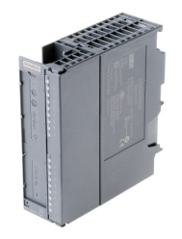
MPS Systems are…
MPS Vac : Vacuum protection
MPS ID : Insertable devices protection
MPS Mag : Magnets protection
MPS BMg : Bending Magnets protection
MPS Trg : Target protection
MPS NSS : Neutron instruments protection
PLC based interlock systems
- Ring topology with 1 fail safe CPU and multiple, distributed I/O
- Each I/O connects to a sensor (VVS, FC, EMU, WS, QV, QH,…)
Slow ! Reaction time > 10ms
MPS Vac
MPS ID
MPS Mag
MPS Trg
FBIS

Slide 26

The Fast Beam Interlock System is…
Actuators
SCU (Signal Converter Unit) concentrating signals from Sensor Systems and MPS PLC based systems
DLN (Decision Logic Node) concentrating signals from several SCUs, deriving global beam permit and acting on Actuators to stop Beam
SCU
DLN
SCU
DLN
DLN
DLN
MPS Vac
MPS ID
DLN
FPGA based systems
- SCU HW design based on standard mechanical components (cPCI)
- DLN HW based on uTCA standard
SCU
MPS Mag
DLN
DLN
DLN
SCU
SCU
SCU
Fast ! Reaction time ~ 5us
MPS Vac
MPS ID
MPS Mag
MPS Trg
FBIS

Slide 27

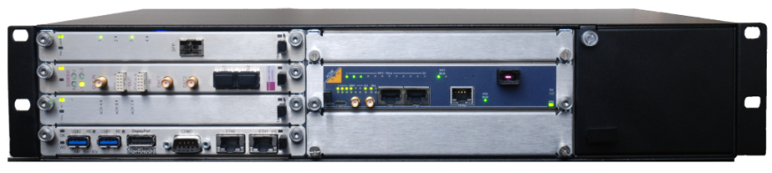
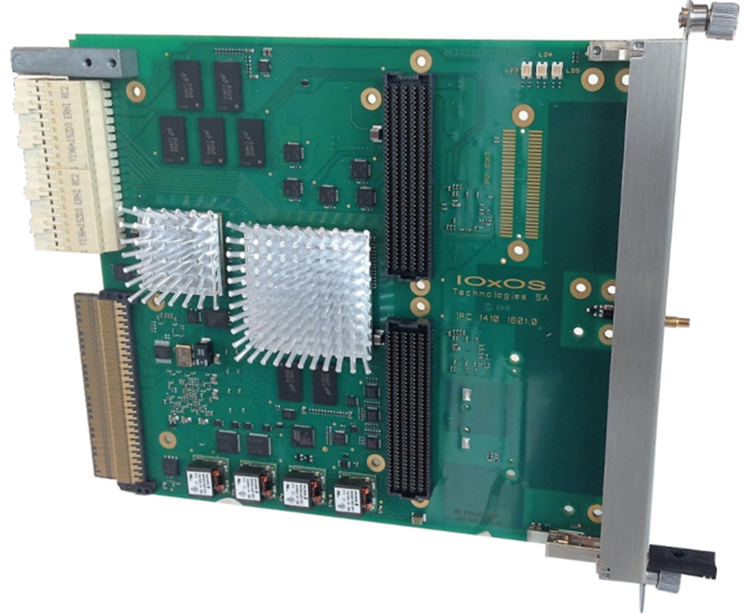

The Fast Beam Interlock System is…
SCU
Optic fibers
DLN
FPGA
Sensor Systems
FPGA:
Critical logic to fulfill protection functions (VHDL hardware description language)
  Decides to remove the global beam permit and stop the beam activating the Actuators
  Decides to inhibit the beam if sensor systems are not ready
  check all MP related systems are properly configured (Beam destination, beam mode)
CPU:
Less critical protection features (c language code)
Interface to EPICS
IFC 1410

Slide 28
Fast Beam Interlock System
Where are we now with the FBIS development?
FBIS CDR#1 in March 2018
https://confluence.esss.lu.se/display/PS/FBIS+CDR+%28Part+1%29+-+March+2018
FBIS CDR#2 in August 2018
https://confluence.esss.lu.se/display/PS/FBIS+CDR+%28Part+2%29+-+August+2018

Slide 29
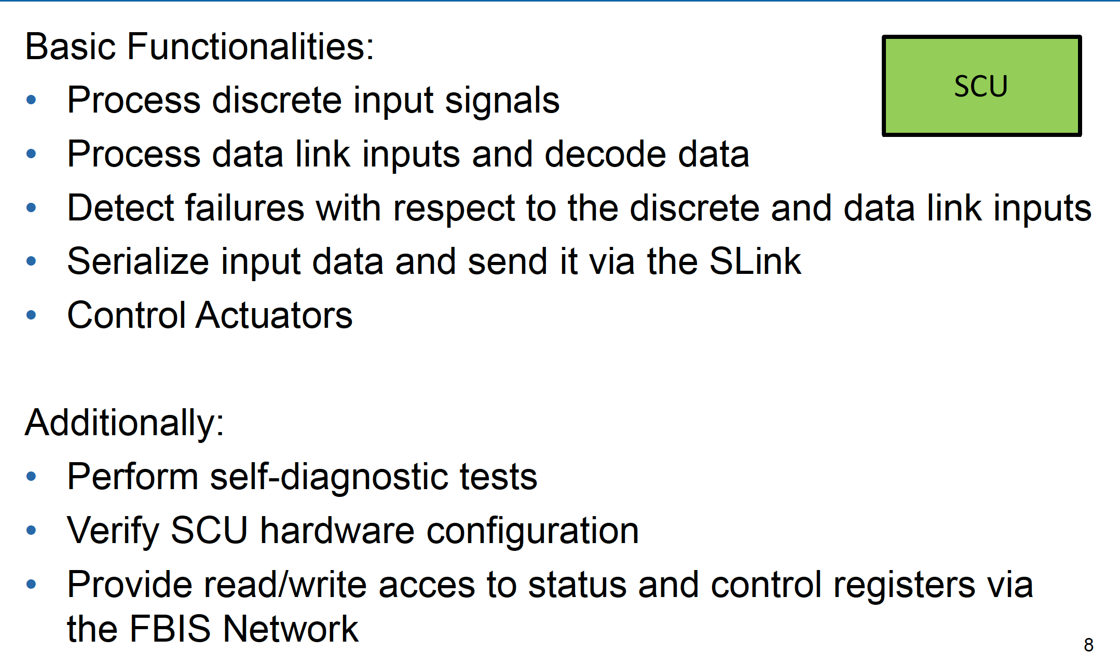
Signal Conditioning Unit (SCU)
Functional Behaviour
29

Slide 30
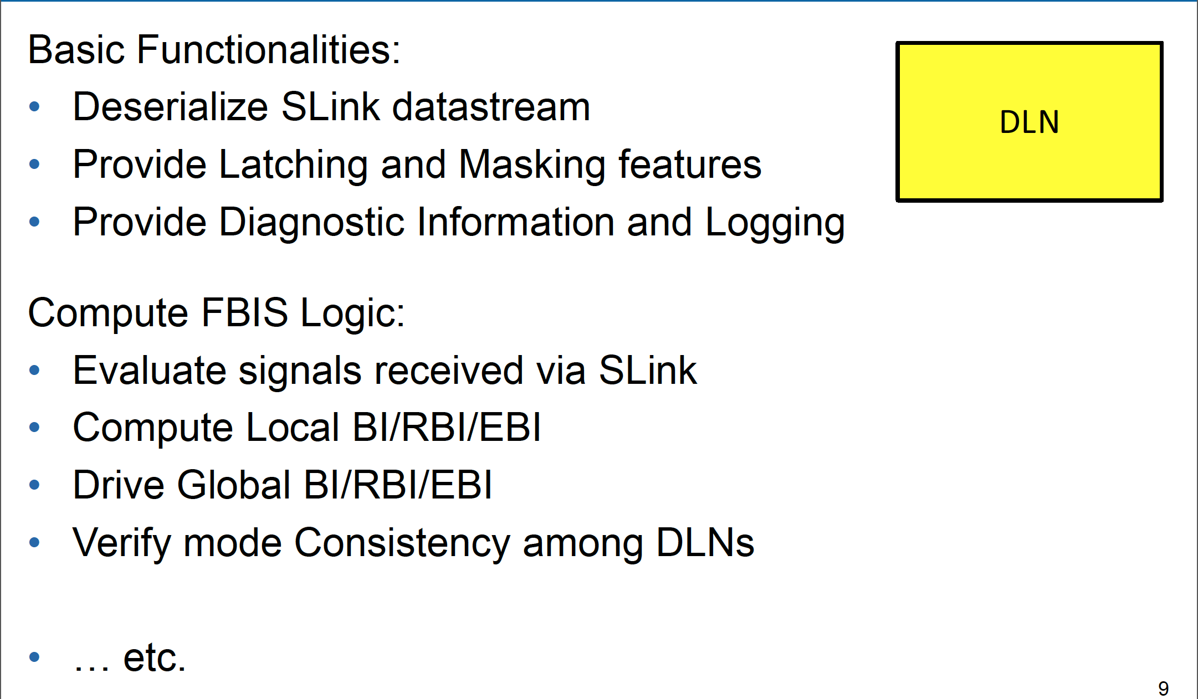
Decision Logic Node (DLN)
Functional Behaviour
30

Slide 31
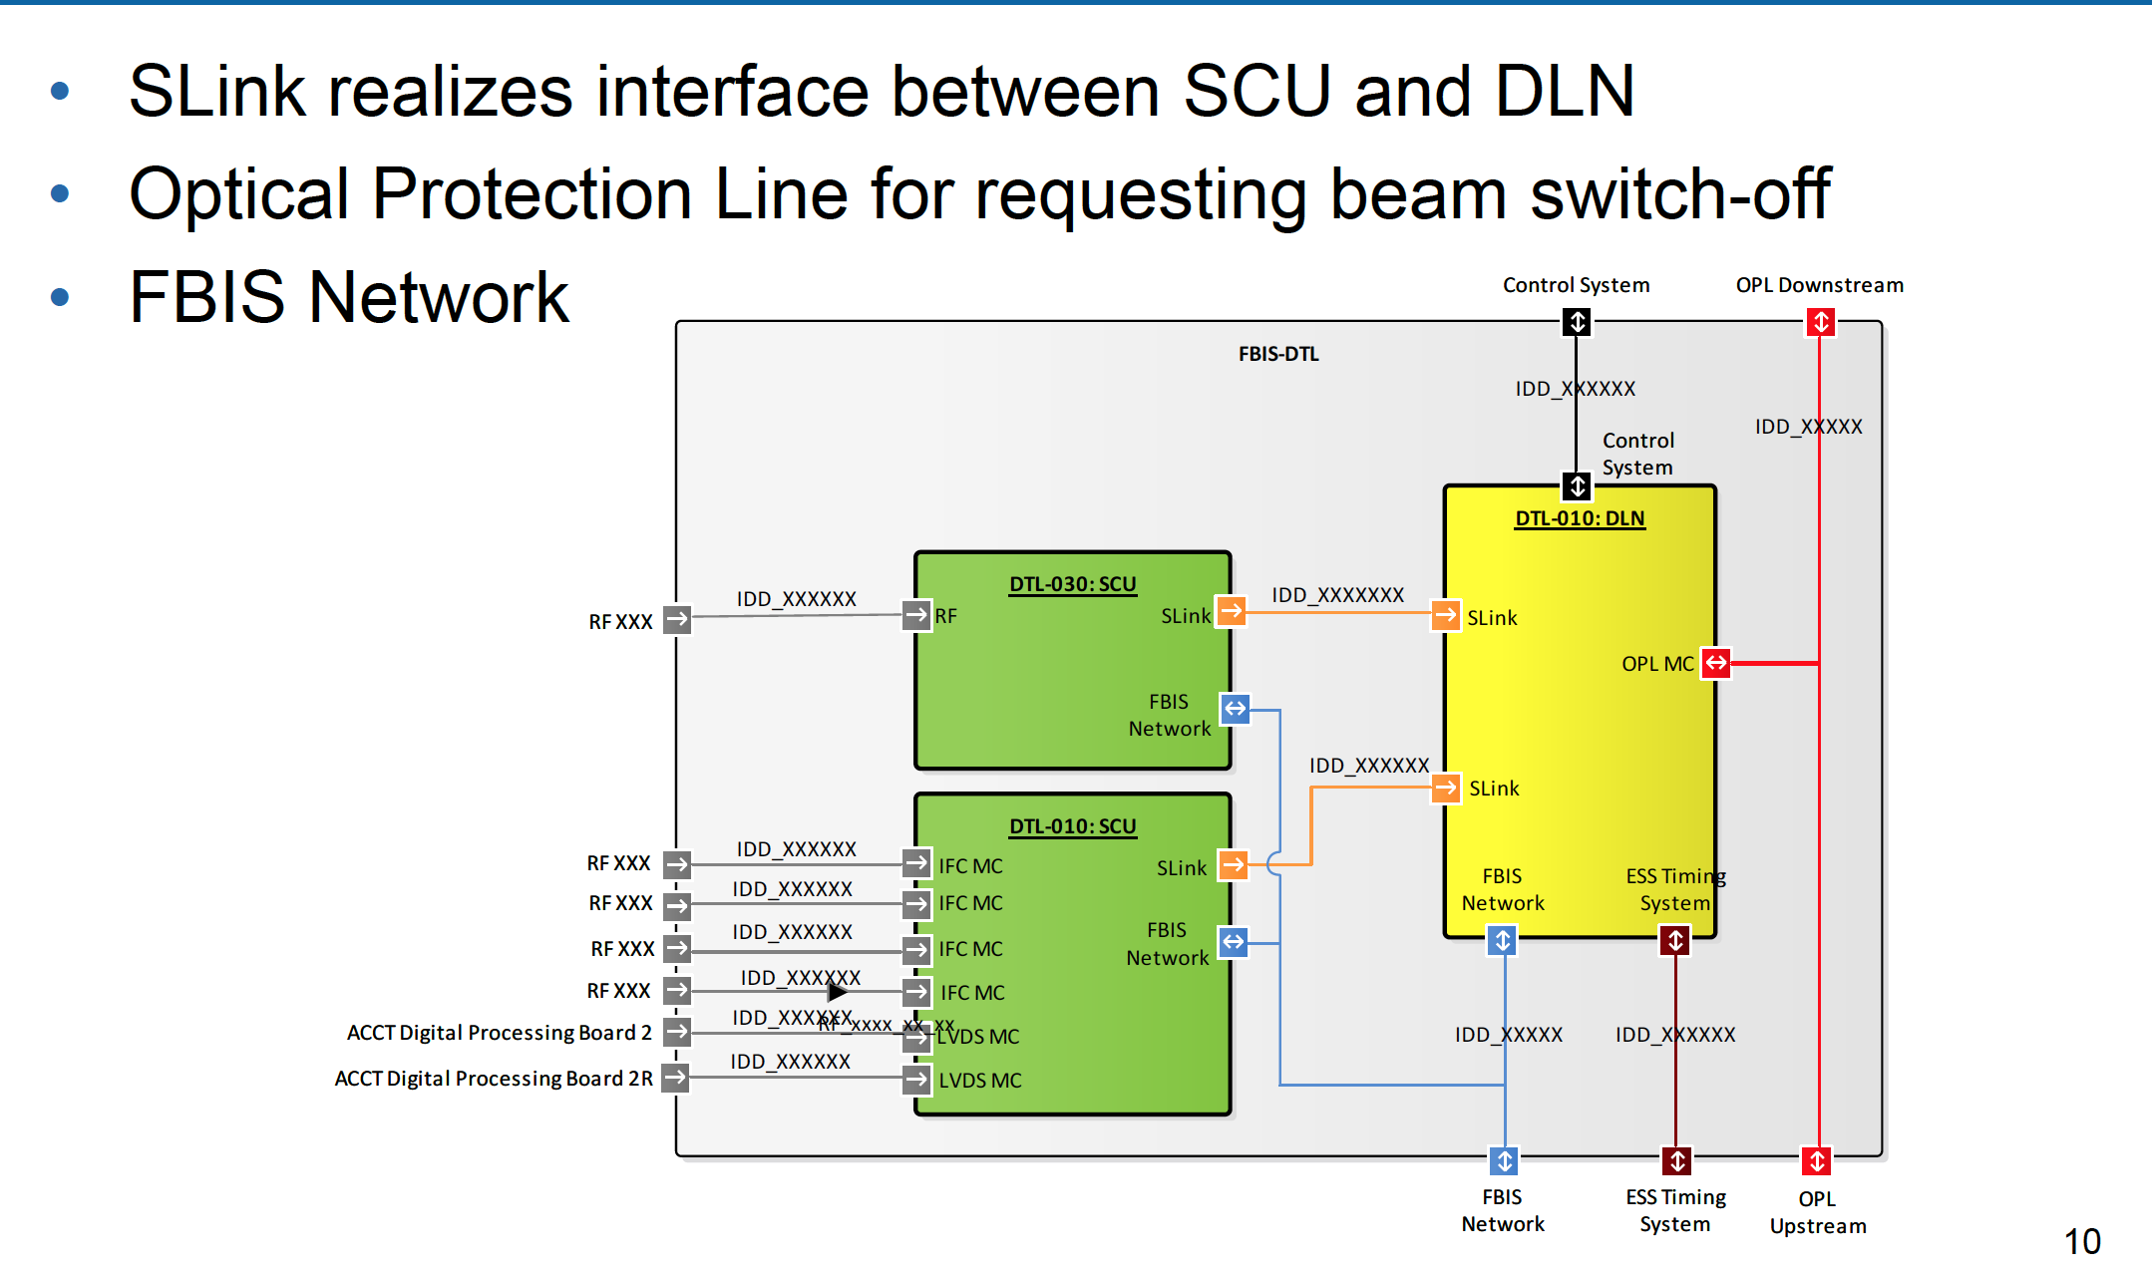
Basic Structure - Interfaces
31

Slide 32
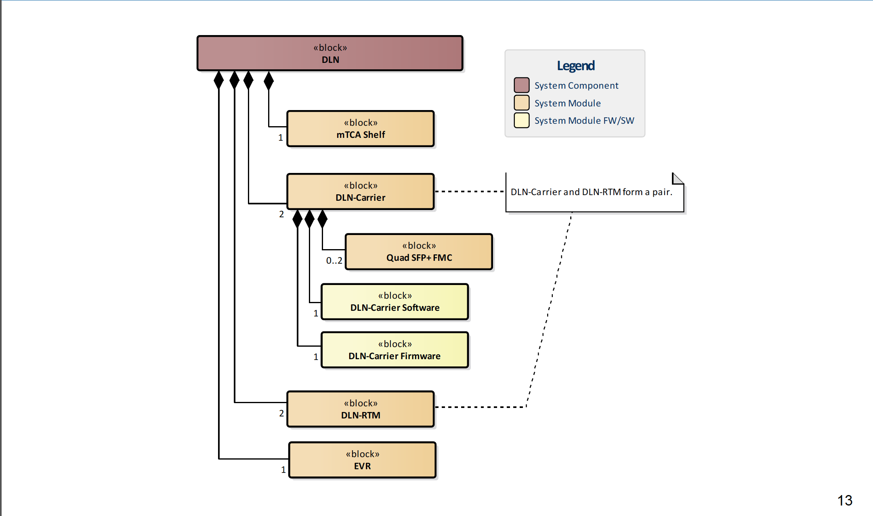
Detailed Design: DLN Breakdown Structure
32

Slide 33
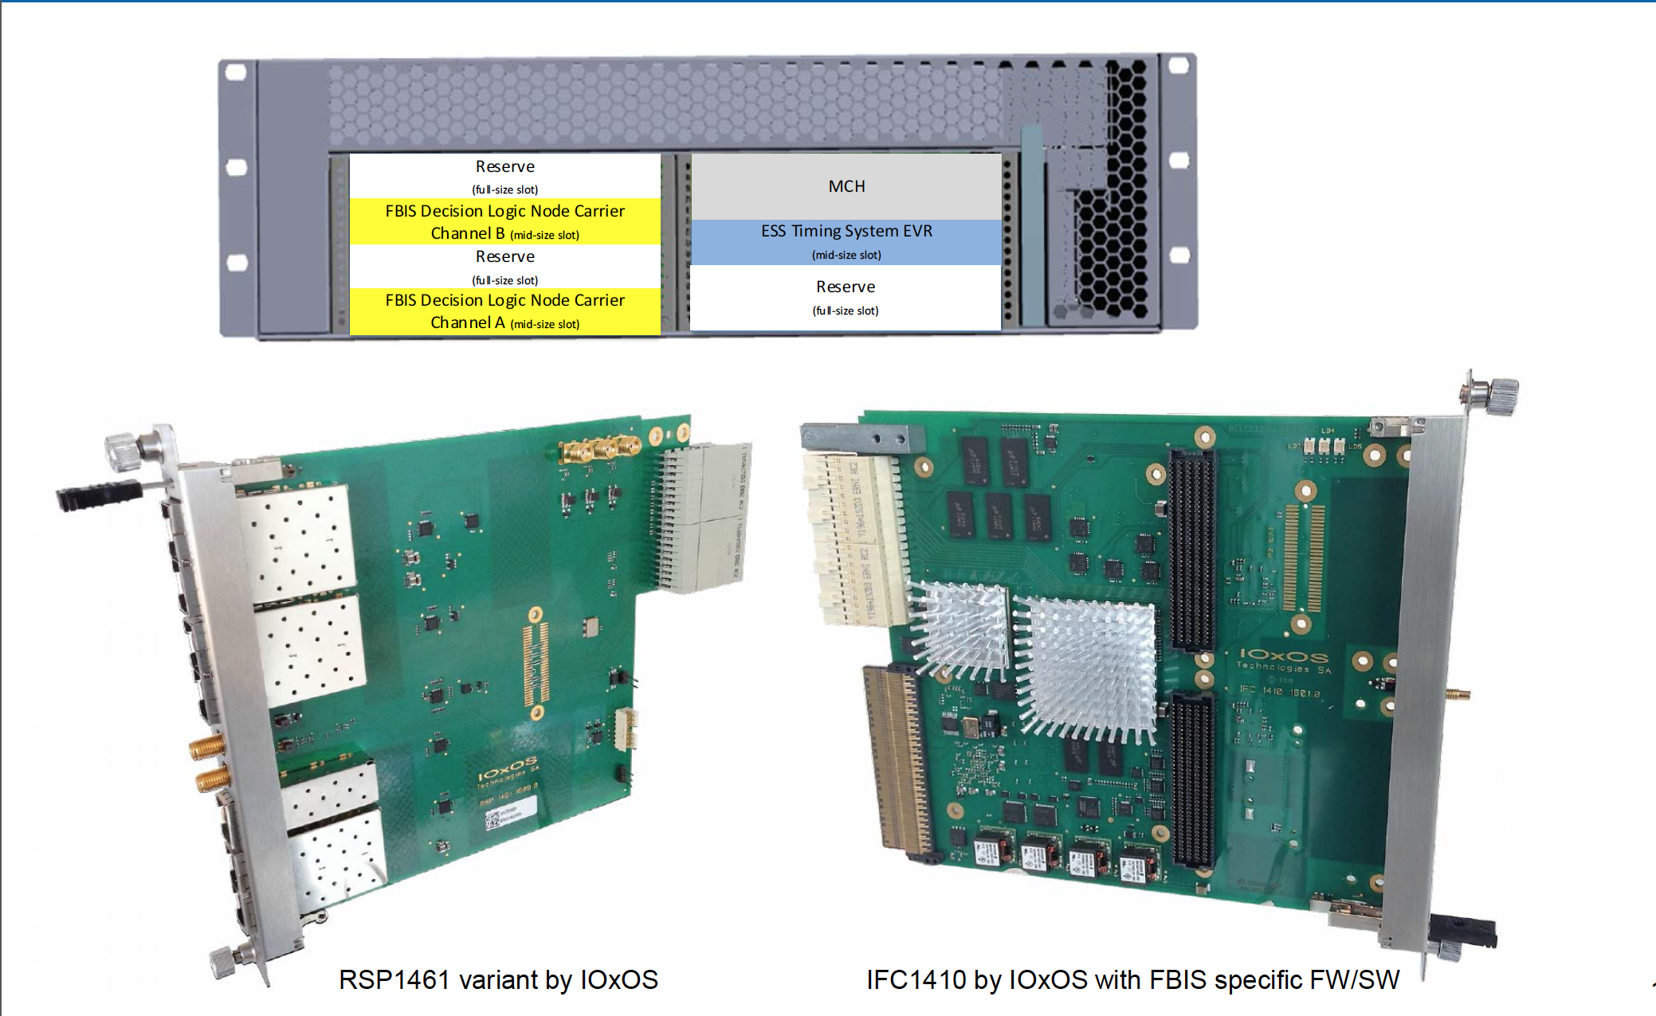
DLN: System Modules

Slide 34
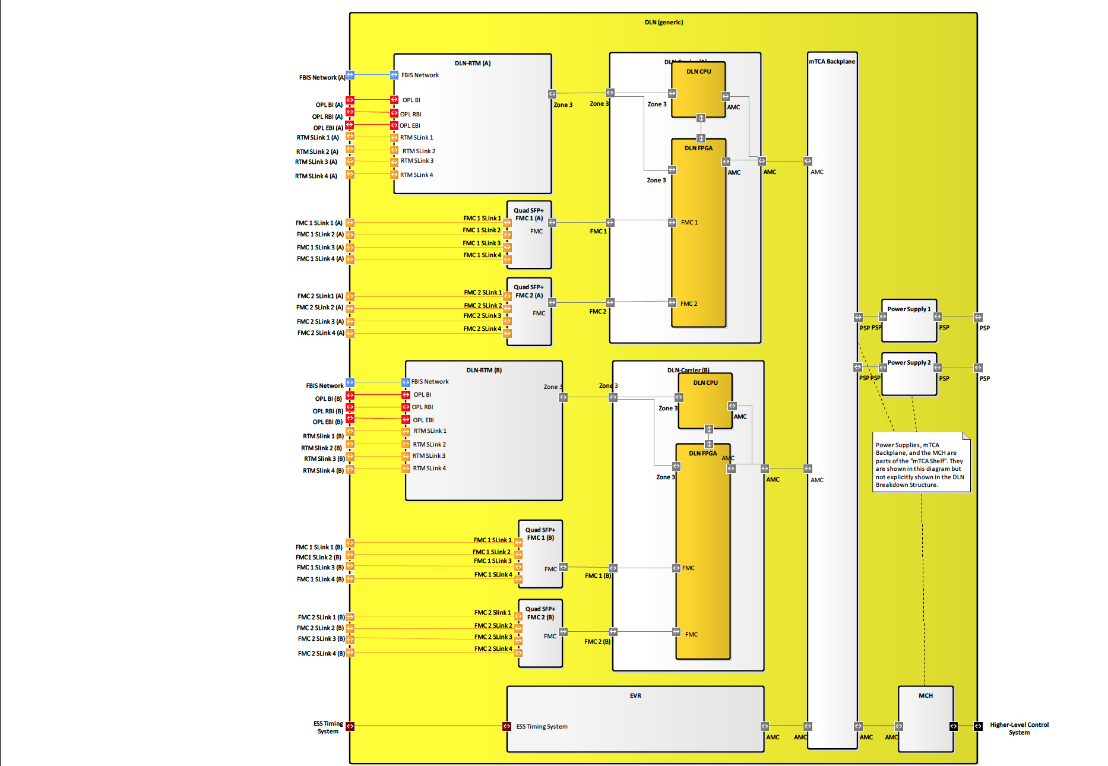
DLN: Internal BLockdiagram

Slide 35
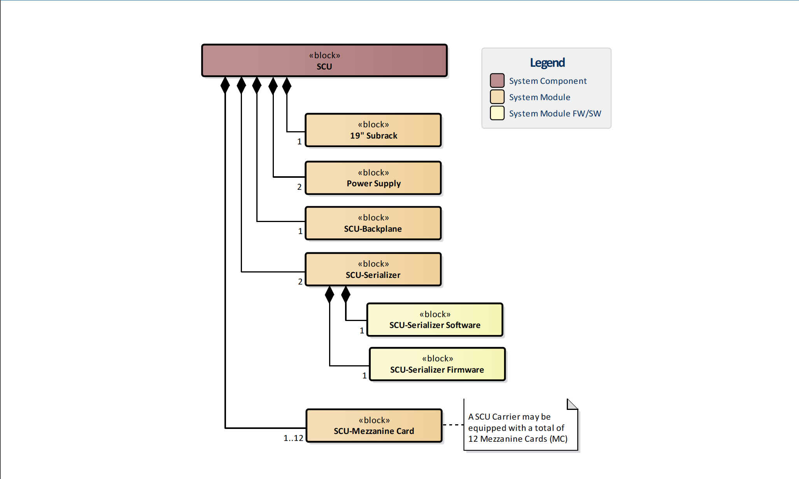
Detailed Design: SCU Breakdown Structure
35

Slide 36
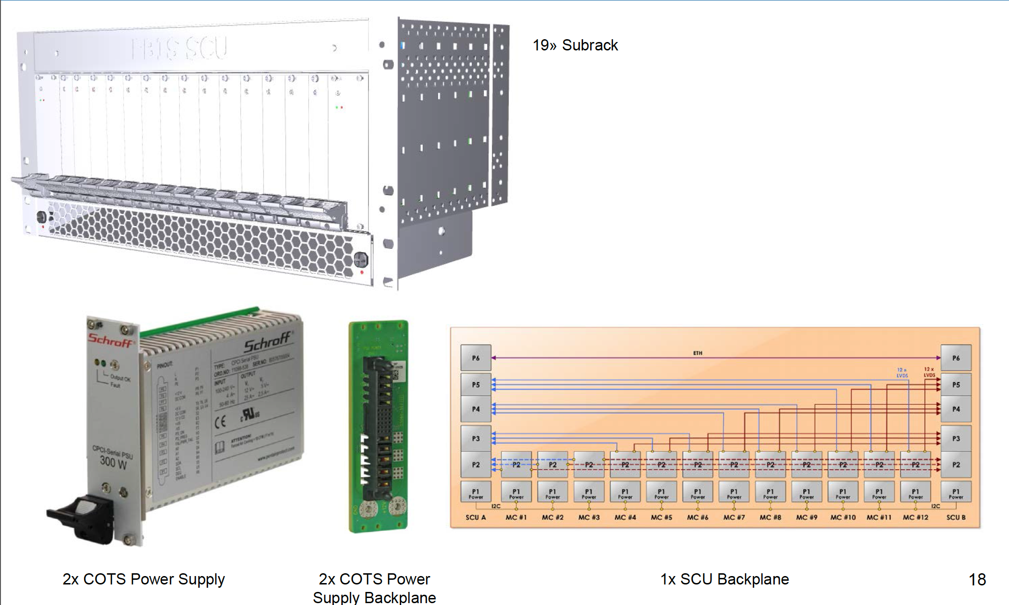
SCU: System Modules
36

Slide 37
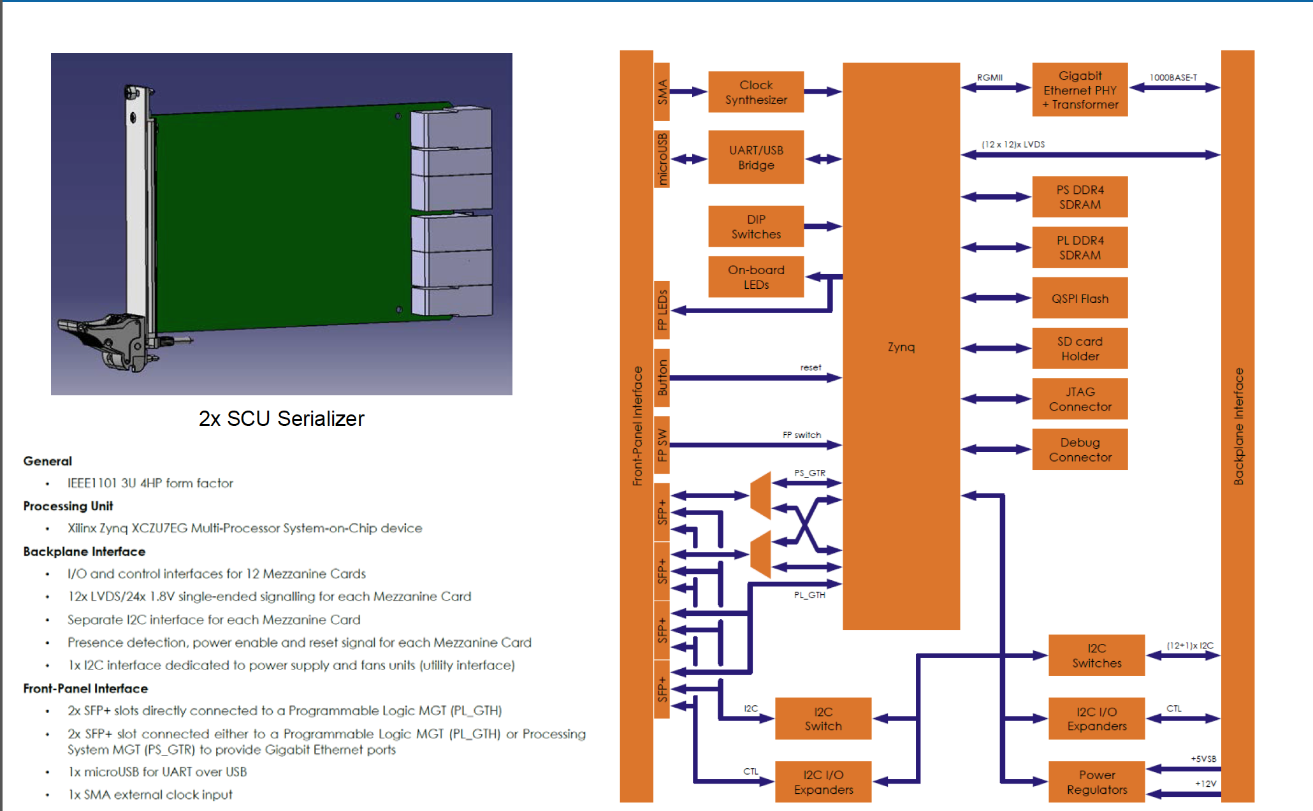
SCU: System Modules

Slide 38
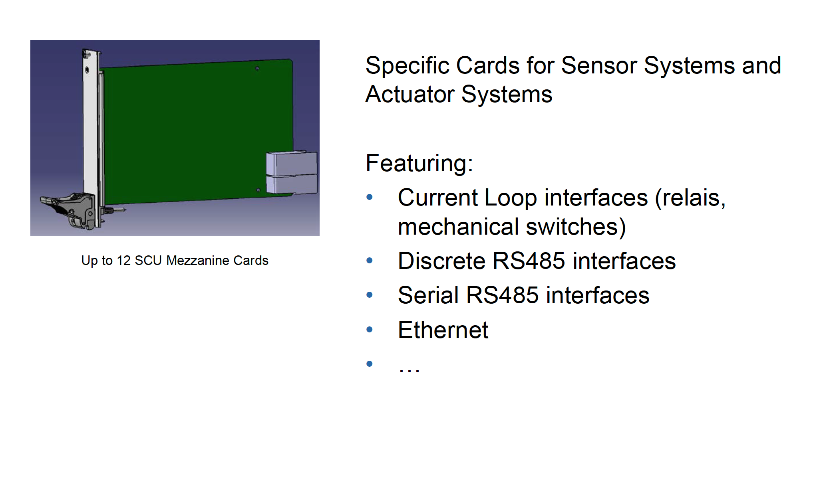
SCU: System Modules
38

Slide 39
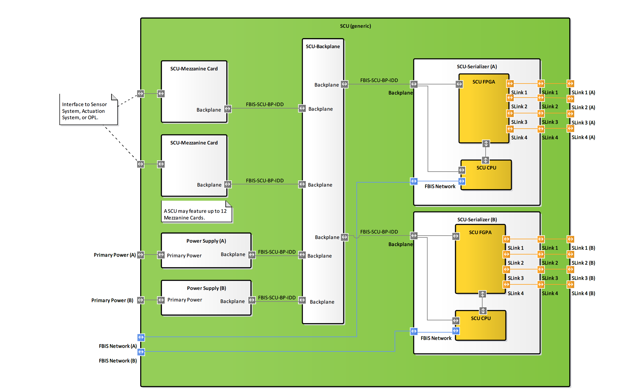
SCU: Internal Blockdiagram

Slide 40
Development, Verification and Validation of the FBIS

Slide 41
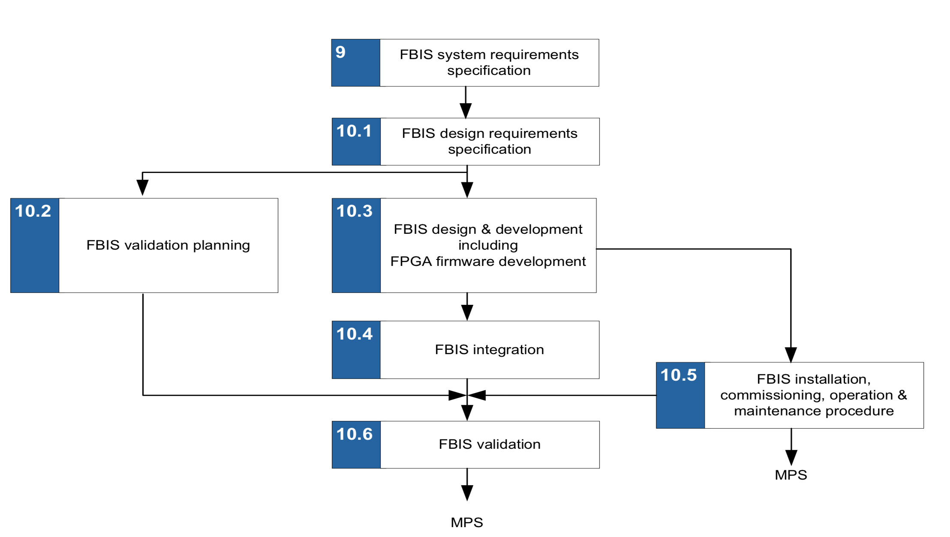
FBIS Lifecycle

Slide 42
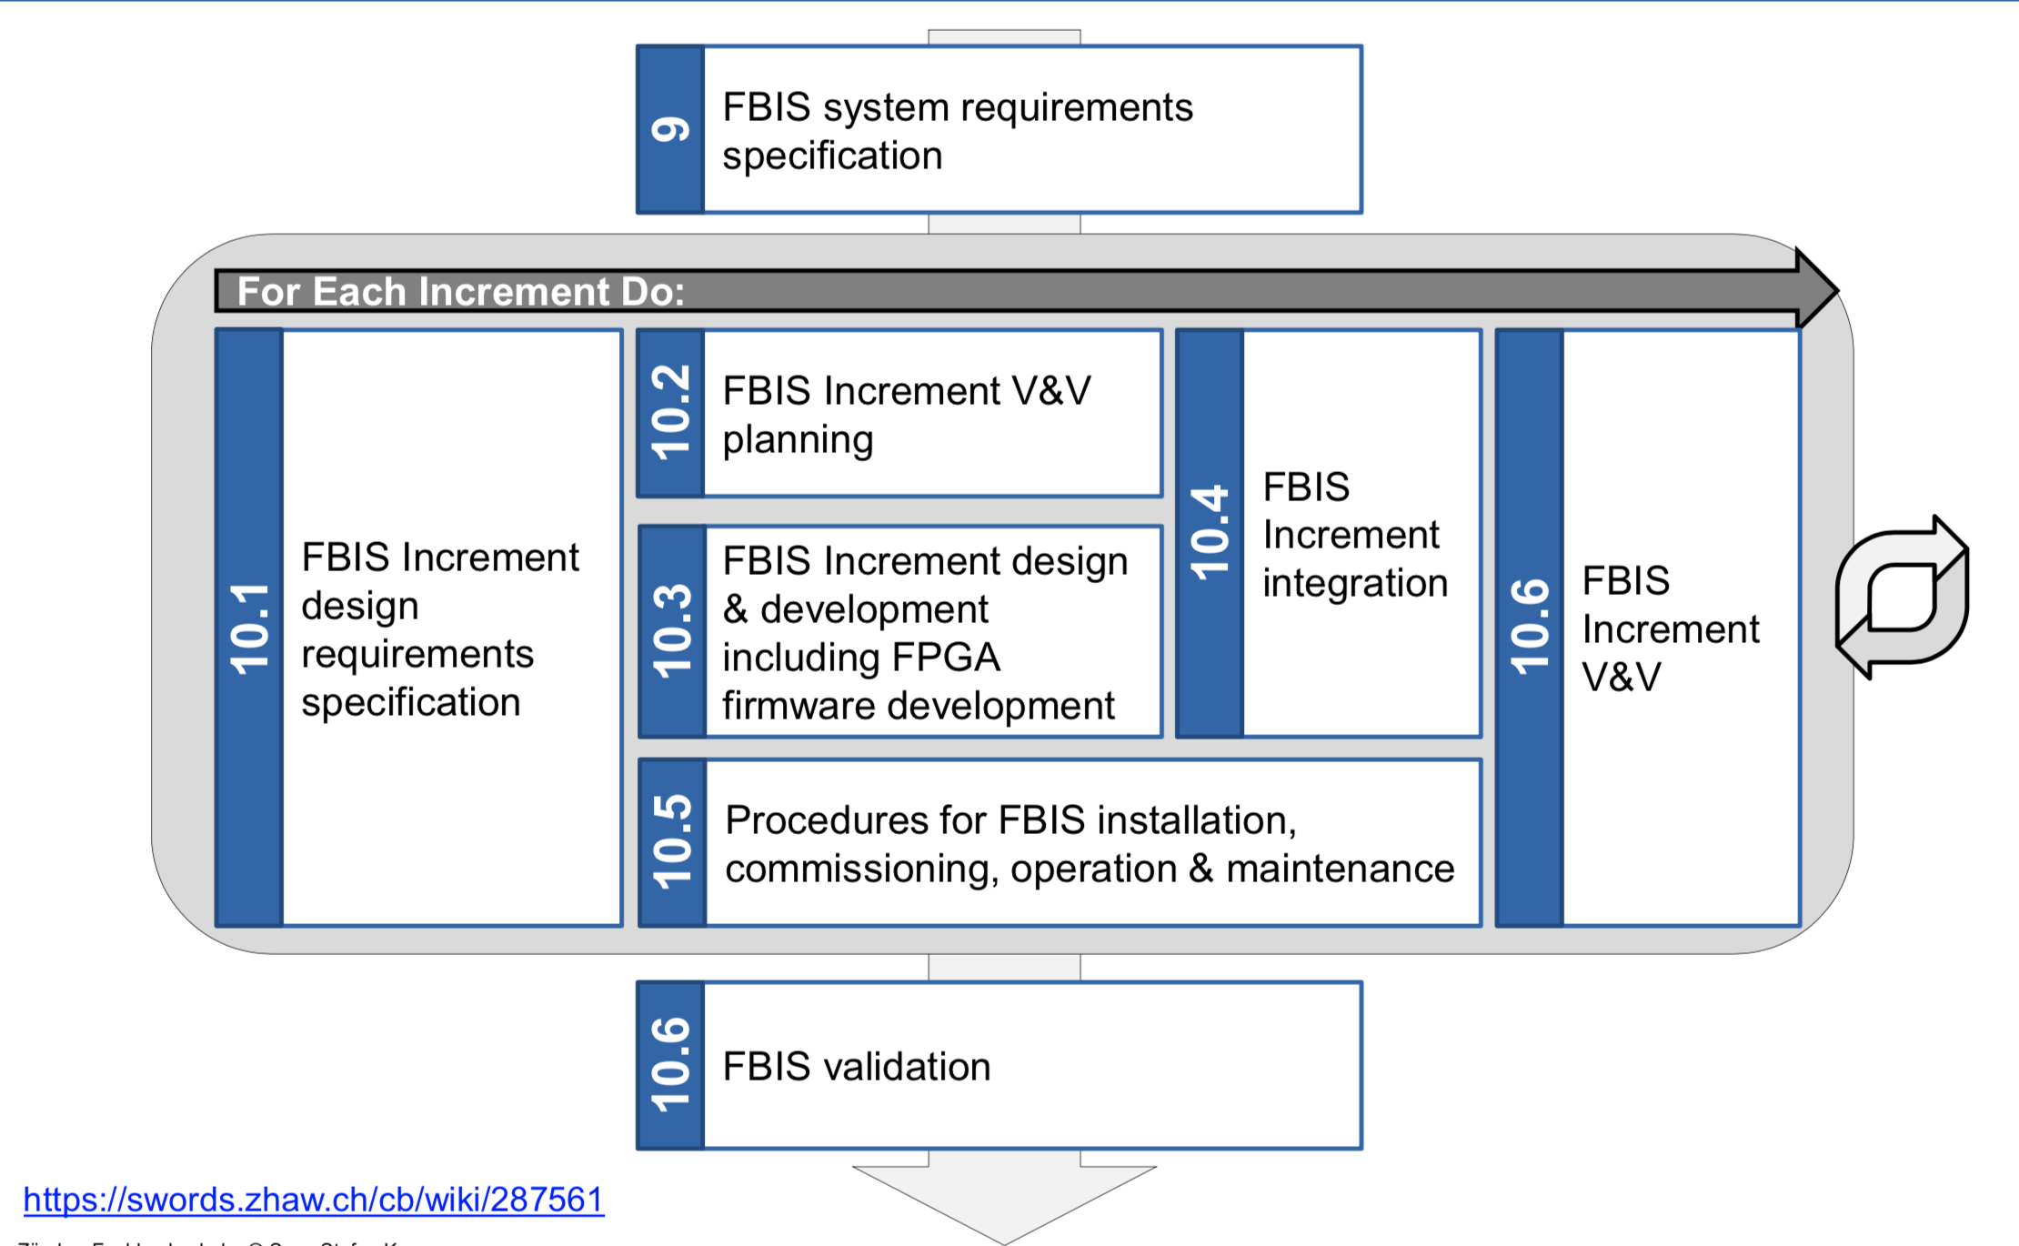
Incremental Development

Slide 43
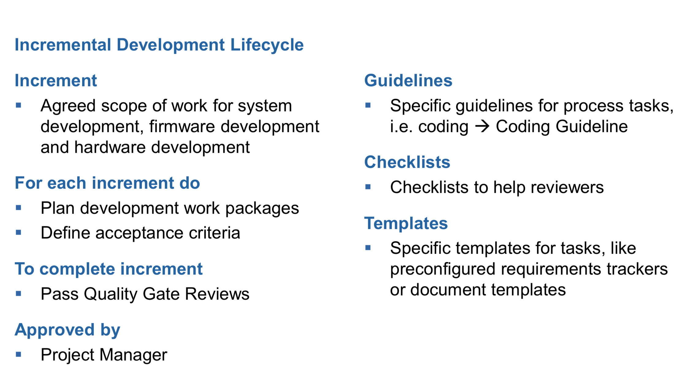
Incremental Development Lifecycle

Slide 44
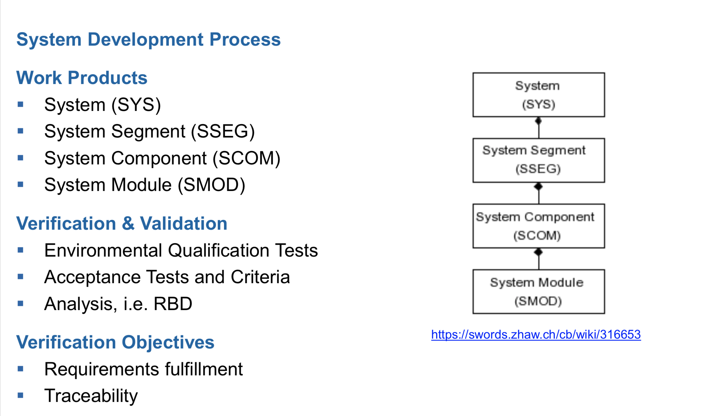
FBI System Development Process

Slide 45
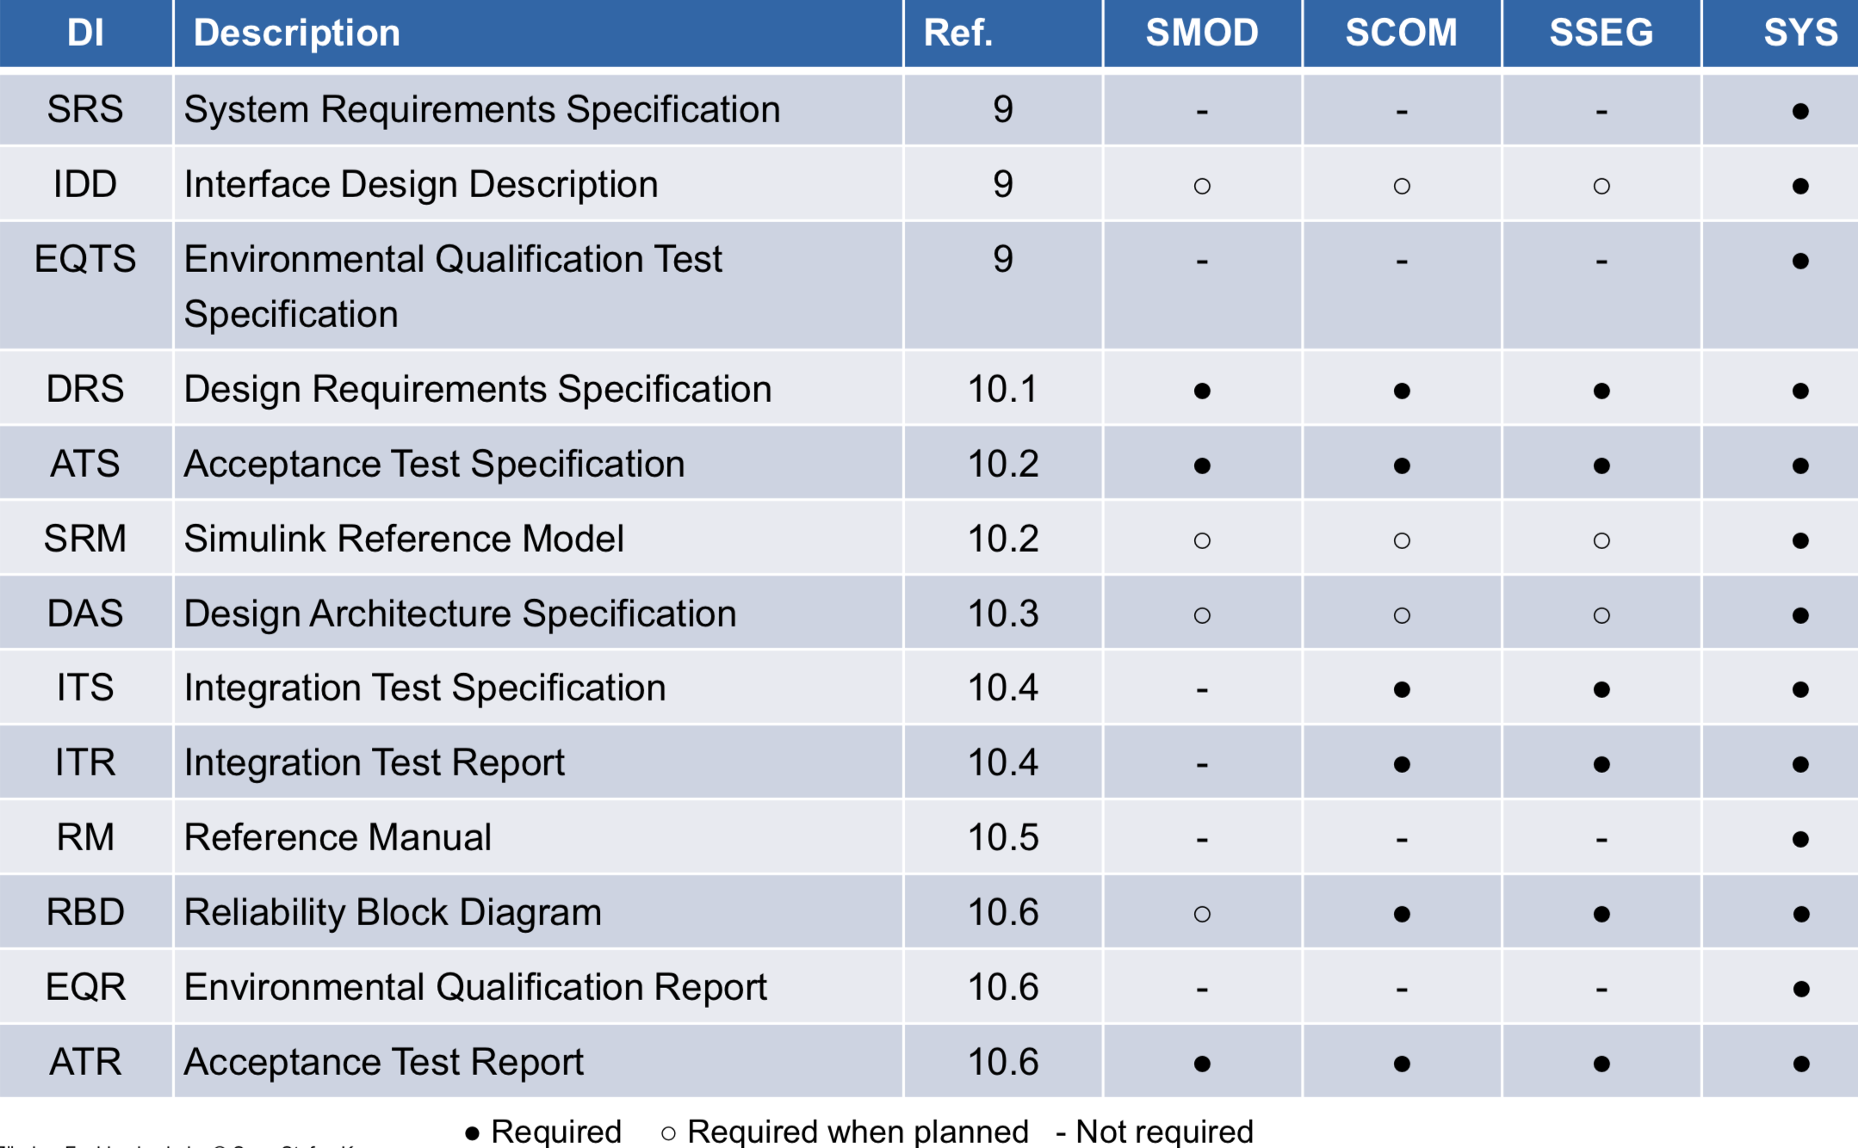
FBI System Development Process

Slide 46
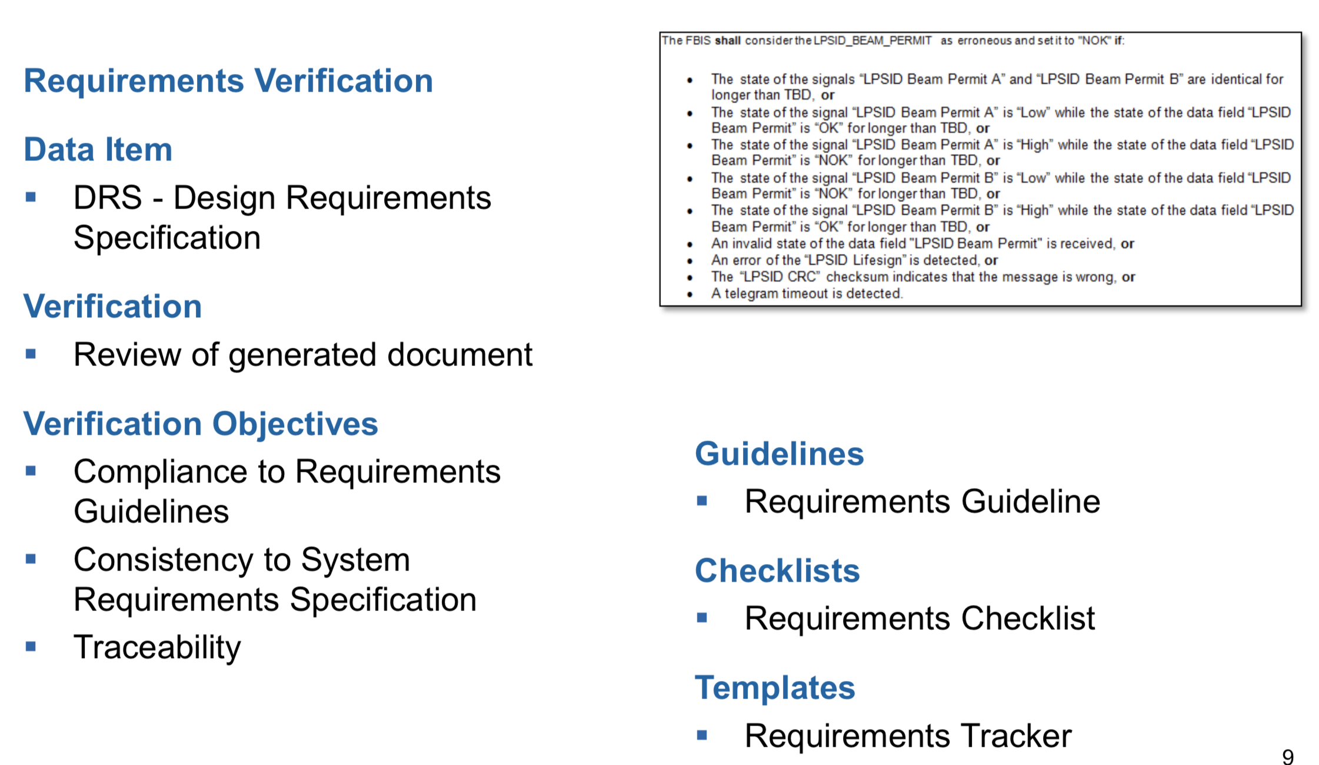
FBI System Development Process
46

Slide 47
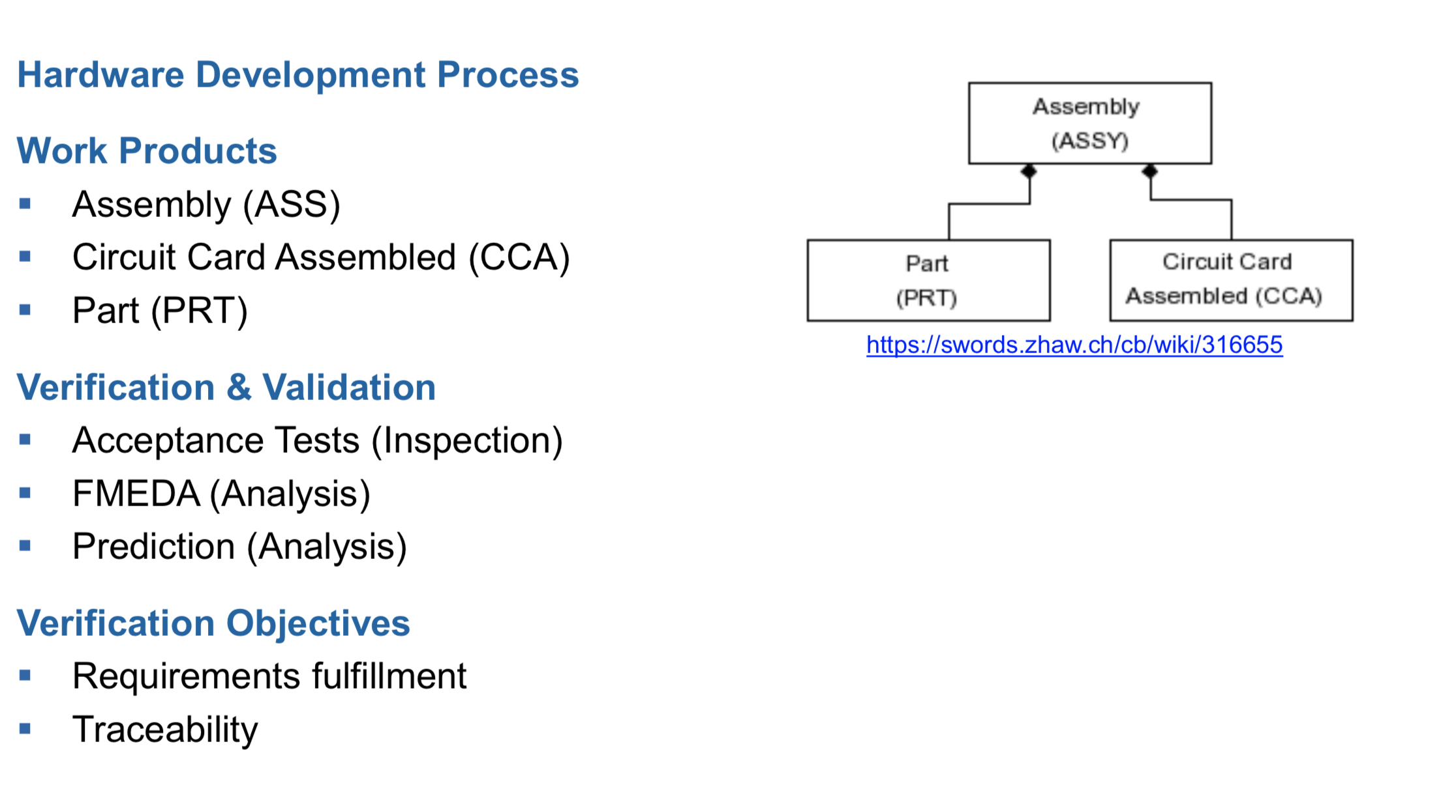
Hardware Development Process

Slide 48
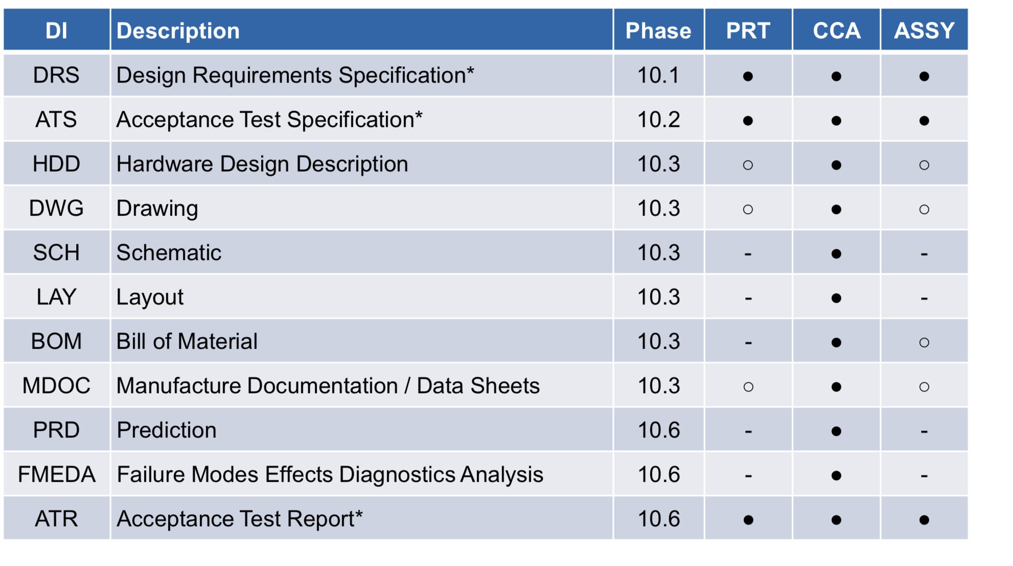
Hardware Development Process

Slide 49
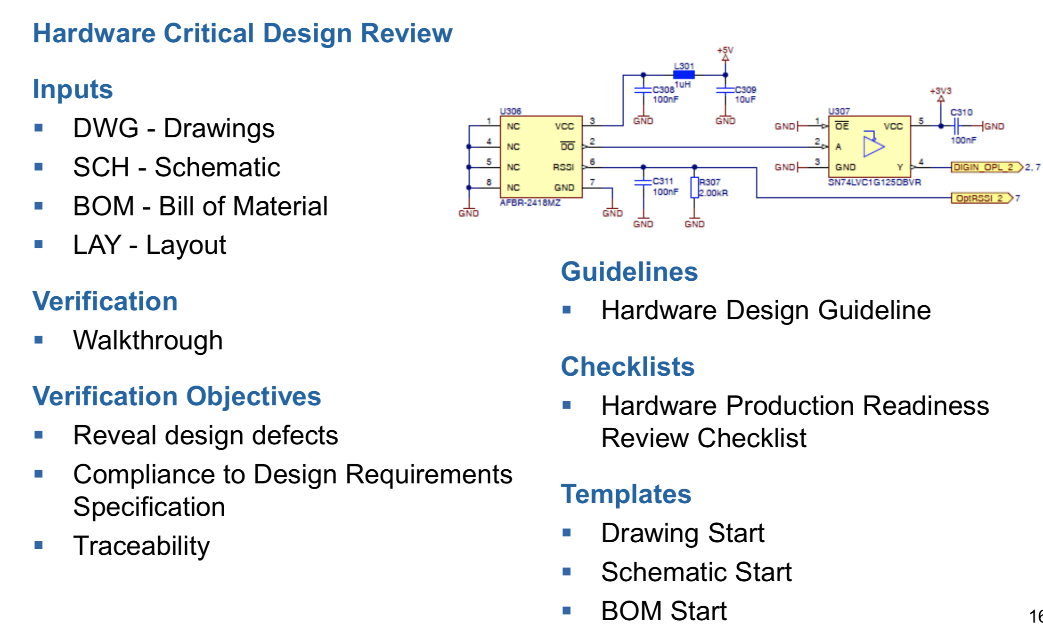
Hardware Development Process
49

Slide 50
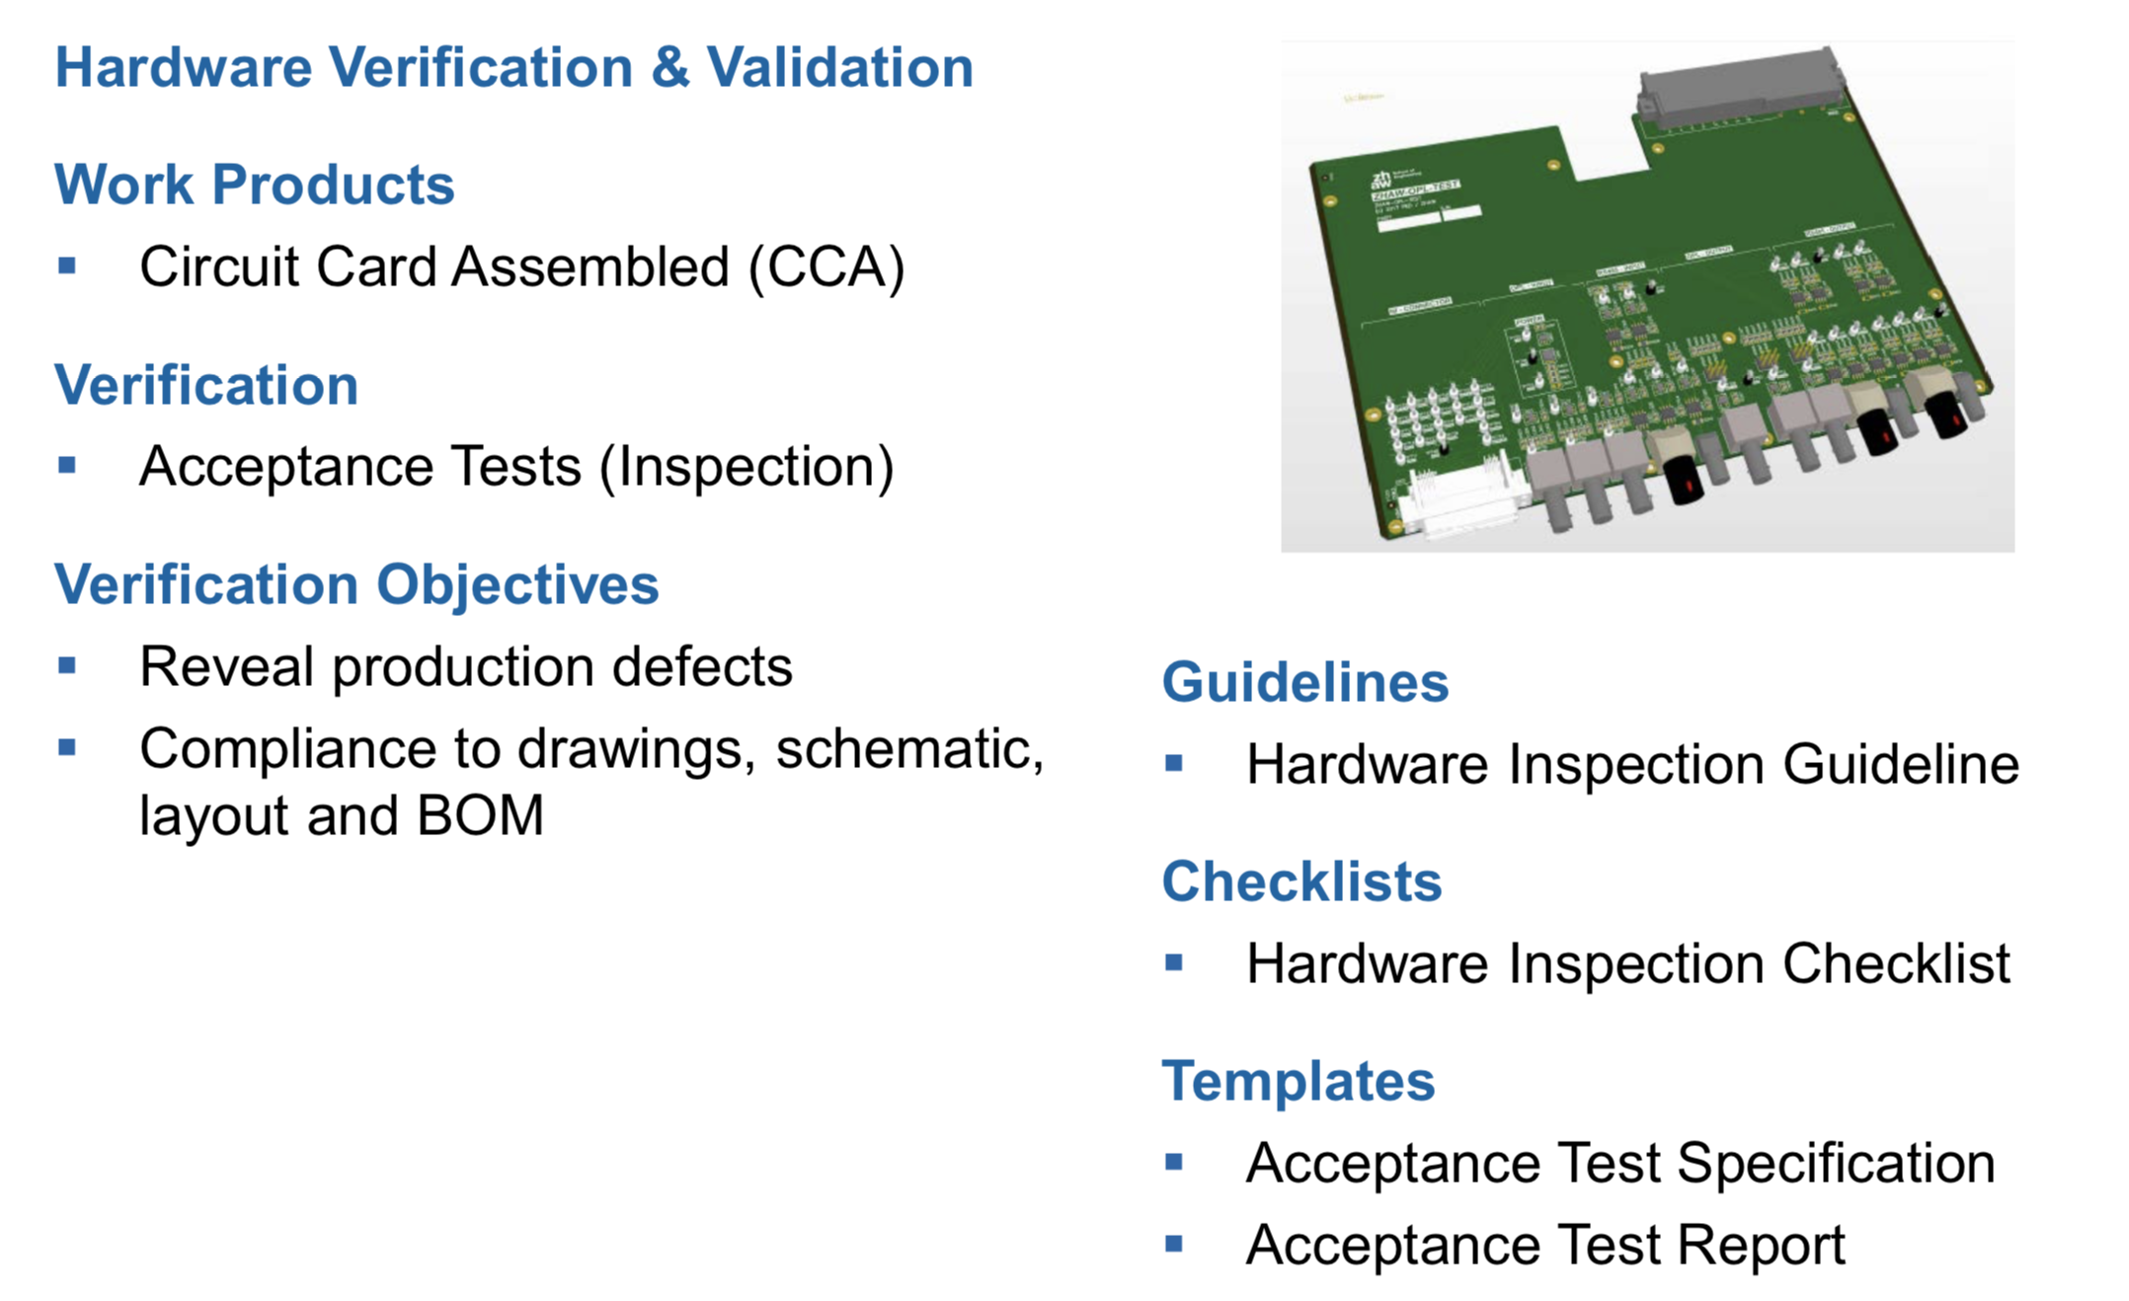
Hardware Development Process

Slide 51
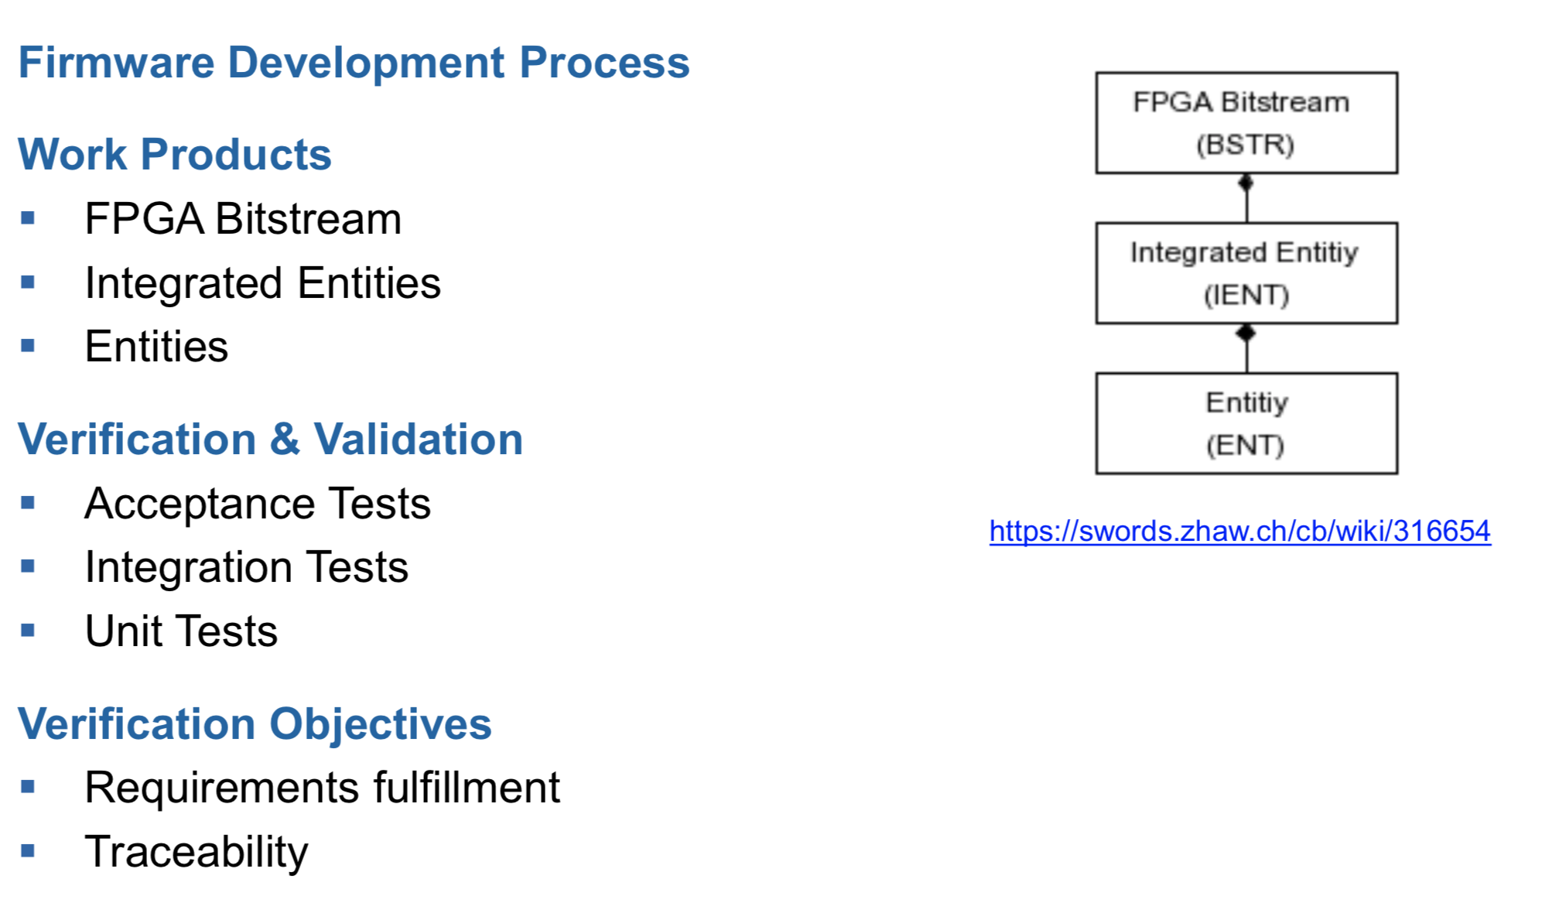
Firmware Development Process

Slide 52
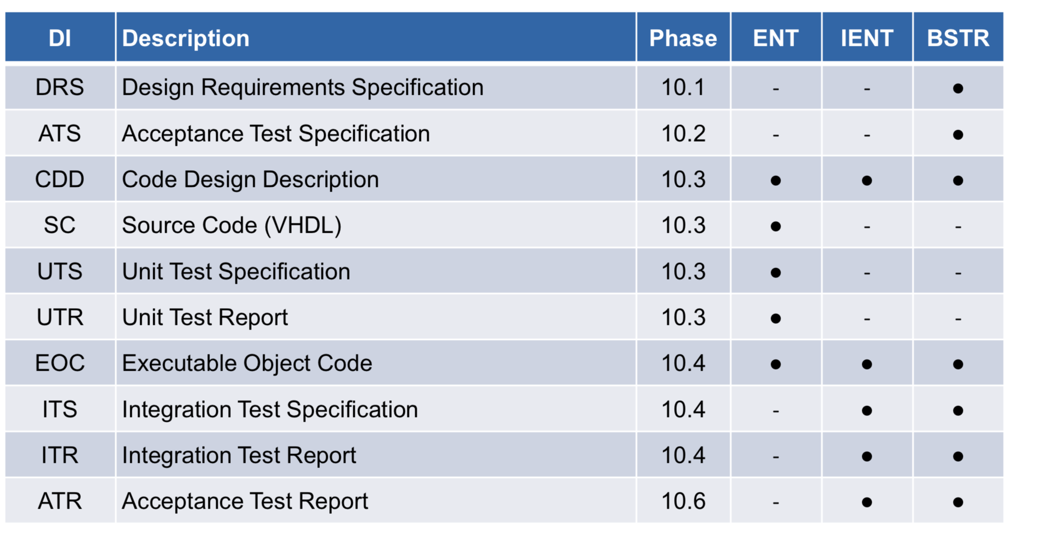
Firmware Development Process

Slide 53
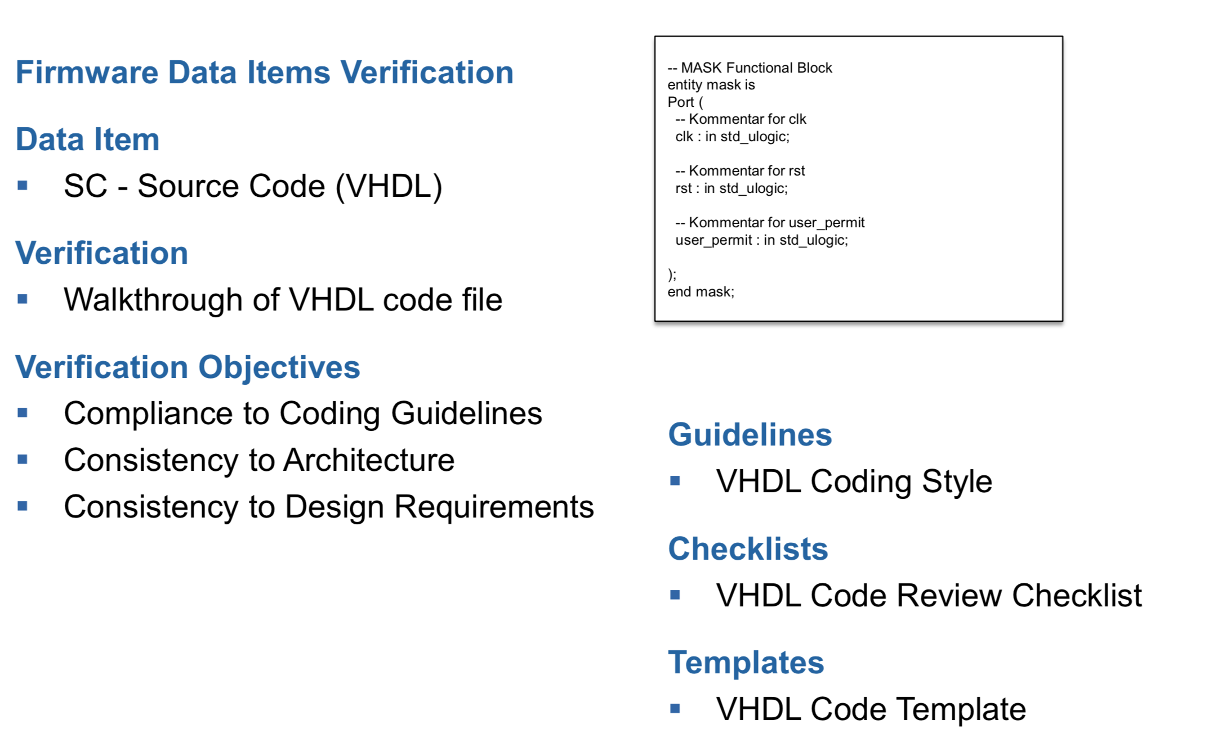
Firmware Development Process

Slide 54
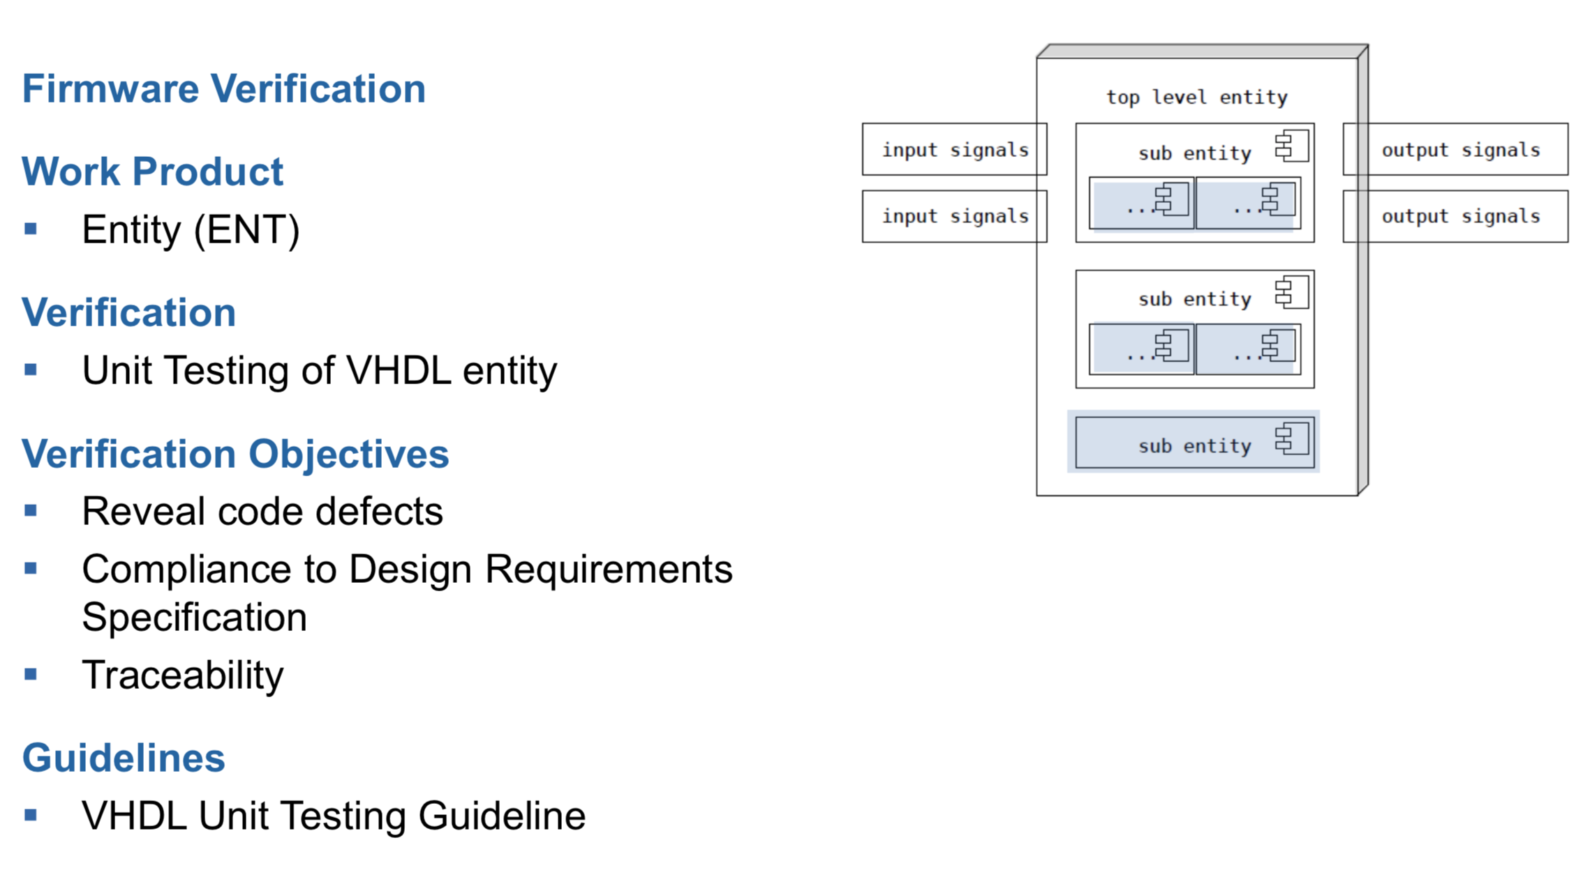
Firmware Development Process

Slide 55
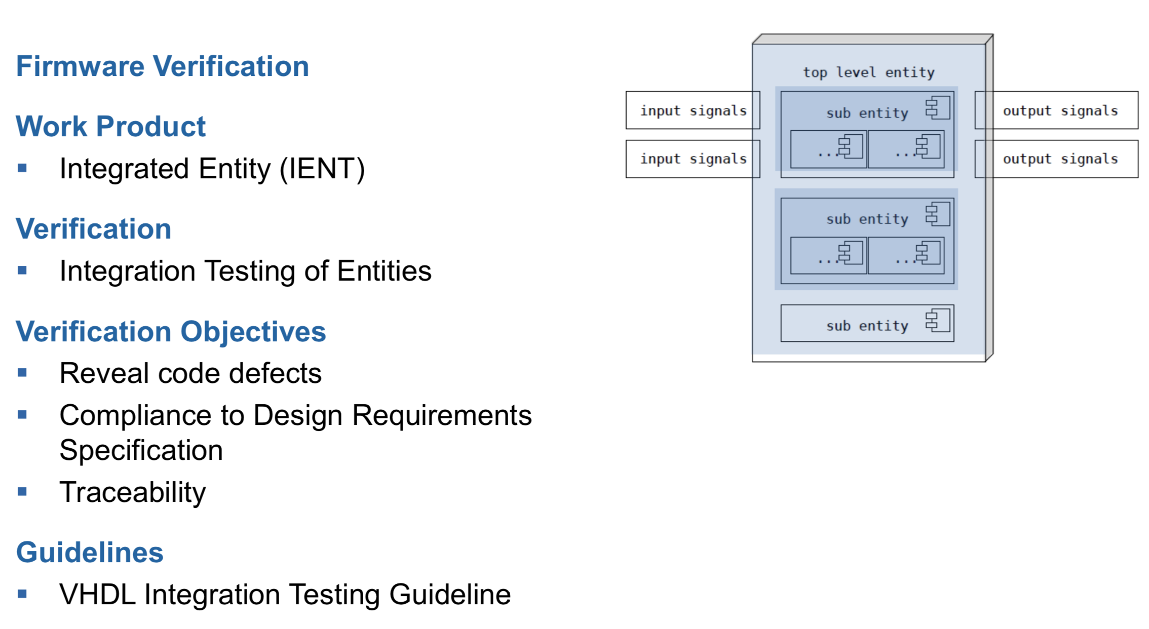
Firmware Development Process

Slide 56
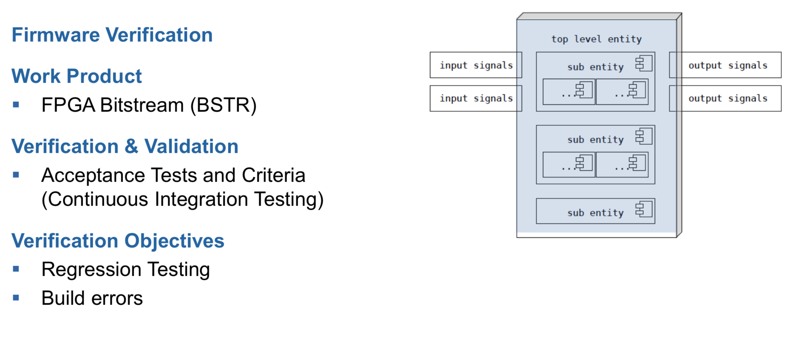
Firmware Development Process

Slide 57
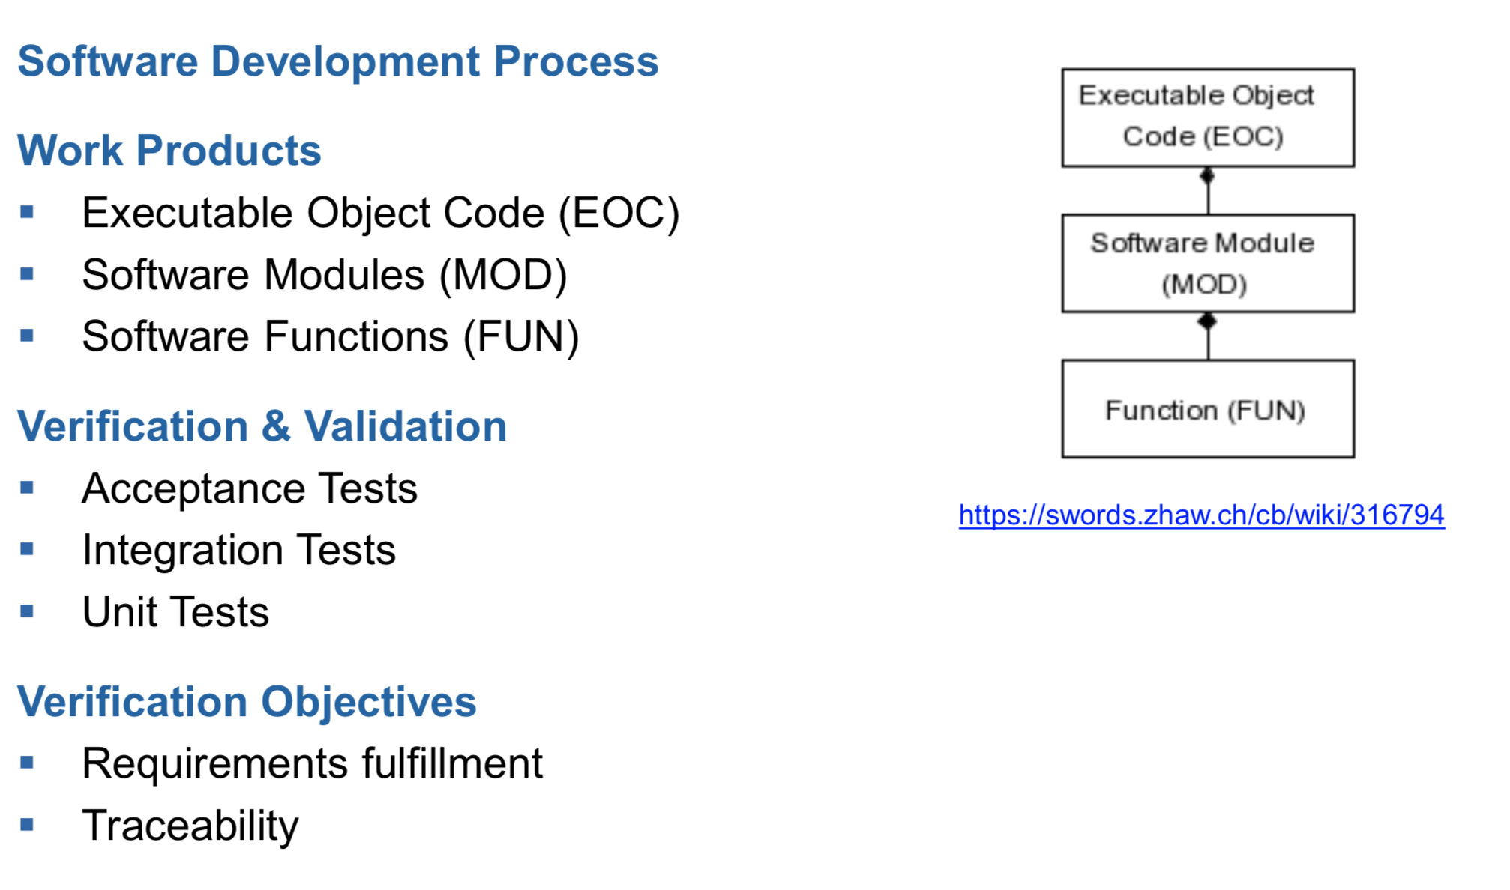
Software Development Process
57

Slide 58
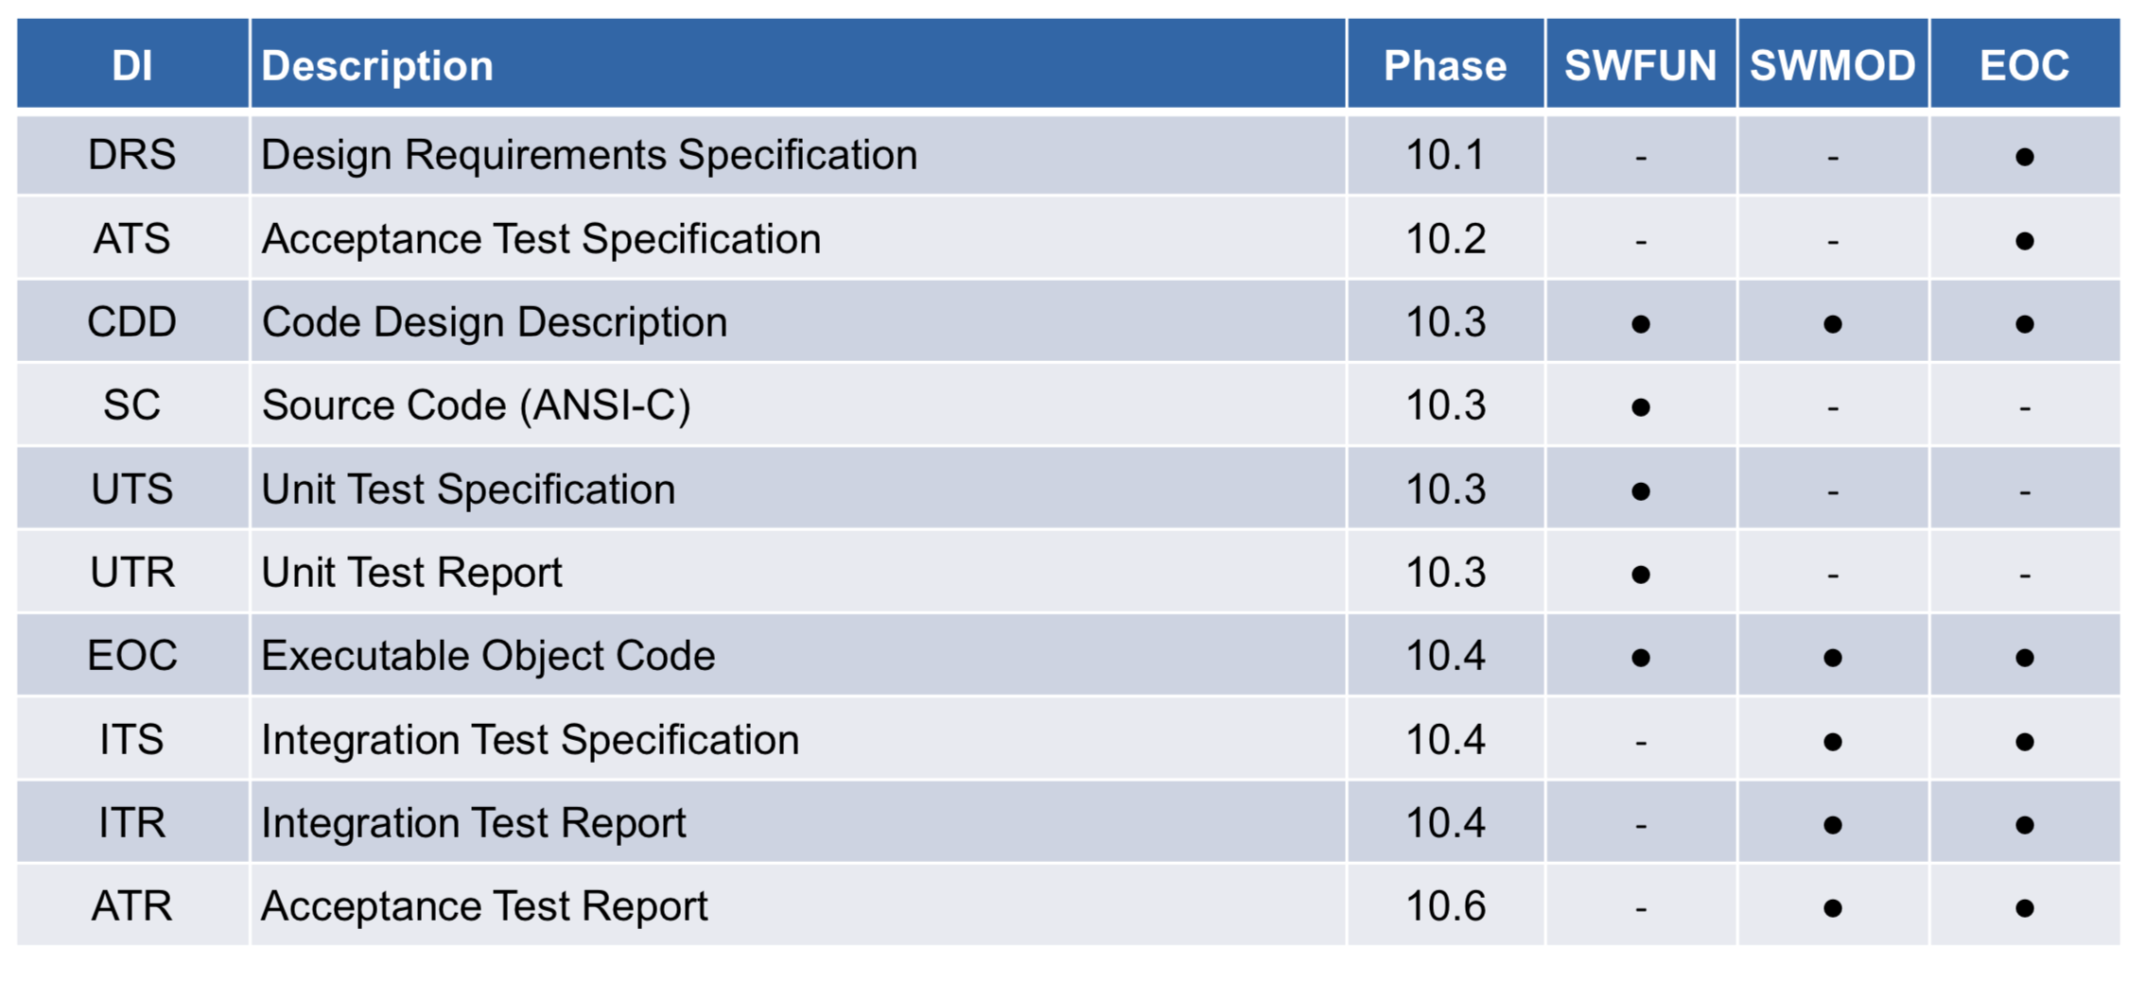
Software Development Process

Slide 59
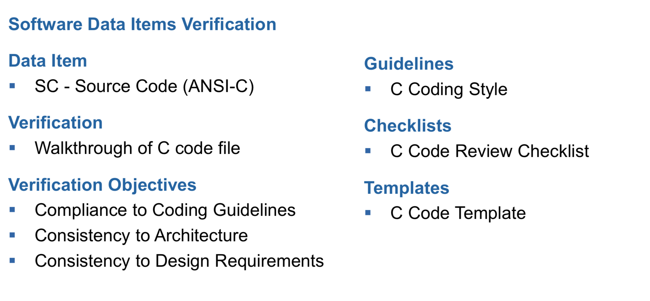
Software Development Process

Slide 60
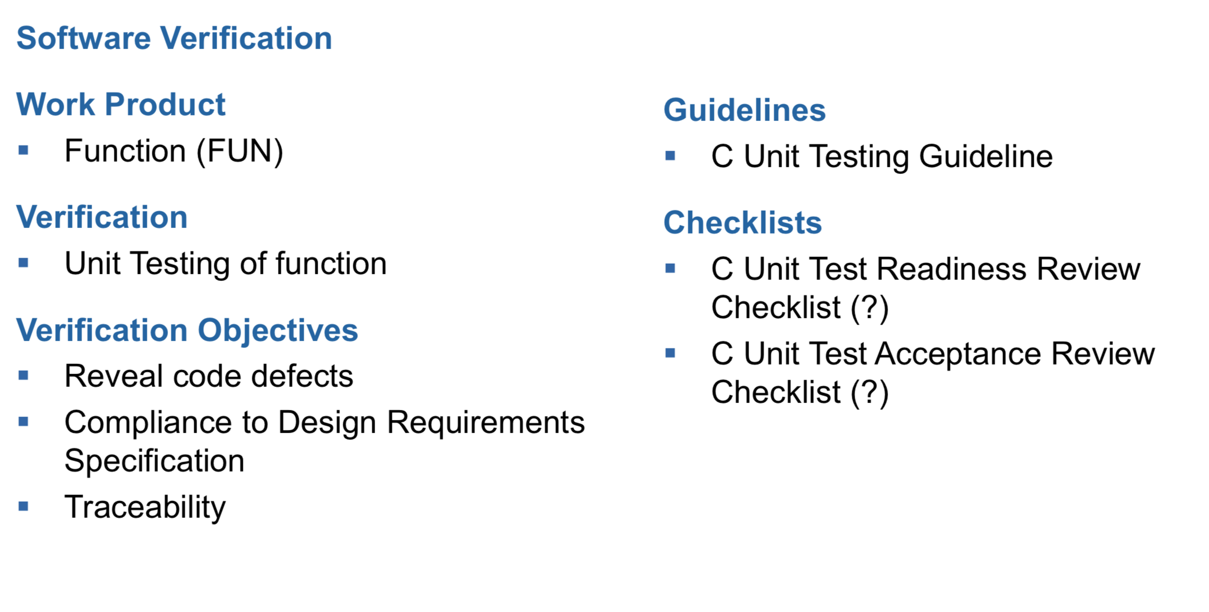
Software Development Process

Slide 61
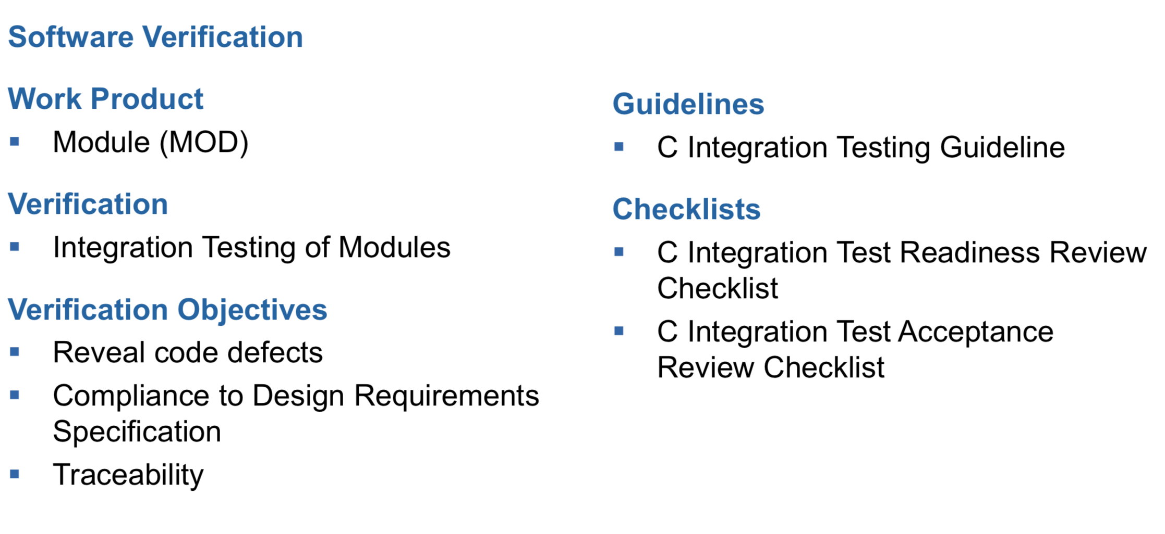
Software Development Process

Slide 62
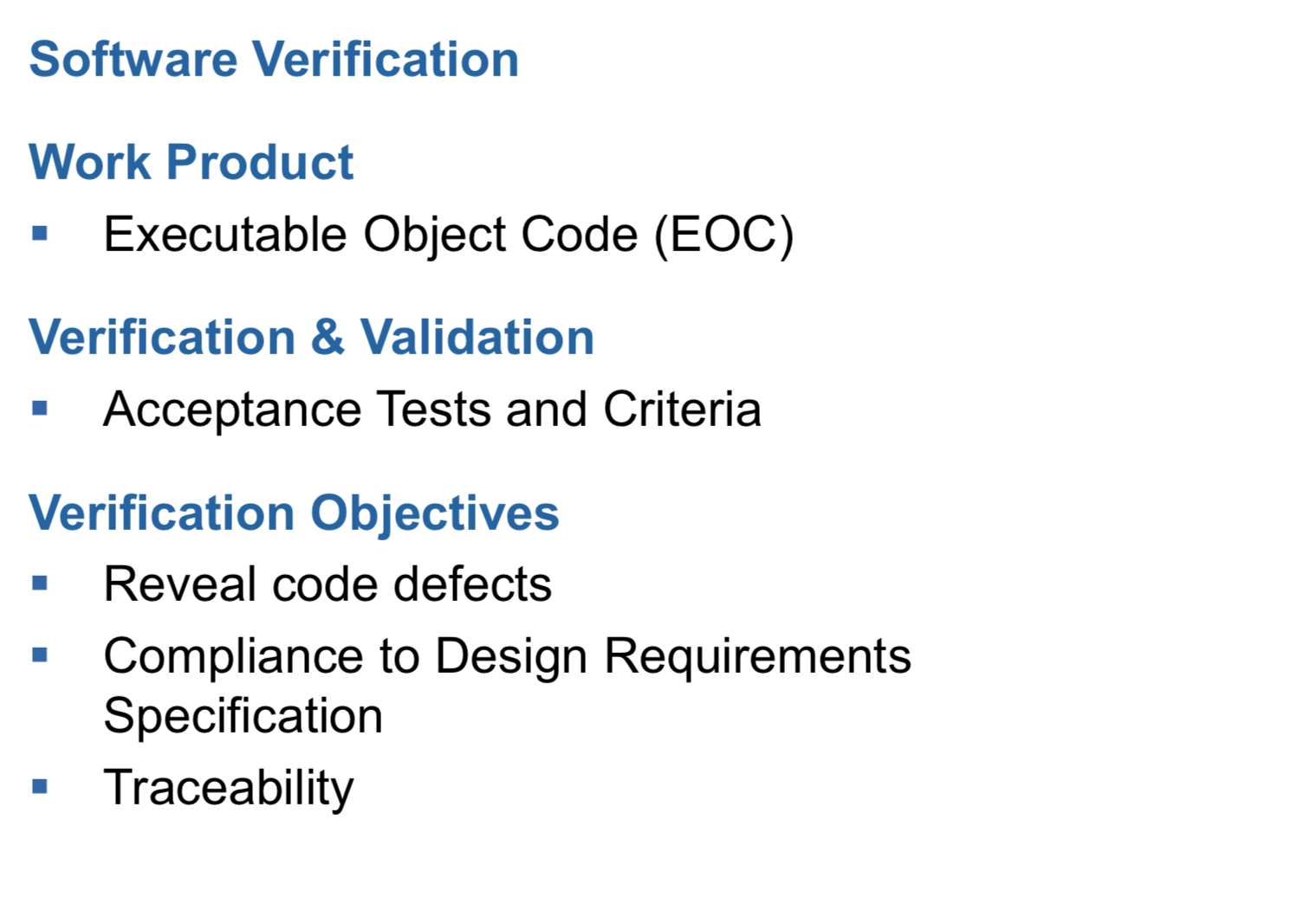
Software Development Process

Slide 63
Some first results on FBIS Reliability Prediction

Slide 64
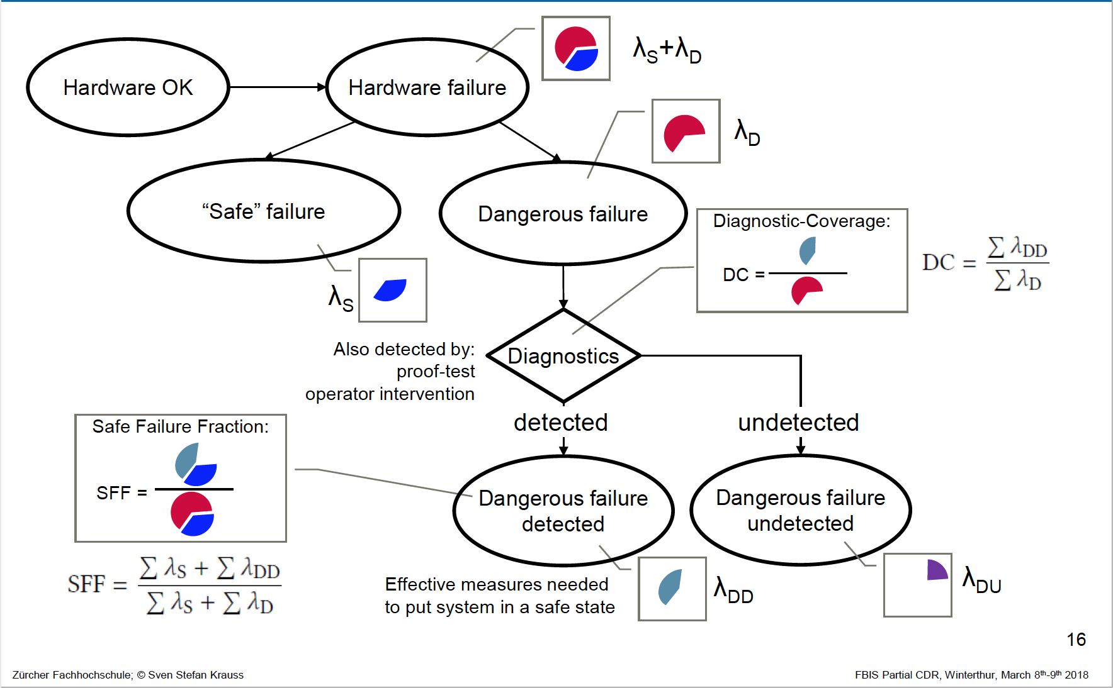
Failure Rates in IEC 61508
64

Slide 65
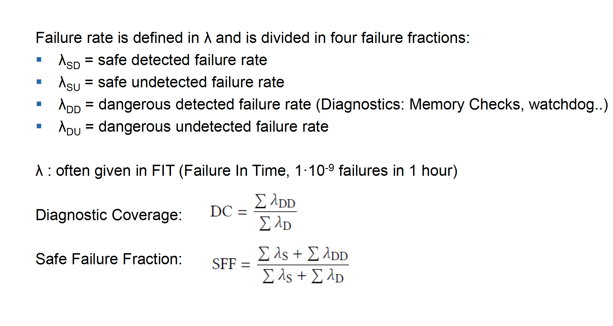
Failure Rates in IEC 61508

Slide 66
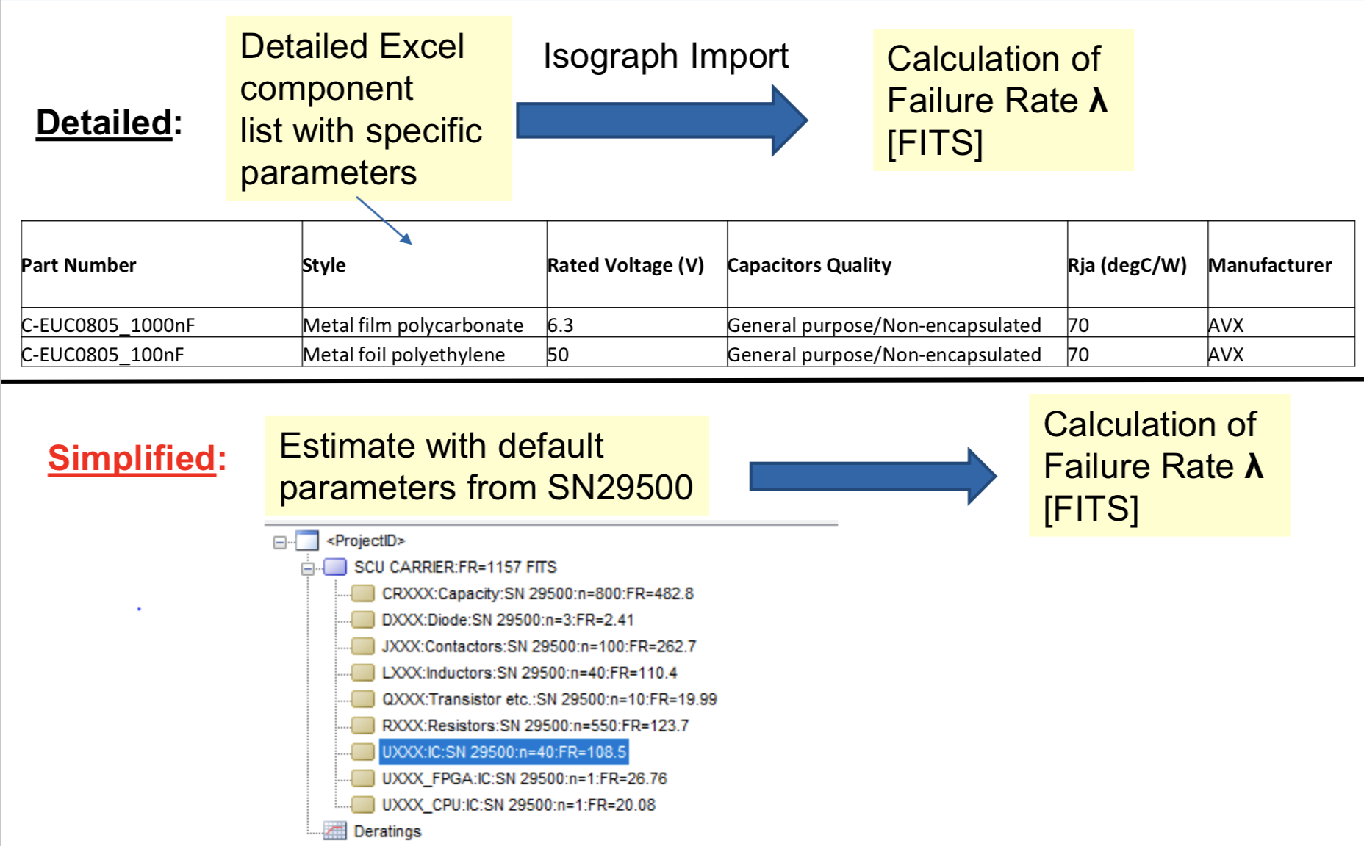
Tool Chain: Isograph Reliability Prediction

Slide 67
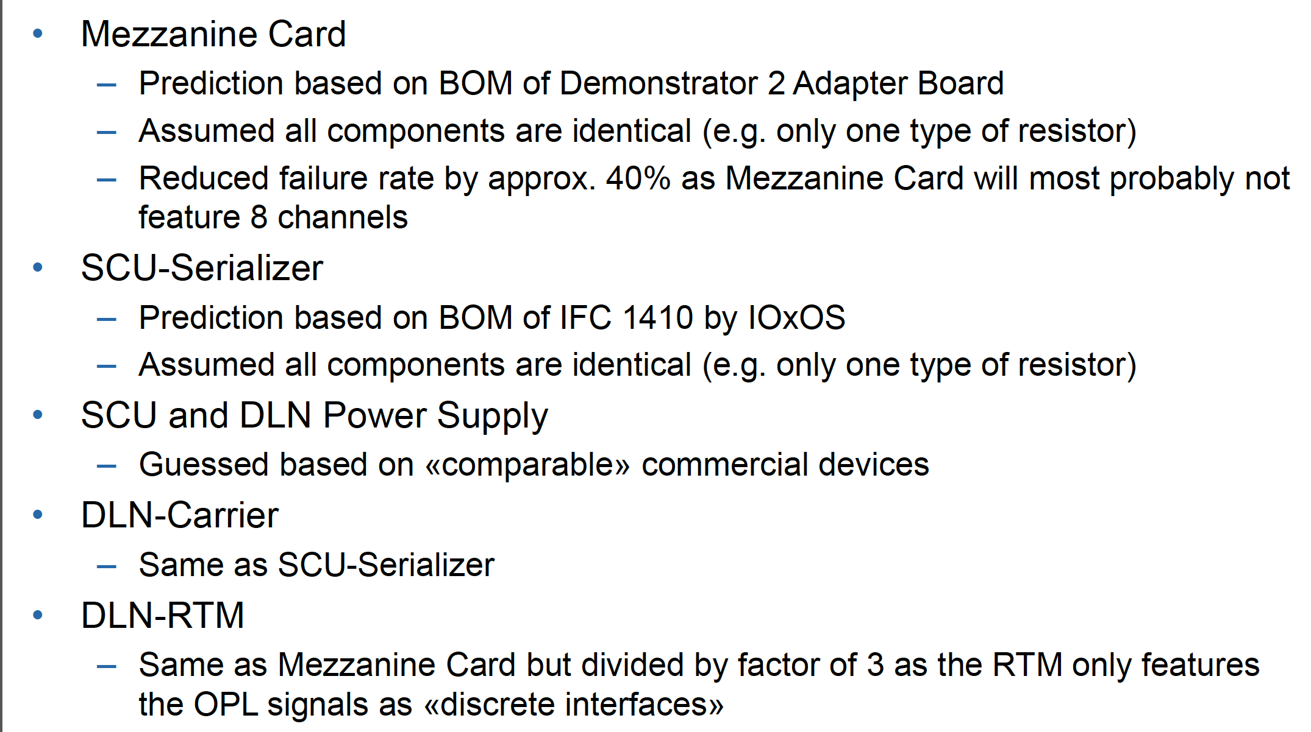
Tool Chain: Isograph Reliability Prediction

Slide 68
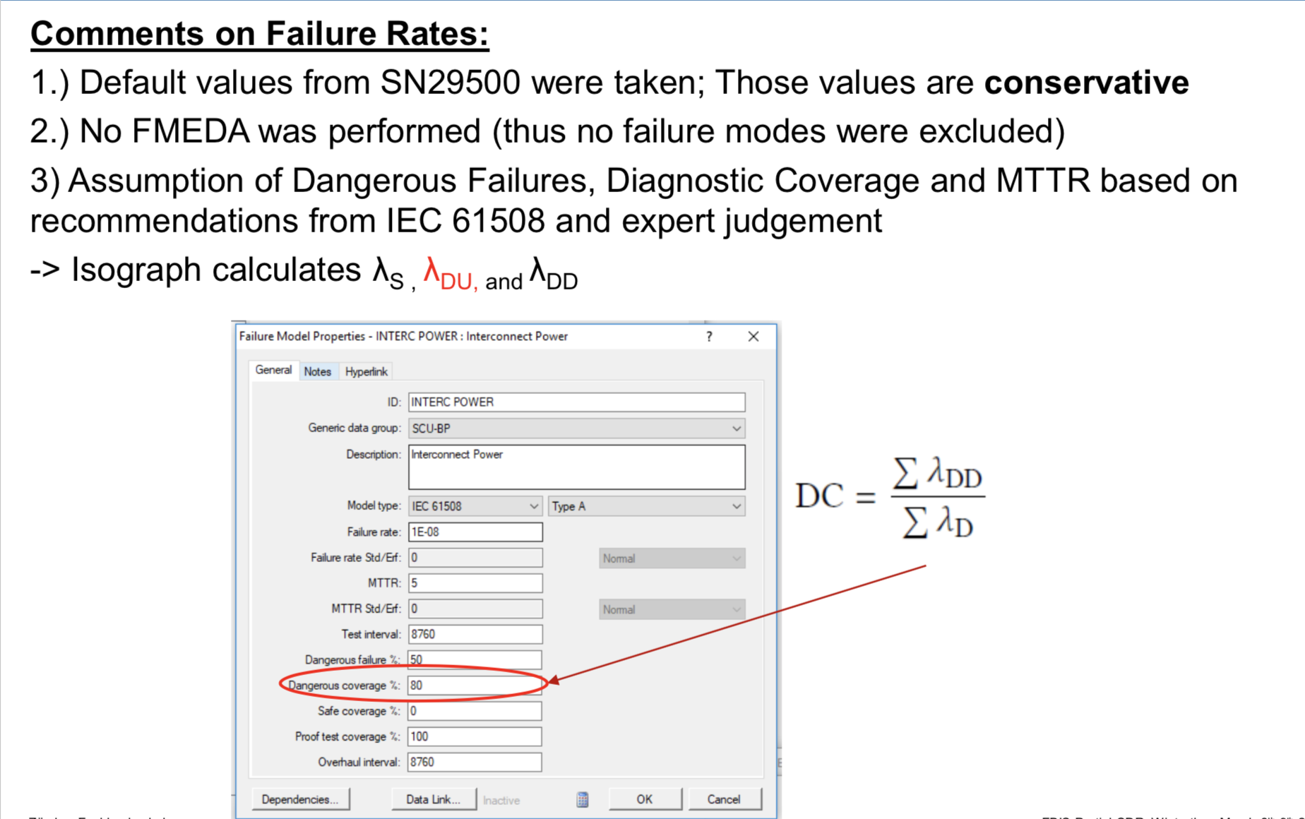
Tool Chain: Isograph Reliability Prediction

Slide 69
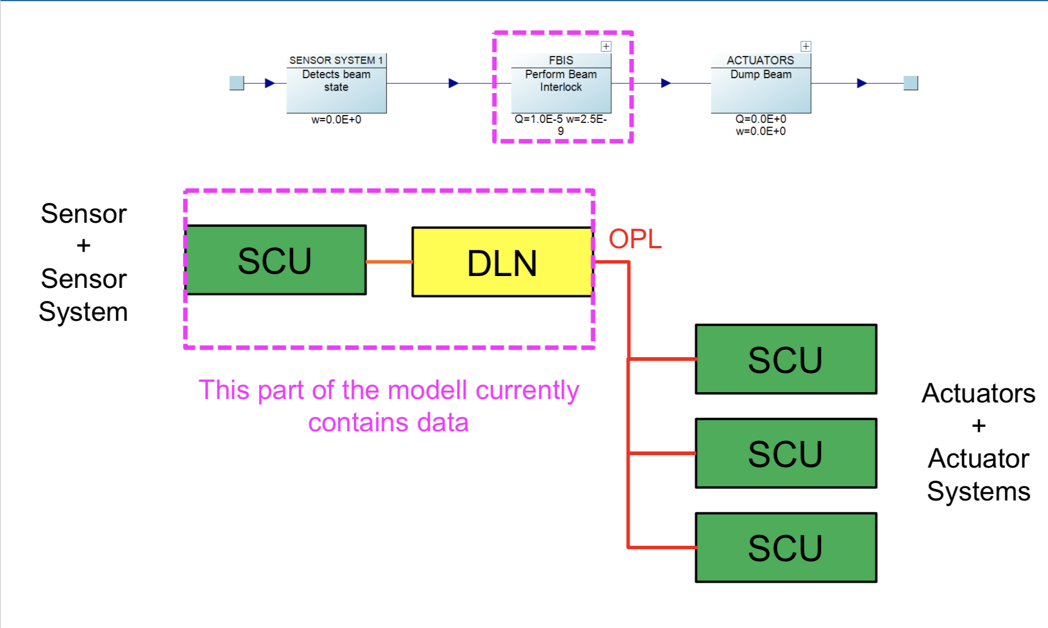
Reliability Block Diagram (RBD) Overview

Slide 70
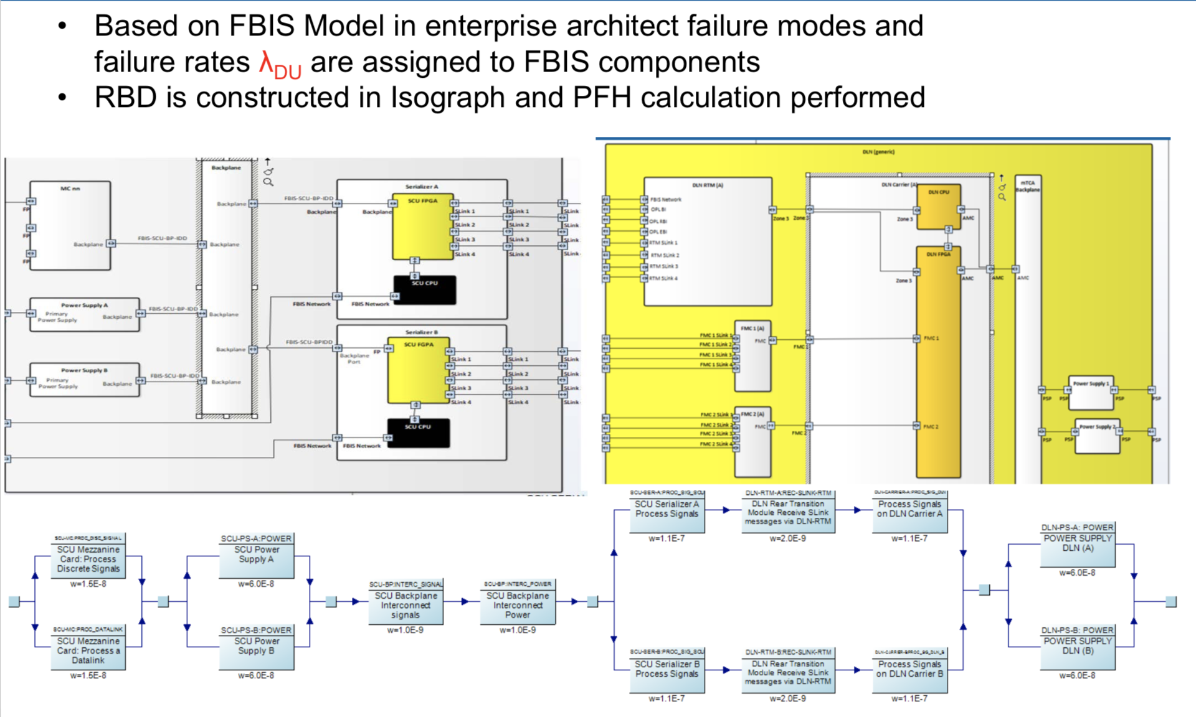
Tool Chain: PFH (average frequency of a dangerous failure per hour)

Slide 71

Preliminary Results FBIS
71

Slide 72


RBD FBIS (SCU and DLN)/ Sensitivity

Slide 73

Results: PIL Level

Slide 74

Protection Function Integrity Level Assessment
74

Slide 75

PF Example Interceptive Devices
75

Slide 76

PF Specification Example Interceptive Devices

Slide 77

PF Integrity Level Assessment

Slide 78

PF Documentation – Suggestion ID-PF-x

Slide 79
Summary
Presented status on MP integration strategy
Gave an overview on FBIS development, verification and validation strategy
Presented overview on reliability predictions for FBIS and how to assess the integrity level of Protection Functions
Thanks a lot for the great work done by the team at ESS and at ZHAW (in kind partner)
It is complex but we are progressing step by step!

Slide 80
Attention
Lets discuss …
What are the issues?
How to be BETTER?

Slide 81
Issues/Concerns/Thoughts/Help?
Detailed MP V&V, commissioning & early operations plans are not yet fully developed (they might fall into InitOps phase): We are aware and working on this
Many related aspects are still open, e.g. threshold management, beam loss strategy, interlocks management, integration of MP into commissioning & operations (e.g. who decides on threshold/interlock changes, who has overall responsibility?)→ Interlocks working group planned
I think an MP representative shall be involved, shall have a mandate when developing the above.
ESS Machine Protection Committee has not representative from Operations on board: Carlo ☺

Slide 82
Issues/Concerns/Thoughts
MP team has 2.5 experienced people (in OP and commissioning)
Not enough, hence,… we train our staff …
ESS MP has a framework agreement with CERN/LHC/LINAC4 - Operations team on training ESS staff on operations and commissioning with focus on Machine Protection, which is FANTASTIC!
Ric and Szandra attended start up of LHC (and LINAC4) in spring 2018 for 2 weeks (Ric however is leaving now ☹, Enric was on sick leave already ☹)
Plan to send Viktor and Fernando to CERN asap (to get inspired on commissioning support tools, installation issues, etc)

Slide 83
Issues/Concerns/Thoughts/Help?
Its difficult to keep staff that is well trained
Replacement of staff leaving ESS is done on a timeline that doesn’t allow for handover
More support from upper management on this front would be extremely highly appreciated. We cannot keep up with a constant high pressure life-style for years!

Slide 84
Awareness Please!
Radiation Safety (Analysis Method change in Spring 2018)
Analyses (TSS driven) indicate that MP plays important role for radiation safety
If communicated not correctly to SSM, this may become a concern
Latest approved Target event classification documents: ESS-0374897, ESS-0320231
Further ex: Can beam monitoring devices connected to MPS be used to detect earthquakes early on/used as layer of protection?

Slide 85

Thank you

Slide 86
BACK UP SLIDES

Slide 87
Status Overview
https://confluence.esss.lu.se/display/PS/MP-SoS+Summary
https://confluence.esss.lu.se/display/PS/MPSVAC+and+MPSID+CDR
https://confluence.esss.lu.se/display/PS/Deployment

Slide 88

Diagnostic and Proof Tests/Example

Slide 89

Diagnostic and Proof Tests/Example

Slide 90

Diagnostic and Proof Tests/Example

Slide 91

Diagnostic and Proof Tests/Example

Slide 92

Diagnostic and Proof Tests/Example

Slide 93

Diagnostic and Proof Tests/Example

Slide 94

Diagnostic and Proof Tests/Example

Slide 95

FBIS RBD

Slide 96

FBIS RBD: Sensitivity One SCU

Slide 97

FBIS RBD: Sensitivity One Serializer only

Slide 98




The MP Look ☺
MP in Erikaviolet RAL 4003

Slide 99



MP connection boxes
MP Patch Panels

Slide 100
Next Steps for FBIS

Slide 101

Deliverables for FBIS / ZHAW

Slide 102

Deliverables for FBIS / ZHAW

Slide 103

Deliverables for FBIS / ZHAW

Slide 104

Deliverables for FBIS / ZHAW

Slide 105

Deliverables for FBIS / ZHAW

Slide 106

Deliverables for FBIS / ZHAW

Slide 107
We want to be ready for NC LINAC Commissioning
HOW?

Slide 108
MP @ NC LINAC
MP systems needed to commission the nc linac:
FBIS (CDR passed: 2018-08)
MPSVAC (protection for vacuum gate valves) (CDR: 2018-10)
MPSID (protection for insertable devices) (CDR: 2018-10)
MPSMAG (protection for magnets) (PDR passed: 2018-10)
Interfaces to MPS systems/FBIS needed for nc LINAC commissioning:
BCMs (hw wise ok, interlock logic tbw)
BLMs: nBLM, ICBLM (hw wise ok, interlock logic tbw)
BPMs (hw wise ok, interlock logic tbw)
RFLPS’s (hw wise ok, interlock logic tbw)
Actuators (LEBT chopper, Ion Source (HV PS, FSU), Timing System, MEBT chopper (hw tested at IS test stand, logic clear)
EPICS (started)
Timing System (hw ok, logic in good state)

