Slide 1
Accelerator status
Mats Lindroos
www.europeanspallationsource.se
October 10, 2018

Slide 2
A few highlights
IS-LEBT commissioning underway
  Plasma established
  HV tested
  Beam testing started
  Dayshift in control room with operation section in charge of PSS-0
  Commissioning and preparing for inauguration
All three ess Cold Boxes delivered and installed
RF at test stand 2, 1.5 MW at full duty cycle
Test of HB cavity package and ESS circulators from AFT at FREIA in Uppsala
Start of Medium Beta Prototype Cryomodule Testing at CEA and nominal field in two cavities
First prototype spoke CM and valve box at FREIA
Changes to IK and installation organization at AD
  AD installation coordinator: Peo Gustavsson
  AD In-Kind manager: Håkan Danared (support from Ebbe Malmstedt)

Slide 3
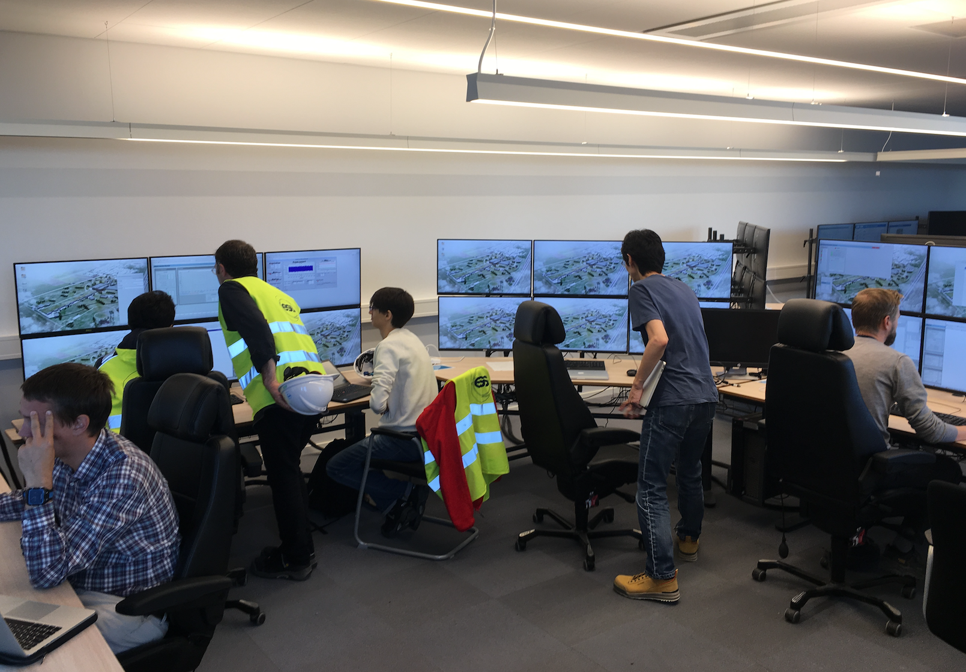
Operation with day shift has started

Slide 4
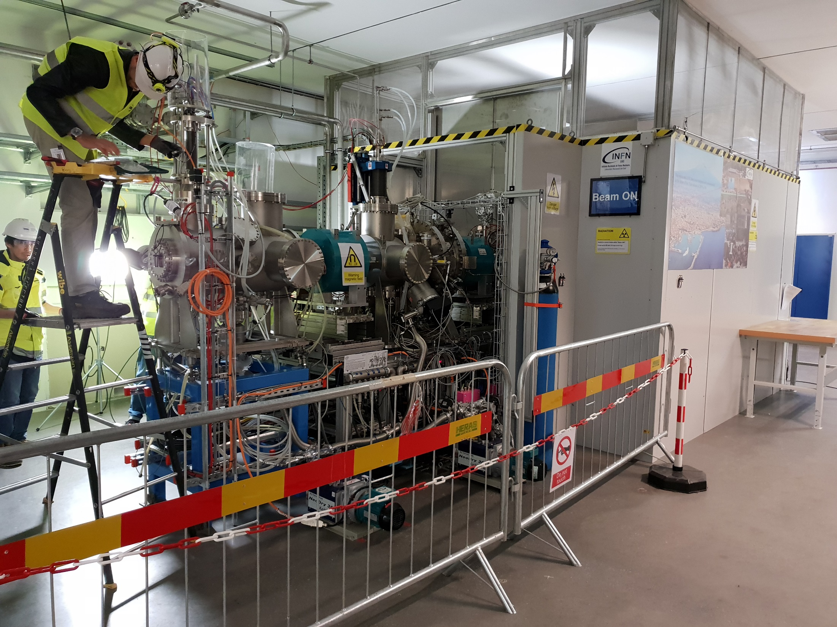
Commissioning of
Ion source & LEBT has started

Slide 5
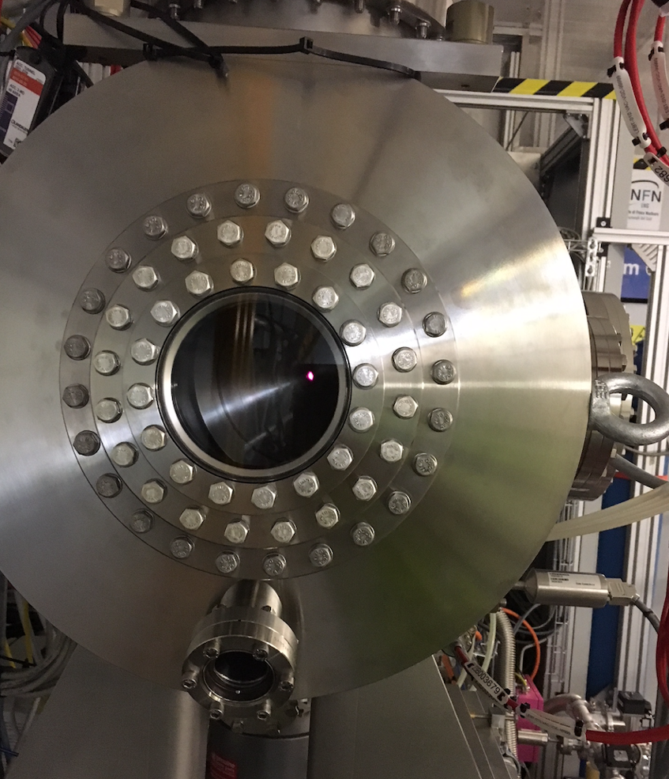
Plasma in the ion source

Slide 6
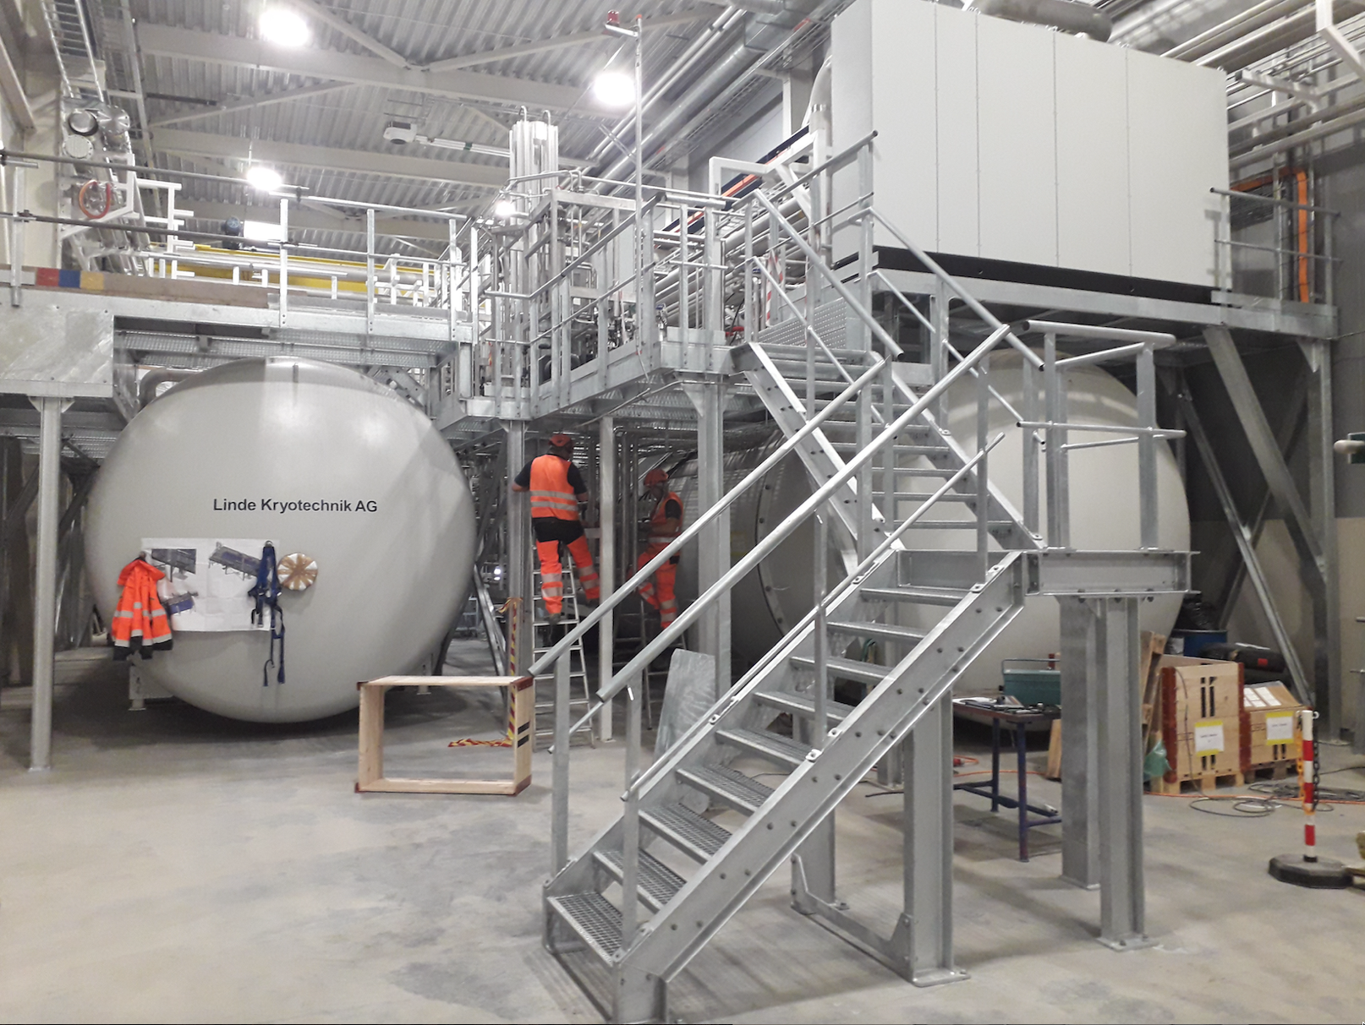
All cryoplants installed
TMCP cryoplant to the left and ACCP to the right (TICP not visible in this photo)

Slide 7
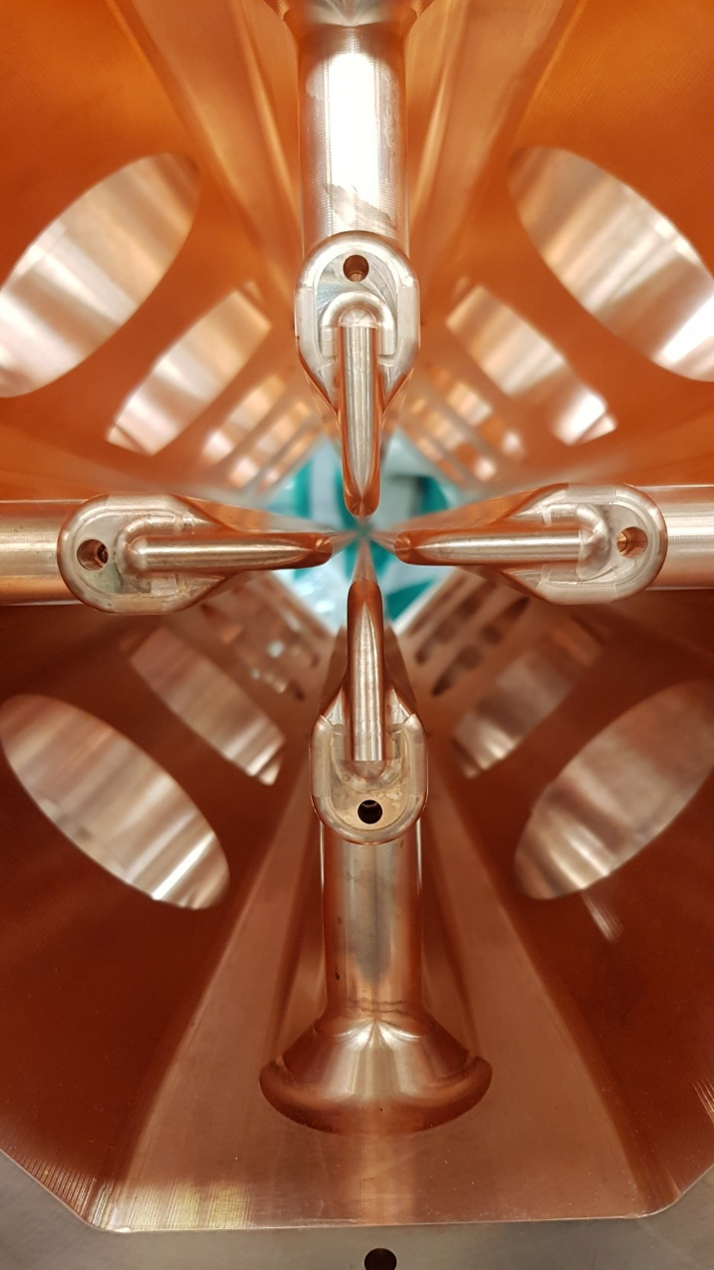
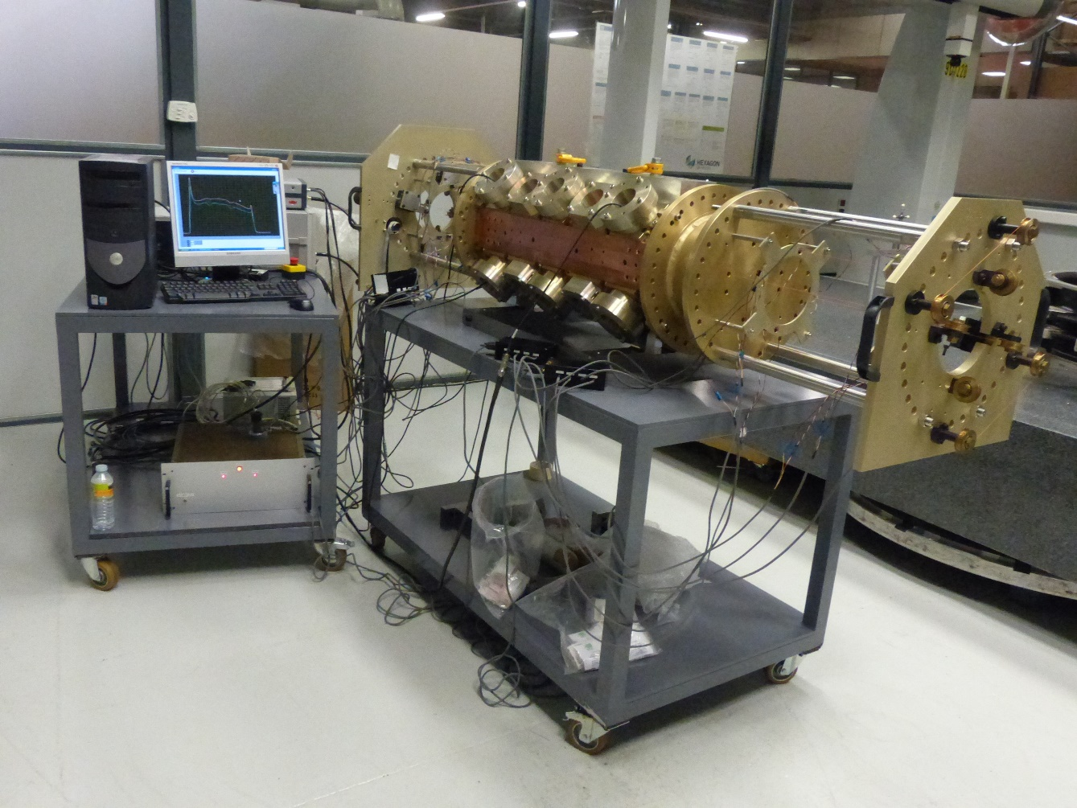
Bead pull of first RFQ segment before brazing
Section 1 Bead-Pull measurement equipment (09/10/2018)
Section 1

Slide 8

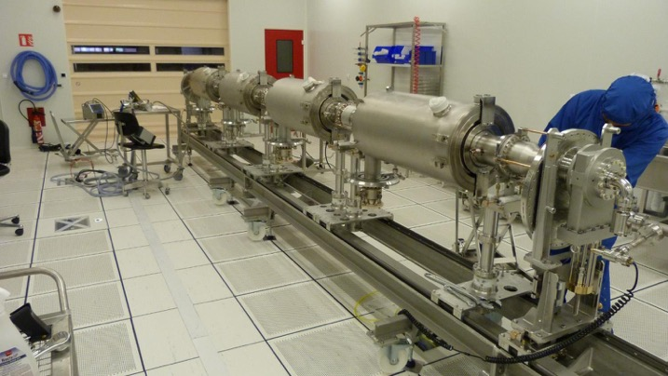
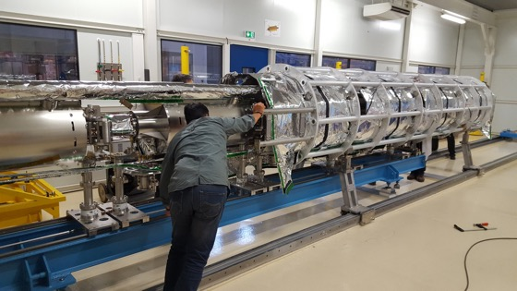
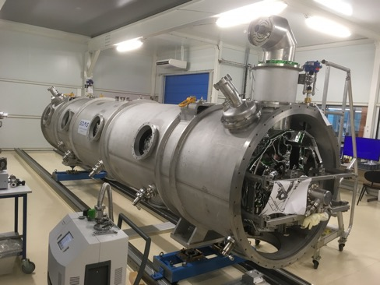
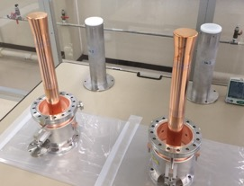
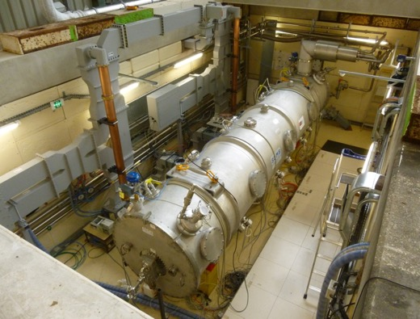
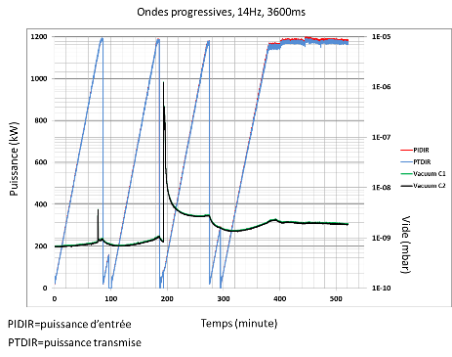
CEA – MB Prototype Cryomodule
March 2017
May 2017
July 2017
Assembly in ISO4 CEA CR
4 medium β 6 cell elliptical SRF cavities (1 LASA/3 CEA)
10 couplers at nominal specs
Two cavities tested to nominal field in September 2018

Slide 9
Nominal field in one cavity of the elliptical CM

Slide 10
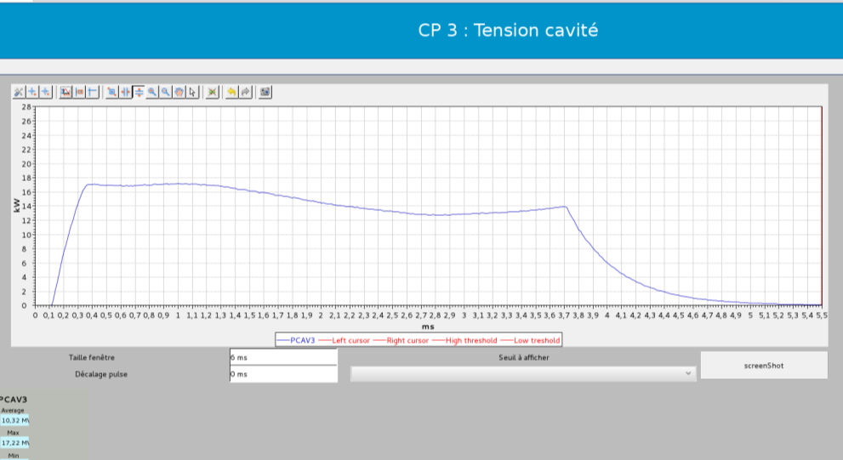
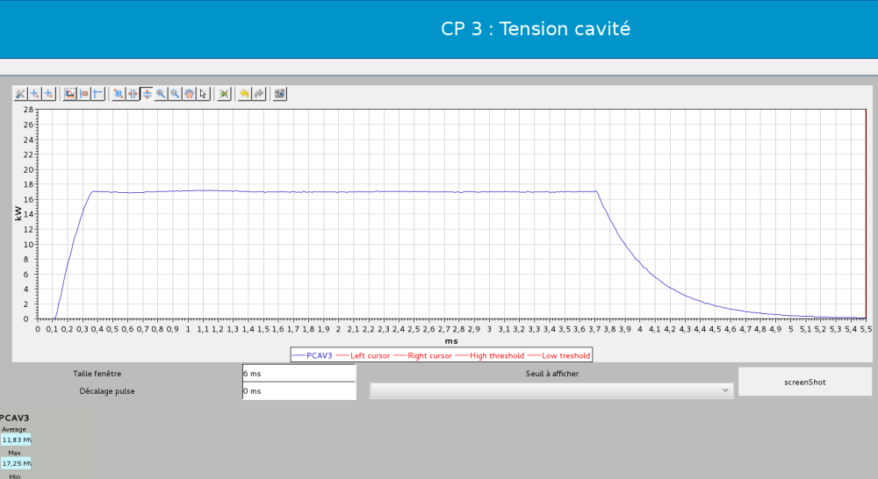
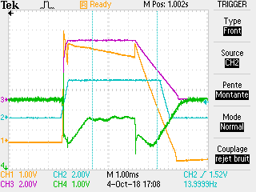
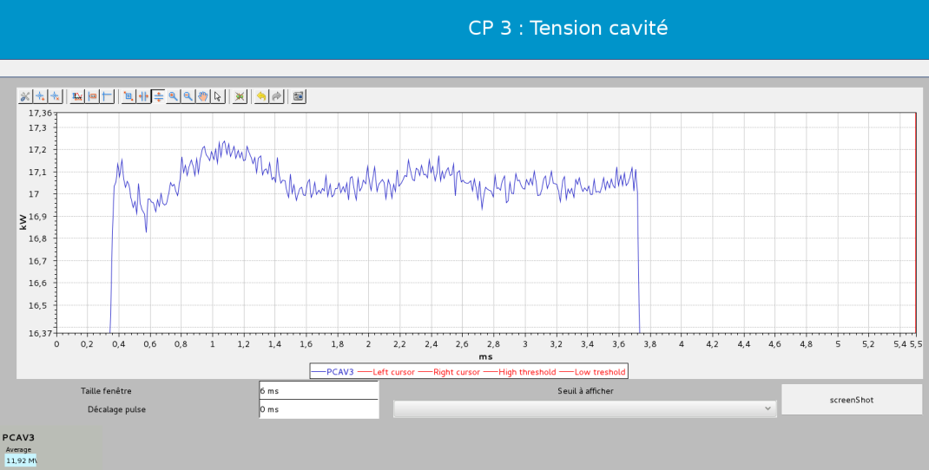
ESS M-ECCTD CAVITY position 3
2018/10/04
MV/m
MV/m
Cavity with static pre-tuning , without piezo compensation
Cavity with static pre-tuning , with piezo compensation
ZOOM of figure above
MV/m
2.86 ms
Piezo driver pulse (blue)
Phase error (green)
Reflected power (orange)
Cavity field (pink)
1Vpp=18.18°pp
1.2Vpp=21.82°pp
4Vpp=72.73°pp
+/- 150 kV during beam pulse : Eacc is stabilized within +/- 0.9%

Slide 11
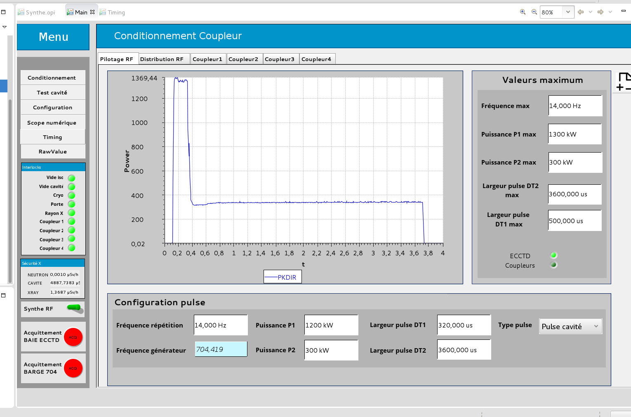
RF pulse at klystron output

Slide 12
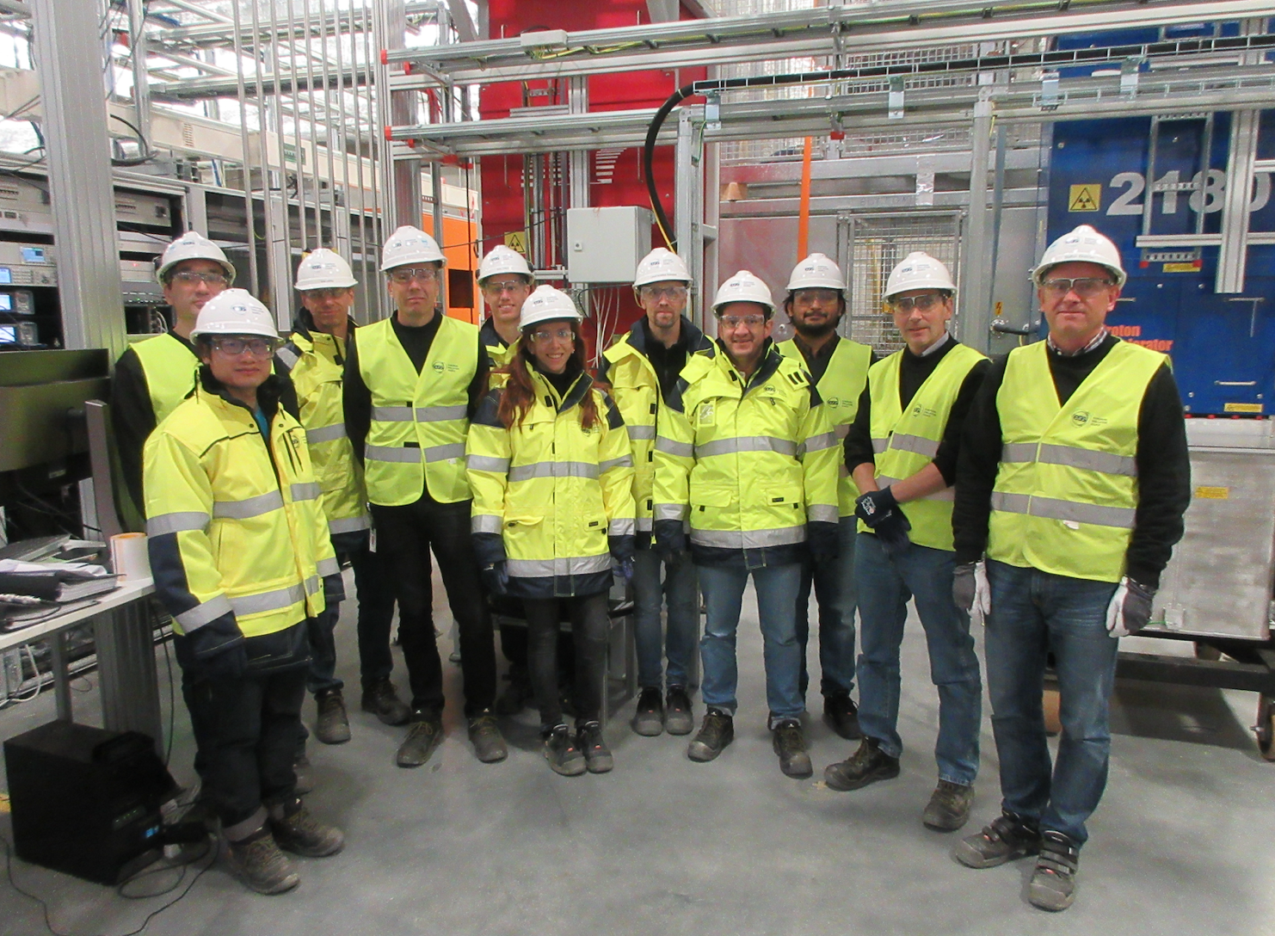
1.5 MW RF at 704 MHz at the ESS construction site

Slide 13
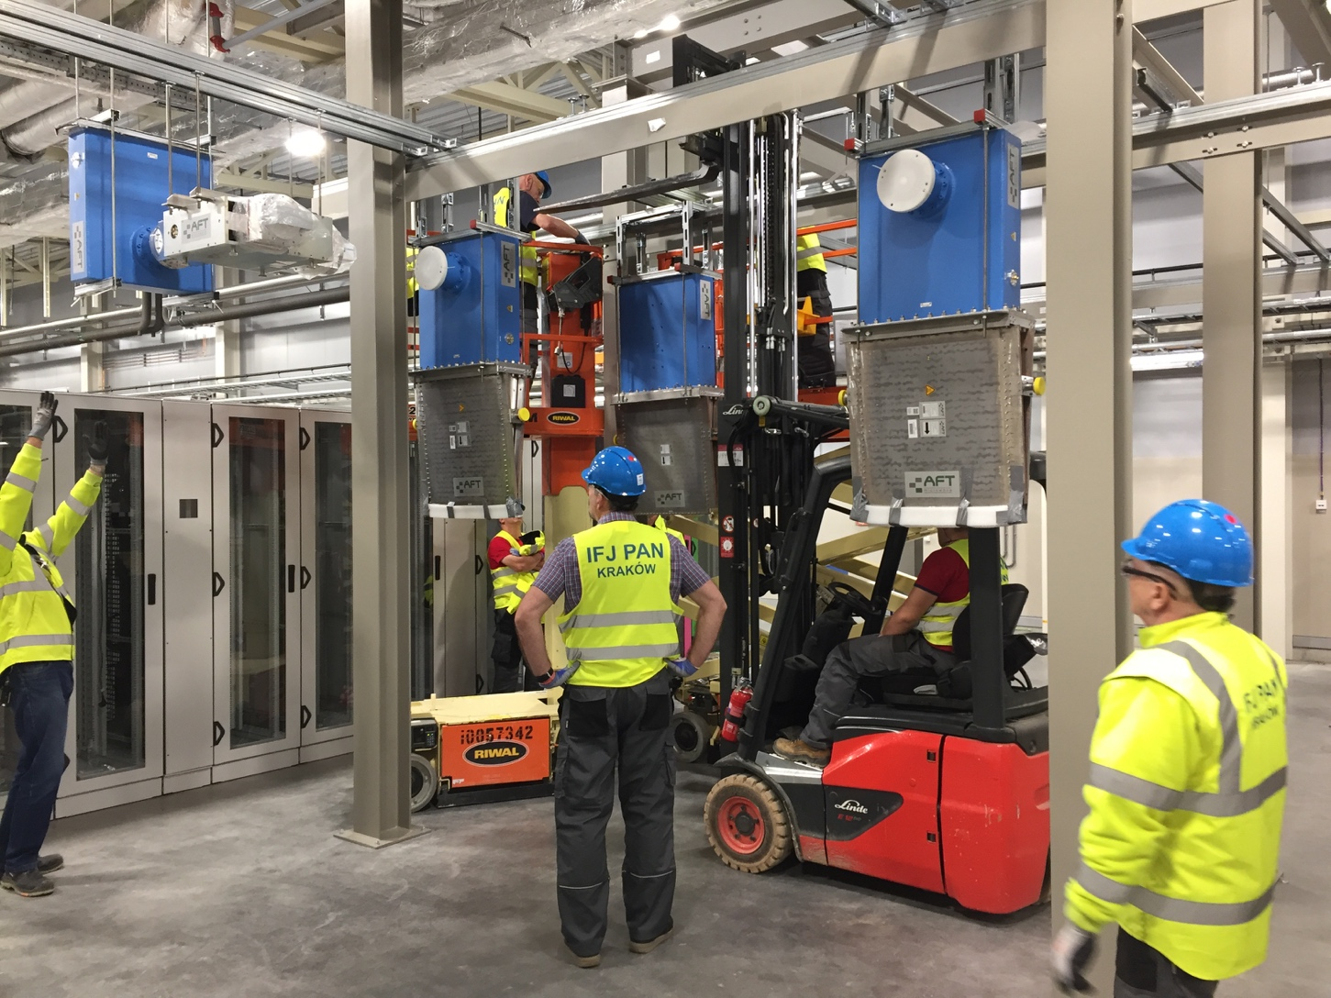
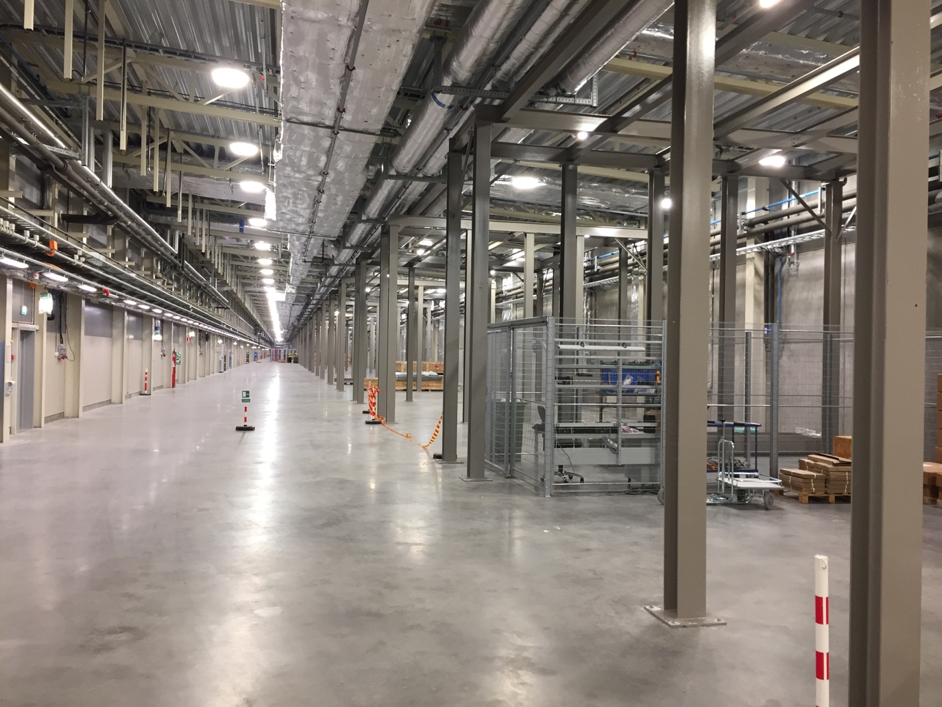
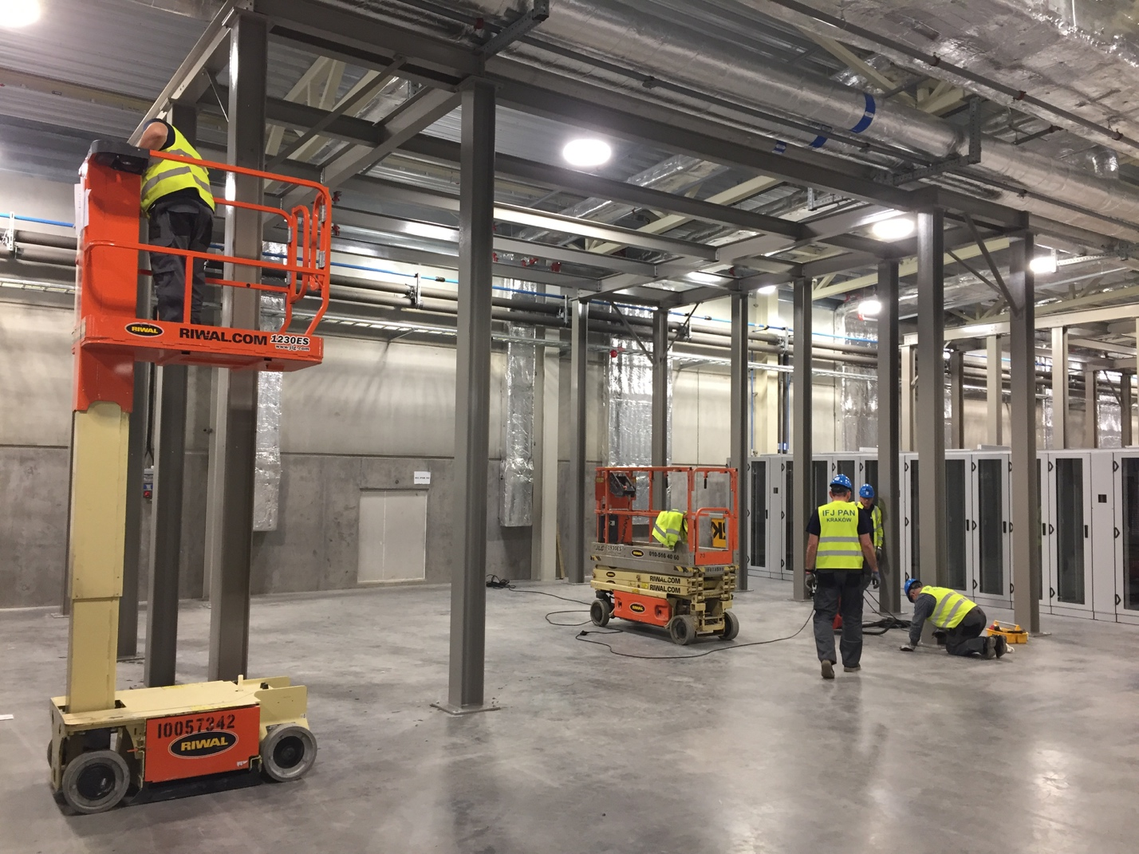
Installation RF components in gallery

Slide 14
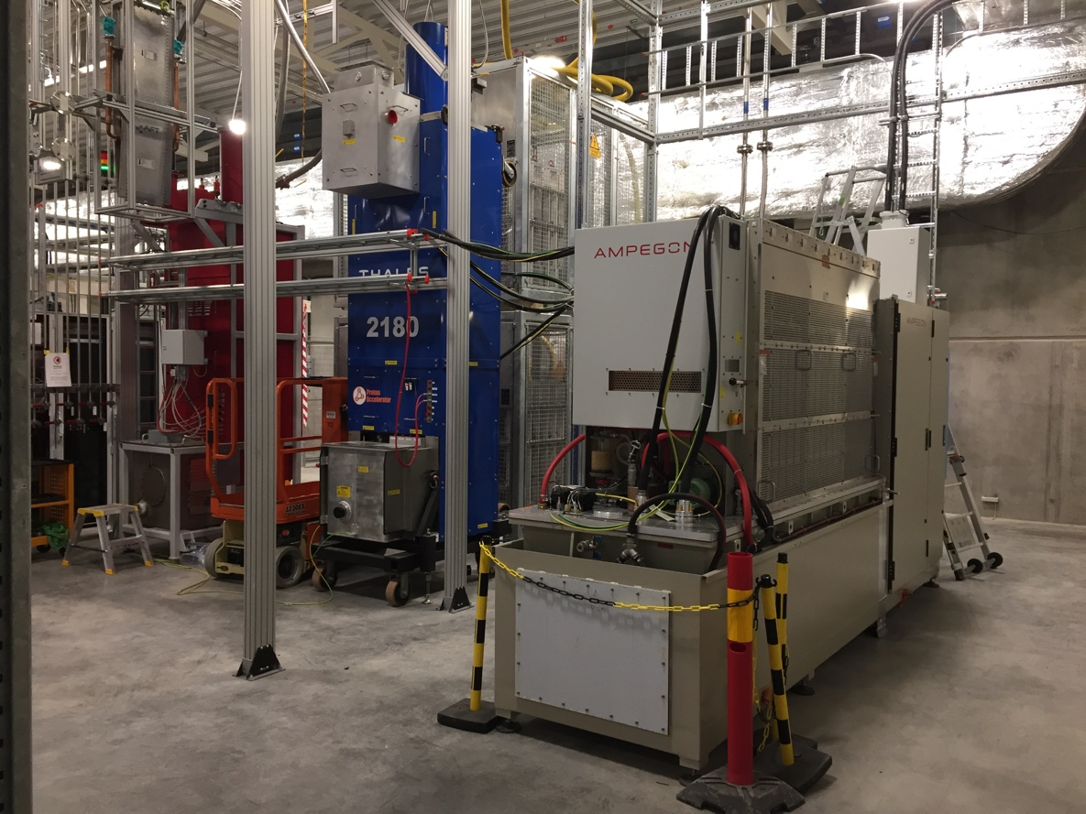
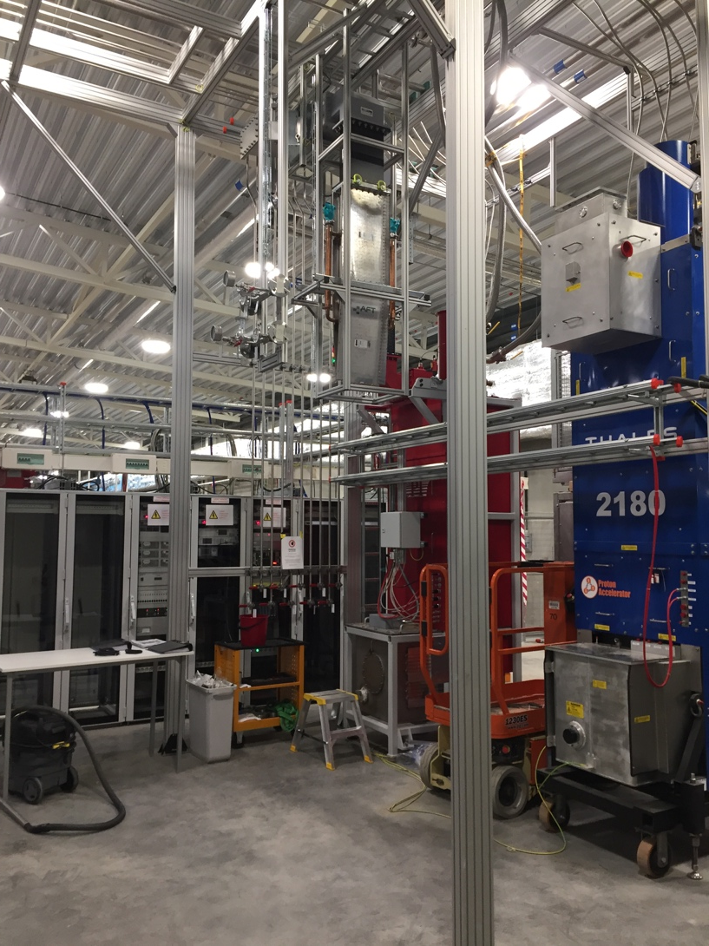
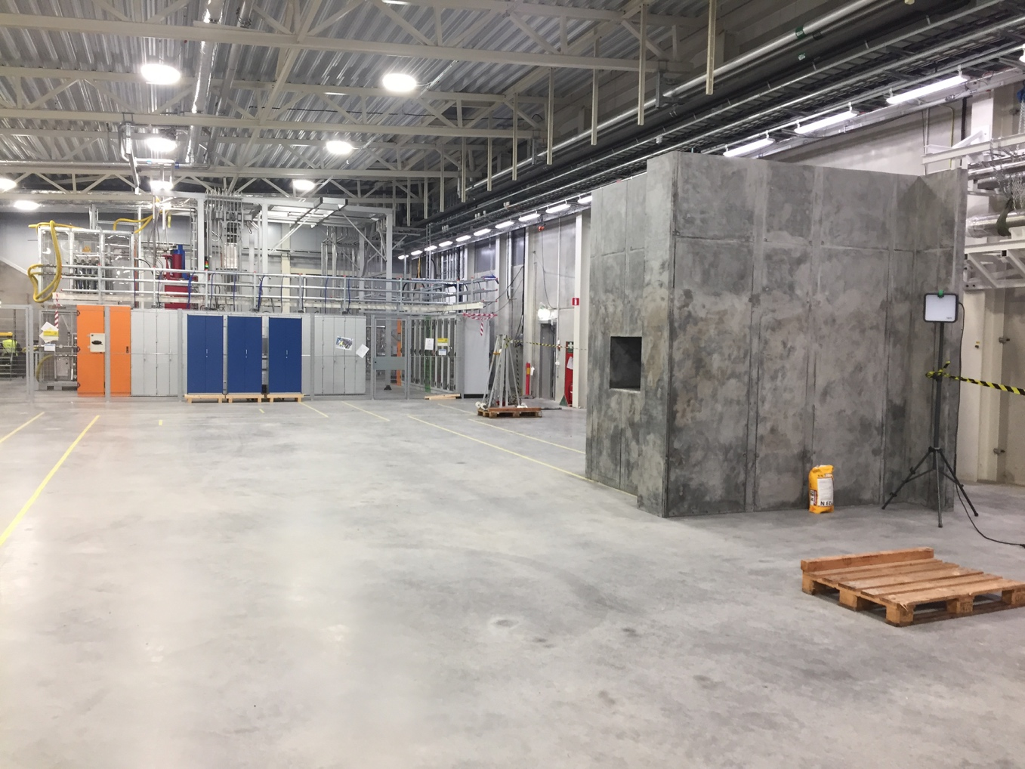
Test stand – HV supplies, Amplifier tubes

Slide 15
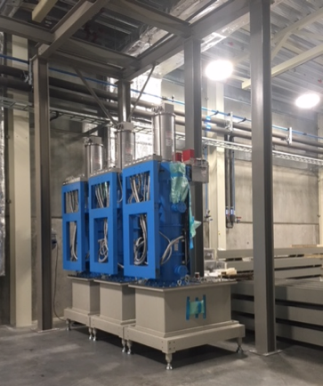
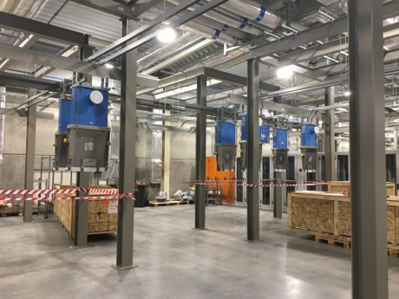
RF systems at ESS

Slide 16
First DTL tank cupper plated

Slide 17
Accelerator Systems (sub-) Project (ACCSYS) – organization
WBS/WP# | TITLE | LEADER | EXT. WP | DEPUTY WP LEADER for EXTERNAL WPS | PCC
11 11.01 | ACCSYS MANAGEMENT | M. LINDROOS J.G. WEISEND II | NO |  | 110100001 & 110100002
11.02 | ACCELERATOR PHYSICS | M. ESHRAQI | NO |  | 110200001
11.03 | NORMAL CONDUCTING FRONT END | S. GAMMINO | YES | E. SARGSYAN | 110300001
11.04 | SPOKE CRYOMODULES | G. OLRY | YES | C. DARVE | 110400001
11.05 | ELLIPTICAL CRYOMODULES | P. BOSLAND | YES | C. DARVE | 110500001
11.06 | BEAM DELIVERY SYSTEMS | S. MØLLER | YES | I. ALONSO | 110600001
11.07 | BEAM DIAGNOSTICS | T. SHEA | MIX |  | 110700001
11.08 | RF SYSTEMS | M. JENSEN | MIX |  | 110800001
11.09 | Not used
11.10 | TEST STANDS | W. HEES | MIX |  | 111000001
11.11 | CRYOGENICS | P. ARNOLD | MIX |  | 111100001
11.12 | VACUUM | M. JUNI-FERRERA | MIX |  | 111200001
11.13 | SAFETY & OPS | L. TCHELIDZE | NO |  | 111300001
11.14 | LINAC | H. DANARED | NO |  | 111400001
11.15 | ELECTRICAL SUPPORT | F. JENSEN | NO |  | 111500001
11.16 | COOLING SUPPORT | A. LUNDMARK | NO |  | 111600001
11.17 | POWER CONVERTERS | C. MARTINS | MIX |  | 111700001
11.18 | ENGINEERING RESOURCES | obsolete | NO |  | 119900001
11.19 | SUPERCONDUCTING RF | P. PIERINI | NO
11.98 | GENERAL INSTALLATION SUPPORT | PO GUSTAFSSON | NO |  | 119800001
11.99 | INSTALLATION | PO GUSTAFSSON | NO |  | -
Accelerator Collaboration Board (ACB) – meets twice annually:
Reps from each IKC & collaborating institute (one elected as chair)
ESS Technical Director
ACCSYS Sub-Project leader
Accelerator Technical Board (ATB) – meets quarterly:
AccMT & all WP leaders and deputies
Reps of all contracted institutes if not already a WP leader
ESS Machine Management Team members invited
Accelerator (Project) Management Team (AccMT) – meets weekly:
Mats Lindroos: Project Leader
Caroline Prabert: Administration
John Weisend II: Dep. Proj Leader (WP 1) & STS (WPs 11,12,15,16)
Lena Gunnarsson & Magnus Israelsson: Project Planners
Diana Bergenholtz: Controller
Lali Tchelidze: Section leader Operations, including radiation safety (WP13)
Peo Gustafsson: Installation coordinator and infrastructure sub-project leader (WP 98)
Håkan Danared: Linac systems leader (WPs 3,4,5,6,14) and IKC coordination manager
Andreas Jansson: Beam Physics, Diagnostics, Init ops planning mgr (WPs 2,7)
Anders Sunesson: RF power systems leader (WPs 8,17)
Note: Section Leaders (AD line) can be called to participate in AccMT meetings
IKC coordination, IKC liaisons & BrightNESS IKC ‘field coordination’:
Håkan Danared: IKC coord mgr Ebbe Malmstedt (C): assists overall IKC coord and risk manager at AD
Georg Hulla: for WP 3 IKC Felix Schlander: for WP 4 & WP 5
Frank Hellström (C): for WP 3 IKC Nuno Elias: for WP 4 & WP 5 IKC
Fredrik Håkansson (C): for WP 4 & 5

Slide 18





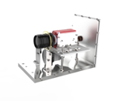
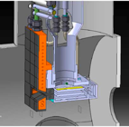
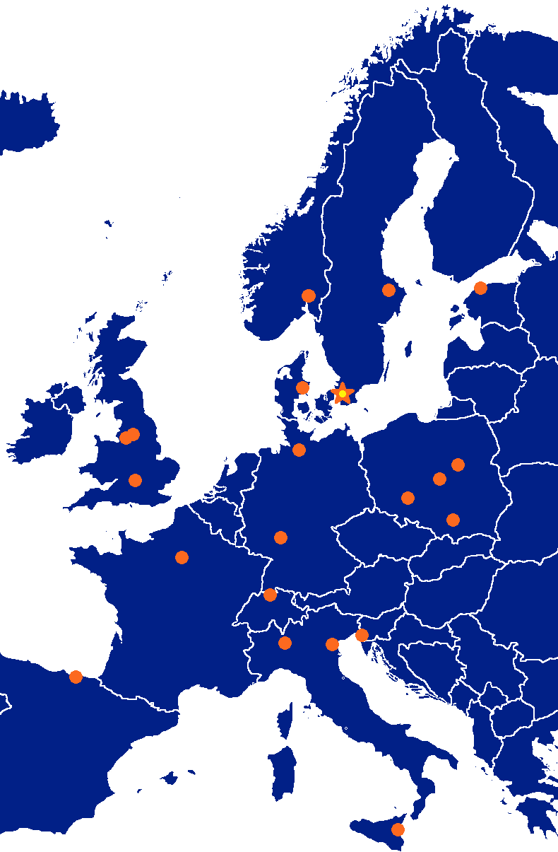





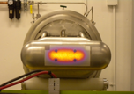







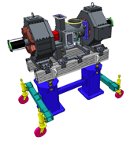





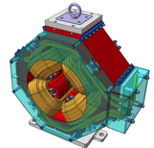



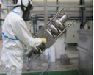
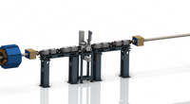
















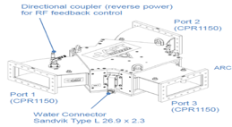
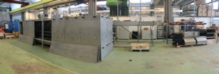
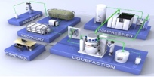











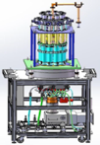
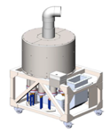



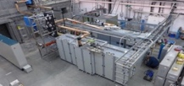
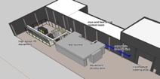
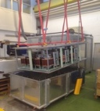
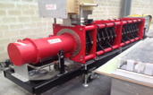
Accelerator Collaboration - Accelerator
352.21 MHz
704.42 MHz
2.4 m
4.6 m
3.8 m
39 m
56 m
77 m
179 m
Target
Source
LEBT
RFQ
MEBT
DTL
Spokes
Medium β
High β
HEBT & Contingency
75 keV
3.6 MeV
90 MeV
216 MeV
571 MeV
2000 MeV
18

Slide 19
Accelerator Division– organigram for line org and In-kinds
Head Count: 140 (2018-10-09)
91 employees
37 from Eng & Integr Support, Visitors, Consultants, Students, Planners
12 In-kind
Mats Lindroos – Head of Division
Håkan Danared – Deputy Head of Division
John Weisend II – Deputy (sub) Project Leader
Administration
Caroline Prabert
Inga Tejedor
WeiYing Li
Planning and Project Control
Lena Gunnarsson
Magnus Israelsson
Karen Jonsdottir (Sept-Oct)
Ciprian Plostinar
Diana Bergenholtz
IN-KIND from IFJ PAN Poland
Leszek Hajduk
Krzysztof Myalski
Michal Sienkiewicz
Tadeusz Ostrowicz
Edward Gornicki
Wawrzyniec Gaj
Marek Skiba
Karol Kasprzak
Pawel Halczynski
IN-KIND from Warsaw University of Technology
Krystian Bec
Installation
Peo Gustafsson
Olle Lagerblad
Dennis de Wit (C)
Carl-Johan Hårdh (C)
Mats Pålsson (C)
Pontus Jönsson (C)
Jenny Cerne (C)
Rasmus Johansson (C)
Nicolas Eke (C)
Dennis Schön (C)
IKC Coordination
Håkan Danared
Ebbe Malmstedt (C)
Quality
Björn Rundcrantz (C)
Beam Physics, Operations & Beam Diagnostics
Andreas Jansson - GL
IN-KIND from Norway
Greyson Christoforo, Oslo
IN-KIND from INFN, Italy
Gianluigi Cibinetto
Beam Physics
Mamad Eshraqi – SL
Renato de Prisco
Ryoichi Miyamoto
Yngve Levinsen
Ciprian Plostinar
Natalia Milas
Björn Gålnander
Emelie Nilsson
YuanShuai Qin (S)
ZhiJun Wang (V)
Benjamin Bolling (S)
Linac
Håkan Danared- GL
Cecilia Maiano
Iñigo Alonso
Radio Frequency Systems
Anders Sunesson- GL
Specialized Technical Services
John Weisend II – GL
Gunilla Jacobsson
Accelerator Installation and Infrastructure group
Vacant - GL
Power Converters
Carlos Martins – SL
Göran Göransson
Marko Kalafatic
Rutambhara Yogi
Petro Pohorilo
Dana McKenzie
Matthew Bergstrom
Anders Andersson (C)
Cryogenics
Philipp Arnold – SL
Jaroslaw Fydrych
Xilong Wang
Xiaotao Su
Johnny Råström
Mattias Olsson
Per Nilsson
Romain Goncalves
Christer Sjöblom (C)
Piotr Tereszkowski (C)
Ole Øystein Bakke (C)
Frans Rödström (C)
Beam Diagnostic
Tom Shea– SL
Cyrille Thomas
Hooman Hassanzadegan
Hinko Kocevar
Irena Dolenc Kittelmann
Rafael Baron
Edvard Bergman
Clement Derrez
Slava Grishin
Dmitri Gudkov (at CERN)
Elena Donegani
Kaj Rosengren
Thomas Grandsaert (EIS)
Johan Norin (C)
Mehdi Mohammadnezhad (C)
Front End & Magnets
Edgar Sargsyan – SL
Georg Hulla
Janet Schmidt
Richard Bebb
Alejandro Garcia Sosa
Emmanouil Trachanas
Frank Hellström (C)
Saverio Ardovino (C)
Superconducting RF
Paolo Pierini – SL
Christine Darve
Felix Schlander
Saeid Pirani
Nuno Elias (EIS)
Fredrik Håkansson (C)
RF Sources
Morten Jensen – SL
Rihua Zeng
Rafael Montano
Bruno Lagoguez
Chiara Marrelli
Staffan Ekström
Stevo Calic
Iñigo de la Fuente
Anders Svensson
Christian Amstutz
Walther Borg
Anirban Krishna Bhattachanyya
Linus Ternelius Svensson
Utilities and Test Stand Wolfgang Hees - SL
Anton Lundmark
Frithiof Jensen
Emilio Asensi
Owen Buchan
Steven McGlasson
Lars Rosberg
Jörgen Jönsson (EIS)
Akif Coku (C)
Andreas Olenmark (C)
Fredrik Persson (C)
Susanna Sjöström (C)
Weiming Yue (V)
Klas Ahlm (C)
Vacuum
Marcelo Juni Ferreira – SL
Hilko Spoelstra
Simone Scolari
Christophe Jarrige
Fabio Ravelli
Kristell Barthélemy
Ralf Huber
Laurence Page
Fredrik Svensson
Henric Gunnarsson
Peter Ladd (C 50%)
Operations
Lali Tchelidze – SL
Marc Munoz
Frank Kornegay (C 15%)

Slide 20
Accelerator: staff categories through time
ESS employees evolving according to the approved accelerator staff plan.
In-kind personnel working abroad: calculated as 30% of the yearly “planned & agreed” in-kind contributions (P6), divided by the average rate per person (60€/hour x 1800 hours/year)
Total = 114 employees in 2026 and onwards→ consistent with
Steady State Operations’ approved numbers
 | 2014 | 2015 | 2016 | 2017 | 2018 | 2019 | 2020 | 2021 | 2022 | 2023 | 2024 | 2025
ACCELERATOR STAFF | 51 | 62 | 68 | 92,5 | 103,5 | 107,5 | 107,5 | 107,5 | 113,5 | 114,5 | 114,5 | 113,5
ESS STAFF-NON ACCELERATOR (planners, EIS staff, controller) | 4 | 4 | 5 | 5 | 6 | 6 | 6 | 6 | 6 | 6 | 6 | 6
CONSULTANTS | 4 | 6 | 14 | 23 | 47 | 47 | 20 | 5 | 0 | 0 | 0 | 0
LONG TERM IN-KIND/PhD's/TEMP CONTRACTS/STUDENTS/VISITORS | 0 | 2 | 6 | 11 | 18 | 20 | 17 | 15 | 15 | 5 | 5 | 5
Number of IN-KIND personnel WORKING ABROAD for the AD (*) | 7 | 24 | 69 | 106 | 187 | 148 | 65 | 20 | 11 | 0 | 0 | 0

Slide 21
Management of In-Kind
In-Kind manager: Håkan Danared
Contract management
New in-kind agreements and collaboration agreements. Only a small number expected.
Addenda to existing agreements to extend duration.
Final Reports for completed in-kind contributions.
In-kind follow-up activity | Responsible
Weekly skype meetings with in-kind partners for technical status and schedule | Work packages
General project follow-up | Deputy Head of Accelerator Project
Monthly progress reports | Contributed by work packages, summarized and presented by Deputy Head of Accelerator Project
Bi-weekly phone meetings with in-kind partners’ project management or similar | Head of Accelerator Division / In-Kind Manager
Regular scheduled visits to selected in-kind partners | Head of Accelerator Division / In-Kind Manager / WP leaders

Slide 22
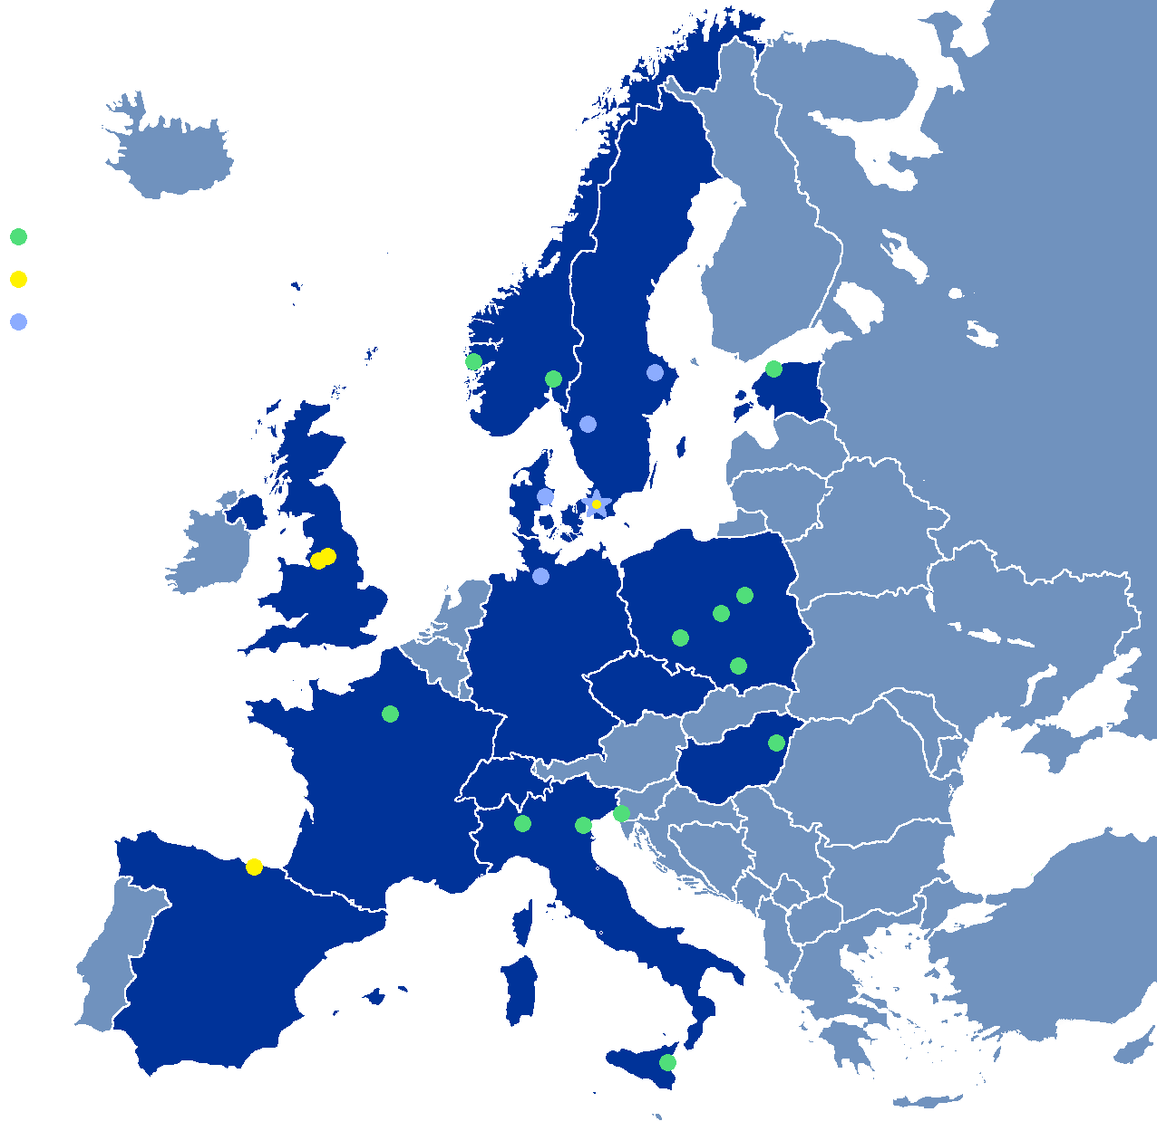
Partner Institutions
In-kind (main contributions)
ATOMKI (RF-LPS)
CEA (RFQ, SRF, Diagn)
CNRS (SRF, Cryogenics)
Cockcroft Inst (Diagn)
Daresbury Lab (SRF, Vacuum)
Elettra (RF, Magnets, PS, Diagn)
ESS-Bilbao (MEBT, RF)
Huddersfield Univ (RF distrib)
IFJ PAN (Installations, test stand)
INFN Catania (Source, LEBT)
INFN Legnaro (DTL)
INFN Milan (SRF)
Lodz UT (LLRF)
NCBJ (LLRF, gamma blockers)
Tallinn UT (RF)
Univ Bergen (Seconded staff)
Univ Oslo (Diagn)
Warsaw UT (LLRF)
Wroclaw UT (Cryogenics)
IK signed
IK endorsed
Collaboration
agreement signed
Collaboration agreements
Aarhus Univ (Beam delivery, diagn)
DESY (Diagn)
Lund Univ (LLRF, RF)
Uppsala Univ (Test stand)
University West (Diagn)

Slide 23
Comments on Warranty and Handover
Essentially all in-kind agreements have been signed, with their clauses about warranty and handover.
Many in-kind agreements include participation of partners in installation and commissioning.
Knowledge transfer is an integrated part of in-kind collaborations for Accelerator.
Warranties will in many cases expire before equipment is tested or taken into use.
  SATs cannot be performed on every small piece of equipment and would not be cost-efficient.
  Time between delivery of sub-components to partners and commissioning of equipment in the accelerator tunnel often exceeds warranty periods.
This has been known and understood by Accelerator since a long time.
Risks are minimized by, when possible,
  Testing samples of large deliveries.
  Testing particularly critical pieces of equipment.
  Testing components where reaching specifications is known to be challenging.

Slide 24
Key IK milestone delays, AD estimates
Delivery Item | IK Partner | Baseline Date (May 2018) | Current Status | Critical Path
RFQ | CEA | 01-Sep-18 | >3 months delay | Yes
DTL | INFN | 01-Jan-19 | Issues with Copper plating | Yes
Full NC RF | ESS Bilbao | 06-May-19 (RFQ circulators) | Procurement under way.. Mitigation with scope swap. Delay being analysed. | Yes
Spoke CMs | IPNO | 21-Jun-19 (first CM) | 0-2 months delay. No mitigation possible. | Yes
Spoke RF Amplifiers | INFN/Elettra | 12-Aug-19 (first PS) | ~3 months delay | Yes
Medium Beta Cavities | LASA | 01-Oct-19 (M1) | ~2 months delay. No mitigation possible. | Yes
Medium Beta CMs due to cavity delay | CEA/LASA | 29-Mar-19 (first CM) | ~4 months cumulative delay. Some mitigation possible (testing reshuffle, skip the 2 HB CMs). | Yes
Cryoline and CDS (Elliptical) | WUST | 3-Dec-18 (start) | ~5 months. Being mitigated. Can be reduced to <3 months. | Yes
RF interlock system | ATOMKI | 7-Jan-19 (first delivery) | ~1-2 months. | No

Slide 25
In-Kind Issues
We have are working on a proposal for a scope swap between ESS-Bilbao and ESS – installation services from ESS-Bilbao swapped against RF equipment bought in Lund
INFN/ELETTRA Spoke RF amplifiers: Appeal rejected by court in Italy and contracts will now proceed to get approved by the INFN board for signature by the INFN president.
INFN, DTL: Contacted GSI to understand why the copperplating been stopped and initiated first contacts with CERN on back-up plan. As LL from ion source, we have introduced more time in schedule for testing.
WUST, CDS: Hearing at next IKRC. We will continue to work on installation plan to mitigate the delay.
CEA and LASA, Medium beta: Agreed to not install two (not powered) HB CMs before BOD

Slide 26
Other Issues
Installation of infrastructure was slow for ion source so a new infrastructure sub-project has been created to only focus on infrastructure installation
We don’t have resources to support CE marking at the level done for the ion source but we have a process. In-Kind has to do the CE marking and we can contribute.
We are still working on the updates and corrections to the P6 plan since the re-baseline review and we see Schedule Variance which is due to the plans quality, not all due to real delays
  We are using Ready For Installation (RFI) dates which we control on project level through Change Requests for installation planning while waiting for the update of P6.
Beam diagnostics work at ESS is resource limited (we had to move staff to SRF) and will slip in the schedule
  We will have to start at 572 MeV for low power beam with less beam instrumentation than foreseen

Slide 27
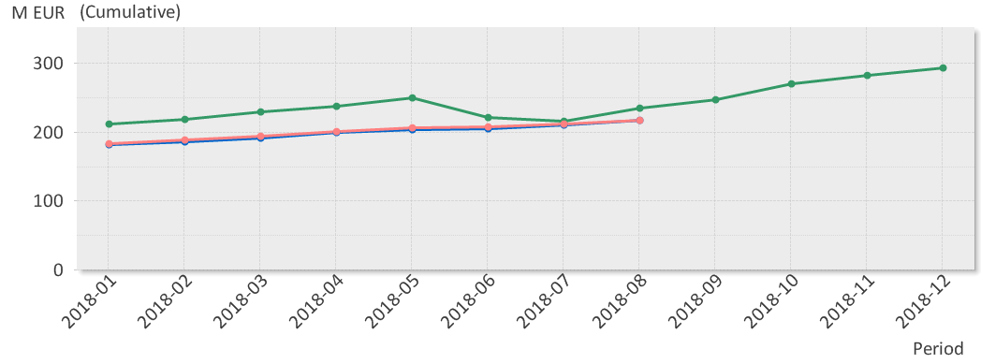
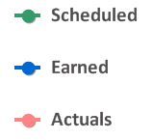
EV Graph
(* No InKind included)
Current Status
Cost Variance is by end of Aug 1.9 M€.
Main contributors to the positive CV are accrued costs not yet booked.
Schedule variance is by end of Aug -18 M€ but this due to a lag with the update of P6 after the re-baseline in May. Real SV is around 3.5 M€
Main contributors to the SV are: NCFE, Spoke cavities & cryomodules and Beam Diagnostics.

Slide 28
Critical Path – September 2018

Slide 29
Near Critical Path
ISrc to Beam Dump (BOD)
26/4/2021
ISrc to DTL1
ISrc to DTL4
RBOT
11/11/2019
13/7/2020
9/8/2021
2018
2019
2020
2021
17/12/18 - 12/07/19
RFQ + DTL 1 RF System
27/05/19 - 31/01/20
Full NC Linac RF System
04/03/19 - 15/11/19
Elliptical CDS
19/08/19 - 15/11/19
SPK CDS
18/11/19 - 28/08/20
SPK CM
18/11/19 - 27/11/20
MBL CM
01/06/20 - 07/08/20
HBL CM
05/08/19 - 20/12/19
HEBT LWU
06/01/20 - 05/06/20
HBL LWU
08/06/20 - 04/09/20
A2T LWU
24/08/20 - 16/10/20
SPK LWU
19/10/20 - 19/02/21
MBL LWU
12/08/19 - 25/09/20
SPK RF Power Stations

Slide 30
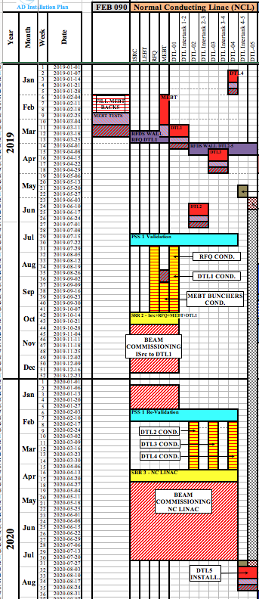
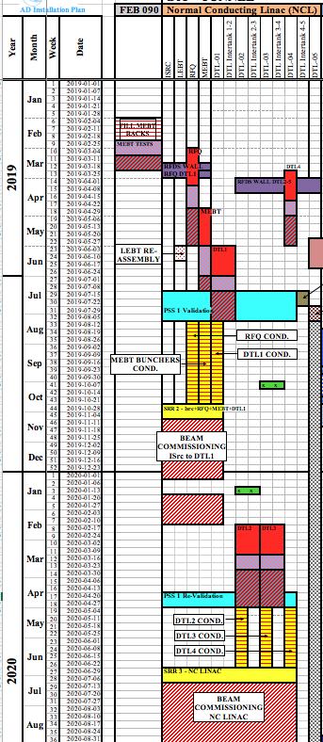
Example on how delays for DTLs impacts plan
Baseline
With the New Dates
Installation Window
DTL4
DTL1
DTL3
Cond/Commissioning Window
DTL2
RFI DTL3
RFI DTL2

Slide 31
Delays on major milestones since the new baseline was approved
ISrc to RFQ/MEBT/DTL1
ISrc to Beam Dump (BOD)
4 Nov '19
8 Feb '21
ISrc to DTL4
RBOT
27 Apr '20
24 May '21
2018 Baseline
2019
2020
2021
0.3 months
Beam to RFQ/MEBT Delay
2.6 months
Beam to DTL4 Delay
2.6 months
BOD Delay
2.6 months
RBOT Delay
September 2018
2019
2020
2021
11/11/2019
13/7/2020
9/8/2021
ISrc to DTL1
ISrc to DTL4
RBOT
26/4/2021
ISrc to Beam Dump (BOD)

Slide 32
ACC – Top 5 Risk Mitigation Status (data from Exonaut)
Value of cost risk = 13,59 M€ (13,59 M€ last month)
Latest risk workshop: CEA & ESS WP4 & WP5, May 17, 2018 ; Next workshop: TBD
Risk ID | Event |  | Potential Impact C – Cost S – Schedule Q – Quality and Function | Proba-bility | Mitigation Measures | Due Date
240 | Insufficient accelerator and ICS coordination |  | C: - S: 7-9 M Q: (1) Top lvl req. | 5 | Develop strategy On-going. Further follow up meeting/review is planned on the firmware framework | 180131 180131
63 | Installation complexity under-estimated |  | C: 945 S: 4-6 M Q: (3) Several req. | 3 | Implement new organization, defining roles and resp. for best possible progress in the project Develop a detailed installation plan that optimizes installation within the limited time available Workshop performed and lessons leaned | 180315 180215 180116
242 | Lack of spares when needed |  | C: 3,3 M€ S: 7-9 M Q: - | 4 | Decision on SRF fascility Identify and quantify amount per system, find funding | - TBD
241 | CE marking has to be implemented |  | C: 3,2 M€ S: 0-3 M Q: (3) Several req. | 5 | Define ESS ambition level Inform and discuss with all institutions On-going. Discuss, agree and create CR | 180315 171215 180315
296 | Lack of staff to support, maintain and consolidate installed equipment due to delayed access to initial operations funds. |  | C: 3.1 M€ S: 4-6 M Q: (3) Several req. | 3 | Seek additional/timely funding to mitigate cost exposure Staff and competence planning for I.O. | 180501 180501
Mitigation actions performed since last report |  | Various treated risks identified and closed. Many treated some time ago, but not registered as such until now. WP2 risks revised. Risk review ongoing with all WP leaders. R295. Higher cost estimated for new logistic and transport organizational structure. Level to be determined and inserted. CEA-ESS Transferred and Shared Risks are analized with the respective WP.

Slide 33
Some Lessons Learnt – Ion Source and LEBT
Infrastructure installation, testing and commissioning takes more time than planned
ICS effort has been resource limited
The CE marking has taken major resources for the AD ion source team and Beam instrumentation team which has slowed testing and installation activities
It is a major effort to prepare for the Safety Readiness Reviews and to follow up on pre-start conditions
The work order system needs to be tuned so that repetitive actions for testing and commissioning doesn’t require separate work orders
  Being done!
Slow progress with infrastructure installation
  Action: Infrastructure sub-project created
See more details in talk by Edgar Sargsyan in a TAC session

Slide 34
Summary
The accelerator sub-project is 85% committed
There is good progress at ESS and at all IK partners
We are doing a new Value Engineering exercise at ESS
  Possible further de-scoping of RF sources
We are in the process of implementing the the re-baselined schedule in P6, there is no float in the schedule all delays are likely to effect RBOT
Any time gained in almost any activity is a gain for the total accelerator construction cost and for the the schedule

Slide 35
a-TAC17 Recommendations and replies

Slide 36
A-TAC 18 replies continues

Slide 37
A-TAC 18 replies continues

Slide 38
A-TAC 18 replies continues

Slide 39
A-TAC 18 replies continues

Slide 40
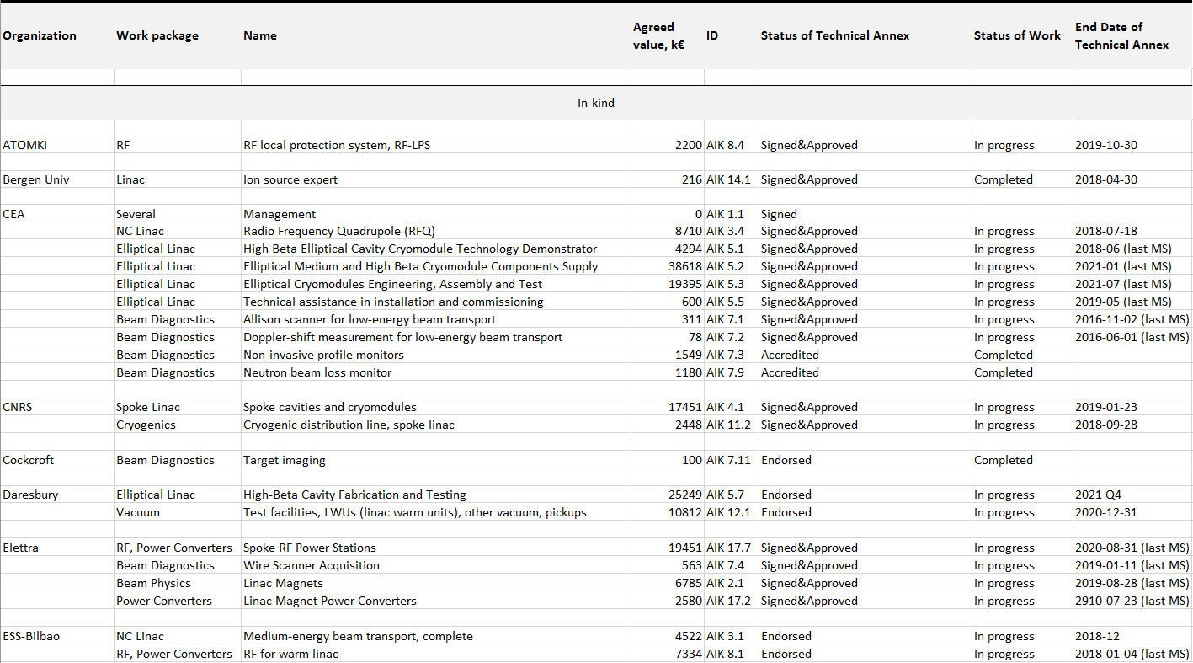
Signed In-Kind Contributions

Slide 41
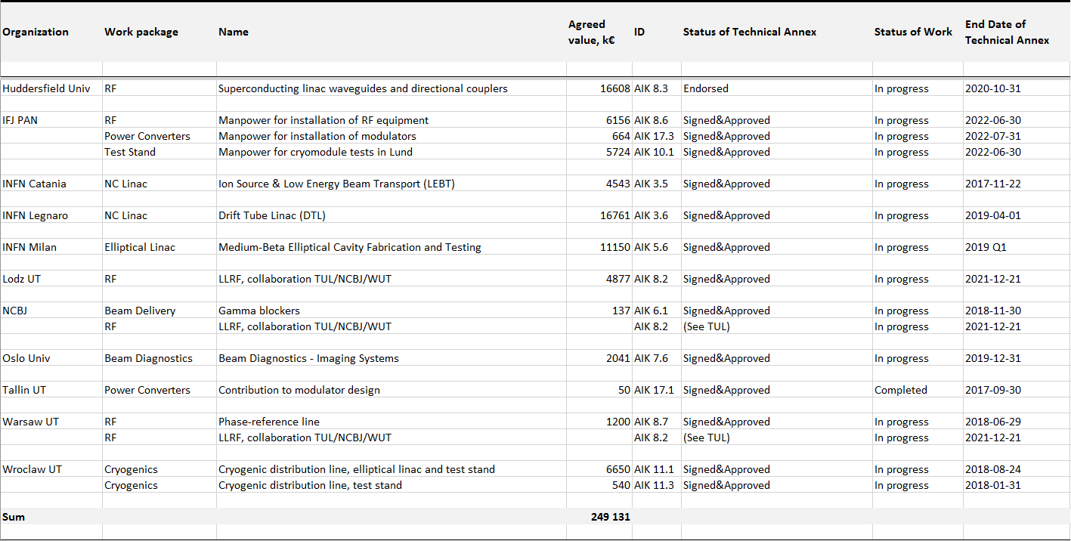
Signed In-Kind Contributions

Slide 42

Signed Collaboration Agreements

Slide 43

Planned In-Kind and Collaboration Agreements

