Slide 1
The ESS integrated control system
Overview and status update
Henrik Carling
Head of integrated control systems, ESS
ESS/ICS
Date: 2018-10-16

Slide 2
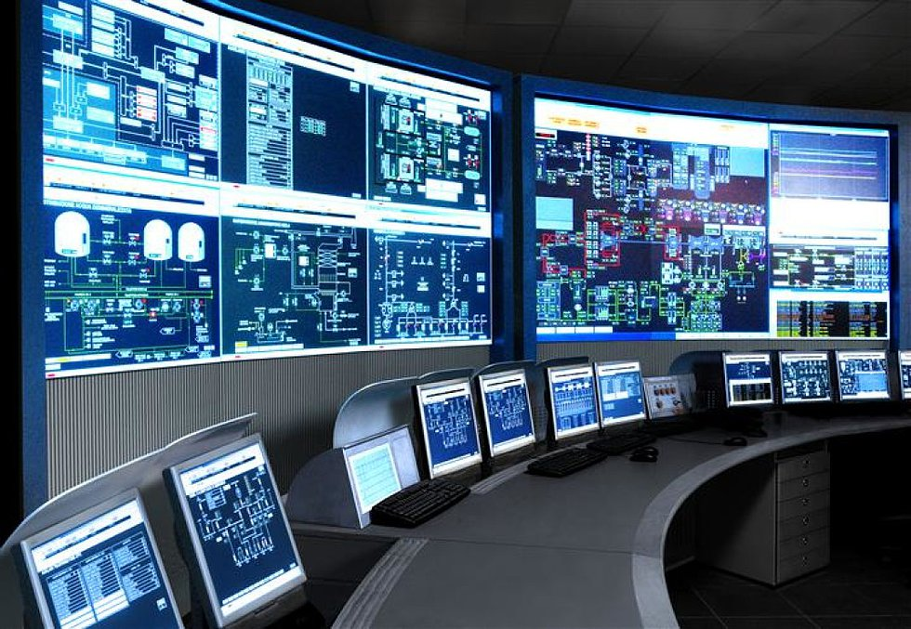
The ESS integrated control system
The ESS facility is a large and complex machine with very much and diverse equipment that needs to work in synchronization and with well-known configurations
The Integrated Control System Division (ICS division) is responsible for the control systems within the ESS facility including controls for
  Accelerator
  Target
  Neutron Scattering Systems
  Conventional Facilities
In addition, ICS will implement
  Machine Protection System
  Personnel Safety System
To build a distributed control
system of this size is a major
undertaking

Slide 3



ESS/ICS challenges
The ESS control system complexity is very high
  About 1 600 000 “process values”
  Ambitious approach to automation of control system configuration
Facility availability goals are very high
  ICS plays a key role for the availability of the facility - 95% availability
  High performance and availability requirements on equipment used
Some new approaches will be implemented at ESS/ICS
  Full scale deployment of EPICS 7
    ESS is committed to contributing to the EPICS community
  Full scale deployment of MicroTCA.4
    ESS is involved in a public procurement for innovation initiative
  Machine learning/Artificial intelligence assisted control system
    Project started to explore how machine learning technologies can be applied

Slide 4





ICS Project scope
Work package 01 Management and administration
Work package 03 Software core
Work package 04 Hardware core
Work package 05 Machine protection
Work package 06 Equipment
Work package 07 Control system infrastructure
Work package 08 Physics
Work package 09 Personnel safety systems
Work package 10 Integration - Accelerator
Work package 11 Integration - Target
Work package 12 Integration - Instruments
Work package 13 Integration - Conventional facilities
Work package 14 Test Stands
Work package 20 Installation
Software
Electronics
Infrastructure
Safety & protection

Slide 5
ICS Organization
2018-08
Henrik Carling
Division head
Wojtek Fabianowski in-kind manager
Thilo Friedrich
Systems engineer
Remy Mudingay
Controls infrastructure
Anna Gillberg
Team assistant
Annika Nordt
Protection systems
Karl Vestin
Hardware and integraion
Hector Novella
Deputy project manager
Susanne Regnell
Controls Software
Timo Korhonen
Chief engineer
Benjamin Bertrand
Software engineer
Alberto Toral
Technician
David Sanchez
Automation engineer
Angel Monera
FPGA Engineer
Benedetto Gallese
Integrator
Ben Folsom
PhD student
Banafsheh Hajinasab
Software engineer
Johan Christensson
Infrastructure technology engineer
Denis Paulic
DGL, PLC engineer
Enric Bargalló
Lead analyst engineer
Faye Chicken
Technician
François Bellorini
Integrator
Claudio Rosati
Software engineer
Dirk Nordt
Software engineer
Susann Skarin
Network administrator
Fernando Carrasco
Technician
Manuel Zaera-Sanz
Lead engineer slow interlocks
Javier Cerejo
PhD Student
Jeong Han Lee
Integrator
Emanuele Laface
Accelerator physicist
Georg Weiss
Software engineer
Stephane Armanet
System reliability engineer
Morteza Mansouri
Safety systems engineer
Mattias Eriksson
Technician
John Sparger
Integrator
Joao Martins
Integrator
Fredrik Söderberg
Software engineer
Jan-Åke Persson
Senior software engineer
Alessio Curri
System administrator
Stephane Gabourin
Lead engineer fast interlocks
Riccard Andersson
Technical coordinator
Peter van Velze
Technician
Julen Etxeberria
Junior controls engineer
Juan Esteban Müller
Software scientist
Karin Rathsman
Accelerator scientist
Anders Harrisson
Software configuration manager
Szandra Kövecses
Lead integrator
Stuart Birch
Senior engineer
Saeed Haghtalab
Integrator
Simone Farina
Embedded systems egineer
Ricardo Fernandes
Control system software architect
Lars Johansson
Software engineer
Fredrik Luthander
Software engineer
Yong Kian Sin
IEC61508 engineer
Viktor Fred
Lead engineer electrical installations
Thomas Fay
Integrator
Tomasz Brys
Integrator
Open position
Consultants
Samuel Crossland
PSS industrial automation
Paulina Skog
Technical coordinator
Philippe Rabis
Work package manager
Miklos Boros
Integrator
Mehdi Mohammednezhad
Integrator
Meike Rönn
Technical coordinator
Michael Beck
Work package manager
Oliver Talevski
Embedded engineer
Nour Akel
ICS Installation coordinator
Open positions (2)
Marino Vojneski
Integrator
Johannes Kazantzidis
Integrator
Krisztian Löki
Integrator
Position under consideration
Maria Romedahl
Technical coordinator
Nicklas Holmberg
Integrator
Open positions (3)
Employee
Consultant
ESS-0081625
Temporary employee
Consultant off-site

Slide 6
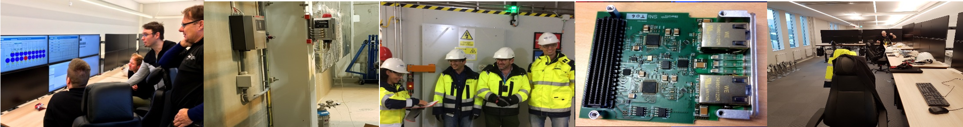
Progress 2018 (1/2)
Project
  Control system for cryo, ion source and low energy beam transport delivered to accelerator operations
  First implementation of the personnel safety system (PSS0) reviewed, installed, site acceptance tested, and handed over to operations group
  Good progress on implementing detailed ICS planning in after the ESS-wide re-baselining of plans in the central planning tool for several work packages
  The control system network - formally known as the technical network - has been fully installed in the accelerator front-end building
  Significant increase in capacity established through commercial framework agreement call-offs. In total adding seven FTE to ICS
  Completion and continued progress on documentation needed for the licensing project for the Swedish radiation safety authority (SSM)
  Training programs for control system software and configuration products held by ICS staff. Some trainings were recorded and will be published
  The first release of an ICS overview document has been made [link]. It is intended as an introduction to scope, principles, architecture etc. of the ICS
  Significant contributions to the EPICS community official website [link] from ICS. Summer student has prepared the site so that it is ready for launch
Organization/in-kind
  In total eleven people have joined ICS during 2018 - four permanent employees and seven consultants. Two permanent employees have resigned
  The new group leader for the hardware and integration team, Karl Vestin, has started at ESS since 2018-04-02
  Significant reorganization of the hardware and integration group with clearly appointed work package managers done
  Good progress with in-kind projects from many in-kind suppliers such as INFN Legnaro, ESS Bilbao, CEA Saclay, TU Tallinn and IFE, Norway
  Closure achieved with ESS in-kind partner IPN Orsay, France, regarding a cancelled in-kind initiative for cryodistribution system controls

Slide 7
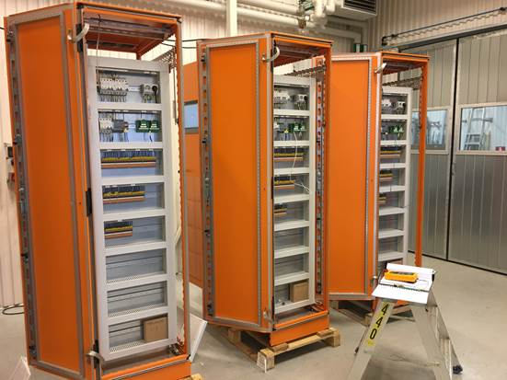
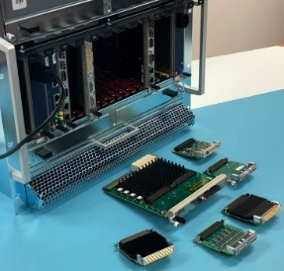
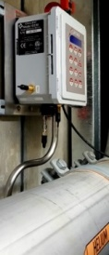
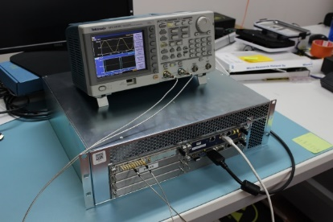
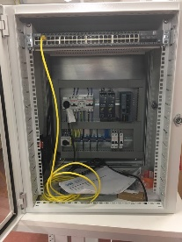
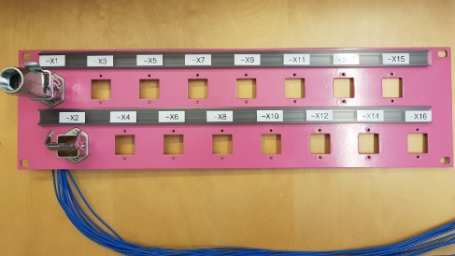
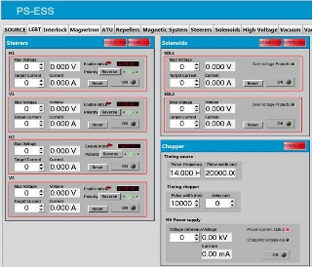
Progress 2018 (2/2)
Technical
  First volume batches of MicroTCA infrastructure equipment (crates, power supplies etc.) received - in total 50 systems
  A public procurement for innovation project on MicroTCA was completed in 2018-05. Very high participation from all major industry actors
  The firewall for the main ESS control system data network (technical network) has been successfully deployed
  The CSEntry inventory helper application rolled out and augmented with software plug-in implementations during 2018
  Re-modelling of E3 (formerly called EEE - ESS EPICS Environment). First version released with many improvements
  First application delivered on high performance electronic platform delivered; RF local protection system
  Continued progress on configuration automation tools such as controls configuration database and ICS PLC factory
  Good progress on design machine protection system for (among other) insertable devices and vacuum made
  Good progress on the development of controls for vacuum applications as exemplified by the development of the vacuum pumping cart
  Good progress on control system infrastructure development such as the ICS-supplied computing virtualization cluster which has been expanded
  Good technical progress on machine protection systems, FPGA-to-PLC communication through Profinet [link] and Anybus [link] interfaces demonstrated
  Completed EPICS IOC development such as Raritan PDU PX3 5190R / 5260R, RF FIM SCB monitoring system and RF Genesys GEN 5kW Power Supply
  Internal strategy for EPICS7 and EPICS middleware development at ESS drafted in collaboration with technical EPICS Core experts
  Control system integrated into an ESS aperture monitor and related equipment prepared, tested and shipped to J-PARC in Japan for testing
  Comprehensive document on getting started with the ICS archiving software; EPICS Archiver Appliance created and published
  Installation of timing system distribution optical fibres in the front-end building has finalized

Slide 8
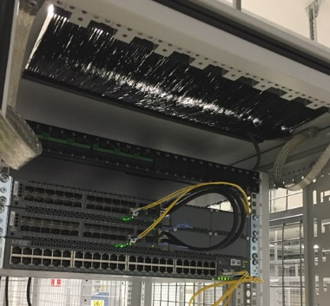
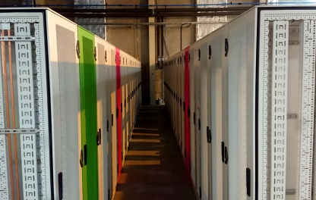
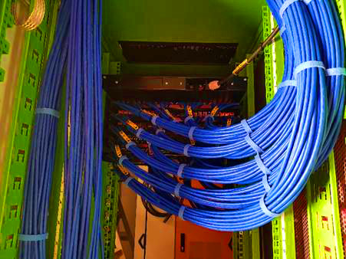
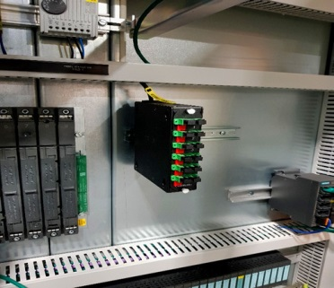
Installation of control system infrastructure
Installation and deployment of control system infrastructure is progressing according to plan
The control system network - formally known as the technical network - has been fully installed in the accelerator front-end building

Slide 9
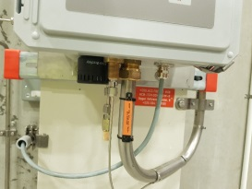
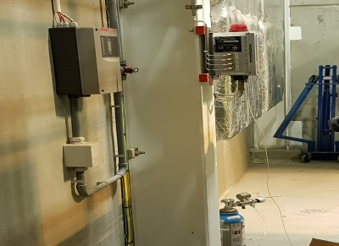
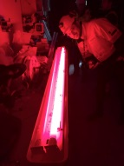
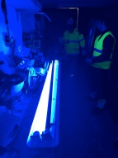
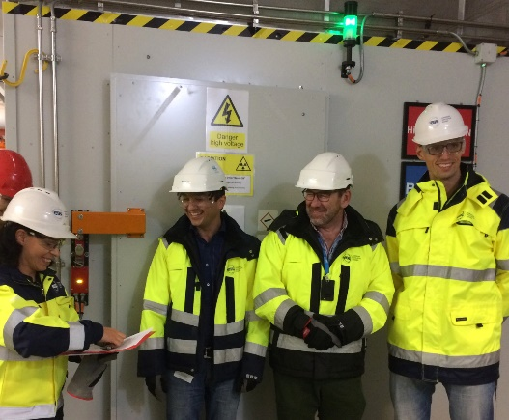
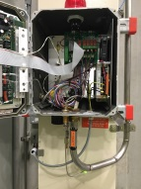
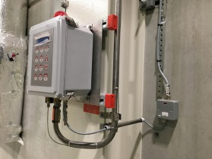
Installation of Personnel safety systems
ESS personnel safety
systems are among the
earliest systems that need to be in
place before operating equipment
The first implementation of the
personnel safety system for the
ion source and low energy
beam transport parts of the
accelerator was delivered in
2018-09

Slide 10

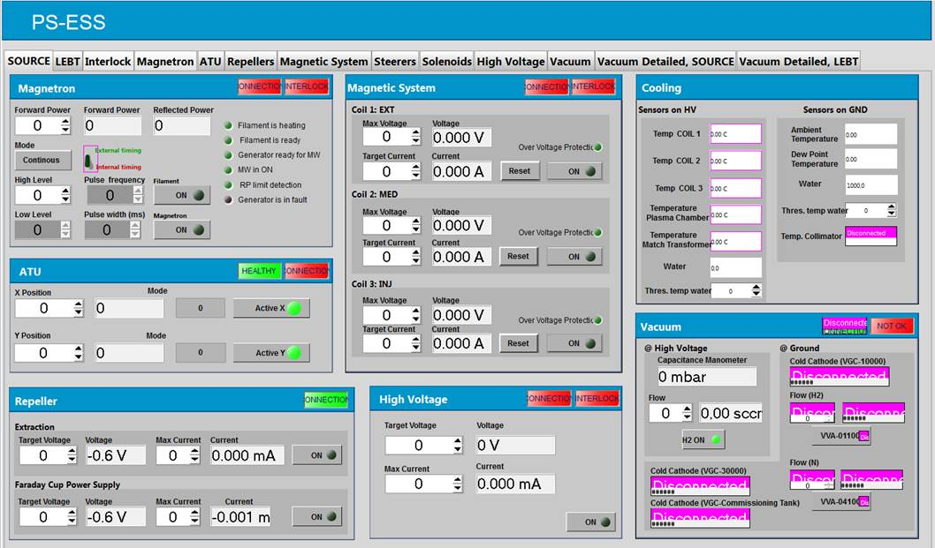
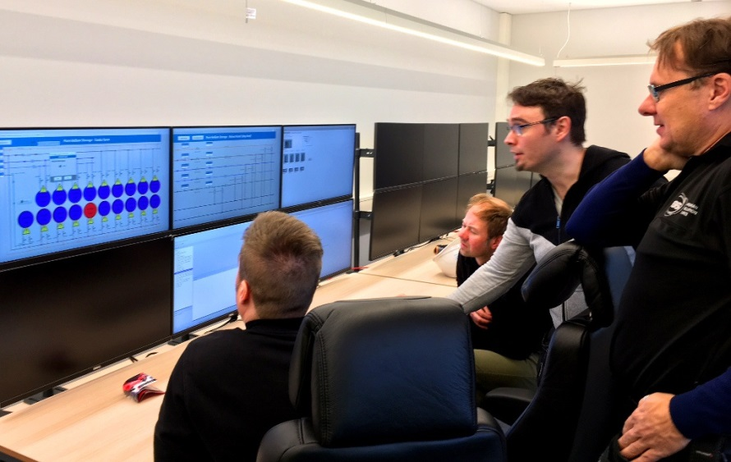
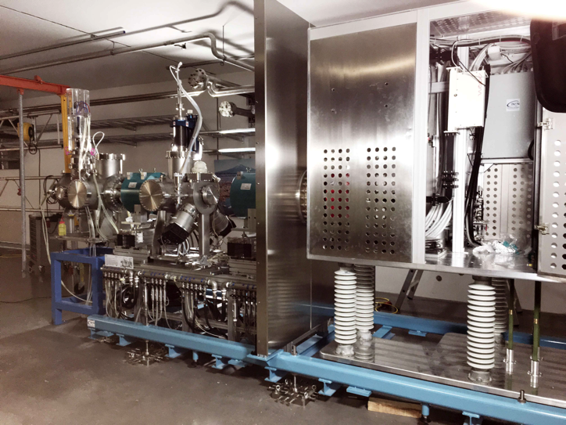
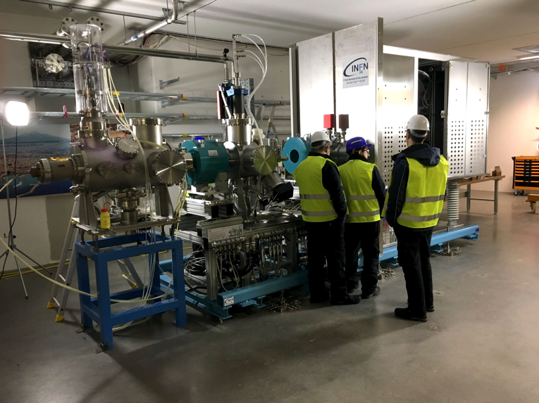
Controlling systems from the local control room
Control system for the ion source and LEBT has been handed over to accelerator operators in 2018-09

Slide 11
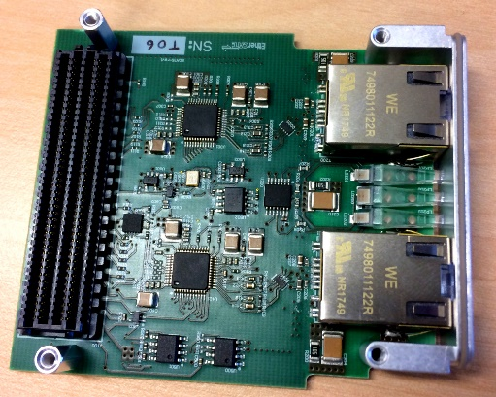
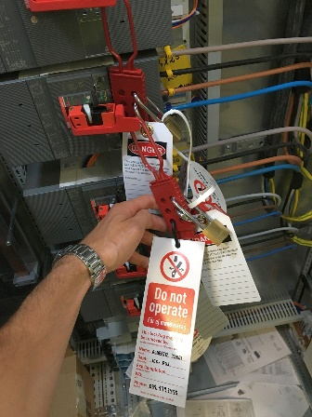
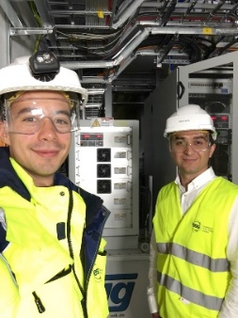
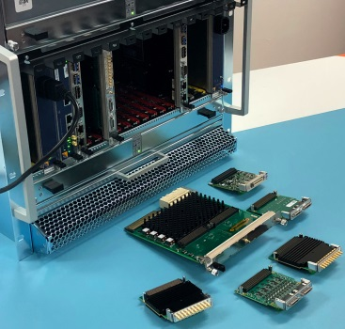
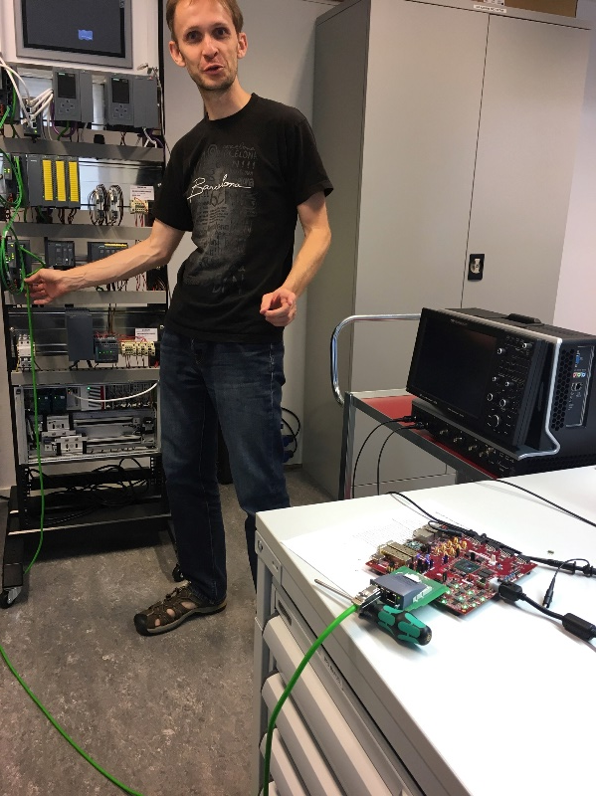
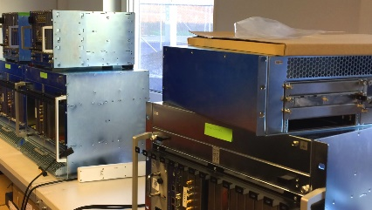
In-kind and in-house technology progress
Good progress on hardware technology development and integration
Meanwhile, work is continuing with maintaining and developing the ICS and EPICS software solutions
High performance
platform (MTCA4)

Slide 12


ICS In-kind partners
Agreement signed
Agreement waiting for signature
Collaboration/other agreement

Slide 13

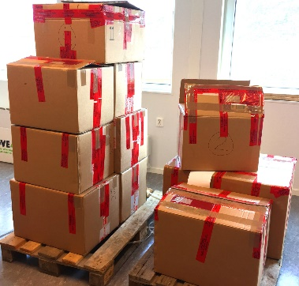


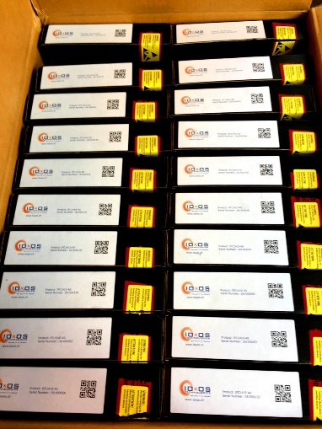







ICS in-kind status
  PSI: First batch of hardware platforms delivered
  TUT: Ethercat: Good progress. FPGA-IOC: getting back on track
  IPNO: Closed - to be self-performed
  CEA: Good progress - delays of hardware may create resource issues
  ESS Bilbao: Discussing installation contribution
  ZHAW: On track - excellent progress. Looking to extend collaboration
  INFN Legnaro: Good progress of controls scope
  IFE: Data centre equipment project ongoing. Issue with MCR installation
  Atomki: Closed
  STFC: Project almost completed
  Łódź: Work ongoing on two of three work units (as planned). Good progress
  Jülich: Defining Target monitoring controls contribution

Slide 14
ICS in-kind activities

Slide 15
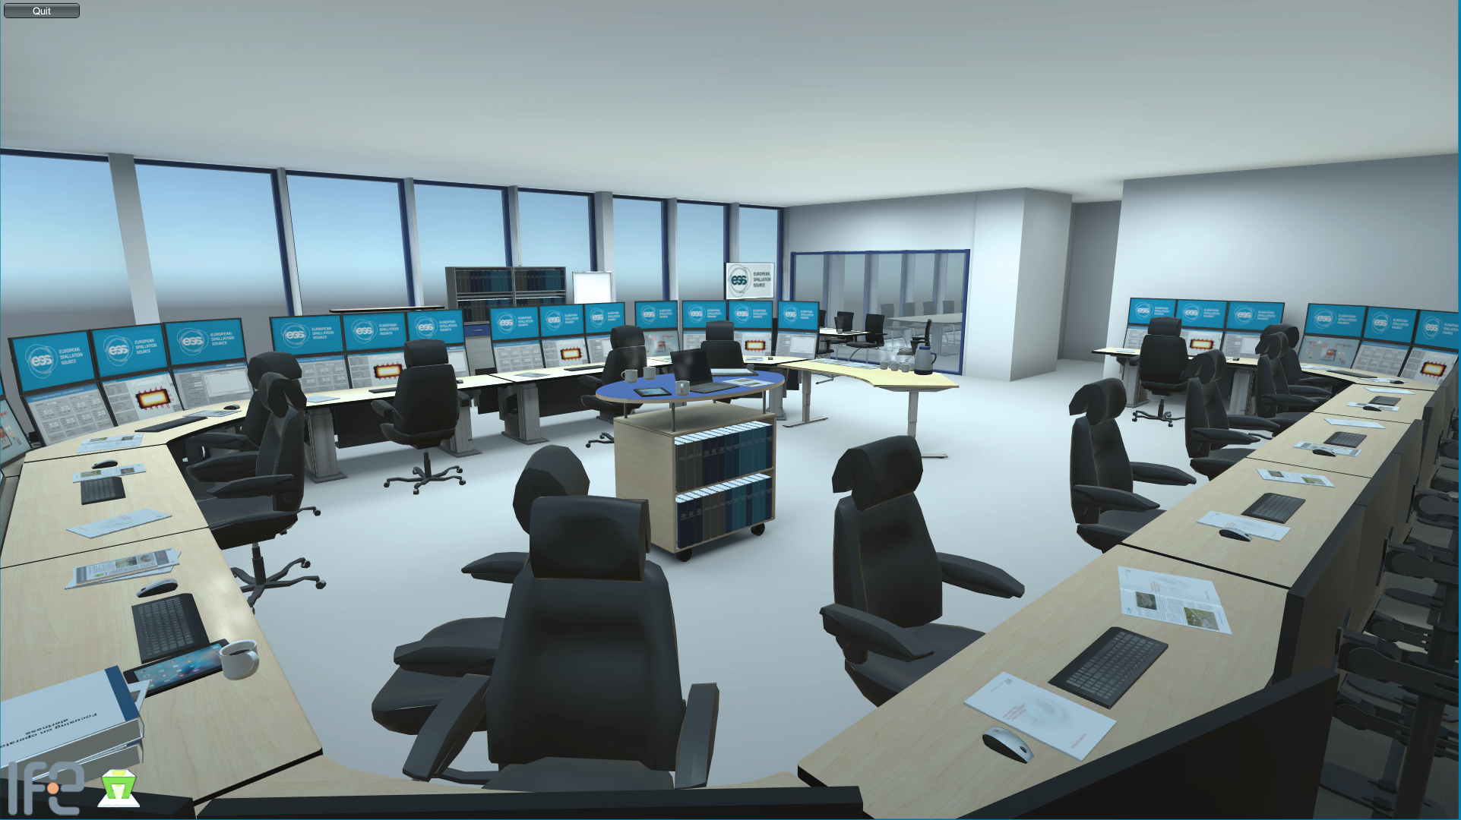
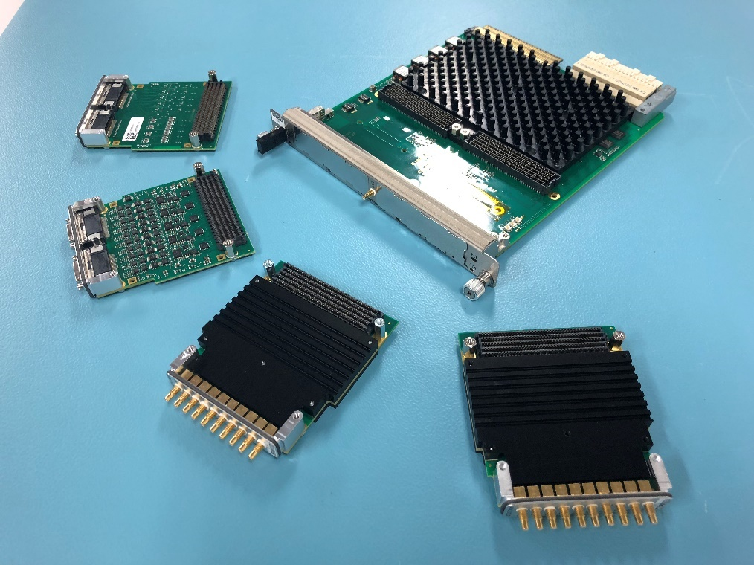
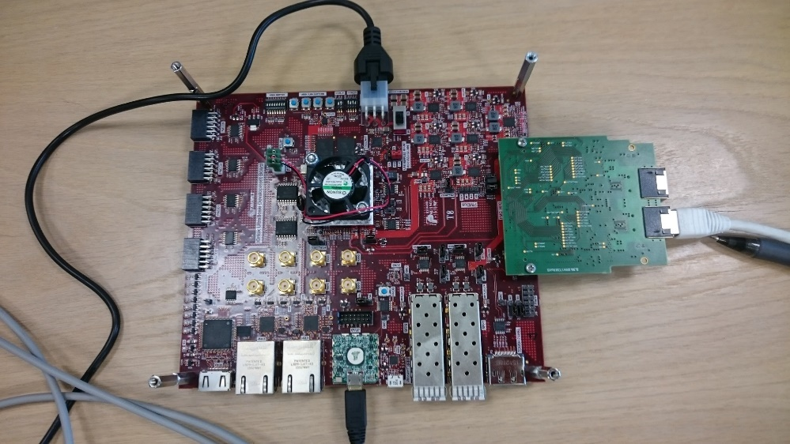
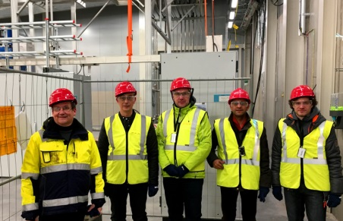
Examples of ongoing in-kind activities
IFE control room contribution
PSI IFC card family contribution
Testing Tallinn University of Technology contribution
An engineering team from Swiss in-kind partner PSI visited ESS

Slide 16
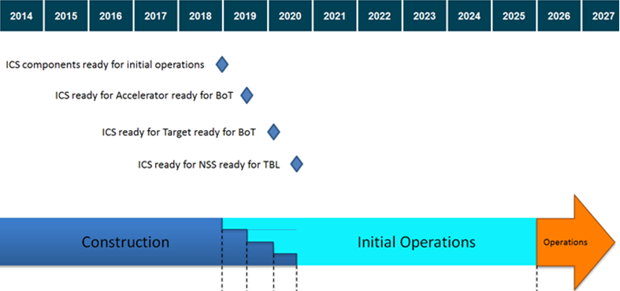
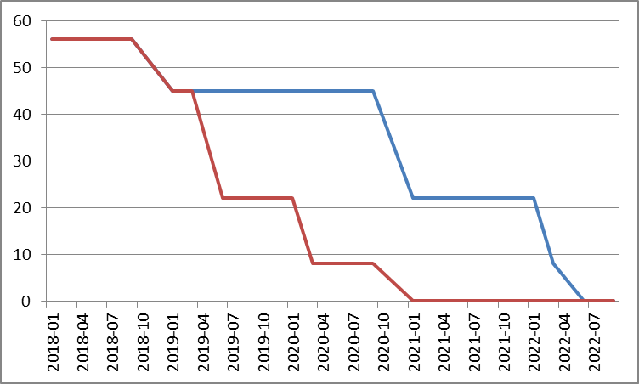
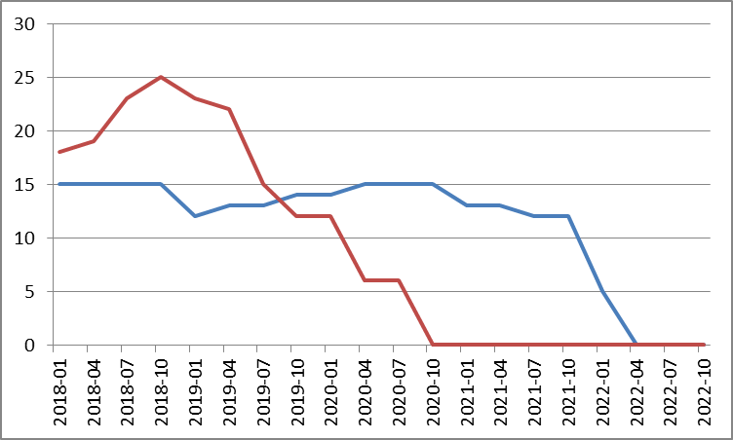
ICS re-baselining - overview
The transition for ICS from Construction to Initial operations phase is defined by four major milestones
  ICS Components ready for initial operations 2018-12-21 -> 2018-12-21
  ICS ready for Accelerator RBOT 2019-06-23 -> 2020-11-30
  ICS ready for Target RBOT 2020-03-31 -> 2022-01-30
  ICS ready for NSS Test Beamline 2020-10-15 -> 2022-05-31

Slide 17
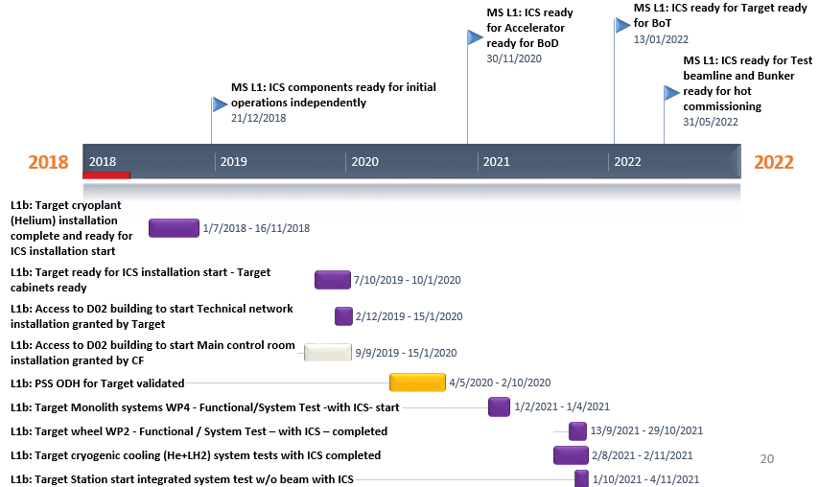
Remainder 2018
Several activities are moved in time with the re-baselined plan
  Much of the installation services will be distributed from 2018 onto 2019 - 2021 and even further
  Some of the compute/electronic equipment can be purchased later to reduce cost/increase performance
  In-kind activities are not heavily impacted - the main control room delivery being one significant exception
  Hiring of staff will continue according to the staffing plan, but consultants will be postponed/canceled in 2018

Slide 18
2019 Major activitiies
Supporting and working with Accelerator
  Personnel safety and machine protection systems for accelerator commissioning
  RF systems for normal conducting, spoke and medium beta parts
  Delivery and installation, commissioning of MEBT, RFQ and
  Controls for Cryogenic distribution systems
  Beam instrumentation systems
Supporting and working with Target, NSS and CF
  Continue working with process control systems and overall target systems
  Continue working with technology development for instruments while supporting integration efforts
  Continue integrating CF systems according to plan
ICS internal
  Timing system deployment
  Finalize control system infrastructure except main control room
  Continue adapting and enhancing controls configuration management software
  Continue adapting and enhancing software infrastructure (EPICS, CSS, Alarm, Logbook …)

Slide 19
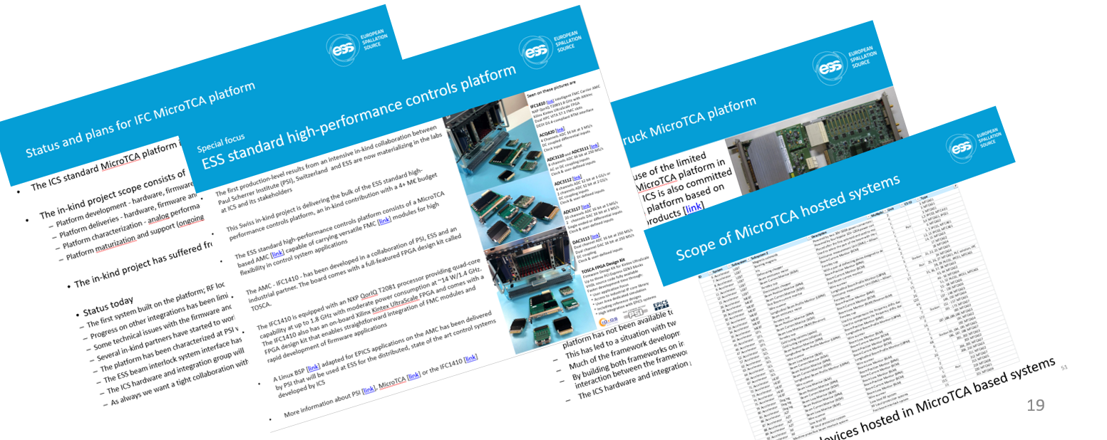
Initiatives on MicroTCA
ESS is driving activities to increase community and industry interest in MicroTCA
  ESS is investing significantly in MicroTCA technology
  ESS will be around for many years to come
  MicroTCA is a hardware platform generating a lot of interest

Slide 20

Initiatives for EPICS development
ESS/ICS is contributing to the open-source EPICS community working on prioritized functionality enhancements for EPICS 7
ESS is an active participant in the EPICS council that coordinates facilities’ contributions
ESS has delivered a refurbishment of the official EPICS web-site in 2018
The community interaction has proven to be very beneficial for rapidly expanding knowledge inside ESS and learning from the experiences of others

Slide 21

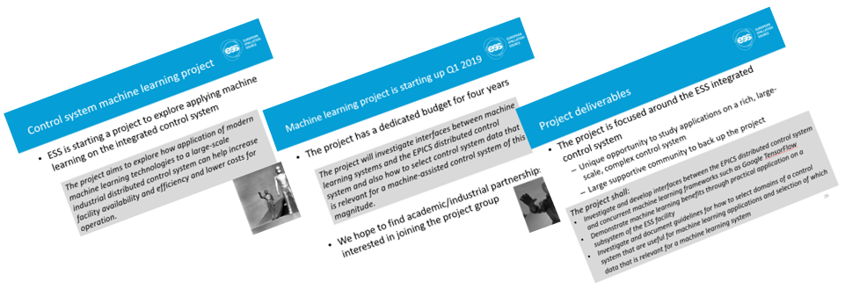
Initiative on machine learning
We want to explore if modern AI/Machine learning technologies can be used to augment the ESS control system
  Decrease commissioning time and effort
  Increased facility availability (95% goal)
  Increased efficiency of operation
  Improved human/machine interaction
  Lowered operational and maintenance costs

Slide 22
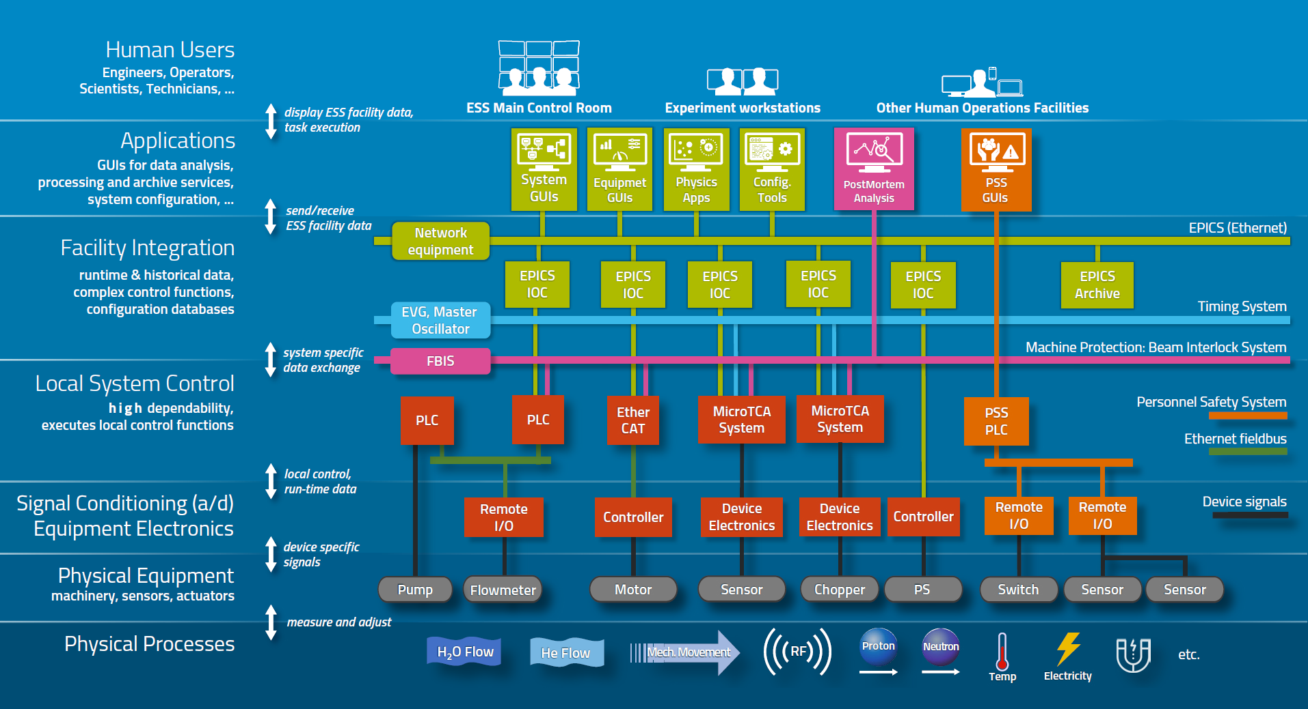
Control system overview
ICS overview document available [link]
ICS weekly reports (130+ recipients)

Slide 23
Recommendations from TAC 17
In considering the restructuring of the Hardware Integration Group ICS Management should think about how to ensure good customer engagement and the development of long term relationships between ICS staff and their customer groups
  The actual restructuring of the hardware and integration group has not yet happened. During the period, we have matured the resource request/allocation methodology in order to test the prioritization mechanisms together with stakeholders. From what we can see now, we have good stakeholder buy-in for this methodology.
  The problem of how to restructure the hardware and integration group (because it is/will be too large for a single group) has not yet been resolved. A few proposals have been reviewed and discussed with employees and stakeholders, but so far no solution has been adopted
Complete the local vertical integration project, continue to elaborate on demonstration (V20) and testing (lab instrument beamline) capabilities.
  The vertical integration project for NSS integration has successfully continued.
  However, it is very clear that the need for ICS support to NSS has not been sufficiently met, despite some resource build-up for this specific purpose.
Division Heads for Accelerator and ICS need to conduct and oversee an internal review of IOXOS platform for all BI systems. Out of which a decision should be made and documented setting out the hardware platform of choice for each subsystem and all parties should move forward on that basis.
  An attempt to answer this recommendation has been made in the break-out presentation by Simone Farina
The Infrastructure Group should consider implementing single sign-on access all ESS systems and help to develop ESS-wide cyber security policies
  Since TAC 17, the ESS chief information security officer has started. This has meant a much better ESS-wide focus on cyber security and ICS is now working with the CISO to coordinate and align cyber security policies

Slide 24
ICS vision and mission statements
ICS vision statement
ESS operated efficiently, reliably and safely, with a control system that everyone loves
ICS mission
The ICS division shall provide and maintain world-class and cost-efficient control, protection and safety systems and services for the ESS facility.
The division shall develop competence and innovative solutions that can be shared in the community through open processes

