Slide 1

Charge and Agenda
of the 18th TAC meeting
17-19 October 2018, Lund
Roland Garoby
https://indico.esss.lu.se/event/1075/

Slide 2
TAC #18 – ESS context
The ESS construction project is now > 50% complete and progress has continued at a high pace even during the summer months. Concerning Conventional Facilities, the Target station building has reached the height of the high bay floor, the long distance experimental hall and the logistics building are erected, the A2T connection between accelerator and Target is an advanced stage of construction…
For Accelerator, Target and ICS, most components are now in construction, either through in-kind partners or directly in industry. Prototypes are being tested (Spoke cryomodule from IPNO in Uppsala, Elliptical cavity cryomodule in Saclay etc.). Klystrons for the Medium beta section of the linac have started arriving.
The infrastructure installation organization is fully operational and it is now focusing on the first 100 meters of the klystron gallery.
Beam commissioning of the ion source and LEBT has started in the tunnel… The RF Test Stand in the klystron gallery has started being used…
The new baseline which had been prepared during the first half of the year has successfully passed the review held in May and it has been accepted by the ESS Council…

Slide 3
Questions to the TAC for its 18th meeting
- Accelerator -
a1) Is the planned organization for installation, testing and commissioning likely to result in an operating accelerator that meets its requirements in a timely manner?
a2) Are there any suggestions for improving the schedule performance of in-kind partners?
a3) Are the schedules for accelerator and utilities installation reasonable? Are there any reasonable strategies for reducing the schedule?
a4) Are the presented testing and commissioning plans appropriate?
a5) Is the strategy for high level readiness reviews reasonable?
a6) Please comment on the experience so far from the ion source and LEBT commissioning and operations. Does this experience and the lessons learned bode well for future linac operations?
a7) Have we missed anything?

Slide 4
Questions to the TAC for its 18th meeting
- Target -
t1) Concerning “Update on Target Station Accident Analyses”:
Does the design philosophy and the methodology for dose calculations provide a solid basis for licensing of the Target Station? We also ask the committee to advice on how to improve the efficiency of the procedure for dose calculations
t2) Concerning “Monolith inner (water-cooled) shielding”:
Will the presented technical solution, for the inner water-cooled monolith shielding, be a reasonable compromise to conflicting and challenging requirements?
t3) Concerning “Scheme for beam lines alignment”:
Will the envisioned installation scheme, in the end, provide satisfactory alignment precision for the neutron science instrument in cold and hot conditions?
t4) Concerning “Update on waste management”:
Will the pursued technical solutions for waste management of filters and contaminated water assure safe, efficient and reliable maintenance work within the Target Station? Proper ALARA?
t5) Concerning interplay between Controls, MPS, TSS and Control Room:
Is the philosophy presented sound and appropriate for a safe and reliable operation of the ESS machine? Operations, Asset Protection and Safety.

Slide 5
Questions to the TAC for its 18th meeting
- ICS (1/2)
c1) Concerning ICS construction and initial operations activities:
Are the presented strategies for ensuring the quality of the control system appropriate?
Are the principles for prioritizing and allocating resources to stakeholder activities adequate, what alternatives exist?
Have we missed anything - are there any particular difficulties that we could expect?
c2) Concerning the operational aspects of ICS:
Are the plans for machine modes and timing integration appropriate and complete enough?
Please comment on any weaknesses in the planned integration and interaction of machine subsystems with ICS?
c3) Concerning the new baseline for the ICS construction project plan:
Is the new baseline for the construction project plan appropriate - do you find any particular weaknesses?
Is the planning methodology, including planning quality objectives, sufficient and relevant?

Slide 6
Questions to the TAC for its 18th meeting
- ICS (2/2)
c4) Concerning the ICS platforms for beam instrumentation:
Are the use cases for using the ICS technical platforms sufficiently developed? Has anything been missed?
Do you have comments to the plan for deploying the ICS platforms for beam instrumentation?
c5) Concerning the ESS machine protection system of systems :
Is the analysis method and integration strategy appropriate for implementing machine protection into the complex accelerator and target systems?
Is the verification and validation strategy for the fast beam interlock system (FBIS) appropriate? What are the issues?
Is the integration of machine protection strategies into operations likely to be successful?
c6) Concerning the automation of control system configuration :
Is the concept for automation of control system configuration valid from an operational/practical point of view?
Please comment on any potential issues with the presented automation of control system configuration?

Slide 7
TAC #18 – Additional information
The Committee is encouraged to provide also suggestions/comments and recommendations on any other subject it would find relevant. Feedback on the follow-up of former TAC recommendations is welcome.
A preliminary version of the TAC report is expected during the close-out session in the afternoon of Friday 19, October. The final report is expected on November 5. The Chairman will orally present the TAC#18 report to the ESS Council on December 3-4.

Slide 8
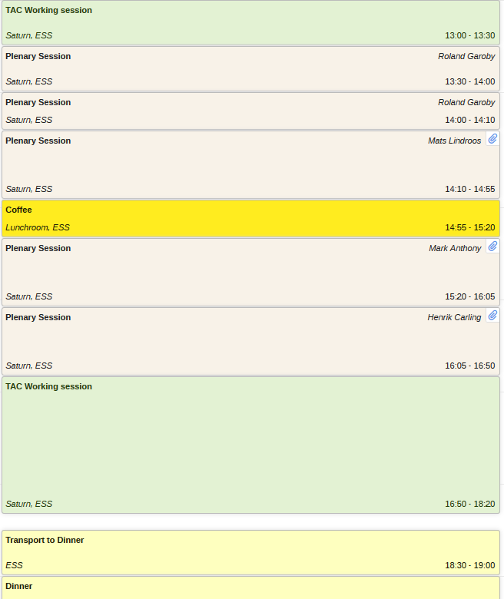
Agenda TAC#18
Wednesday 17 October 2018
TAC initial session
Plenary session
TAC session
Dinner

Slide 9
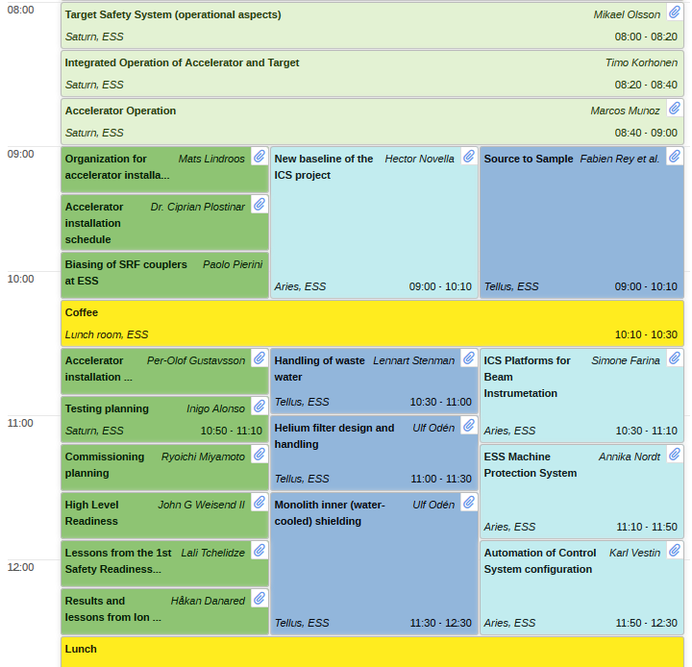
Agenda TAC#18
Thursday 18 October 2018 (am)
Joint session
Parallel sessions

Slide 10
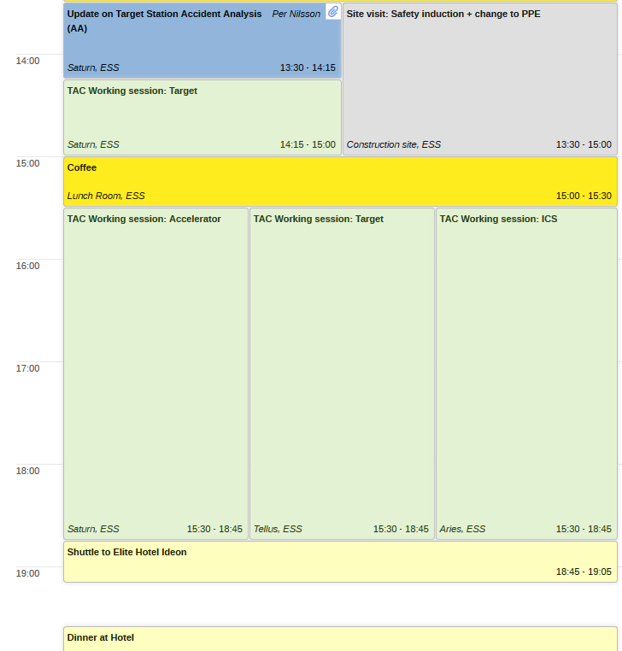
Agenda TAC#18
Thursday 18 October 2018 (pm)
tTAC session
Site visit
(Accelerator + ICS)
TAC sessions

Slide 11
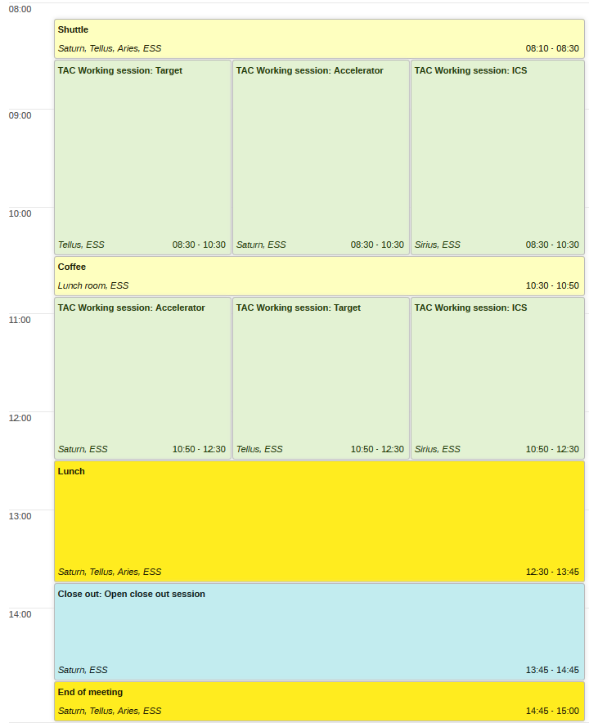
Agenda TAC#18
Friday 19 October 2018
TAC sessions
Public close-out

Slide 12
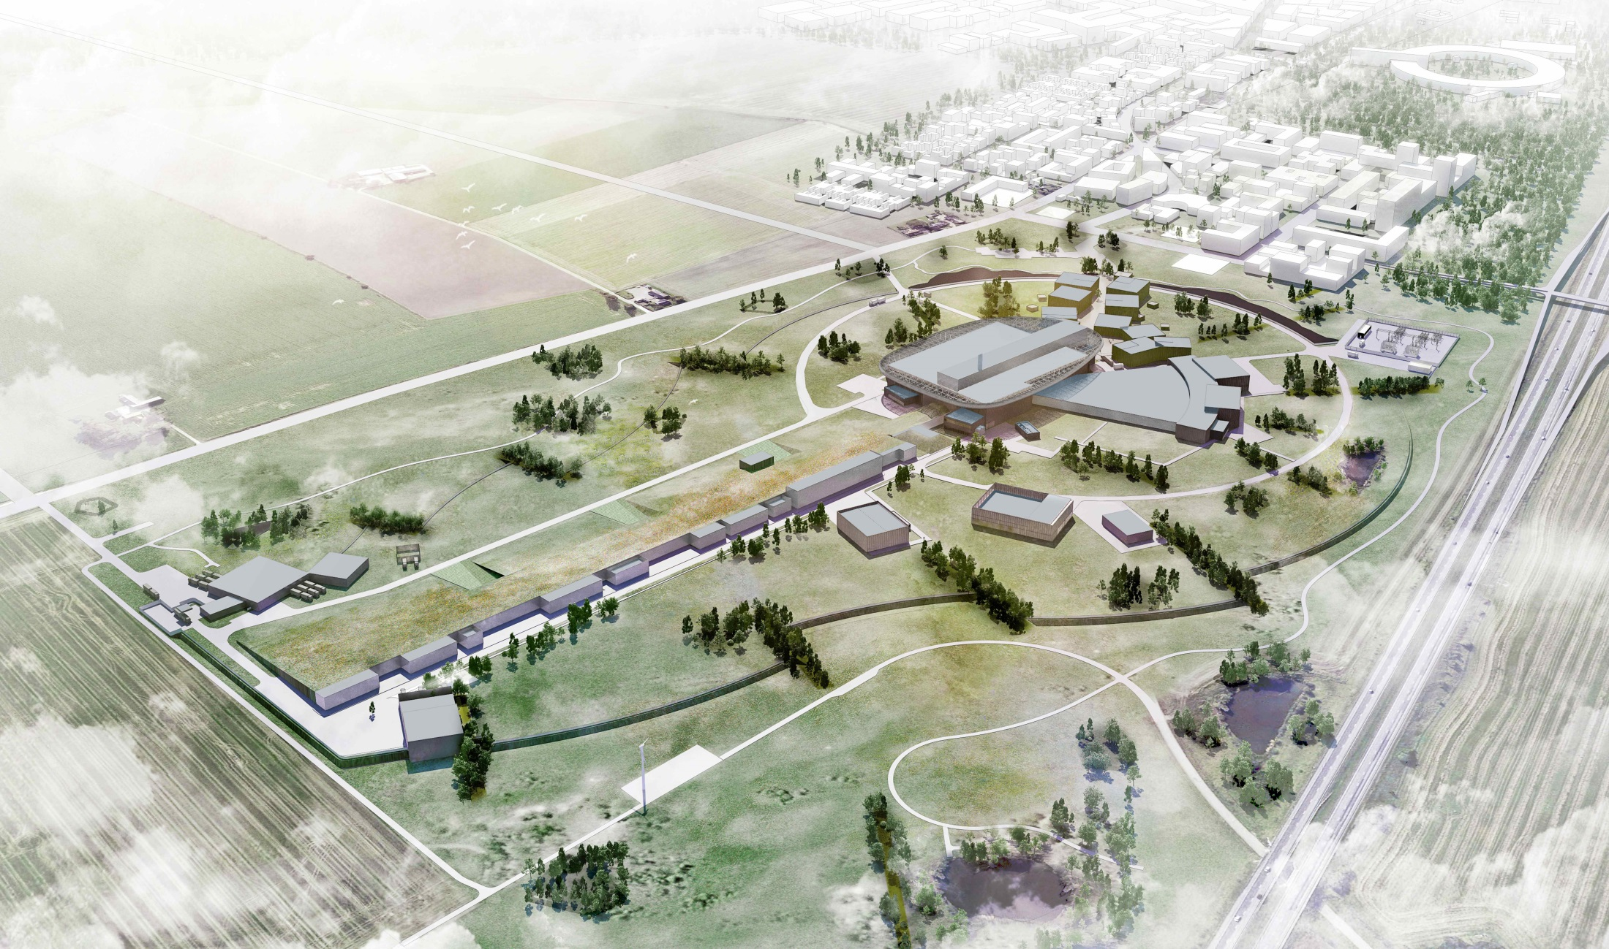
Thank you for being here.
We look forward to your advice!

