Slide 1
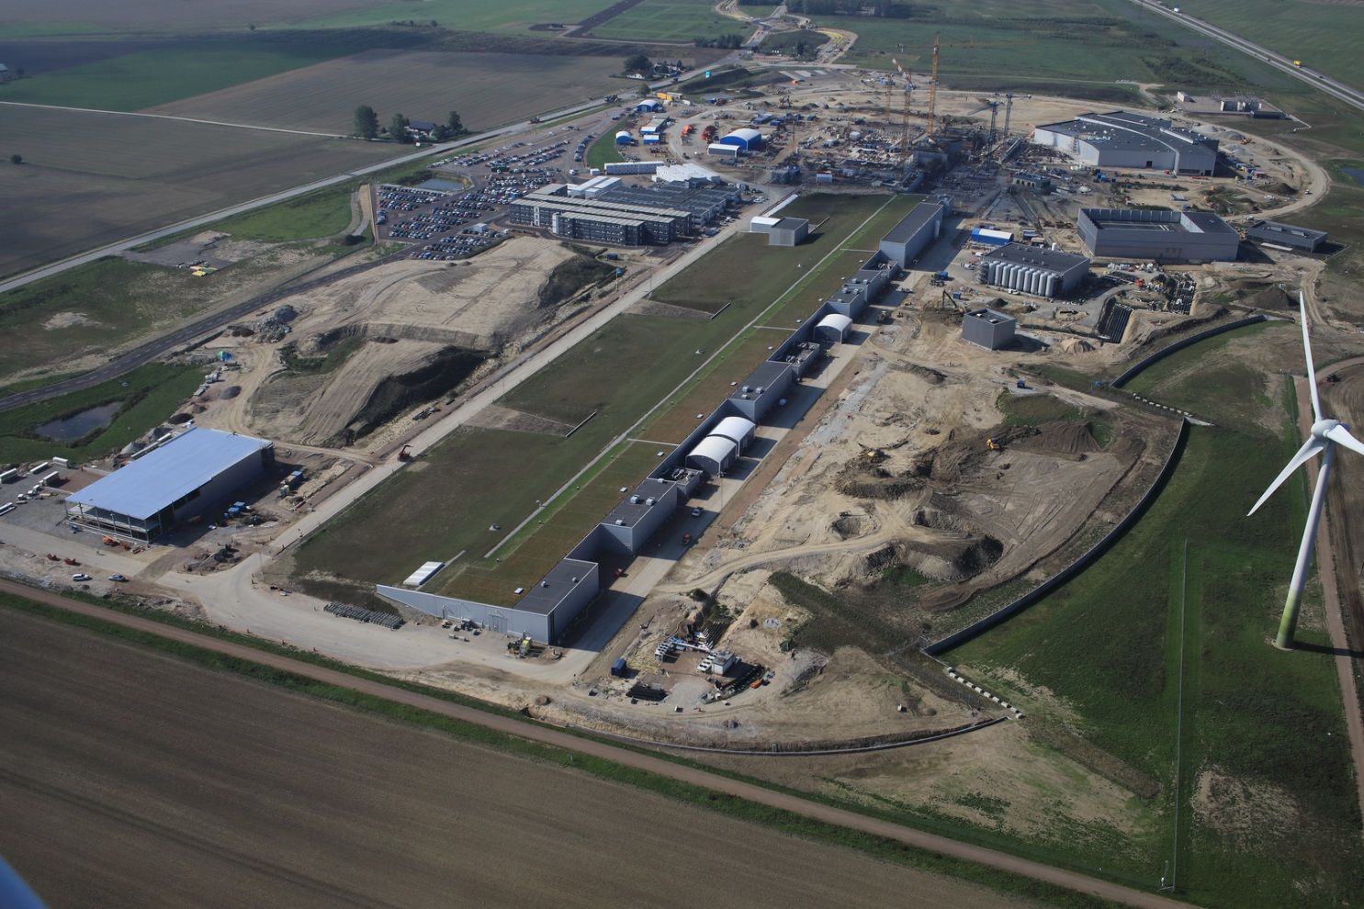

  ESS Project Status
  Roland Garoby – Technical Director
  October 2018

Slide 2
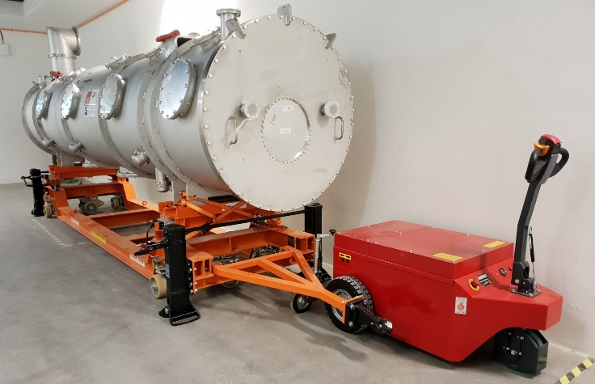
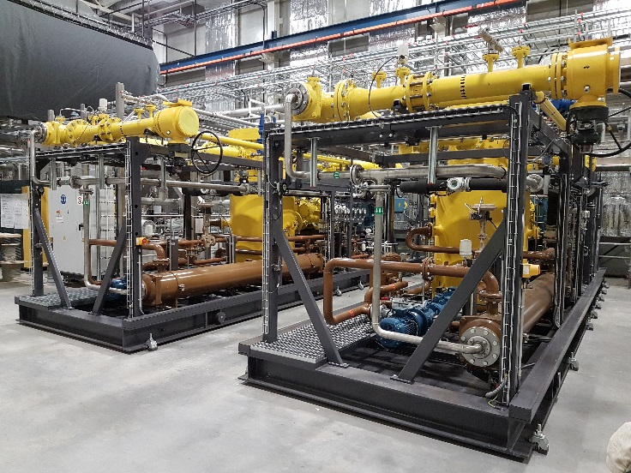
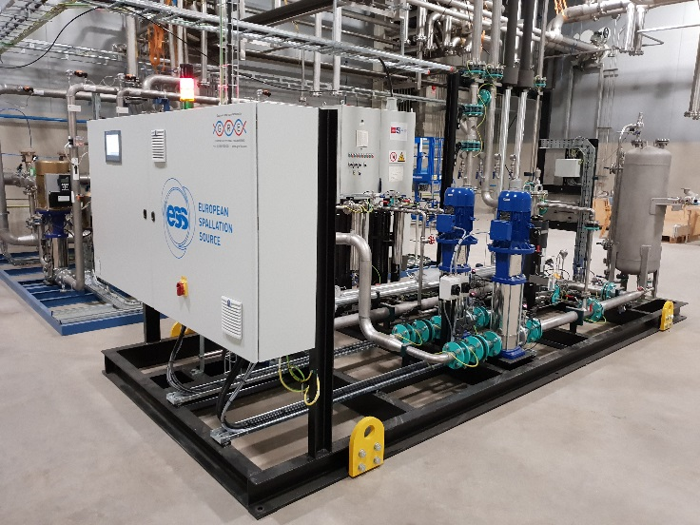
ESS is more than 50% complete
2018 is the peak of construction activity
In-kind deliveries of high tech equipment arriving
Commissioning of ion source has started
All staff moved out to site in June this year…
~600 Work places
~10 000 m²
Ion source skid
Prototype cryomodule
and its transport
vehicle
TMCP compressors

Slide 3
Progress with respect to the Goals for 2018
Goals for 2018 | Status in October 2018
Submit to SSM the application for the trial operations of the Warm Linac | Delayed till April 2019
Move ESS Lund organisation to site | Done
A detailed plan for first two years (2019 & 2020) of Initial Operations | In progress (budget defined)
Start of commissioning of ion source and LEBT, temporary control room operational | Done
Complete manufacturing and Factory Acceptance Tests of Moderator plug, Cryo-Moderator System and Cryoplant. | Done
All instruments start Tollgate 3 process and begun procurement | ?
First joint user meeting with the ILL | Done
Secure Spain as an ERIC member | Done
Work with ILL to establish a neutron initiative recognised by the European commission in their planning for FP9 | Done

Slide 4
The ESS Council has approved the new baseline schedule in June 2018
2018
2019
2020
2021
2022
2023
2024
2025
BOT
SOUP
Warm LINAC Commissioning Steps
EOC
1.3 GeV Capability Installed
Accelerator + ICS
Hi-Beta Install
Beam on Dump
(570 MeV)
Accelerator RBOT
Accelerator Schedule Float to BOT
CF + Target + NSS (Bunker+TBL) + ICS
Bunker and Test Beam Line RBOT
Access for Monolith Installation
Target RBOT
15th Instrument Complete (Ready for hot commissioning)
NSS Instruments + ICS
Instrument Hall Access for Start of Installation
Start beam commissioning for 1st Instruments
SOUP

Slide 5
New schedule of Accelerator
ISrc to RFQ/MEBT/DTL1
ISrc to Beam Dump (BOD)
4 Nov '19
8 Feb '21
ISrc to LEBT
ISrc to DTL4
RBOT
25 Jun '18
27 Apr '20
24 May '21
New Baseline
2019
2020
2021
18.8 months
Beam to RFQ/MEBT Delay
21.8 months
Beam to DTL4 Delay
21.2 months
BOD Delay
23.9 months
RBOT Delay
Old Baseline
2019
2020
2021
5 Jul '18
28 May '19
ISrc to DTL4
RBOT
11 Apr '18
30 Apr '19
ISrc to RFQ/MEBT
ISrc to Beam Dump (BOD)

Slide 6
New schedule of Target and Instruments
2018
2019
2020
2021
2022
Monolith Area Superstructure
Monolith and A2T Concrete
High Bay Infrastructure Installation
BOT
Target Building (D02) Access for Monolith Installation
Testing and Readiness Review
Monolith Installation & Testing
Ready for parallel bunker and monolith works
Target Wheel & MR Installed
Target RBOT
CF D01/D03 Build-out to weather tight
3 months float
Parallel Works
Target Integrated Bunker Scope
Final testing and Readiness Review
Bunker Construction and Installation
Monolith inserts & shutters installed
NSS RBOT

Slide 7
Licensing timeline
Ref Doc ready 2018-10-15
Ref Doc ready 2019-11-15
Ref Doc ready 2020-10-30
PSAR updated
PSAR updated
PSAR updated
Self Assessment
Self Assessment
Self Assessment
ESS
Independent Safety Review
Independent Safety Review
Independent Safety Review
Submission 2019-04-30
Submission 2020-04-30
Submission 2021-04-15
Response to
questions
SRR2
SRR4
SRR5
Subm.
Submission
Submission
SRR1
SRR
RFQ Beam
BoD
RBoT
BoT
IoS Beam
2019
2020
2021
2022
IoS
permit
IoS
Extension
For Klystron test
IoS Extension
For cavity test
TS2
Extension
Conditional permit
Conditional permit
Conditional permit
Warm LINAC trial operation review
SC LINAC trial operation review
Intentional neutron production trial operation review
SSM
RFQ – Radio Frequency Quadrupole
BoD – Beam on Dump
BoT - Beam on Target
RBoT - Ready for Beam on Target
PSAR – Preliminary Safety Analysis Report
SRR - Safety Readiness Review
SSM – Swedish Radiation Safety Authority

Slide 8
Transition to Operations
Updated description of “Early Operations of the ESS Neutron Instruments and first scientific results” (ESS-0420218) distinguishing successive stages:
Up to Beam on Target (-July 2022)
ESS initial stages (July 2022-December 2023)
  Early Days: BOT to (BOT + 3 months) (July – September 2022)
  Consolidation Days: The next 3 months: (BOT + 3 months) to (BOT + 6 months) (October – December 2022)
  Performance Assessment days: (BOT + 6 months) to (BOT + 9 months) (January – March 2023).
  First Performance Demonstration Days: (BOT + 9 months) to (BOT + 12 months) (April – June 2023)
  Ramp up and Early Science: (BOT + 12 months) to (BOT + 18 months) (July – December 2023)
Start of the ESS User programme SOUP (2024-2027)

Slide 9
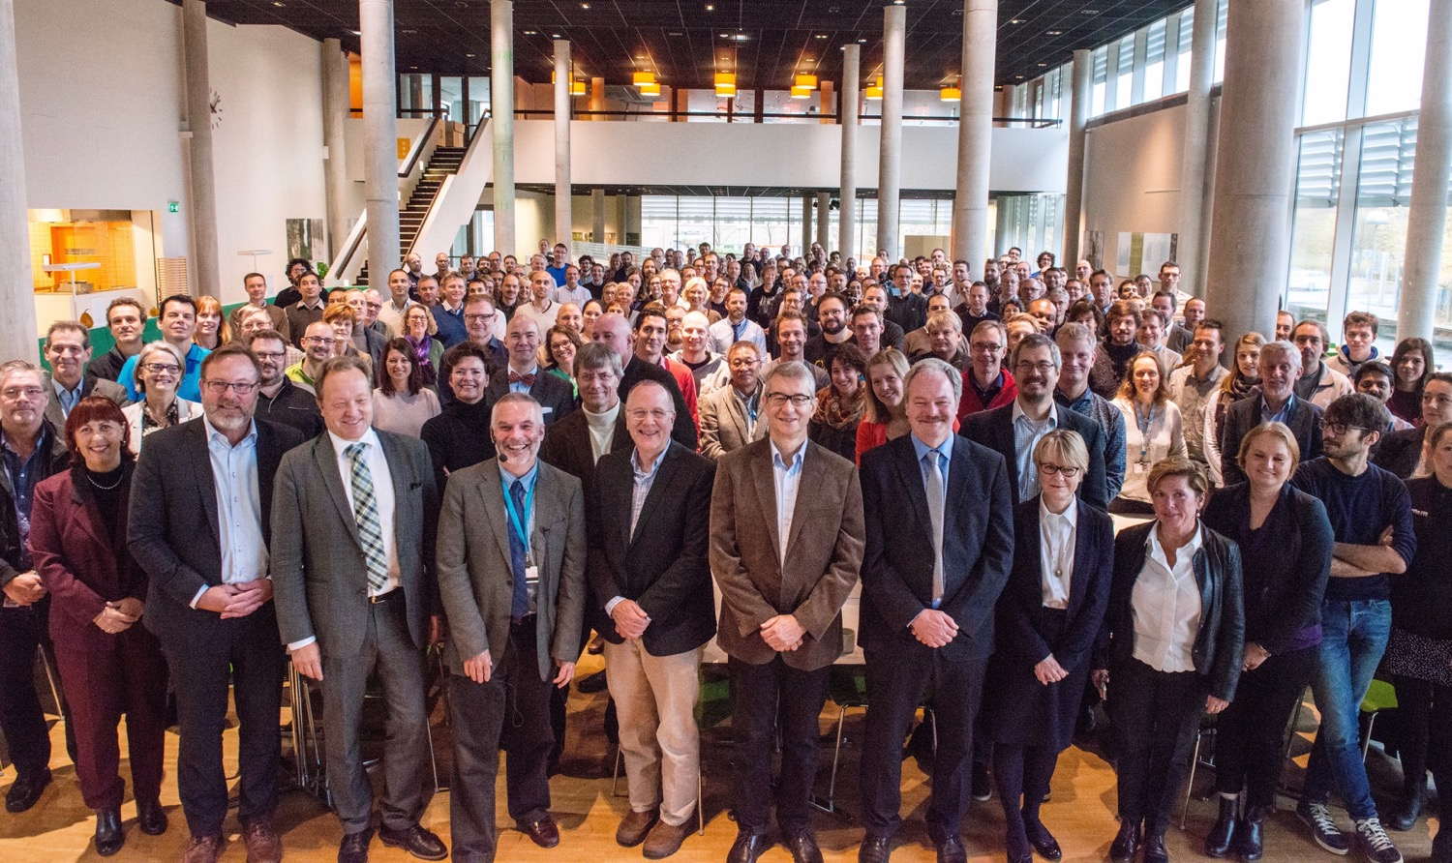


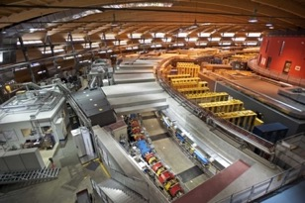
Organisation and People
471
Employees
50
Nationalities
~ 100
Collaborating Institutions
+ 146
Contracted
Notes:
Updated September 2017

Slide 10
ESS high level structure during Initial Operations
DG
Three Directors
  Science plus Deputy focused on Operations
  Technical plus Deputy focused on Operations
  Administration plus Deputy
Two Associate Directors
  ESH&Q
  Strategy
Matrixed responsibilities
  Installation manager
  Engineering Manager
  Operations Manager

Slide 11
Changes/new senior staff positions since April 2018
Associate Director for Strategy:
  Sharon Cosgrove
Head of Communications:
Martin Sjöstrand
Deputy Technical Director (Operations Manager):
Carlo Bocchetta
Engineering Manager:
Peter Radahl

Slide 12
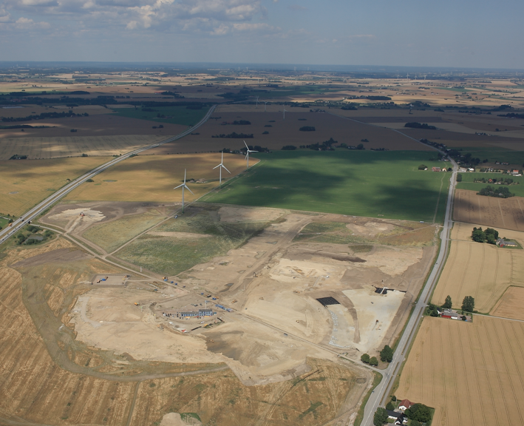
Civil Construction Groundbreaking
September 2014

Slide 13
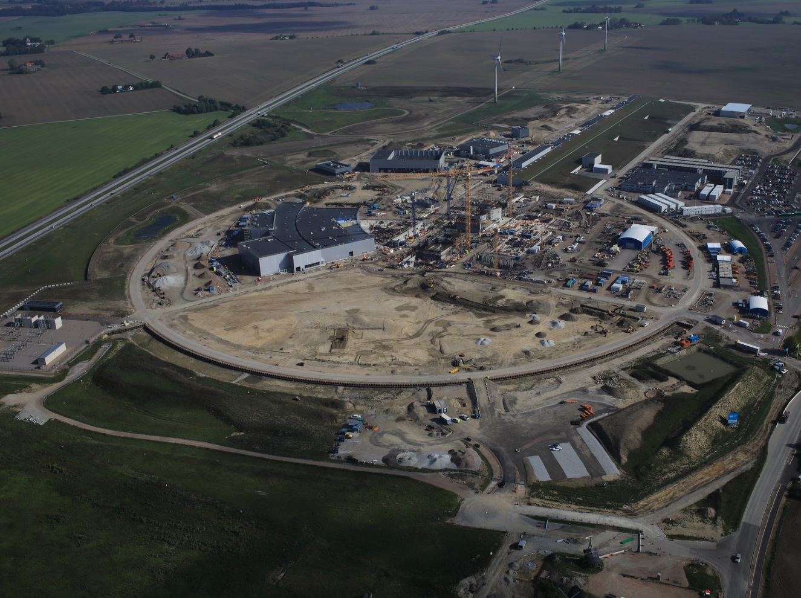
September 2018

Slide 14
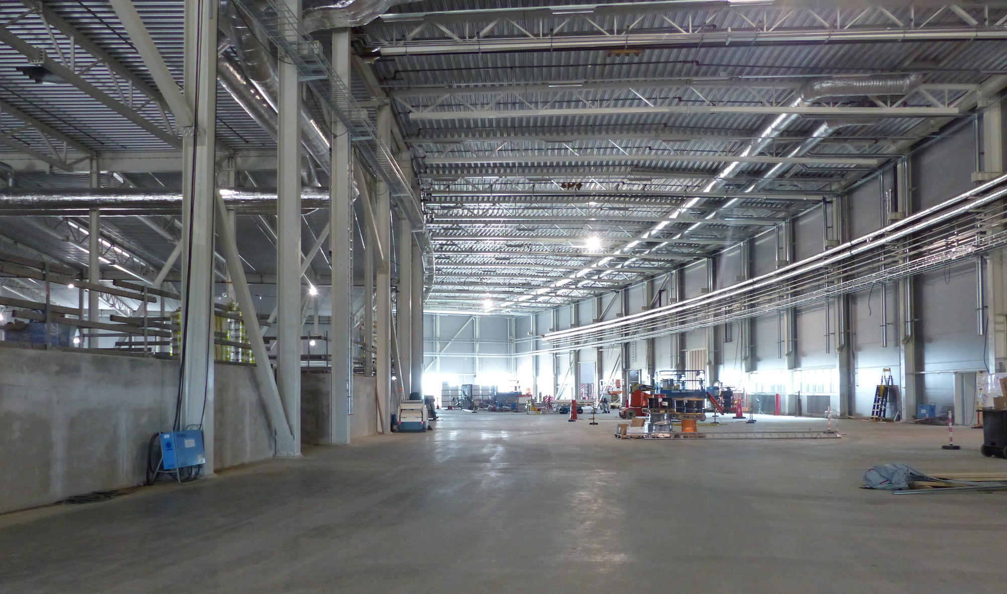
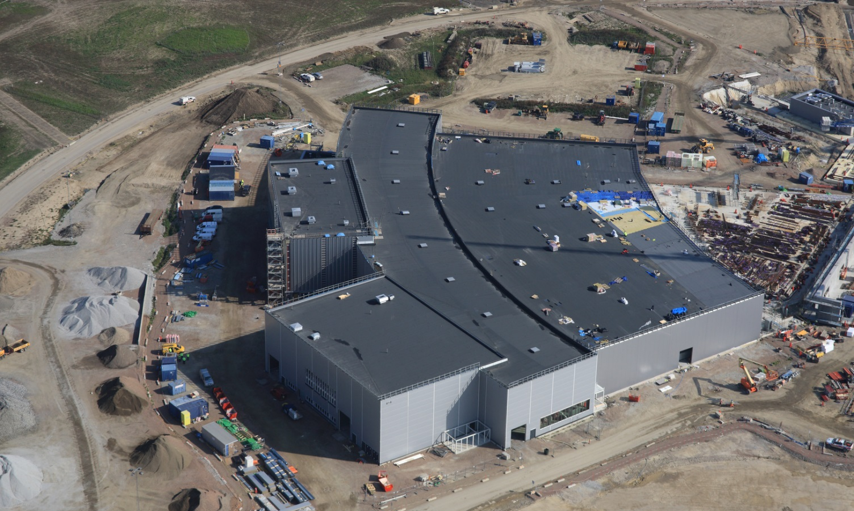
Experimental Hall (E01)

Slide 15
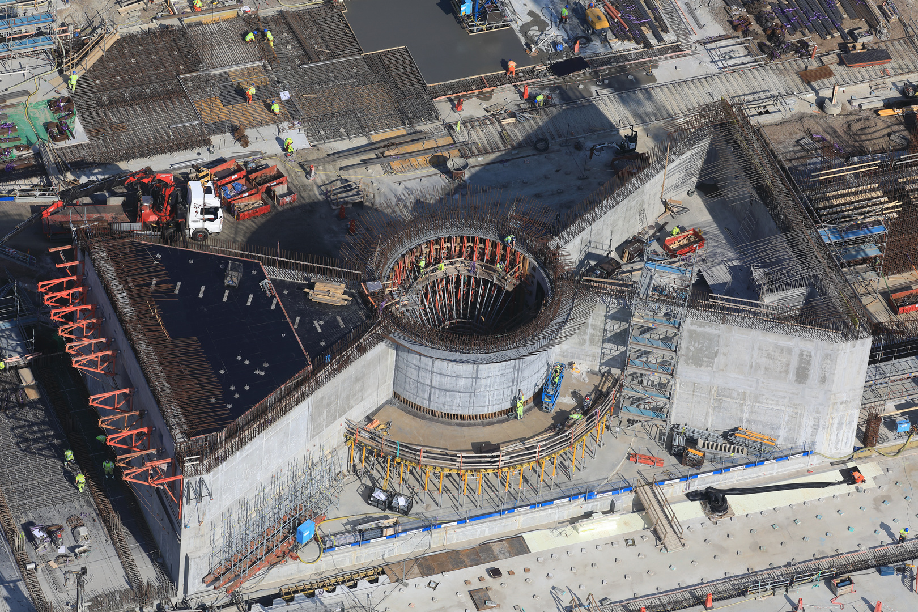
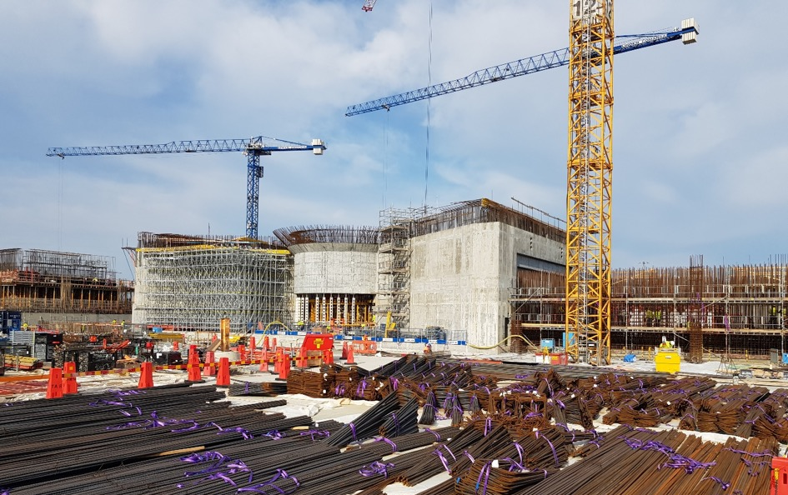
Target building (D02)

Slide 16
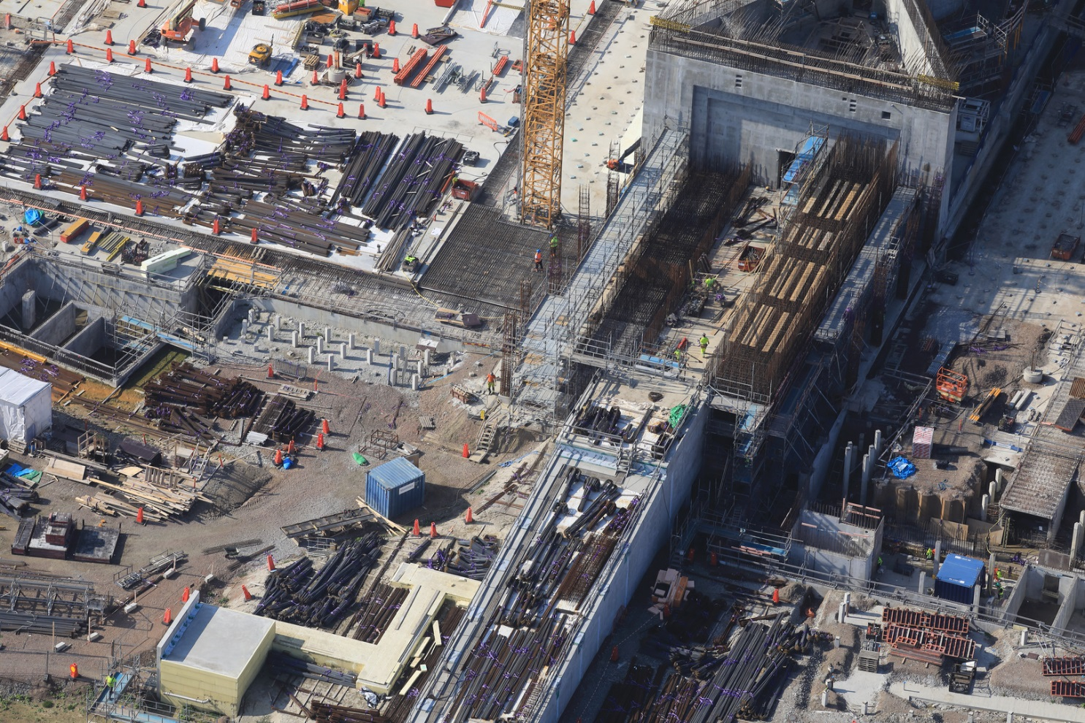
A2T (junction G02 – D02)

Slide 17
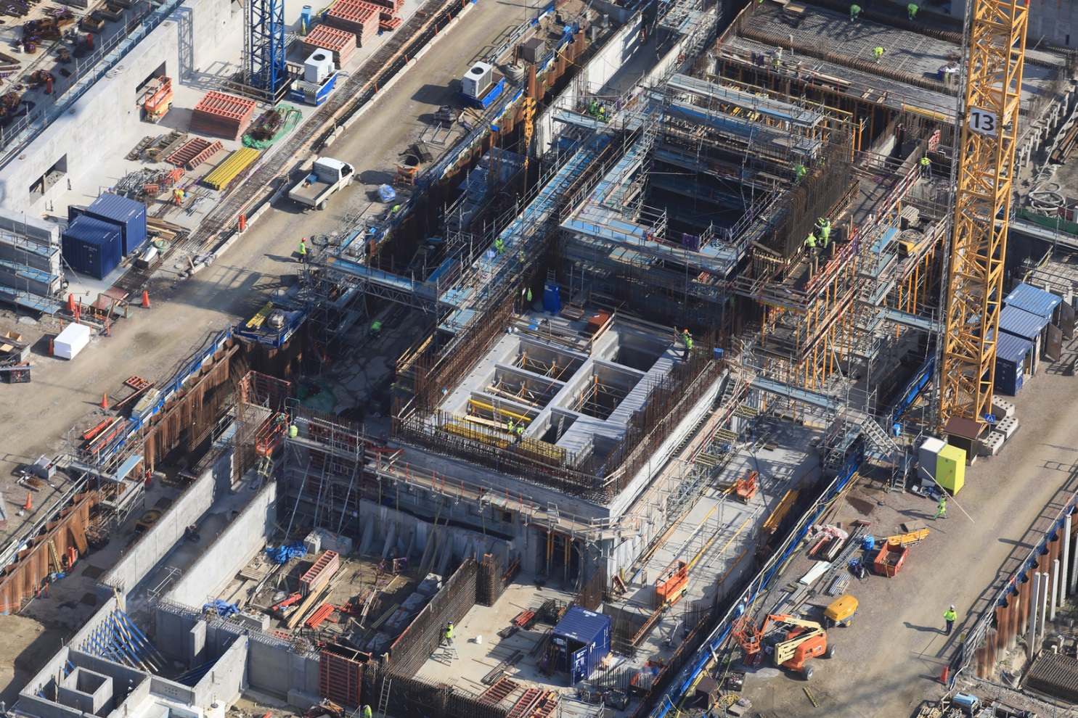
Active Cell in D02

Slide 18
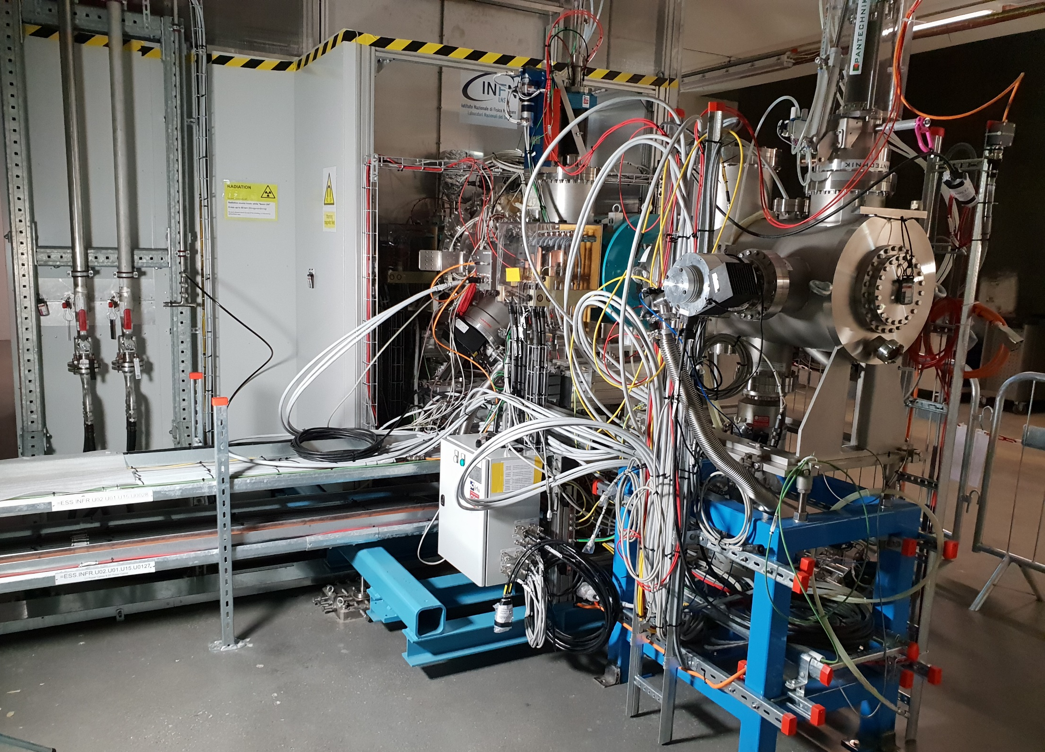
Ion source & LEBT are under commissioning

Slide 19
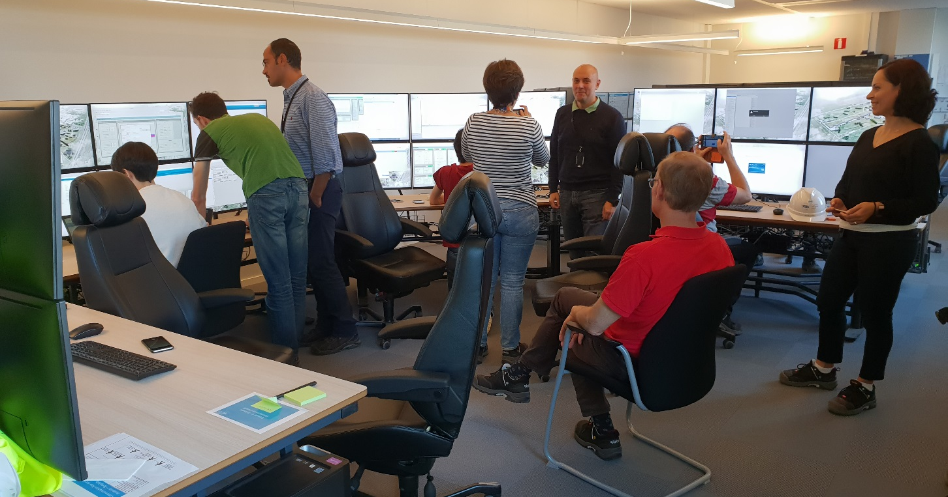
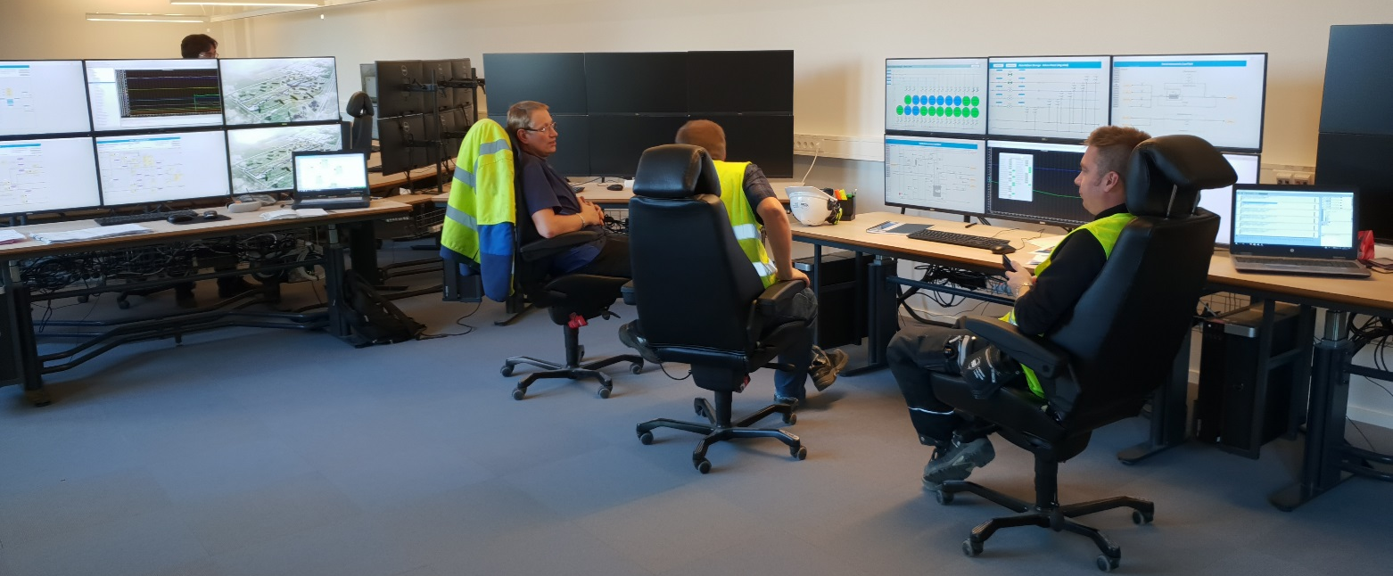
The temporary control room is operational
For commissioning
the ion source…
…and for commissioning
the cryoplants.

Slide 20
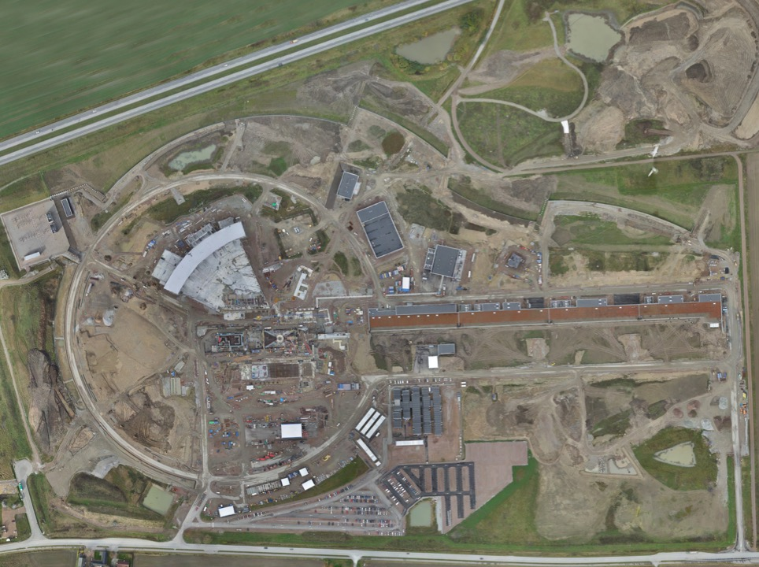
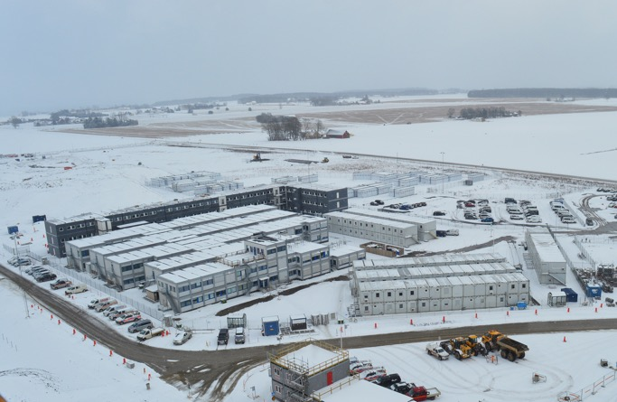
Permanent
Office Campus
2021
New 2018 ESS offices for all staff
New Bus Stop
Lund Tramway Depot

Slide 21
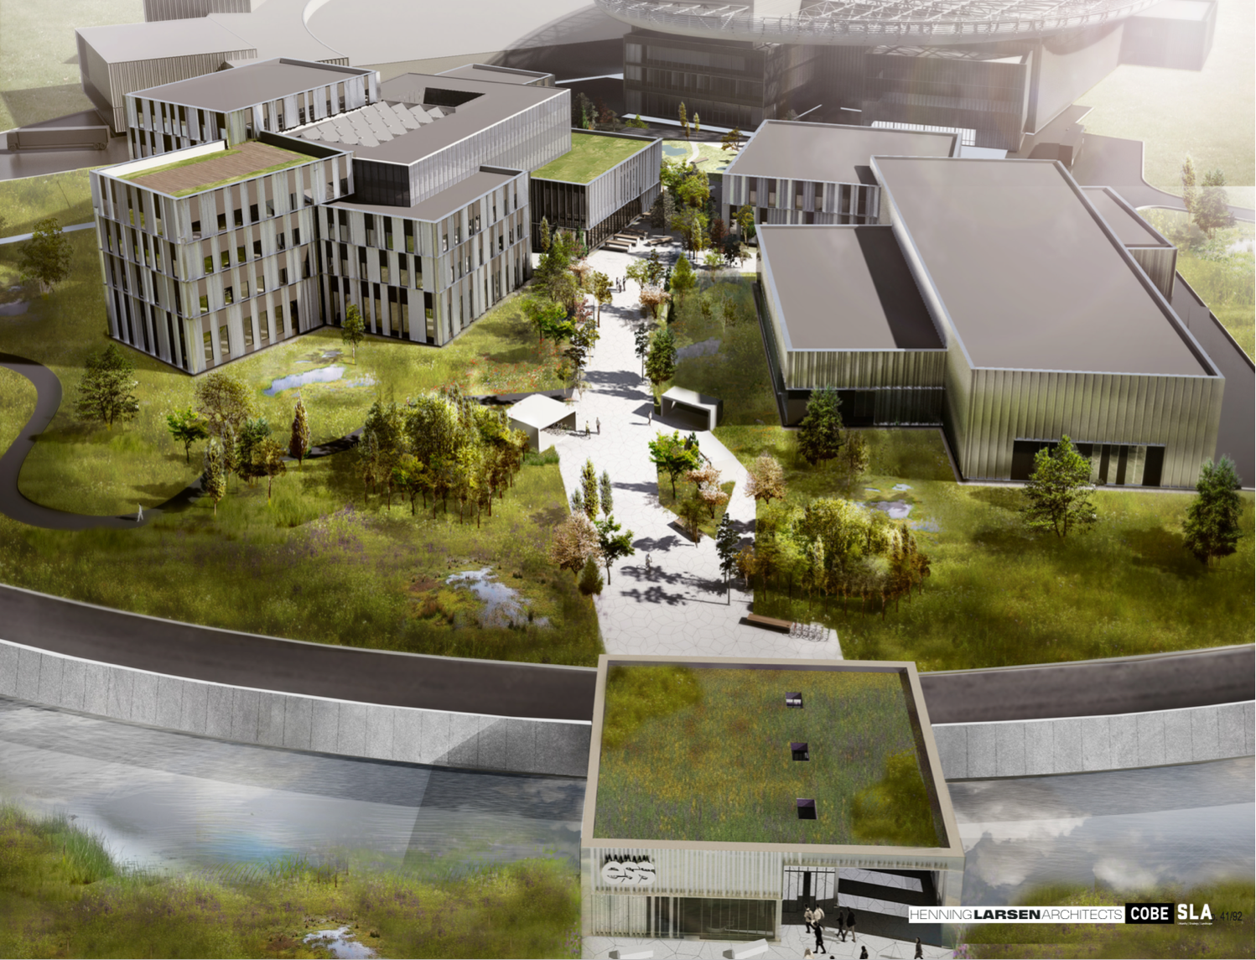
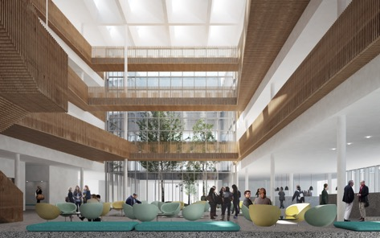
Campus
Campus construction started in September 2018
Offices, auditorium canteen
Labs and Workshops
Signed construction and financing agreements in February
Now in detailed design before target cost is agreed
Cost of the lease is included in the operations costs
Entrance Building

Slide 22
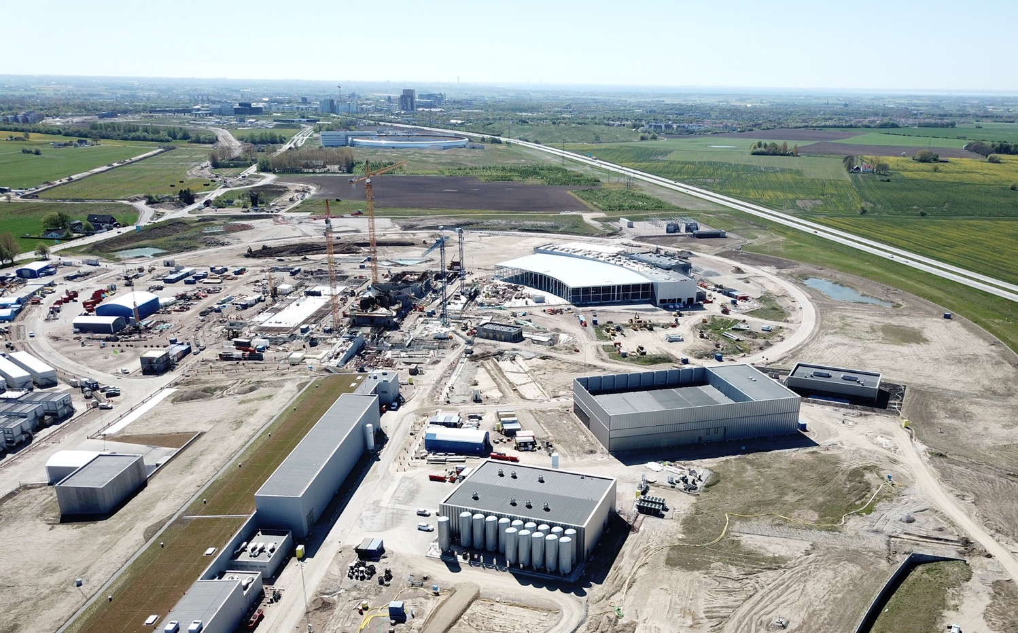


Slide 23
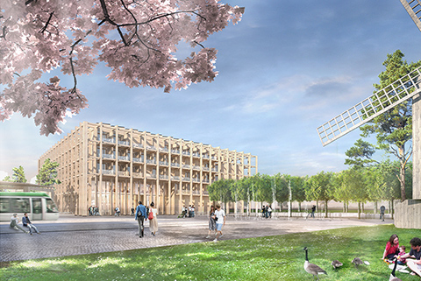
SPACE Building: Reception, exhibition space,
guest house for MAX IV and ESS (~100 rooms),
office and meeting space, restaurant
Modelled on the Harwell Campus
Swedish Government approval
August 2018
Tramway from Lund C station

Slide 24

Funding decisions in 2018
AFC.07
Budget Plan 19/20 (R)
Indicative Plan 21-25 (I)
Construction Budget 2019 (I)
Schedule Review
8 Feb
10-11 Apr
Focus on re-baselining
Will mostly impact indicative plan 21-25
Council.12
Workshop
Budget plan 19/20 (I)
Indicative plan 21-25 (I)
High-Level Document (D)
Sharing Policy (D)
22-24 May
Council.14
Constr. budget 2019 (A)
Init ops budget 2019 (A)
Indicative plan 2021-2025 (A)
Commitments from Members for 2021-2025
Commitments from Members to completion of construction
Council.13
4-5 June
Budget Plan 19/20 (A)
Indicative Plan 21-25 (I)
Commitments from Members for 2019/20
initial ops funding
AFC.08
Constr. budget 2019 (R)
Init ops budget 2019 (R)
Indicative planning 2021-2025 (R)
Political decision-making
High level meeting
Aug
30-31 Oct
3-4 Dec
11-14 Dec
Annual Review
Project review

Slide 25


