Slide 1
Update on Target Station
Accident Analysis
Per Nilsson
CFD Specialist
www.europeanspallationsource.se
9 October, 2018
Notes:
18/10 13.30 Update on Target Station Accident Analysis (AA) 45m Saturn
- Monolith pressure relief system requirements and design
- Dose calculation procedure for accident analyses

Slide 2
Outline
AA status
Monolith pressure relief
Dose calculations

Slide 3
Charge
Does the design philosophy and the methodology for dose calculations provide a solid basis for licensing of the Target Station?
We also ask the committee to advice on how to improve the efficiency of the procedure for dose calculations.

Slide 4
Summary in text to be read, not presented
The presentation covers two associated topics:
Design and analysis of the monolith pressure relief
Methodology for obtaining doses in the accident analyses
The monolith vessel is normally kept evacuated by pumps, but may be rapidly pressurised by large leaks from fluid systems. These pressurise in different ways and have different inventories. The wheel helium gives the fastest pressurisation but contains limited inventory. The cold moderator system has a similar capacity to pressurise, contains essentially no inventory, but hydrogen is explosive. The water systems cannot pressurise to relief, but contain significant inventory.
These capacities, together with requirements on thin neutron windows and a long distance to the outside, result in competing requirements on the relief line. The design pressure of the vessel and windows is 2 bar(g), which requires low pressure losses in the relief line. The closest path to the roof of the target building is about 45 m and there is very limited space around the monolith, preventing large dimensions, resulting in high losses.
The current design includes a rupture disc and an unfiltered direct release at the roof. This dynamic relief process has been simulated and it is concluded to be acceptable.
Is this sufficent and efficient or are there alternatives?
Each of the 22 target Accident Analyses (AAs) contain at least one, but most often several, calculated radiological doses. The AAs are currently under significant change to comply with authority requirements. Changes to parts of the analyses are expected to continue into operation.
The accident analysis and dose calculation procedure is composed of complicated and iterative parts, involving different competences. Initially, the inventories are calculated by specialist physicists, based on the design.
Now at a first stage, it has to be assumed that there is no functional safety system. The accident scenarios are found, developed and described, mainly by the engineers responsible for the design of the systems. Then the simplified descriptions of the flow of inventory are transferred from the engineers of the system to other specialist physicists. They calculate the dilution, decay, dispersion, exposure and finally the unmitigated doses. By these the engineers can assess whether safety functions are needed and what the requirements are on those, e.g. quality.
In the second stage, the same process is followed including the safety functions to confirm that the consequences, the mitigated doses, are acceptable compared to the objectives.
Both stages are wrapped up in the dose calculation and AA reports.
Is this sufficent and efficient or are there alternatives?

Slide 5
Accident Analyses
22 AAs released early 2017, with that SSM application
Changes since then:
- Review comments from SSM, e.g. tracability
- New release fractions from tungsten, due to TOAST
- Strictly deterministic process, assessing alternatives
- Operational group functions, e.g. MPS, may be used
- Different, separate framework for workers
- Minor decreases in dose calculations
Handful revised with next SSM application, only public
AA1, AA3, AA4, AA10, AA11, AA13 and AA14

Slide 6
Monolith Vessel
Pressure Relief

Slide 7
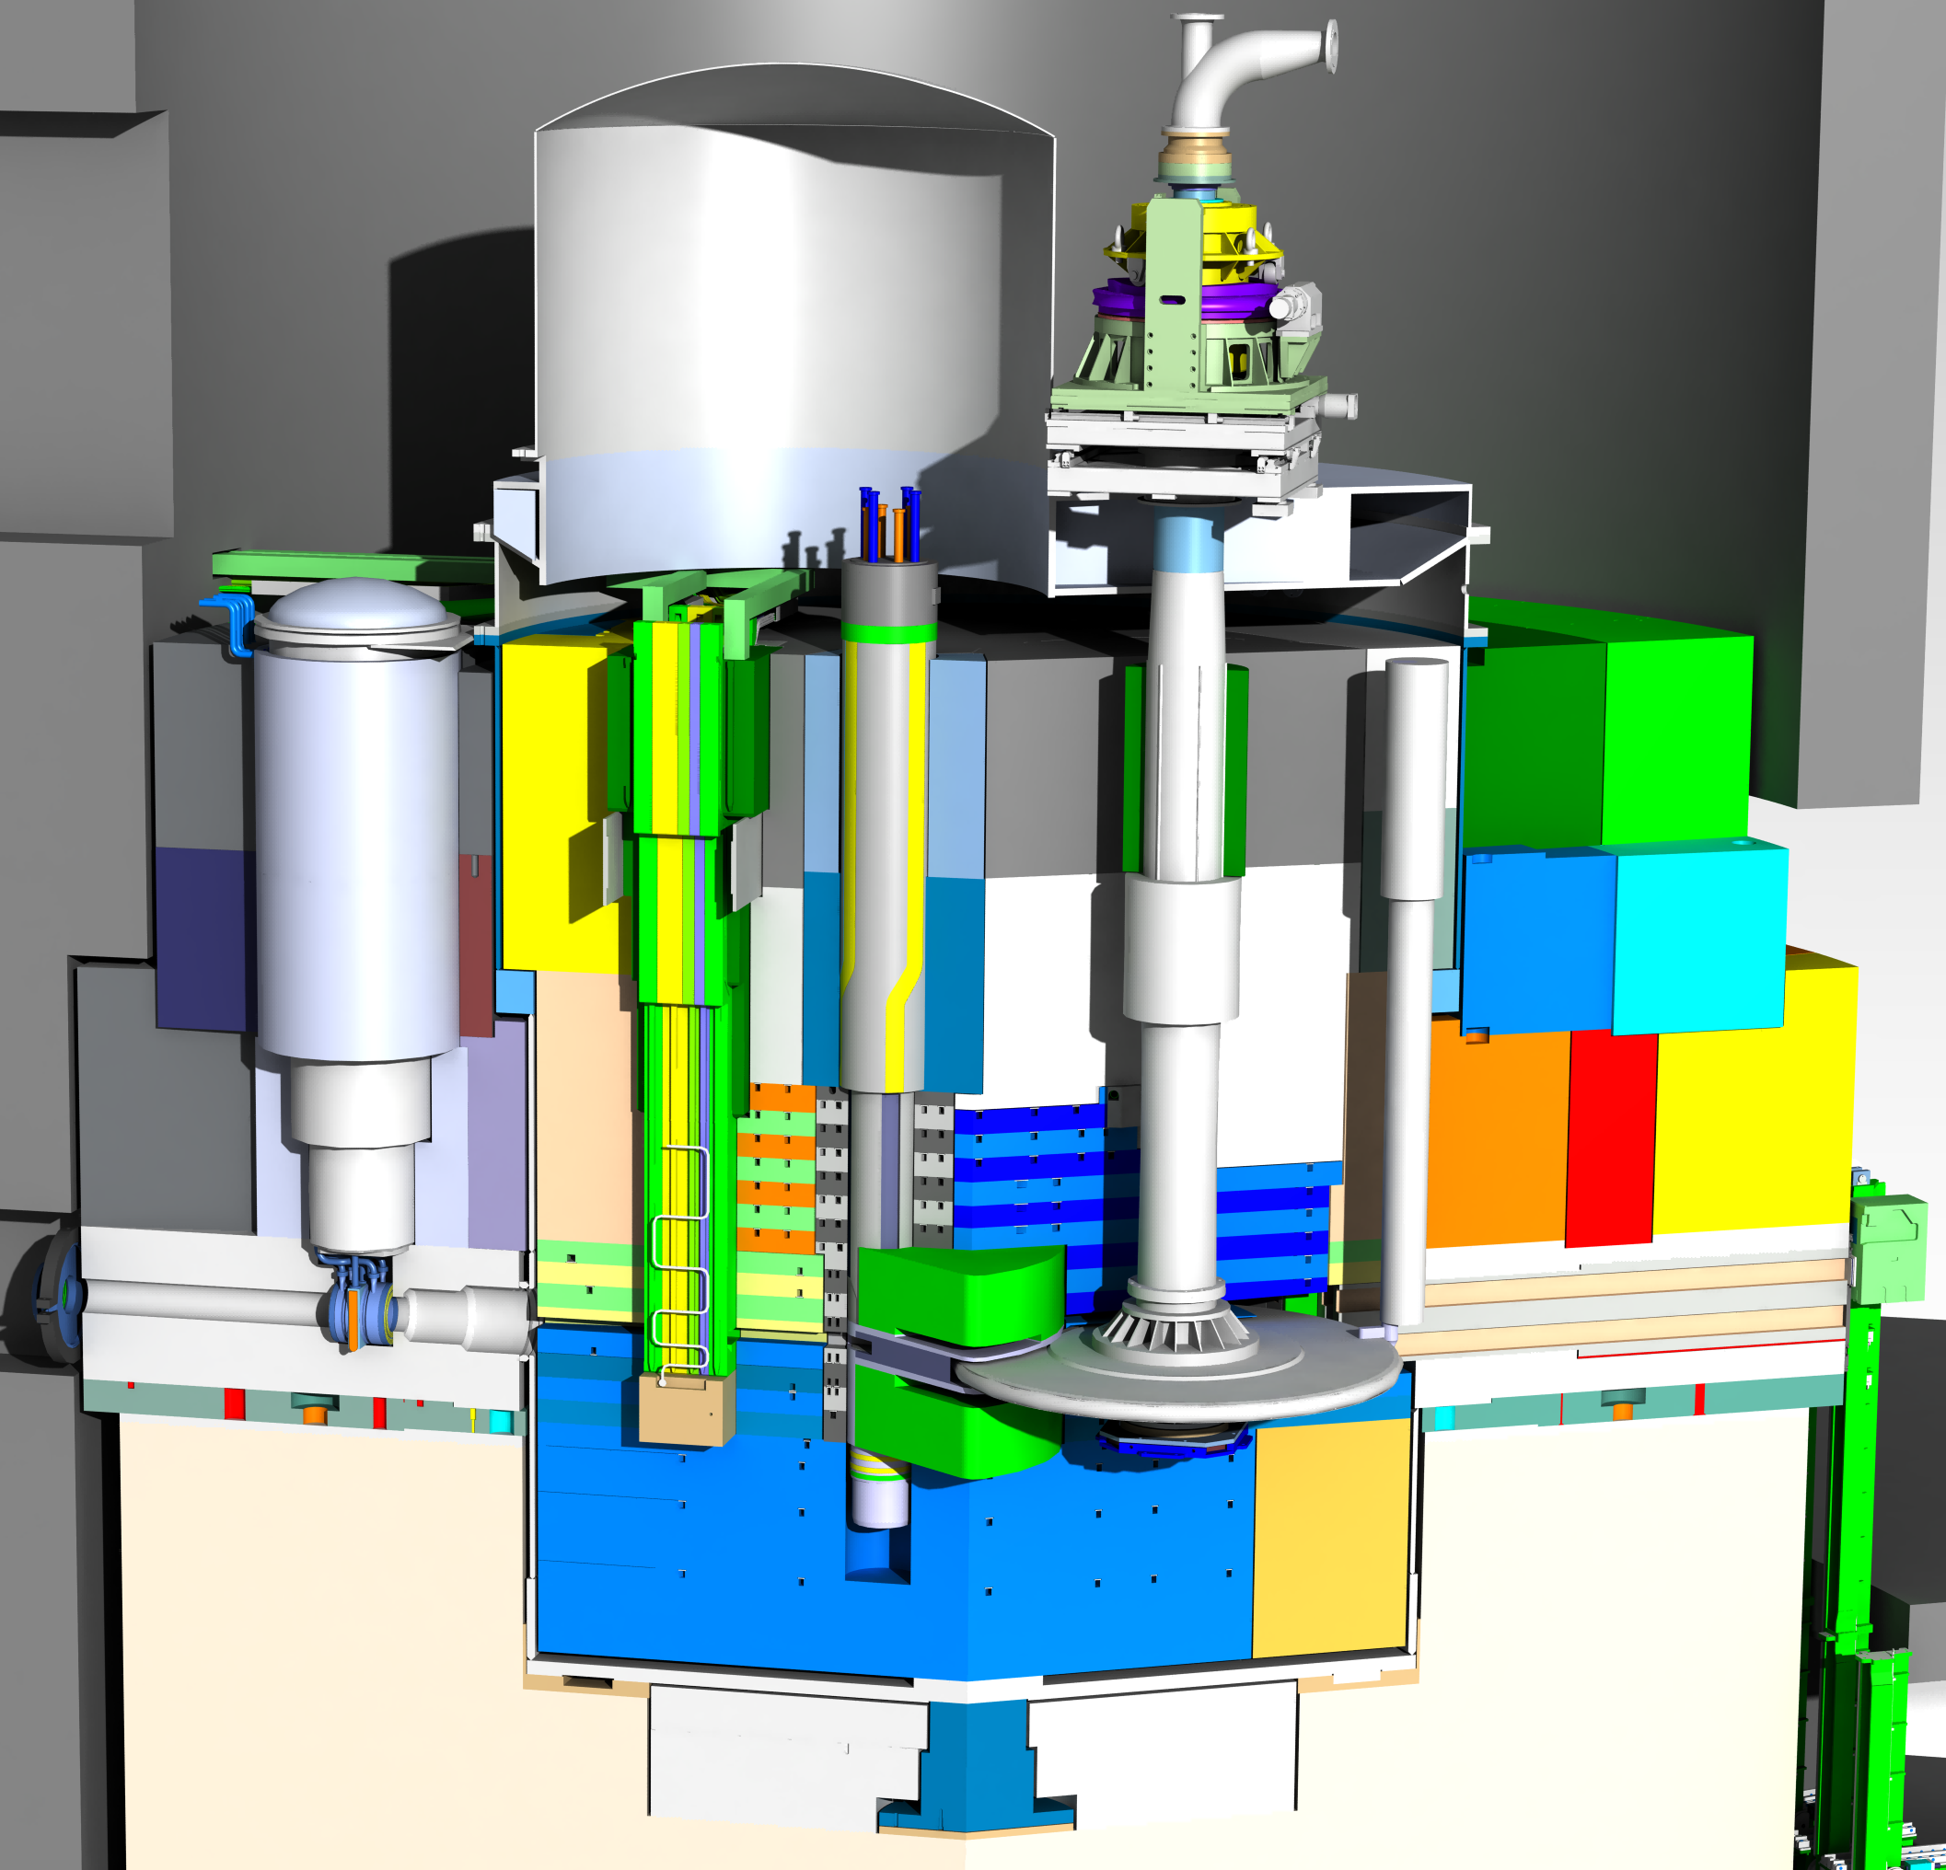
Accidents
AA1 Wheel stop
AA2 Bad beam
AA3 Lost cooling
AA4 Wheel leaks
AA9 Hydrogen leak
All can pressurize
monolith vessel
Released AAs:
Tightness required
for workers

Slide 8
Two problems
Rapid pressurization by
helium or hydrogen
Significant inventory in water slowly evaporating
Optimal but difficult:
Release the pressure then confine the inventory

Slide 9
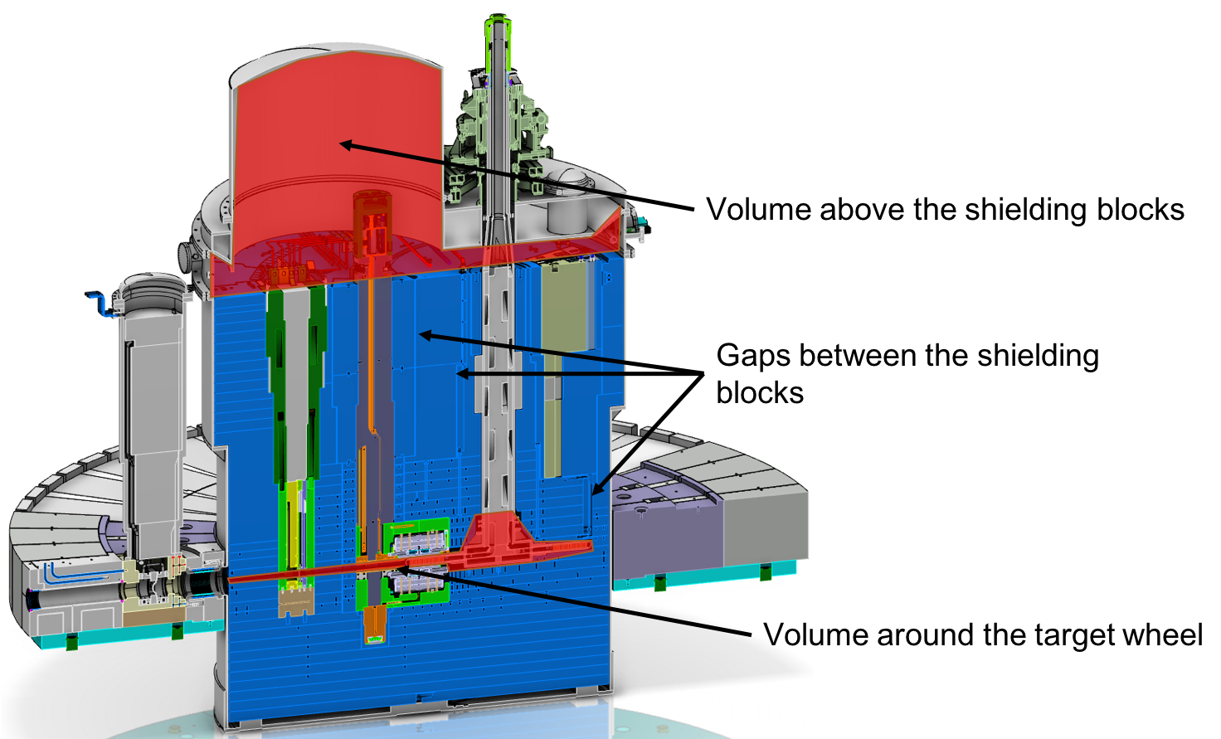
Void volumes in vessel
Relief in upper volume
Release in lower volume
->
Pressure difference

Slide 10
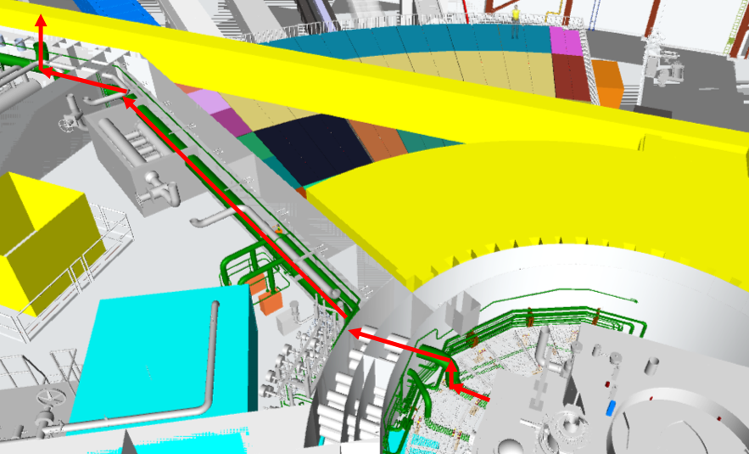
Relief line solution
5 m DN350
40 m DN500
Unfiltered
Target roof at 30 m
Rupture disc

Slide 11
Simplified model
Monolith vessel
5 m DN350
40 m DN500
Unfiltered
Target roof at 30 m
Flange
Upper volume
Shielding
Rupture disc to relief line
H2 in vacuum
Lower volume
NBW
PBW
Tungsten
in wheel helium
Wheel shaft and helium system
also modeled to get limited pressure

Slide 12
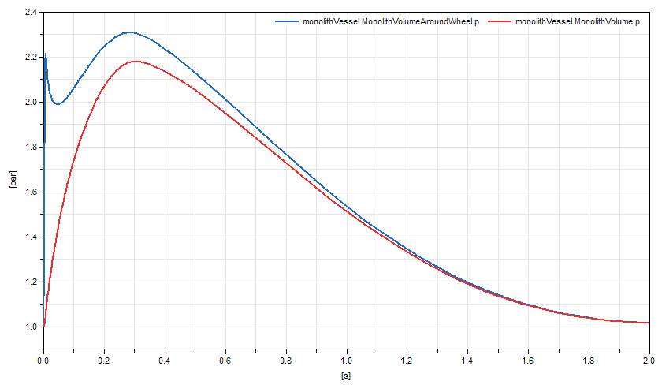
Modelica (by Emil Lundh)
Lower volume
Upper volume
Well below
2 bar(g) = 3 bar(a)
Model only handles one gas (chose helium)
Tricking by cold helium in relief line to mimick air

Slide 13
RELAP5 (by Pascal Veber)
Lower volume
Also well below
2 bar(g) = 3 bar(a)
Upper volume
Massflow about 25 kg/s
0.15 kg/m³ –> 170 m³/s

Slide 14
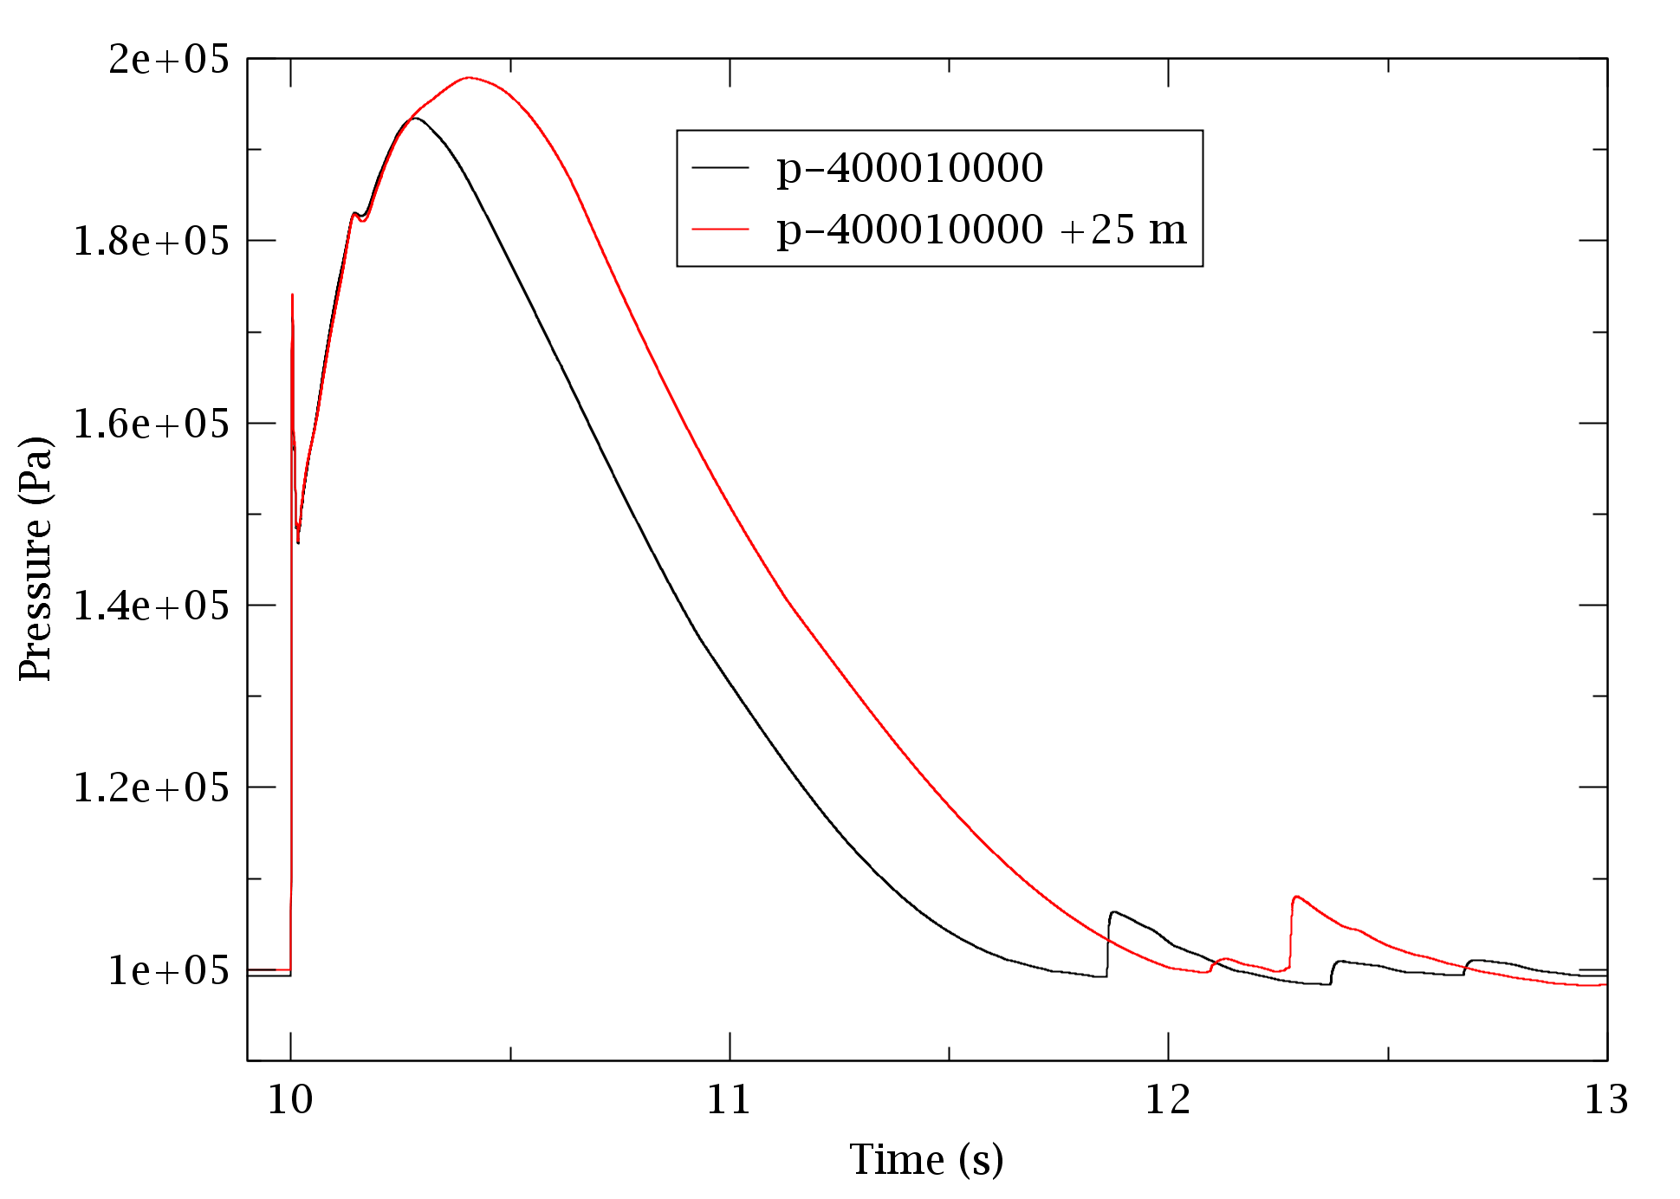
RELAP5 (patch 5)
Due to size of the relief line
it works like a large vessel
Therefore additional length
makes small difference
(lower volume)

Slide 15
Hydrogen release (by Hideki Tatsumoto)
Massflow about 1.4 kg/s
0.075 kg/m³ –> 19 m³/s
OK!

Slide 16
Solution alternatives
Issues:
What quality class
Is monitoring required
Separate relief line (current solution)
+ Low pressure losses
Direct to stack
- Higher pressure losses
+ More elevated release, via existing monitoring
Add filters or similar
- Higher pressure losses
+ Removes particles
Relief valve instead of rupture disc
- Active component
+ Releases pressure, then confines slow processes
Recommendations?

Slide 17
Dose calculation procedure for accident analyses

Slide 18
Dose calculation flow
Need and importance
of safety functions
Sufficiency
of safety functions
Show
safety case
Design
System & Operation
Calculate
Activation
Analyse
Accident
Unmitigated
Report
Accident
Analysis
Calculate Doses
Unmitigated
Analyse
Accident
Mitigated
Calculate Doses
Mitigated
System
Description
Inventory
Inventories
& Flows
Unmitigated
Accident
Analysis
Doses
Unmitigated
Inventories
& Flows
Mitigated
Doses
Mitigated

Slide 19
Analyse accident scenario - Unmitigated
Event initiation from hazard analysis
Probability
-> Event class & dose limits
Sequence, e.g. quantifying
- Heat load
- Oxidiser access
- Damage to MAR, e.g. tungsten
- Combustion
- Pressurisation and flow out

Slide 20
Analyse accident scenario - Unmitigated
Operational group functions, e.g.
MPS and pipe quality may be used
No safety functions, e.g.
TSS and ventilation may not be used
Requires multiple alternatives

Slide 21
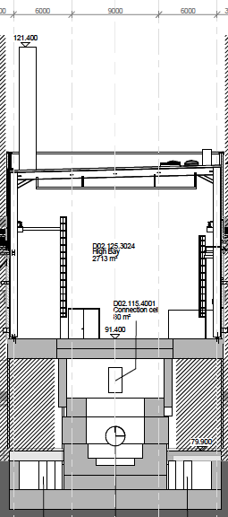
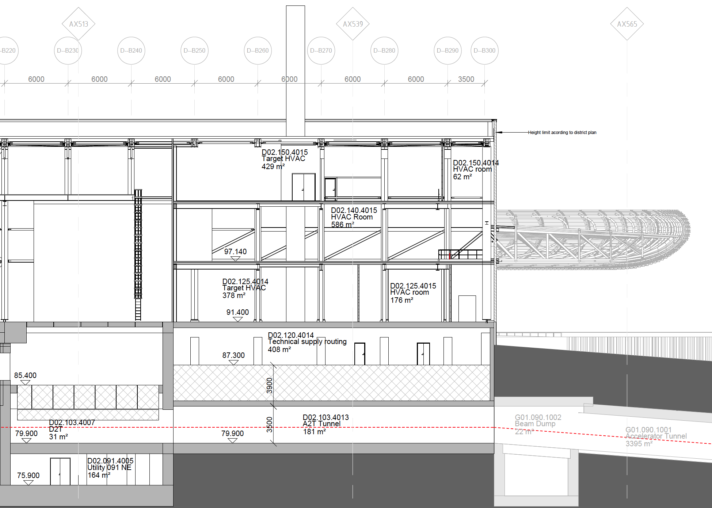
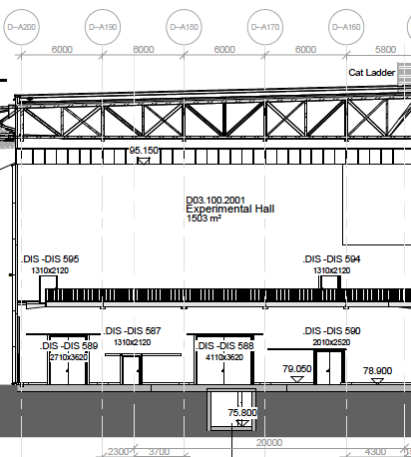
Multiple release paths investigated
Stack flow is more dispersed and diluted
Ventilation is faster than leaks
Large rooms dilute and delay more
Large rooms may have higher leak rate
Which is worse? -> Calculate multiple!
45 m
LP-102b
LP-101
LP-113
LP-104
30 m
f
f
f
LP-113
EXAMPLE LEAK PATHS
LP-102
20 m
LP-101b
10 m

Slide 22
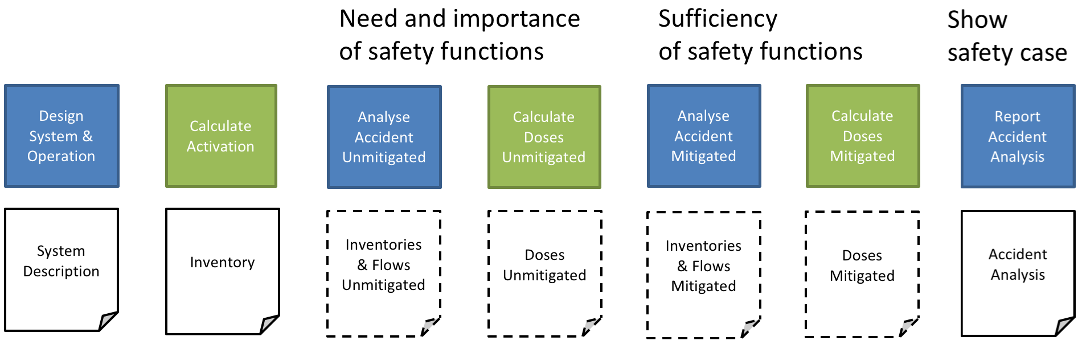


Transfer of flow description
Release | Affected | ARF | Release time | Inner volume | Volume flow | Emission height
Helium coolant | MAR*DR = 30 kg Target coolant | 1 | 100 s < t < 110 s | Monolith 4 m³ | Average 18 Nm³ /s for 10 s | 30 m
Filter particles | MAR*DR = 10 g Filter aerosols | 0.01 | 100 s < t < 110 s | Monolith 4 m³ | Average 18 Nm³ /s for 10 s | 30 m
Moderator water | MAR*DR = 400 kg Moderator Water | 0.46 | 100 s < t < 20000 s | Monolith 4 m³ | (in conversion to volume flow a density of 0.5 kg/m³ should be used) | 30 m
Tungsten target oxidation | MAR*DR = 54.7 kg Tungsten | Aerosols = 0.4 Volatiles = 0.4 Gases = 1 | 200 s < t < 1000s | Monolith 4 m³ |  | 30 m
Tungsten target diffusion | MAR*DR = 1100 kg Tungsten | Gases = 8.8*10⁻⁴ Hydrogen = 1 | 200 s < t < 1000s | Monolith 4 m³ | Following the same release rate as the tungsten | 30 m
Beryllium moderator melting | MAR*DR = 15.7 kg Beryllium | Aerosols = 0.01 Volatiles = 0.01 Gases = 1 | 200 s < t < 1000s | Monolith 4 m³ | Following the same release rate as tungsten | 30 m
Tungsten target explosion | MAR*DR*ARF = 54.7 kg tungsten | Aerosols = 0.003 Volatiles = 0.003 Gases = 0 | 5000 s | Monolith 4 m³ | Instantly, after 5000 seconds. | 30 m
EXAMPLE in AA3

Slide 23
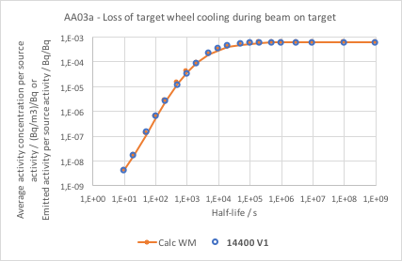
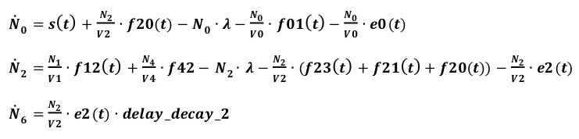

Transport and Decay
EXAMPLE in AA3
Each Line:
one source
one model
one system of ODEs
Solve
Fit to Weibull function each
${ae}_{i}=e^{(a−b∙e^{{−c∙(ln⁡(t_{1/2,i}))}^{d}})}$

Slide 24
Simpified volumes
V0
V2
V4
S
N0
N2
N4
N6

Slide 25
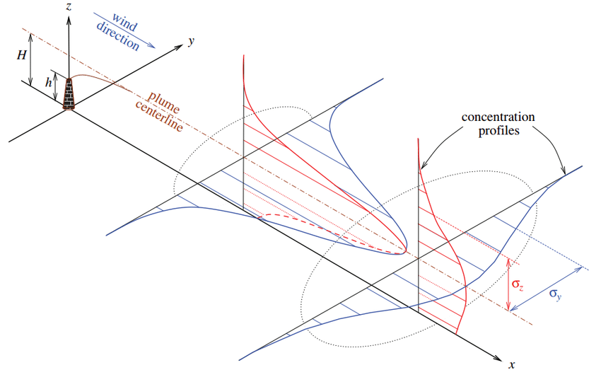
Spread calculations
Depends on e.g.
- Height
- Duration
Gaussian plume
Relative concentration

Slide 26
Exposure calculation
Different for the four exposures
Cloud shine
Inhalation (e.g. rate)
Ground shine (e.g. deposition)
Ingestion (e.g. deposition and consumptions)
All depend on location and duration

Slide 27
Dose calculation
All of the above
Dose coefficients, here based on isotope

Slide 28
n
Accident Analysis
Design and Operation
Release
Fractions
(per isotope)
Inventory
Flow
Release
heights
(10,20,30,45)
Weather metrics
50 % & 90 %
Exposure metrics
(inhalate, cloud, ground, ingest)
Transport
and Decay Calculations
Weather
Calculation
Deposition
and Exposure
Calculation
Average activity concentration
Relative
Concentration
Exposure
Concentration
Dose Coefficents
(per isotope)
Calculation Inventories
Calculation
Inner Source
Calculation
Outer Source
Dose
Calculation
Methods:
Leif Spanier
Inventory
Inner
Source Term
Outer
Source Term
Dose

Slide 29
Time consuming process
For 1 well defined dose
it takes of the order of a day to calculate
sources, transport, (weather, exposure) and dose
Several files are generated, MathCad, Excel
Reports and reviews add on
Changes, iterations and errors multiply the times it is needed
(22 AAs are done in the first round, but all are revised)
In the order of 100 dose calculations needed
(22 AAs, several sources, alternative scenarios etc.)
Notes:
1 target line review
3 ESH reviewers

Slide 30
Changes repeated
Review comments from SSM, e.g. Tracability
New release fractions from tungsten, due to TOAST
Strictly deterministic process, assessing alternatives
Operational group functions, e.g. MPS, may be used
Different, separate framework for workers
Minor decreases in dose calculations

Slide 31
Strict alternative
Need and importance
of safety functions
Sufficiency
of safety functions
Show
safety case
Design
System & Operation
Calculate
Activation
Analyse
Accident
Unmitigated
Calculate Doses
Unmitigated
Analyse
Accident
Mitigated
Calculate Doses
Mitigated
Report
Accident
Analysis
System
Description
Inventory
Inventories
& Flows
Unmitigated
Doses
Unmitigated
Inventories
& Flows
Mitigated
Doses
Mitigated
Accident
Analysis
Several reports

Slide 32

Software alternative
Need and importance
of safety functions
Sufficiency
of safety functions
Show
safety case
Design
System & Operation
Calculate
Activation
Analyse
Accident
Unmitigated
Calculate Doses
Unmitigated
Analyse
Accident
Mitigated
Calculate Doses
Mitigated
Report
Accident
Analysis
System
Description
Inventory
Inventories
& Flows
Unmitigated
Doses
Unmitigated
Inventories
& Flows
Mitigated
Doses
Mitigated
Accident
Analysis
Develop dose calculation software
Expert
Review
worst dose

Slide 33
Simplifications?
Doses tabulated in some manner?

Slide 34
Does the design philosophy and the methodology for dose calculations provide a solid basis for licensing of the Target Station?
We also ask the committee to advice on how to improve the efficiency of the procedure for dose calculations.
Charge repeated

