Slide 1
Biasing of SRF Couplers at ESS
Paolo Pierini
Superconducting RF Section, Linac Group, AD
WP19 “SRF”
aTAC Session @ TAC#18
www.europeanspallationsource.se
18 October 2018

Slide 2
Outline
Need for bias
Experience and status of the elliptical FPC at CEA
Experience and status of the spoke FPC at IPNO
Implementation in the ESS linac and options
(all technical material provided by WP4/5 IK)

Slide 3
CEA Analysis of the FPC need for Bias
From P. Bosland
The FPC will be processed at high RF power before being mounted on the cavities
  The main goal (…) is to clean the inner surface of the coupler in safe condition and to suppress any dangerous electronic or glow discharge “activities” that may break the coupler when RF power is applied
  During the life of the FPC in the LINAC, progressive or sudden degradation of the power coupler may occur. One of the possible causes of degradation are the multipactor barriers
A bias voltage on the antenna allows to change the resonant conditions of the multipactor barrier to suppress it. This solution can be applied when a coupler starts to be limited by multipacting
  Operational aspect

Slide 4
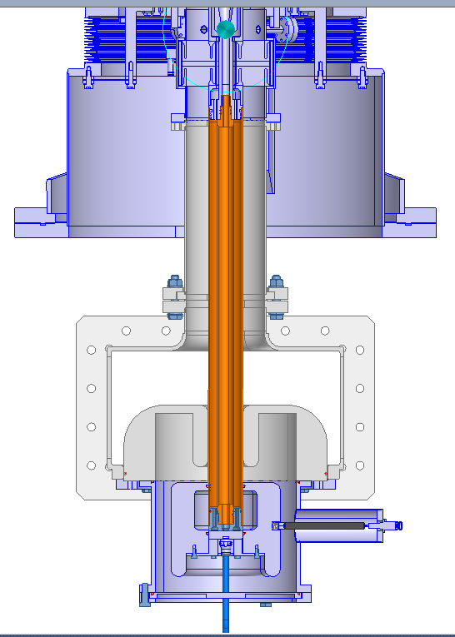
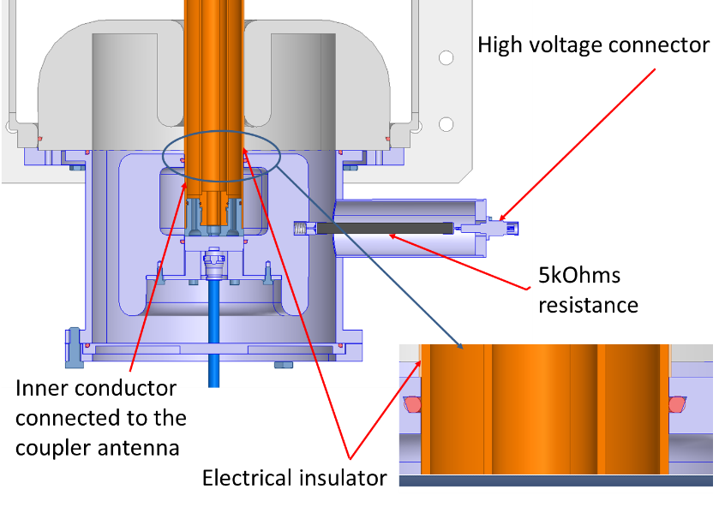
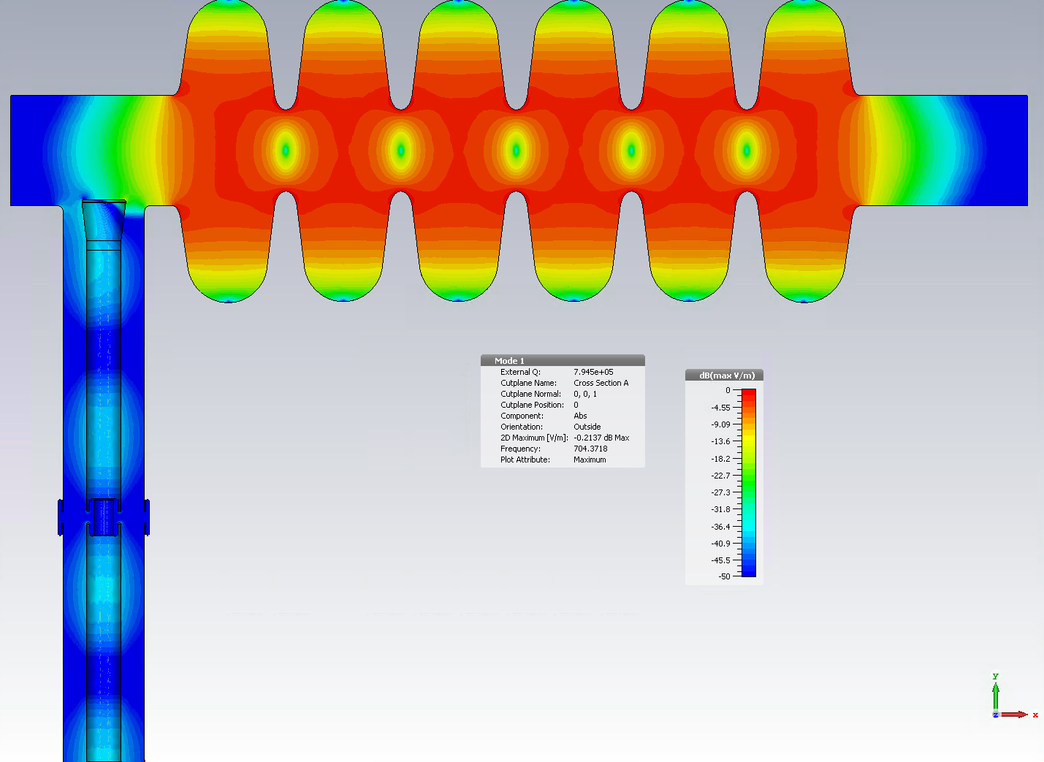
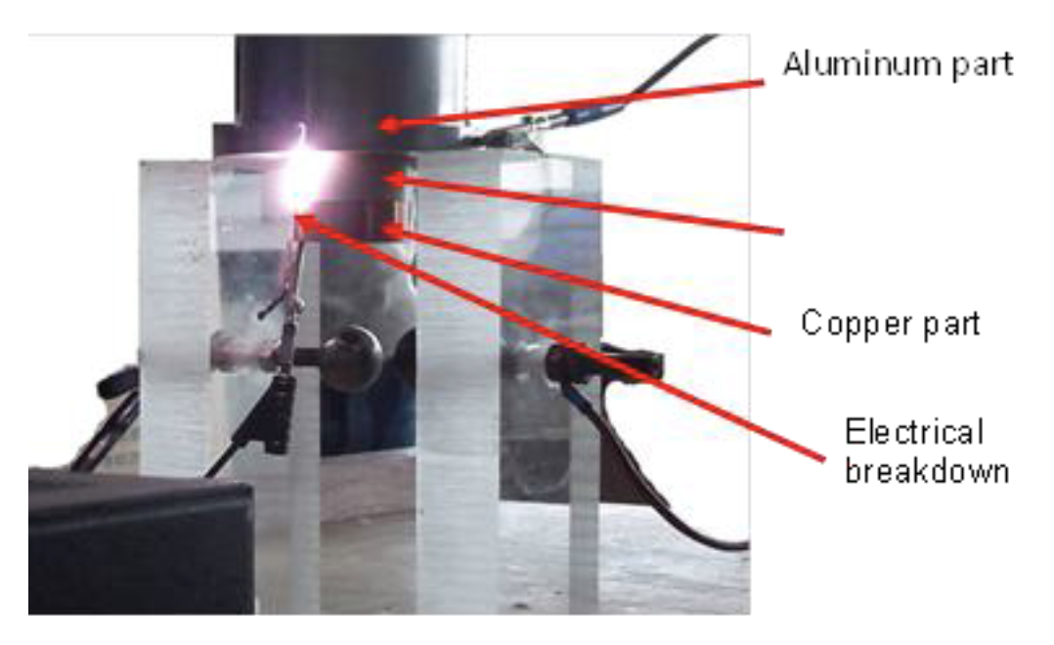
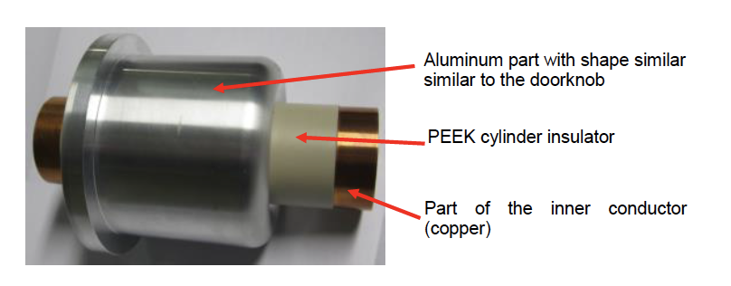
Current Elliptical Coupler Design
From P. Bosland
Bias capable
Bias insulation qualified during prototyping phase
From S. Pirani
From C. Arcambal, CDR-1 MB Cryomodule, April 2017

Slide 5
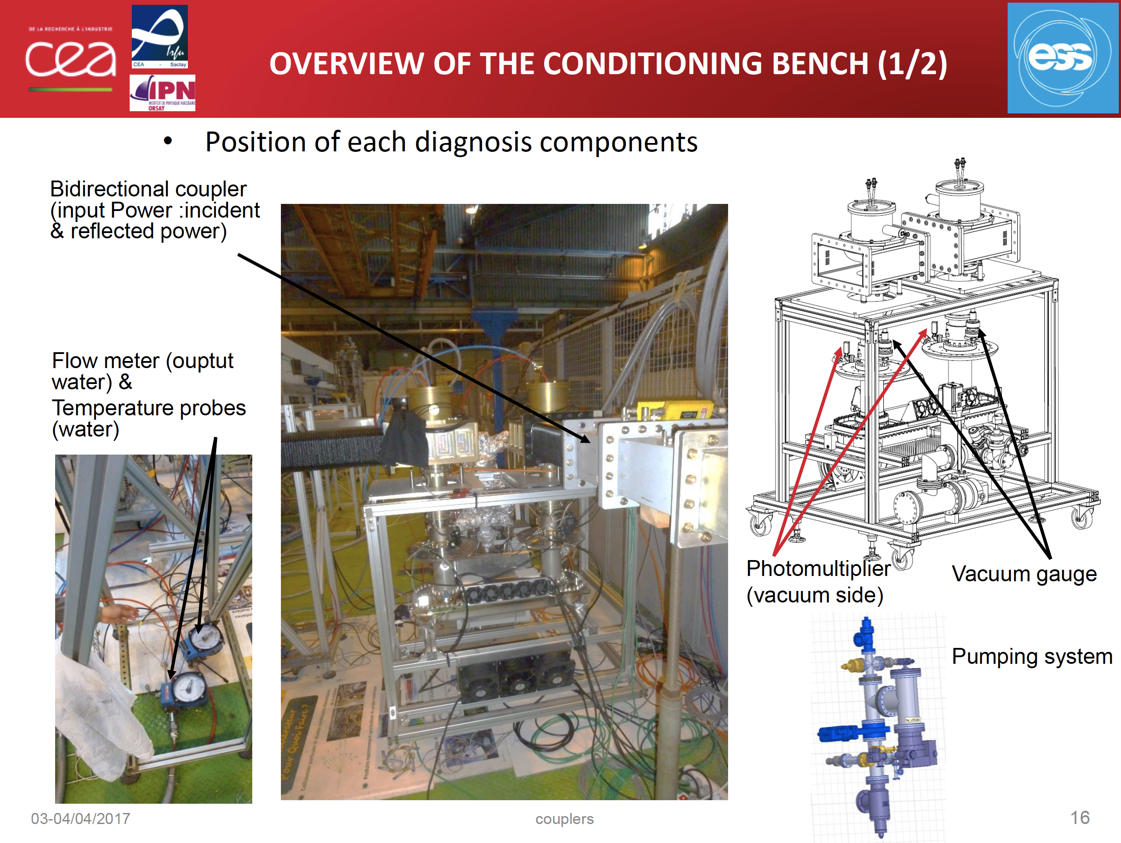
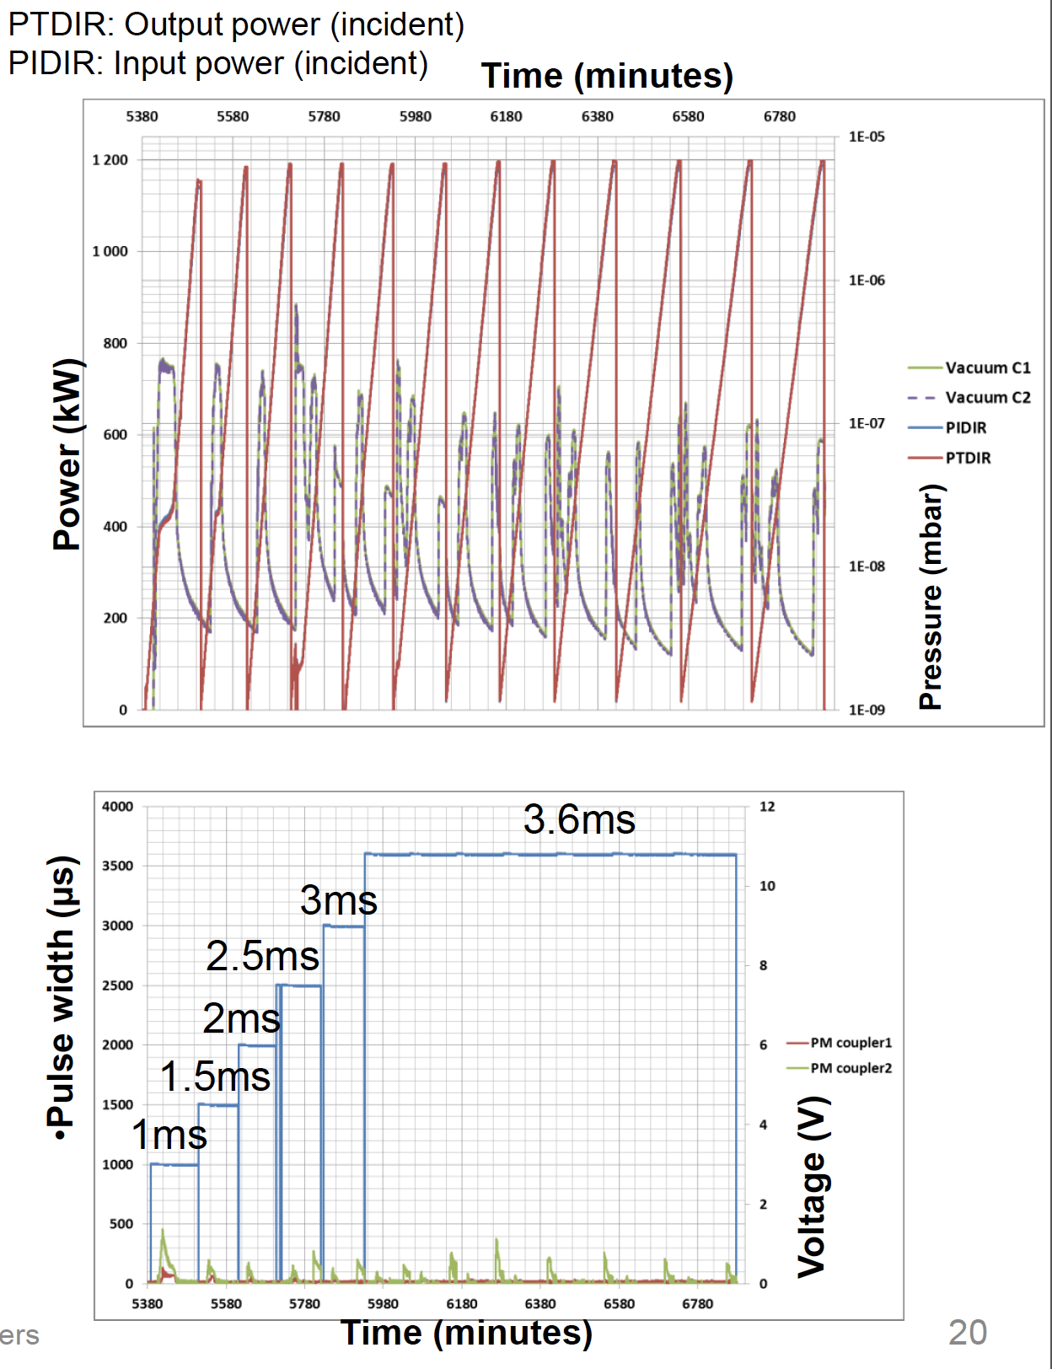
Processing before operation
At coupler test stand (CEA)
  TW: Full power (1.2 MW)
  SW: Full power < 0.5 ms,
  then 300 kW
    two positions of the shortcircuit
Portion of the typical
conditioning sequence,
sweeping power, increasing
pulse length and duty cycle
From C. Arcambal, CDR-1 MB Cryomodule, April 2017
At modules, TS/Linac (CEA/ESS)
  Warm conditioning
  Cold conditioning
    (off-resonance and then tuned)
(…)
(…)

Slide 6
Coupler processing choices
Both CEA and IPNO currently do not foresee the use of bias at the coupler test stands and during module testing in the test stands at CEA and UU, although it could be arranged
AT TS2 in Lund WP17 will provide bias capabilities
We all agree on this on the ground that conditioning without a bias system allows a better “cleaning” of the RF surfaces out of the initial testing phases
However, bias would provide the flexibility to cope with some degree of contamination and long recondition times during the long operation lifetime foreseen by the facility
  To which extent we factor in this consideration?

Slide 7
Processing experience at CEA
At coupler test stand (no use of bias voltage)
  5 pairs of prototype couplers, 3 pairs of pre-series couplers
    15 conditioned within 60-100 h of conditioning time (<1 wk)
    One showed vacuum activity higher than specs (improper cleanliness?, under investigation with vendor, keeps series on hold)
At M-ECCTD (no bias)
  Warm conditioning was performed in 3 out of 4 of the couplers, and processed in 4 h (230 min)
    Last cavity processed this week
  Cold conditioning uneventful (go through sequence)
At Uppsala, HB (no bias)
  Warm conditioning was performed in 20 h
  Cold conditioning 10 h

Slide 8
Bias system specification from CEA
From P. Bosland
The provisional specifications from CEA are summarized here
  Maximum voltage: 10kV
  Maximum current: lower than 20mA
  Voltage regulation when I<20mA. No voltage regulation for I=20mA.
  Low accuracy of the voltage regulation needed (TBC)
  Fully reversible supply
The voltage of 10kV for the supply has been defined by the voltage of the RF power occurring in the 50 Ohm power coupler at ~1MW
The maximum current of 20mA is defined by:
  the maximum current of the protecting resistance of 5kOhms installed in the electrical circuit (margin has been taken into account)
  Suppression of any risk of glow discharge occurring in the power coupler that may damage it
The final maximum current value of the electrical supply can be lower or equal to 20mA

Slide 9
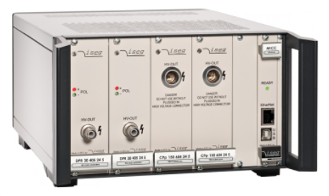
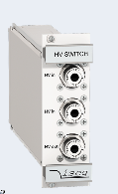
Integrated into interface requirements
The bias requests have been captured by the following interface requirements:
User Defined ID | DOORS-ID | Name | Description | Clarification | Traced Up To | Verify Method | Interface Side A | Interface Side B | Units | Min. | Nom. | Max.
CRM-EMR-PWRC-010 |  | EMR-PWRC - physical interface between power coupler and HV bias supply | The physical interface between power coupler and HV bias supply shall be a TBD for SPK / Radiall R317 405 000 (elliptical) connector on the coupler side | connector has to withstand a potential of 10kV and radiation environment. Connector Radiall R317 005 000 is the counterpart for the connector on the coupler. |  | Inspection | SPK. EMR MBL.EMR HBL.EMR | SPK.PWRC MBL.PWRC HBL.PWRC
CRM-EMR-PWRC-020 |  | EMR-PWRC - HV bias supply maximum voltage | The HV bias voltage shall be up to 10 kV | Voltage has to be adjustable to be optimised for each coupler, grounding of supply has to be identical with the cryomodule |  | Measurement | SPK. EMR MBL.EMR HBL.EMR | SPK.PWRC MBL.PWRC HBL.PWRC | kV |  |  | 10.00000
CRM-EMR-PWRC-030 |  | EMR-PWRC - HV bias supply polarity | The HV bias supply shall allow to reverse the polarity. |  |  | Measurement | SPK. EMR MBL.EMR HBL.EMR | SPK.PWRC MBL.PWRC HBL.PWRC
CRM-EMR-PWRC-040 |  | EMR-PWRC - HV bias supply maximum current | The HV bias supply shall provide a current of up to 3 mA. | A current 20% higher may be tolerable before voltage breakdown |  | Measurement | SPK. EMR MBL.EMR HBL.EMR | SPK.PWRC MBL.PWRC HBL.PWRC |  |  |  | 3.00000
CRM-EMR-PWRC-050 |  | EMR-PWRC - HV bias supply connection to interlock | The HV bias supply shall provide an interlock output. | Connection to this output TBD (probably RF) |  | Inspection | SPK. EMR MBL.EMR HBL.EMR | SPK.PWRC MBL.PWRC HBL.PWRC
These have been used to procure the system for the TS2 at ESS (4 PS, COTS)
  Fully bipolar solution, 10 kV
  6 mA
  Integrated in EPICS
From P. Torri, WP17
2 x ECH 12A 10 slots 3U crate with(on each crate):
- MICC Local Controller;
2 x +10 kV 6 mA PS (EPS model);
2 x -10 kV 6 mA PS (EPS model) and
2 x HV Switch

Slide 10
Proposal for the linac/Elliptical
Instruction for routing HV cables through the stubs for all couplers in the linac have been provided in the cable database
  Do this now. We might need bias capabilities at all cavities at a later stage, mitigate cable installation delays
A “reduced” set of HVPS (up to 30% of the SC cavities) is in WP17 budget (~300 kE for all linac)
  Estimated lead time for procurement is 8 wks
  We may defer most (or all) the PS to a later stage, during operation, while keeping the cable installation
    Foreseen de-scope impact only a fraction of the above

Slide 11
Status of bias for spoke coupler
Four unbiased doorknob components have been procured and tested at IPNO/UU
  Two are required at coupler test stand in IPNO
  Two are available for module testing at UU
  Series procurement for this design could start now
A preliminary design of a bias-capable doorknob exist and two prototypes are being procured
  ”plug compatible”, same interfaces at module and RFDS
  Derived from the CEA elliptical design, but not yet validated
  Procurement ongoing, test expected in February 2019
  If all well components in-house by end of 2019
Using same requirements for HV PS than elliptical
  Power level substantially smaller/Geometry different

Slide 12
Processing experience for spokes
Less operational experience with
respect to elliptical components
At IPNO coupler test stand (no bias)
  2 pairs prototype an 1 pair pre-series
    Pre-series conditioned in ~ 16 h
At Uppsala in HNOSS with prototype cavity (no bias)
  Warm conditioning was performed in 30 h (SW, 120 kW)
  Cold conditioning 14 h (then spoke MP conditioning 30 h)
Series component under procurement
  Split into antenna&window/double wall tube/doorknob at different vendors
  4 series coupler components expected before end of 2018 (antennas and DW pipes)

Slide 13
Doorknob components
These are not ordered yet
  4 unbias prototypes exist
Series module testing at UU ~ April 2019-June 2020
  Cfr. Ciprian: CM1 9wks, CM2-3 6wks, CM4-13 4 wks
  6 wk test plan will push testing to end of 2020
  Bias validation foreseen February 2019
  Prototypes have 14 wks expected delivery
Will not have bias version in time for the UU testing
  Acceptance tests performed with a single set of two unbias prototypes
  Module provided to UU without individual DK pairs
  Bias DKs assembled during installation at ESS, HP testing at IPNO

Slide 14
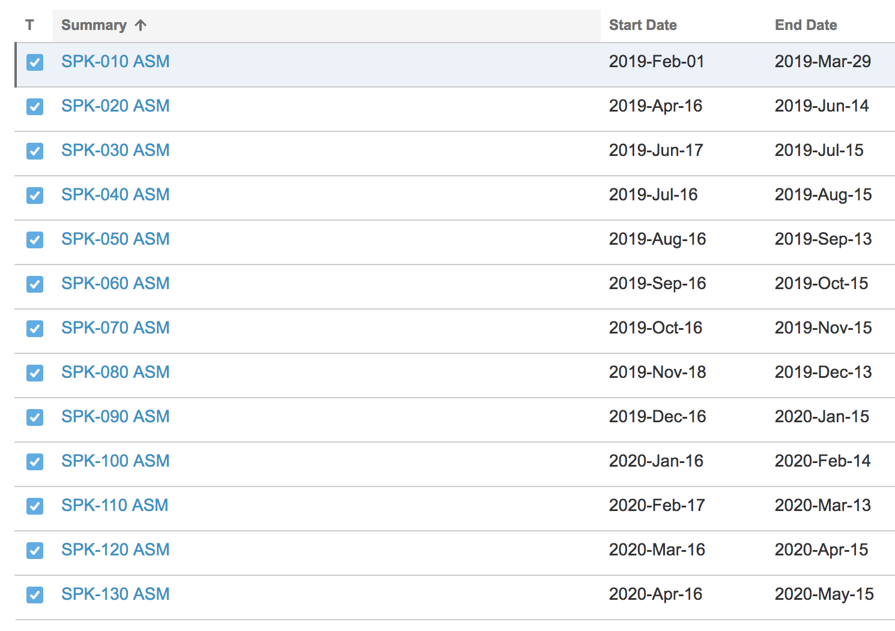
Options for Spoke test/installation plan
Criticity
  Bias design not validated: cannot go
  to procurement of series now
  Lack of “spare components” for
  the test stand operations (IPNO / UU)
Options (10/20 kE DK wo/w bias) :
  Wait for qualification to install all bias DK in tunnel and buy few unbias spares to cope with accidents/problems
  Procure now unbiased DK for all couplers, use them for testing modules and be prepared to install them in tunnel if qualification takes longer and DK enter the CP for installation
    If bias needed later, labor intensive DK exchange in the tunnel
  Do both, most expensive, or a mix of the approaches
Spokes
Assembly
schedule

Slide 15
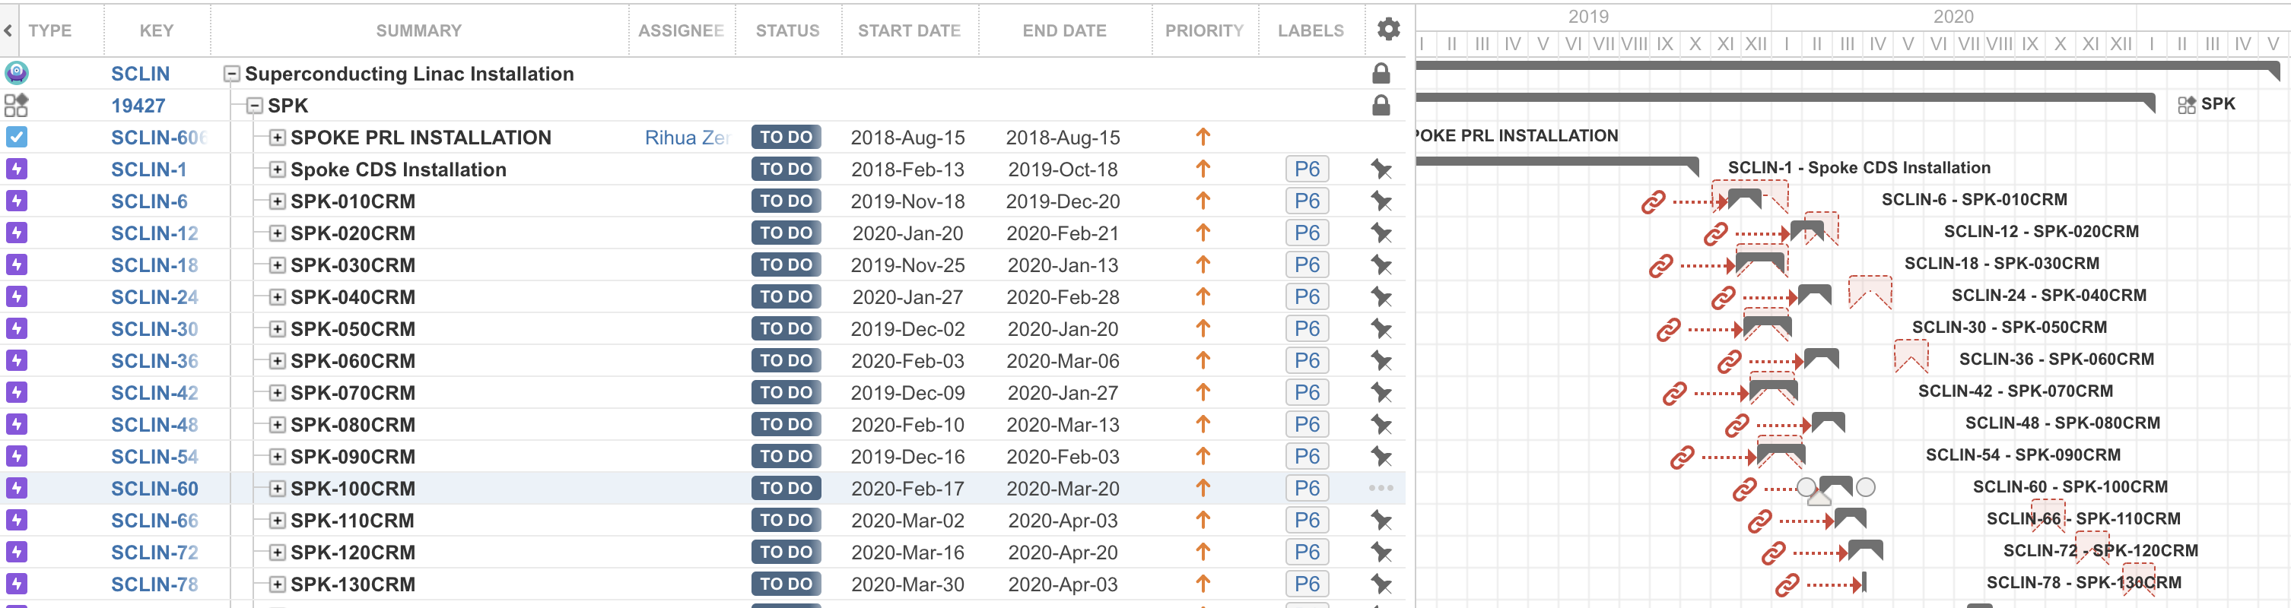
Present installation plan
Late receival of bias capable DKs looks still (~) compatible with module installation schedule in tunnel (cfr. Ciprian talk, RFI June 2019-July 2020)
  Start installations end 2019, after CDS ready
  Qualification/Fabrication delays will drive DK to CP
  Install ”fresh” components without power “soaking”?
    NO: RF conditioning of DKs at IPNO test stand before ship to ESS
2020
test uncertainty

Slide 16
Summary of proposals
For Elliptical
  Install HV cables through stubs at all couplers
  Test functionality of bias at TS2
  Defer installation of PS to operation
Spokes DK
  Install HV cables through stubs at all couplers
  Test functionality at UU as soon as prototype are qualified
  Defer installation of PS to operation
  Fix the strategy for spoke DK
    Procure few (4-6) extra unbiased DK for the testing phase and prepare and keep on hold procurement for full set of 26
    Monitor bias version development at IPNO and release fabrication once validated, with the aim to install all 26 in the tunnel
      But may require additional development time and to resort to procurement of unbiased version to avoid CP for installation

Slide 17
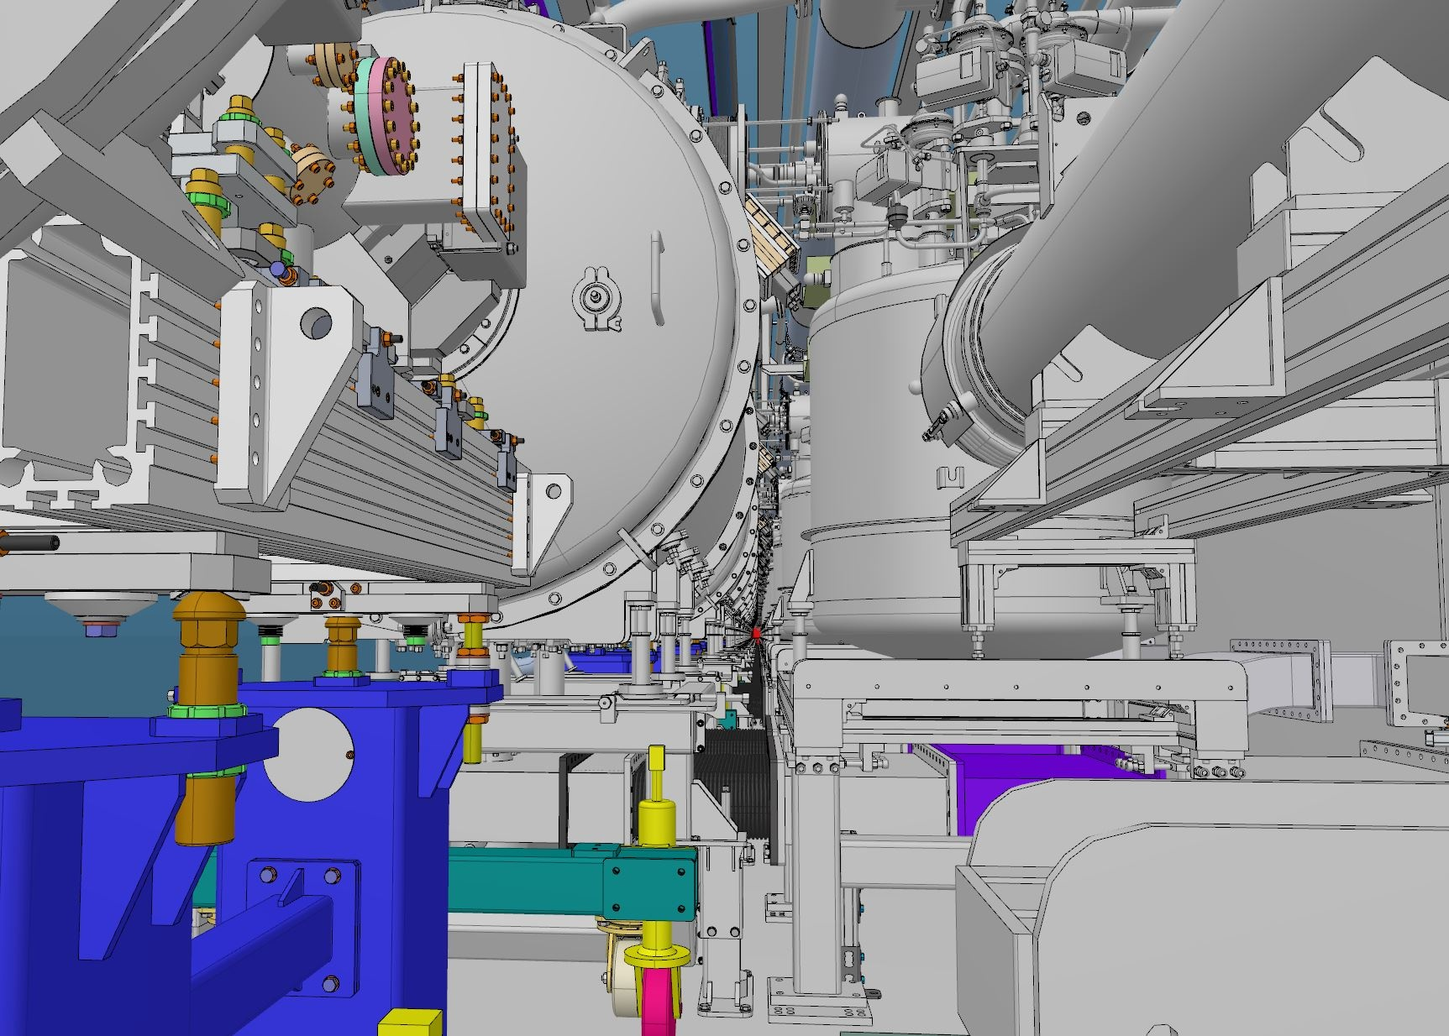
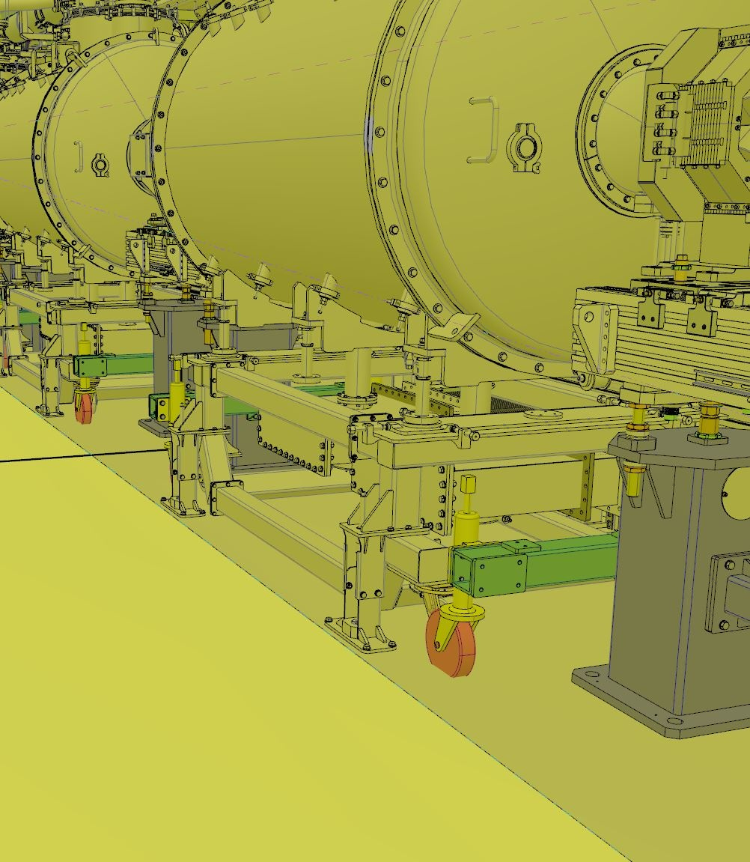
Exchange DK components later?
Extremely confined space, access from VB side challenging
  Would be safer to avoid DK assembly phases in tunnel

Slide 18
Comments, suggestions?
Thanks!

