Slide 1
Licensing update
TAC 18 October 2018
Johan Waldeck
Senior Engineer / Licensing project manager
www.europeanspallationsource.se
18 October, 2018
Notes:
Compliance to national law and European directives
Regulated by SSM as a Complex facility
Licensing activities a complex project in it self

Slide 2
Outline
About SSM Licensing
Status
Work ahead

Slide 3

Licensing overview
Detailed design
Procurement and Installation
Commissioning
Operation
Preliminary Design
ESS project phases
Permissibility
Permit
Installation
Permit
Trial operation
Permit
Routine operation
Permit
SSM stepwise licensing process

Slide 4
High level trial operation plan
The three stage approach for trial operation
ESS wide planning determine submission dates for trial operation permits
Warm LINAC
Trial operation permit
Full LINAC
Trial operation permit
Neutron production
Trial operation permit

Slide 5
Licensing Project Goals
Licensing plan to support execution of ESS project schedule
Adequate quality of submission, minimising delays in approval process
  We can not afford significant requests for complementary information without delaying the start of RFQ commissioning

Slide 6
Progress since April
Updated dimensioning scenario for Emergency Preparedness submitted to SSM in early April
  New scenario triggered by new experimental data on air born release fraction
Decision by SSM 25 April
  ESS is Category 2 (NPPs Cat 1)
  No serious deterministic effects outside the facility
  Allows construction start of Science village
SSM decision 7 May on information security for safety critical I&C software development

Slide 7
Progress since April continued
Land and Environmental Court decision 19 June
  Final judgement of the court. Probationary period ended and preliminary conditions lifted (prohibition to start accelerator)
  SSM is now the sole regulator for radiation safety
SSM decisions 20 June
  Permit for trial operation of Ion Source
  Permit to hold and use calibration sources
SSM observers at SRR1 17-18 July
  Follow-up surveillance visit 30 August

Slide 8
SSM interactions
Preview of revised conditions
  Physical Security
  Emergency preparedness
Training, safety culture and Management system
Agreement on principles to handle workers safety
Planning meetings
ESS-SSM Management meeting
Agreement on how to change and extend current test stands
Study visits by
  SSM Research Council
  SSM management team
  DGs of Nordic Radiation Safety Authorities

Slide 9
Interactions with ESS management
Beyond weekly licensing project team meetings
Close dialogue with ESS project manager and ESS installation project manager
Weekly updates at ETB by Licensing Project manager
Regular updates to EMT by Ass. Director
Key licensing milestones in P6 plan for each construction project
Explicit support and prioritization by EMT and ETB

Slide 10
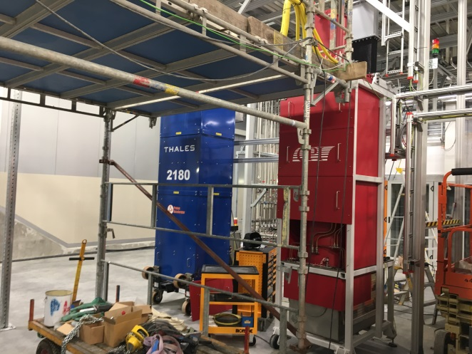
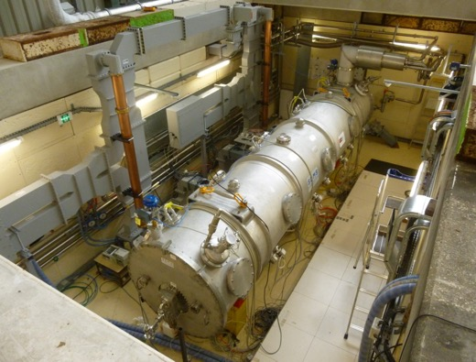
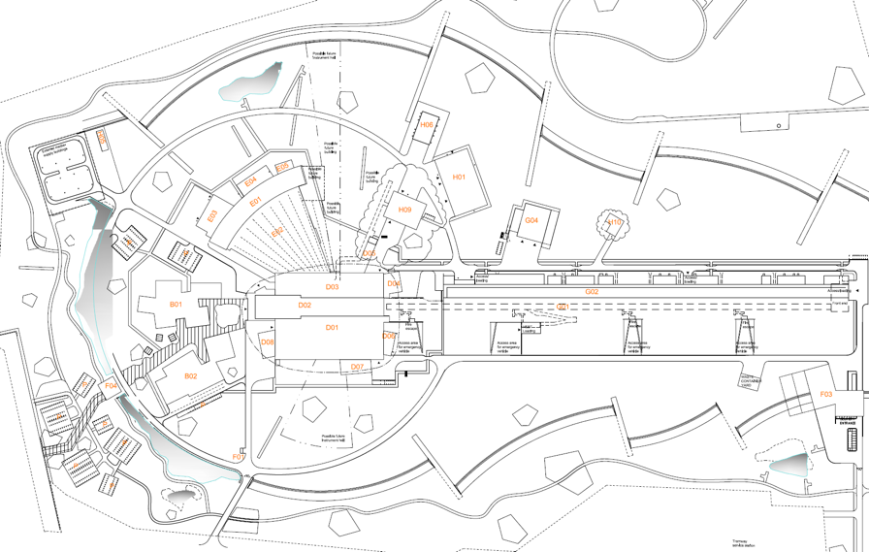
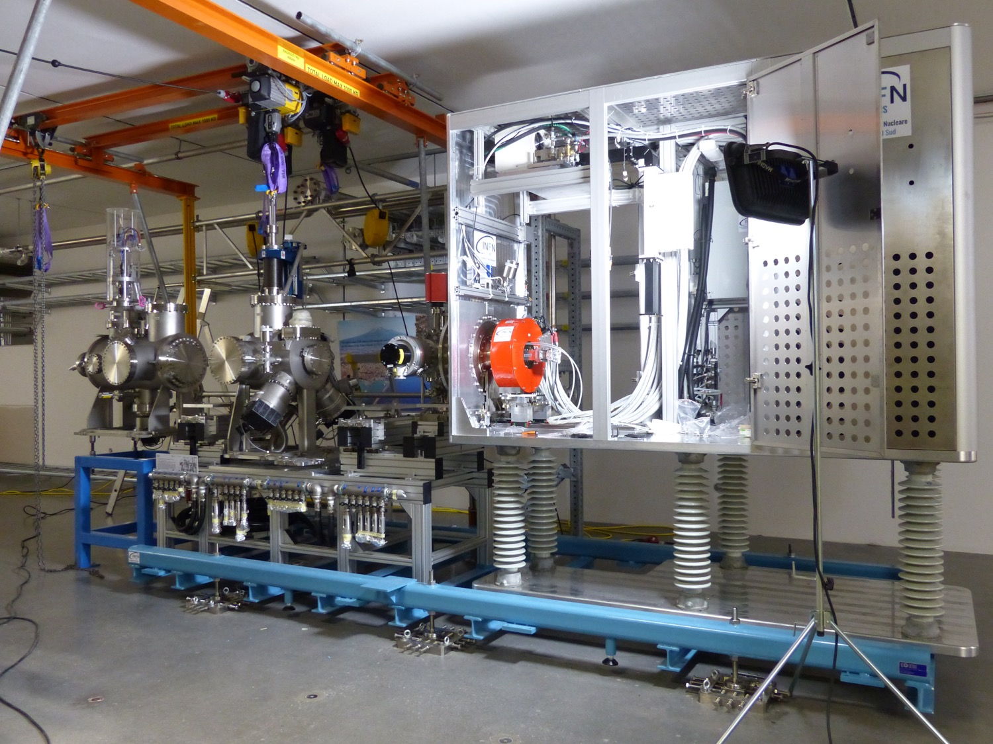
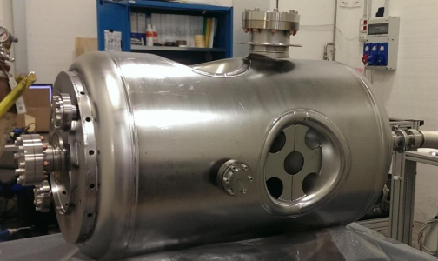
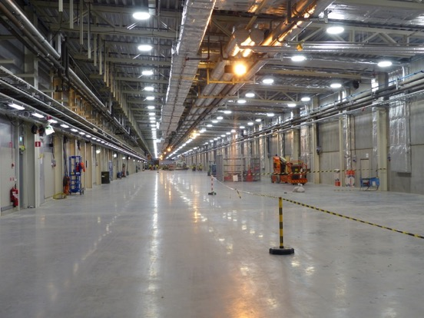
Changes and Extensions of Test Stand permits staged approach according to project needs keeps licensing off critical path
Test Stand 2 Change
RF SC Cavity test
Notification November 2018
Planned operation
Feb 2019
Test Stand 2
RF Klystron test
Permit June 2017
Operation started 13 Sept 2018
Ion Source
Permit 20 June 2018
Safety Readiness Review
18 July 2018
Operation started 19 Sept 2018
Extension of permit
Klystron test in gallery
Submission Dec 2018
Planned operation Feb 2019
Extension of permit
RF cavity test in tunnel
Submission May 2019
Planned operation July 2019

Slide 11
Licensing timeline for trial operation
As agreed at ESS-SSM management meeting June 2018
Ref Doc ready 2018-06-30
Ref Doc ready 2019-11-15
Ref Doc ready 2020-10-30
PSAR updated
PSAR updated
PSAR updated
Self Assessment
ESS
Self Assessment
Self Assessment
Independent Safety Review
Independent Safety Review
Independent Safety Review
Submission 2018-12-15
Submission 2020-04-30
Submission 2021-04-15
Response to
questions
SRR2
SRR4
SRR5
SRR1
RFQBeam
BoD
RBoT
BoT
IoS Beam
2019
2020
2021
2022
IoS
permit
Updated conditions
Conditional permit
Conditional permit
Conditional permit
Warm LINAC trial operation review
SC LINAC trial operation review
Intentional neutron production trial operation review
SSM
RFQ – Radio Frequency Quadropole
BoD – Beam on Dump
BoT - Beam on Target
RBoT - Ready for Beam on Target
PSAR – Preliminary Safety Analysis Report
SRR - Safety Readiness Review
SSM – Swedish Radiation Safety Authority

Slide 12
Licensing timeline for trial operation
Plan adjusted for transition to new conditions
Ref Doc ready 2018-10-15
Ref Doc ready 2019-11-15
Ref Doc ready 2020-10-30
PSAR updated
PSAR updated
PSAR updated
Self Assessment
ESS
Self Assessment
Self Assessment
Independent Safety Review
Independent Safety Review
Independent Safety Review
Submission 2019-04-30
Submission 2020-04-30
Submission 2021-04-15
Response to
questions
SRR2
SRR4
SRR5
Subm.
Submission
Submission
SRR1
SRR
RFQ Beam
BoD
RBoT
BoT
IoS Beam
2019
2020
2021
2022
IoS
permit
IoS
Extension
For Klystron test
IoS Extension
For cavity test
TS2
Extension
Conditional permit
Conditional permit
Conditional permit
Warm LINAC trial operation review
SC LINAC trial operation review
Intentional neutron production trial operation review
SSM
RFQ – Radio Frequency Quadropole
BoD – Beam on Dump
BoT - Beam on Target
RBoT - Ready for Beam on Target
PSAR – Preliminary Safety Analysis Report
SRR - Safety Readiness Review
SSM – Swedish Radiation Safety Authority

Slide 13
Swedish implementation of directive 2013/59/Euratom considering ICRP, EU, IAEA, WENRA guidance
Radiation protection act SFS 2018:396 replaces SFS 1988:220
  Radiation protection regulation SFS 2018:506 replaces SFS 1988:293 and 2007:193
    Radiation protection rule SSMFS 2018:1 replaces 2008:27, 2008:29, 2008:51, 2008:52
    Radiation protection rule SSMFS 2018:3 replaces 2011:2
    Updated Special conditions for ESS
      Many of the current special conditions is now regulated in 2018:1
      Some of the remaining special conditions are less prescriptive
      Some special conditions has been removed due to a deeper insight to ESS
Fewer and a more consistent and cohesive set of regulatory requirements
Updated conditions received 15 October based on a mutually agreed transition point

Slide 14
The updated plan for NC LINAC submission including transition to new conditions
Anticipated completion, changes and updates to reference documents
Ref Doc ready 2018-10-15
Update of PSAR
RevisedPSAR
RevisedPSAR
PSAR
Translate updated conditions
Self Assessment/Primary Safety Review
Revised Self Assessment
Implement PSR findings
Self Assessment
Translation of Self Assessment
Independent Safety Review
ISR report
Submission 2019-04-30
Implement ISR recommendations
Oct 2018
Nov 2018
Dec 2018
Jan 2019
Feb 2019
Mar 2019
Apr 2019
Notes:
Add translation of self assessment

Slide 15
Summary
Permits received to allow Ion source commissioning and development of I&C software
Numerous interactions with SSM
  Good collaboration and a clear strategy for moving forward
Planning top down/bottom up
  Detailed schedule with weekly follow up implemented
  Schedule execution being challenging due to overallocation of resources or too optimistic work estimations
Licensing not on critical path

Slide 16
Backup slides

