Slide 1
(Beam) Commissioning Plan
Ryoichi Miyamoto
Scientist (AD/BPOD/BP)
SRR 1 – Ion Source & LEBT
2018-07-17--18

Slide 2
Systems under focus during beam commissioning (1)
Objectives of beam commissioning:
Adjust parameters of components and achieve required beam parameters.
Characterize the beam with diagnostics devices.
Relations with beam parameters and components:
Beam parameters | Source components | LEBT components
Energy | High-voltage
Current | Magnetron H₂ injection | Iris
Pulse shape | Solenoids | Chopper
Repetition rate | Magnetron | (Chopper)
Size (envelope) | (Magnetron) (H₂ injection) | Solenoids N₂ injection
Trajectory |  | Steerers

Slide 3
Systems under focus during beam commissioning (2)
Ion source
Low energy beam transport (LEBT)
PSS0 controlled area
and radiation shielding
Ion source
LEBT 1
LEBT 2
Plasma chamber
Extraction system
Pumping box
Solenoid
2 x steerer
Gate valve
Iris
Diagnostics tank
Gate valve
Solenoid
2 x steerer
Collimator
Commissioning tank (RFQ)
Magnetron
Waveguide
H₂ bottle
HV controls
3 x solenoid
Repeller
2 x TMP
Chopper
Repeller
Beam stop
EMU H+V
ACCT
EMU H+V
N₂ bottle
Faraday cup
Faraday cup
High voltage (HV) platform
NPM H+V
NPM H+V
ACCT
Voltage divider
Doppler shift
Doppler shift
2 x TMP
2 x TMP
Primary pump
Primary pump
Isolation transformer
HV power supply
Ground potential controls
Front End and Magnets
Vacuum
PSS
ACCT: AC current transformer
EMU: Emittance measurement unit
NPM: Non-invasive profile monitor
TMP: Turbomolecular pump
Alternative location of beam instruments for commissioning
Beam Diagnostics
Cooling water
Control system

Slide 4
Table of contents
System Requirements (2 complements)
Specific safety systems
Operating & safety procedures
Test & Verification (Commissioning overview)
Open issues

Slide 5
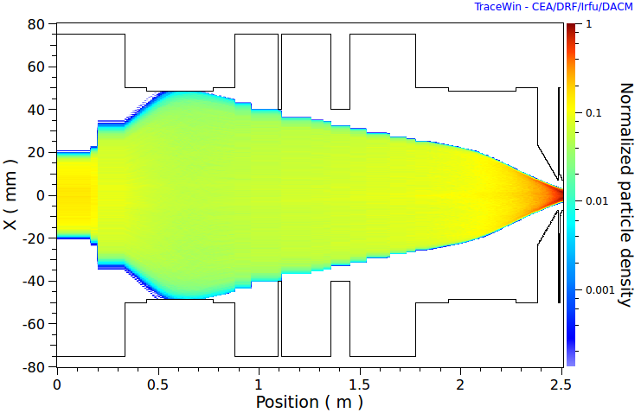
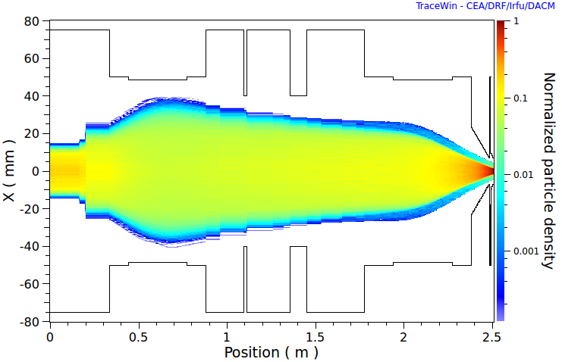
Complements to system requirements: Current
The presented requirements on proton current were:
74 mA out of the source, and
70 mA out the LEBT.
These include educated guesses for the worst case losses in the LEBT and RFQ.
Extracting too much current could spoil beam quality with the space charge force.
The current out of the RFQ shouldn't exceed ~63 mA.
84 mA (100 mA total) simulation
(old extraction electrode position)
70 mA (83 mA total) simulation
(new extraction electrode position)

Slide 6
Complements to system requirements: Beam modes
ISrc
< 100 mA
~1000-3000 µs
5-2860 µs
~100 µs
Beam modes
LEBT
6-70 mA
Mode | Current [mA] | Duration [µs] | Rep [Hz]
Probe | ~6 | ≤ 5 | ≤ 1
Fast tuning | ≤ 62.5 | ≤ 5 | ≤ 14
Slow tuning | ≤ 62.5 | ≤ 50 | ≤ 1
Long pulse verification | ≤ 62.5 | ≤ 2860 | ≤ 1/30
Production | ≤ 62.5 | 2860 | 14
~0.1+20 µs
5-2860 µs
~0.1 µs
RFQ
6-63 mA
MEBT
6-62.5 mA
~0.01 µs
5-2860 µs
~0.01 µs

Slide 7
Tests and verifications: Takeaways from the off-site commissioning
Source demonstrated capability of producing up to ~80 mA of protons.
Source demonstrated great flexibility and a wide operation range.
Some diagnostics devices missed commissioning.
Understanding between the source parameters and beam parameters could be improved.
Beam transport (steering and matching) in LEBT wasn't thoroughly tested due to lack of time.
Beam modes production wasn't thoroughly tested due to lack of time.
An issue was found for the chopper and re-design is ongoing.
For further details, see ESS-0190279 ("Off-site commissioning report for the ESS proton source and LEBT", under review).

Slide 8
Tests and verifications: Lund commissioning overview
6(+1) steps for ~3 months:
Systems verifications with beam (~3 weeks)
Source characterization (at mid-point) (~3 weeks)
(Chopper and 2nd EMU installation and test) (~1 week)
LEBT optics tuning (steering and solenoids scan) (~2 weeks)
Beam modes verifications (~2 weeks)
Source and LEBT integrated optimization (~2 weeks)
Long-term stability tests (~2 weeks)
Single 8 hours shift per day. (Possibility to do occasional multiple shifts in a day isn't excluded.)
Available duration depends on the RFQ schedule.
Planning and tracking of activities are conducted with Jira tool.
Documents:
ESS-0149990: "Normal-conducting linac beam commissioning scenarios and steps" (approved).
ESS-0123228: "ISrc and LEBT beam commissioning plan" (under development)

Slide 9
Test and verifications: Overview in Jira tool

Slide 10
Planning and progress tracking: Activities sequence in Jira tool
Activities (sub-steps) under each step are defined in sequence down to half shift.

Slide 11
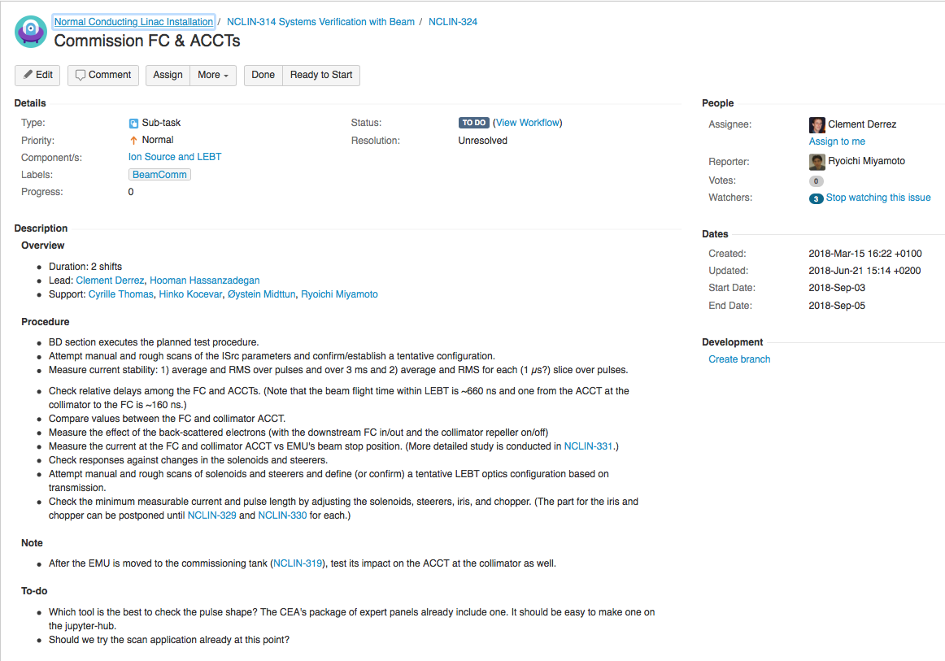
Planning and progress tracking: Details of each activity are being developed

Slide 12
Tests and verifications: LEBT commissioning layout #1
BCM
Layout is changed twice during commissioning
- FC
- EMU (H)
- EMU (V)
- NPM (H)
- NPM (V)
- Dpl
- NPM (H)
- NPM (V)
- BCM
- EMU (V)
- NPM (H)
- NPM (V)
- FC
Source extraction
Solenoid 1 (Steerer 1)
Iris
Permanent tank
Solenoid 2
(Steerer 2)
Commissioning tank
Chopper
Collimator
Beam stop

Slide 13
Tests and verifications: LEBT commissioning layout #2
BCM
- FC
- EMU (H)
- EMU (V)
- NPM (H)
- NPM (V)
- Dpl
- NPM (H)
- NPM (V)
- BCM
- EMU (V)
- NPM (H)
- NPM (V)
- FC
Source extraction
Solenoid 1 (Steerer 1)
Iris
Permanent tank
Solenoid 2
(Steerer 2)
Commissioning tank
Chopper
Collimator
Beam stop

Slide 14
Tests and verifications: LEBT commissioning layout #3
BCM
- FC
- EMU (H)
- EMU (V)
- NPM (H)
- NPM (V)
- Dpl
- NPM (H)
- NPM (V)
- BCM
- EMU (V)
- NPM (H)
- NPM (V)
- FC
Source extraction
Solenoid 1 (Steerer 1)
Iris
Permanent tank
Solenoid 2
(Steerer 2)
Commissioning tank
Chopper
Collimator
Beam stop

Slide 15
Outstanding issues
Issues were already covered in talks of each system.

Slide 16
Backup

Slide 17
Test and verification: Configurations from off-site commissioning
Section | Parameter | Unit | '17-Nov | '17-Sept | '17-Sept (Alt)
ISrc | RF | W | 420 | 650 | 1220
 | H₂ | sccm | 3.75 | 3.80 | 4.75
 | Sol 1 | A | 109.0 | 104.2 | 108.6
 | Sol 2 | A | 67.2 | 69.0 | 68.1
 | Sol 3 | A | 232.0 | 230.0 | 244.6
 | HV | kV | 75.132 | 75.132 | 75.132
LEBT | N₂ | sccm | 1.0 | 0.0 | 0.0
 | Sol 1 | A (mT) | 275.0 (228.0) | 300.0 (248.7) | 299.0 (247.9)
 | Sol 2 | A (mT) | 320.0 (265.3) | 150.0 (124.4) | 202.0 (167.5)
 | Steerer 1H | A | 0.0 | 0.0 | 0.0
 | Steerer 1V | A | 0.0 | 0.0 | 2.0
 | Steerer 2H | A | 0.0 | 0.0 | 0.0
 | Steerer 2V | A | 0.0 | 15.0 | 10.0

Slide 18
Tests and verifications: Goals of each commissioning step (1)
Systems verifications with beam (~3 weeks)
Complete basic verification tests of all diagnostics devices.
Verify that the iris is functioning.
Verify that the configurations from the off-site commissioning reproduce similar currents (in the commissioning tank) and emittances (in the permanent tank).
Source characterization (at mid-point) (~3 weeks)
Test effects from source parameters and N2 injection level on the beam, while stopping the beam in the permanent tank, and establish working points (at least 3) of the source and N2 injection for a later step.
Sample emittance vs solenoid 1 (in the permanent tank) for the selected working points of the source and N2 injection.
Test and establish steering to the permanent tank.
Test beam quality vs source repetition rate.
(Chopper and 2nd EMU installation and test) (~1 week)
Complete installation and hardware testing of the chopper and its power supply.
Verify the temporary and or final chopper with the beam.

Slide 19
Tests and verifications: Goals of each commissioning step (2)
LEBT optics tuning (steering and solenoids scan) (~2 weeks)
Verify linear optics.
Establish steering in the whole LEBT (for any given solenoids configuration).
Establish solenoids scan.
Beam modes verifications (~2 weeks)
Establish capabilities to adjust repetition rate, pulse length, and current and thus to produce the required beam modes.
Attempt repetition rate adjustments with the source itself, with the chopper, and with the source and chopper combined.
Study carefully the sensitivity of chopping efficiency against the chopper voltage, trajectory, and solenoid 2 strength.
Test the matching condition for intermediate currents.
Test the fast beam interlock system.
Rehearse the procedure for the first injection into the RFQ.
Source and LEBT integrated optimization (~2 weeks)
Check the matching condition for the working points of the source and N2 injection, prepared in Step 2.
Long-term stability tests (~2 weeks)
Verify stability of the source.

Slide 20
Tests and verifications: LEBT layout during operations
BCM
- FC
- EMU (H)
- EMU (V)
- NPM (H)
- NPM (V)
- Dpl
- NPM (H)
- NPM (V)
- BCM
Source extraction
Solenoid 1 (Steerer 1)
Iris
Permanent tank
Solenoid 2
(Steerer 2)
Chopper
Collimator

