Slide 1
Radiation protection & monitoring
Ida Bergström
Radiation Protection Officer
ESH - RP
SRR 1 – Ion Source & LEBT
2018-07-17--18

Slide 2
Radiation Monitoring
Ion source
Low energy beam transport (LEBT)
Radiation Monitoring
PSS0 controlled area
and radiation shielding
Ion source
LEBT 1
LEBT 2
Plasma chamber
Extraction system
Pumping box
Solenoid
2 x steerer
Gate valve
Iris
Diagnostics tank
Gate valve
Solenoid
2 x steerer
Collimator
Commissioning tank (RFQ)
Magnetron
Waveguide
H₂ bottle
HV controls
3 x solenoid
Repeller
2 x TMP
Chopper
Repeller
Beam stop
EMU H+V
ACCT
EMU H+V
N₂ bottle
Faraday cup
Faraday cup
High voltage (HV) platform
NPM H+V
NPM H+V
ACCT
Voltage divider
Doppler shift
Doppler shift
2 x TMP
2 x TMP
Primary pump
Primary pump
Isolation transformer
HV power supply
Ground potential controls
Front End and Magnets
Vacuum
PSS
ACCT: AC current transformer
EMU: Emittance measurement unit
NPM: Non-invasive profile monitor
TMP: Turbomolecular pump
Alternative location of beam instruments for commissioning
Beam Diagnostics
Cooling water
Control system

Slide 3
Table of content
Requirements on Radiation protection
Radiation protection in operation
Test & Verification
Open issues

Slide 4
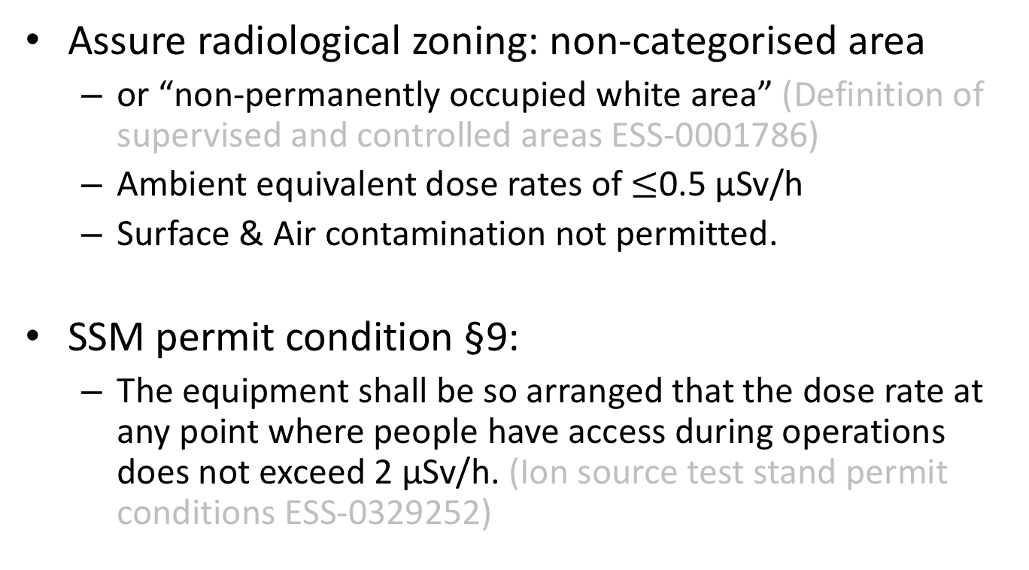
Requirements on Radiation Protection (RP)
Assure radiological zoning: non-categorised area
  or “non-permanently occupied white area” (Definition of supervised and controlled areas ESS-0001786)
  Ambient equivalent dose rates of $≤$0.5 μSv/h
  Surface & Air contamination not permitted.
SSM permit condition §9:
  The equipment shall be so arranged that the dose rate at any point where people have access during operations does not exceed 2 μSv/h. (Ion source test stand permit conditions ESS-0329252)

Slide 5
RP in operation: Monitoring
Passive area monitoring using OSL dosimeters inside and around safety fence.
RPO to act if reported dose is above 50 μSv outside safety fence in any month.
Not expose OSL dosimeters to radiographic testing.
RP survey of shielding if configuration changes.
Work not allowed above shielding while the high voltage is on.

Slide 6
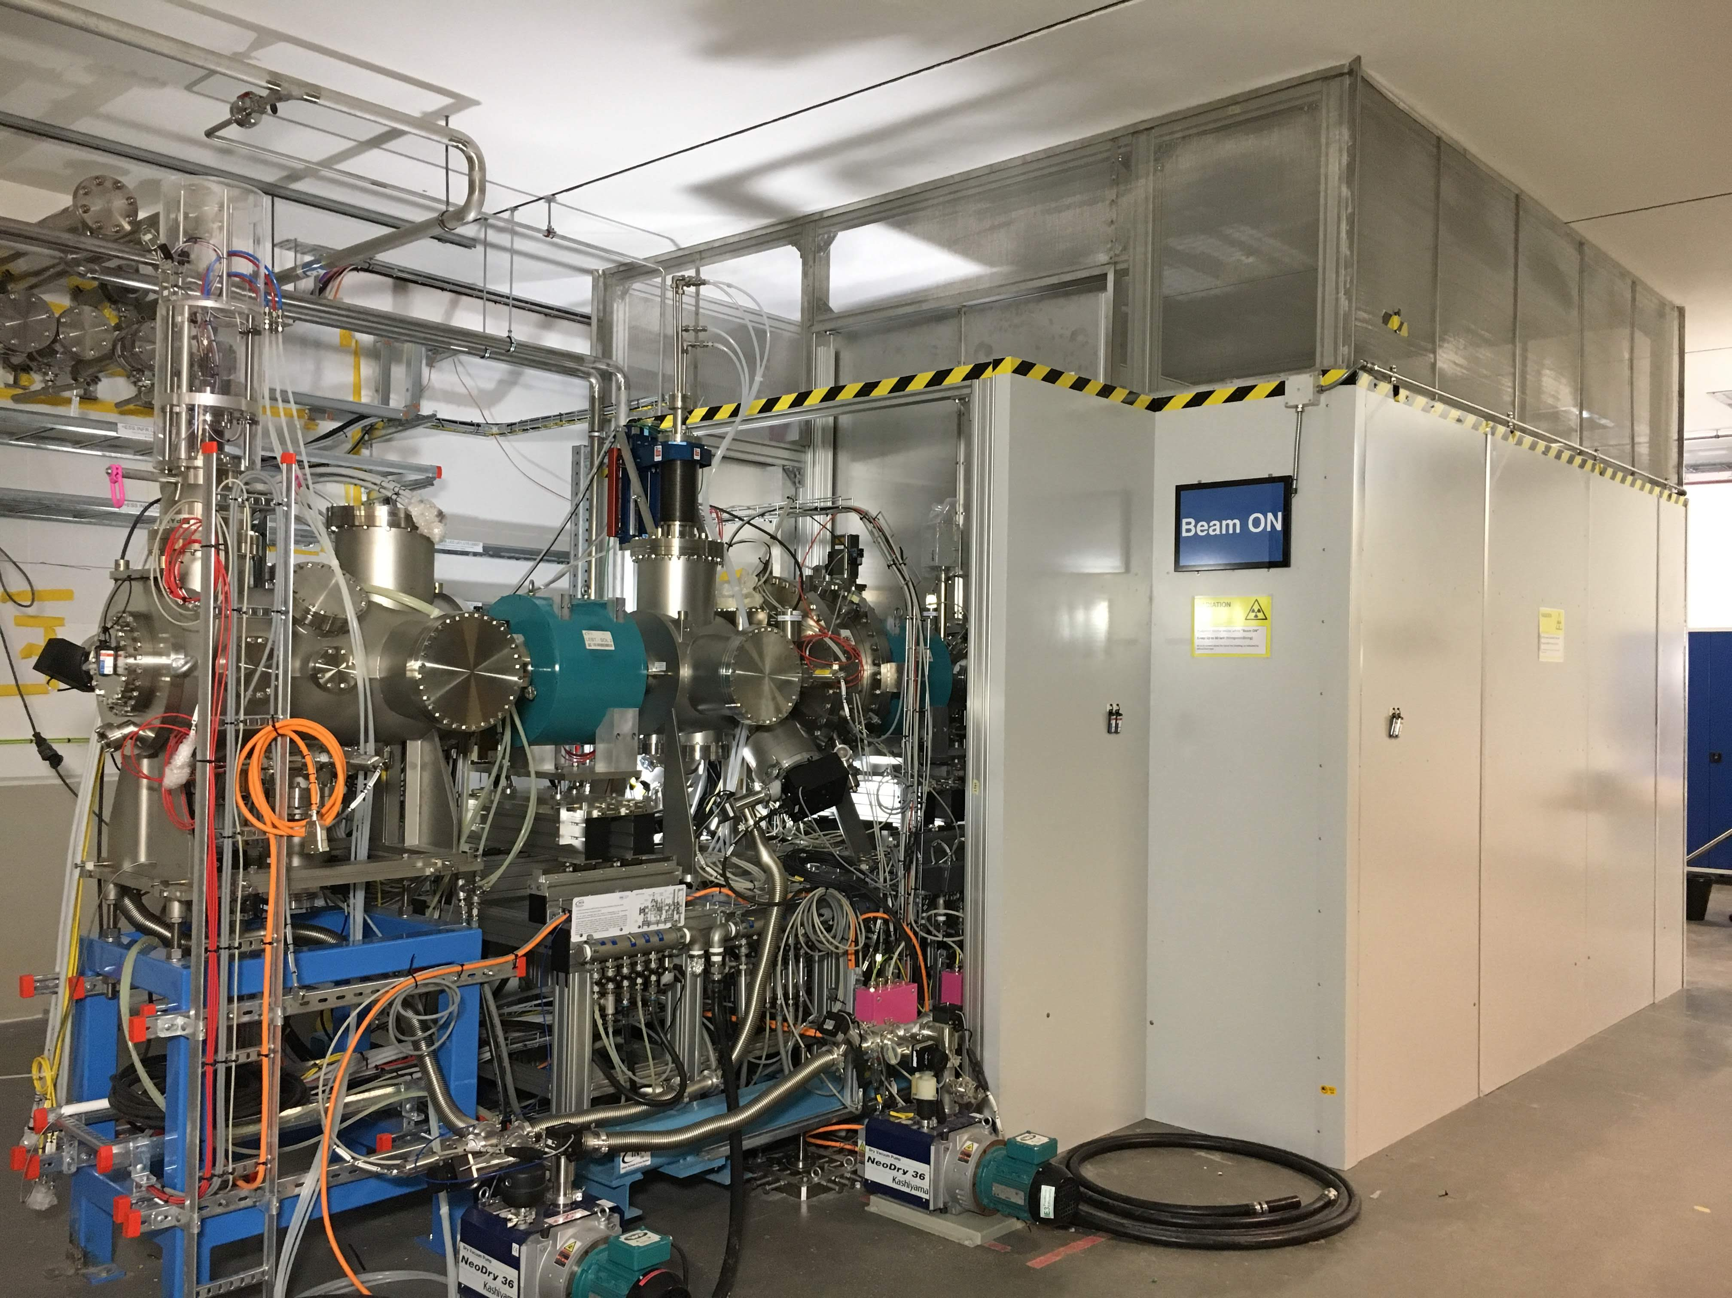
RP in operation: Signage
(Ion source test stand permit conditions, §10 ESS-0329252)

Slide 7

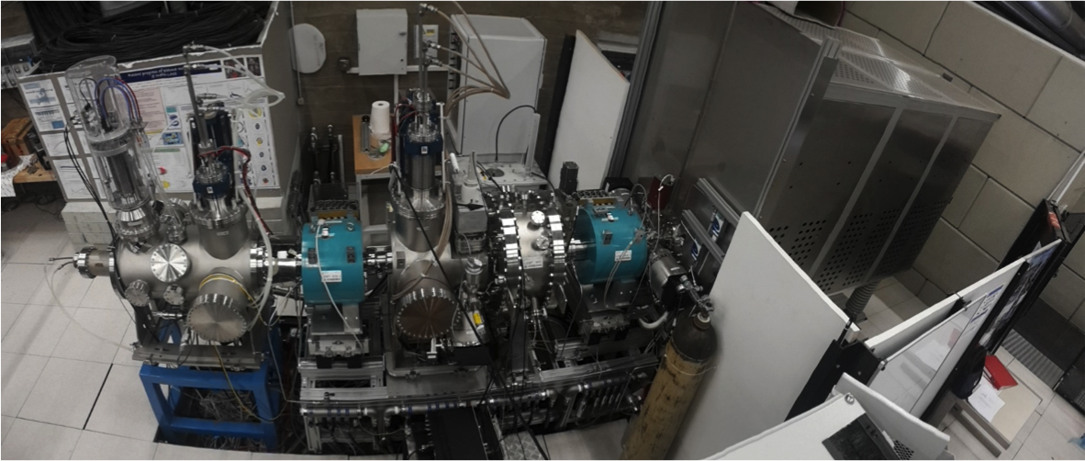
Test & Verification:
Measurements in Catania 2017
Extraction
Faraday
cup
② = 1.27 mSv
③
A ∼ 2 μSv/h
⑦
⑨
⑧ #3-9 below background
① = 0.50 mSv
⑥
⑤
Safety fence
Beam
stop
D ∼ 2 μSv/h
B = 0 μSv/h
C = 0 μSv/h
Yellow – Measurements with ion-chambers and GM counters
White – Accumulated dose measurements (OSL) 2 Aug – 6 Nov 2017

Slide 8
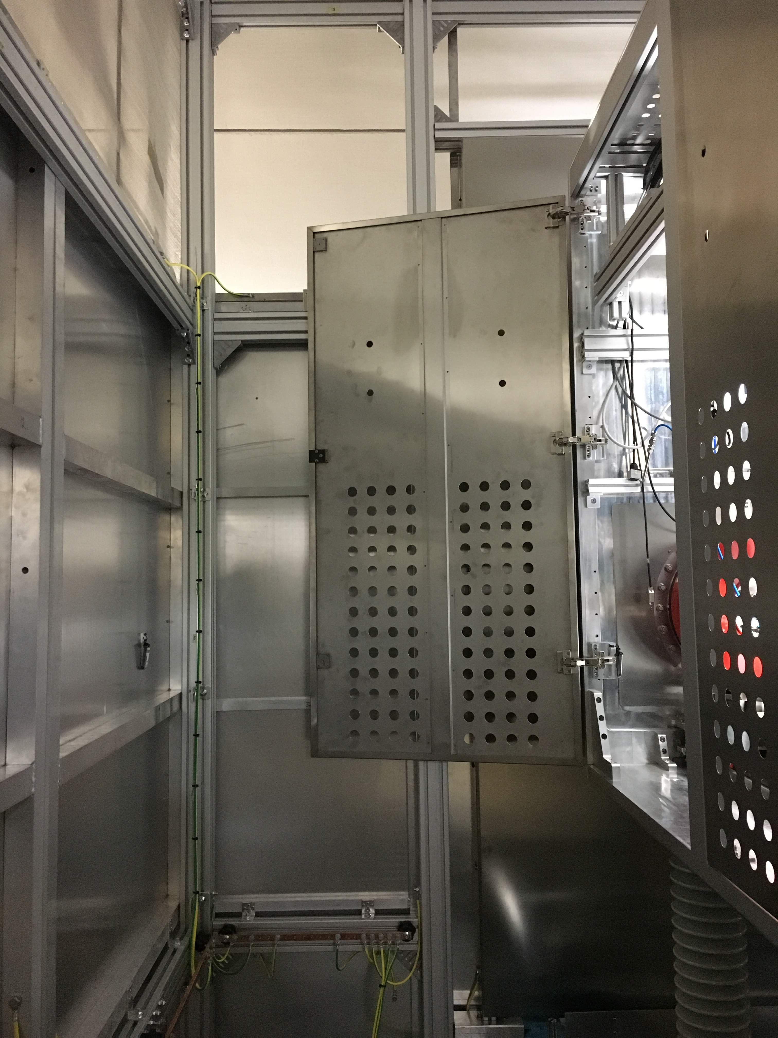
Test & Verification:
Monitoring at ESS
Yellow; monthly (14 pc)
Red; every trimester (8 pc)
Notes:
2.5 meter shielding: 2mm alu + 2 mm lead + 2 mm alu (sandwiched, overlapping)
1 m stainless steel mesh

Slide 9
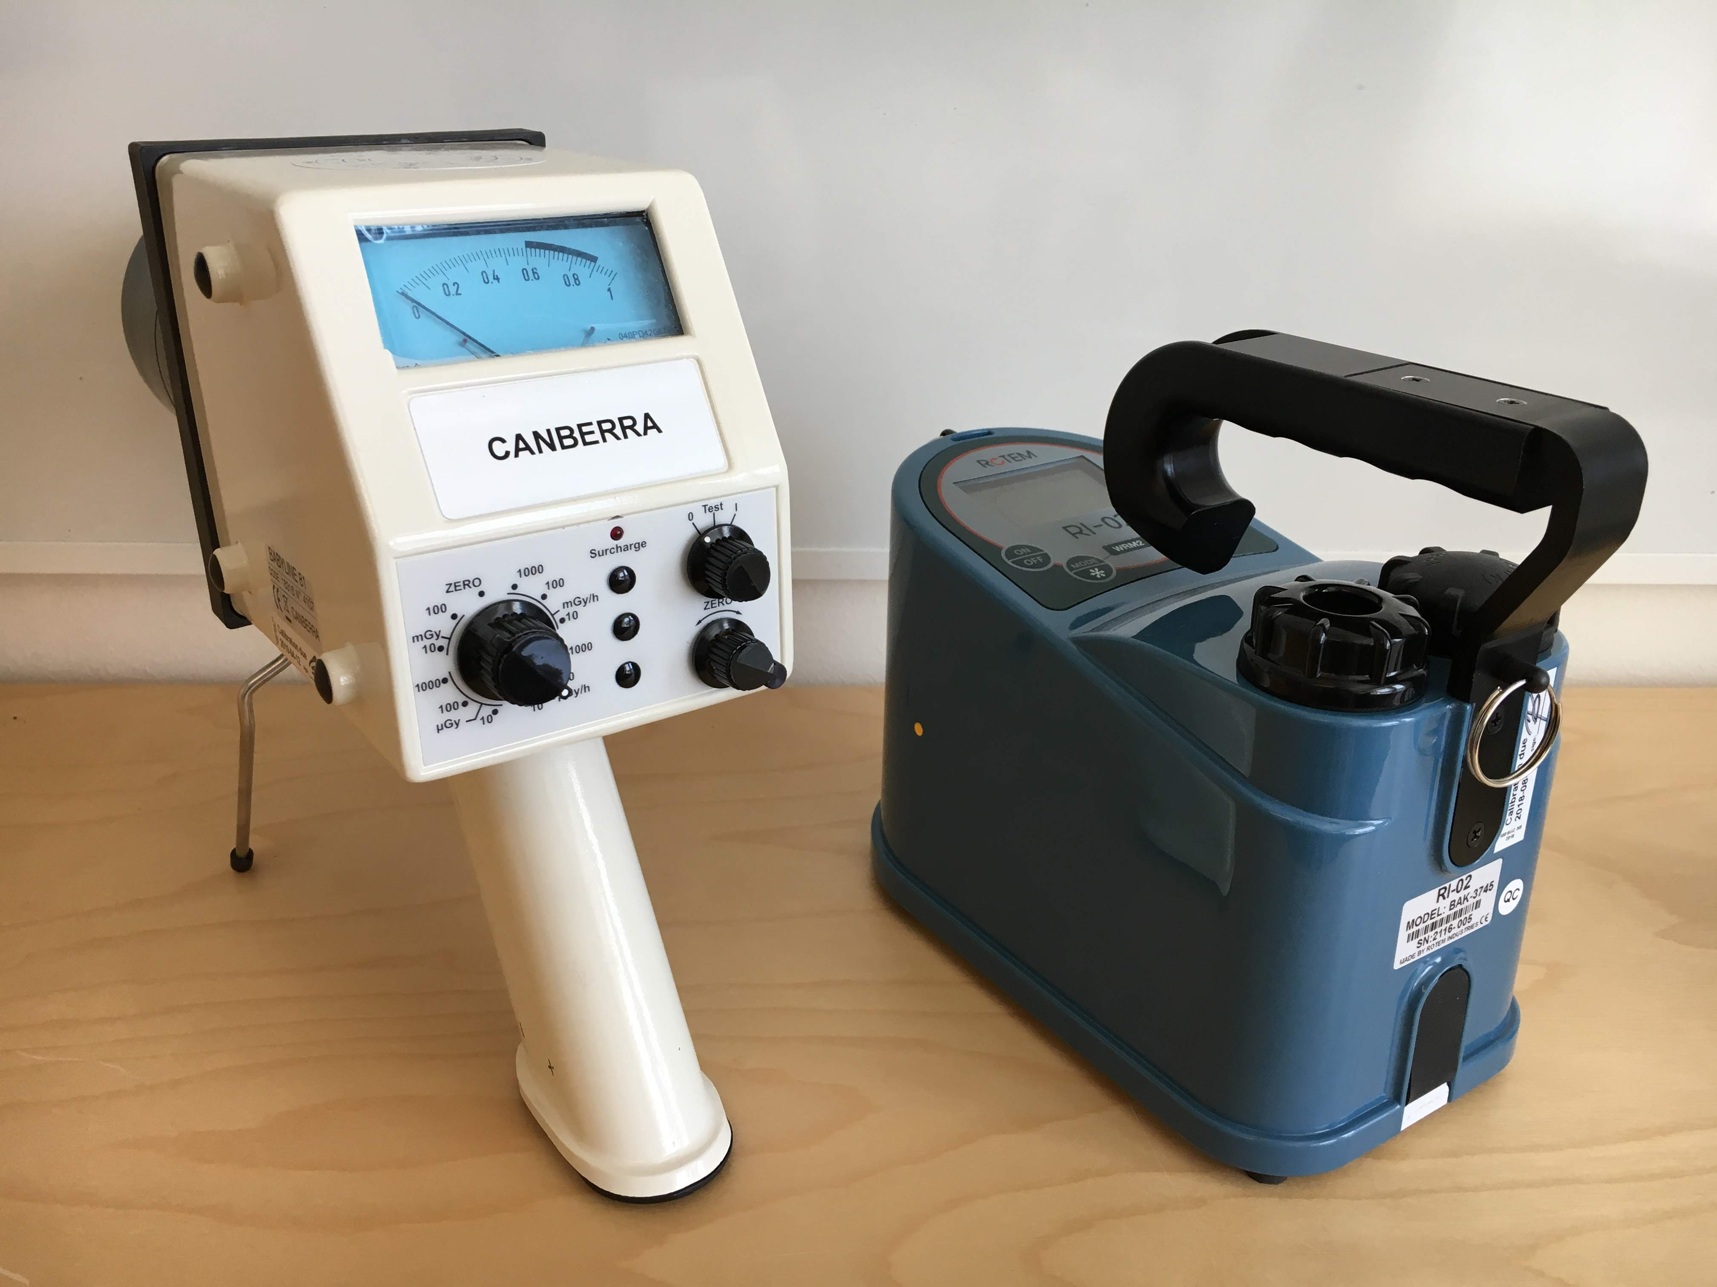
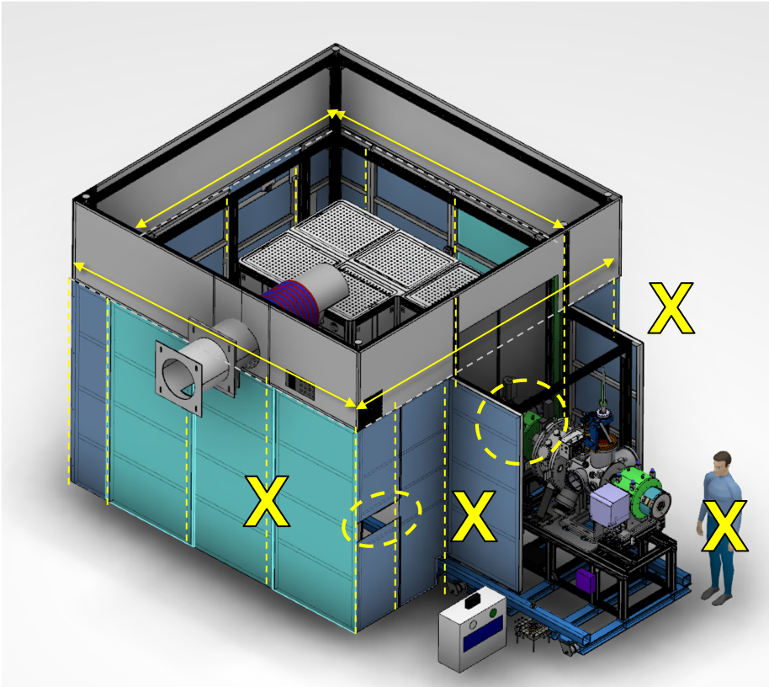
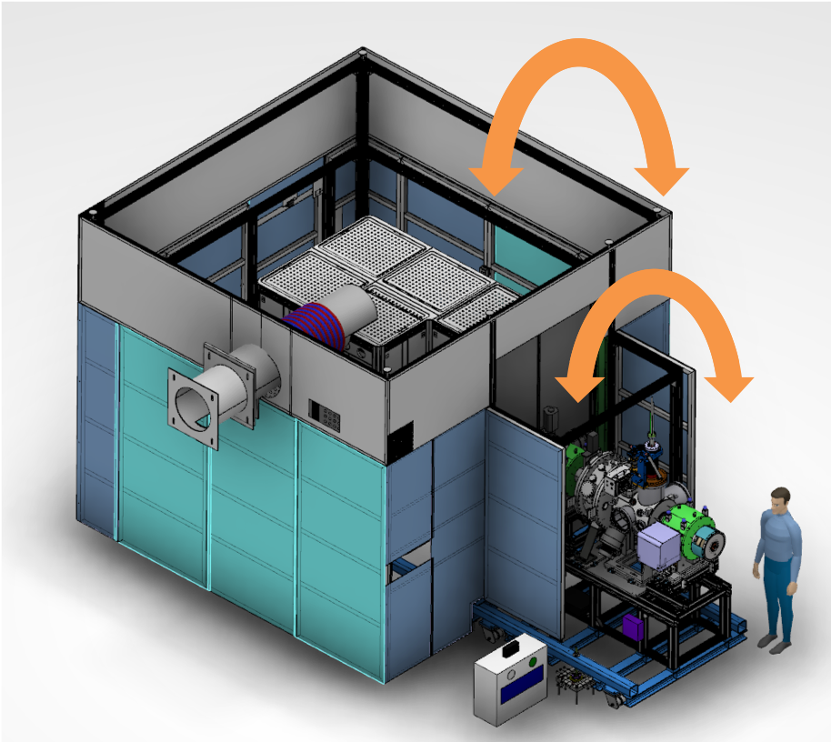
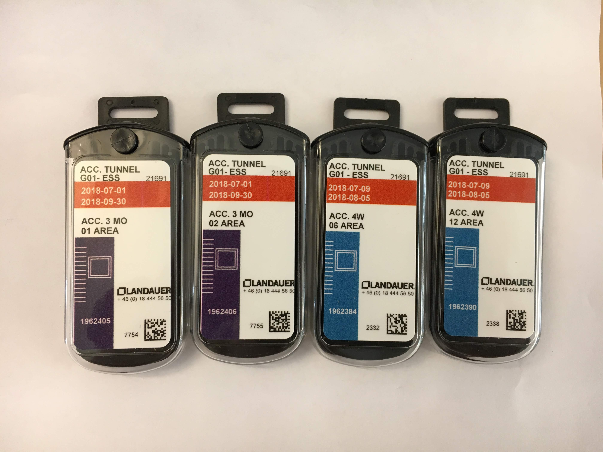
Test & Verification:
RP Survey during start-up
First time beam turns on:
  Evacuate part of the accelerator tunnel.
  Start – Adjust – Confirm beam.
Once stable beam (1 Hz):
  Leave Radion inside/outside the lead shielding.
  Evacuate part of the accelerator tunnel.
  Turn the beam on for 30 minutes.
  Read accumulated dose and maximum dose rate.
  Repeat (a)–(d) with Radion in different locations.
Repeat (2) up to 14 Hz.
Once considered safe for hands-on survey:
  Limited access to the accelerator tunnel.
  Beam configured for detectable radiation
  RP survey of shielding, feed throughs, gaps & LEBT with Babyline.
  If leaks or hot spots found, use Radion to determine dose rate.
Once shielding and radiation levels have been verified
  Normal access to accelerator tunnel.
  Continue commissioning.
Re-confirm dose levels after first OSL evaluation.
Babyline Radion
Ionisation chambers

Slide 10
Outstanding issues
# | System/Comp. | Status | Description | Due date | Remark
1 | Survey instrument | In repair | The Babyline is broken. | 1 w before start of commissioning. | Estimated return date unknown. Possible to borrow Babyline e.g. from MAXIV. Plan B instrument.

Slide 11
THANK YOU

Slide 12
Reference documentation
Chess | Title | Description | Status | Type
ESS-0114736 | Ion source radioprotection report INFN-LNS | A radioprotection report for the ambient measurements of X-Ray emitted from the PS-ESS Source. | Released | .docx
ESS-0135333 | Positions of OSL in PS-ESS, Catania | OSL area dosimeters placed around the IS&LEBT while installed at the in-kind laboratory INFN-LNS in Catania, Italy. | Released | .pptx
ESS-0135312 | OSL dose report for ion source in INFN-LNS | Dose report for OSL dosimeters installed at the ESS ion source while in the INFN-LNS laboratory. | Released | .pdf .xlsm
ESS-0217801 | Dose measurement of ESS ion source at INFN-LNS | ESS Radiation protection group sent passive OSL dosimeters to INFN-LNS in Catania, to measure dose around the ion source and LEBT before its arrival to ESS, using the same detectors as will be used at site. This report includes the results and discussion. | Released | .docx
ESS-0329252 | Ion source test stand permit conditions | SSM Permit conditions for commissioning of ion source. (translation) | Preliminary | .pdf
ESS-0337304 | OSL Positions in IS+LEBT test stand | OSL area dosimeters placed around the IS+LEBT test stand in ESS Accelerator tunnel. | Released | .pptx
ESS-0337313 | Dose reports Normal Conduction Linac | Dose reports from Ion source (and later NCL) | Preliminary (live doc) | .xlsm

Slide 13
Catania measurements with ESS dosimeters
For full documentation see ESS-0135333

Slide 14
OSL dosimeters
8 x three months (trimester)
14 x four weeks

Slide 15
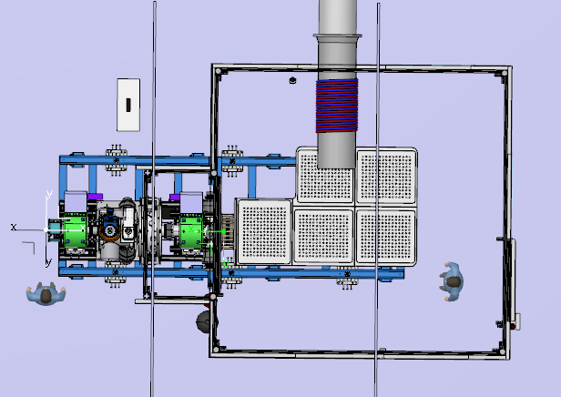
OSL dosimeters
11
12
⑧
10
⑦
⑨
⑧
13
⑥
③
①
⑤
⑦
①
⑥
④
③
⑤
②
14
④
②

Slide 16
OSL dosimeters
14
2
1

Slide 17
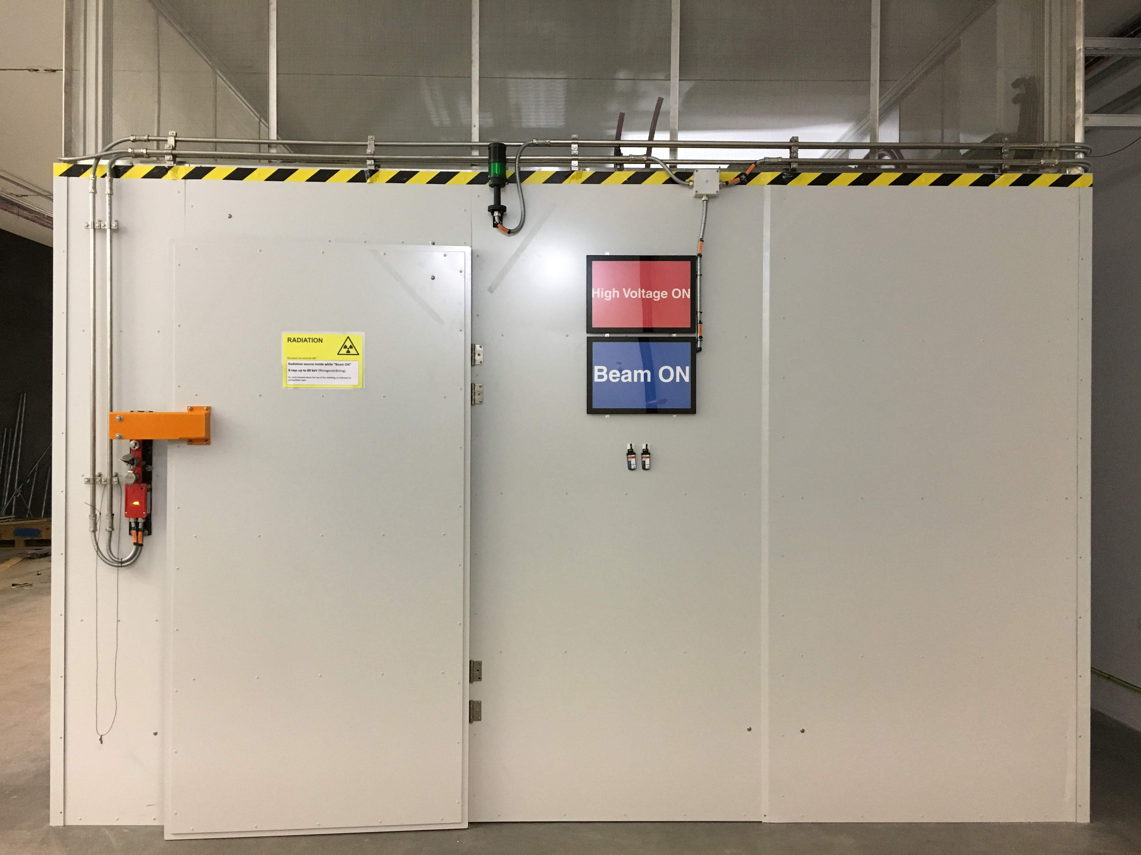
OSL dosimeters
13
3
1

Slide 18
OSL dosimeters
14
8
7
5
6
4
5
3
4
2

Slide 19
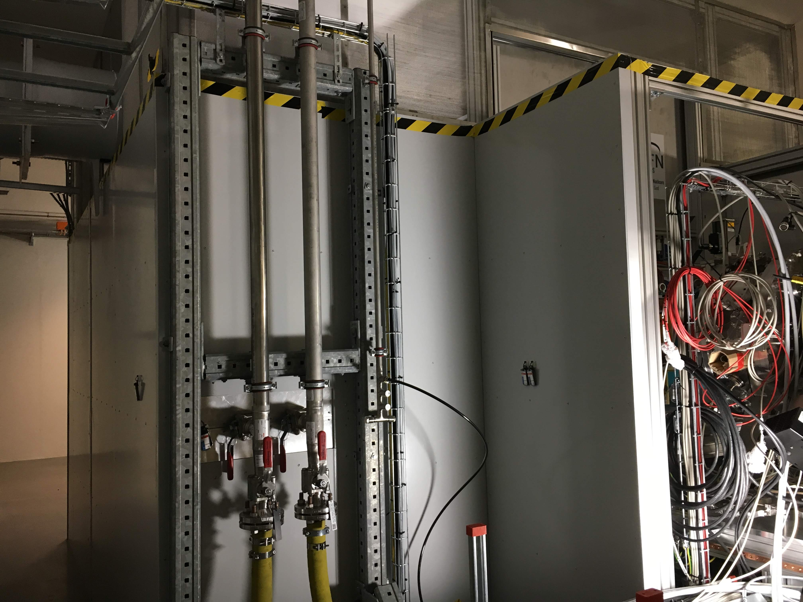
OSL dosimeters
12
11
9
7
8
6
10
8

Slide 20
Dose rate instruments
Mirion’s Babyline 81/S
Ion-chamber, analogue
Specifications:
ESS-0318104
Manual:
ESS-0337971
Calibration certificates:
ESS-0297925
Mirion’s Radion RI-02
Ion-chamber
Specifications:
ESS-0318103
User instruction:
ESS-0322943
Calibration certificates:
ESS-0127059, ESS-0131277

Slide 21
Dose rate instruments
Babyline – in repair
Radion
Only for search of leaks & hotspots.
Analogue
Absorbed dose rate from μGy/h to 1 Gy/h; from 10 μG – 100 mGy absorbed dose
Energy Response: From 8 keV to 2 MeV
Battery Life: > X hours
Measures equivalent dose, H*(10)
Dose rate 1 μSv/h to 1 Sv/h, up to 10 Sv dose
Energy Response: From 20 keV to 2 MeV
Battery Life: >200 hours
Possibility to measure accumulated dose and maximum dose rate during an extended period.

Slide 22
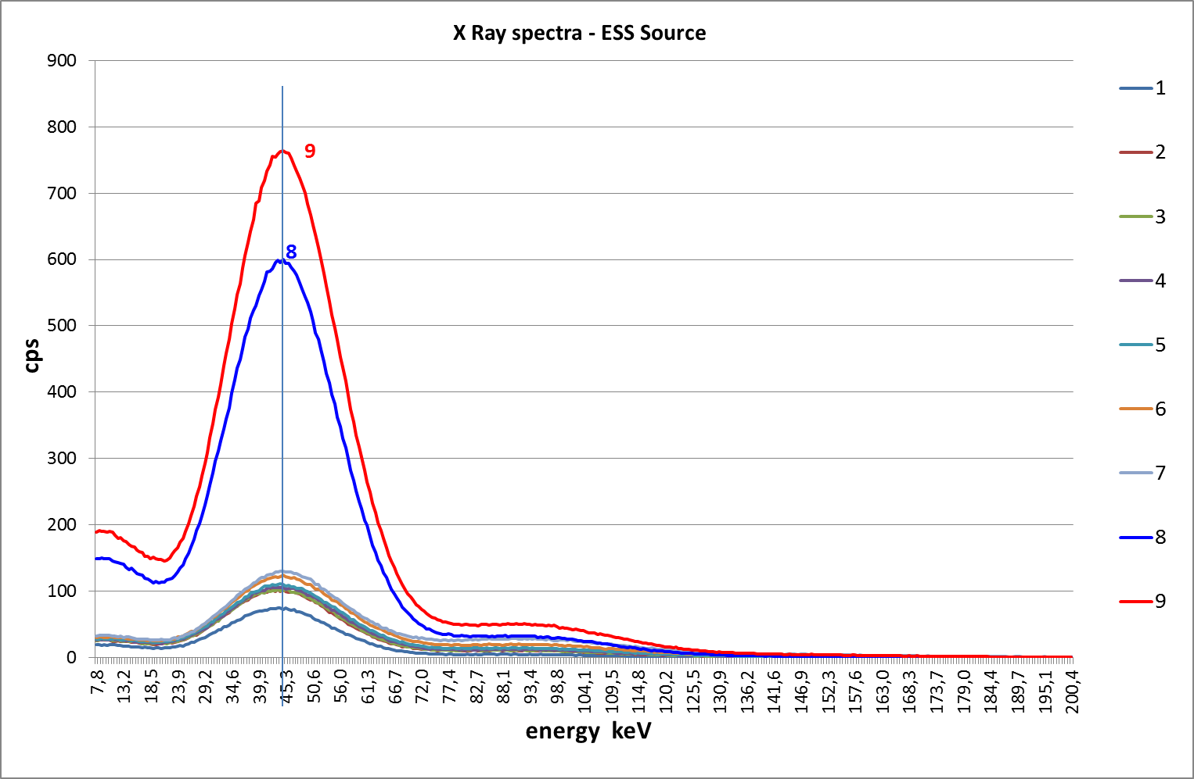
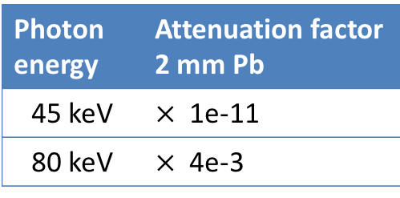
Catania’s Gamma spectroscopy and attenuation factors
Report ESS-0114736
45 keV
80 keV
Photon energy | Attenuation factor 2 mm Pb
45 keV | $×$ 1e-11
80 keV | $×$ 4e-3
//
Babyline from 8 keV (Survey)
//
Radion from 20 keV (Ambient equivalent dose rates from 1 μSv/h)

Slide 23
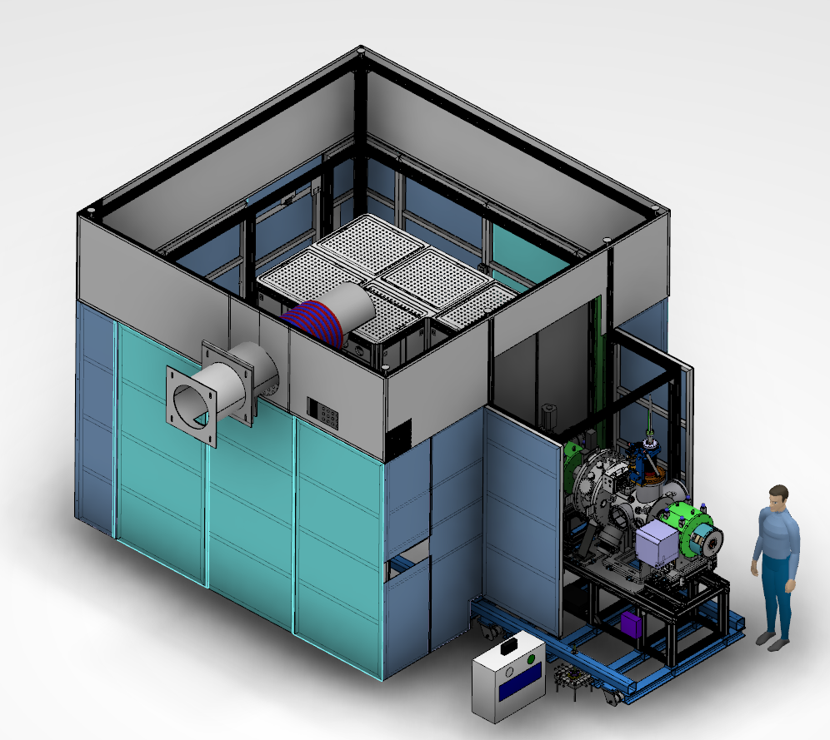
RP Survey of shielding
Feed through’s & Possible gaps in shielding
Ambient dose rates around installation
X
X
X
X

Slide 24
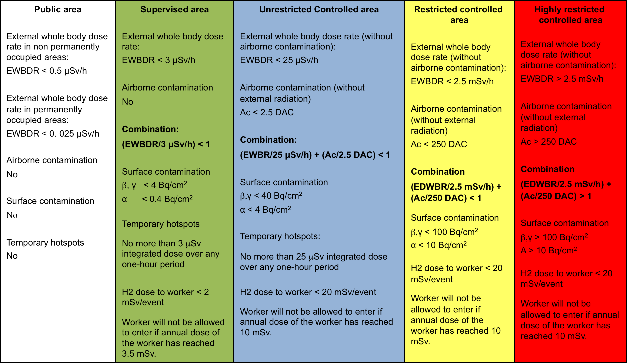
Definition of Supervised and Controlled radiation areas (ESS-0001786)

Slide 25
Radiation area signage

