Slide 1
Operator Training, Control Room Procedures and Emergency Preparedness
Lali Tchelidze
Operations Section Leader
SRR 1 – Ion Source & LEBT
2018-07-17--18

Slide 2
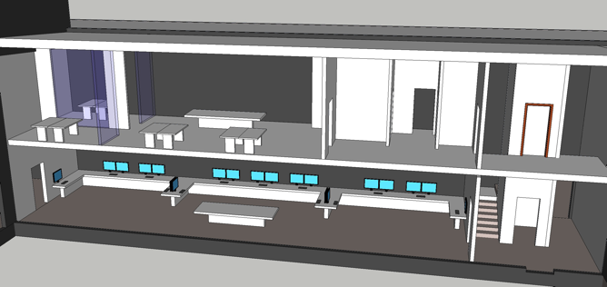
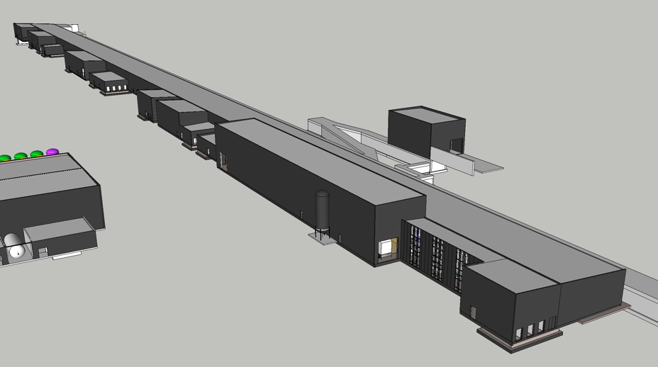
Operations
Ion Source
Control room

Slide 3
Overview
Control room roles
Operators, and operator training
Operator tools
Operational procedures
Equipment handover and change control during the commissioning
Operating instructions and operational limits for equipment.
Emergency plan and responsibilities

Slide 4
Control room roles
Operations personnel roles and responsibilities in the Main control room [ESS-0149550]
MCR Shift Leader
MCR Operator
Study Leader
Physicist/Engineer
Shift leader
Operator 1
Operator N
Study leader
Physicist 1
Engineer N
The priority is the operational aspects: safe operation, documentation, PSS access.
Secondary aspect is to help the studies
The priority is commissioning studies.
Any change in the machine parameters with the potential to exceed the operational limits to be made by the Shift Leader

Slide 5
Operator/Shift Leaders and training
No dedicated, full time operators foreseen until 2019
Training existing staff from BPOD* and LINAC groups in AD.
Some of these may fill either shift leader or study leader role (at different times)
Operator/Shift Leader Training
Training requirements defined (ESS-0290889)
no distinction between shift leader and operator training for this step
Partially self taught (web link to documents)
Self certification (using safety training approach)
Training sessions (e.g. on PSS0)
Dry runs to be carried out before beam available
Hands on training, final step
Have initial pool of Shift Leaders. Will be finalized once the commissioning calendar is fixed.
* Beam Physics, Operation and Beam Diagnostics
Notes:
Can we add an actual web link?
Need to double check procedures for # of operators in control requirement.

Slide 6
Operator tools
Operator screens
Alarm Screen
To be set up based on operational limits
Logbook
PSI elog to be used for IS/LEBT commissioning
Possibility to use the new olog GUI for input
Archiver
Updating list of signals to be archived as exact PV names become available
Procedure for adding PVs to archive incrementally to be defined
Access to data from office network needed for off line analysis
Save/restore
Operations save/restore sets created
Remote VPN access not required at this stage (since daytime hours only).

Slide 7
Operating procedures
Logbook keeping
Guidelines to write the logbook available (ESS-0146509)
Templates for entries to be added
PSS0 access control
Shift leader controls PSS0 key, and grants access.
Shift Handover
General procedure exists, (ESS-0131410) mainly focussed on 24/7 operations
May use lock box to pass PSS0 key between shift leaders, as no continuous occupation in control room.
Equipment handover and change control
Working in standard form
Other relevant procedures listed in “Relevant management system for the test of ion source …” [ESS-0304902]

Slide 8
Equipment Handover and Change Control
Subsystem responsible to declare their equipment ready for operation, and provide operating instructions and any operational limits for the subsystem to the control room.
Should ideally happen before SRR, but must happen before beam.
Following handover, any repair/maintenance or modifications on (or near) operational equipment shall be cleared with the control room shift leader (through the work authorization process), and properly logged.
Shift leader is responsible that operational limits (including licensing conditions) are respected.
Some systems will be partially handed over, as they require beam for final validation
Notes:
Should write procedure for this.
Need a list of systems already declared operational, presumably minimum PSS0.
Should include approval from Division Head, ESH head and Area Supervisor before beam start.

Slide 9
Coordination with other activities
Coordination with other people/activities in the control room (TS2/Cryo Commissioning)
Access training for Control Room and Tunnel.
Awareness of tunnel hazards and relevant control room roles and procedures.
Implementation in progress, working with ESH training responsible.

Slide 10
Emergency preparedness
Emergency procedures for the site are defined in ”Emergency Contingency Plan “ (ESS-0150450).
In this phase, control room shift leader does not have any site-wide role in case of emergency.
In case of an emergency affecting the accelerator buildings, the control room should be informed and ion source operations will be halted.
Notes:
Would be good to have a procedure documented for the 2nd bullet.

Slide 11
Outstanding issues
# | System/Comp. | Status | Description | Due date | Remark
1 | Hands on Training | Planed by End August | Hands on Training for commissioning personal in the Control Room | Before start BC | Waiting for all system online and close to the BC
2 | Jira/Confluence | Ticket Open | Access to Confluence and jira from the CR network | End July | Proxy to be implemented at LCR
3 | LCR | In progress | Final LCR features (fixed telephone, big screen, …) | End August
4 | Archiver | Not easy | A final solution to access the archiver data from the office network is needed. | End August | A solution is close to be implemented
4 | Archiver |  | Procedure to incrementally add PVs needed | End August
5 | Dry Runs | Planned |  | End August
6 | PSS0 | open | Transfer of the PSS0 box key between SL | End August | Solutions exist, need to be implemented
7 | Global | open | Equipment handover and change control procedure/.form | End August
8 | G01 | ongoing | Tunnel and control room access training | End august | Implementation ongoing

