Slide 1
Welcome and charge to the committee
Ralf Trant
Ass. Director ESH&Q
SRR 1 – Ion Source & LEBT
2018-07-17--18

Slide 2
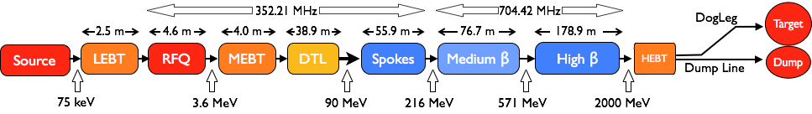
Safety Readiness Review of
Ion Source & Low Energy Beam Transport
The purpose of the SRR Process is to review the readiness to safely commission and
operate any system, which could constitute a part of the facility or the whole facility.
The scope is safety, both conventional safety, safety related to ionizing radiation and
environmental safety aspects where applicable.
The SRR is a process by which hardware, personnel and procedures associated with commissioning and operation of the system are verified.
Start of commissioning is scheduled for 3rd of September 2018

Slide 3
ESS Organigram related to the commissioning of the Isrc & LEBT

Slide 4

ESS licensing status
permit for
CONSTRUCTION
(conditional) permit for
INSTALLATION
TRIAL OPERATION
ISrc NC SC BoT
June
December
2014
2017
2018
Safety Classification
Revised Source Term for Emergency Preparedness Zone
IT Security rules for TSS/PSS code development
Environmental Court: permit received
BoT – Beam on Target
ISrc – Ion Source & LEBT
NC - Normal Conducting
PSS – Personal Safety System
SC – Super Conducting
TSS – Target Safety System
SSM: ISrc permit received
Submission of application for
Trial Operation of NC LINAC

Slide 5
SRR #1 - Committee & Charge
John E. Anderson Jr., Ass. Head - Office of the Chief Safety Officer, FNL
Yves Loertscher, Head of Occupational Health & Safety, CERN
Sam Jackson, Head of QSHE at Culham Centre, UKAEA
Katarina Norén, Head of Safety Group, MAX IV
Linda Coney, Head of Control Group, Target Division, ESS
Mattias Skafar, Head of Quality, ESS
Michael Plagge, OHS Officer

Slide 6
Charge to the committee
The SRR committee is expected to [process description ESS-0123091]
  review prepared documentation
  perform interviews with personnel
  inspect installed systems
  observe dry-runs of operating procedures, if possible
The SRR committee provides the main conclusion at the close-out;
  To recommend commissioning, or not.
This could include actions which needs to be taken prior to commissioning.
Final version of the SRR report, its main conclusion and underlying detailed findings is then expected to be provided within some weeks.

Slide 7
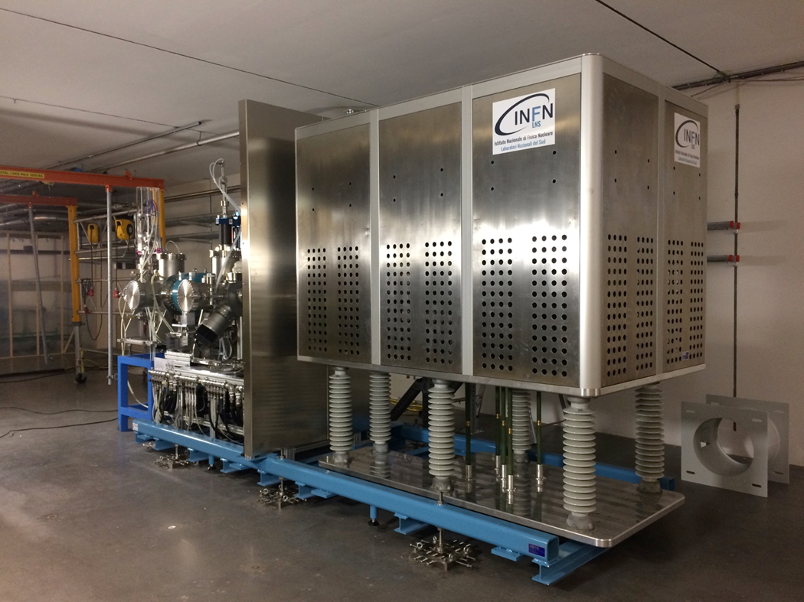
Organisational remarks
Coffee breaks
Lunch for committee and speakers
Site visit
Prepared to provide additional information
Close-out

