Slide 1
Ion Source & Supporting Systems
Øystein Midttun
System Leader – Ion source and LEBT
SRR 1 – Ion Source & LEBT
2018-07-17--18

Slide 2
System – Ion source
Ion source
Low energy beam transport (LEBT)
PSS0 controlled area
and radiation shielding
Ion source
LEBT 1
LEBT 2
Plasma chamber
Extraction system
Pumping box
Solenoid
2 x steerer
Gate valve
Iris
Diagnostics tank
Gate valve
Solenoid
2 x steerer
Collimator
Commissioning tank (RFQ)
Magnetron
Waveguide
H₂ bottle
HV controls
3 x solenoid
Repeller
2 x TMP
Chopper
Repeller
Beam stop
EMU H+V
ACCT
EMU H+V
N₂ bottle
Faraday cup
Faraday cup
High voltage (HV) platform
NPM H+V
NPM H+V
ACCT
Voltage divider
Doppler shift
Doppler shift
2 x TMP
2 x TMP
Primary pump
Primary pump
Isolation transformer
HV power supply
Ground potential controls
Front End and Magnets
Vacuum
PSS
ACCT: AC current transformer
EMU: Emittance measurement unit
NPM: Non-invasive profile monitor
TMP: Turbomolecular pump
Alternative location of beam instruments for commissioning
Beam Diagnostics
Cooling water
Control system

Slide 3
Table of content
System Requirements
Specific safety and protection systems
Test & Verification
Open issues

Slide 4
System Requirements – Beam parameters from the ion source
Particle Protons (H⁺)
Proton current 74 mA
Proton fraction > 75%
Energy 75 kV
Pulse length 6 ms
Repetition rate 14 Hz
Duty cycle 8%
Emittance (99%) 1.8 mm mrad
Stability
Flat top ±2%
Pulse to pulse ±3.5%

Slide 5
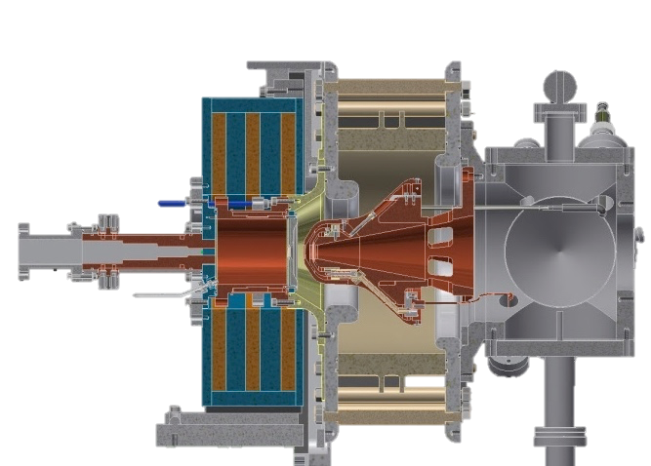
Microwave discharge ion source
High voltage insulator
Extraction electrodes
Plasma chamber
Waveguide
Pumping ports
H₂ gas injection
Solenoid magnets
50 cm

Slide 6
The plasma generator sits inside a high voltage platform

Slide 7
Electrode at ground potential extracts the beam from the plasma

Slide 8
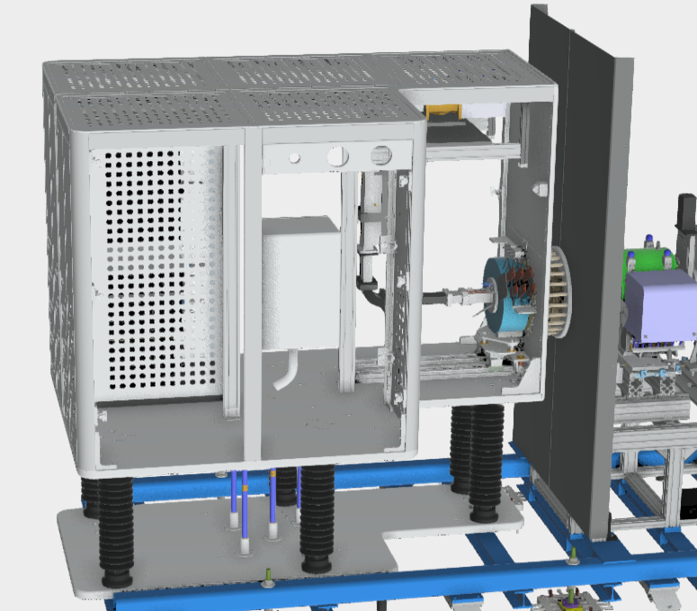
Specific safety systems – Hydrogen gas
– ATEX zone in unused part of the HV platform
– Build a “U” shape to isolate to H₂ bottle from source of ignition
– Holes in the roof and door allows dilution of the gas in case of a leak
– ESS-0333368 - Risk assessment and area classification for the ion source hydrogen system
Injection point
H₂ bottle

Slide 9
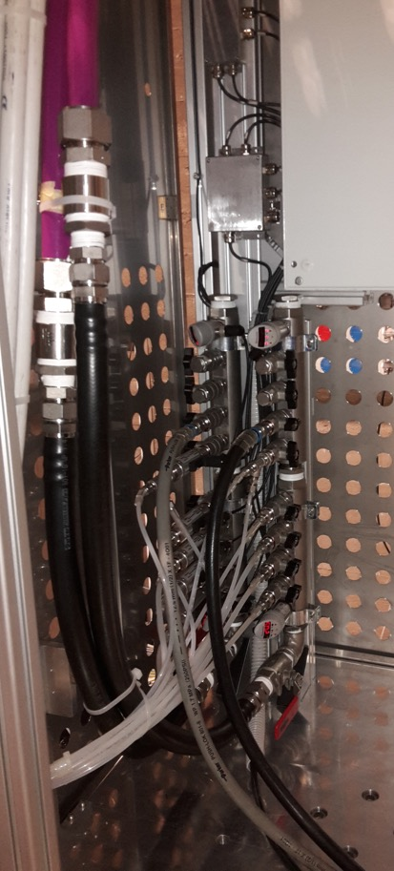
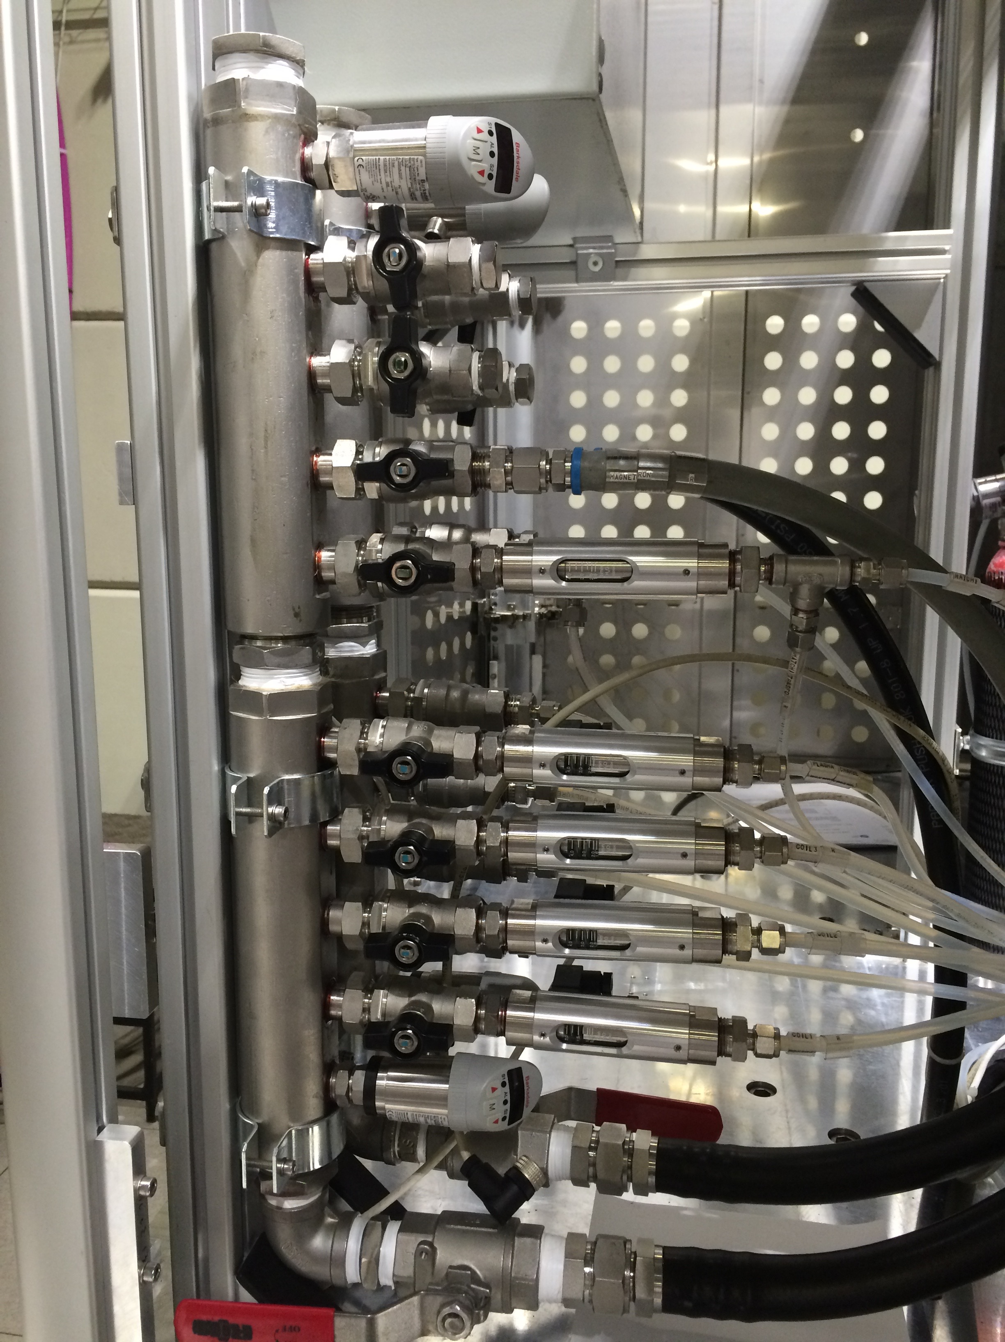
Protection systems – Temperature sensors and flow meters on cooling water manifold
– Temperature switches on solenoids
– Controlled by the interlock system

Slide 10
Test & Verification – ESS-0317305 - Ion source and LEBT verification plan
System testing
High voltage
Isolation transformer
Magnetic system of plasma generator
Magnetron and microwave injection
Repeller electrode
Gas injection
Plasma generation
Protection systems testing
Manual testing of interlocks, i.e. flow meters, temperature and pressure sensors

Slide 11
Outstanding issues
# | System/Comp. | Status | Description | Due date | Remark
1 | Ion source test and verification | Not started | All tests in the verification plan | end-August | Procedure defined in ESS-0317305 - Ion source and LEBT verification plan
2 | ATEX zone | Being designed | “U” shape of aluminium (or steel) to enclose and hold the H₂ bottle | mid-August | The ATEX classification of the area is completed

