Slide 1
Ion Source and LEBT control system topology, Interlock strategy
Saeed Haghtalab
Control System Engineer
SRR 1 – Ion Source & LEBT
2018-07-17--18

Slide 2
System – Control System
Ion source
Low energy beam transport (LEBT)
PSS0 controlled area
and radiation shielding
Ion source
LEBT 1
LEBT 2
Plasma chamber
Extraction system
Pumping box
Solenoid
2 x steerer
Gate valve
Iris
Diagnostics tank
Gate valve
Solenoid
2 x steerer
Collimator
Commissioning tank (RFQ)
Magnetron
Waveguide
H₂ bottle
HV controls
3 x solenoid
Repeller
2 x TMP
Chopper
Repeller
Beam stop
EMU H+V
ACCT
EMU H+V
N₂ bottle
Faraday cup
Faraday cup
High voltage (HV) platform
NPM H+V
NPM H+V
ACCT
Voltage divider
Doppler shift
Doppler shift
2 x TMP
2 x TMP
Primary pump
Primary pump
Isolation transformer
HV power supply
Ground potential controls
Front End and Magnets
Vacuum
PSS
ACCT: AC current transformer
EMU: Emittance measurement unit
NPM: Non-invasive profile monitor
TMP: Turbomolecular pump
Alternative location of beam instruments for commissioning
Beam Diagnostics
Cooling water
Control system

Slide 3
Table of content
System Requirements
Control System Architecture
Operating & safety procedures
Test & Verification
Outstanding issues

Slide 4
System Requirements
Be based on ICS standards (EPICS, Naming, HW, SW toolchain, etc.)
Controls of equipment both in Ground and High Voltage Platform
Local protection system
Timing signals to ISrc-LEBT equipment and BD instruments
ESS-0214258 : ISrc and LEBT Controls - System Requirement Specification

Slide 5
Control System Architecture - ISrc
Electrical, etc.
(physical I/O, power, etc.)
Scalance
X204-2 (0)
Controls Equipment (PLC, IPC, I/O, etc.)
Serial, etc.
Source IPC
LINAC Equipment (PS, etc.)
Fibre
CAT5 Ethernet (10.10.1.xxx)
Source VME
CAT5 Ethernet (10.10.0.xxx,
Channel Acces, boot, nfs,…)
EtherCAT I/O - GND
CU1561
Scalance X212-2 (1)
Profinet
Source PLC
1
EtherCAT I/O - HV
CU1561
Scalance
X204-2 (2)
Scalance X212-2 (6)
Magnetron
Modbus TCP
Scalance
X204-2 (3)
Modbus TCP
ATU
SCPI
Repeller Electrodes PS (x2)
Serial Server
ASCII
Mass Flow and Gauge Controller
Scalance
X212-2 (4)
SCPI
Source Coils PS (x3)
Scalance
X204-2 (5)
SCPI
HV PS
Profinet
Source PLC
Remote I/O
HV Platform
ESS-0177833 : ISrc and LEBT Controls - Detailed Systems Design Document

Slide 6
Control System Architecture - LEBT
Electrical, etc.
(physical I/O, power, etc.)
Controls Equipment (PLC, IPC, I/O, etc.)
Serial, etc.
LINAC Equipment (PS, etc.)
Fibre
CAT5 Ethernet
NPM IPC
FC MTCA
DSM ECAT
DSM
IPC
NPM ECAT
To Source
VME
FC ECAT
DSM Spectrometer
Camera
FC
NPM
Magnets
IRIS
Chopper
DSM
BCM
EMU
To ISRC
VME
IRIS GB
EMU GB
BCM MTCA
To ISRC
PLC
To ISRC
VME
1
EMU VME
ASCII
EMU PLC
EMU IPC
EMU ECAT
ESS-0177833 : ISrc and LEBT Controls - Detailed Systems Design Document

Slide 7
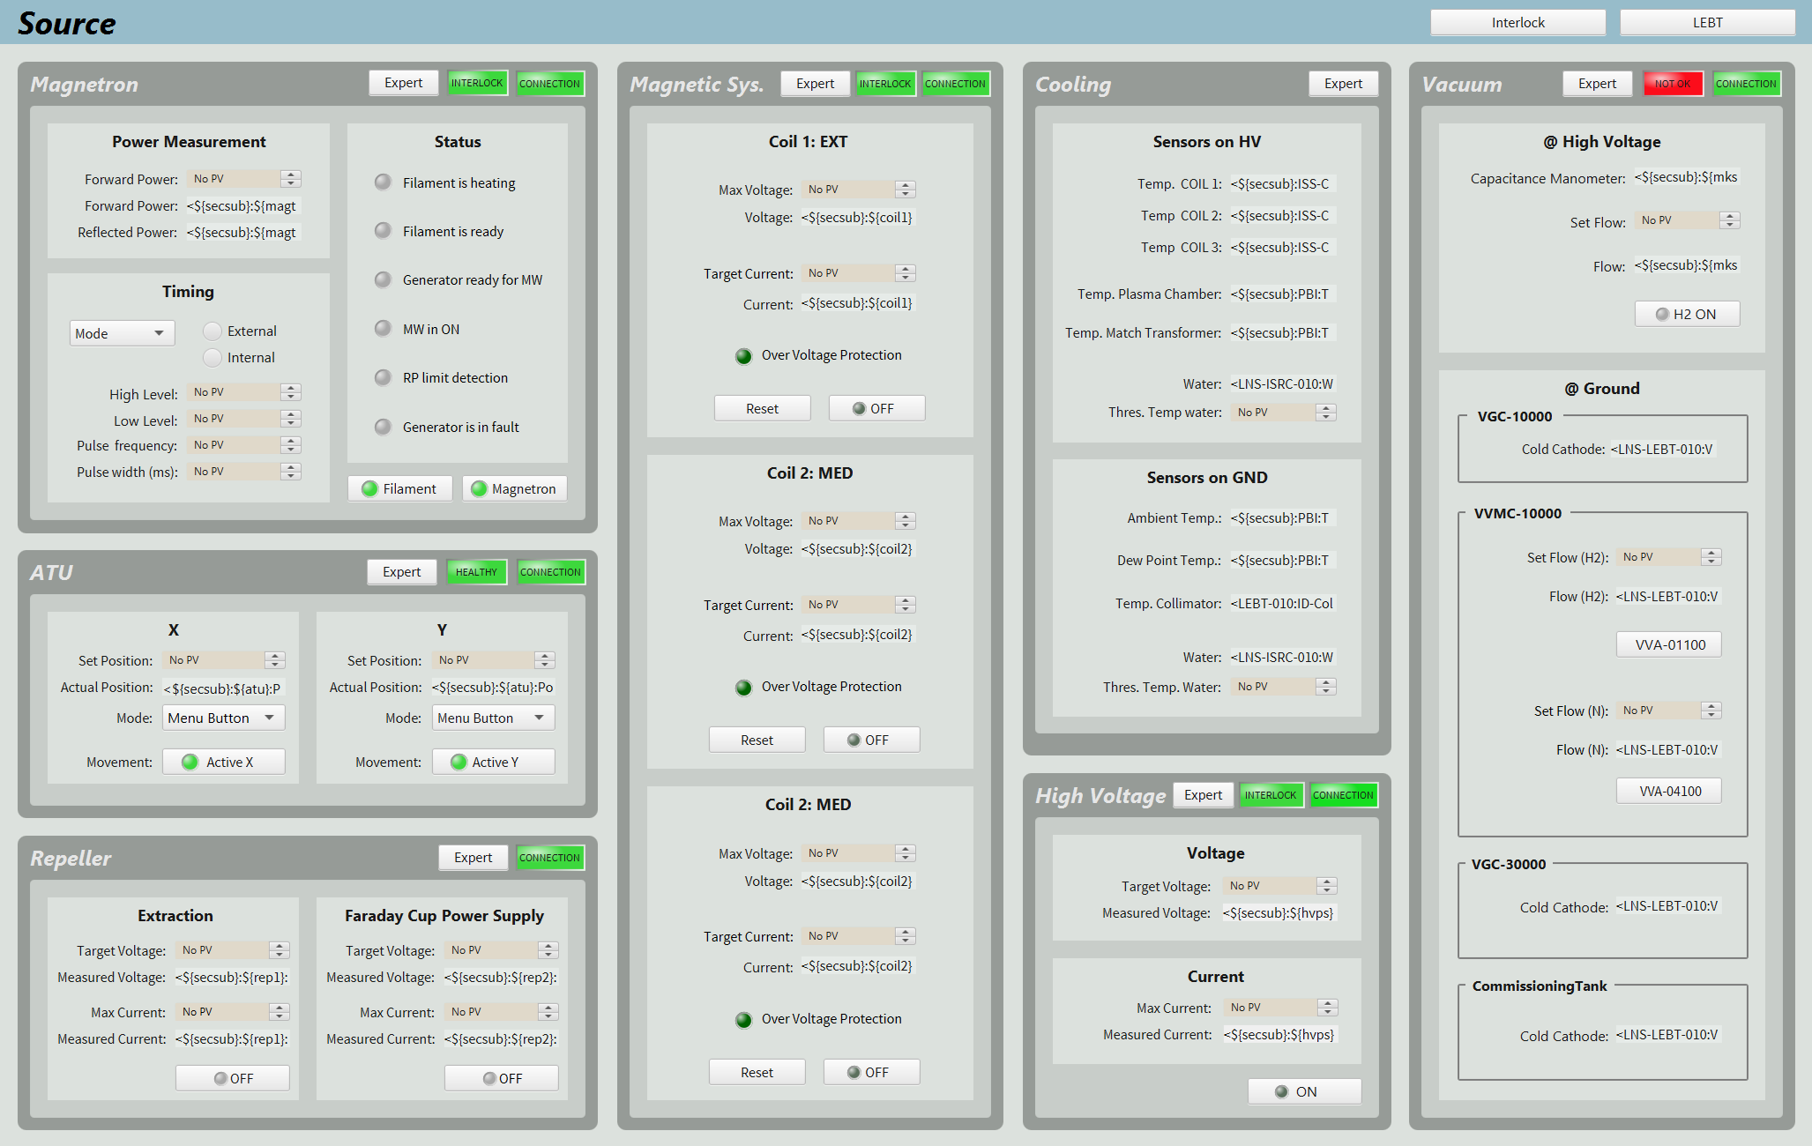
Operating Procedures

Slide 8
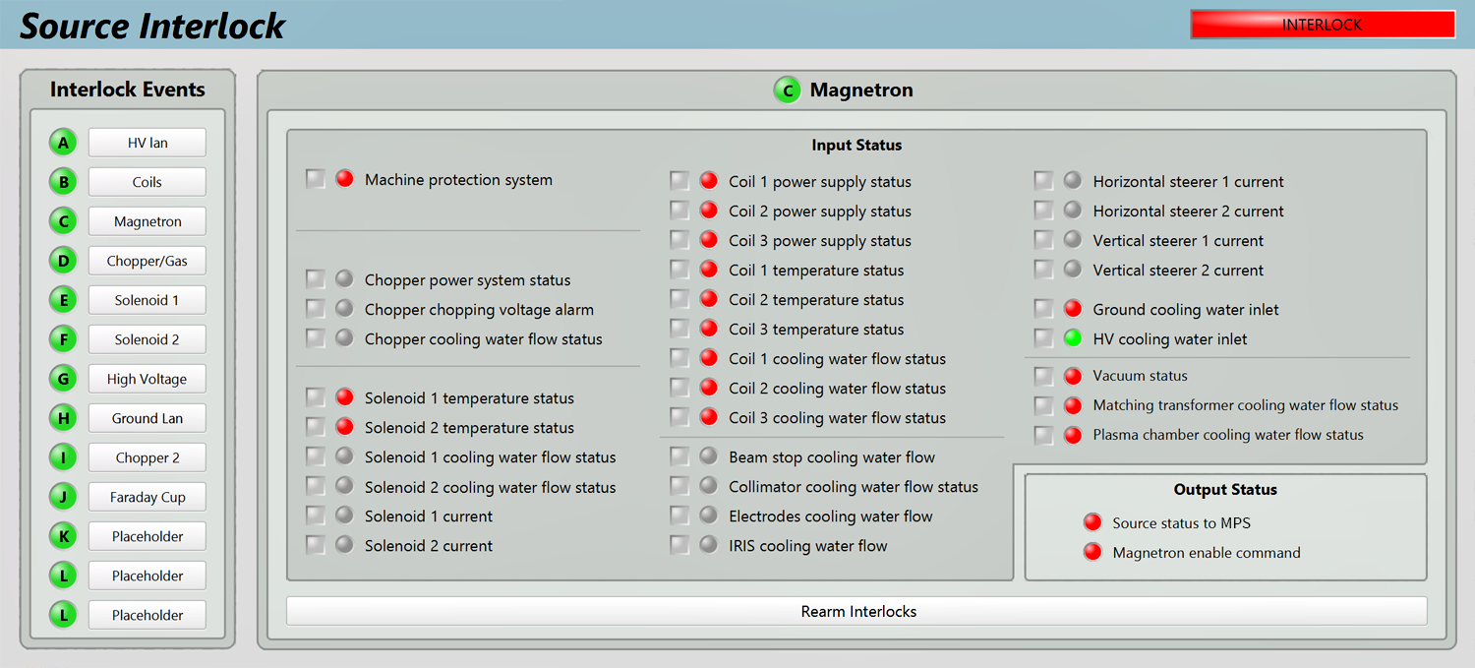
Protection Procedures
ISrc-LEBT Control system doesn’t have any personal safety functionality.
ESS-0121186 : ISrc and LEBT Interlock PLC user manual

Slide 9
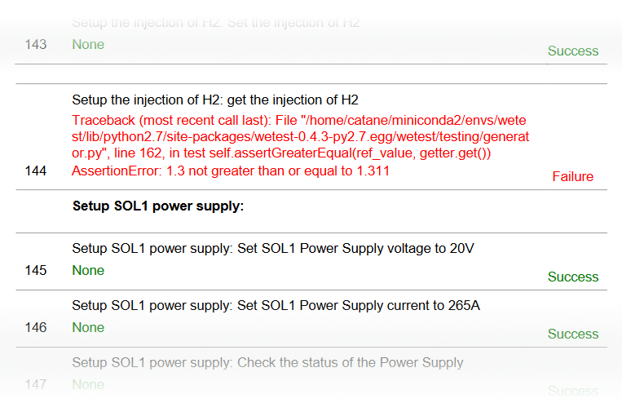
Test & Verification
Automatic test tool “WeTest”:
Reads scenario input.
Write the PV value.
Compare the write value with feedback.
Generate verification report.
ESS-0265170 : ISrc-LEBT Control System Verification Plan
ESS-0135274 : ISrc-LEBT Acceptance Tests Report (Catania)

Slide 10
Outstanding issues
# | System/Comp. | Status | Description | Due date | Remark
1 | ISrc-LEBT control system | Not started | Control Test and Verification | 2018-08-31
2 | Lund Migration | In progress | Naming convention, SW toolchain | 2018-08-31
3 | ISrc Control | In progress | Iris thermocouples Isolation transformer switches | 2018-07-20
4 | FaradayCup – Ion Source | Not started | Remove FaradayCup controls from ISrc VME since controls are moved to MTCA | 2018-07-27
5 | Iris Motion Control | In progress | Iris Geobrick motion control will be ported to EtherCAT

Slide 11
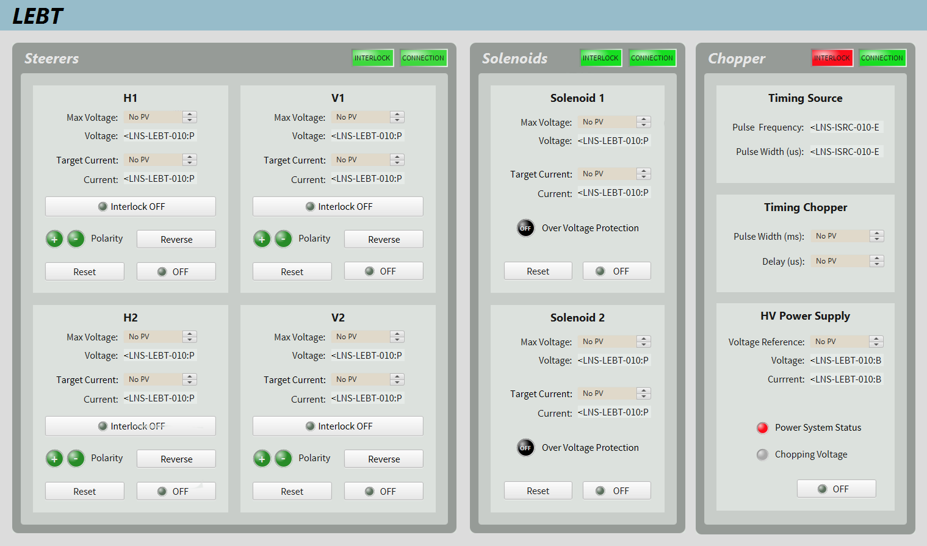
LEBT

Slide 12
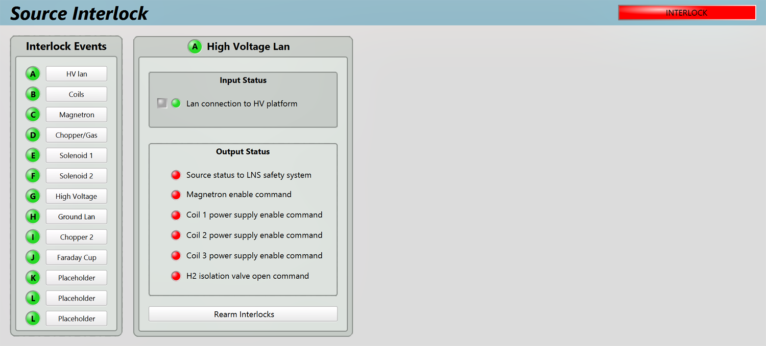
High Voltage Lan

Slide 13
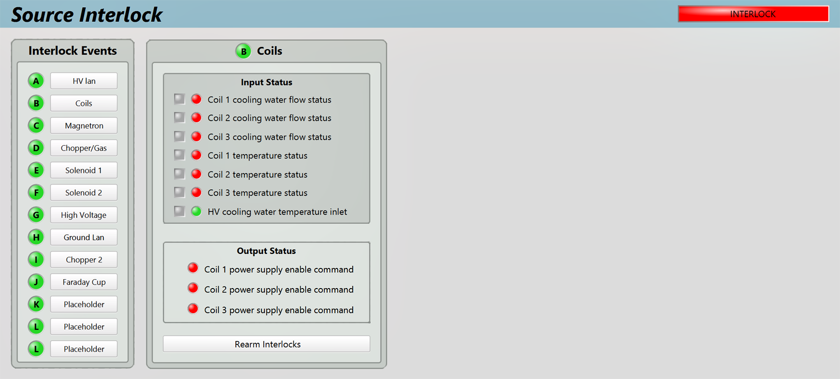
Coils

Slide 14
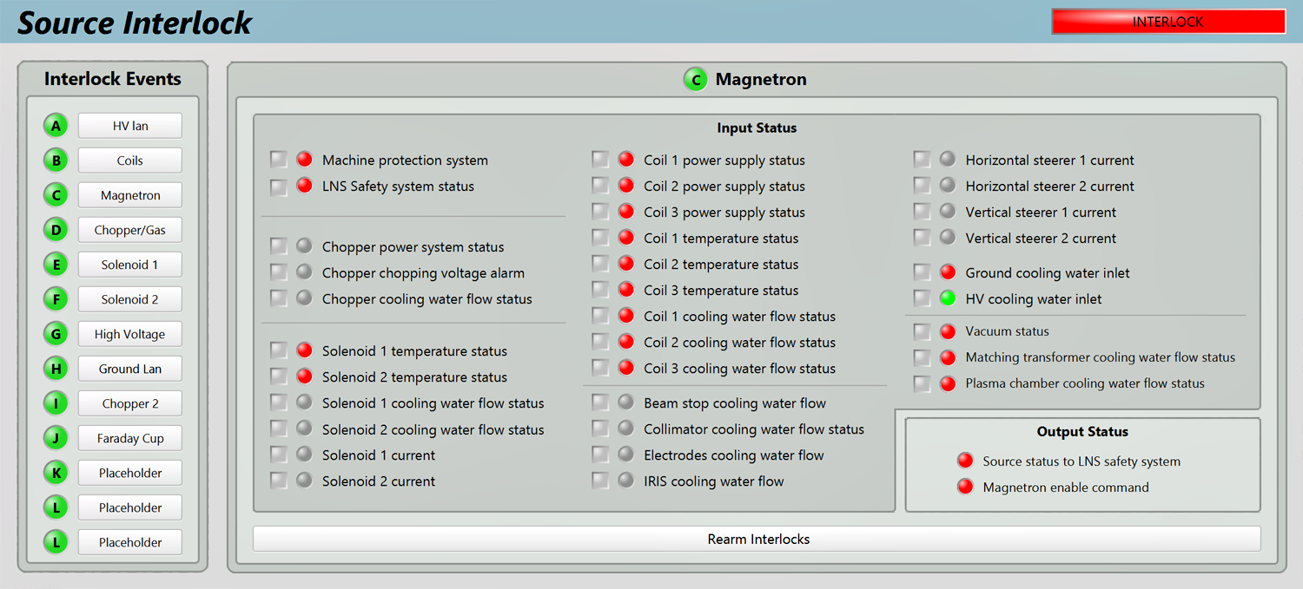
Magnetron

Slide 15
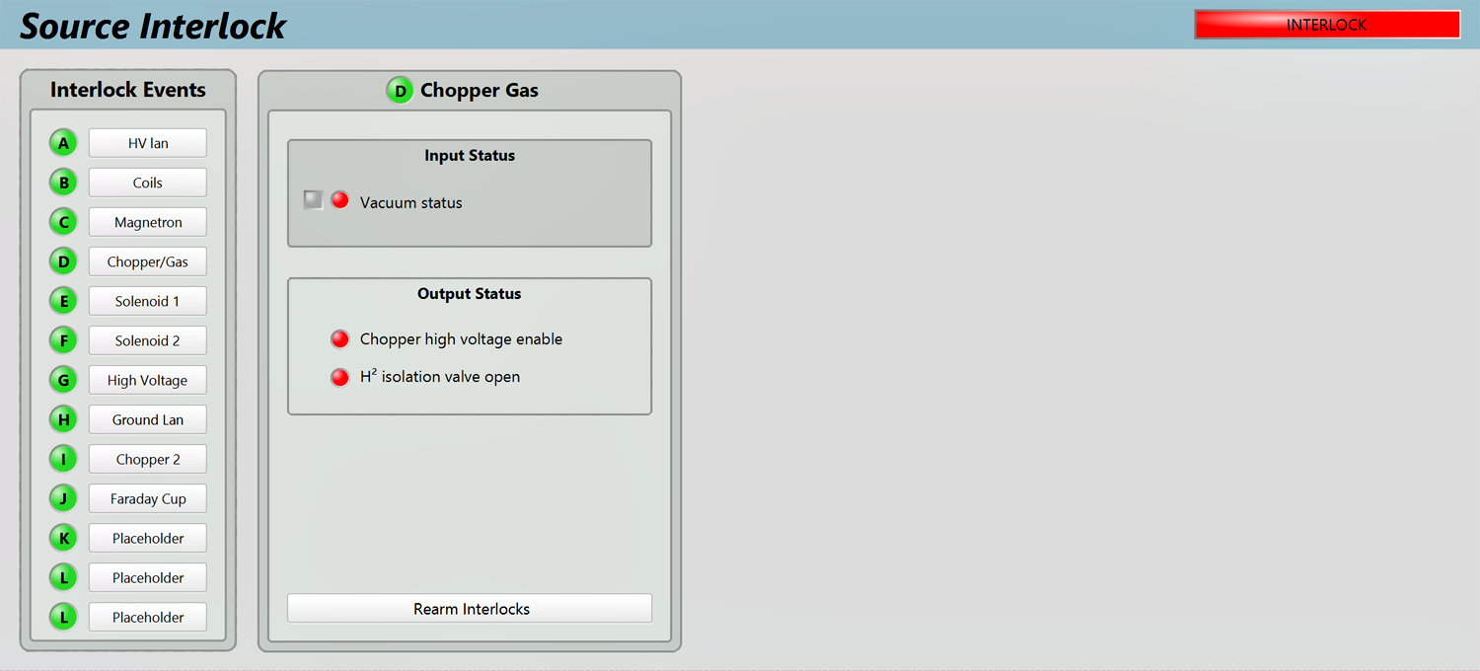
Chopper Gas

Slide 16
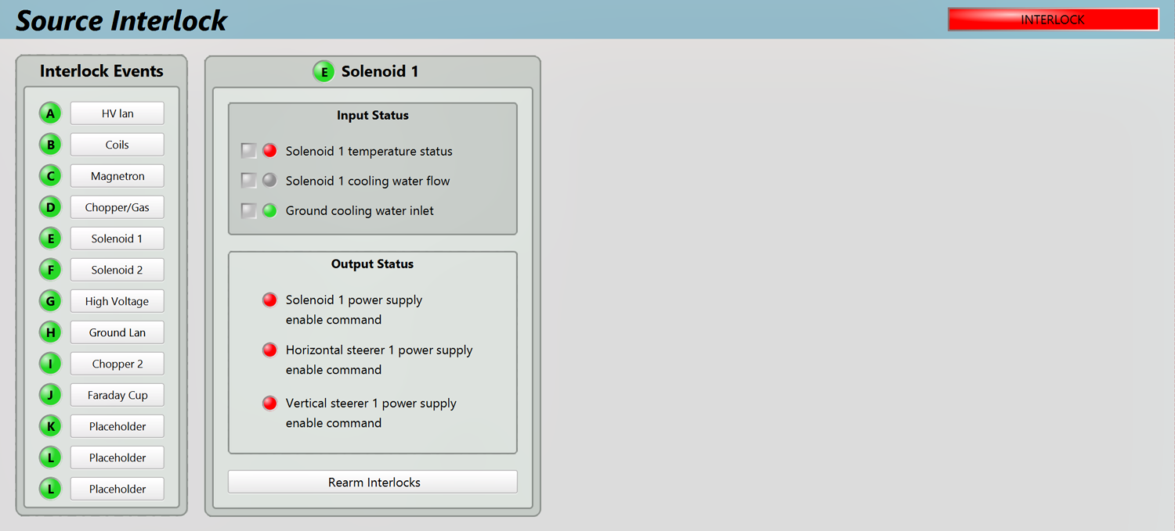
Solenoid 1

Slide 17
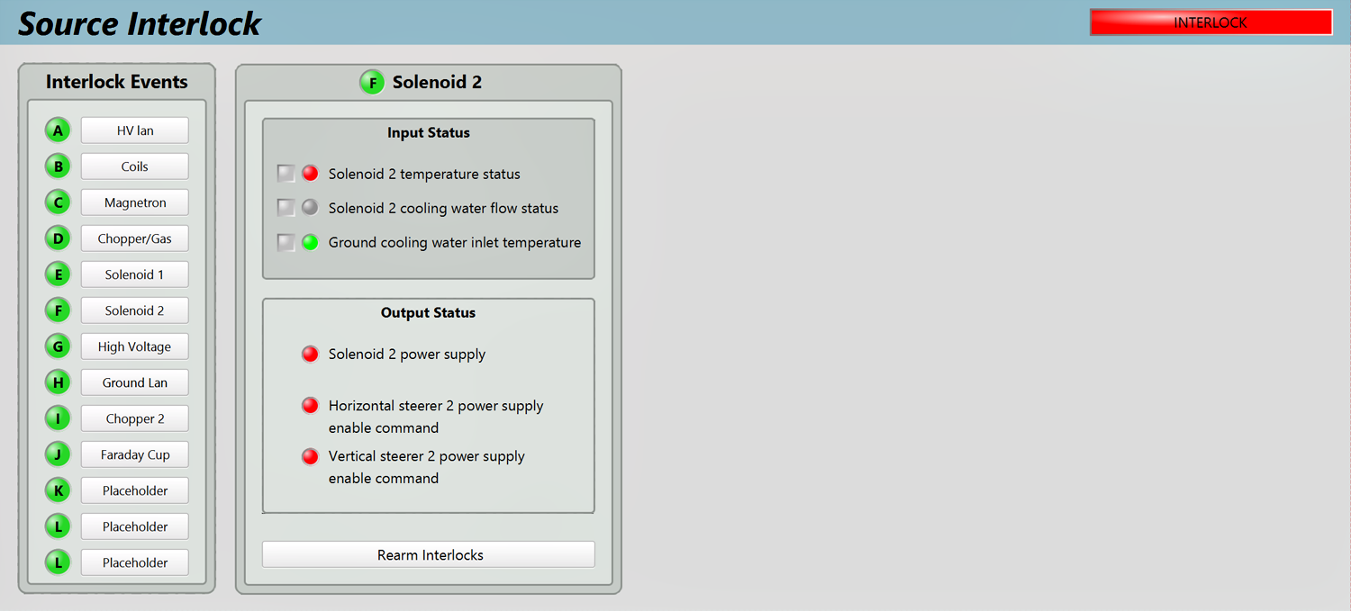
Solenoid 2

Slide 18
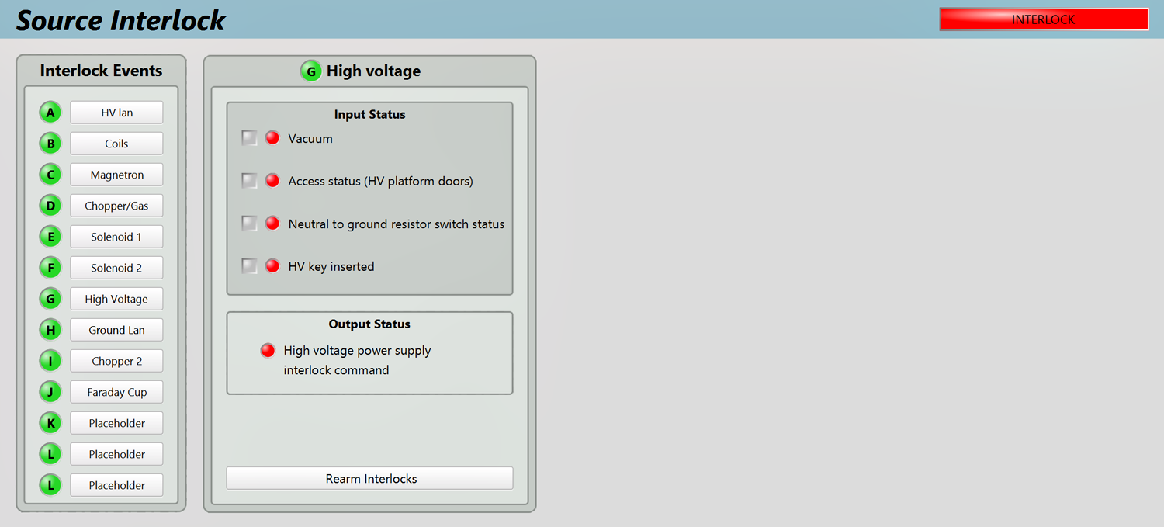
High Voltage

Slide 19
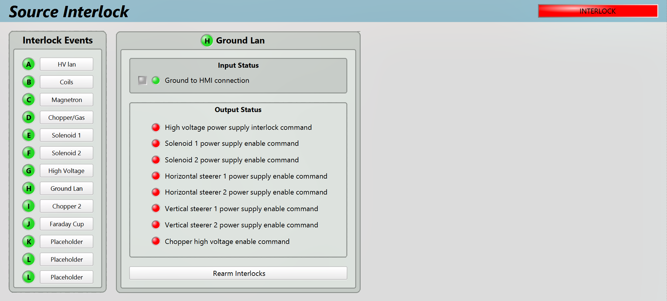
Ground Lan

Slide 20
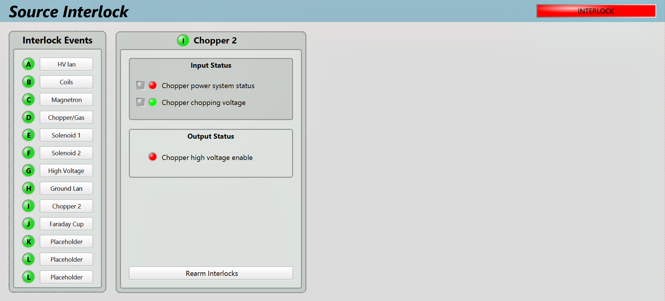
Chopper 2

Slide 21
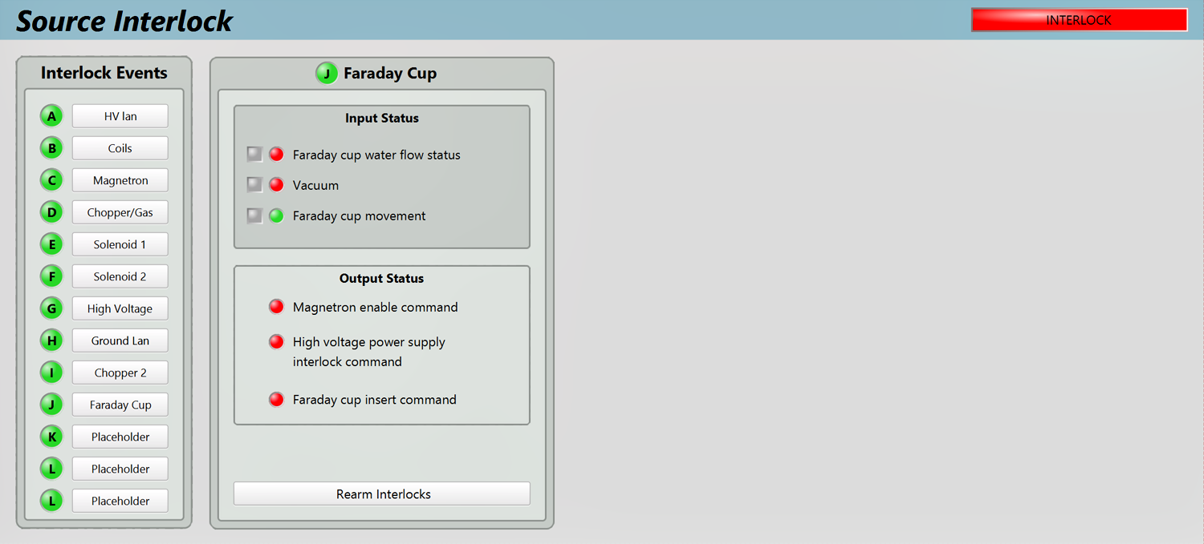
Faraday Cup

Slide 22
Chopper 2

