Slide 1
LEBT water cooling system
Lars Rosberg
Senior Technician Cooling Water Systems
SRR 1 – Ion Source & LEBT
2018-07-17--18

Slide 2
System – Cooling Water System
Ion source
Low energy beam transport (LEBT)
PSS0 controlled area
and radiation shielding
Ion source
LEBT 1
LEBT 2
Plasma chamber
Extraction system
Pumping box
Solenoid
2 x steerer
Gate valve
Iris
Diagnostics tank
Gate valve
Solenoid
2 x steerer
Collimator
Commissioning tank (RFQ)
Magnetron
Waveguide
H₂ bottle
HV controls
3 x solenoid
Repeller
2 x TMP
Chopper
Repeller
Beam stop
EMU H+V
ACCT
EMU H+V
N₂ bottle
Faraday cup
Faraday cup
High voltage (HV) platform
NPM H+V
NPM H+V
ACCT
Voltage divider
Doppler shift
Doppler shift
2 x TMP
2 x TMP
Primary pump
Primary pump
Isolation transformer
HV power supply
Ground potential controls
Front End and Magnets
Vacuum
PSS
ACCT: AC current transformer
EMU: Emittance measurement unit
NPM: Non-invasive profile monitor
TMP: Turbomolecular pump
Alternative location of beam instruments for commissioning
Beam Diagnostics
Cooling water
Control system

Slide 3
Table of content
System Requirements
Operating procedures
Skid state of Operation
Operating procedures
Test & Verification
Open issues

Slide 4
CWS01 Cooling Water Skid

Slide 5
System Requirements
Provide cooling to ISrc and LEBT
The system has been designed to reject 85kW when supplying circulating coolant deionized water at a maximum of 40°C in a maximum ambient temperature of 20°C and at a flow rate of 300 lpm at a design pressure of 10 barg.
Main components are Run/Standby centrifugal pumps, stainless steel plate heat exchanger, deionisation sub circuit, degassing system, isolation valves, water filters, expansion vessel, fill loop

Slide 6
System Requirements
Design pressure/flow:
Process circuit: 6 barg/305 lpm
Primary CWL circuit: DP 1,1 bar/305 lpm
Maintain cooling water quality (<0.3 uS/cm, DO 40-50 ppb)
Local control and HMI on the skid.
All PV-transfer by Profinet to Control System (EPICS)

Slide 7
Operation procedures
Skid will start on rising edge pulse from Control System
The system will run automatically, to control pressure, flow, temperature, conductivity, oxygen content all within stated parameters.
Ion-exchangers and filters to be monitored and maintained (yearly)
Sensors to be checked (yearly)
Nitrogen gas supply (bottles) to be monitored and exchanged. (weekly)
Deoxygenation system must be purged when longer periods without operation.

Slide 8
Skid state of Operation
Hard wired control and alarm from/to Control System
Start / Stop Enable Run Mode
System Running The system is in Run Mode
Enable Load The System is in Run Mode AND
Flow has been established AND
Flow AND Temperature is within acceptable limits AND Conductivity is within acceptable limits
Alarm Present There is an active or unacknowledged alarm on the system
Trip Present There is an active trip.
High Temp Alarm Trip

Slide 9
Test & Verification
All internal signals, alarms and trips has been verified during FAT and SAT acc to test procedure.
CW manifolds and connections integrity tested with nitrogen (7bar)

Slide 10
Outstanding issues
# | System/Comp. | Status | Description | Due date | Remark
1 | CWS01 | Pending | Documentation | July 2018
2 | CW Pipes to ISrc | Not connected | Connections to be modified | July 2018
3 | CWL Pipes | Ongoing | Insulation of pipes | July 2018

Slide 11
Thank You!
Questions?

Slide 12
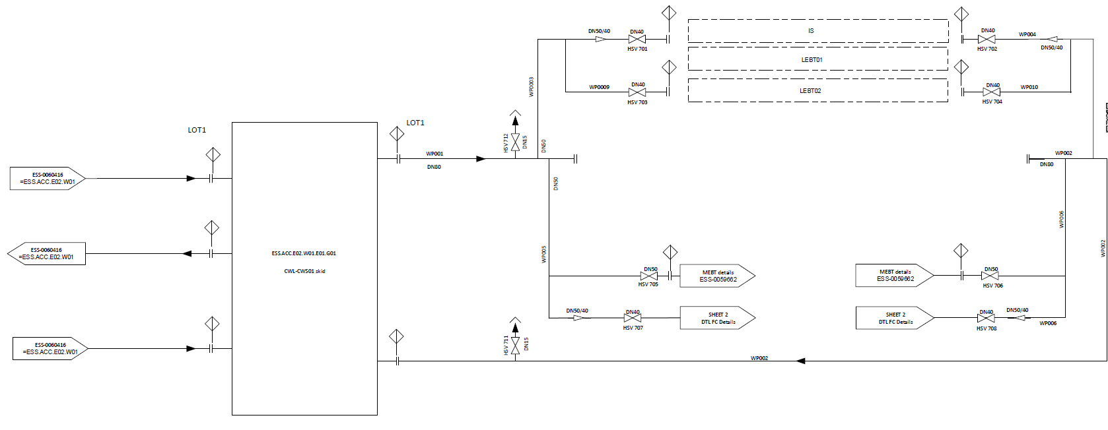
P&ID

Slide 13
P&ID

Slide 14
P&ID

Slide 15
P&ID

Slide 16
P&ID

Slide 17
P&ID

Slide 18
P&ID

