Slide 1
Ion Source and LEBT Beam Diagnostics
Tom Shea
Beam Diagnostics Section Leader
Beam Diagnostics (WP7) Work Package Manager
SRR 1 – Ion Source & LEBT
2018-07-17--18

Slide 2
Beam Diagnostics
Ion source
Low energy beam transport (LEBT)
PSS0 controlled area
and radiation shielding
Ion source
LEBT 1
LEBT 2
Plasma chamber
Extraction system
Pumping box
Solenoid
2 x steerer
Gate valve
Iris
Diagnostics tank
Gate valve
Solenoid
2 x steerer
Collimator
Commissioning tank (RFQ)
Magnetron
Waveguide
H₂ bottle
HV controls
3 x solenoid
Repeller
2 x TMP
Chopper
Repeller
Beam stop
EMU H+V
ACCT
EMU H+V
N₂ bottle
Beam Diagnostics
Faraday cup
Beam Diagnostics
Faraday cup
High voltage (HV) platform
NPM H+V
NPM H+V
Beam Diagnostics
ACCT
Voltage divider
Doppler shift
Doppler shift
2 x TMP
2 x TMP
Primary pump
Primary pump
Isolation transformer
HV power supply
Ground potential controls
Front End and Magnets
Vacuum
PSS
ACCT: AC current transformer
EMU: Emittance measurement unit
NPM: Non-invasive profile monitor
TMP: Turbomolecular pump
Alternative location of beam instruments for commissioning
Beam Diagnostics
Cooling water
Control system

Slide 3
Table of Content
System Requirements
Safety Aspects
Operating procedures and training
Test & Verification
Remaining issues

Slide 4
System Requirements
Measurement Requirements allocated to 5 system types
Beam Accounting
Beam Current Monitors (BCM)
Faraday Cup (FC)
Doppler (DPL)
Beam Centroid
Non-invasive profile monitor (NPM)
Beam Distribution
Non-invasive profile monitor (NPM)
Emittance measurement unit (EMU)
Examples of key requirements
1 mA accuracy on current
1% uncertainty on ion species fraction
100 µm accuracy on position
10% beam size precision
10% emittance accuracy

Slide 5
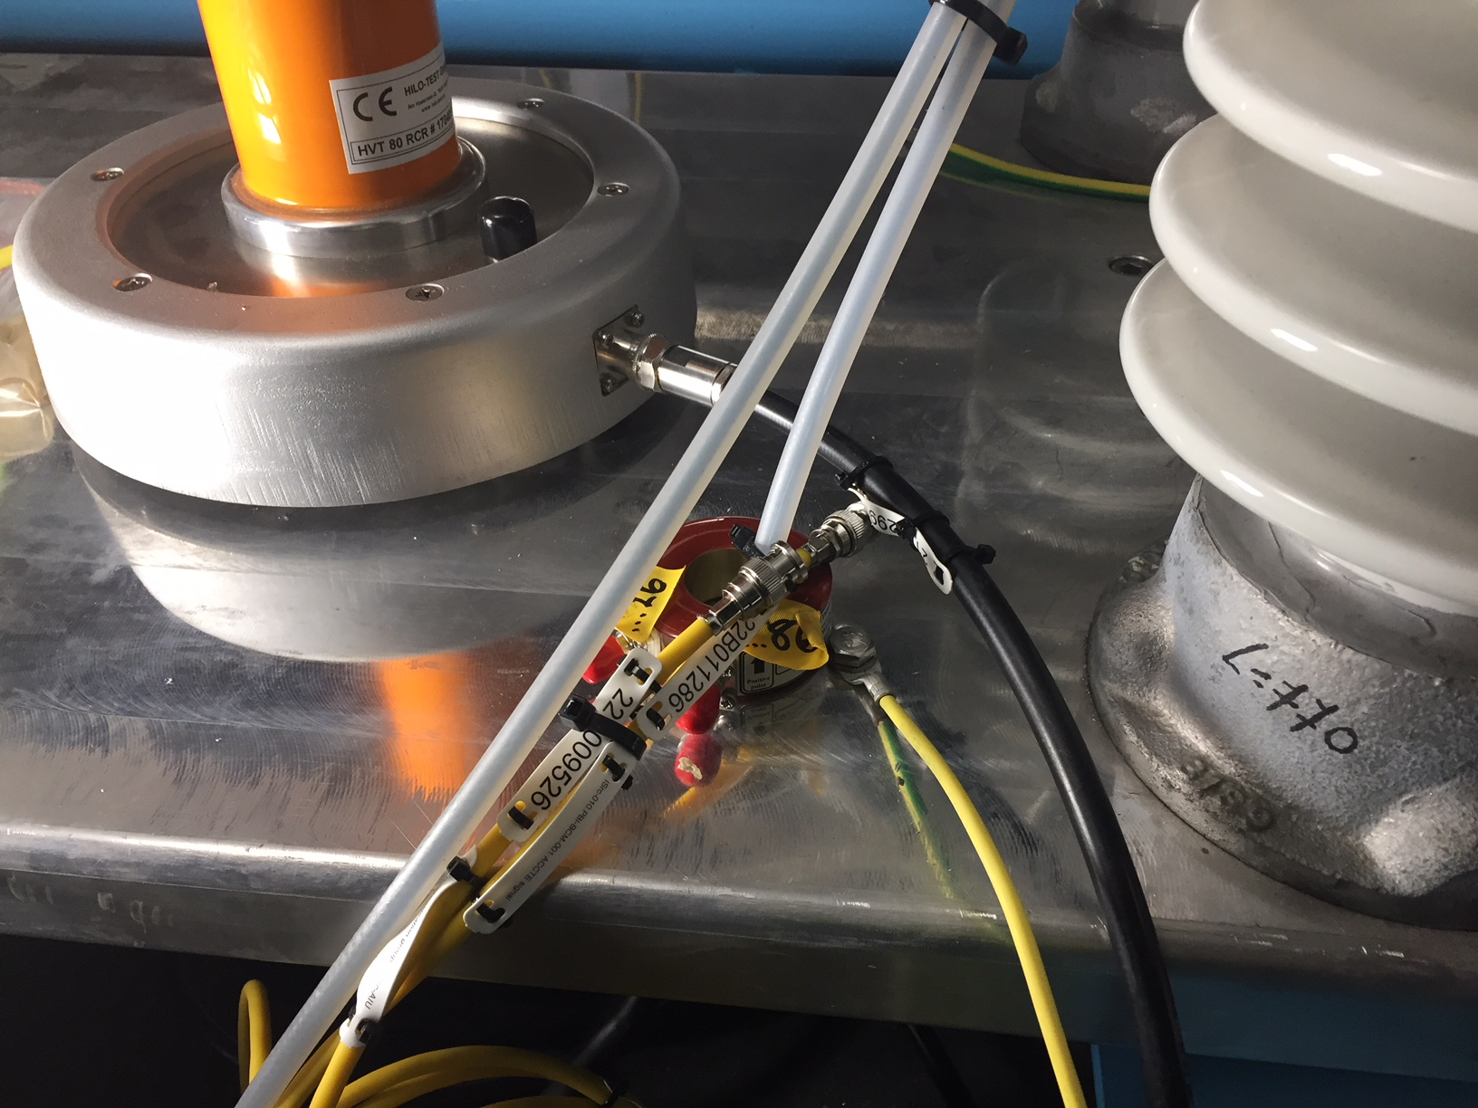
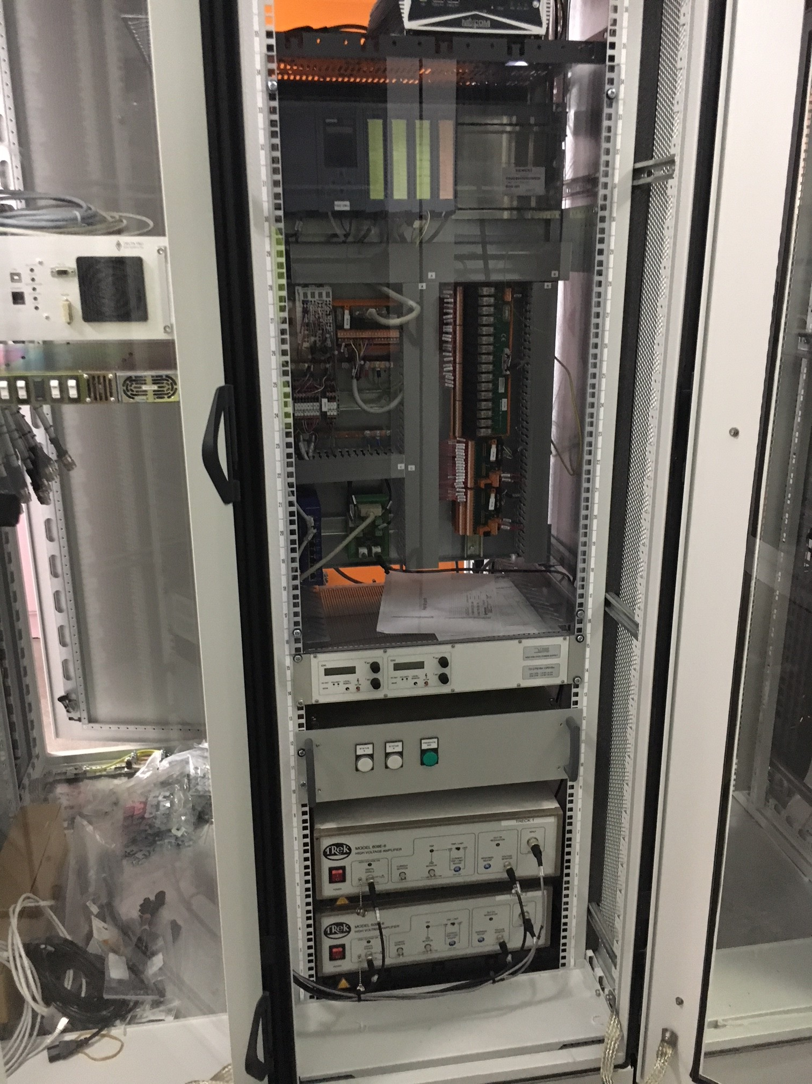
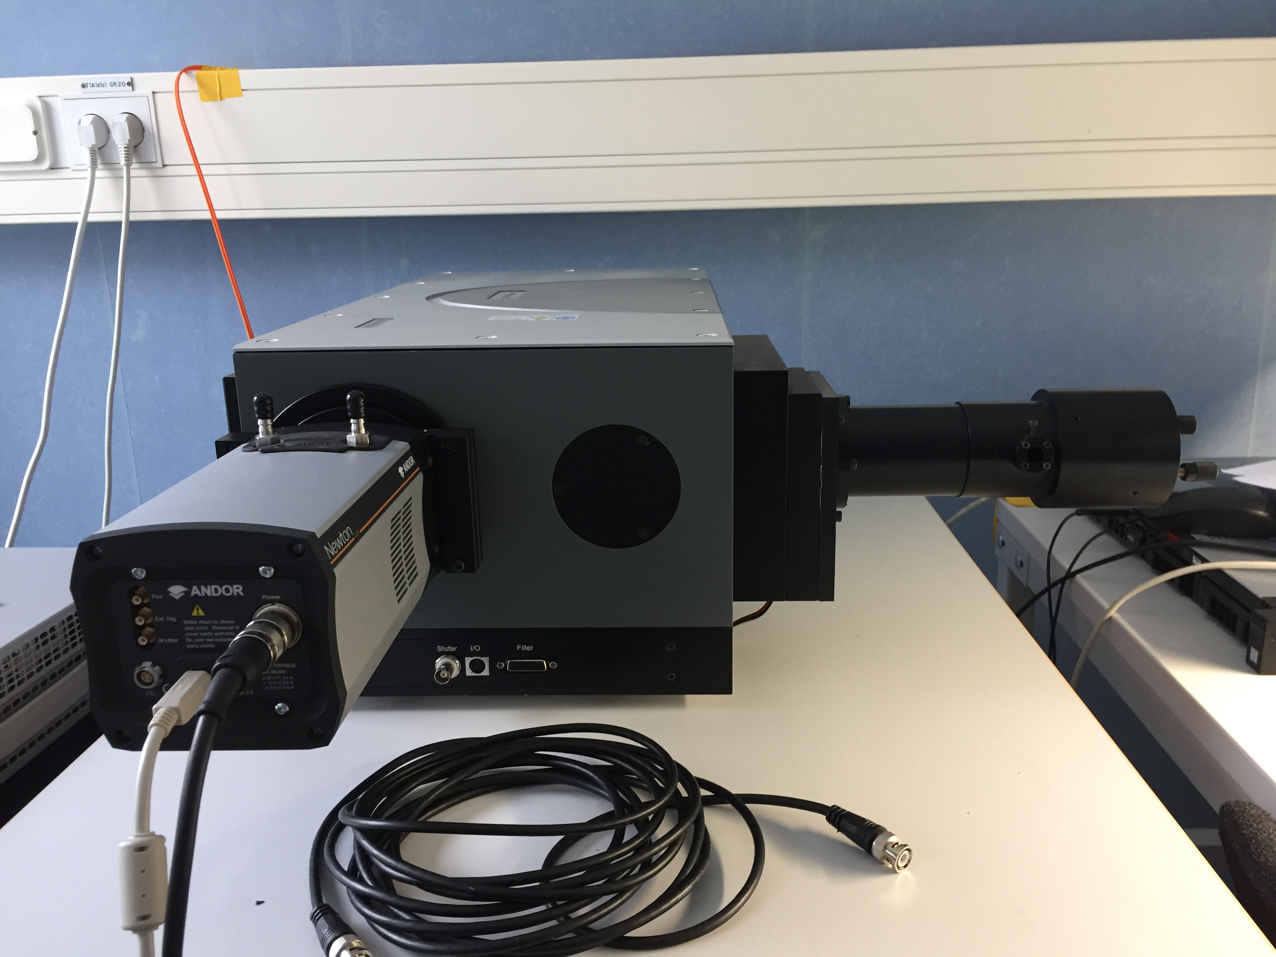
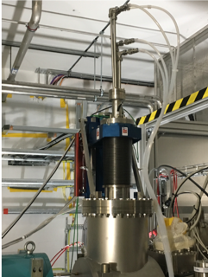
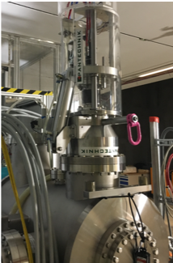
System Components
Beam Current Monitor for Ion Source Supply Current
Non-invasive Profile Monitor Camera system
Most electronics rack-mounted, power via Schuko sockets
Doppler Spectrometer
Emittance Measurement Unit
Actuator on LEBT
Faraday Cup on LEBT

Slide 6
Safety Aspects
The Beam Diagnostic systems are not classified as safety systems
During IS and LEBT commissioning, they are not yet relied upon to report beam properties that are limited by licensing conditions.
They do contribute to a safe operations culture by providing situational awareness.
Trustworthy operation is assured by completing calibration prior to beam operations
The beam diagnostics section members participate in commissioning activities to verify performance with beam
They do present some hazards that are mitigated by by engineering controls. As a primary example, finger-safe enclosures encapsulate:
voltage/current
mechanical pinch points

Slide 7
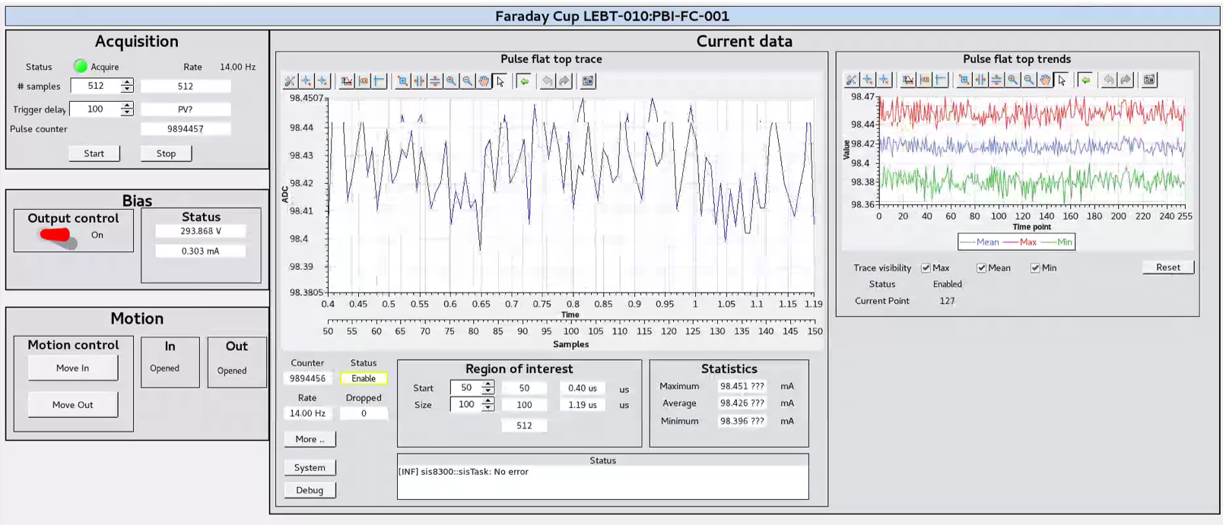
Operating procedures and training
One user manual per system. Training will be provided prior to first protons.
One high-level operator screen per system
Key beam data consolidated on overview screens
Faraday Cup screen

Slide 8
Test & Verification
One Verification Plan/report per system
Data in HDF5 linked to each asset (field-replaceable units and systems)
System | FAT | SAT | Installation | Integration | Verification | Verification with beam
BCM
FC
EMU
Doppler
NPM
completed
in progress

Slide 9
Remaining Issues
week | 28 | 29 | 30 | 31 | 32 | 33 | 34 | 35 | 36 | 37 | 38 | 39 | Oct
First rack powered
~4 weeks to integrate and verify all systems
Beam
ICS infrastructure
~3 weeks for issue mitigation and training
Verify BCM
Verify FC
Verify NPM and DPL
Verify EMU (single plane)
Beam verification, BCM, FC
Beam verification, EMU, NPM, DPL
Install repaired EMU (second plane)

