Slide 1
ISRC and LEBT Vacuum System Design
Simone Maria Scolari
Vacuum System Engineer
SRR 1 – Ion Source & LEBT
2018-07-17--18

Slide 2
System - Vacuum
Ion source
Low energy beam transport (LEBT)
PSS0 controlled area
and radiation shielding
Ion source
LEBT 1
LEBT 2
Plasma chamber
Extraction system
Pumping box
Solenoid
2 x steerer
Gate valve
Iris
Diagnostics tank
Gate valve
Solenoid
2 x steerer
Collimator
Commissioning tank (RFQ)
Magnetron
Waveguide
H₂ bottle
HV controls
3 x solenoid
Repeller
2 x TMP
Chopper
Repeller
Beam stop
EMU H+V
ACCT
EMU H+V
N₂ bottle
Faraday cup
Faraday cup
High voltage (HV) platform
NPM H+V
NPM H+V
ACCT
Voltage divider
Doppler shift
Doppler shift
2 x TMP
2 x TMP
Primary pump
Primary pump
Isolation transformer
HV power supply
Ground potential controls
Front End and Magnets
Vacuum
PSS
ACCT: AC current transformer
EMU: Emittance measurement unit
NPM: Non-invasive profile monitor
TMP: Turbomolecular pump
Alternative location of beam instruments for commissioning
Beam Diagnostics
Cooling water
Control system

Slide 3
Table of content
System Requirements (high level)
Specific safety systems (engineered control)
Operating & safety procedures (administrative control)
Test & Verification
Allowed testing Envelope
Open issues

Slide 4
System Requirements (high level)
Operational pressure
The gas throughput from the LEBT to the RFQ at the LEBT-RFQ mechanical interface shall not exceed 2x10⁻³ mbar l/s (P = 6E-5 mbar)
Leak Tightness
2x10-10 mbar l/s for metal connections;
2E-8 mbar l/s for connections where polymeric gaskets are used

Slide 5
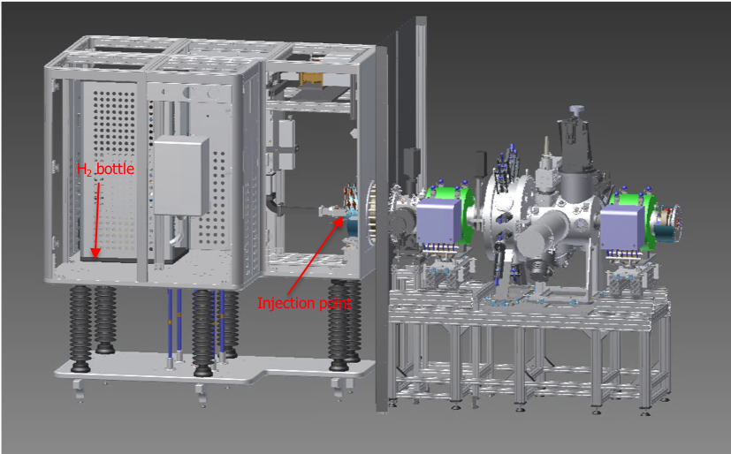
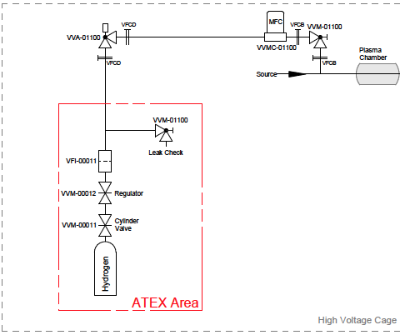
Specific safety systems
No ”on-line” leak monitoring system is envisaged in the design.
Leak Check of the delivery line will be executed at each bottle exchange according to ESS-0012897 – ”ESS Vacuum Handbook Part 4 – Helium Leak Test”.
Bottle exchange will be carried only by trained operator.
A self-venting regulator has been selected since the accidental release of the entire content of hydrogen is not considered hazardous. A 10 l, 100 bar bottle will be used.

Slide 6
Operation procedures
Primary pump
Pneumatic angle valve
Gauge
Turbomolecular pump
Sector gate valve
Mass Flow controller

Slide 7
Test & Verification
Vacuum Control System (ICS scope)
Test and Verification is on going according to:
ESS-0087031 - LEBT Vacuum Control System - System Requirement Specification
ESS-0087038 - LEBT Vacuum Control System - Verification and Validation Plan
Leak Check
Leak Check according to ESS-0012897 – ”ESS Vacuum Handbook Part 4 – Helium Leak Test”.
All the existing connection have been leck checked. The beam stop cooling system presents a water leak.
Leak check on gas delivery systems to be executed.

Slide 8
Outstanding issues
# | System/Comp. | Status | Description | Due date | Remark
1 | Iris cooling line | OK | Polymeric gaskets on cooling lines | N/A | Risk to run the IRIS with polymeric gasket when RFQ will be in place.
2 | Turbomolecular pump | Failure | The pump is not working | N/A | Not a stop for starting operations
3 | H2 and N2 delivery system | Not ready | Gas delivery systems have not been installed yet | End of July | All part have been already procured
4 | Beam stop | Leaking | A water leak has been found | On going | FC can be used; no issue for starting of operation. Beam stop will be substituted with a water cooled flange.

Slide 9
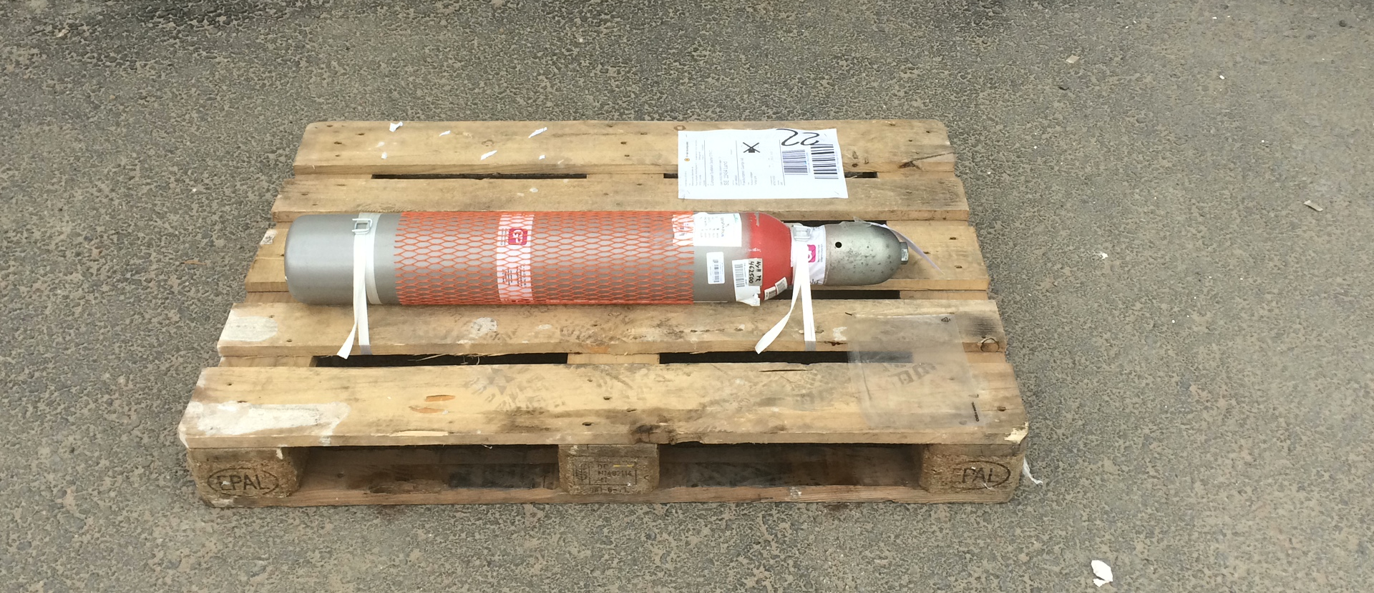
Questions
First ESS proton is in this bottle!

