Slide 1
European Spallation Source ERIC
Procurement Processes
Mirko Menninga
Head of Supply, Procurement & Logistics Division
www.europeanspallationsource.se
29 August 2018

Slide 2
Opportunities for doing business with ESS
Skanska for civil construction
  Contract in place with Skanska for conventional facilities, Skanska conducting procurement for sub-contractors for materials and works
ESS Procurement for goods and services from ESS budget
  European Spallation Source ERIC follows ERIC public procurement rules
In-kind contributions (IKCs) from partner institutions in ESS member countries
  Opportunities through IKCs from partner institutes in member countries

Slide 3
Construction and Operation Budget Profile – Business opportunities during construction (near-term) and operations (long-term)

Slide 4
European Spallation Source ERIC Procurement Rules
ESS procurement governed by the European Spallation Source ERIC procurement rules (as of 1 October 2015, revision as of 1 April 2017)
Purpose
  To explain how ESS ERIC conducts procurement, providing transparency on tender procedures, rights and obligations of suppliers, including a review and appeal procedure
  Applies to all contracts for pecuniary interest for the provision of goods, works and services between ESS and a 3rd party [supplier]
Principles and objectives
  Following the EU treaty principles of:
    Transparency, proportionality, mutual recognition, equal treatment and non-discrimination
  Promoting the objectives of:
    Value for money, publicity, integrity, innovation, sustainability
Available at https://europeanspallationsource.se/procurement
4

Slide 5
European Spallation Source ERIC Procurement Rules – Overview of Procurement Procedures*
*Minimum procedure applicable by value
**Minimum timing does not include time required for preparation and evaluation**

Slide 6
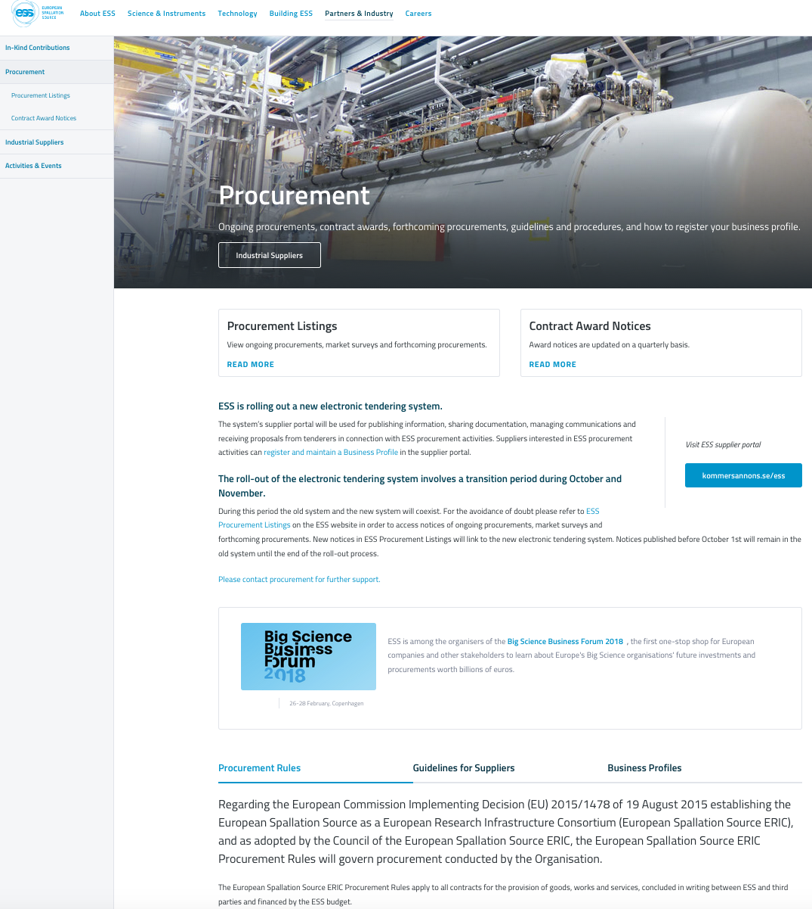
ESS procurement information
ESS Website
(http://europeanspallationsource.se/procurement)
Procurement Listings
Contract Notices >50,000 EUR
Market Surveys / Requests for Information
Forthcoming Procurement
Indicative information published to give greater visibility to industry on ESS’ procurement plans.
Contract Award Notices
For procurements published on the website, published by month of contract signature, updated quarterly
Guidelines for Suppliers on ESS procurement
Official Journal of the European Union
May be used for contract notices >200,000 EUR
Pre-Commercial Procurements and/or Public Procurement of Innovation
Industrial Liaison Offices (ILOs)
Via weekly email and notifications of new call for tenders

Slide 7
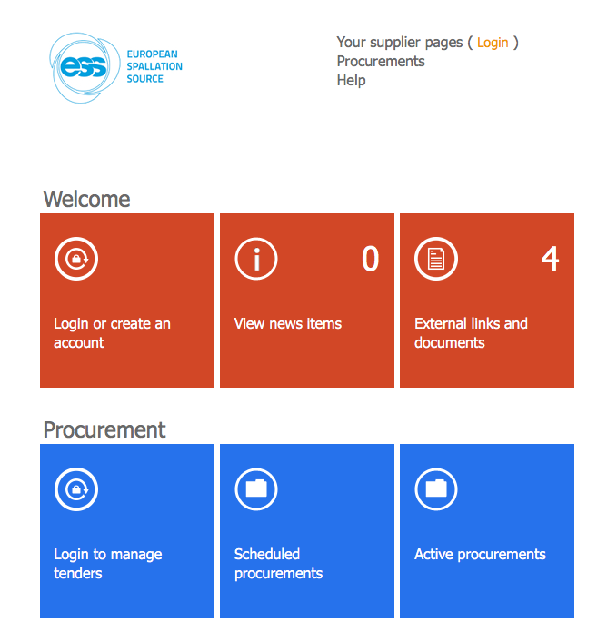
E-Procurement Tool
Rolled-out 1 October 2017
Used for publishing information, sharing documentation, managing communications and receiving proposals
Interested suppliers can register and maintain a business profile in the tool and configure notifications for new tenders

Slide 8
Upcoming tender opportunities
https://europeanspallationsource.se/procurement/listings#forthcoming-procurements
Examples:
  Inner shielding (3 parts / tenders)
  Material for inner shielding (published)
  Outer shielding (published)
  Installation related framework agreements (resources and/or material) – 2 about to be published this week!
  Neutron Beam Extraction systems, tooling, beam guides, light shutters, plug, test stand and skids
  Baseplates NBEX and Instruments
  CUB server room implementation (based on existing design)
  Bunker project (published)
  Klystrons High-Beta
  Monolith Baseplate (awarded, stand-still period ongoing)
  2 Circulators and 4 Loads for RFQ and DTL section (published)

Slide 9
Estabalished framework agreements - 1
Software Licenses and Services - CAD-Tool for Electrical Design | From July 2015 - 1 July 2017 (+1 +1 years) | EPLAN Software & Service AB
FWA for Technical Consultants & Services | From July 2016 - 30 June 2018 (+1 +1 +1 years) | 31 Suppliers
FWA for Moving Services (for staff moving household upon recruitment) | From Februrary 2016 - 31 January 2018 (+1 +1 years) | Alfa Quality Moving
Catalogue IT Equipment | From December 2015 (2 + 2 years) | Dustin AB / Atea Sverige AB / TDC AB
Catalogue Personal Safety Sytems | From June 2015 (4 years) | Siemens AB
Catalogue Automation Systems | From September 2015 (2 + 2 years) | Siemens AB
Agreement for Provision of Relocation Services | From March 2016 (2+2 years) | Alfa Quality Moving

Slide 10
Estabalished framework agreements - 2
FWA for Temporary Administrative staff (Concultancy) | Under new procurement | Perido AB, Proffice AB, Adecco AB
FWA for Communication Services | From May 2016 (2+1+1 years): Lot 1 and Lot 4; From August 2016 (2+1+1 years): Lot 2 | Lot 1: Bysted AB, ID Kommunikation AB, Mannov A/S; Lot 2: Aspekta AB, Mannov A/S, AprilSix Proof; Lot 4: First Flight Eigth Wonderleap FEW AB, Odd Hill AB, Ottoboni Sweden AB
Office Furniture and Complements | From January 2018 (1+1+1+1+1 years) | Kinnarps AB
P&ID and Piping Tool | From May 2016 (2+1+1+1 years) | Aveva Sverige AB
FWA for the provision of Inspection Services | From July 2016 (2+1+1 years) | Lot1: TUV NORD SWEDEN AB, INSPECTA NUCLEAR AB Lot 2: DEKRA AB;INSPECTA NUCLEAR AB; FORCE TECHNOLOGY AB Lot3: FORCE TECHNOLOGY AB; DEKRA AB; INSPECTA NUCLEAR AB Lot4: DEKRA AB; INSPECTA NUCLEAR AB; FORCE TECHNOLOGY AB

Slide 11
Estabalished framework agreements - 3
FWA for consultacy support concerning provision of Software Development Services for ESS Integrated Control Systems | From August 2016 (2+1+1+1 years) | Lot 1: 10 suppliers Lot 2: 9 suppliers Lot 3: 5 suppliers Lot 4: 5 suppliers
FWA for vacuum components | From August 2017 (1+1+1+1 years) | Leybold GmbH; Pfeiffer Vacuum Scandinavia AB; Low2High Vacuum AB; MKS Instruments UK Ltd; SAES Getters SpA
FWA for Data and Communication Cables | From August 2017 (2+1+1 years) | Coromatic AB
FWA for moving of goods | From February 2018 (2+1+1 years) | 1. Move4U 2. Freys Express
FWA for Industrial Cleaning Services | From January 2018 (1+1+1+1+1 years) | Svedala Utemiljo
Scaffolding | From January 2017 (2+1+1+1 years) | Heab

Slide 12
Estabalished framework agreements - 4
Site Services | From February 2017 (2+1+1+1 years) | Skanska Maskin
FWA for Consultancy support for provision of Integration Services for ESS Integrated Control Systems | From October 2017 (4+1 years) | 15 suppliers
FWA for Electrial components | From August 2017 (2+1+1 years) | Ahlsell, RS Components, Elfa Distrelec
FWA for Lab equipment | From April 2017 (2+1+1 years) | VWR International, TH Geyer
FWA for Timing System Components and Related Technical Support | From November 2017 (1+1+1+1+1 years) | Micro Research Finland
FWA for Consultancy Support - PLM, PDM and CAD consultancy support | From June 2015 - 1 June 2019 (2+1+1 years) | Assistera, Combitech, Infuseit, Nobletek, Qgroup, Semcon, Spectrum, Technia

Slide 13
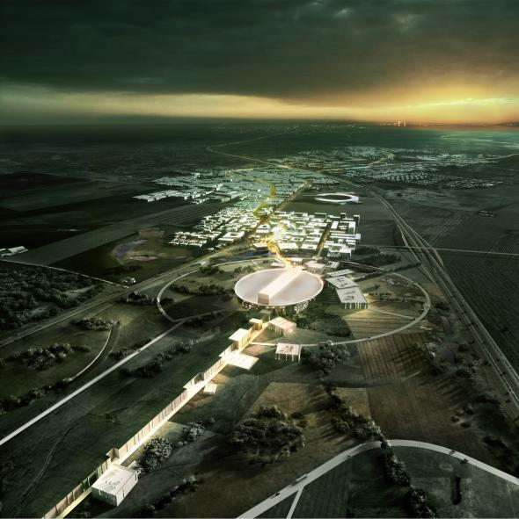
Thank you for your attention

