Slide 1
Installation Site Organization Target Division
Tobias Lexholm
Installation Coordinator, Target Division
www.europeanspallationsource.se
Aug 2018

Slide 2
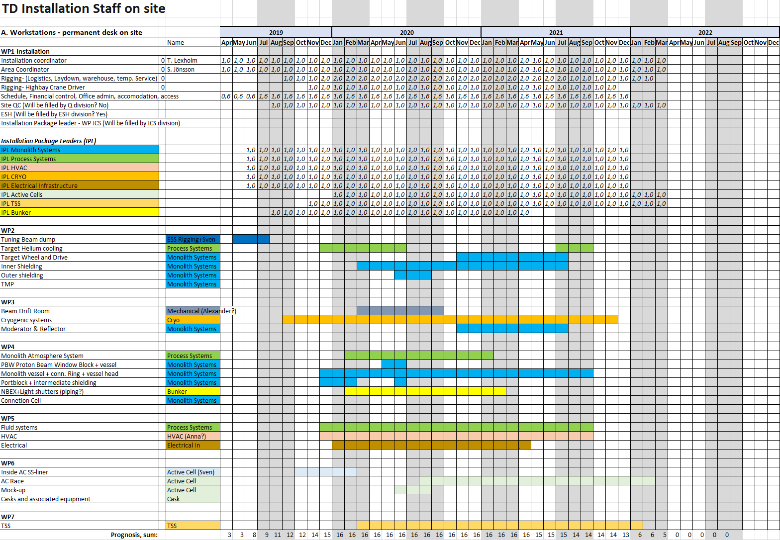
Site Organization

Slide 3
Organization Over all site organization
Over all QC
Installation Inspection
Receival inspection
NDT (X-ray, PT, UT etc.)
Accredited Inspection Body AIB
Accredited Body AB
Final quality documentation
ESS Project Manager
Deputy ESS Installation Coordinator
Available Temporary Services on ESS site
Scaffolding
Laydown Areas
Crane Drivers
Logistics/Transport
Warehouse
Heavy lifting
Temporary Power & Fluids
Concrete Boring/Drilling
Survey/Alignment
Waste
Workshop
ESS Installation Manager
Deputy ESS Installation Manager
Site Admin
Time Schedule
Financial control
Procurement inst. hardware/manpower
ESH
Mechanical Installation support
Electrical Installation support
Rigging support
ESS Framework Agreements
Welders
Fitters
Electrical
I&C
Technicians
Etc.
TD
Installation Coordinator
ACC
Installation Coordinator
NSS
Installation Coordinator
ICS
Installation Coordinator
CF
Installation Coordinator

Slide 4
Organization Target project site organization
Over all QC
Installation Inspection
Receival inspection
NDT (X-ray, PT, UT etc.)
Accredited Inspection Body AIB
Accredited Body AB
Final quality documentation
ESS Installation Manager
Mikael Jakobsson
Site Admin (2-3 pers)
Document control
Time Schedule (Görel Hagermark)
ESH (MrX)
Work Permit
Accommodation (Site & Hotel)
Financial control
Procurement inst. hardware/manpower
NCR (Non Conformity Report)
Available Temporary Services on ESS site
Scaffolding
Laydown Areas
Crane Drivers
Logistics/Transport
Warehouse
Heavy lifting
Temporary Power & Fluids
Concrete Boring/Drilling
Survey/Alignment
Waste
Workshop
Target Installation Coordinator Tobias Lexholm
Deputy Target Installation Coordinator Sven Jönsson
Commissioning
Rikard Linander
Jaime Arriagada
Nils Jönsson
Site Operatives
Area Coordinator D02, Sven Jönsson
Temporary services (2-3 pers)
Temporary Service
Logistic / Laydown Area
Rigging / Lifting
El and I&C installation coordinator
ESS Framework Agreements
Welders
Fitters
Electrical
I&C
Technicians
ICS
Installation Package Leader
Monolith Systems
WP2-TW, Inner/outer shielding, TMP
WP3-M&R
WP4-Monolith vessel, PBW, Portbl.
Installation Package Leader
Process Systems
WP2-Helium cooling
WP4-Monolith Atmosphere systems
WP5-Fluid systems
Installation Package Leader
Target HVAC Systems
WP5- Target HVAC
Installation Package Leader
Target Cryo Systems
WP3- CMS Cryogenic Moderator System
Installation Package Leader
Instrument Bunker
WP4- NBEX, Light shutter
Installation Package Leader
Active Cells
WP6- Race scope
Installation Package Leader
TSS
WP7- Target Safety Systems

Slide 5
Framework agreements with contractors El / Mech. / Controls / Heavy Lifting Etc.
Example:
What if all (IK and contractors) use the same Electrical framework?
Positive:
Easier to coordinate work on site
Less companies on site -> Less overhead
More cost efficient if planned right
More flexible (move manpower to different areas)
Easier to control/mitigate critical path activities
Safer way of working
Negative:
Harder to keep control of cost
All contracts preferred to be ”time & material”
Why not fixed price? Very hard to control if at the same time ”time and material”.
More Administration - financial control (cost follow-up on PCC’s)
Is it posible in reallity for IK to do this kind of procurements ”time and material”
VAT?

Slide 6
Inkind use of ESS Installation Services & FWA Contracts
Services – eg Rigging, Lifting, Tool hiring, NDE etc
Framework Contracts – Electrical work, Mechanical work etc.
Services - Recommendation
Can use ESS existing (established) services (via ESS Contracts)
Installation Package leads arranges for services during installation (signoff when used)
Cost transactions are identified and tracked during use
ESS continuously pays for service
Cost book value is adjusted once installations complete

Slide 7
Inkind use of ESS Installation Services & FWA Contracts
Framework Contracts - Recommendation
Partners can use ESS existing FWA Contract
Appointed Inkind person is responsible for setting up and running project towards contractor (time material or fixed)
Cost transactions (for project) are tracked and aggregated
Inkind approves invoices and ESS pays
Cost book value is adjusted once installations complete

Slide 8
Agenda topics from procurement
ESS Frameworks
Execution of frameworks from projects
Can the IK use the Framework (due to IK procurement rules)
Fast procurements Skanska /Ahlsell/Heab
Map over local suppliers
Scope transfer to skanska - lower IK value (T-Lex)
Maybe CF shall attend (T-Lex)

