Slide 1
TIK 5.1 Primary water cooling systems TIK 5.2 Intermediate water cooling systems TIK 5.3 Target station HVAC
Jan Černý
TTB meeting, Lund 28 August, 2018

Slide 2
Project Schedule
TIK 5.1 Primary Water Cooling System
Milestone 1 – CDR completed - DONE 31.8.2017

Slide 3
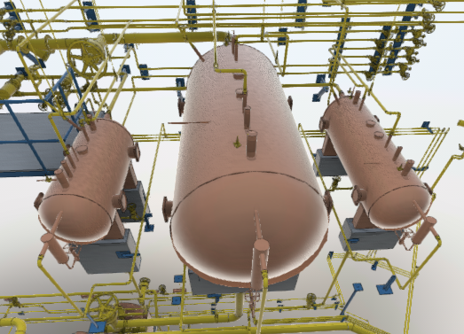
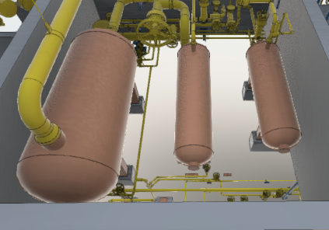
Current status
12/2017 – ESS announced revision of safety classification.
04/2018 – Change of quality class was confirmed (MQC3 -> MQC4).
Discussion about requirements is in progress, waiting for ESS to confirm new parameters of the system.
Procurement and manufacturing of equipment should start in following months.

Slide 4
Project Planning
TIK 5.1 Primary Water Cooling System
Milestone 2 – Manufacturing completed 31.01.2019
Milestone 3 – Delivery to ESS site completed 28.02.2019
Milestone 4 – Final report completed 31.5.2019

Slide 5
Project Schedule
TIK 5.2 Intermediate water cooling systems
Milestone 1 – CDR completed - DONE 30.6.2017 

Slide 6
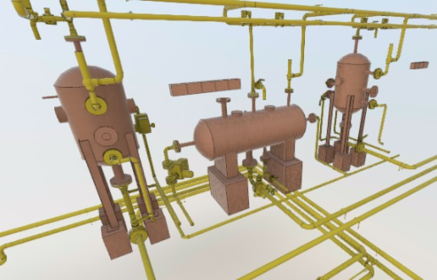
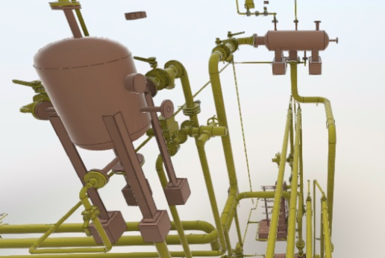
Current status
Revision of system parameters was announced in the beginning of 2018 from a new process engineer in ESS.
Pumps, heat exchangers and tanks parameters were discussed in past few months.
Some minor components were already ordered.
Procurement and manufacturing of main components should start in following weeks.

Slide 7
Project Planning
TIK 5.2 Intermediate water cooling systems
Milestone 2 – Manufacturing completed 30.11.2018
Milestone 3 – Delivery to ESS site completed 31.12.2018
Milestone 4 – Installation and commissioning completed will be scheduled
Milestone 5 – SAR completed will be scheduled
Milestone 6 – Final report completed will be scheduled

Slide 8
Project Schedule
TIK 5.3 TS HVAC System
Milestone 1 – CDR completed - DONE 30.8.2017 

Slide 9
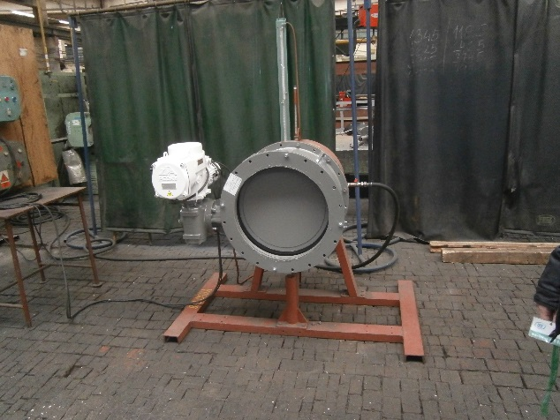
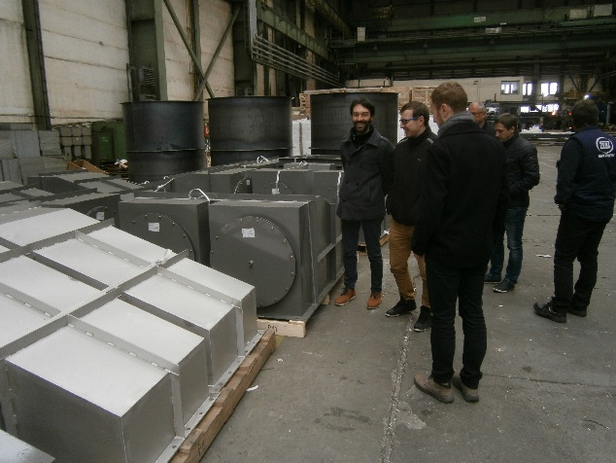
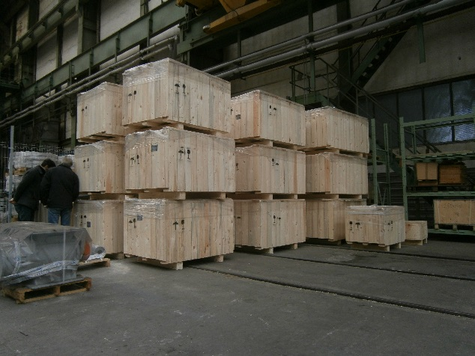
Current status
Collisions in 3D model are continuously solved with ESS.
Control philosophy was agreed with ESS.
Manufacturing of filter stations and shutters was finished in 03/2018.

Slide 10
Current status
ESS reviews and approves datasheets for components to be procured or manufactured.
Procurement and manufacturing of other approved components will start in following weeks.

Slide 11
Project Planning
TIK 5.3 TS HVAC System
Milestone 2 – Manufacturing completed 30.11.2018
Milestone 3 – Delivery to ESS site completed 31.12.2018
Milestone 4 – Final report completed 31.12.2018

Slide 12
General problems
Delays on the ESS side are problematic in terms of contractual time schedule.
Electrical and ICS design has no major improvement at the moment, as ESS declared modification of input data.

Slide 13
Thank you for your attention

