Slide 1
Target Helium Cooling System Design Code 10th Target Technical Board Meeting
Ulf Odén
WP2 Manager
www.europeanspallationsource.se
29 August, 2018

Slide 2
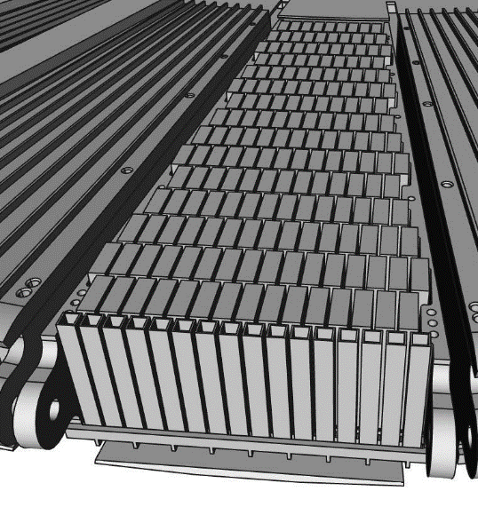
Target Systems
Target wheel and drive unit
Manufacturing of cassettes and spallation material is finalized
Manufacturing of prototype is on-going
CDR for Target Wheel and Shaft planned in November 2017
Progress on Target Helium Cooling System
Preparation for manufacturing of the helium circulators
Detailed design and procurement is on-going for the rest of the cooling loop
Target monitoring
Final Design started
Tungsten Bricks in Cassette

Slide 3
System Classification
TIK 2.2 design code based on early assumptions regarding results from the safety analysis. -> RCC MRx N3_{RX}
Design code to fulfil formal safety requirements AND general quality requirements
ESS safety guidelines revisited and refined. Impact on the formal classification requirement. Dose calculations and requirements for public/workers safety
Requirements in signed TIK:s still valid

Slide 4
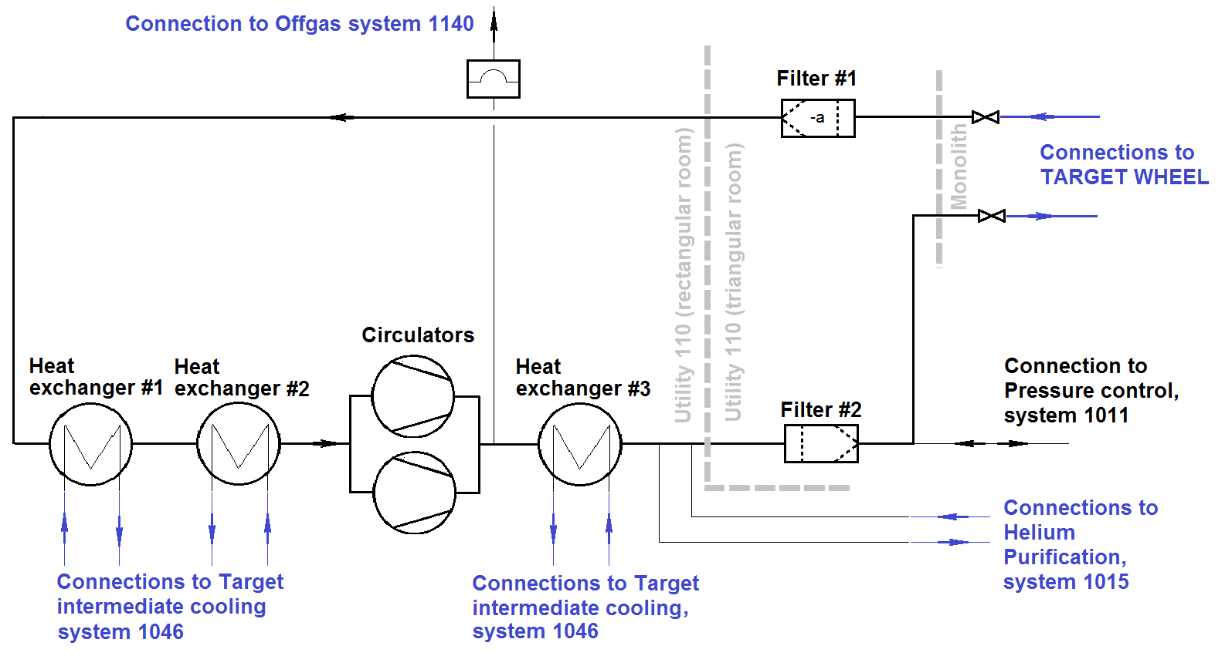
Target He Cooling System cost book value
Design code TIK 2.2 -> RCC MRx N3RX
AIB and Certificate of compliance

Slide 5
Change in Design Code
Documented in ESS-0338157
CONCLUSION “To mitigate the increased costs for the heat exchangers and valves due to fulfilling the RCC MRx N3_{RX} , the mechanical classification is changed from MQC3 to MQC4. The design code for MQC4 is the PED and EN standards. For all other components in TIK 2.2 the selection, design, manufacturing and installation, the RCC MRx N3_{RX} shall be used.”

