Slide 1
ESS Active Cells Project
Target Technical Board Meeting
29th August2018

Slide 2
Active Cell Facility
Progress Highlights
Lessons Learnt/ Issues
  Procurement
  Installation
Project Risks

Slide 3
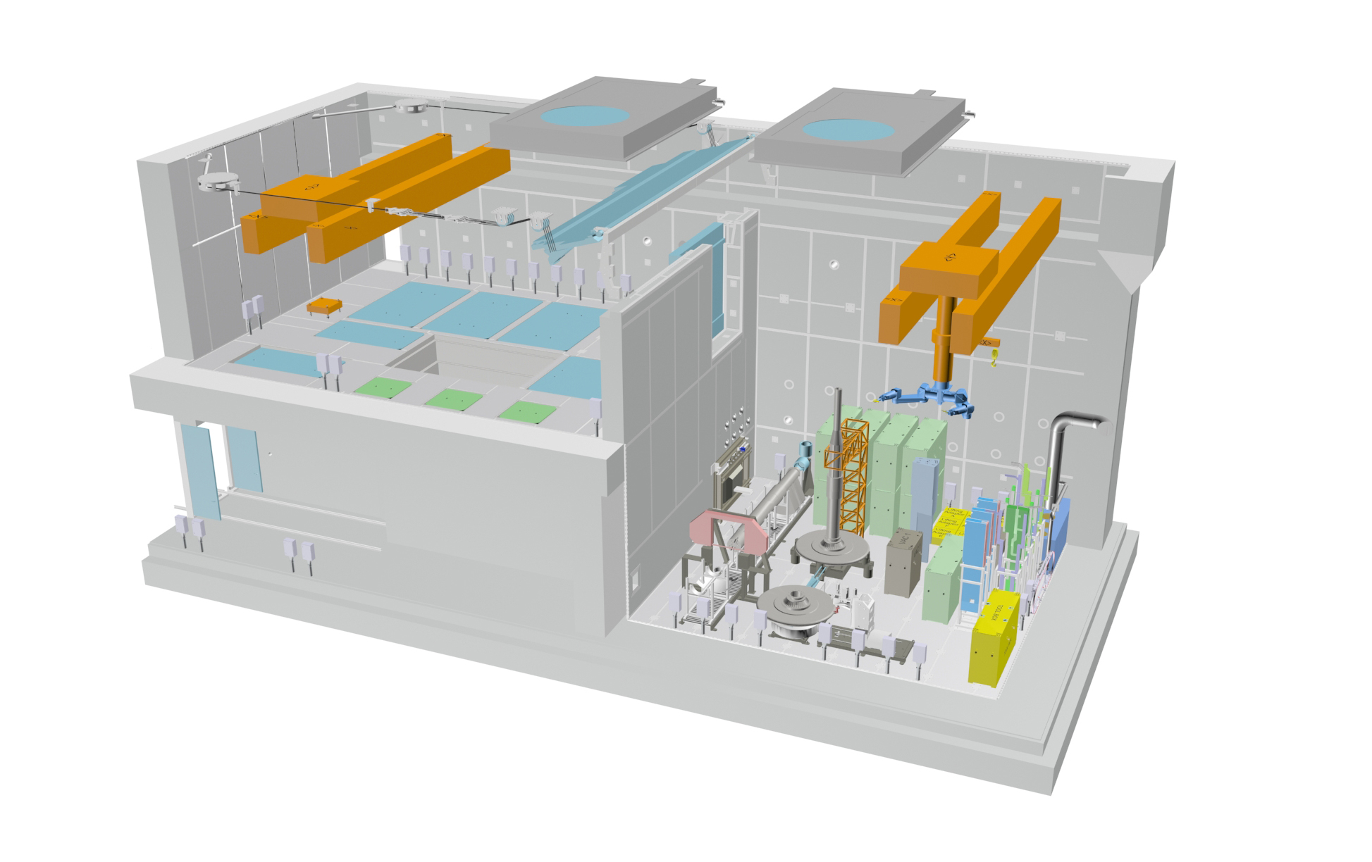
Progress in all areas of design

Slide 4
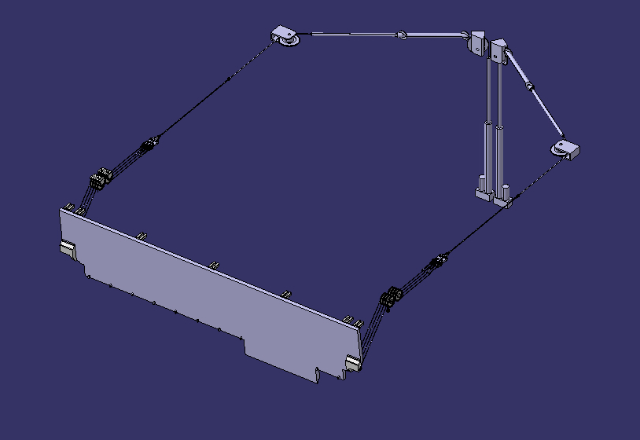
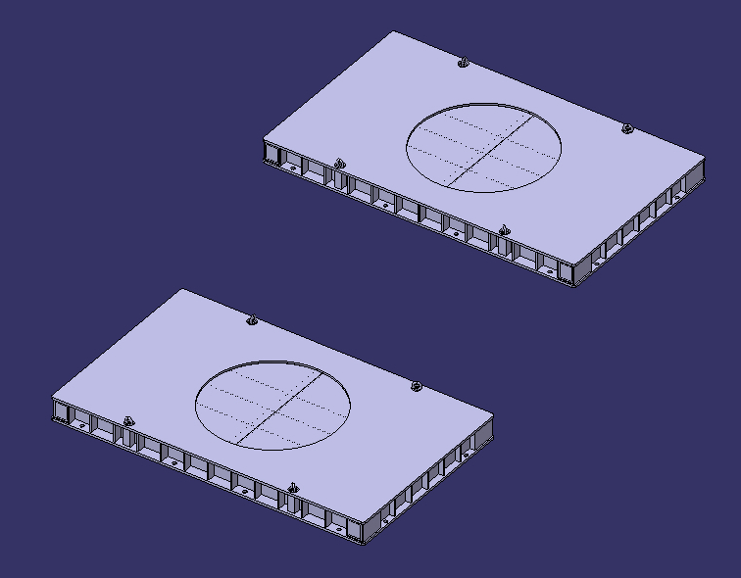
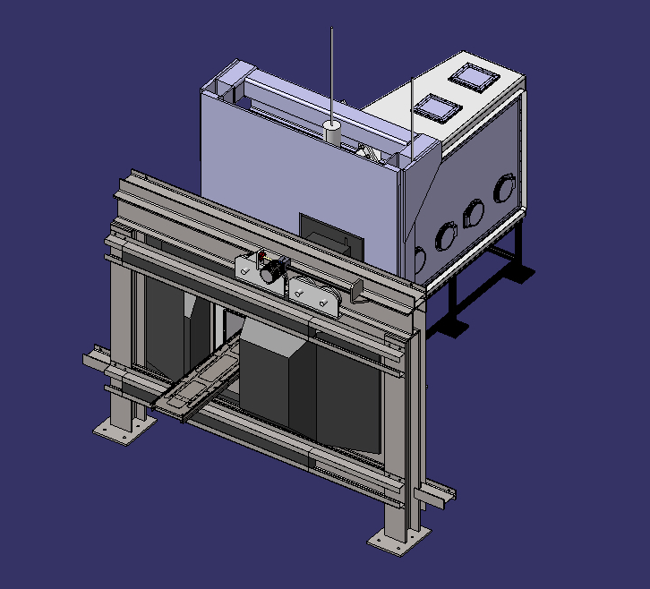
Shield Doors in Final Stage of procuremnet

Slide 5
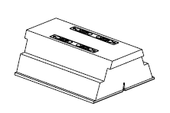
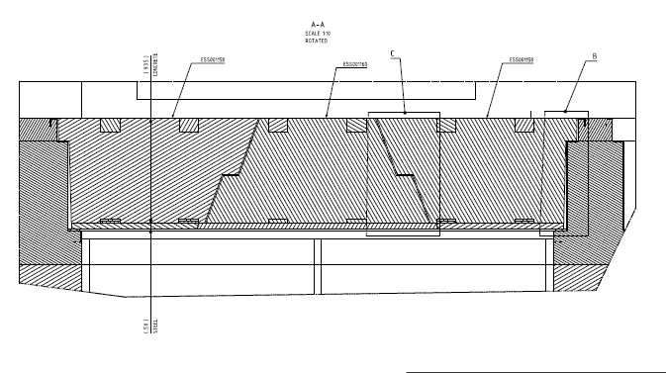
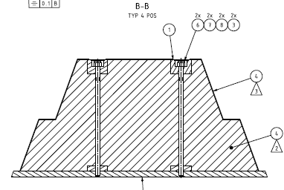
Storage Pit Lids Checking as Built Dimensions

Slide 6
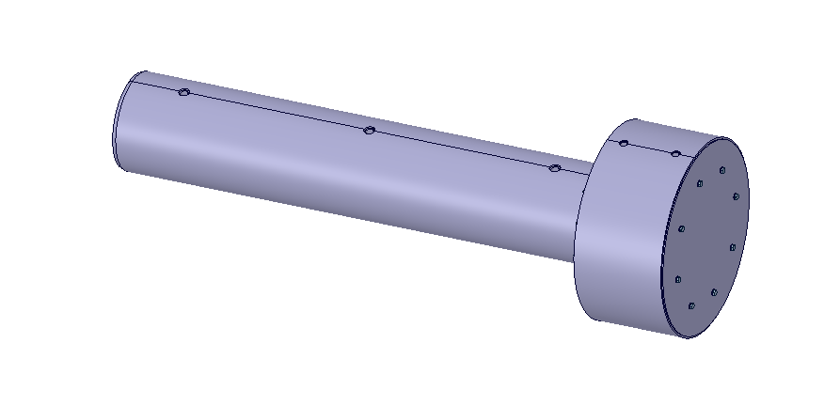
Design of Penetration Plugs ready for manufacture

Slide 7
Remote Handling System in Procurement

Slide 8
Shaft Cutting Station in final stages of procurement

Slide 9
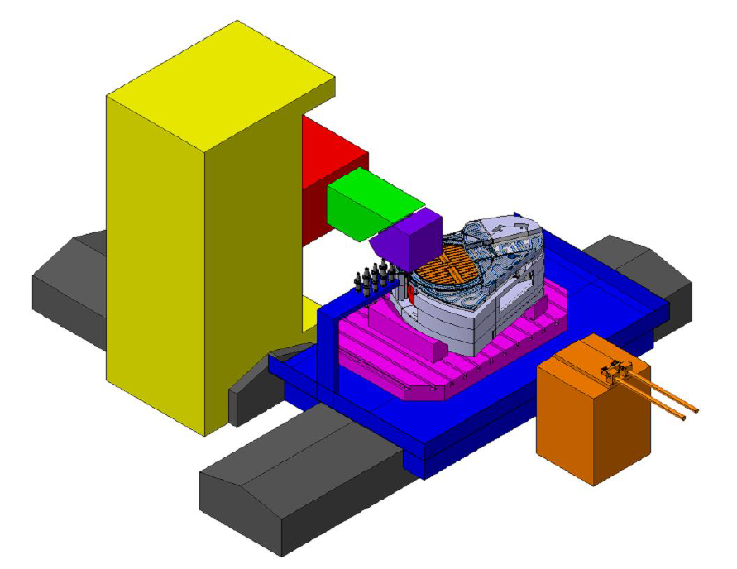
Equipment in the Supplier’s Scope
Procurement Strategy
Swarf and dust extraction
Lifting Adaptors to manoeuvre the components to be cut. (Not shown)
Cutting Element
Control and Power Supply Racking. (Not shown)
Actuation Systems
Interface adaptors for MRP and Target Wheel

Slide 10
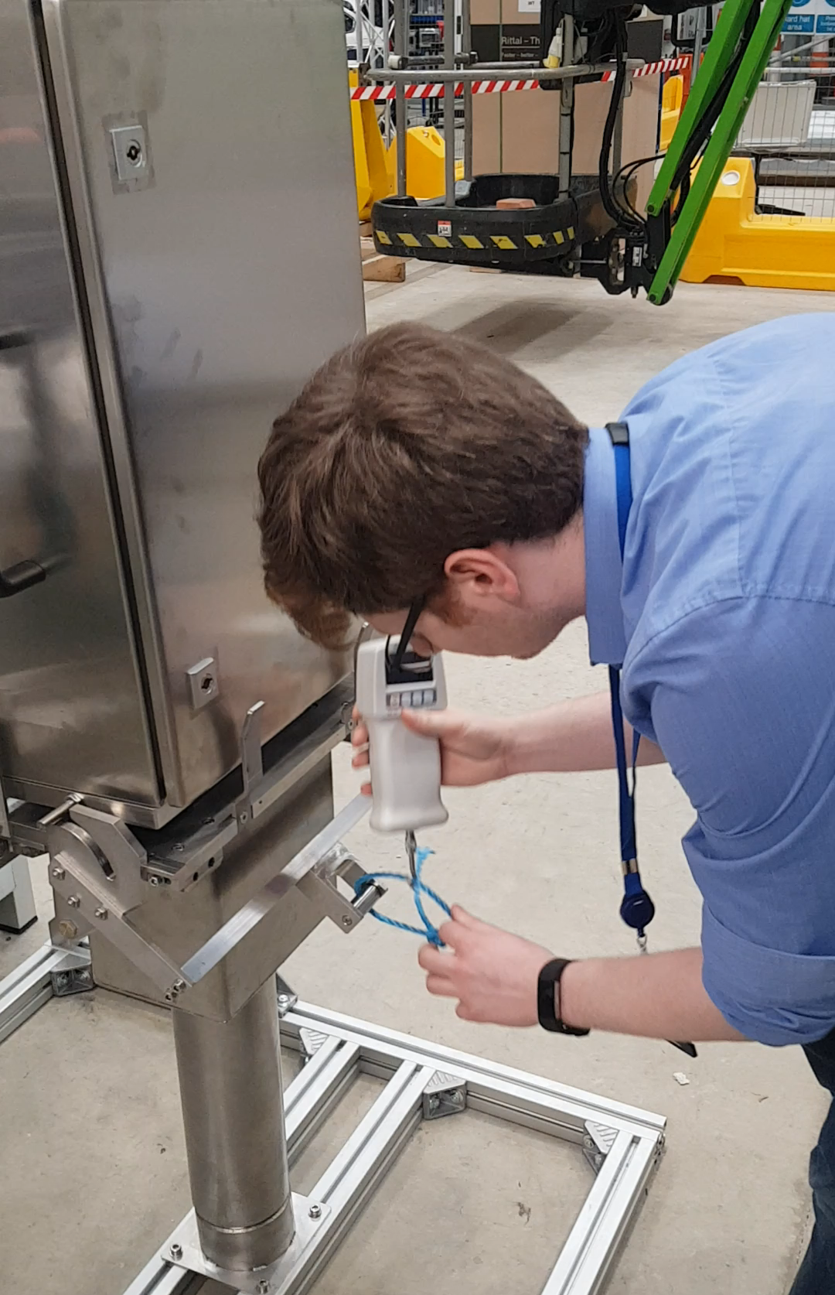
Remote Junction Box designed, built and tested
Prototype Junction Box complete
Successfully assembled
Confinement weld tested
Repeated opening closure trials
  No damage to electrical connection pins
  Seal repeatedly made
  Opportunities to improve design identified

Slide 11
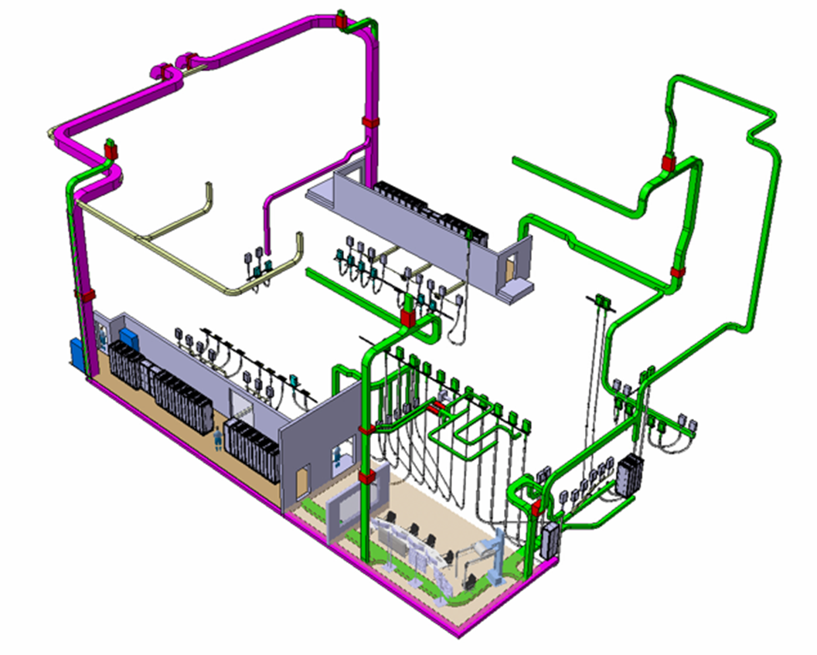
Electrical Layout Designed

Slide 12
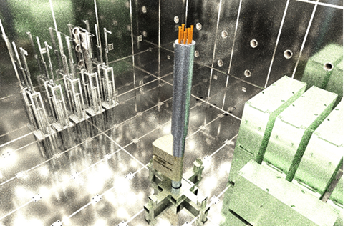
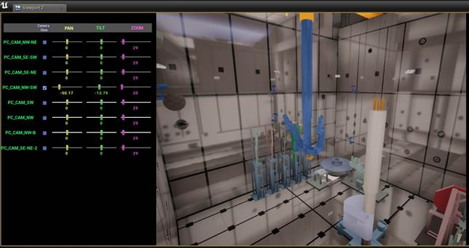
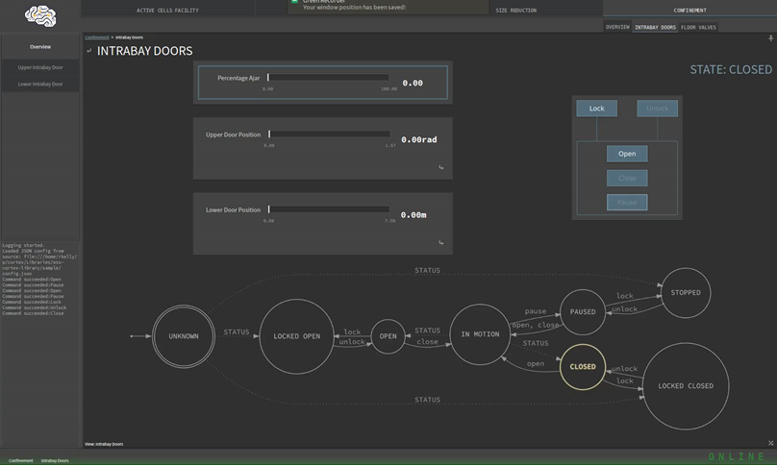
High Level Control System progressing well
Cortex operating test actuators
Viewing system producing accurate camera view simulations
New version of HLCS and HMI released

Slide 13
Lessons Learnt - Procurements
Handling | Robotic Handling System
Confinement and Shielding | Shield Doors
Size Reduction | Milling Station
Size Reduction | Bandsaw
Confinement and Shielding | Storage Pit Lids
Control | Control System
Electrical | Electrical distribution and signalling
Handling | Waste Transfer System and Skirt
Size Reduction | Component lifting adaptors
Control | Viewing System
Handling | Remote maintenance tooling and tooling stillages
Confinement and Shielding | Confinement penetration blanking plugs and media couplings
Fire Suppression | Fire Suppression System
Electrical | Installation of electrical distribution and signalling
Size Reduction | Misc. size reduction tooling
Electrical | In-cell lighting
Size Reduction | Receiving fixtures
Handling | Decontamination equipment (vacuum system)
Safety | Safety Systems
Size Reduction | Prototype waste storage basket
Test Components | Cold Test Components
Electrical | Operational environmental sensors
Confinement and Shielding | Process Cell Access System

Slide 14
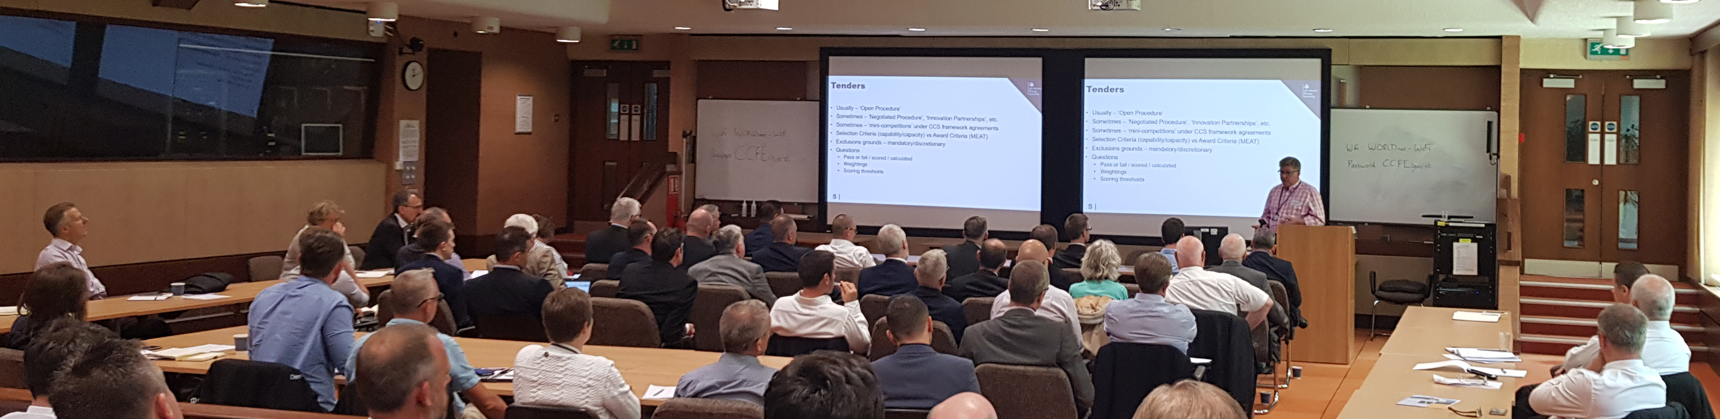
Lessons Learnt – Market Engagement Key
Under Resourced 1st Time Around
Promote Participation
Supporting Partnering
Understand Market – Market Understands Project

Slide 15
Flexible Procurement Approach Helpful for First of a Kind
OJEU negotiated procedure allows flexibility
Process is lengthy
Event | Indicative Date
OJEU Notice published | 30 April 2018
PQQ Publication | 07 May 2018
PQQ Assessment Complete | 25 June 2018
Tender/Negotiate (Award) Stage
Negotiation of Pricing, Scope and Risk, etc. | 29 October 2018
Update works information and reissue for Best and Final Offer (BAFO) | 29 October 2018
Submit BAFO | 16 November 2018
Assess BAFO | 10 December 2018
Select Preferred Bidder | 24 December 2018
Contract Award | 10 January 2019

Slide 16
Lessons Learnt – Storage Pit Installation
As Built Measurement Critical
Tight and challenging tolerances are common
CF not always able meet tolerances
No established process of incorporating into DMU

Slide 17
Key Risks
Project Issues/Active Risks (Top 5)
Identification |  |  |  | Disposition |  |  | Rating post mitigation
“As a result of….” | “There is a risk that….” | “Resulting in….” | Level | Treatment | Handling strategy / mitigation | Status | Level
Unreliable basis for budgetary estimates · Unforeseen complexity to meet requirements · Unreliable industry estimates · Effects of high steel price cost rises and detrimental exchange rate changes | Tenders exceed budget for procured items: | Contract not awarded, engagement with stakeholders, re-tender exercises must be undertaken. | VERY HIGH | Reducing | · Specific Scope reviews completed · Budget estimates reviewed new lows side hide EAC published · Ensure value for money (industry engagement, use of more flexible procurement process) · Benchmarking activities to validate costing · Initiate drafting of change order with team at ESS target division | In Progress | VERY HIGH
Context CAD data we receive from ESS is not version controlled or configured. Data comes from multiple sources. There is no clear process of transmitting as-built data. Some data is duplicated. | Cannot determine if the correct model is being used. Incorrect or out-of-date information is used in the design of the Active Cells equipment. | Equipment is made to fit differing dimensions than those of its building interfaces and does not fit or function correctly when installed. | VERY HIGH | Reducing | · ESS working group developing improved systems of configuration management. | In progress | HIGH
Delays to the procurement process for the confinement shielding doors. | The doors will not be available for the defined installation window | Delays to the installation programme and knock-on impacts or | VERY HIGH | Reducing | · Aggressive procurement plan to minimise schedule · Active preparation and engagement of stakeholders involved in the revised budget approval · Discussion of shorter lead times with supplier · Consideration of staggered deliveries permitting installation to commence. | In Progress | HIGH

Slide 18
Key Risks
Project Issues/Active Risks (Top 5)
Identification |  |  |  | Disposition |  |  | Rating post mitigation
“As a result of….” | “There is a risk that….” | “Resulting in….” | Level | Treatment | Handling strategy / mitigation | Status | Level
Ongoing processes to finalise the accident analysis and safety cases around the ACF, presentation and agreement around from the regulator and finalisation and communication of the documentation. | The ESS ACF safety systems may require a high SIL level than currently designed | Increased design time and costs (there are no proprietary SIL3 controls) | HIGH | Reducing | · UKAEA have been engaged with the safety team to review safety case.
Delays to the ESS Construction programme | Delays to the ACF, high bay and technical gallery | Create delays to the programme and RBOT and additional storage costs and additional costs of retained staff from UKAEA and subcontractors to complete commissioning activities | HIGH | Reducing | · Revised plan created to match the revised access dates. · Flexibility in the supply contract to permit flexible installation dates. · Regular communication meetings and installation preparation meetings | In Progress | HIGH

