Slide 1



Status of the CNRS Contribution to the ESS Accelerator
On behalf of the IPN Orsay Team
CNRS/IN2P3/IPNO - ESS Collaboration Meeting – 27 August 2018 - Lund

Slide 2
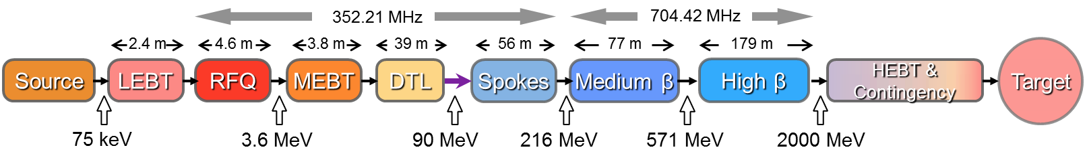
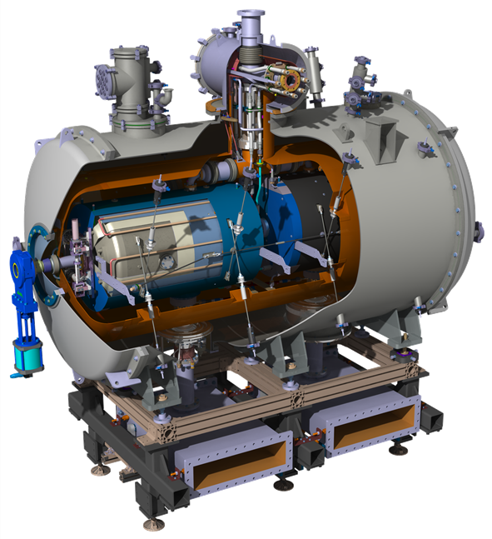
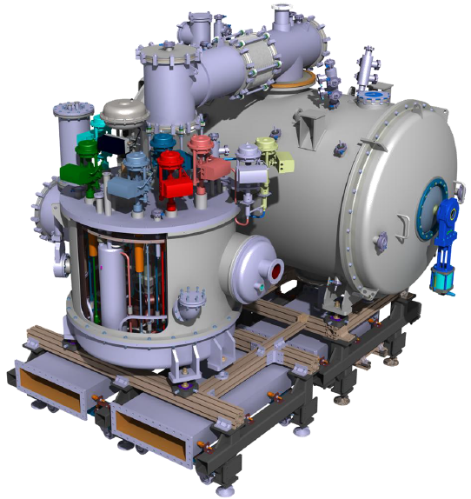
CNRS/IN2P3/IPNO Contributions to ESS
Warm linac
SCRF linac (T=2K)
The 13 spoke cryomodule composing the first superconducting acceleration stage.
All the cryogenic distribution system for the spoke section (valve boxes, cryolines, cryo end box)
WP4
WP11

Slide 3
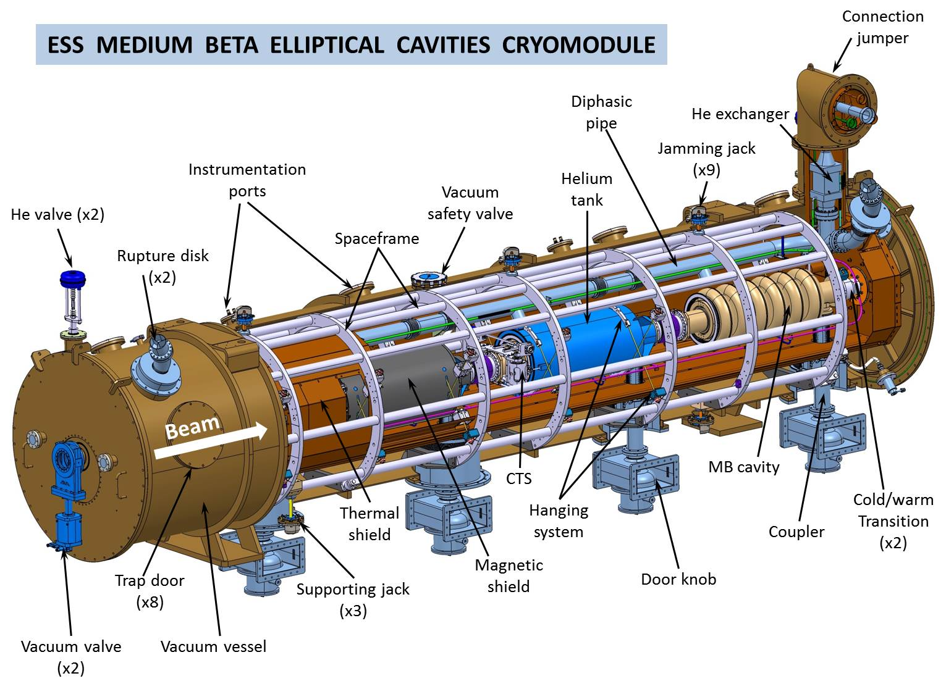
CNRS/IN2P3/IPNO Contributions to ESS
Warm linac
SCRF linac (T=2K)
Design of the elliptical cryomodules (medium β and high β) & medβ prototyping
WP5

Slide 4
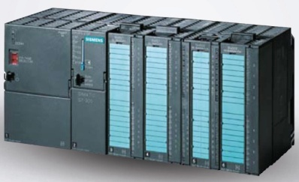
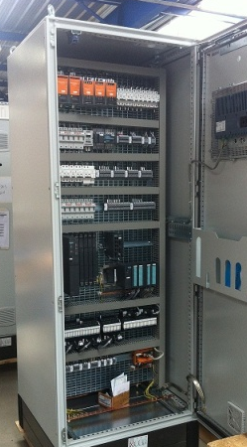
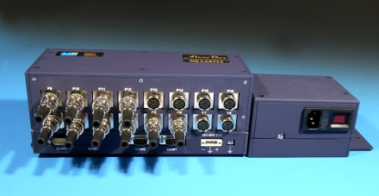
CNRS/IN2P3/IPNO Contributions to ESS
Warm linac
SCRF linac (T=2K)
The control & command system for all superconducting cryomodules (spoke, medium β and high β).

Slide 5
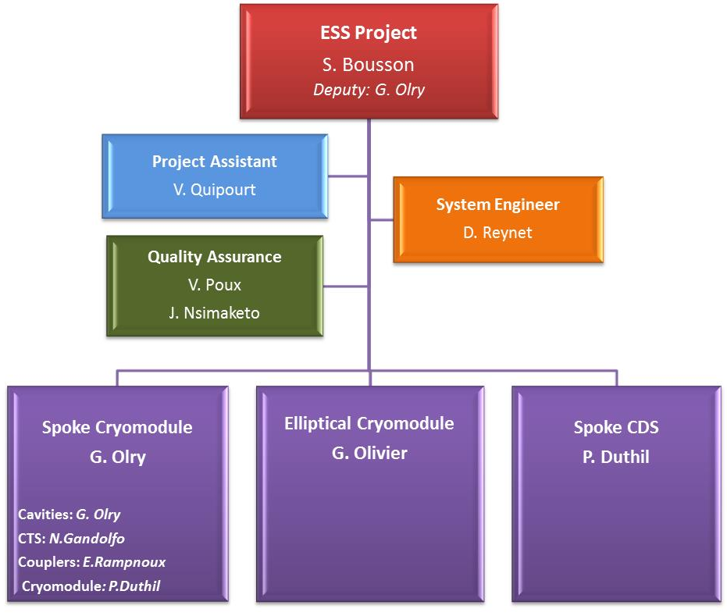
Project organization
    Human resources :
    At IPNO Accelerator Division, 34 people are working on the CNRS contribution to ESS
    And more in the CNRS, IN2P3 and IPNO general services (procurement, financing, project management and follow-up)
    At IPNO, on the first 6 months of 2018 (1st January – 31st June): 15.2 FTE on ESS

Slide 6
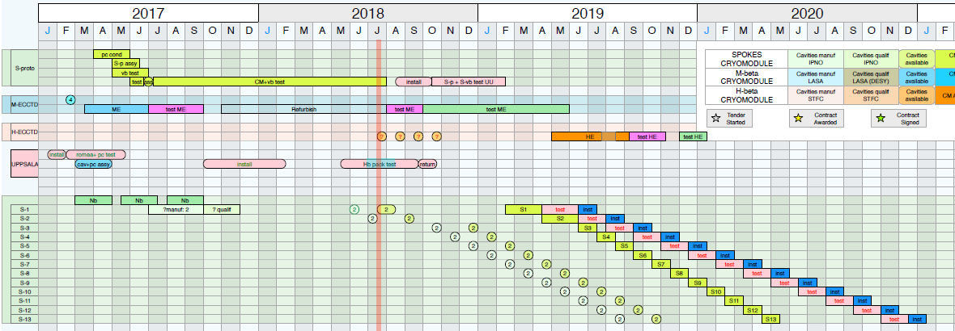
Overall Planning
    No change in the planning since many months now both for WP4 & WP11
    First cryomodule ready for test : April 2019
    Last cryomodule shipped to Uppsala: May 2020
    WP11: Updated schedule sent to ESS on 08/20th/2018 (there is no change in the delivery date of the CDS-SL wrt the last schedule sent to ESS on 07/05th/2017)

Slide 7
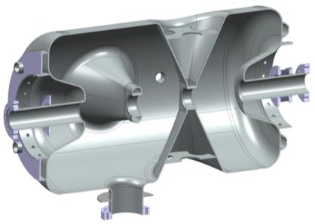
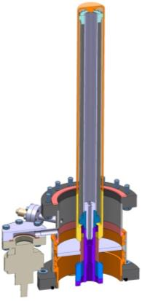
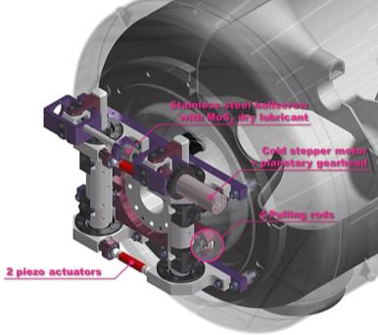
Les composants du cryomodule spoke
Cavité double spoke
Cavité double spoke (3-gaps), 352.2 MHz, β=0.50
Objectif: Eacc = 9 MV/m [Bp= 62 mT ; Ep = 39 MV/m]
4.2 mm (nominal) d’épaisseur en Niobium
Tank hélium et renforts mécaniques en Titane
Coeff de Lorentz : ~-5.5 Hz/(MV/m)²
Sensibilité à l’accord: Δf/Δz = 130 kHz/mm
Cold Tuning System
Tuning « lent » (moteur pas à pas)
Course max: ~ 1.3 mm
Plage d’accord: ~ 170 kHz
Résolution: 1.1 Hz
Tuning rapide(piezo):
Tension jusqu ’à +/- 120V
Plage d’accord à 2K:
675 Hz (minimum)
Coupleurs RF de puissance
Disque céramique, 100 mm de diamètre
400 kW puissance crête (335 kW nominal)
Antenne & fenêtre refroidie par eau
Conducteur ext. refroidi en hélium supercritique
Transition du type « Doorknob » avec guide
d’onde ½ hauteur WR2300

Slide 8
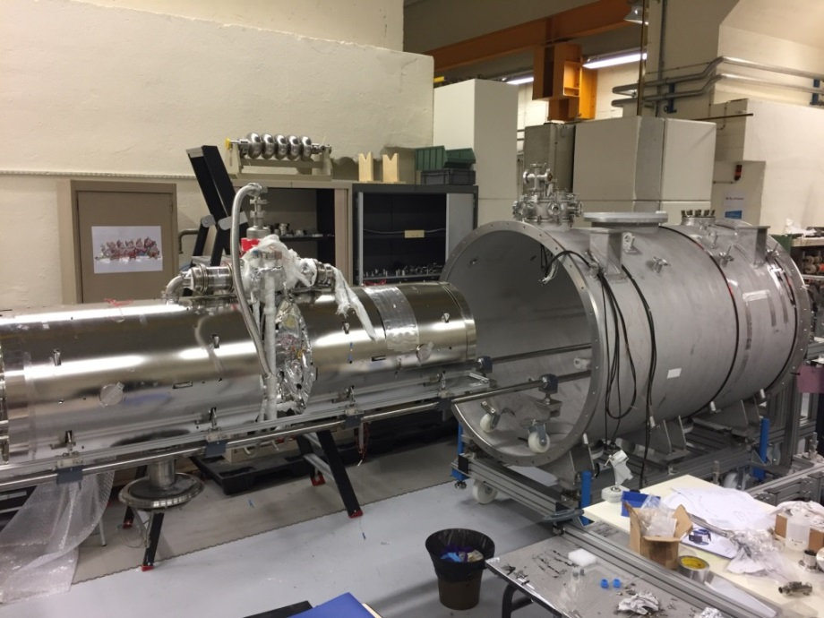
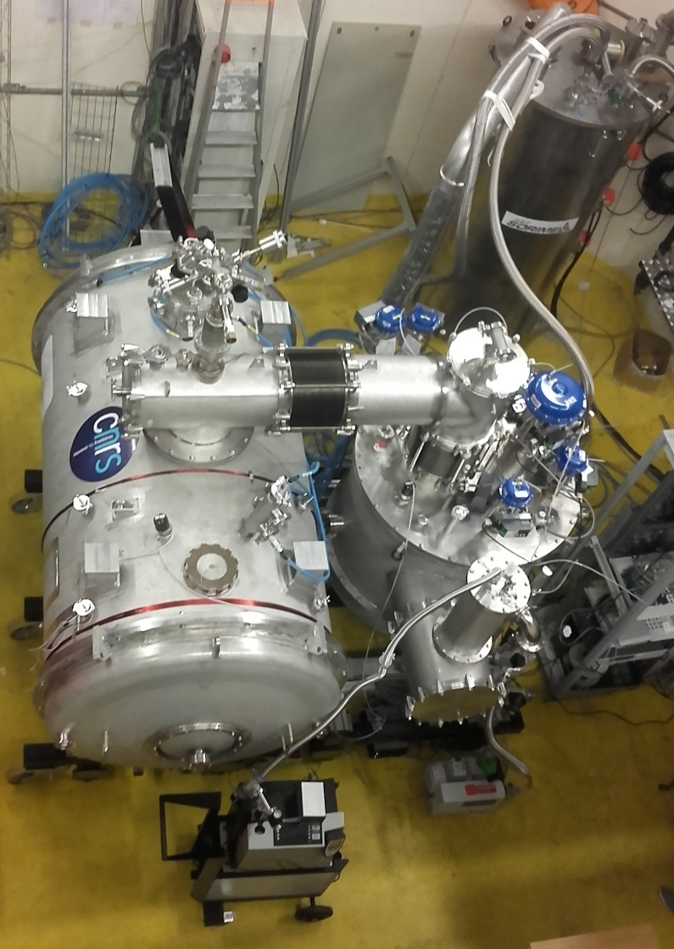
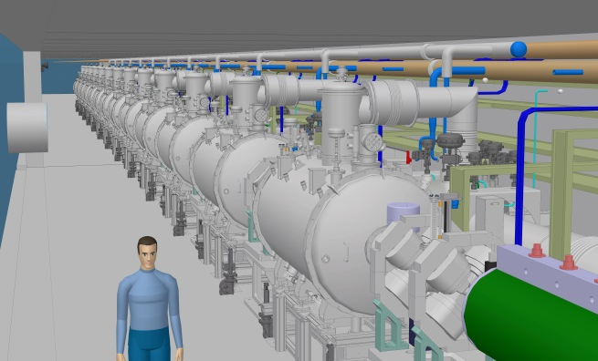
Cryomodule spoke

Slide 9
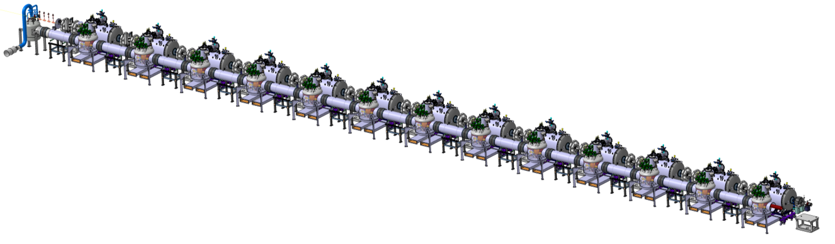
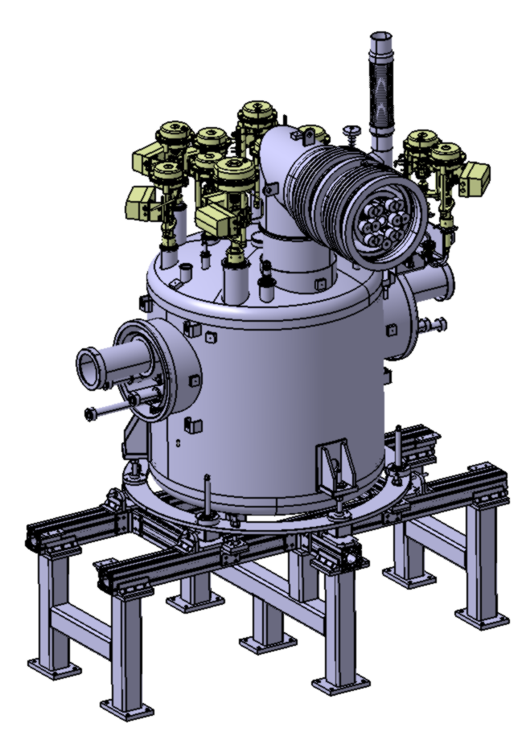

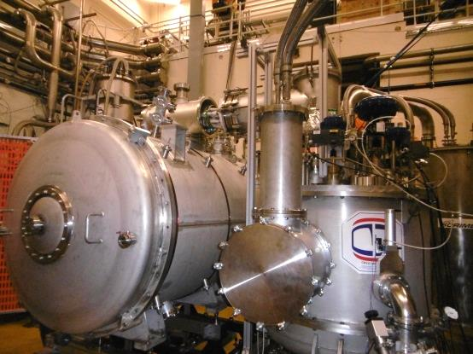
Cryodistribution spoke
Spoke cryomodule
End box →
Cryogenic valves
He relief branch line
Interface with the cryomodule
Beam direction
Valve box
Interface with the Header unit
To the CDS-EL and ACCP→
Fiducials supports
Positioning frame
Valve box support

Slide 10
Tendering
    On-going tenders
    Cryomodule vacuum vessels (x13):
      first call for tender published in June
      All 5 offers non-conformed (mainly due to the first milestone in the planning)
      Republished in July (within a dedicated “negociated tender”)
      Offers received on the 21st August
      Offers analysis is being performed
    Magnetic shielding: kick-off to come in the following weeks
    Remaining tenders: only 2…
    Power coupler doorknobs (x26): June 2019 (kick-off)
    Spoke cryodistribution installation on site: March 2019 (kick-off)

Slide 11
Actions follow-up (1/2)
    Actions defined at the last meeting (7th May 2018)
    #1: Inform about the schedule of remaining ESS public tenders
      The detailed status of the ongoing and planned tenders are communicated to ESS at each bi-weekly meeting.
      We are now at a stage where we have 1 tender ongoing (cryomodule vacuum vessels) and only 2 are remaining : coupler doorknob (June 2019) and SPK-CDS installation (February 2019)
    #2: IN2P3 will alert CNRS financial department (DSFIM) on the present tender issues and follow closely their evolution
      IN2P3 (JL. Biarrotte) is in charge of this follow-up.
    #3: A person at IPNO should be dedicated to the daily follow-up of these tenders
      V. Quipourt (IPNO/DA) was assigned to this specific task, but each tender is also very closely followed by the WU or WP leader in charge
    #4: Further strengthened the IPN Team
      2018: large increase of recruitment (temporary) dedicated to ESS
      LAL to join for power coupler fabrication follow-up and preparation
    #5: IN2P3 to follow the project evolution more closely
      IN2P3 is now informed of the bi-weekly meeting dates and has (most of the time) the presented ppt files.

Slide 12
Actions follow-up (2/2)
    Actions defined at the last meeting (7th May 2018)
    #6: IPNO Human Resources to help for cryomodule installation and test at UU
      Partially taken into account
    #7: Study the feasibility and evaluate the cost of building a full spare cryomodule
      On-going.
    #8: Closing the IK contribution to cryo C&C: check french ministry agreement and evaluate and archive the already invested MP and hardware by IPNO
      Done.

