Slide 1
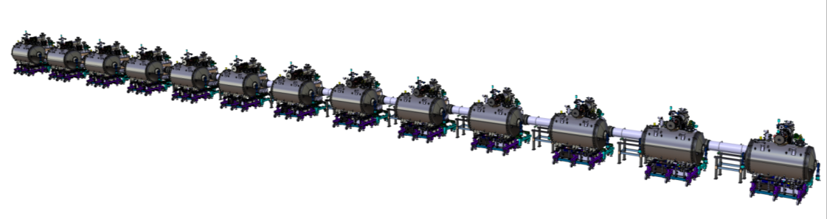
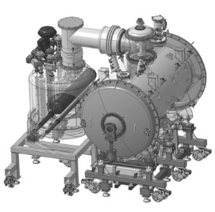
Spoke section of the ESS linac:
- Status of prototypes and CDS-SL
2018/08/20th
P. DUTHIL (CNRS-IN2P3 IPN Orsay / Division Accélérateurs)
on behalf of the IPNO team

Slide 2
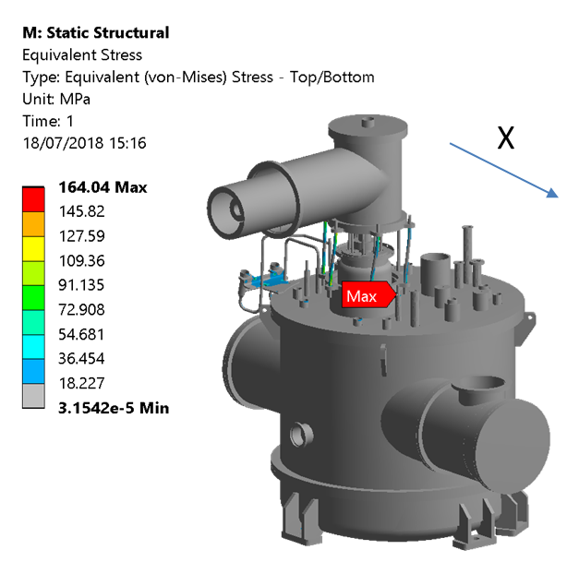
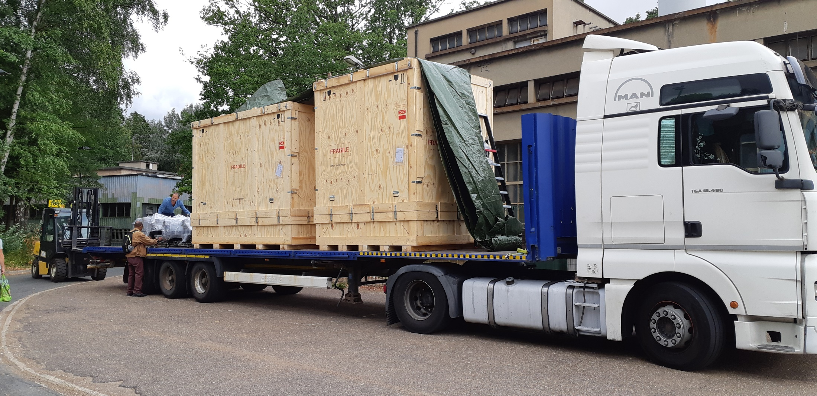
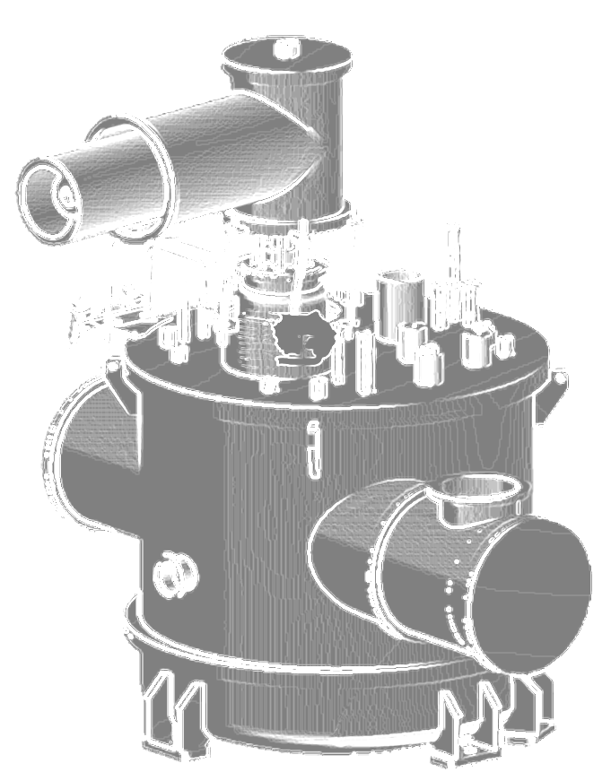
Prototype cryomodule and valve box
Valve box
    Was opened again (June-July).
    Accessible T sensors (and controllers) were controlled again:
      some of them plunged into LHe -> measured voltage in agreement with the calibration (no drift observed);
      conditioners were controlled by use of a calibrated resistor -> output signal OK
    Simulations of the transport were updated in order to take into account the maximum accelerations (along X, Y, Z) allowed by the crate support;
    A new test box new test box (to be connected to the jumper and used for 2 K preliminary operations at Uppsala; it includes a small phase separator) was designed and started to be manufactured.
Cryomodule
    re-assembled with two double Spoke cavities
    and two power couplers.
Transport to UU
    VB and cryomodule were closed and packed into their
    crates;
    They were shipped to UU (Monday 08/13th ->Friday 24th).
Eg: stress resulting from an acceleration of 1.4 g along X

Slide 3
CDS-SL
CDS-SL design
  End Box
    Design is done
    Tech spec + drawings to finalize before the call for tender (beginning of October)
  Headers units :
    Design of HU 1 to 13 nearly finalized -> call for tender (beginning of September)
    Design of HU14 (= HU-EL = interface between the CDS-SL and CDS-EL) to be finalized (separate call for tender later in autumn);
TCS axis
y
x
Beam direction
HU01
HU02
HU03
HU13
HU-EL
End box
VB01
VB02
VB03
VB13
Interface with the CDS-EL

Slide 4
CDS-SL
CDS-SL design
  Support CDS-SL :
    Support of the End box is done;
    Supports of VB01 to 12 is done;
    Call for tender of those components: November
    Support of the valve box n°13 and HU n°14 (interface avec CDS-SL/CDS-EL) to be finalized -> separate call for tender in autumn
  To ESS:
    Updated schedule sent to ESS on 08/20th/2018 (there is no change in the delivery date of the CDS-SL wrt the last schedule sent to ESS on 07/05th/2017)
TCS axis
y
x
Beam direction
HU01
HU02
HU03
HU13
HU-EL
End box
VB01
VB02
VB03
VB13
Interface with the CDS-EL

Slide 5
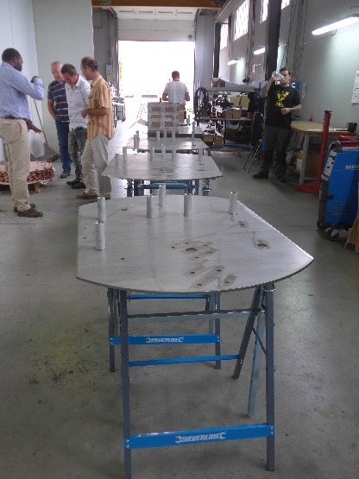
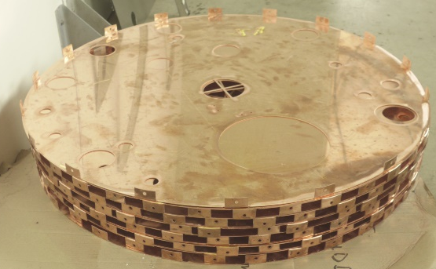
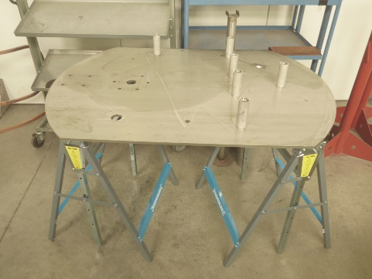
CDS-SL
Procurements
  Valves boxes (on the critical path of the CDS-SL procurement for ESS):
    Manufacturing folder (including manufacturing drawings, manufacturing process and controls) was sent to IPNO at the beginning of August; part of this documentation was already approved by IPNO;
    However, manufacturing already started:
      vacuum vessels were launched;
      stainless steel pipes were procured
      thermal shield: serpentine circuit and top plates done
      support tooling for piping assembly was manufactured in several units to allow for a parallel production of the VBs.
Top plate of the thermal shield
Support tooling for piping assembly

Slide 6
CDS-SL
Procurements
  Valve boxes components
    Heat exchangers (HEX):
      The production of all heat exchanger was accepted by IPNO
    Cryogenic valves
      The production of all cryogenic valves was accepted by IPNO
Project review: TRR1 will be held on September 14th

Slide 7
Thank you for your attention
CSP12
28 Novembre 2014

