Slide 1
The Common Shielding Project
Neutronics Workshop
ESS, 24th of August 2018
Ken Andersen, Neutron Instruments Division, European Spallation Source ERIC

Slide 2
Scope of proposal
Proposal: guide shielding for long and medium instruments
  from bunker to cave
  include shielding around choppers
  Include all long instruments (West sector)
  No short instruments: LOKI, FREIA, ESTIA
    strongly integrated with neighbouring beamlines
  Include medium instruments: ODIN, DREAM, VESPA, SKADI
Use engineering resources from bunker team
Use whatever neutronics resources we can get our hands on
  Mainly from instruments which have signed up
8 instruments signed up:
  Long instruments: CSPEC (TUM), BIFROST (IFE), MAGIC (LLB), T-REX (CNR&FZJ), HEIMDAL (IFE)
  Medium instruments: ODIN (TUM), DREAM (LLB), VESPA (CNR&ISIS)

Slide 3
Project Timeline
 | 2018 H1 | 2018 H2 | 2019 H1 | 2019 H2 | 2020 H1 | 2020 H2 | 2021 H1 | 2021 H2
Proposal Development
ICB10 Meeting
Concept Development
PDR
Detailed Design
CDR
Procurement
Contract Signature
Manufacturing
First Delivery
Installation
Register interest:
pay 10 k€ towards concept development
Decision point:
cost offer made
commit expenditure from instrument budget
Earliest possible start of installation

Slide 4
Project Scope
PDR deliverables (December 2018)
  mechanical design completed
    analysis of different beamline scenarios (straight, curved, high-m)
    analysis of compatibility with logistics
    3D model
    integration drawing(s)
  neutronics calculations completed
    validating and driving mechanical design
    reports issued
  hazard analysis done and documented
  cost estimate for each instrument
  manufacturing and purchasing strategy agreed
CDR deliverables (May 2019)
  mechanical design completed and approved
  all neutronics work completed
    design, validation, background
    all reports completed and approved
  all systems documentation completed and approved
  procurement and manufacturing plan prepared and ready for initiation

Slide 5
Workshop Scope
Work out what needs to be done
  Generic cases: curved guides, straight guides, chopper pits, high-m SMs
  Specific instruments
Work out availabilities
  Today and Monday
  From now until end-November
Distribute the work
Agree on how we work together
  Meetings
  Sharing of results
  Documenting results
  Coordination with Engineering Design
Agree on schedule
  Neutronics work should be completed by early November
  Spend November finishing the report
How to make use of IKON meeting
  4.5 hour parallel session on shielding

Slide 6
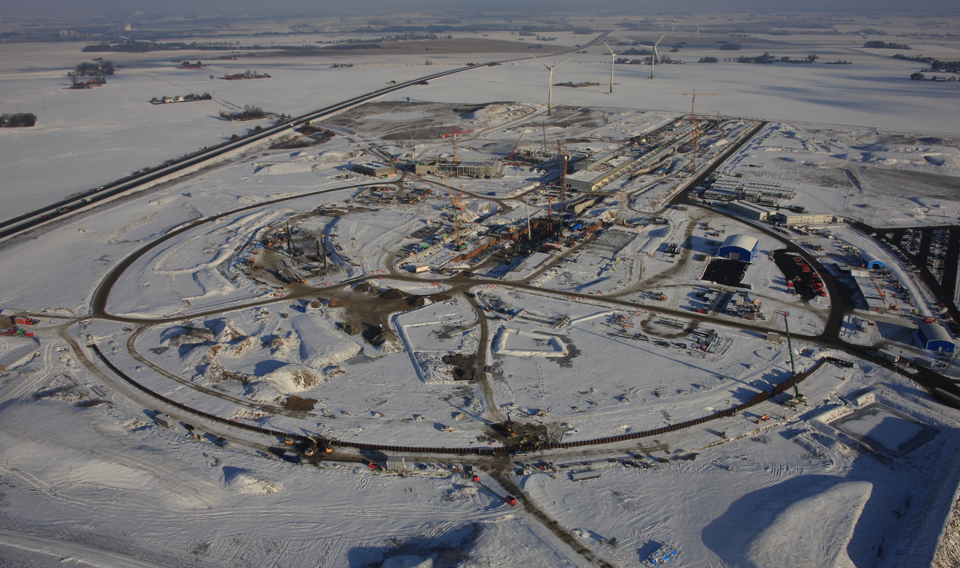
Thank you!
ESS site 2016
5th June 2015

