Slide 1

Uwe Filges
Laboratory for scientific Developments and novel Materials (LDM)
Paul Scherrer Institut
Development of New Shielding Materials
and
ESTIA - Simulations

Slide 2
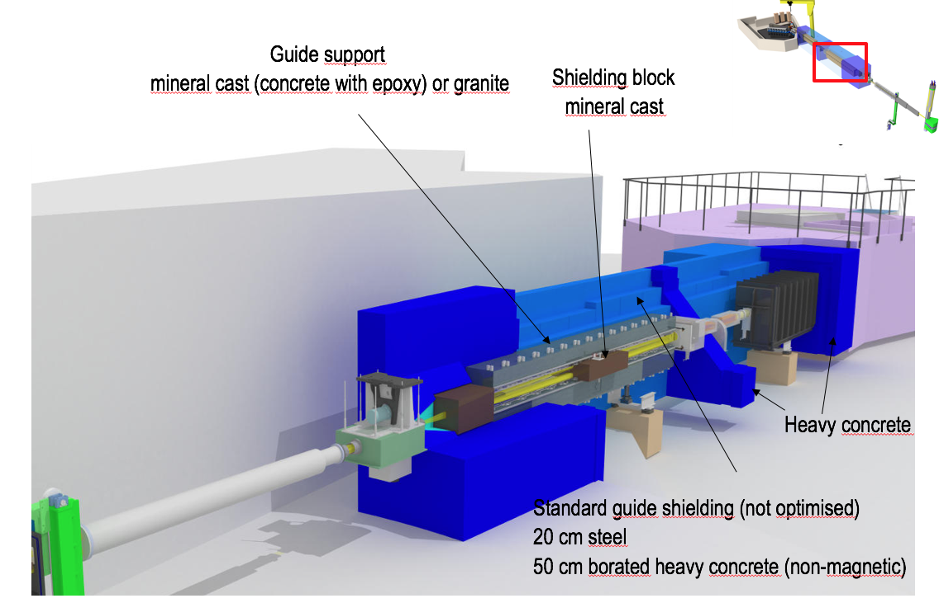
Needs at PSI/ESS - ESTIA

Slide 3
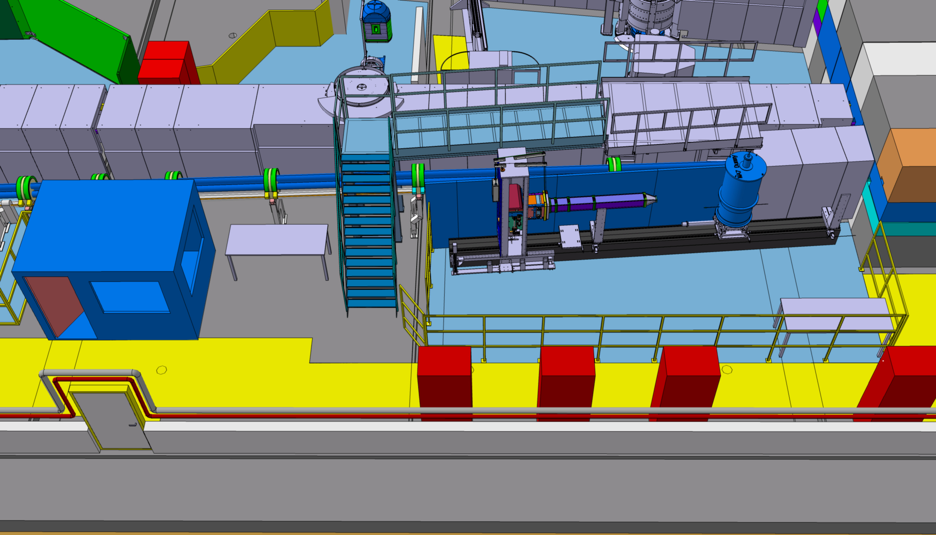
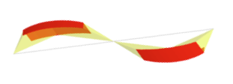
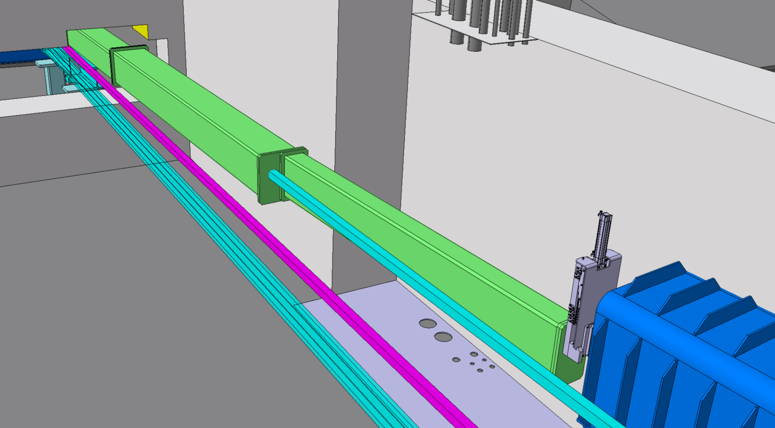
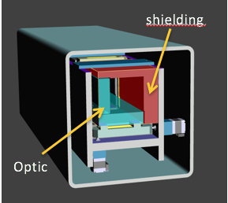
Needs at PSI/SINQ – Upgrade AMOR
Upgraded AMOR – SELENE Type guide
Bunker wall
inside vacuum housing 32 shielding blocks are positioned
must be high precision and non-magnetic (polarized beam)
shielding through neutron guide bunker must be very
compact because of space limitation (performance),
use of non-magnetic heavy concrete is foreseen
Vaccum Housing of Selene guide system

Slide 4
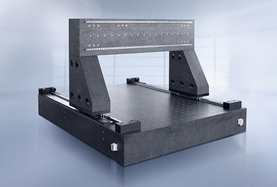
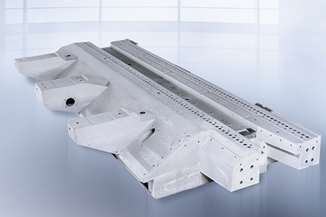
New high-precision Shielding Material – Mineral Cast
Epustone
Epument
Mineral cast is used as the base of high-precision machines
Epustone has the mechanical properties of granite – interesting for our ESTIA project
Epument has good shielding properties like concrete – high hydrogen content – SINQ Upgrade (AMOR)
Optimisation: add a thermal neutron absorber (B4C) in the composition.
First test series (14 compositions) in the BOA neutron field were done (activation, attenuation for diff. E)
Partner: RAMPF Machine Systems GmbH & Co. KG

Slide 5
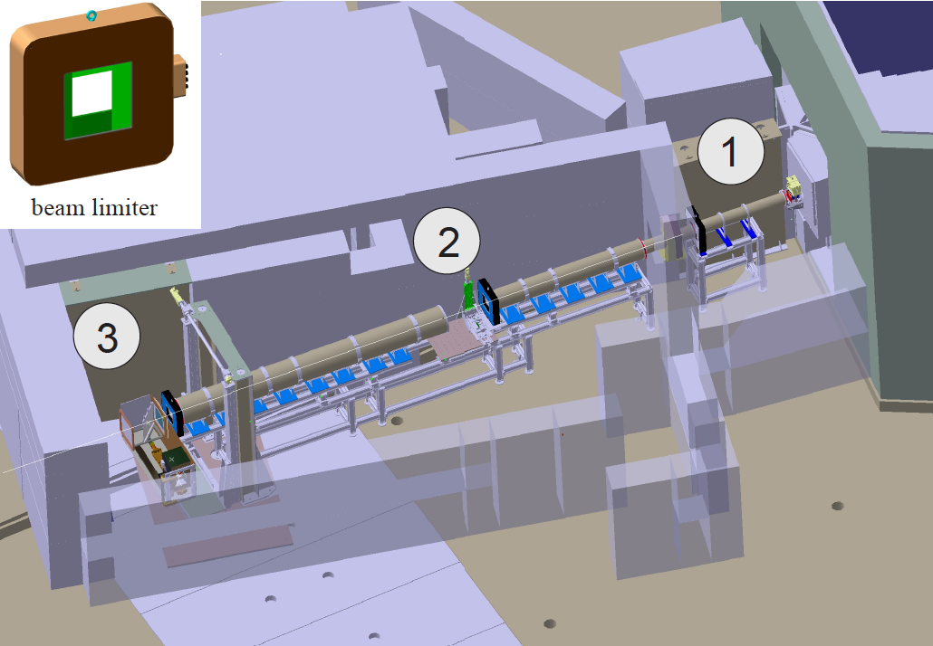
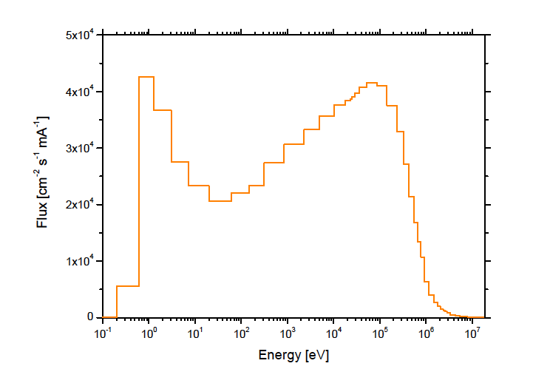
High dencity concrete
Requirement
non-magnetic material -> polarized beamlines
high content of boron
high dencity material for compact shielding (> 5 g/cm3)
Characterisation on BOA and ICON Beamline at SINQ (both beamlines have fast neutrons)
measured fast neutron spectrum
ICON beamline
Partner: SACAC AG Switzerland

Slide 6
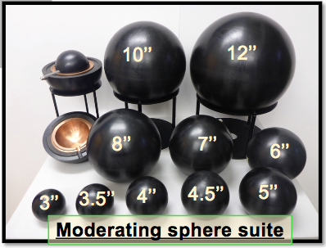
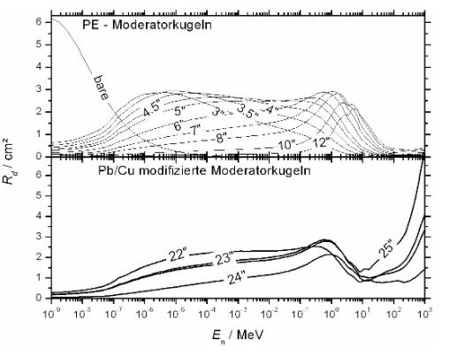
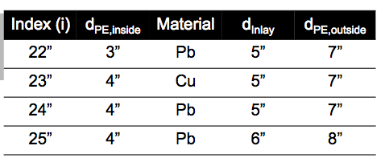
Measurements by Extended BSS System
PSI/BSS – System can measure neutrons up to 6 GeV

Slide 7
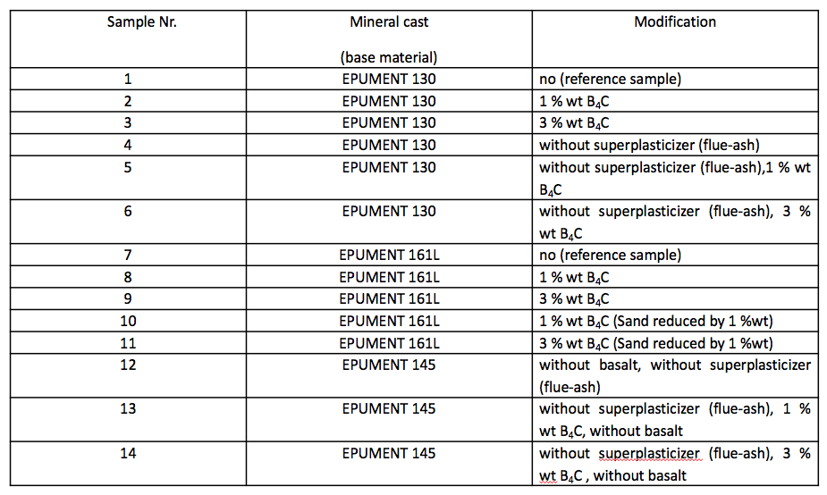
Mineral Cast Samples
14 different mineral cast samples were investigated.
Epument 130 and Epument 145 are comparible to concrete
Epustone 161 is specially made as a replacement for granite
Epument is usually without Boron (test samples have 1 and 3 % B4C)
EFA (ash) is a problem because C-60 is included

Slide 8
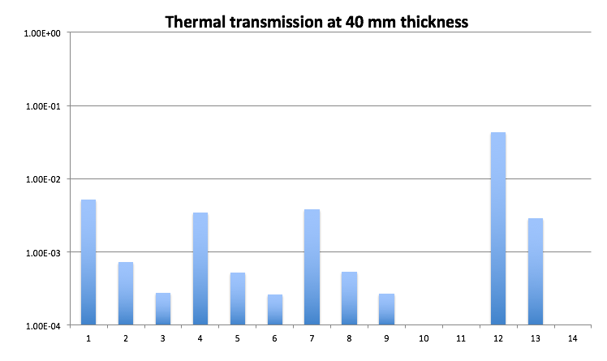
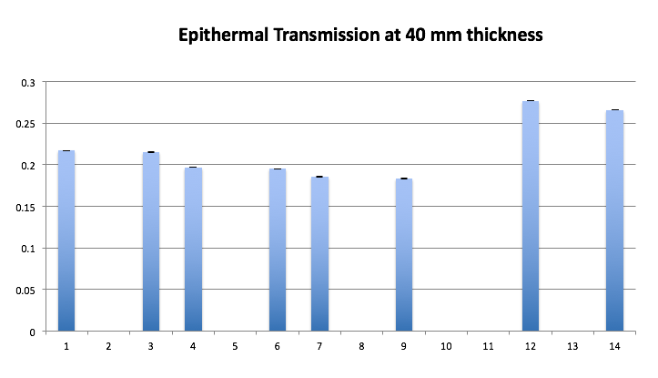
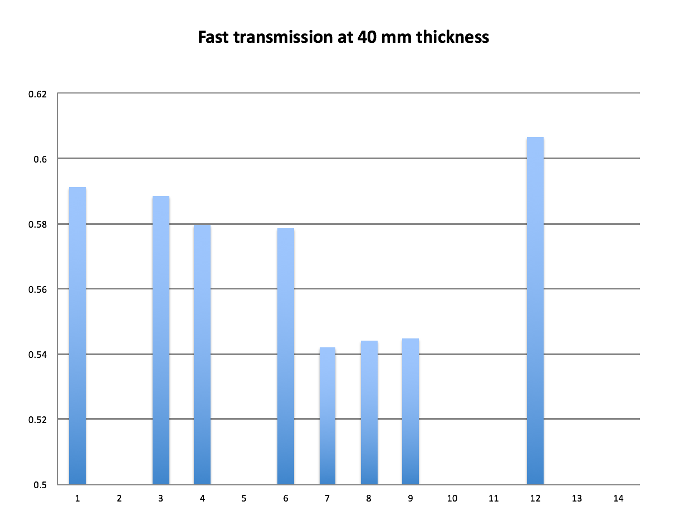
Mineral Cast Measurements
Best samples are: without ash and a high B4C (5%) content -> sample 6 and 9
Next Step in 2018: increasing hydrogen in sample 6 (will be measured in July 2018)

Slide 9
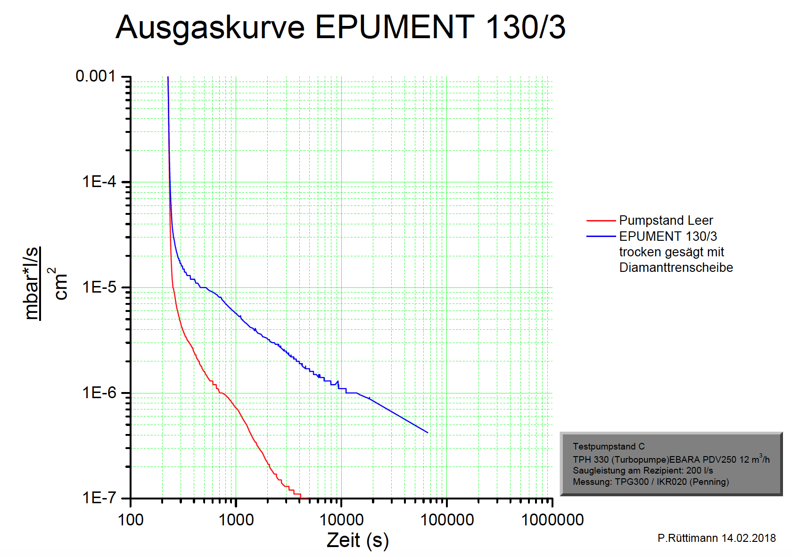
Vacuum tests
EPUMENT 130/3 – Gas Treatment
without sample
Only for high vacuum environment mineral cast shows a delayed behaviour, but neutron guides require only 1E-3 mbar

Slide 10
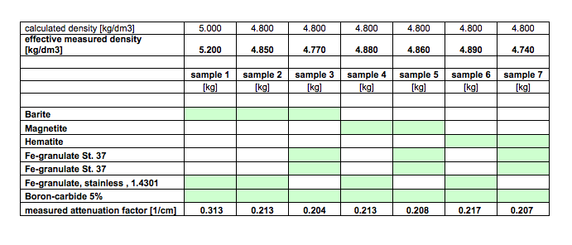
Heavy Concrete Measurements
7 different concrete compositions were tested
non-magnetic / magnetic samples for different applications
Sample 1: special efforts - stainless steel balls with different sizes and thermal treatment
In addition Sample 1 includes as mineral Baryte – very good gamma shielding material
Comparison: normal concrete: < 0.13 cm⁻¹

Slide 11
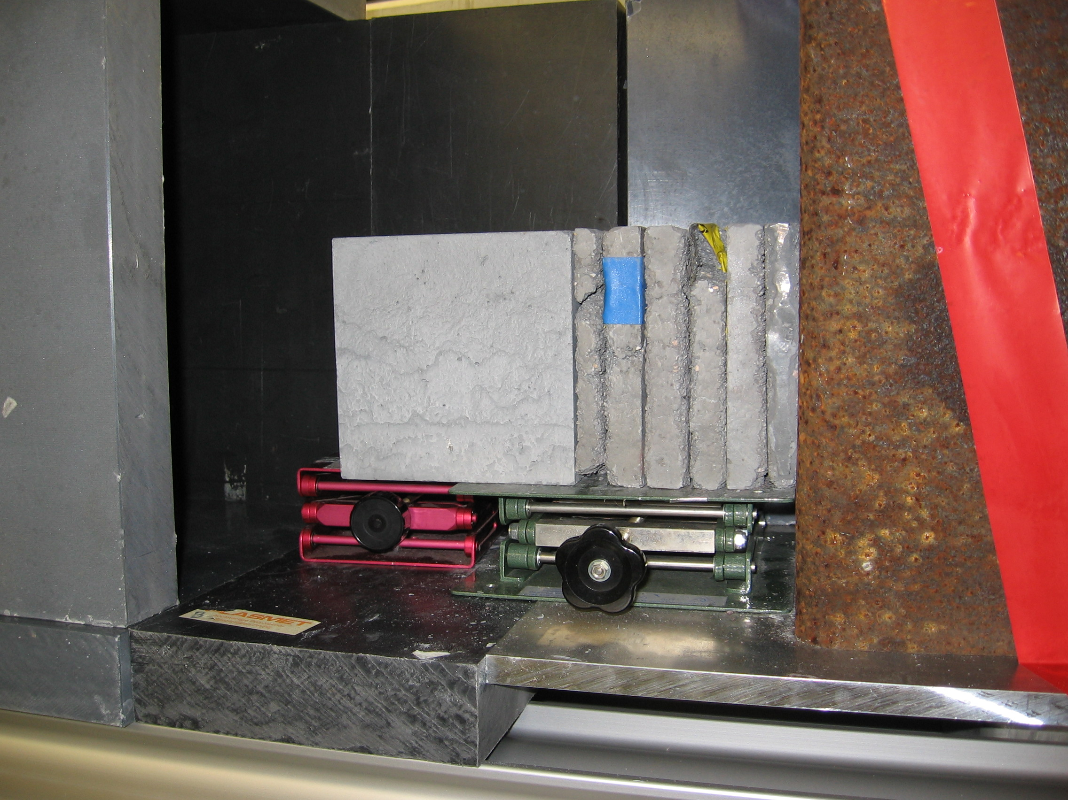
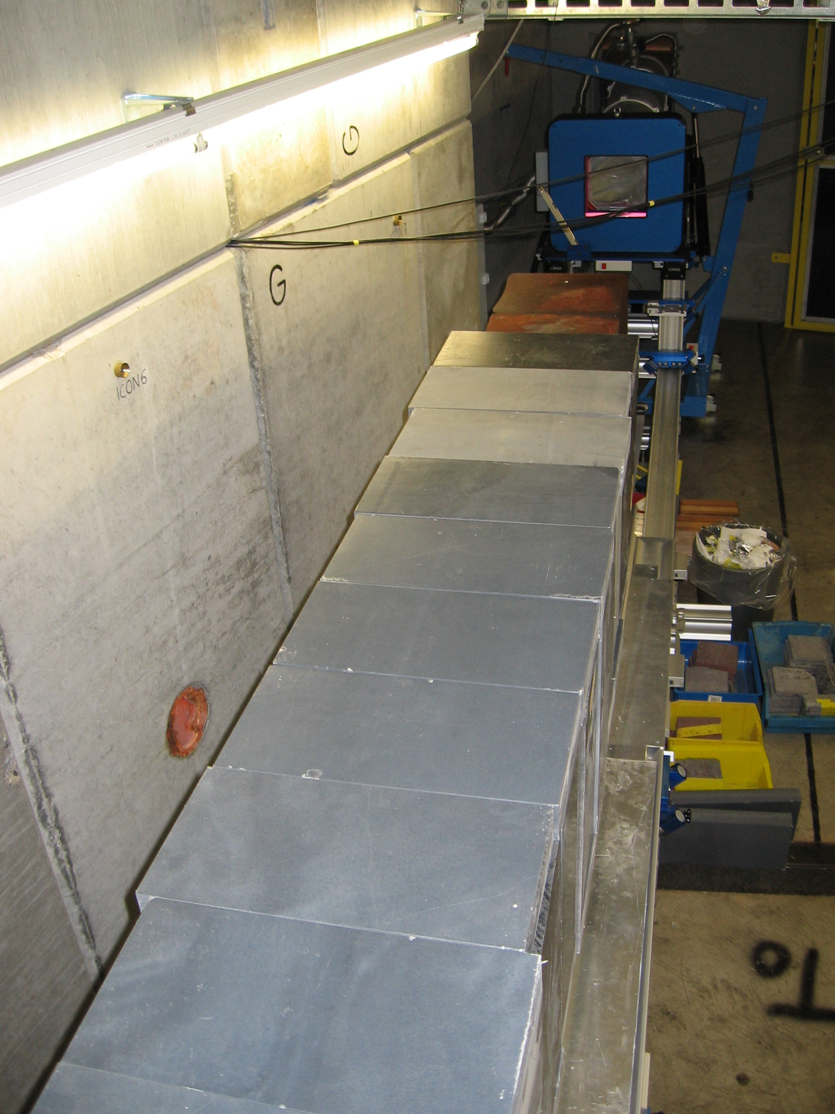
Heavy concrete Measurements
Attenuation for the fast Neutrons
Incoming spectrum at ICON beamline
12 inch sphere
Background
shielding was needed
Sample with strong steel collimator (1m)

Slide 12
Comparison 1 – Standard mineral cast
Thermal neutron transmission
Fast neutron transmission
bare counter
12 inch sphere
Activation decay (irradiation time 10 sec)
Mineral cast is better as
standard concrete or granite
Granite includes Thorium!

Slide 13
Comparison 2 – Borated mineral cast – Composition 6
Thermal neutron transmission
Epithermal neutron transmission
bare counter
3.5 inch sphere
Fast neutron transmission
12 inch sphere
Mineral cast acts like
heavy concrete !!!

Slide 14
Additional Samples
Improving shielding properties -> increase hydrogene
Improving vacuum properties -> reducing wax for making the samples
Check of mechanical properties
N1: plus 1 % more hydrogene (added over binder)
N2: plus 2 % more hydrogene (added over binder)
N3: plus 3 % more hydrogene (added over binder)
N4: new high-precision concrete with 3% B4C

Slide 15
4. 3.5”, transmission of 5 samples (Epi-thermal)
3.5” – has broad sensitivity in epithermal, the peak is at 10keV
sample | linear attenuation coefficiency [mm⁻¹]
no.6 | 0.0393
N1 | 0.0409
N2 | 0.0412
N3 | 0.0423
N4 | 0.0333
Best sample is N3

Slide 16
5. 12”, transmission of 5 samples (Fast neutrons)
12” – sensitivity peak is at 4 MeV
sample | linear attenuation coefficiency [mm⁻¹]
no.6 | 0.0135
N1 | 0.0139
N2 | 0.0138
N3 | 0.0141
N4 | 0.0128
Best sample is N3

Slide 17
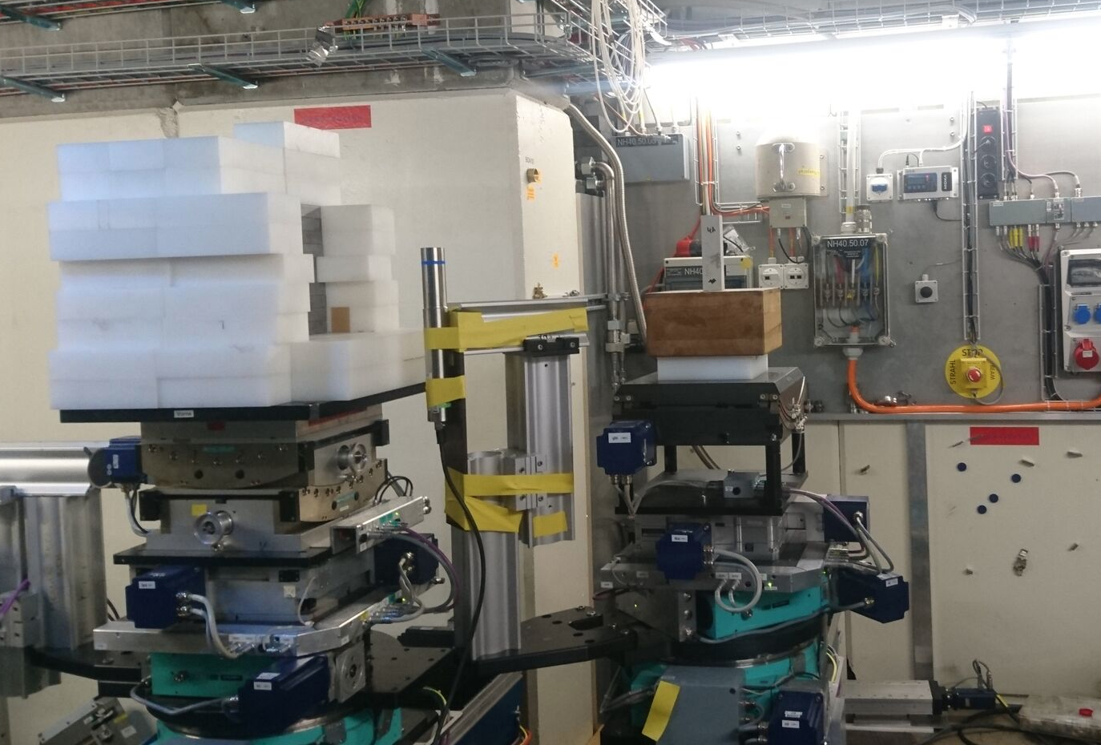
6. Activation with thermal neutrons
Conclusion:
N1, N2, and N3 have the same activation level as #6. N4 has a lower activation level, but shielding performance is low.

Slide 18
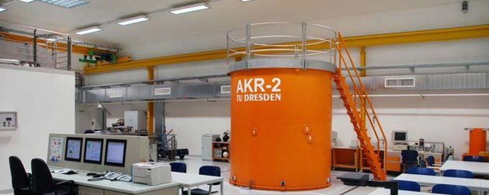
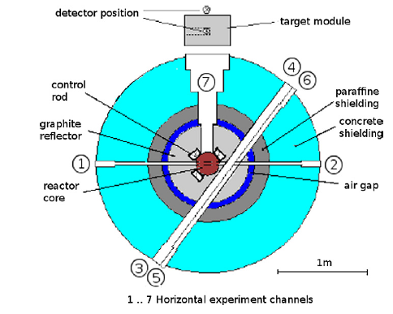
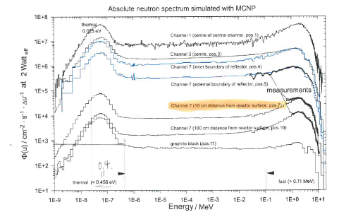
Field Test with BSS system
A
AKR reactor at Dresden University
B
Small reactor facility (2 W) with very well-known
configuration
detailed MCNP model exists
at position A the fast neutron spectrum was measured
by another group (proton recoil method)
Field test was in April 2018
Verification of the known n-spectrum
Measurement an un-known n-spectrum (Pos. B)

Slide 19
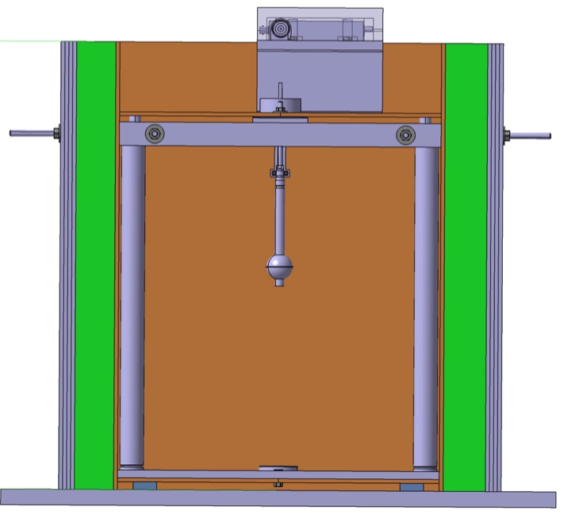
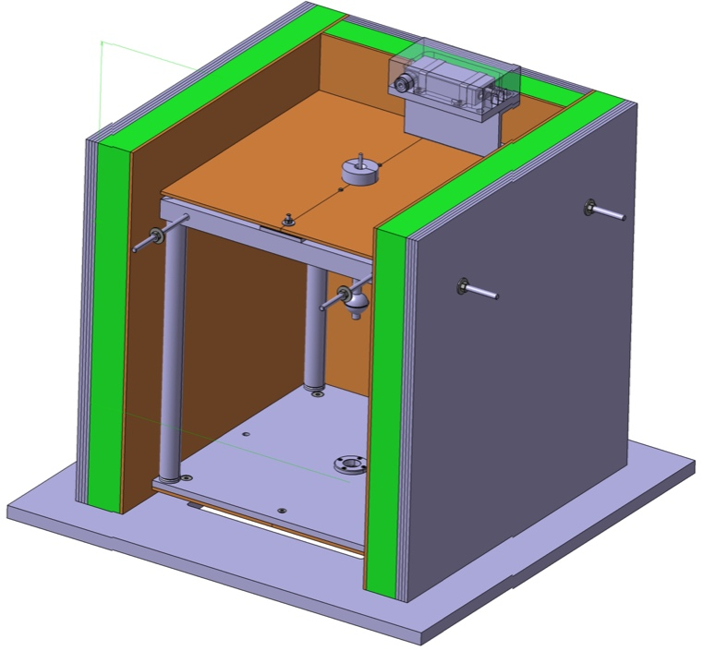
Extension for “In-beam” measurement
1. High intensity beam
➔ The flux is ~ 10² to 10³ times higher than “background” field.
→ Low-efficiency detector (10⁻²) is available now.
2. Discriminate the “back ground” neutrons from the beam
➔ The shielding box (which has a lamella structure) is built and will be
tested in September 2018 at BOA.
→The ideal design will be investigated.
3. Partial illumination of spheres (special response functions)
Steel
BPE
B-Al

Slide 20
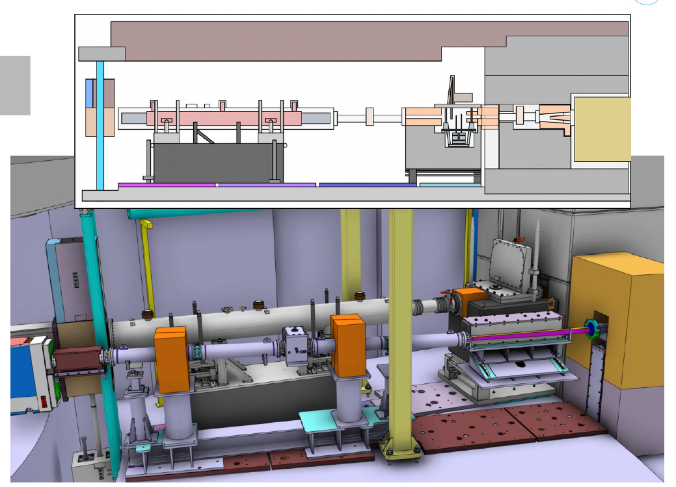
Bunker Components – Detailed Simulations

Slide 21
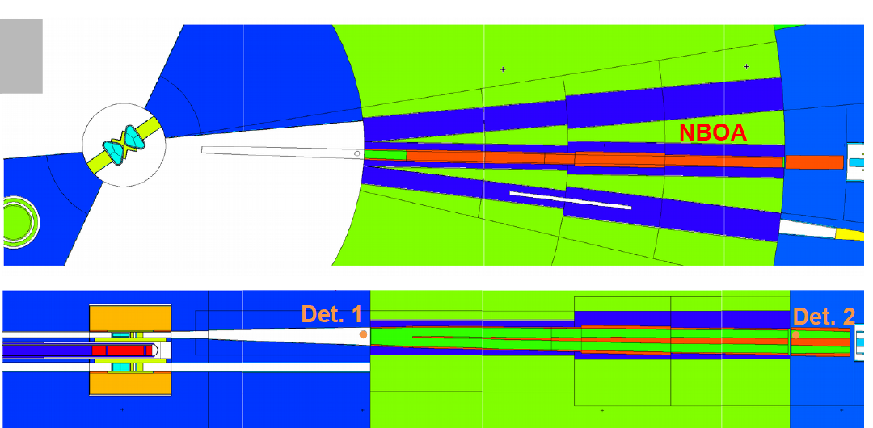
ESTIA - NBOA
Re-design of the MCNPX model (includes the geometry from CATIA)

Slide 22
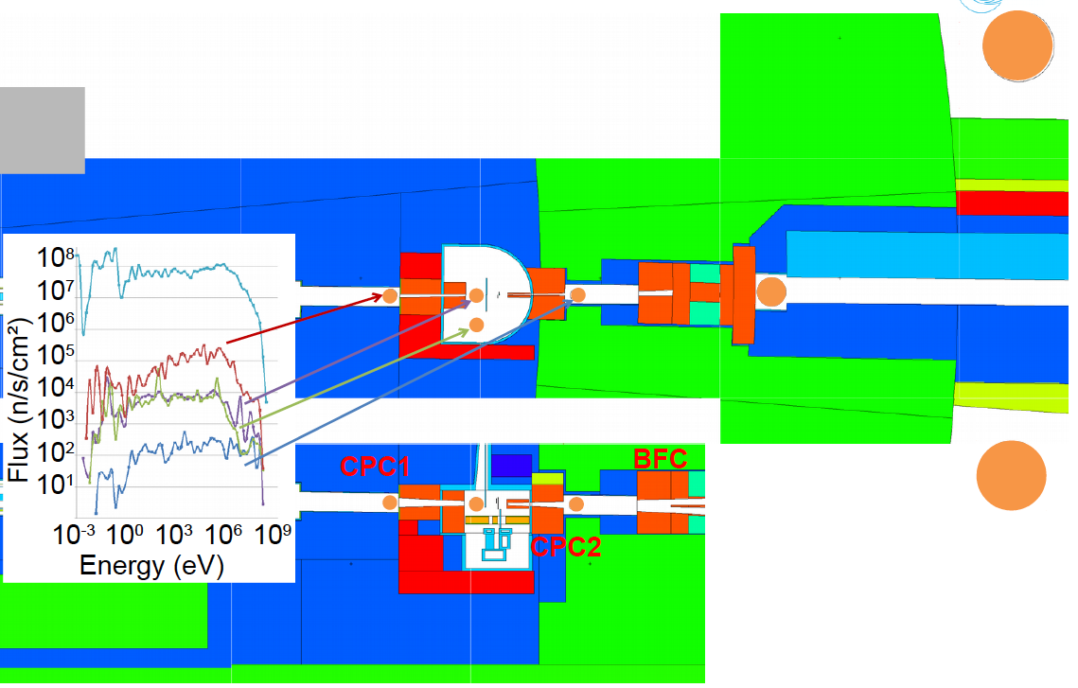
Collimator Simulations

Slide 23
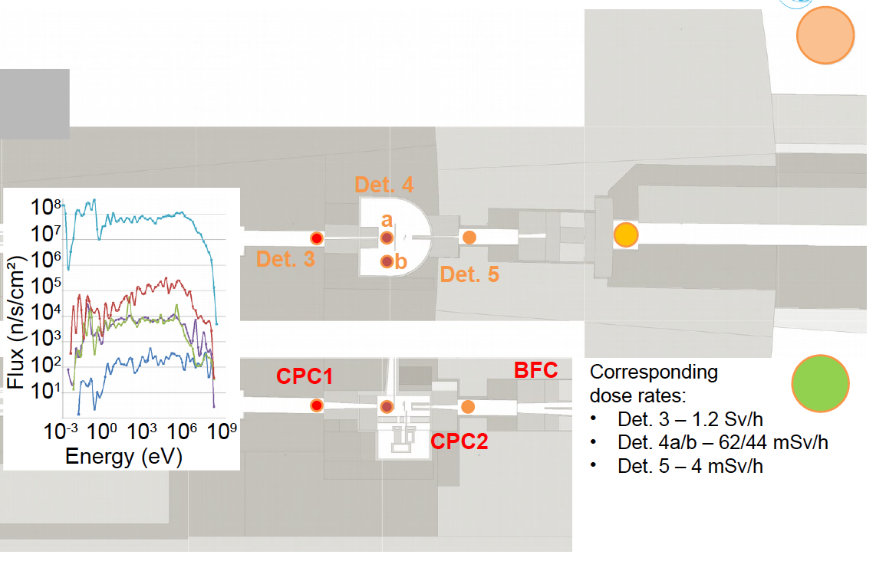
n - Dose Rates
Det.7
Det.6
Det.8
Det.6 – 40 muSv/h
Det.7 – 85 muSv/h !!
Det. 8 – 0.2 muSv/h

Slide 24
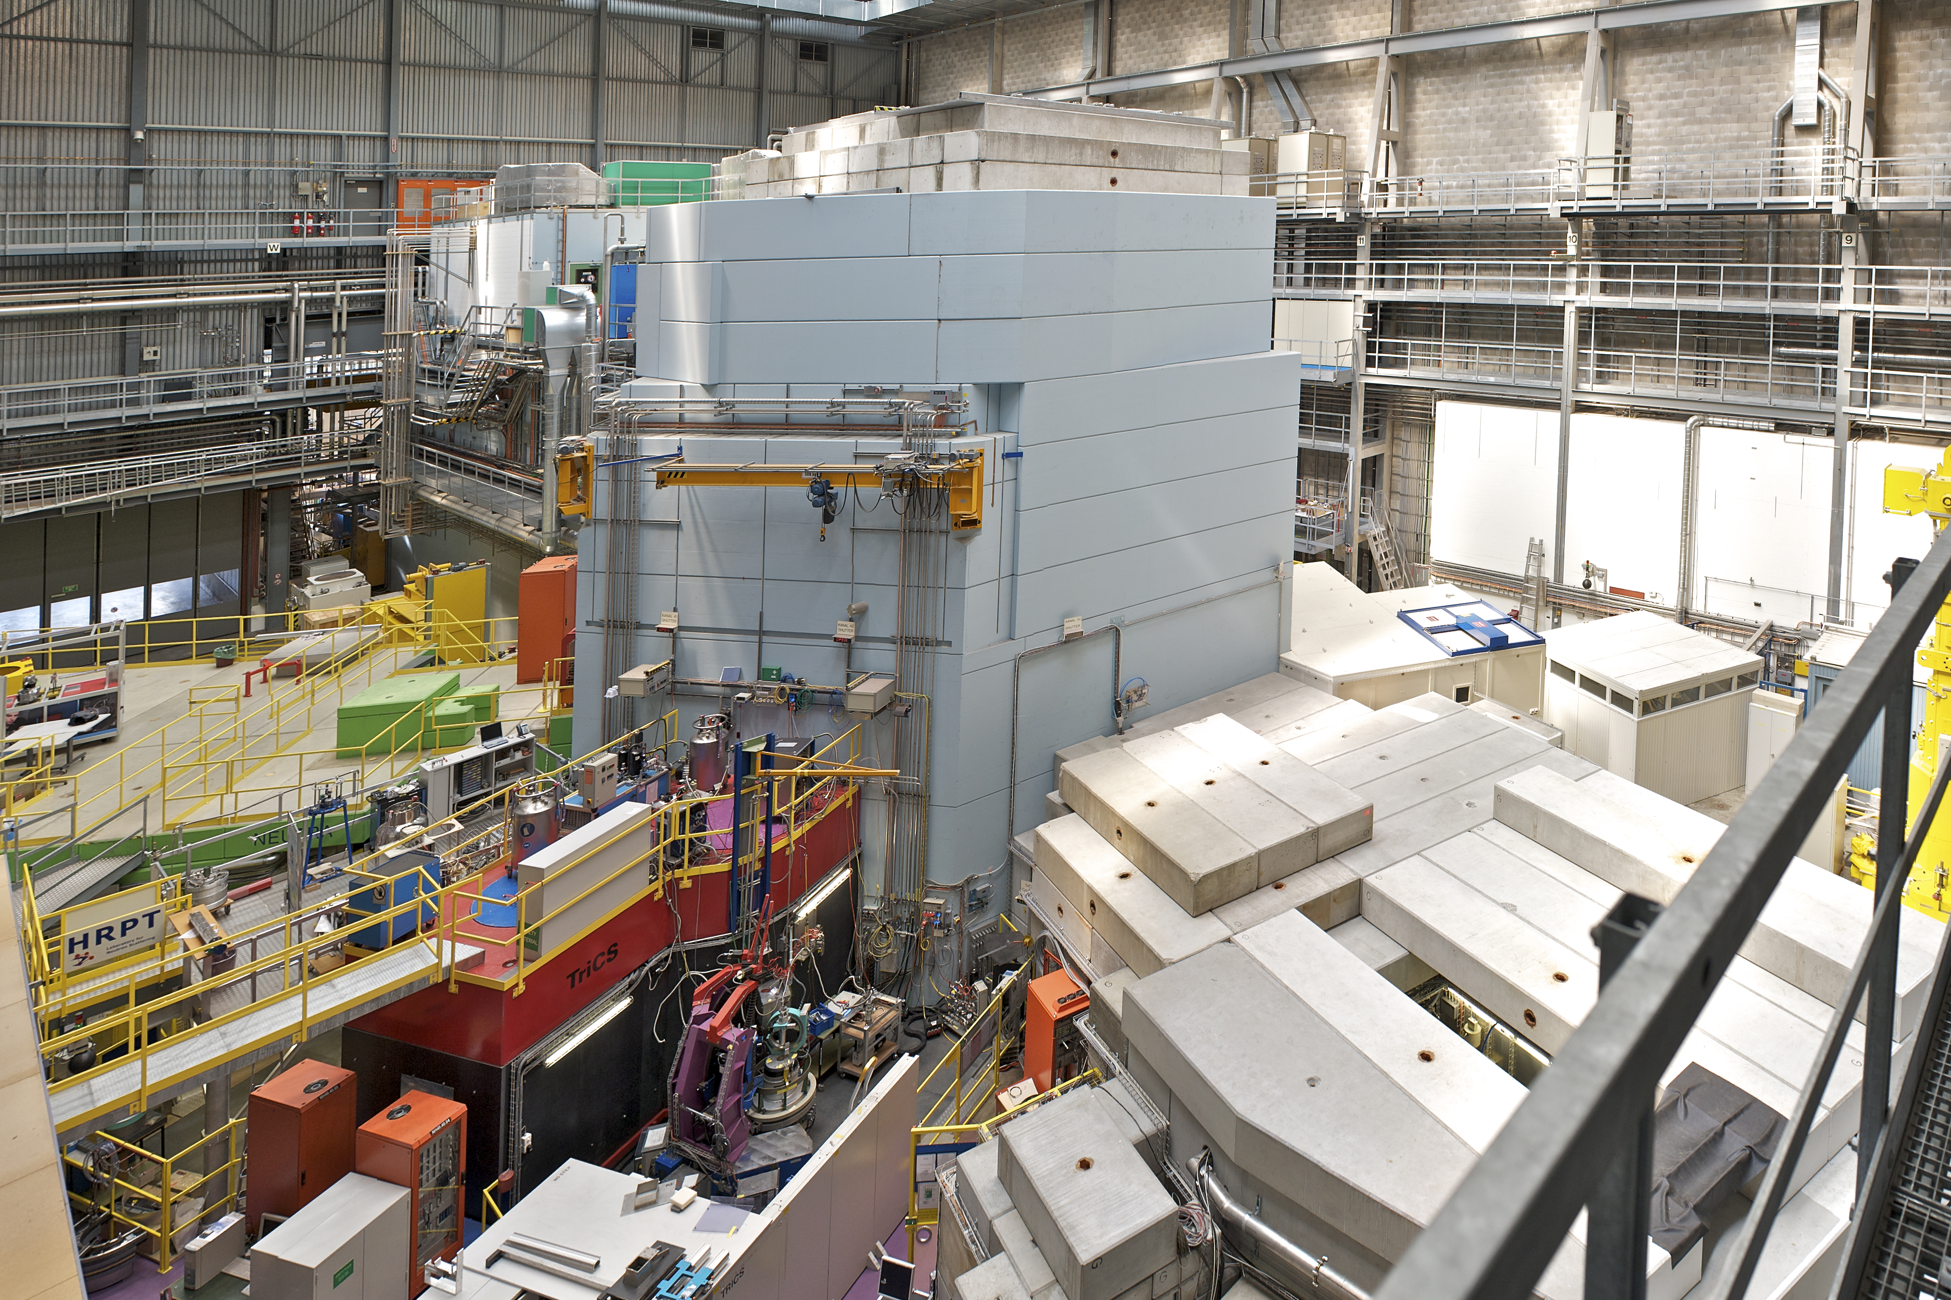
Thank you for your attention.

