Slide 1

ESS Shielding Simulations
MaGIC and Estia
Uwe Filges
Laboratory for scientific Developments and novel Materials (LDM)
Paul Scherrer Institut

Slide 2
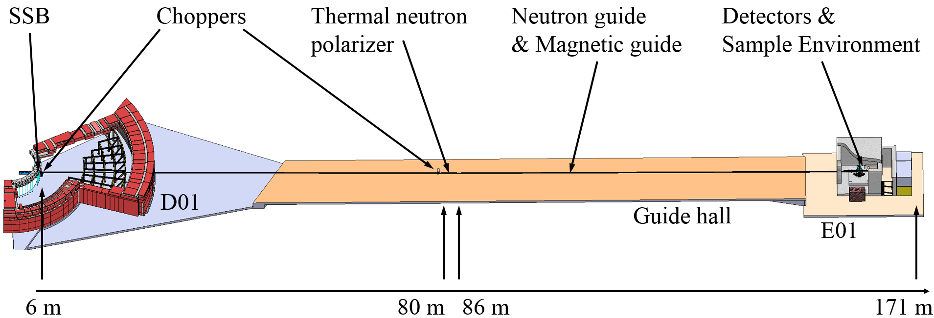
MAGiC beamline layout
polarized single crystal diffractometer at beamport W6
Cold & thermal beam extraction
Elliptic guide system with a kink at 80 m

Slide 3
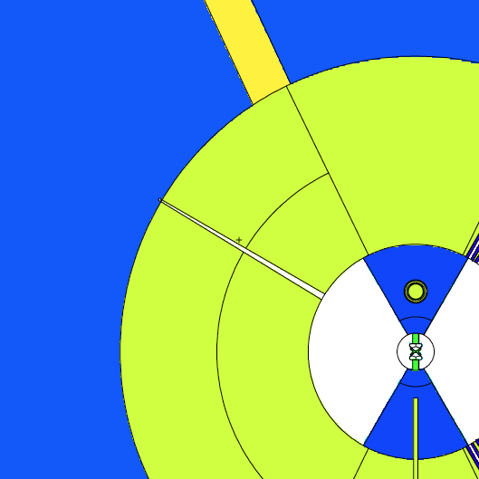
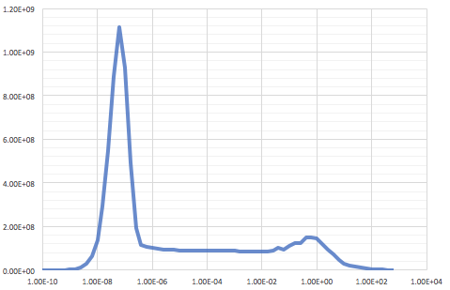
Neutron and prompt gamma dose rates at 5.5m (W6)
Total: 27 Sv/h
Gamma dose rate (muSv/h)
Energy (MeV)
Neutron flux: 8.4*E9 n/s/cm²
Total: 447 Sv/h
W6 – beam entrance 30 mm x 124 mm
Neutron dose rate (muSv/h)
W6 – beam exit 30 mm x 38 mm
Note: no other beamports are modelled
Energy (MeV)

Slide 4
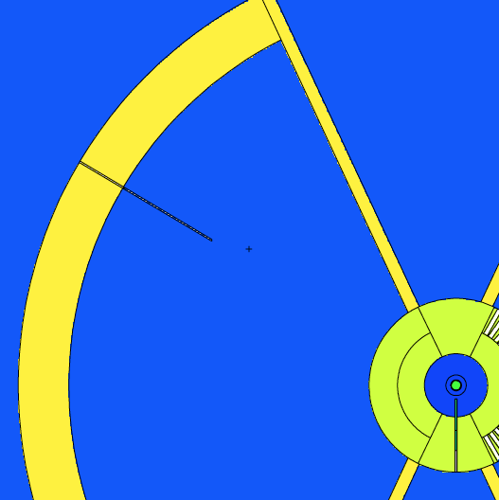
Neutron and prompt gamma dose rates at 24.5 m (W6)
Gamma dose rate
Dose rates @ 24.5m
Gamma dose rate (muSv/h)
Total: 0.79 Sv/h
Energy (MeV)
Neutron dose rate
Neutron dose rate (muSv/h)
Total: 13.8 Sv/h
W6 – vacuum channel 10 cm x 10 cm (0.5 deg tilt)
New SDEF-card defined for guide shielding calculations
Energy (MeV)

Slide 5
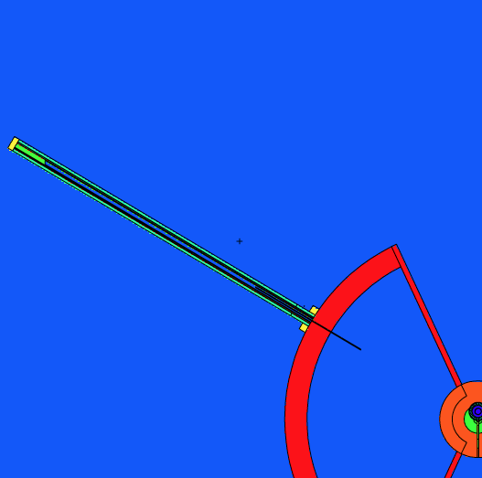
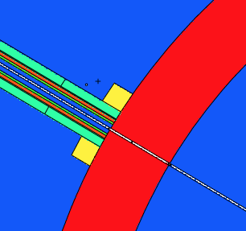
Neutron dose rates along guide system (W6)
cross section inside shielding: 50 cm x 50cm
Shielding around guide:
10 cm borated concrete
10 cm standard steel
50 cm standard concrete
New neutron source definition
(SDEF card)
A
D
Source – tally S: 13.8 Sv/h
@77m - tally A: 8.8 mSv/h
fast neutron flux: 4.7E4 n/cm²/s
@30m – outside guide shielding
tally B: 3.4 µSv/h
@50m ouside guide shielding
tally C: 1.9 µSv/h
@77m ouside guide shielding
tally D: 1.1 µSv/h
C
B
S

Slide 6
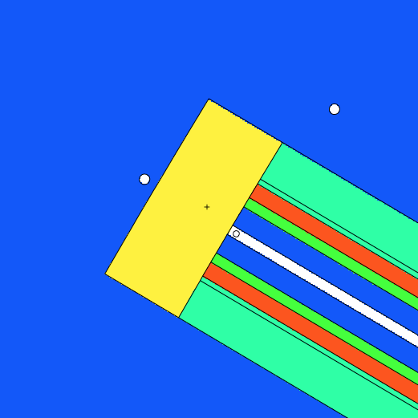
Shielding the direct beam at 77m
Remember:
@77m center of beam: 8.8 mSv/h neutron dose rate
Beam dump consists of 50 cm
heavy concrete (4.9 g/cm³)
Concrete includes 5 % B₄C
Behind beam dump:
n-dose rate : 1.6 µSv/h
g-dose rate : < 0.1 µSv/h
Detector size: d=6 cm
30 n/s/cm²

Slide 7
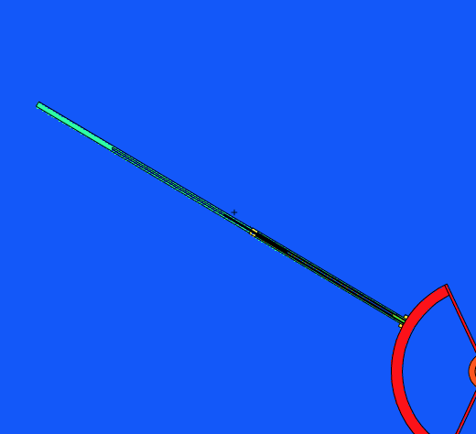
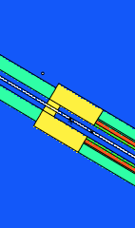
150m Guide Shielding
Neutron background at 150 m
Shielding around guide behind 77m:
2m heavy concrete with vacuum tube belt
75m standard concrete (0.5 m thickness)
F
neutrons
Source – tally S: 13.8 Sv/h
@80m ouside guide shielding
tally E: 1.3 µSv/h
@150m inside guide shielding
tally F: 0.2 µSv/h
4.2 n/s/cm²
E

Slide 8
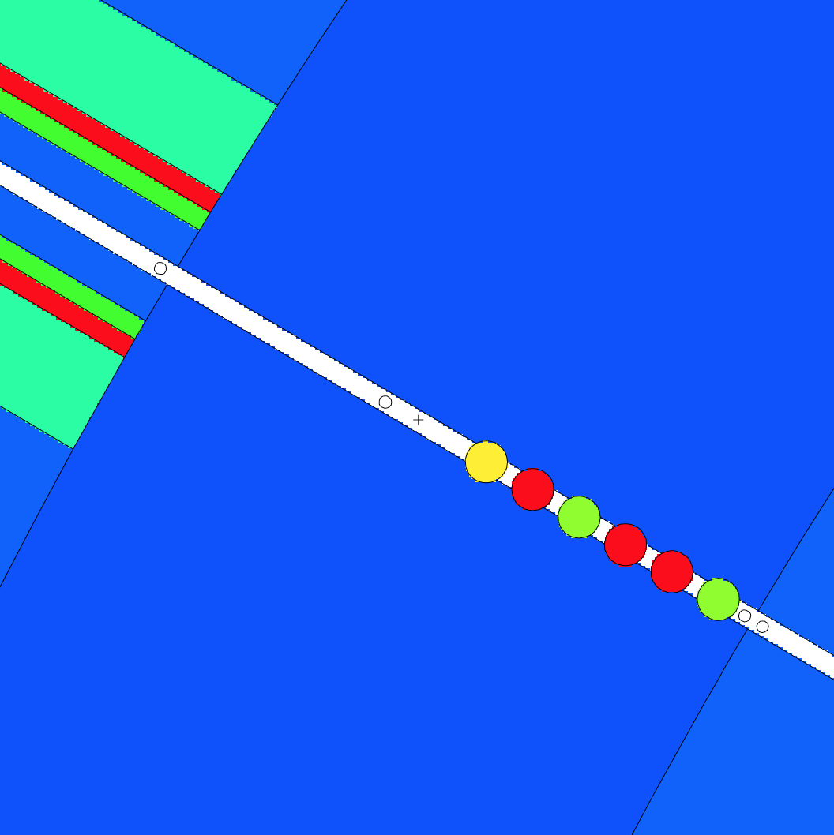
High energy shutter setup
6 drums are positioned within the neutron bunker wall.
Drum Sequence:
Borax (50% epoxy / 50% B₄C)
Standard steel
Standard steel
Borax
Standard steel
Tungsten/parafin (density 11.8 g/cm³)
Effective thickness: each drum 20 cm
n-dose rate: 15.2 µSv/h
g-dose rate: 0.5 µSv/h
(only prompt gammas from the drums)
N-Dose rate can be reduced more by replacing steel with tungsten drums.

Slide 9

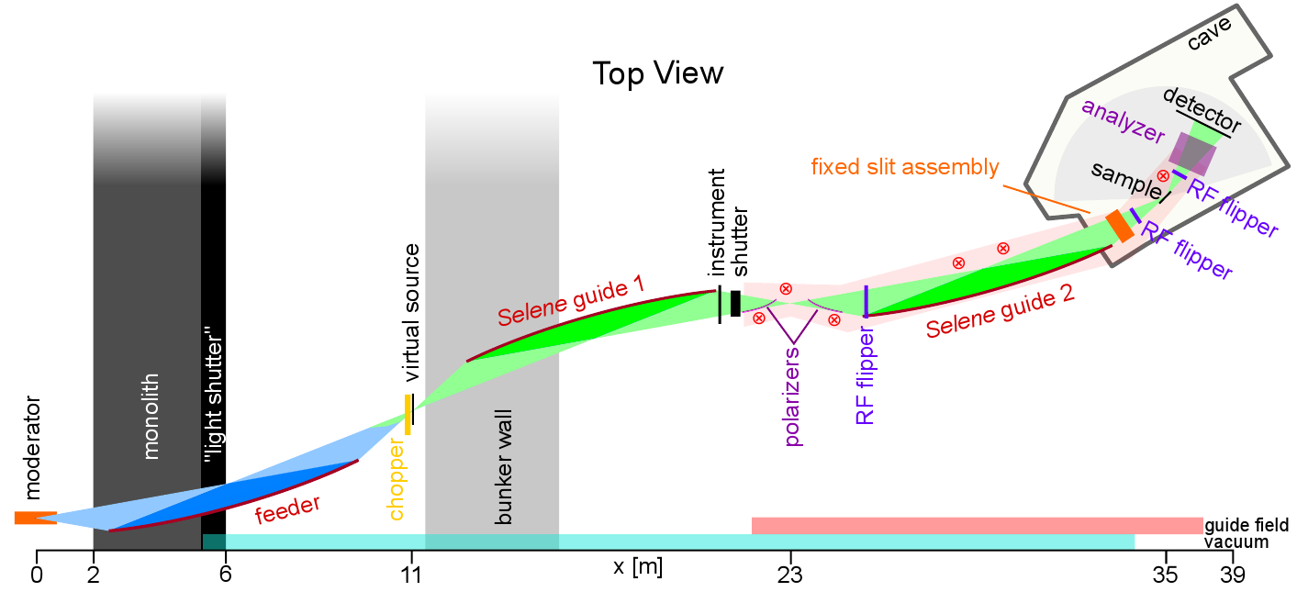
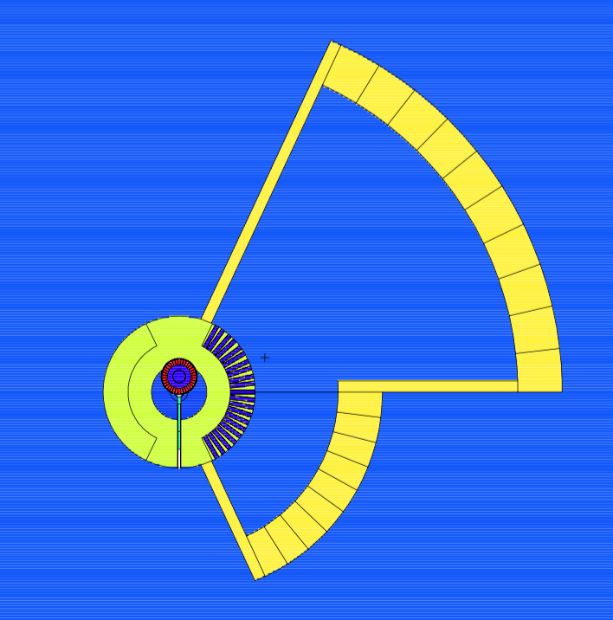
Estia – E2 Beamport
E2 – Estia beamport
Reflectometer at beamport E
Cold neutron beam line
Elliptic guide system (Selene) – only 40 m long

Slide 10
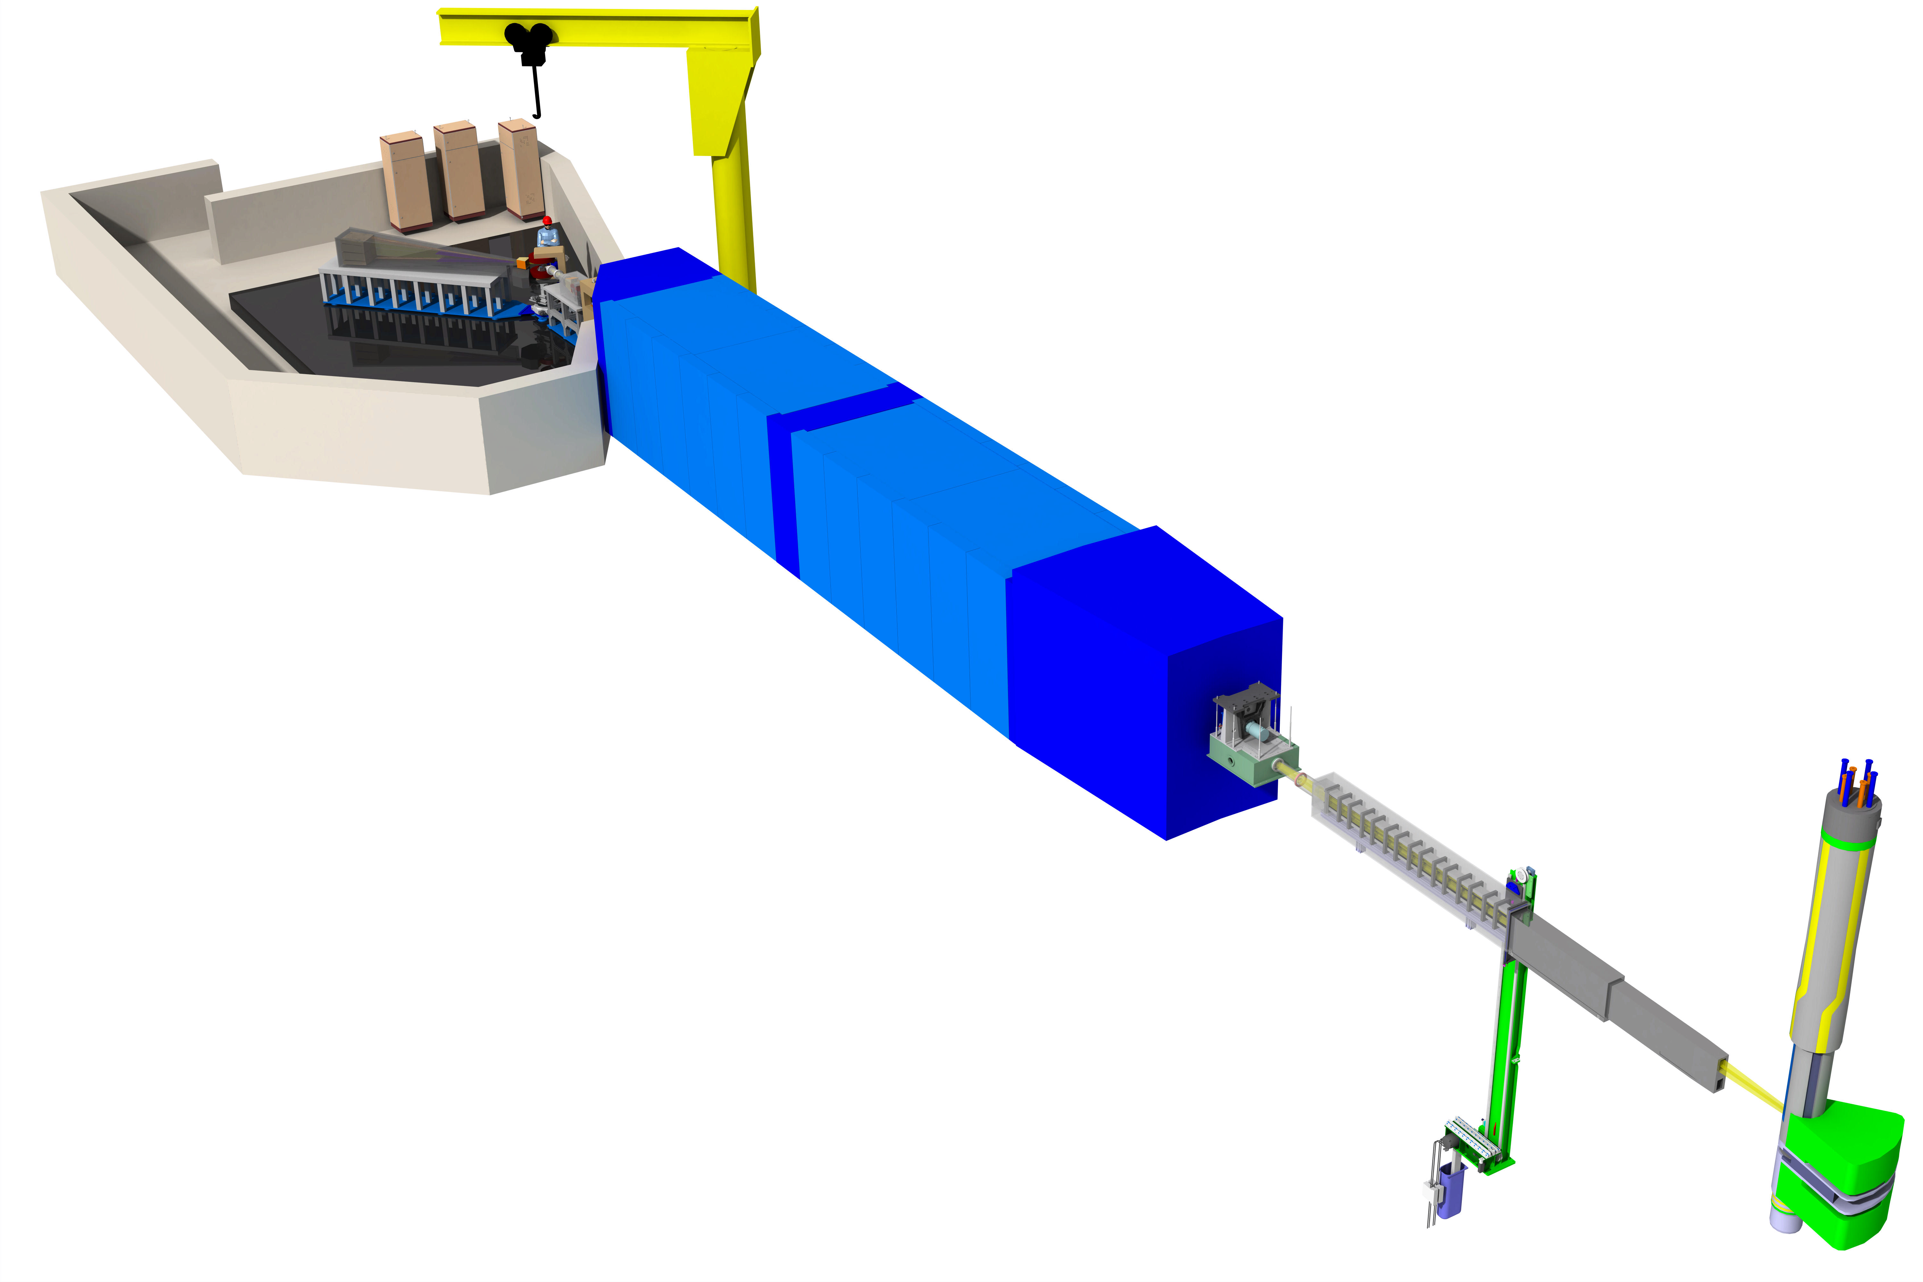
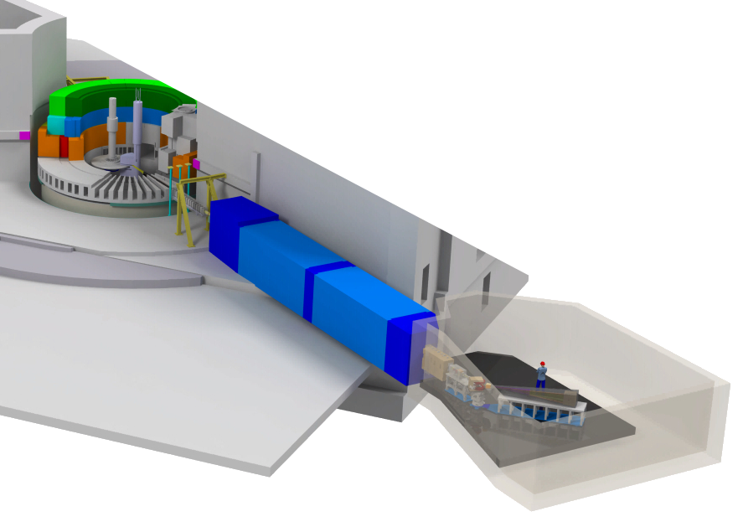
Instrument Design Overview
Estia Beamline:
Only one Chopper
Elliptic feeder to Virtual Source

Slide 11
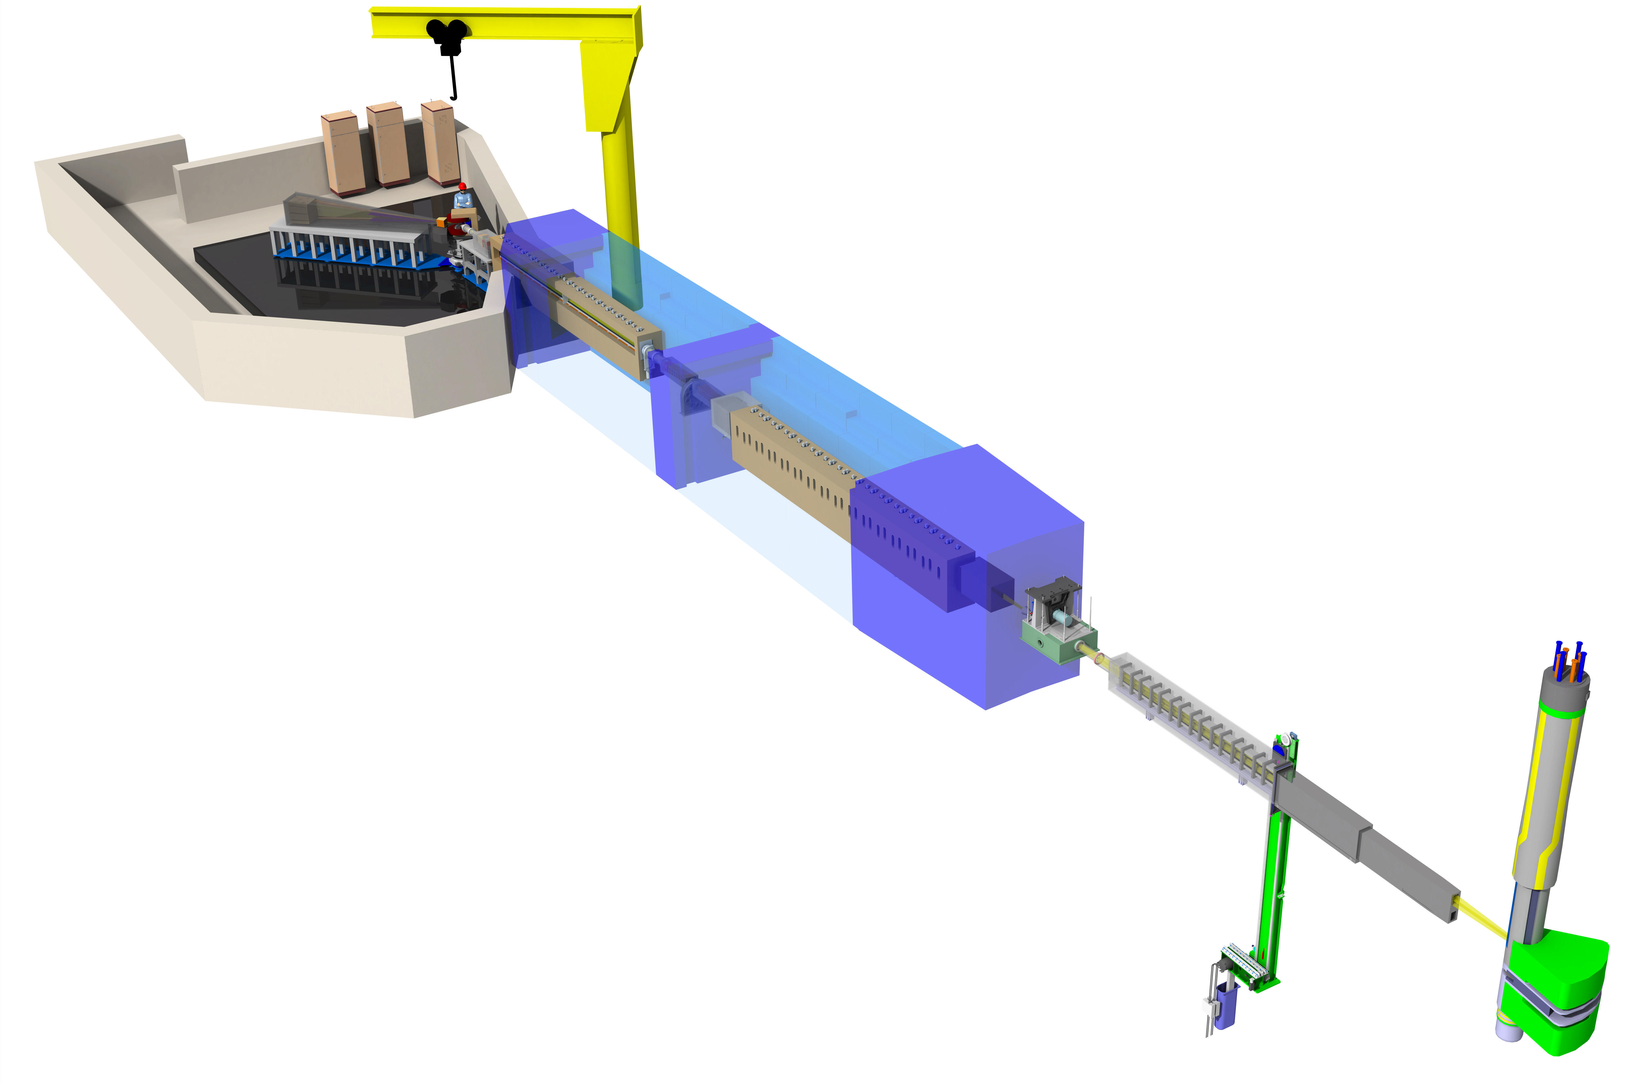
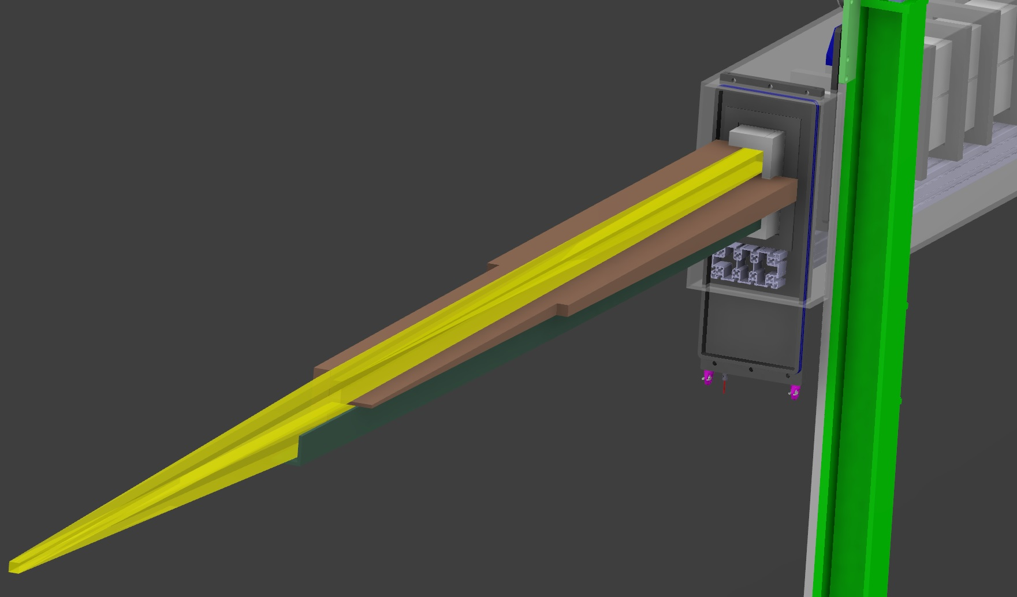
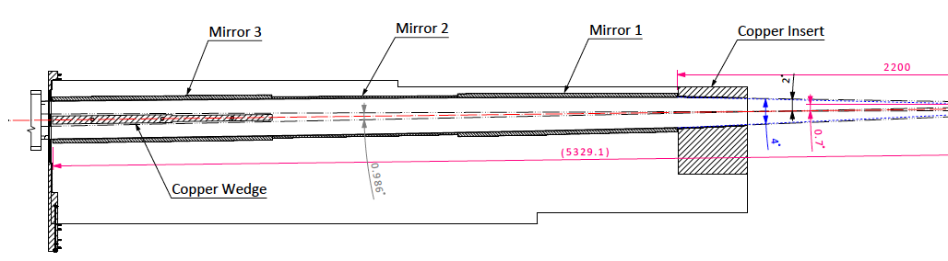
Shielding Concept - Insert
large dimensions of the feeder (opening 210 mm x 68 mm)
Dose rate reduction by factor 2-3 by additional shielding inside feeder
Additional shielding Cu

Slide 12
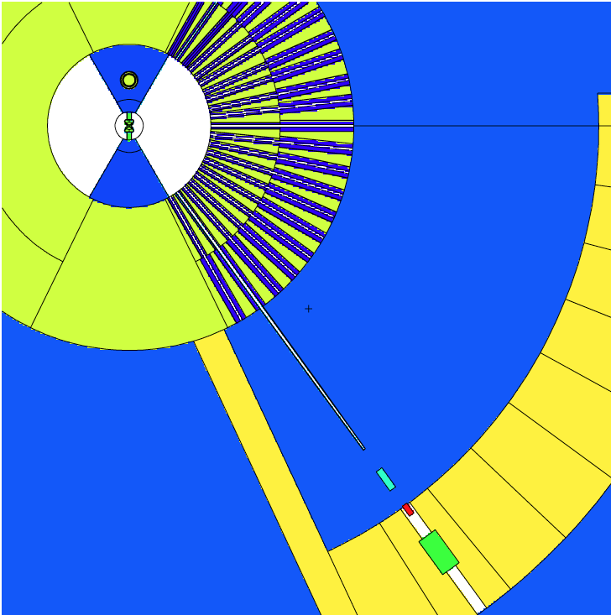
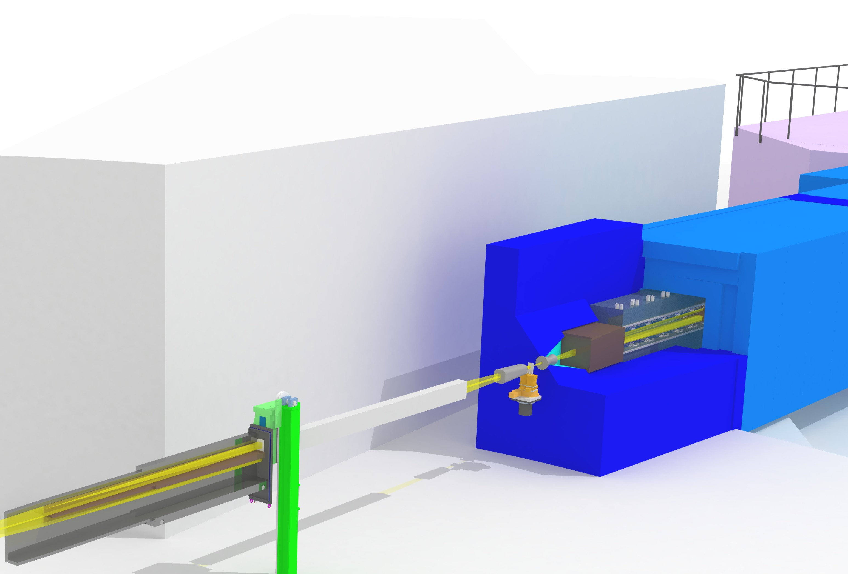
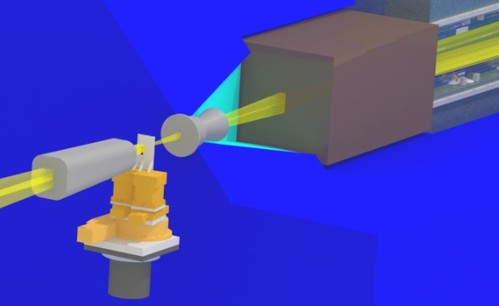
Shielding concept - inside the bunker
Virtual Source collimators
FeNi Tungsten
Shielding block inside bunker wall
Cu + Hydrogen compound
L_{FeNi} = 60 cm (opening 37 mm x 84 mm)
L_{W} = 30 cm (opening 20 mm x 70 mm)
L _{Cu} = 99.5 cm
35 kSv/h (n-dose rate)
750 Sv/h (n-dose rate)
mainly neutrons < 8 MeV

Slide 13
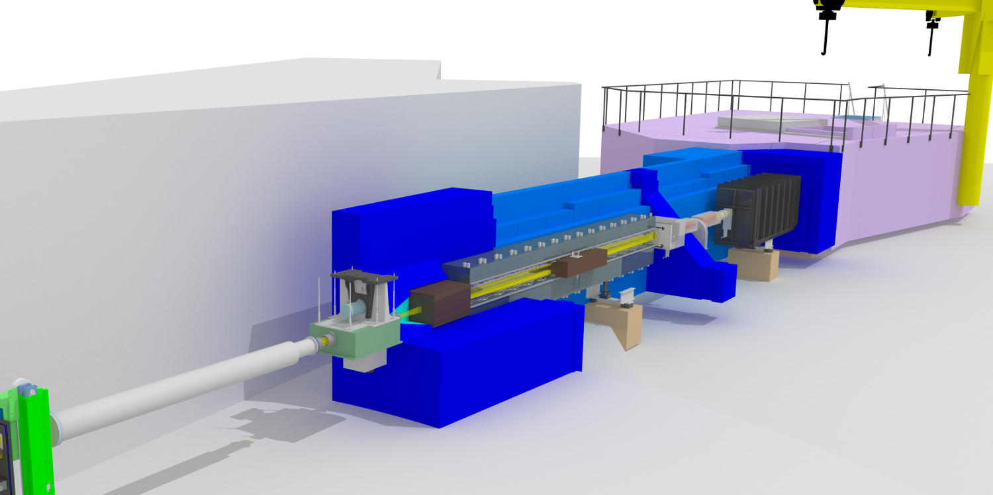
Shielding Concept – Along the Selene guide
Guide support
mineral cast (concrete with epoxy) or granite
Shielding block
mineral cast
Heavy concrete
Standard guide shielding (not optimised)
20 cm steel
50 cm borated concrete

Slide 14
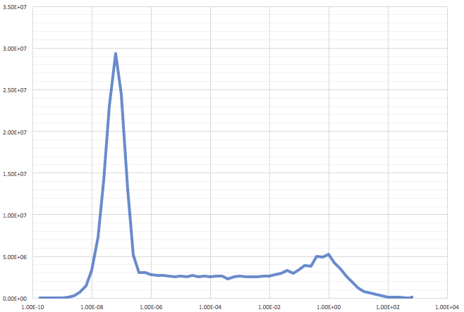
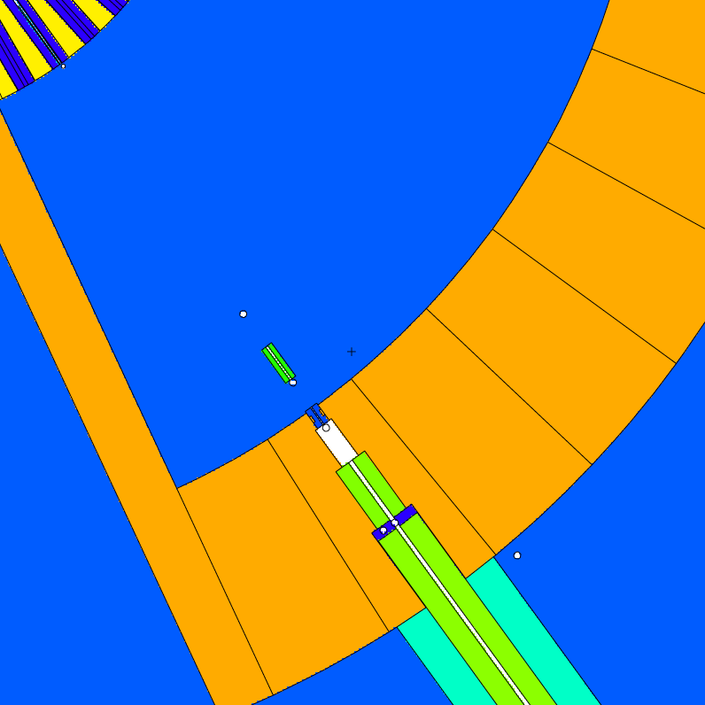
Dose rates outside the bunker
ca. 140 mSv/h
Neutron flux (n/s/cm2 )
Energy (MeV)
Neutron flux after copper collimator
N-Dose detector position
1.2 µSv/h
borated concrete (Carsten) 70 cm thickness
PSI mineral cast - around 25 cm
Copper collimator (to be optimized)

Slide 15
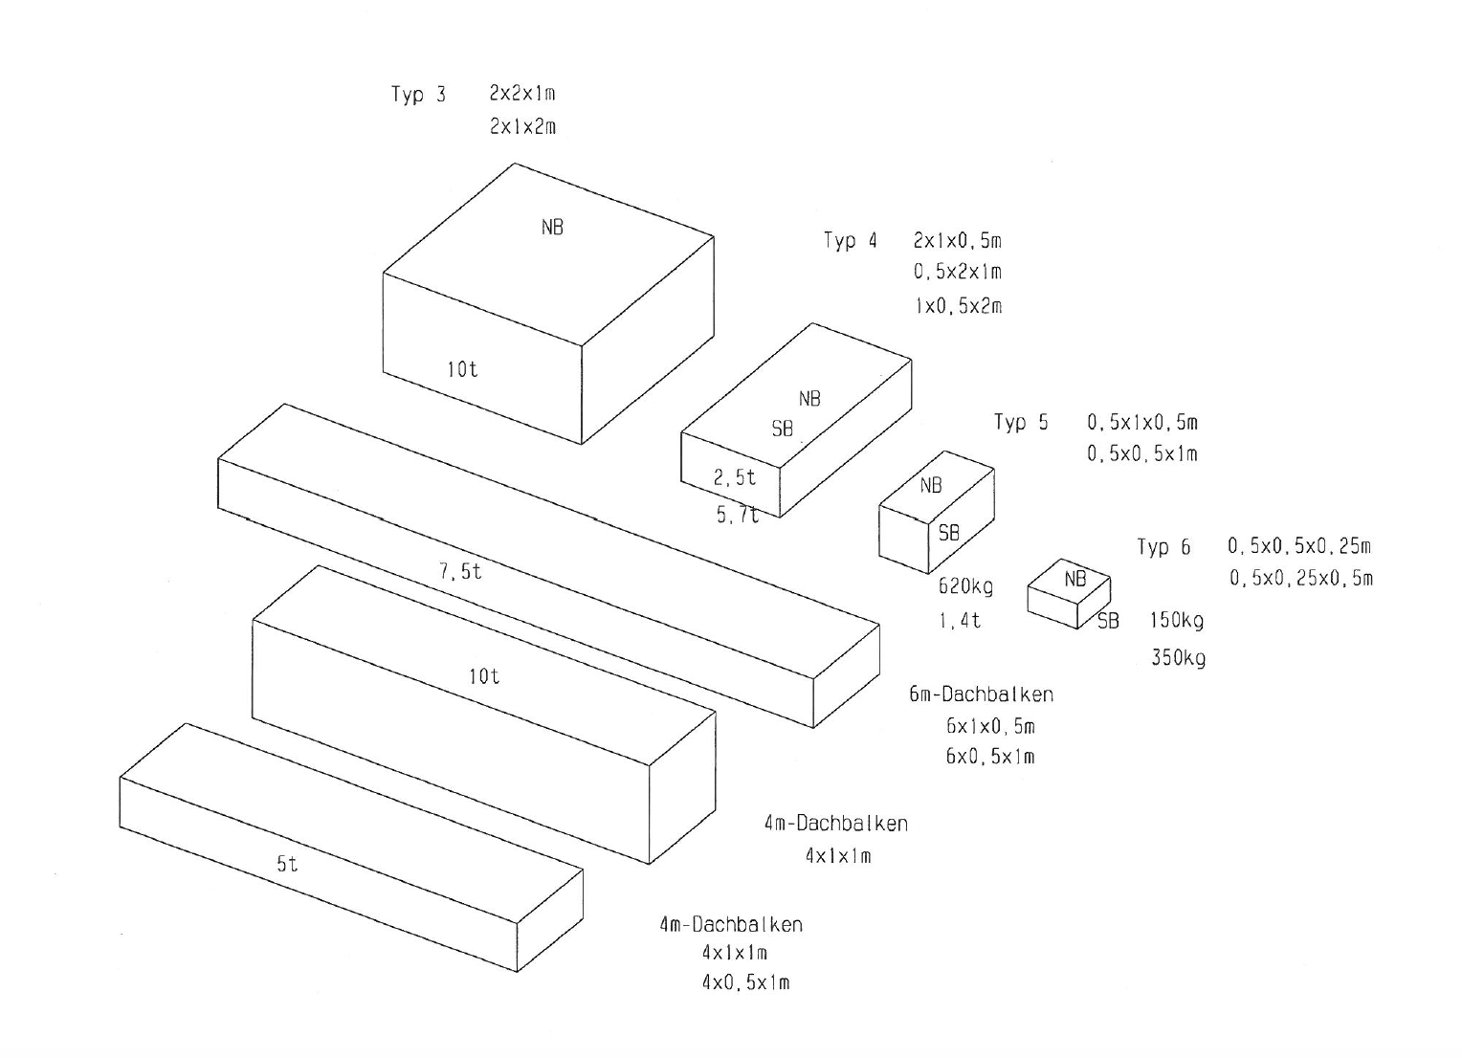
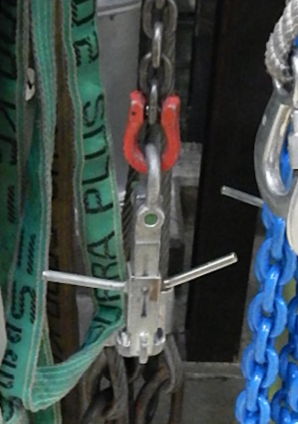
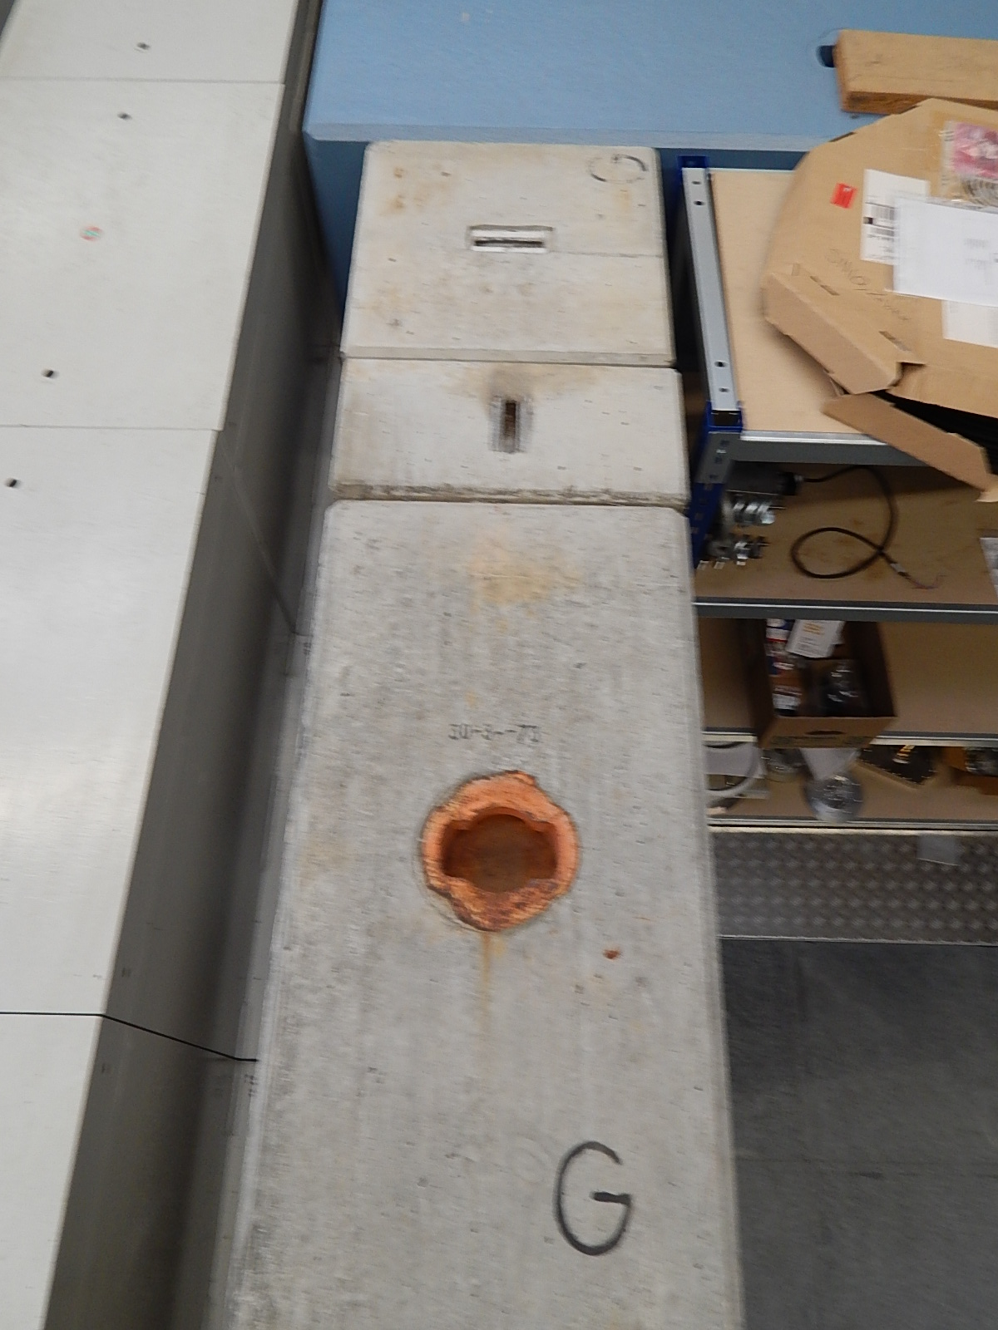
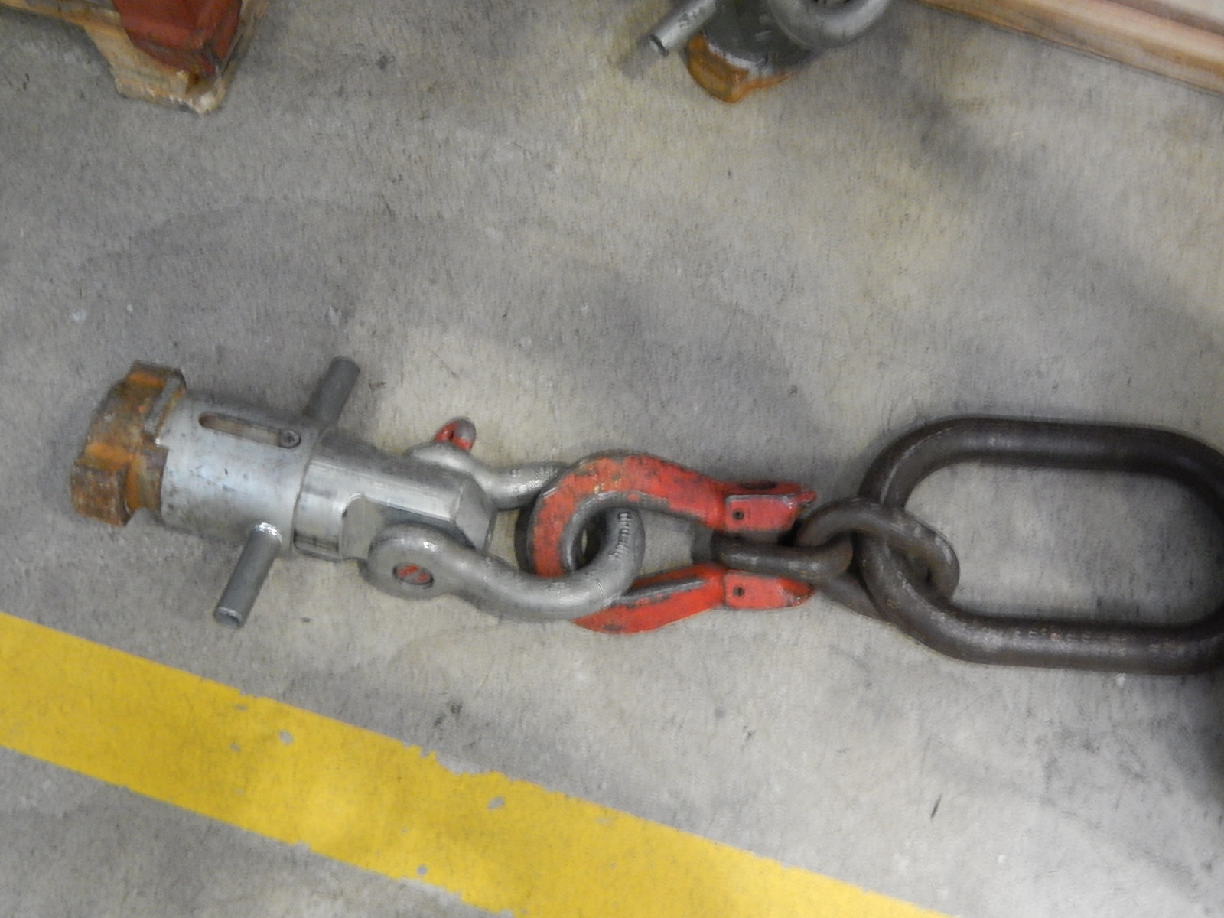
PSI standard shielding
Materials
normal concrete
borated concrete (5% boron carbite)
scrap metal concrete (density around 4g/cm3)
14 different standard geometries are available
9 types are used side-walls
5 types are special made for building bunker roofs
Two types of crane connectors

Slide 16
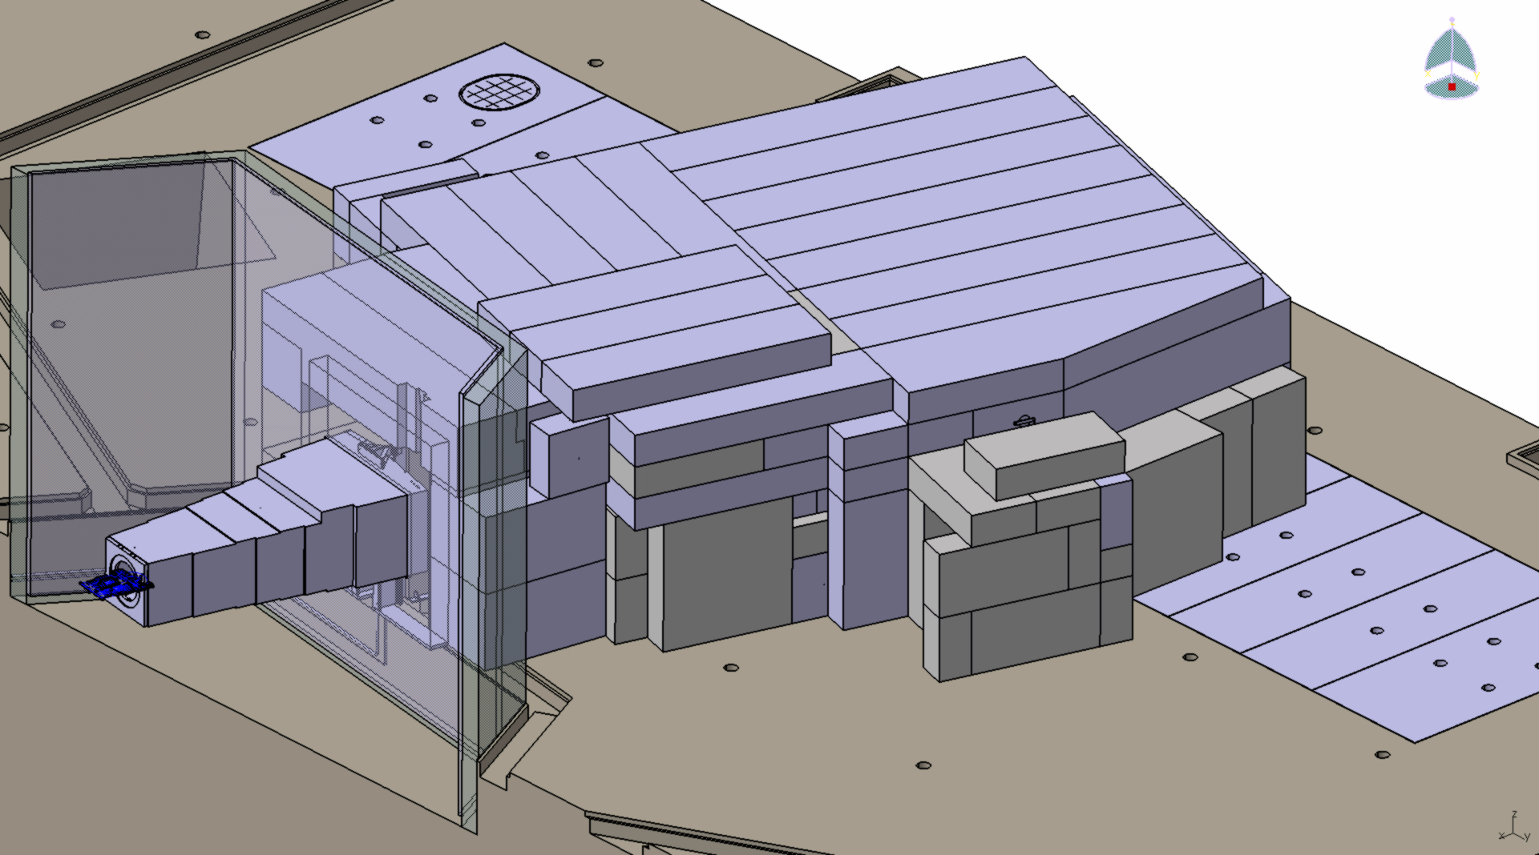
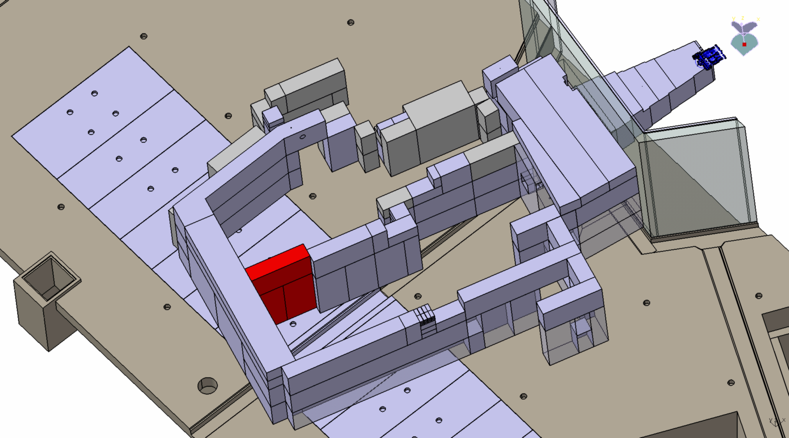
Bunker design
BOA % ICON beamline
Roof
Normal concrete
Thickness: 0.5 m
Side walls between beamlines
Scrap metal concrete
Thickness: 0.5 m
Back wall
Borated concrete
Thickness: 1m
Side walls
Standard concrete
Thickness: 0.5 m

Slide 17
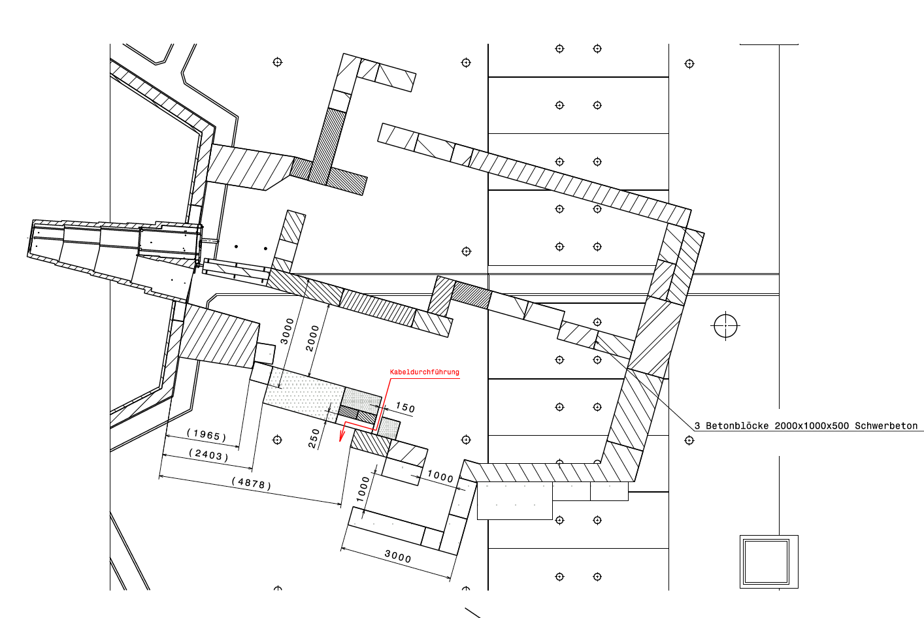
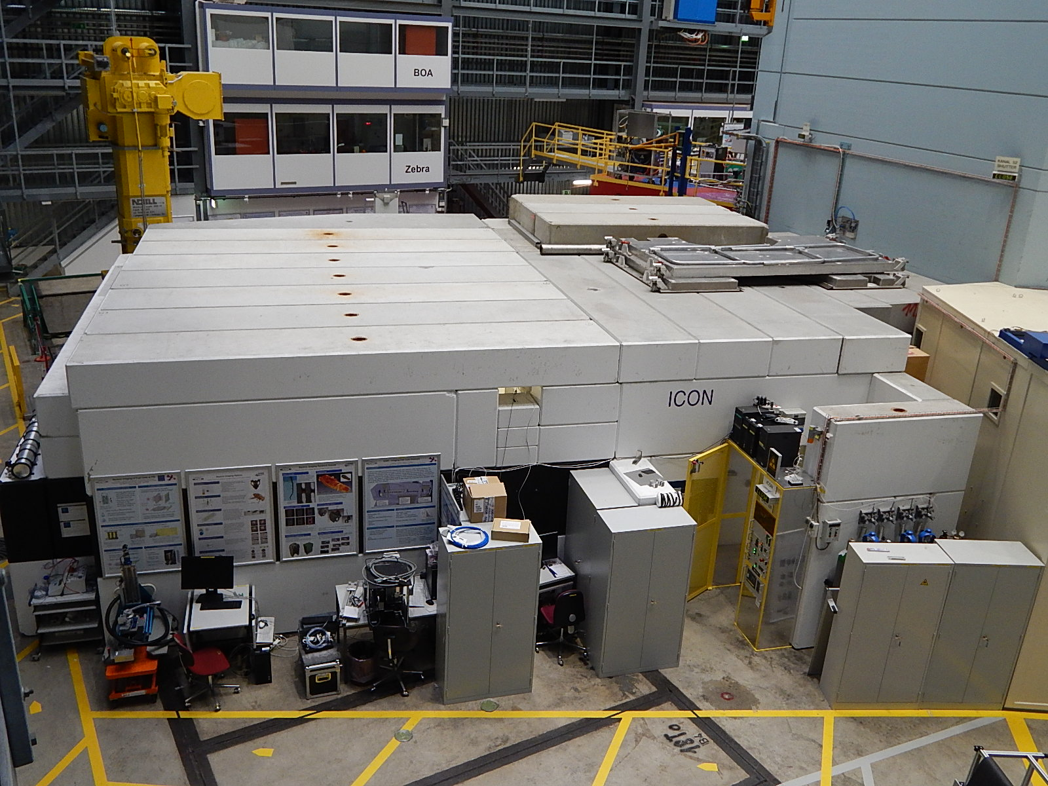
Cabling in the bunker
Chicane: yes or not ?
Cable channel never at the back-side
ICON: no chicane but the cable channel is in 2.5 m heigth from the floor
BOA: chicane with standard elements
in 1 m height from the floor

Slide 18
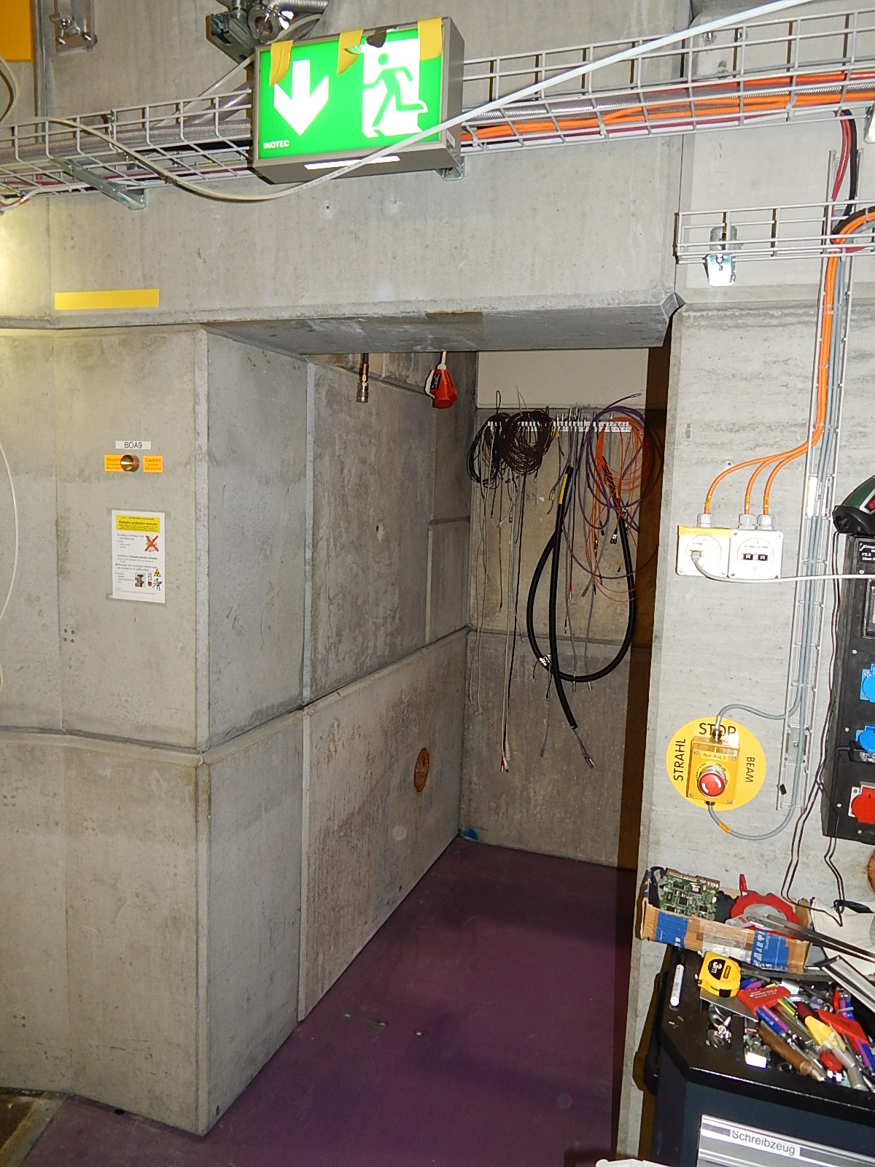
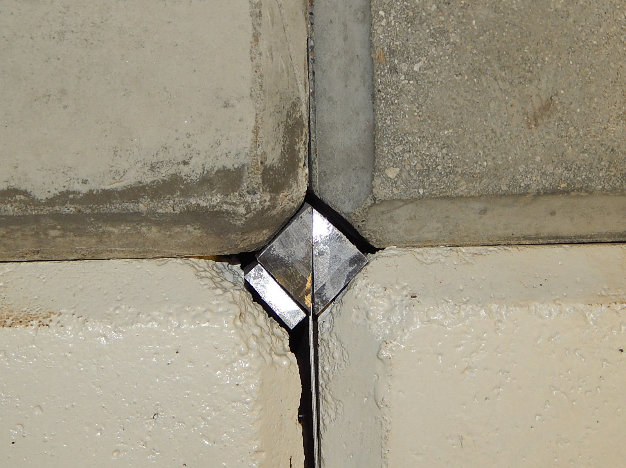
Handling – practical issues
Standard blocks are built with a 45 deg edge around the block -> avoiding spalling/peeling during positioning
Another aspect: turning of the elements is possible
Problem: 4 blocks assembled results in a 2 cm x 2 cm
gap !!
Solution: gap filled with a Pb / PE laminat structure

Slide 19
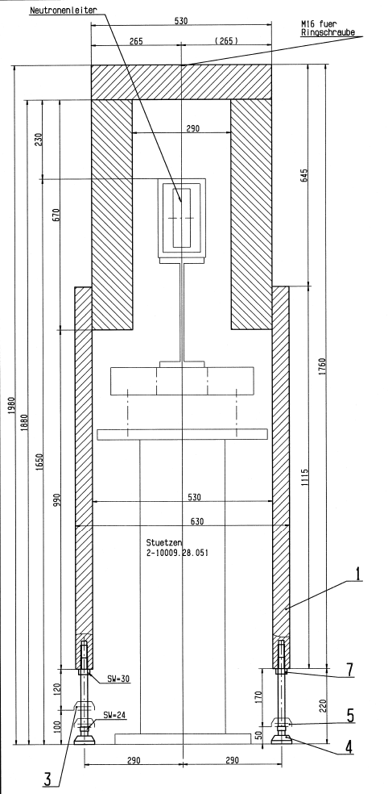
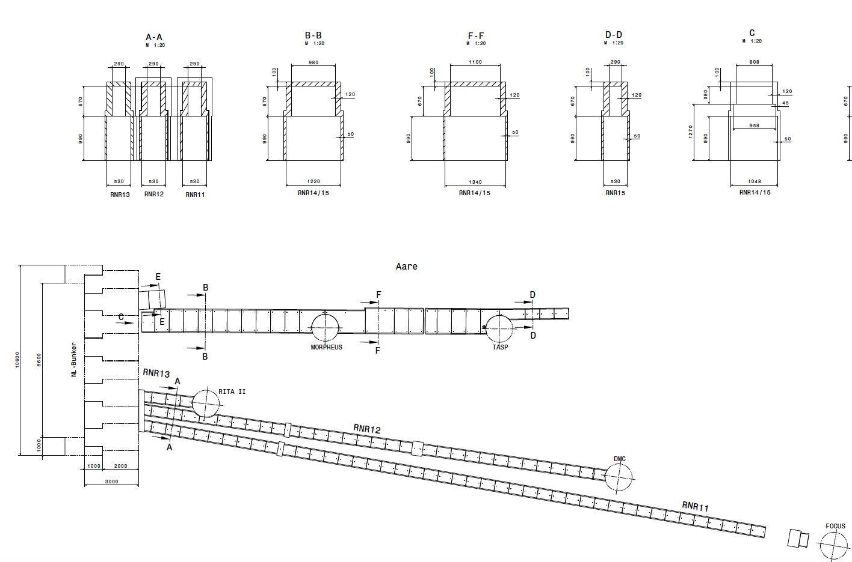
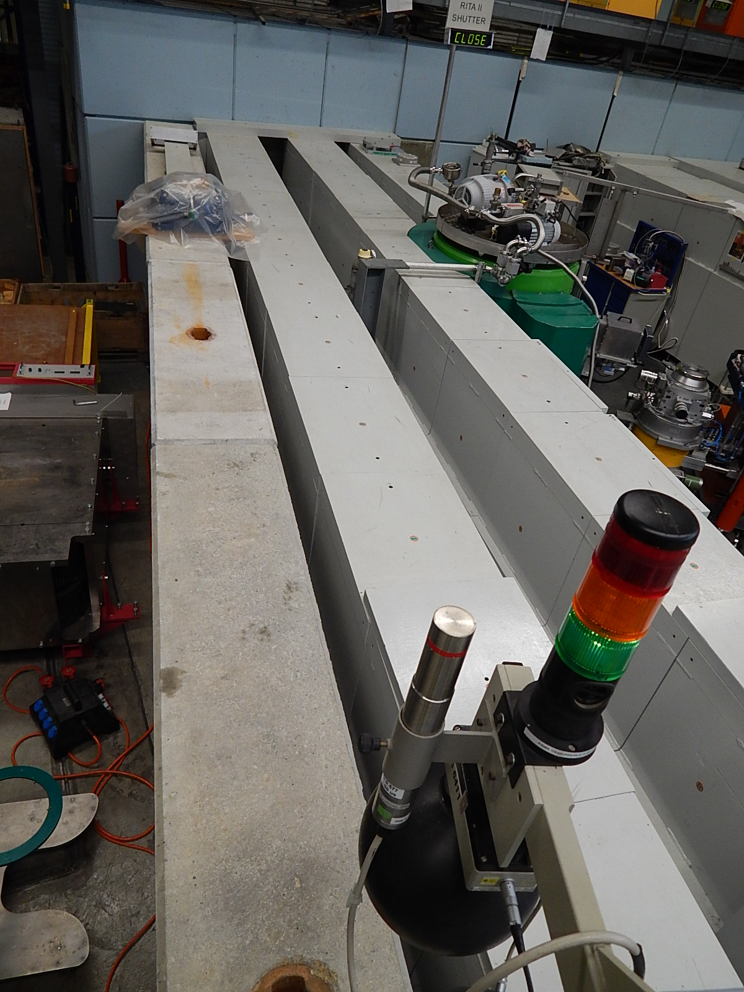
Guide shielding outside the bunker
shielding: 120 mm steel around the guide; 50 mm on the lower region
Additional shielding to public ways: 500 mm standard concrete blocks (fullfiled < 1 µSv/h)

Slide 20
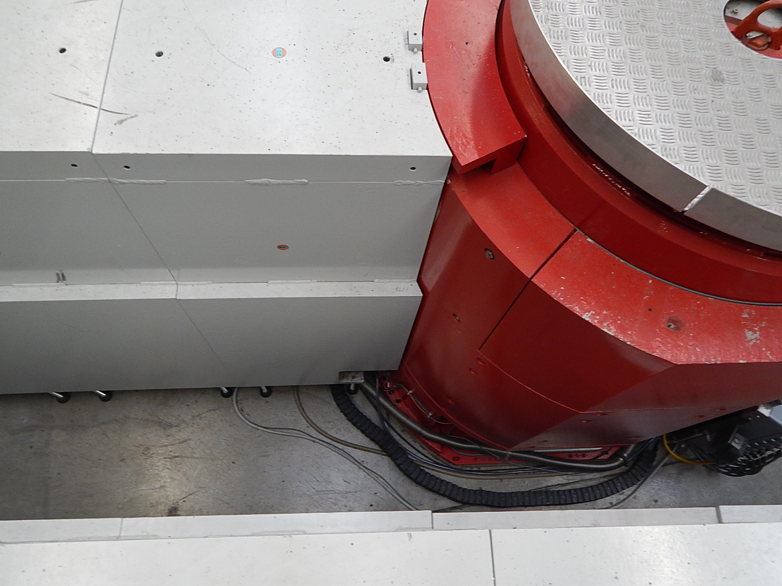
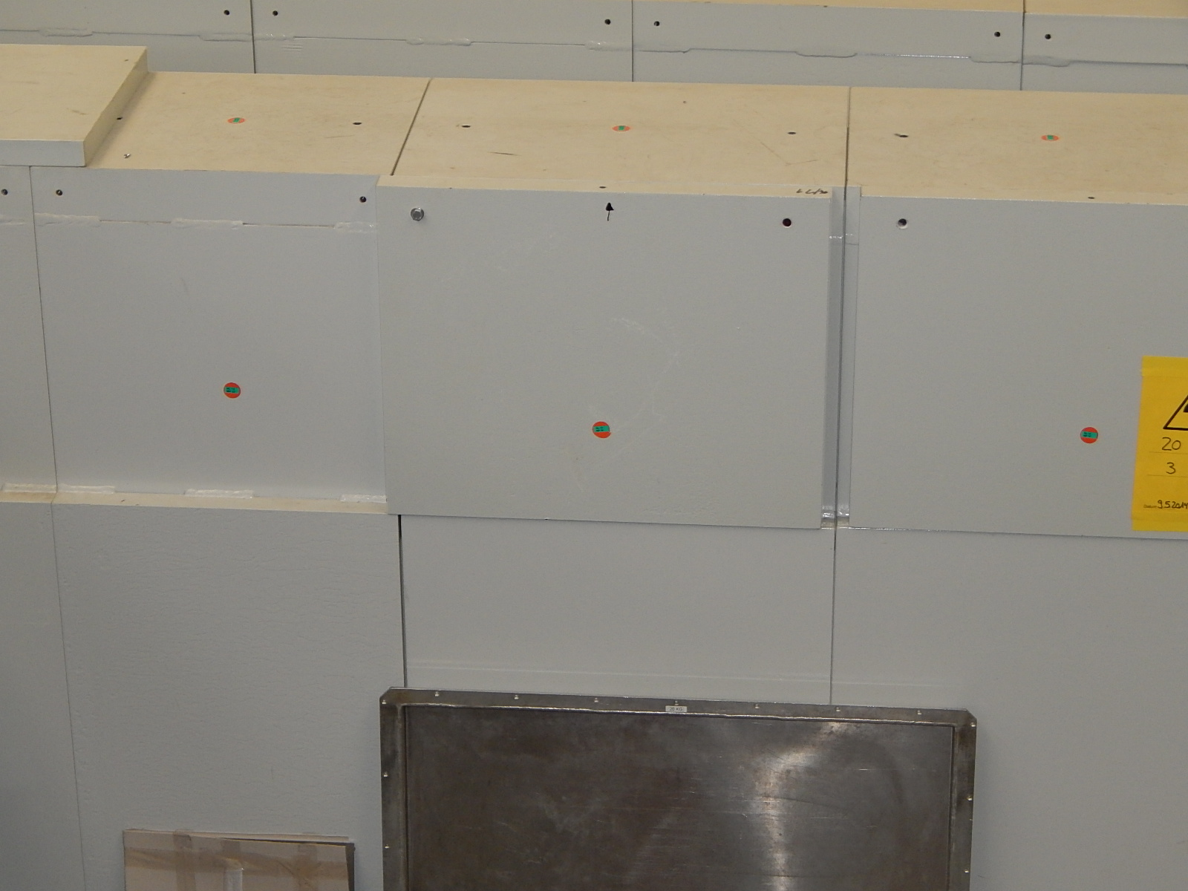
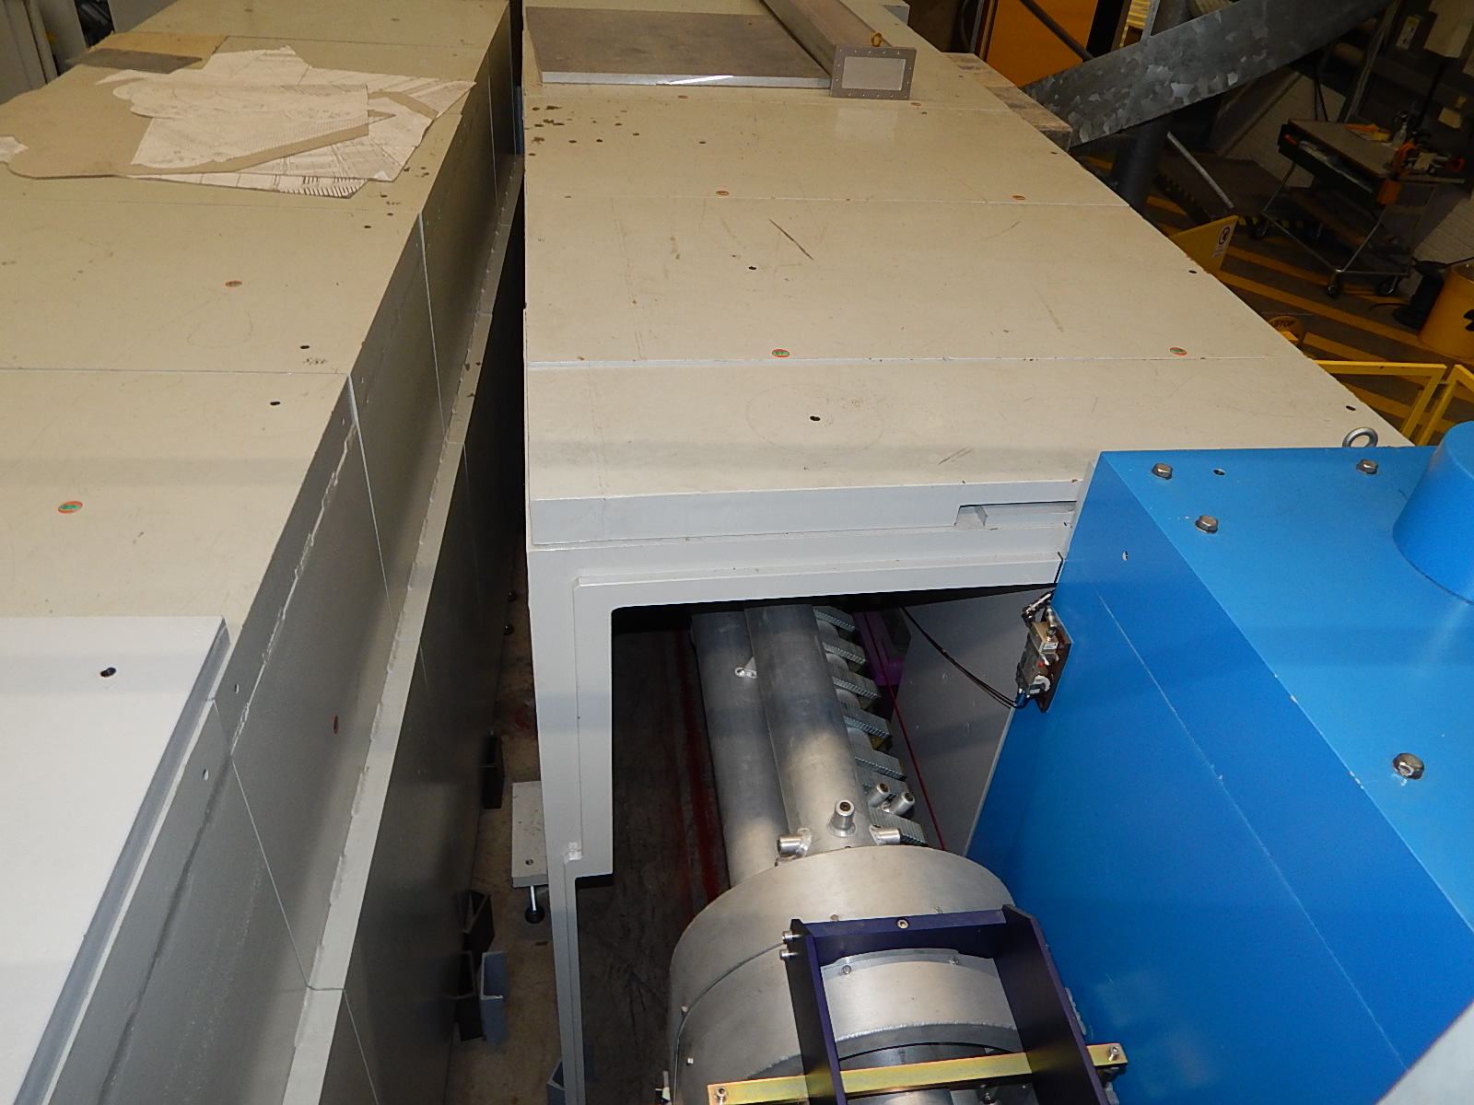
Guide shielding – Design
Guide shielding stays on 10 cm foots.
Shielding can be extended.
Guide shielding has steps.

Slide 21
