Slide 1
Neutronics. Update from IFE.
Rodion Kolevatov
ESS shielding workshop, 24/08/2018

Slide 2
Outline
Update on prompt gamma shielding
  Capture related to low angle reflectivity loss
  Shielding_logger and Shielding_caclulator –final version
Status update on neutronics simulation
  CombLayer and FLUKA
  Cave wall simulation

Slide 3
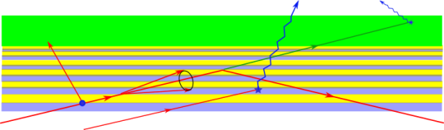
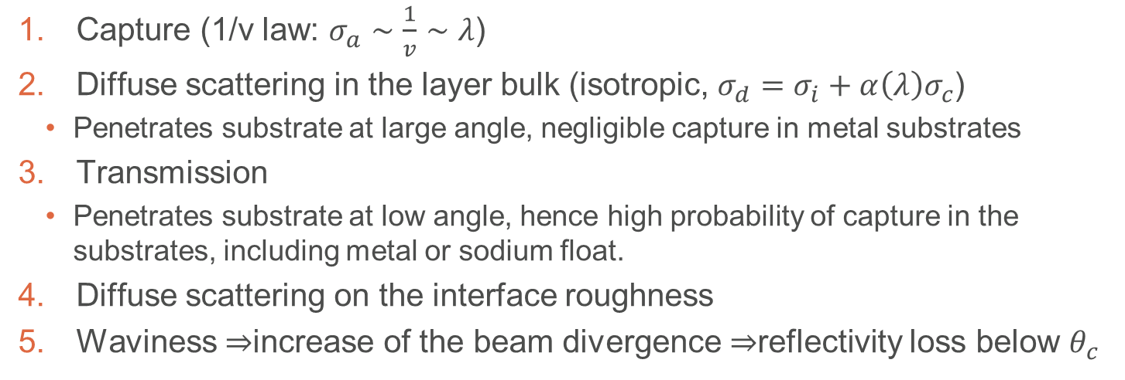
Reflection from the supermirror
3
4
2
1
Capture (1/v law: $σ_{a}∼\frac{1}{v}∼λ$)
Diffuse scattering in the layer bulk (isotropic, $σ_{d}=σ_{i}+α\left(λ\right)σ_{c}$)
  Penetrates substrate at large angle, negligible capture in metal substrates
Transmission
  Penetrates substrate at low angle, hence high probability of capture in the substrates, including metal or sodium float.
Diffuse scattering on the interface roughness
Waviness $⇒$increase of the beam divergence $⇒$reflectivity loss below $θ_{c}$

Slide 4
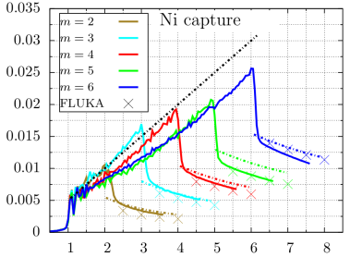

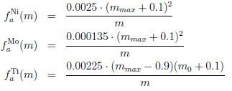
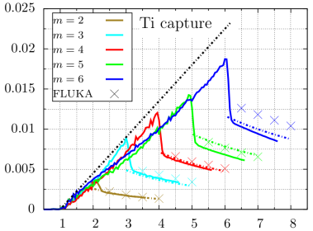
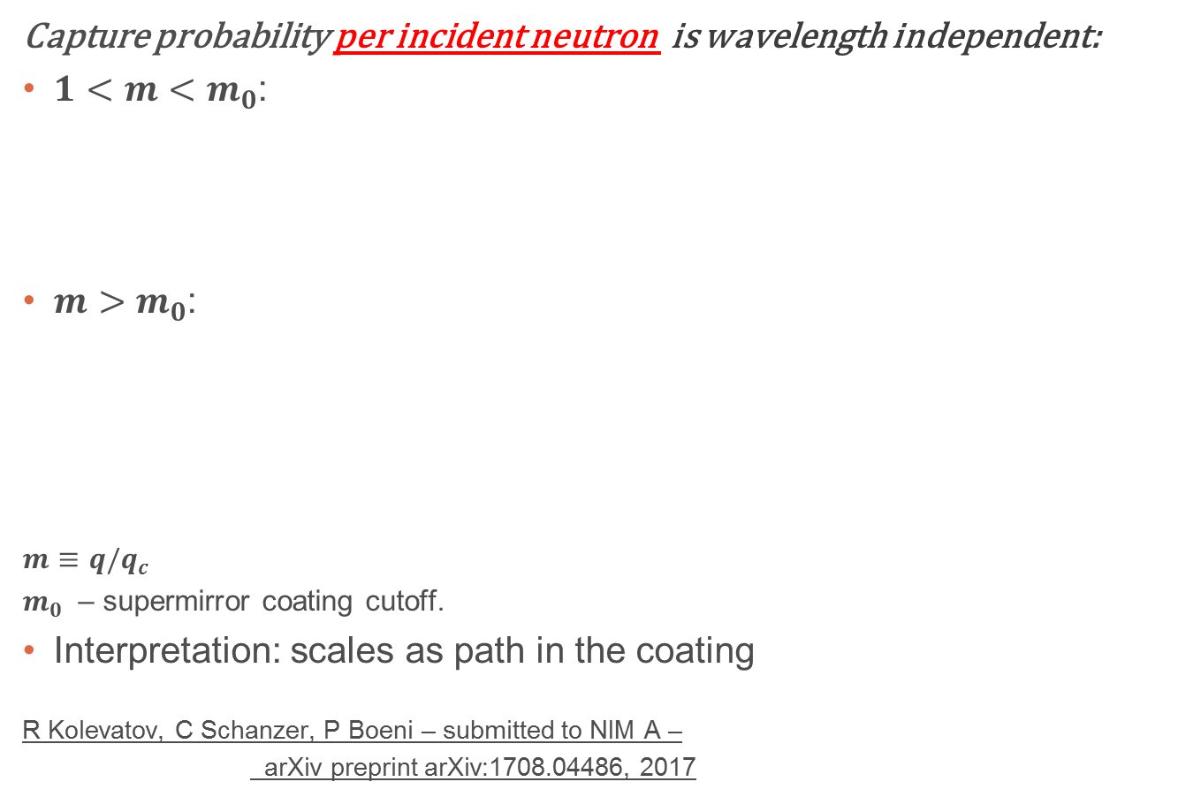
Multilayer coatings, parameterization for q>q_{c}^{Ni}
Capture probability per incident neutron is wavelength independent:
$1<m<m_{0}$:
$m>m_{0}$:
${m≡q/q}_{c}$
$m_{0}$ – supermirror coating cutoff.
Interpretation: scales as path in the coating
R Kolevatov, C Schanzer, P Boeni – submitted to NIM A –
arXiv preprint arXiv:1708.04486, 2017
*⁾ Showing calculations with account of interfacial roughness

Slide 5
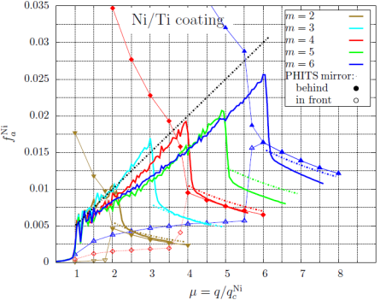
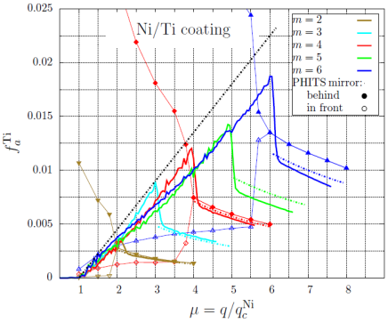
PHITS/MCNPX supermirror: be careful!
Ni capture
Ti capture
Plotted: capture probability per incident neutron vs momentum transfer
PHITS fails completely for momentum transfer q between q_{c} and coating cutoff, no matter where the reflecting surface is set.

Slide 6
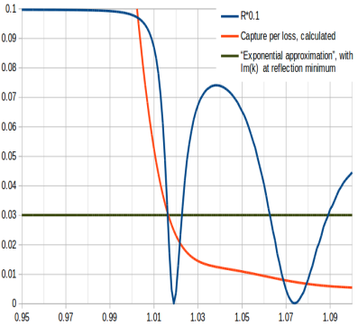
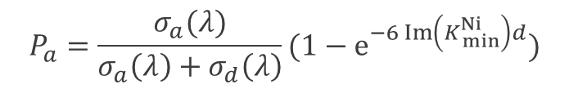
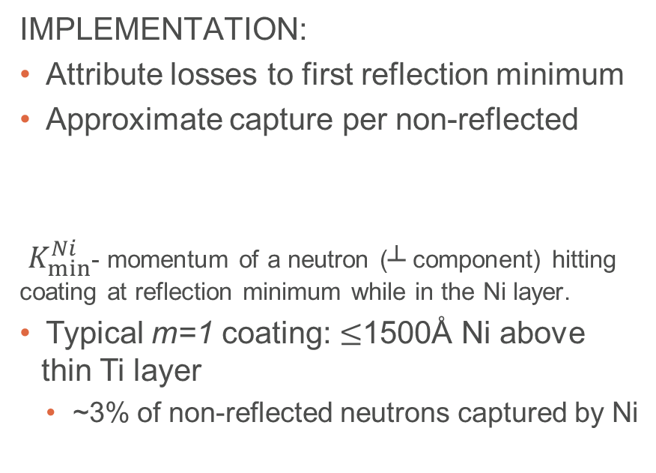
q<q_{c}^{Ni}: absorption per non-reflected
Idea by Marton Marko:
Waviness increases beam divergence, higher glancing angle on the average
A fraction of neutrons hits coating above the cutoff, is not transported further
0.5÷1% loss/incident is compatible with waviness reported by manufacturers.
Weight of neutrons with q<q_{c} tagged as “non reflected” by McStas is physically transmitted through the coating with q above coating cutoff.
IMPLEMENTATION:
Attribute losses to first reflection minimum
Approximate capture per non-reflected
$K_{min}^{Ni}$- momentum of a neutron (┴ component) hitting coating at reflection minimum while in the Ni layer.
Typical m=1 coating: $≤$1500Å Ni above thin Ti layer
  ~3% of non-reflected neutrons captured by Ni
$$P_{a}=\frac{σ_{a}(λ)}{σ_{a}\left(λ\right)+σ_{d}\left(λ\right)}(1−e^{−6 Im\left(K_{ min}^{Ni}\right)d})$$
Probability
m=q/q_{c}

Slide 7
Evaluating coating absorption along guide systems using McStas
Make use of the existing McStas Scatter Logger Bundle by E. Knudsen et al
  Scatter_logger for recording neutron states before and after each hit of optics
  Scatter_log_iterator for processing saved states, returns non-reflected weight
Customize McStas components to set variable for m-value at reflection point:
  Guide_custom, Guide_curved_custom (to replace Bender in shielding calculations, has same syntax), Elliptic_guide_gravity_custom, Guide_chanelled_custom
Shielding_logger component records neutron states and m-value at reflection
Implement coating capture probability in Scatter Log Iterator:
  Shielding_log_iteratorNi, Shielding_log_iteratorTi, Shielding_log_iterator_total iterate though the unreflected states returning corresponding weights for capture
  Processing neutrons entering iterators allows a straightforward construction of source terms for Monte-Carlo transport codes.
Table values for the capture γ spectra, attenuation and buildup factors of typical shielding materials for a direct evaluation of shielding parameters are implemented in Shielding_calculator McStas component.
  Calculates thickness of lateral shielding required to fulfill dose rate restrictions.

Slide 8
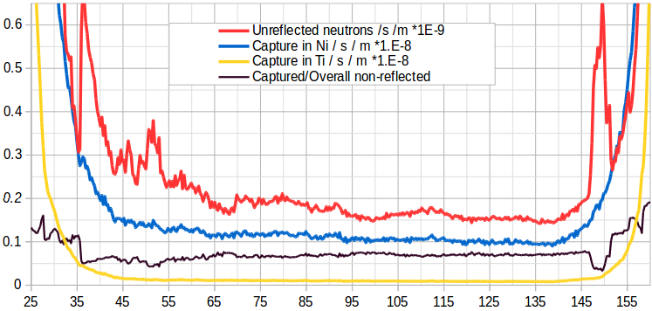
Example: most fancy of the explored ESS BIFROST layouts
Loss of high divergence
Defocusing,
variable m
Straight, m=1.5 at 50-140 m from source
Focusing,
variable m

Slide 9
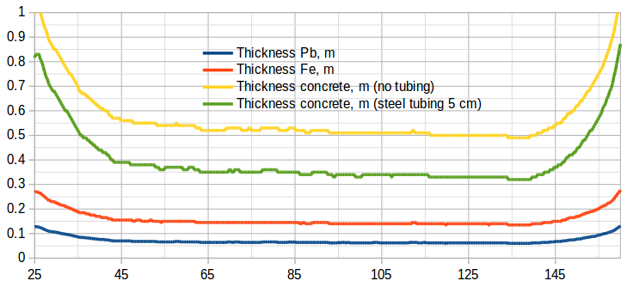
Example: most fancy of the explored ESS BIFROST layouts
5MW,
R₀=0.99
1uSv/hr outside
Current shielding layout of BIFROST (to the best of my knowledge)
60 cm concrete up to ~130 m
120 cm concrete 130m—cave
Extra steel in D03.
Could be similar concrete shielding for HEIMDAL (but different steel parts)

Slide 10
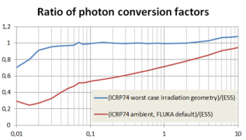
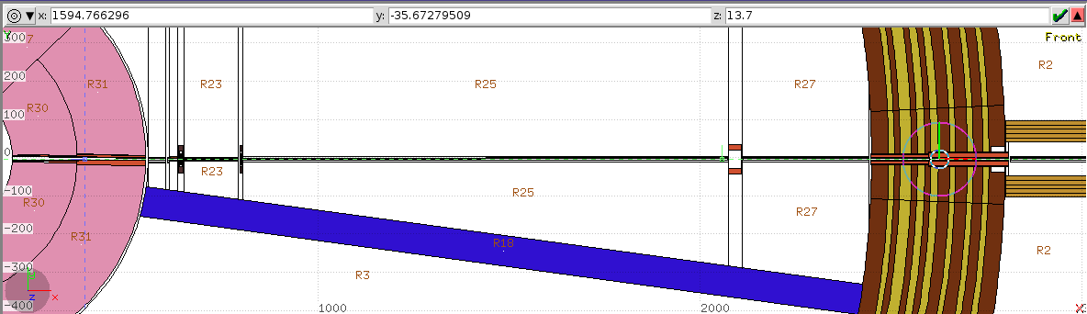
CombLayer+FLUKA issues
FLUKA features:
Flux to dose conversion:
  FLUKA default: ambient dose equivalent from ICRP74
  ESS: equivalent to ICRP74 data for frontal irradiation
  Use of factors for “worst case” geometry must be specified in the simulation.
Built-in geometry optimization:
  Preprocesses of cell definitions, transforms expressions into union of intersections.
  Up to 100k terms allowed in decomposition of expression with nested parentheses. Unnecessary surfaces and complicated cuttings crash simulation.
  Need less detailed definitions: construct no moderator for shielding simulations and split complicated cells (so far bunker and outer void) to avoid crashes.

Slide 11
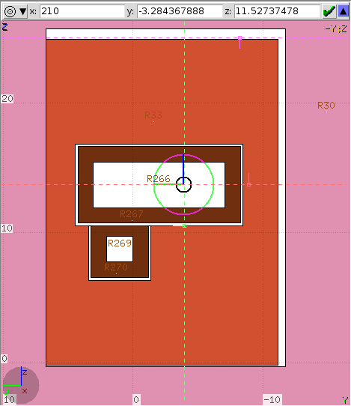
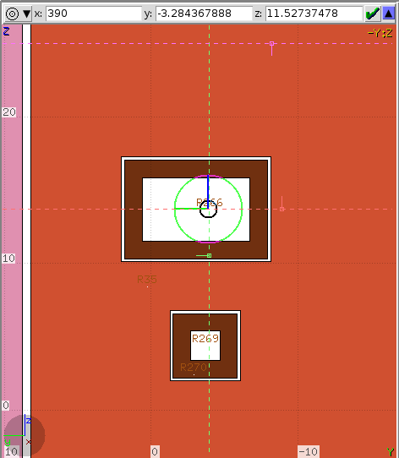
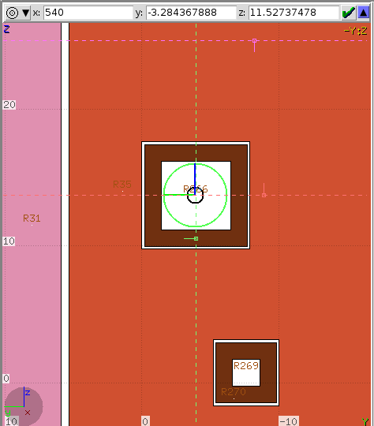
HEIMDAL, simulation setup
NBOA cut at 210, 300 and 540 cm from target
Implemented dimensions of the instrument optics in CombLayer (almost)
  No steps in the NBOA
  Tapered shapes
NMX source at 2 meters
  Biasing in position, angular and energy distribution
Transport of neutrons E > 1keV.
Study effect of substrates and copper aperture for the dose rate beyond bunker wall

Slide 12

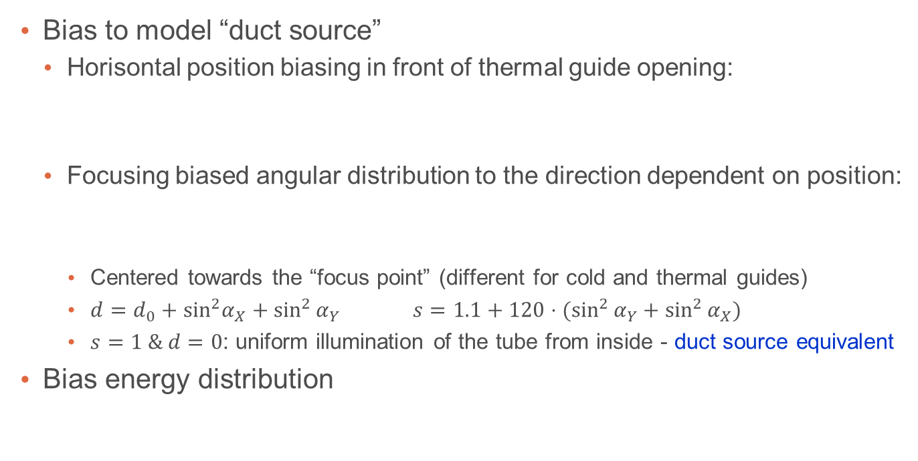


Source biasing
Sample more neutrons which propagate further (and adjust weights):
x_{min}
x₀
α_{X}
“Focus point”
x_{max}
Bias to model “duct source”
  Horisontal position biasing in front of thermal guide opening:
  Focusing biased angular distribution to the direction dependent on position:
    Centered towards the “focus point” (different for cold and thermal guides)
    $d=d_{0}+\sin^{2}α_{X}+\sin^{2}{α_{Y}} s=1.1+120⋅(\sin^{2}{α_{Y}}+\sin^{2}{α_{X}})$
    $s=1 \& d=0$: uniform illumination of the tube from inside - duct source equivalent
Bias energy distribution
$$p_{bias}\left(x|x<x_{0}\right)=\frac{4 {\left(x−x_{min}\right)}^{3}}{\left(x_{max}−x_{min}\right){\left(x_{0}−x_{min}\right)}^{3}}$$
$$p_{bias}\left(x|x>x_{0}\right)=\frac{4 {\left(x_{max}−x\right)}^{3}}{\left(x_{max}−x_{min}\right){\left(x_{max}−x_{0}\right)}^{3}}$$
$$p_{bias}\left(t_{X}, t_{Y}\right)=\frac{1−s}{π{\left[{(d}^{2}+1\right)}^{1−s}−d^{2(1−s)} ]} ⋅ \frac{1}{{\left[d^{2}+t_{X}^{2}+t_{Y}^{2}\right]}^{s}}$$
$$p_{bias}\left(E\right)=\frac{1−α}{[E_{max}^{1−α}−E_{min}^{1−α}]}⋅\frac{1}{E^{α}}$$

Slide 13
Mesh-based importance biasing
Make use of FLUKA user routines (in addition to SOURCE)
MDSTK subroutine manipulates the buffer of secondaries produced in a hadronic interaction. In the monolith: Perform RR for neutrons going backwards and to the sides. Leave forward unchanged.
USIMBS subroutime is applied at each step in particle transport. Used to implement importance biasing.
  Split neutrons hitting substrates and tubing in the bunker from inside
    Together with focusing in the source fills the bunker nicely
  Mesh-based splitting of particles propagating in the bunker wall towards outside.
  Mesh-based splitting of particles propagating outside lateral shielding beyond the bunker wall.

Slide 14
HEIMDAL substrates, explored options
2
1
3
A
Copper or Al substrates in the thermal guide sections labeled 1, 2, 3
  Substrate thickness is always 5mm
Copper aperture A depth of either 5 or 20 cm
  12 cm width, 3Hx5V cm opening
T0 chopper housing is kept empty.

Slide 15
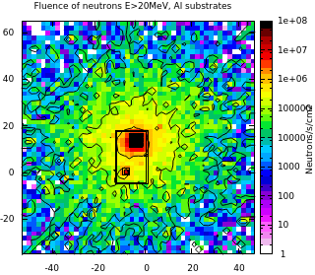
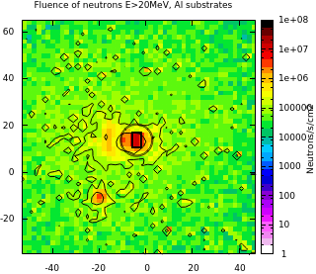
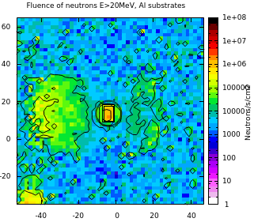
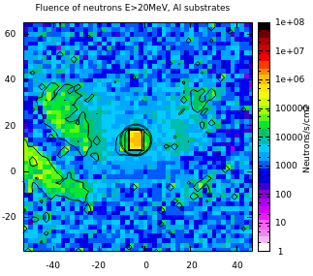
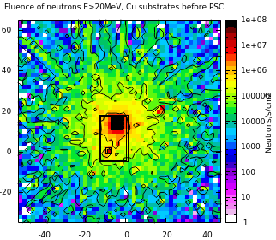
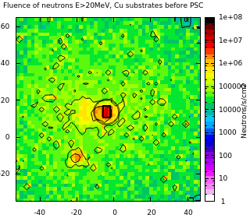
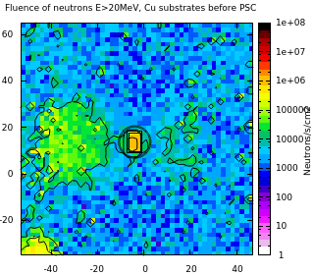
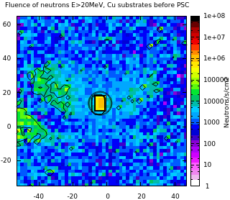
5cm Cu aperture before PSC, E>20MeV
Plot of neutron fluence (E>20MeV) at 5.6, 10, 20, 24.4 m from moderator
  Top: 5mm Al substrates in the bunker,
  Bottom: Cu substrates before PSC, Al elsewhere

Slide 16
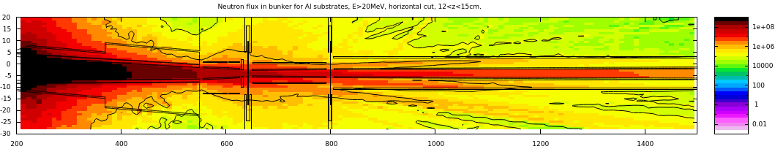
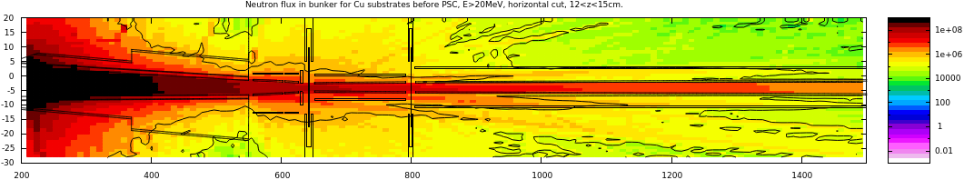
5cm Cu aperture before PSC, E>20MeV
Al substrates
Towards “Bright spot”
Cu substrates before 6.5m
Plot of neutron fluence (E>20MeV) horizontal projection, 12<z<15cm
Vacuum tubing works as shielding element, effect clearly seen.
With Cu substrates:
  Streaming in the vacuum tubing outside guide E>20MeV reduces significantly
  Some reduction in HE neutron flux around the vacuum tubing (spot on the wall to the right of the guide)

Slide 17
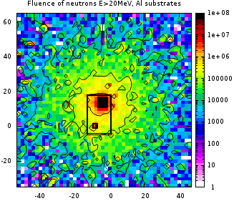
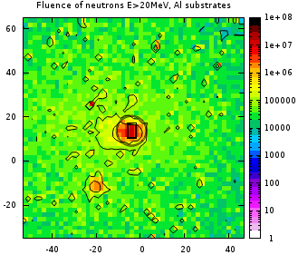
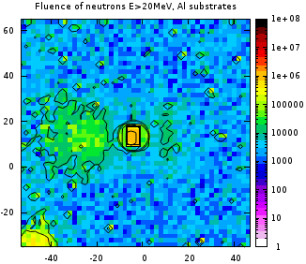
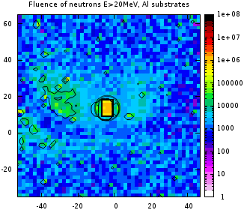
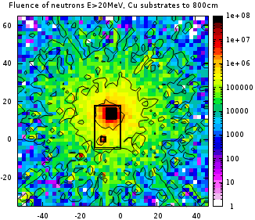
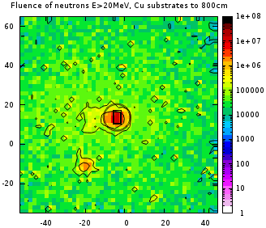
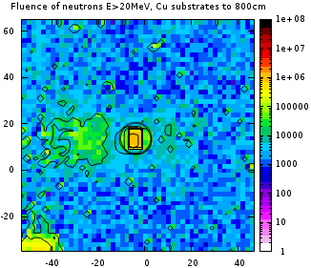
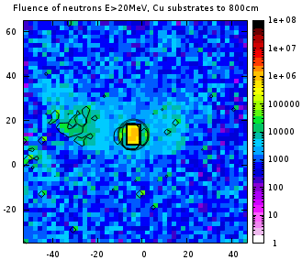
20 cm Cu aperture before PSC, E>20MeV
Plot of neutron fluence (E>20MeV) at 5.6, 10, 20, 24.4 m from moderator
  Top: 5mm Al substrates in the bunker,
  Bottom: Cu substrates before 8 meters, Al elsewhere

Slide 18
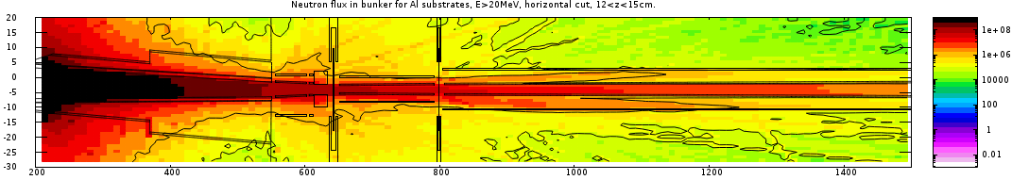
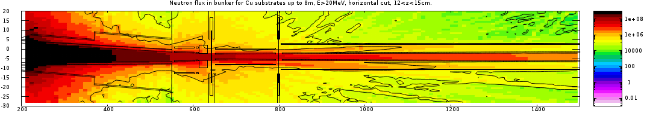
20 cm Cu aperture before PSC, E>20MeV
Al substrates
Cu substrates before 8m
Plot of neutron fluence (E>20MeV) horizontal projection, 12<z<15cm
Effect of copper substrates is also seen in this case.

Slide 19
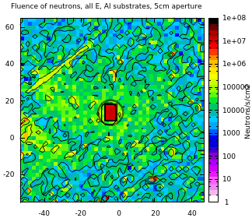
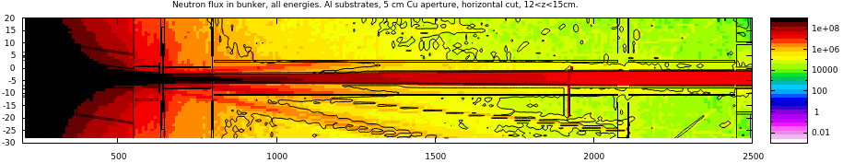
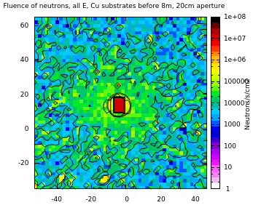
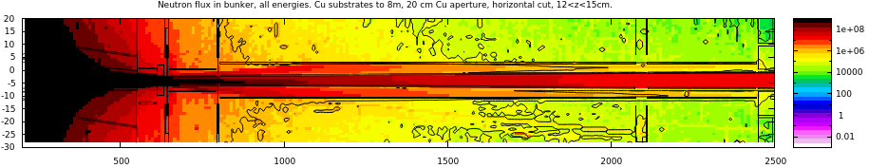
Lower energy neutrons
5 cm aperture, Al substrates
20 cm aperture, Cu substrates to 8m
Neutrons of lower energies are collimated to the vacuum tubing.
  Potentially higher activation of bunker wall insert tip.

Slide 20
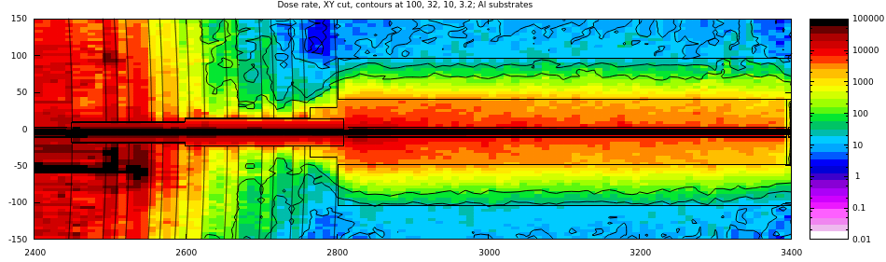
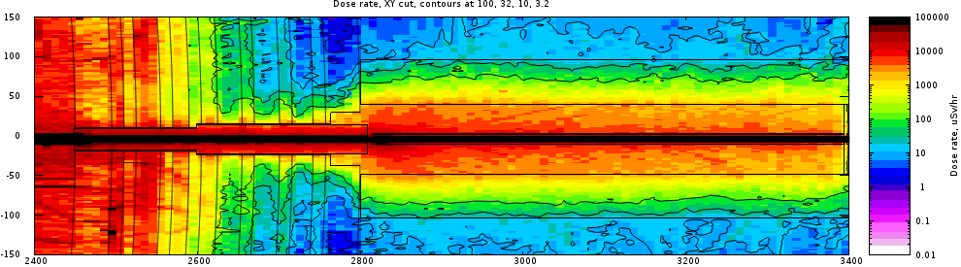
Effects on D03 shielding and streaming in the guide
5 cm Cu aperture and Al substrates
10
32
100
32
10
20 cm Cu aperture and Cu substrates to 8m
32
3.2
10
10
32
100
100
32
10
Aperture dimensions and substrates material has little effect for dose rate in D03 while the bunker wall does its job

Slide 21
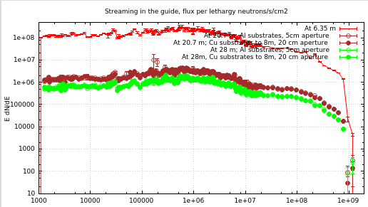
Streaming in the guide
No sizeable effect on streaming in the guide from Cu pieces

Slide 22
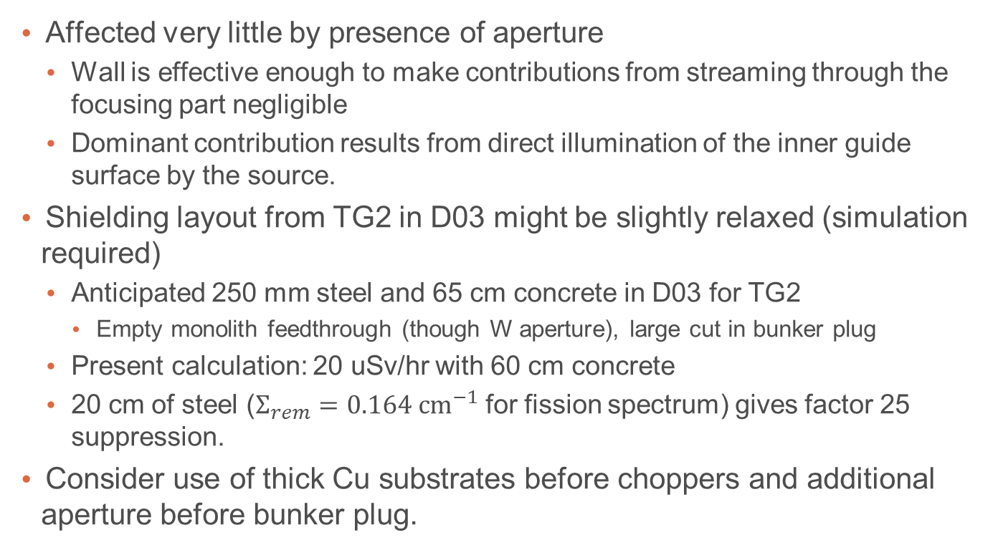
HEIMDAL shielding in D03
Affected very little by presence of aperture
  Wall is effective enough to make contributions from streaming through the focusing part negligible
  Dominant contribution results from direct illumination of the inner guide surface by the source.
Shielding layout from TG2 in D03 might be slightly relaxed (simulation required)
  Anticipated 250 mm steel and 65 cm concrete in D03 for TG2
    Empty monolith feedthrough (though W aperture), large cut in bunker plug
  Present calculation: 20 uSv/hr with 60 cm concrete
  20 cm of steel ($Σ_{rem}=0.164 cm^{−1}$ for fission spectrum) gives factor 25 suppression.
Consider use of thick Cu substrates before choppers and additional aperture before bunker plug.

Slide 23
Cave simulations for BIFROST
Hatch access
Gaps in the wall assembly
Detector shielding (gamma sensitivity and photoneutron issue)

Slide 24
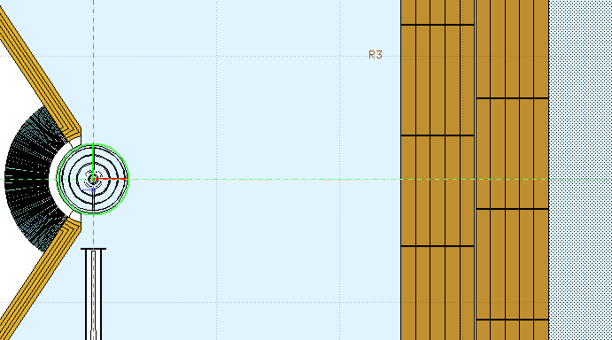
Streaming in the gaps
CombLayer model with brick structure with both horizontal and vertical shifts between layers.
Result: dose rate increases ~factor 3 in front of the gaps in the outer layer (see next slides)

Slide 25
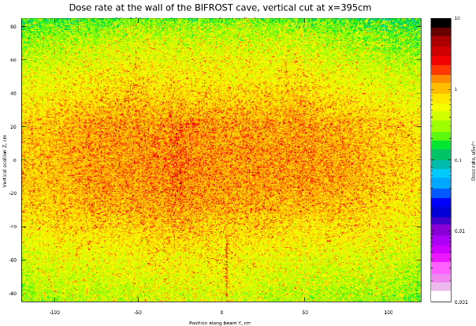
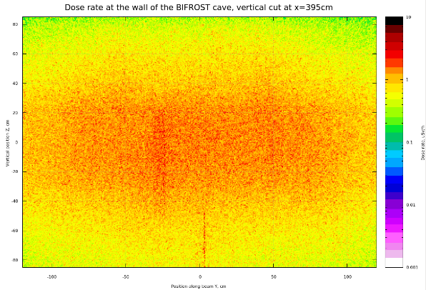
Cd sample
Vanadium sample

Slide 26



Slide 27
BACKUP SLIDES

Slide 28
Fluence in the bunker E>20MeV
5 cm aperture, Al substrates
5 cm aperture, Cu substrates to 6.5m
20 cm aperture, Al substrates
20 cm aperture, Cu substrates to 8m

Slide 29

3 distinct regimes. Path length scaling
*⁾ Calculation performed for zero interfacial roughness
Capture probability per incident *
2
3
1
2.1
Momentum transfer at reflection in units of q_{c}^{Ni}
Little absorption per incident neutron for q<q_{c}^{Ni} .
Approximately linear growth for 1 < q < m q_{c}^{Ni}
  Step in Ni absorption determined by a thickness of the outermost Ni layer
1/q scaling above the coating cutoff (transmission for q > m q_{c}^{Ni}, path length is inverse proportional to the glancing angle)

