Slide 1

Neutron guide Shielding Concept
Senad Kudumovic
14.08.2018

Slide 2
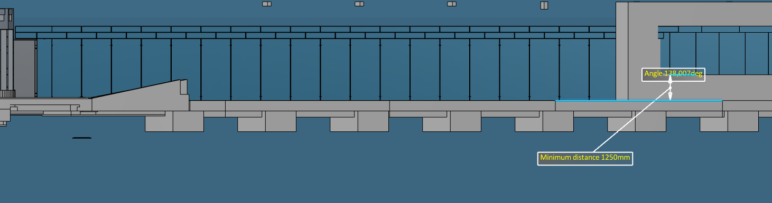
D03/D01 and E02
Side view
Top view
Height difference between D03 and E02 - 1000 mm

Slide 3
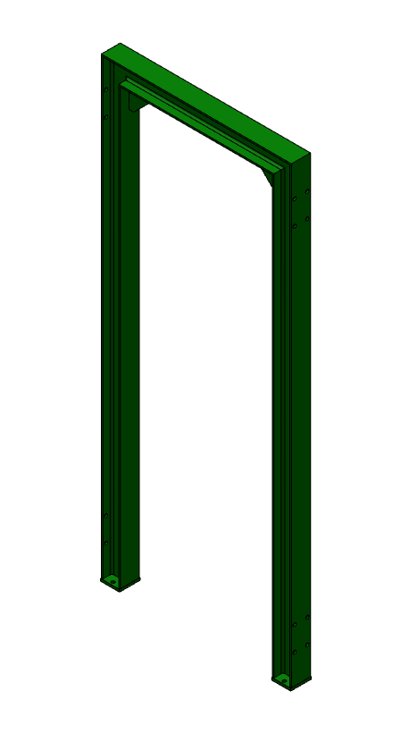
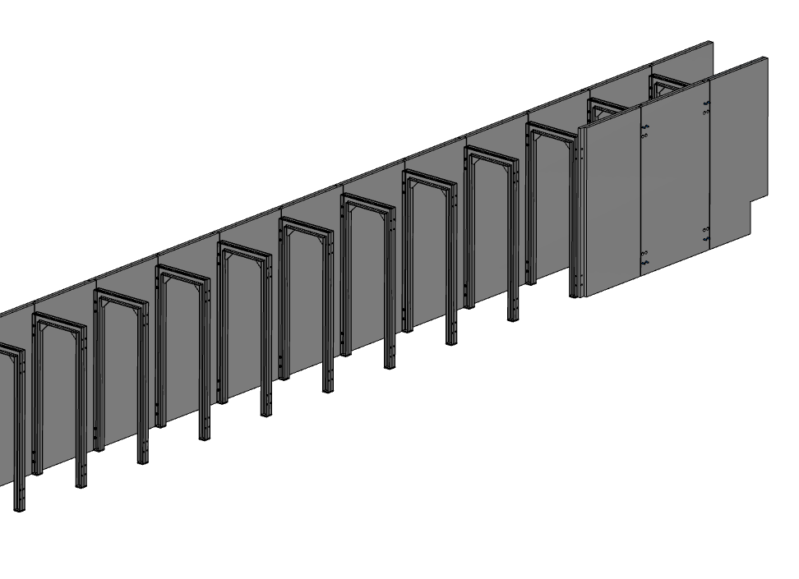
D03/D01 Concept 1
Step 1: “U” steel frame anchored to the floor
Optional: Instead of ”U” shape, split into 2 pillars and beam.
HEA 140
Material available:
CARBON STEEL - S235JR / S355JO / S355J2 - EN 10025
Stainless Steel- 304, 304L, 316

Slide 4
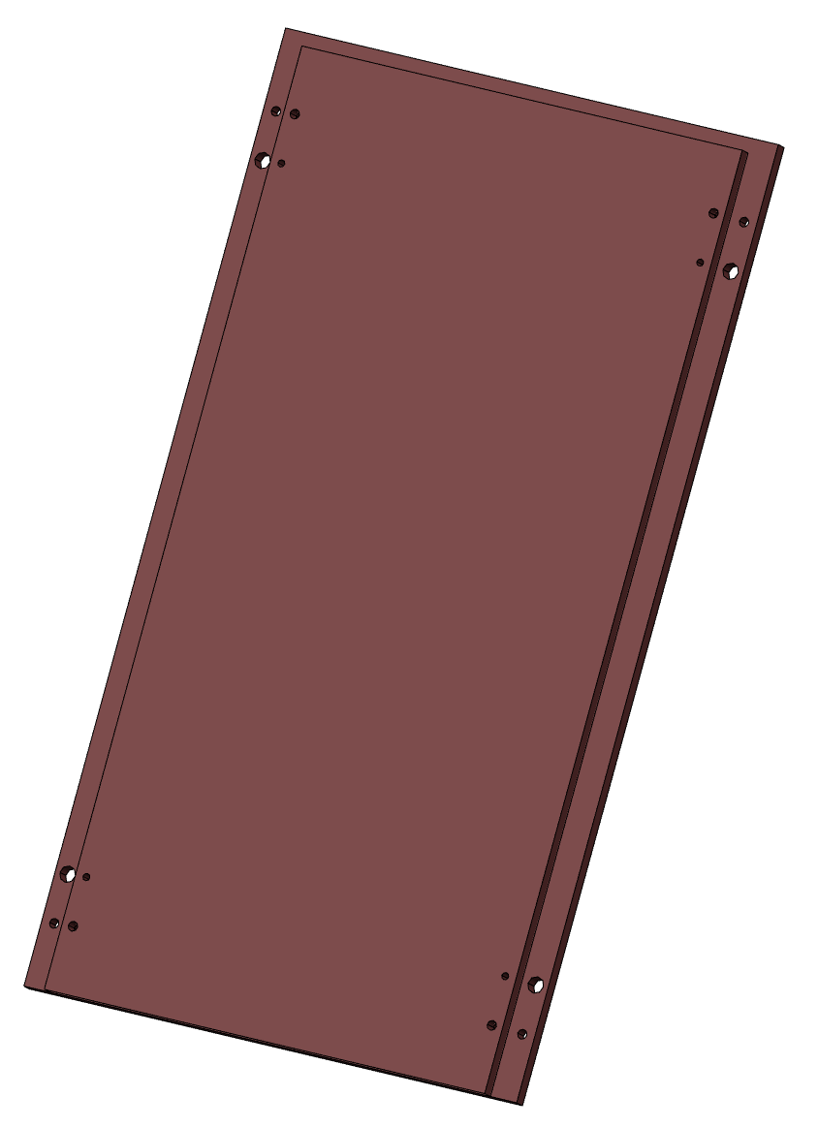
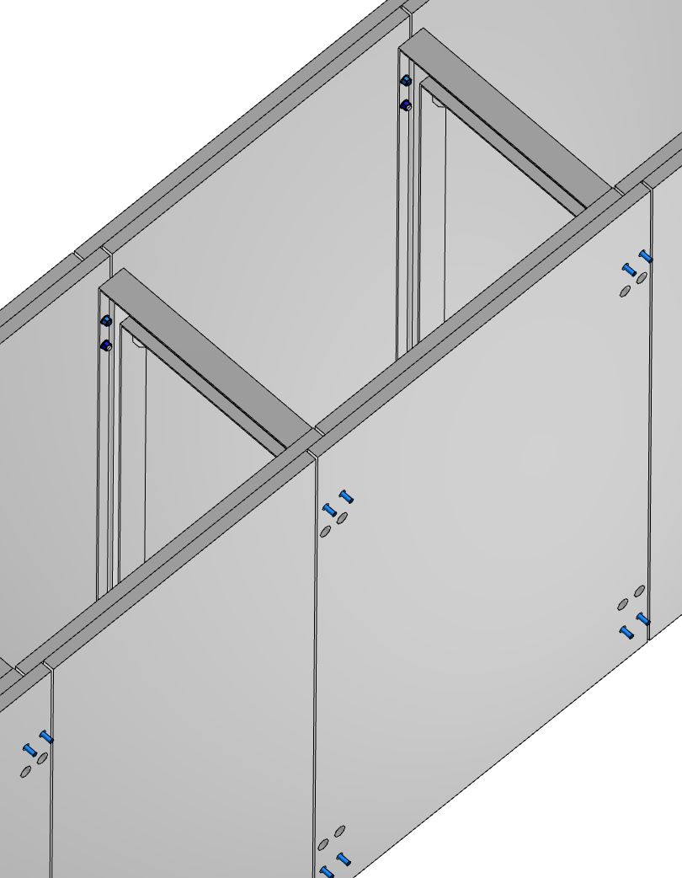
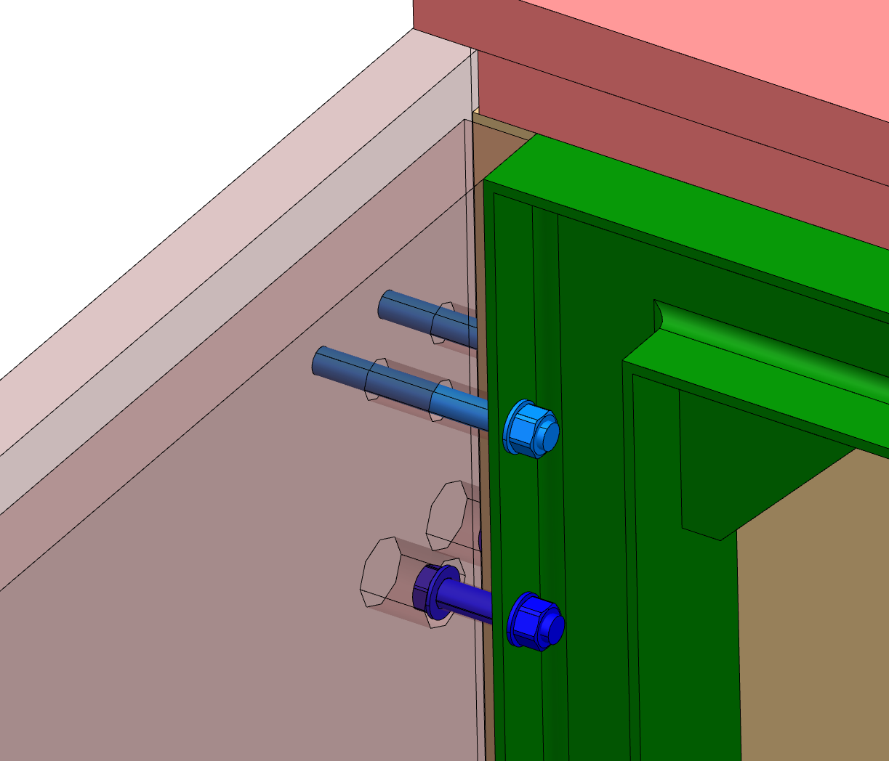
D03/D01 Concept 1
Step 2: Steel plates bolted to the side of the frame
Plates to be thermal cutted and welded together without additional machining
Bolt free surface from the ouside which will allow close contact between steel and concrete
Total thickness:
2x50 mm = 100 mm

Slide 5
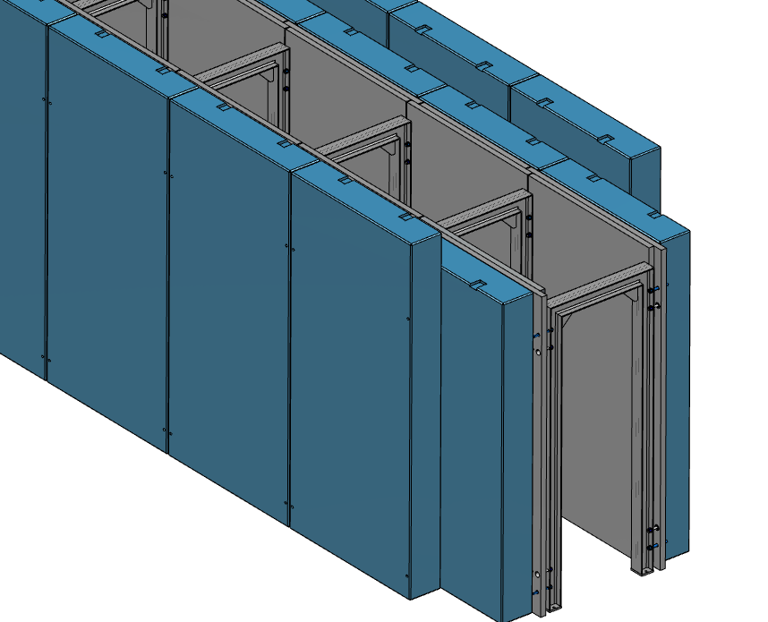
D03/D01 Concept 1
Step 3: Concrete slabs bolted to the side of the frame
2nd layer connected to the first layer
1st layer connected to the frame,

Slide 6
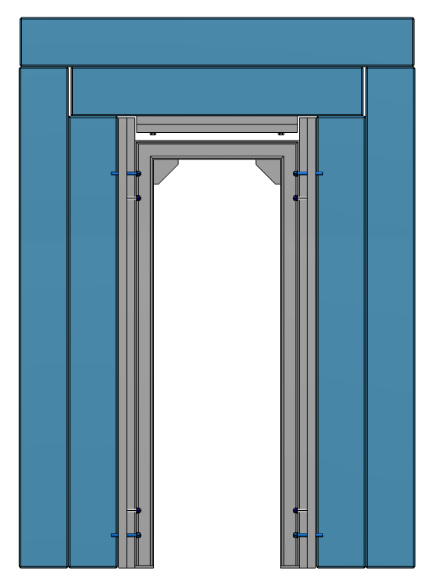
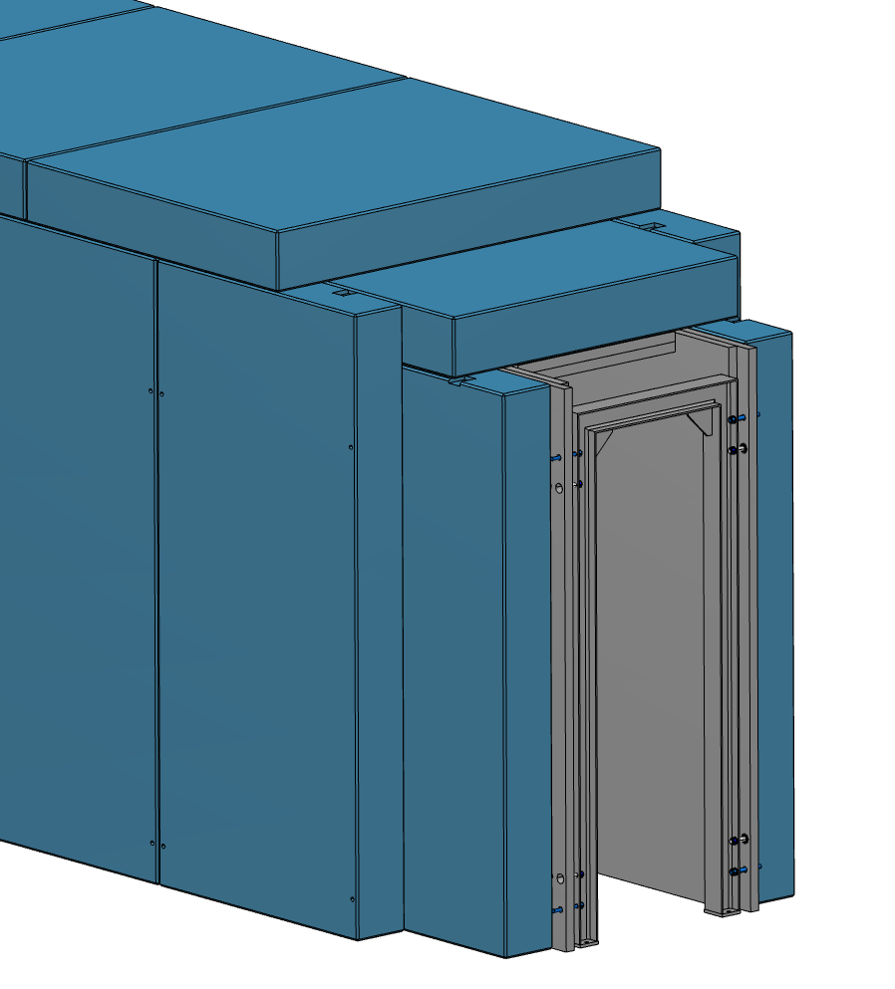
D03/D01 Concept 1
Step 3: Roof blocks resting on the side walls

Slide 7
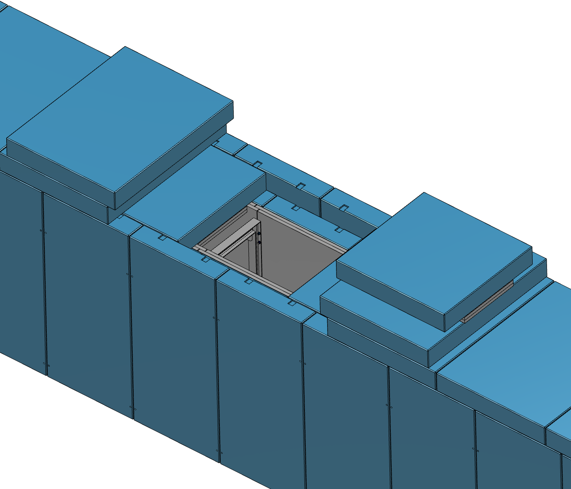
D03/D01 Concept 1
Maintenance of inside components
Full access by removing three pieces
3 lifts
≈1800 mm opening length

Slide 8
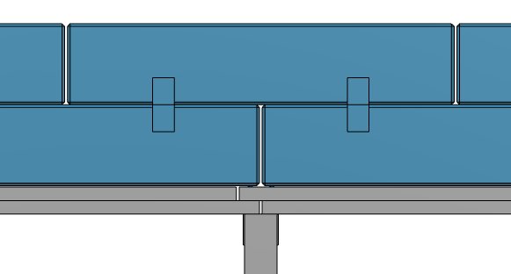
D03/D01 Concept 1
Streaming
Front view
10 mm gap
Top view

Slide 9
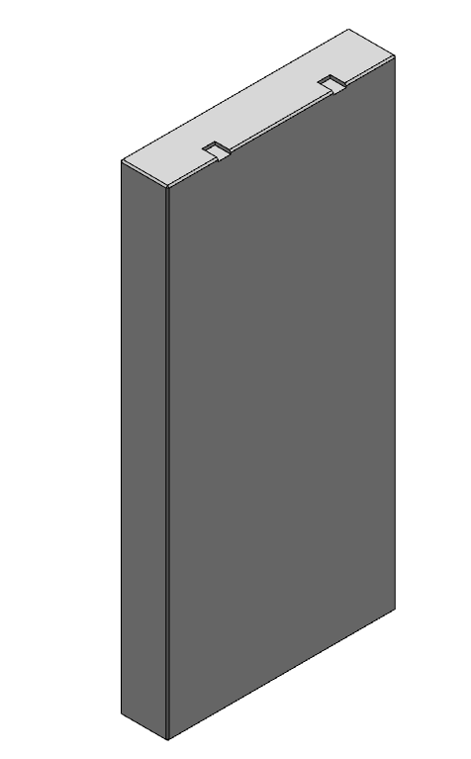
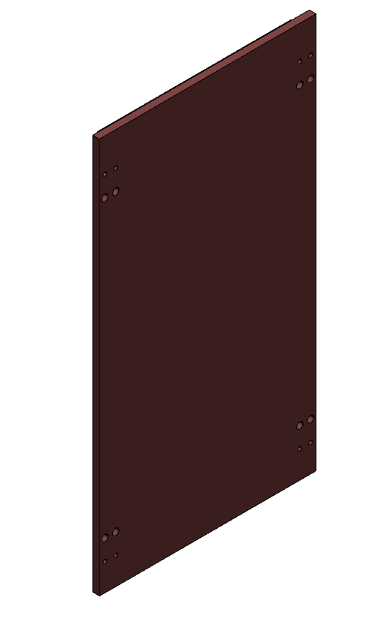
D03/D01 Concept
Logistic
HEA 140
Size: ≈ 2900 x 1200 mm
Weight: ≈130 kg
Size: ≈ 3000 x 1500 x 300 mm
Weight: ≈3 t
Size: ≈ 3000 x 1600 x 100 mm
Weight: ≈3.5 t

Slide 10
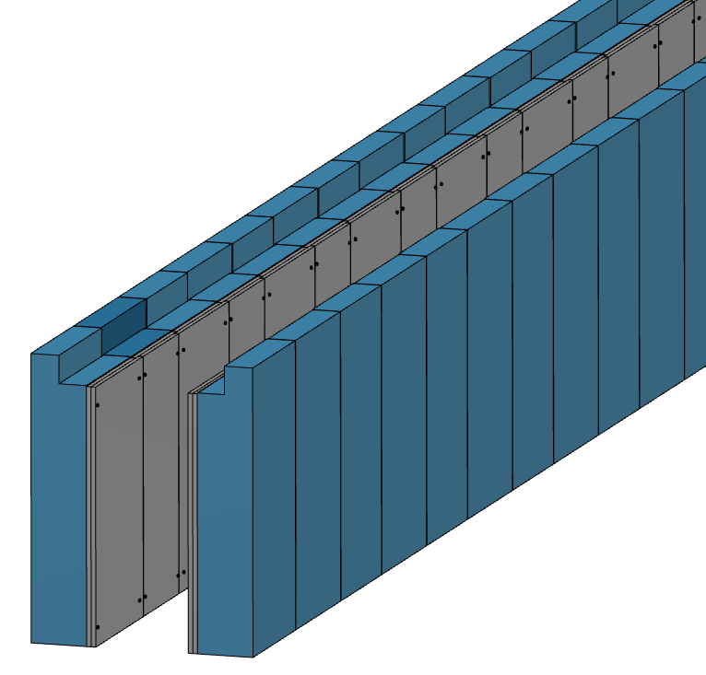
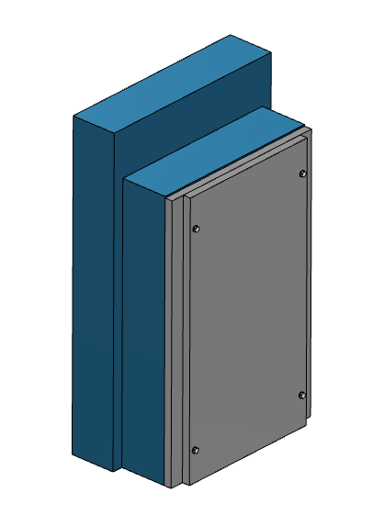
D03/D01 Concept 2
Side walls installation
Blocks installed in line
Steel plates bolted to concrete block

Slide 11
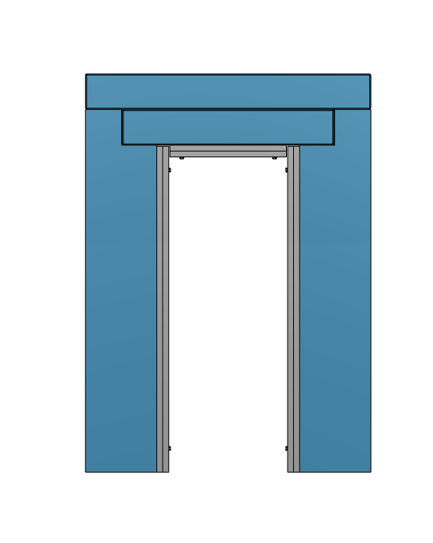
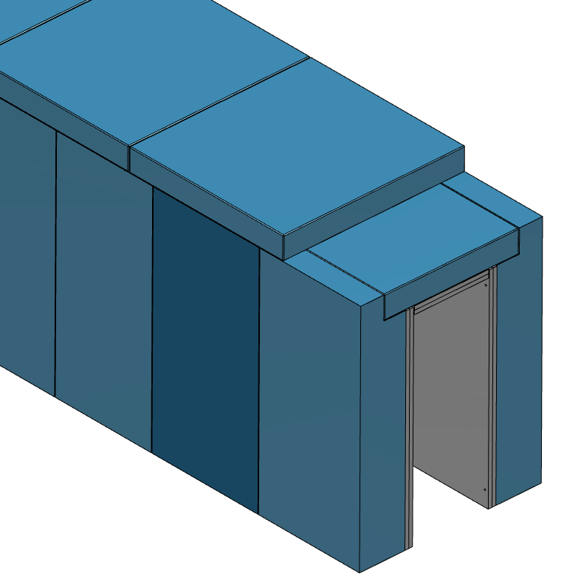
D03/D01 Concept 2
Roof blocks installation
Roof blocks resting on the side walls

Slide 12
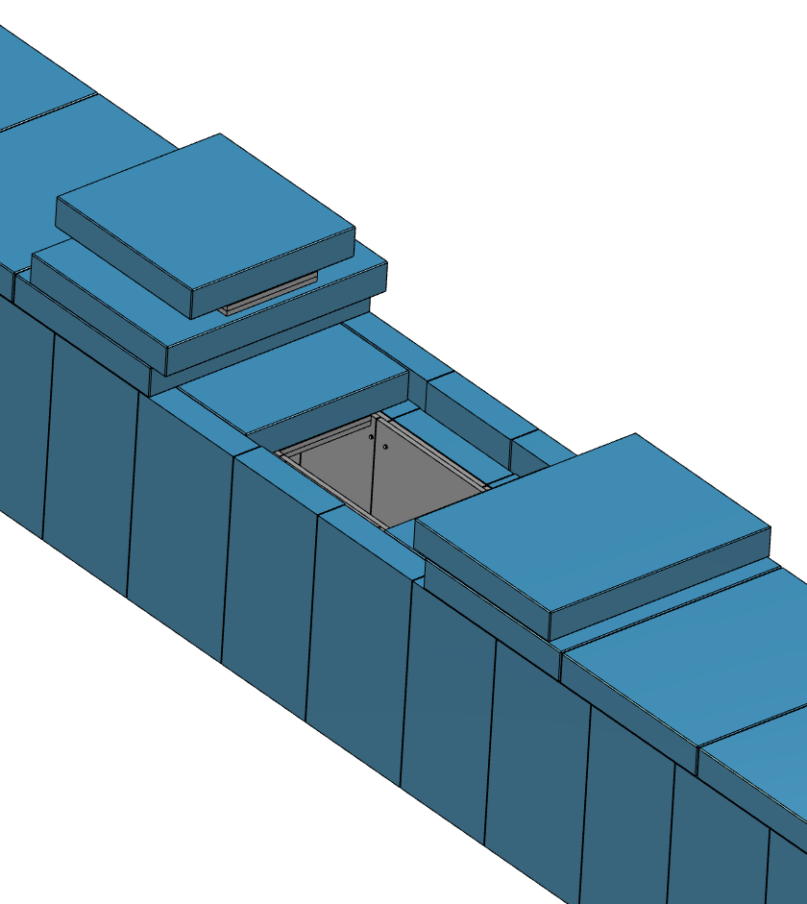
D03/D01 Concept 2
Maintenance of components inside
Full access by removing three pieces
3 lifts
≈1800 mm opening length

Slide 13
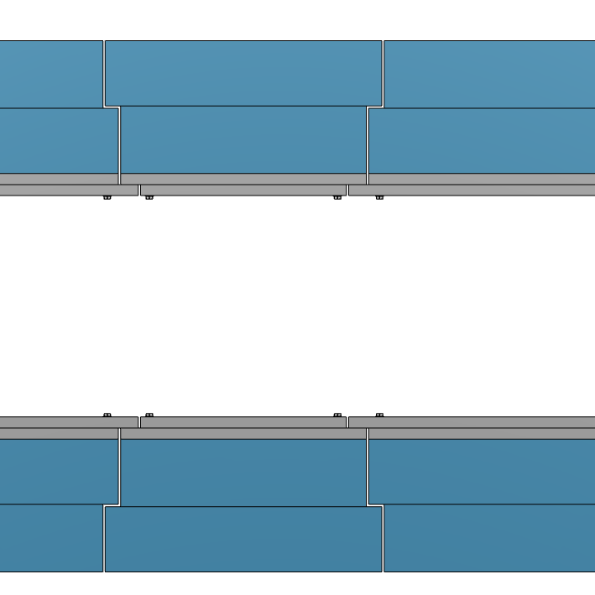
D03/D01 Concept 2
Streaming
Front view
10 mm gap
Top view

Slide 14
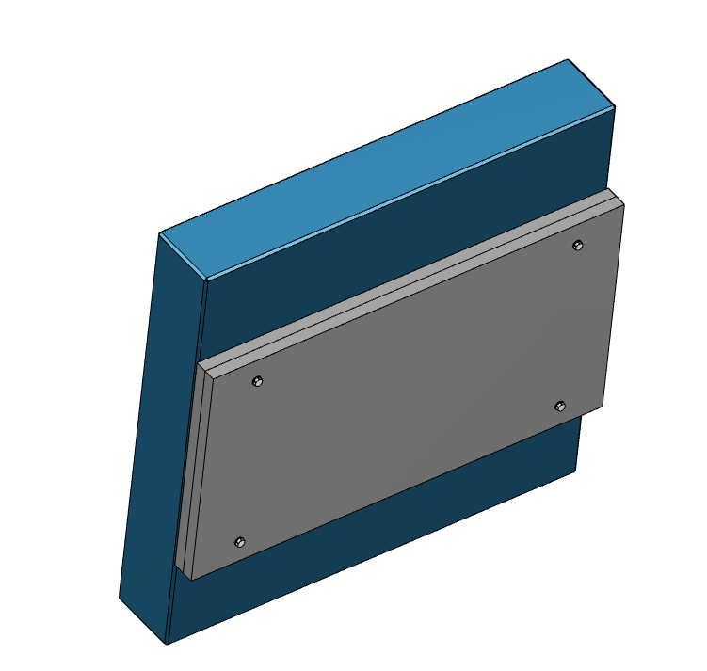
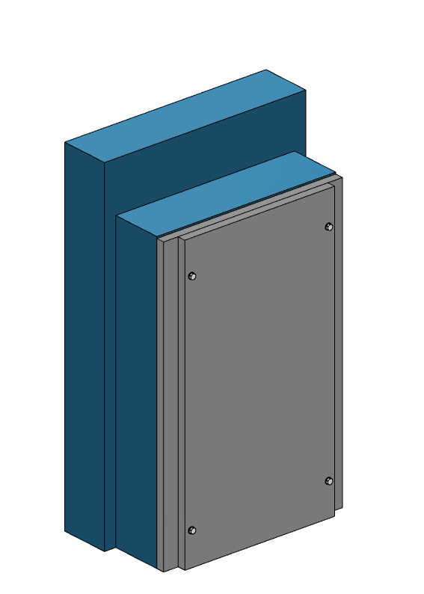
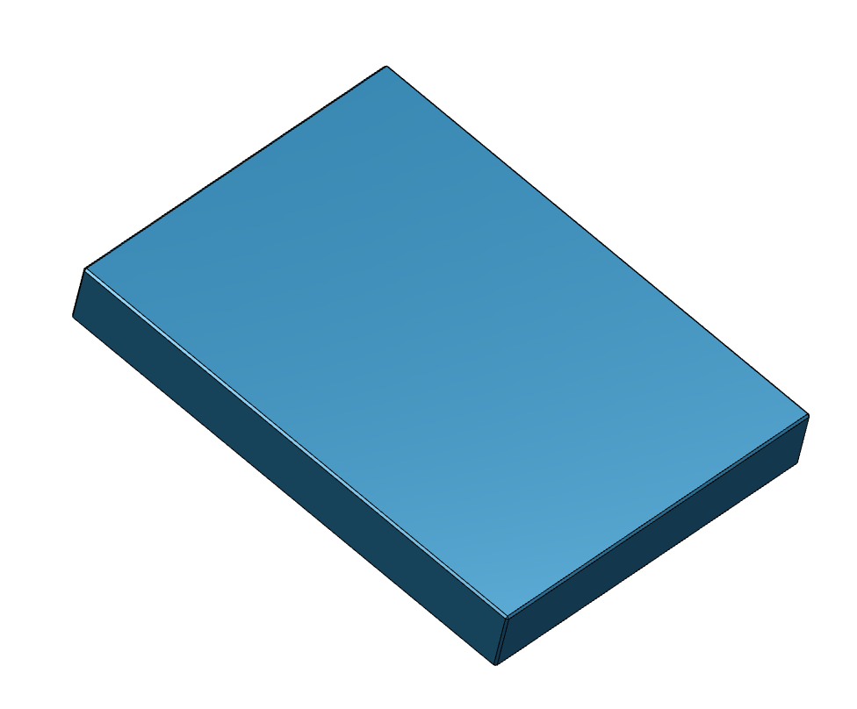
D03/D01 Concept 2
Logistic
Size: ≈ 1800 x 1600 x 400 mm
Weight: ≈3.5 t
Size: ≈ 3000 x 1500 x 700 mm
Weight: ≈9.3 t
Size: ≈ 2600 x 1800 x 300 mm
Weight: ≈3.5 t

Slide 15
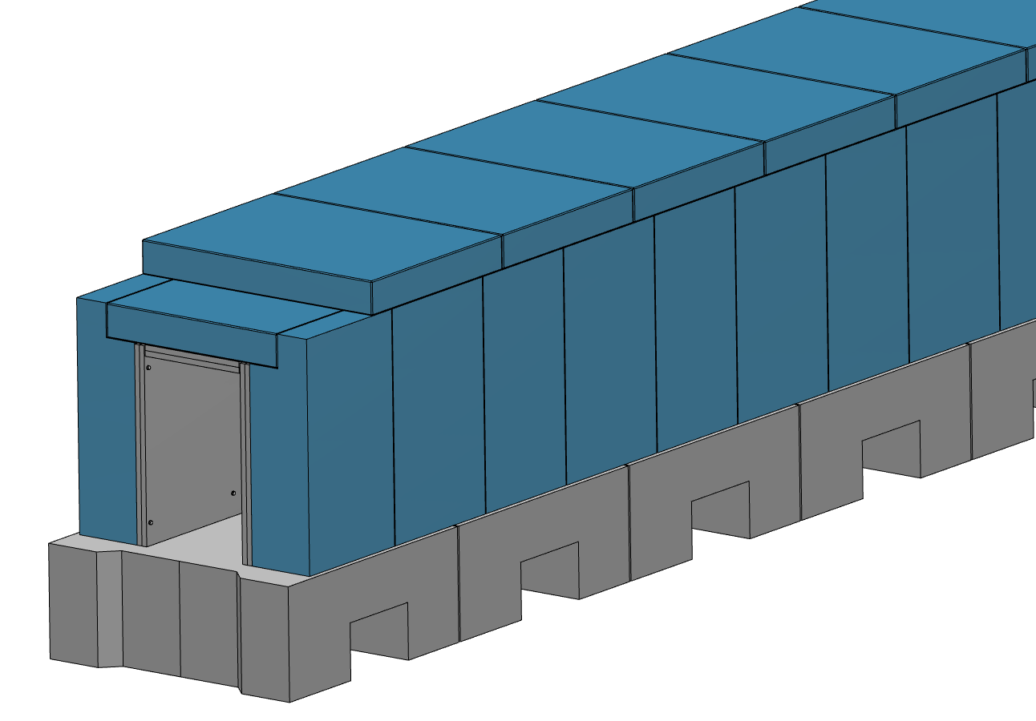
D03/D01 (E02) Concept 3
Similar as Concept 2 but with supporting blocks
Blocks installed in line
Applicable to E02 (without supporting blocks)
Steel plates bolted to concrete block

Slide 16
D03/D01 (E02) Concept 3
Logistic
Size: ≈ 1800 x 1600 x 400 mm
Weight: ≈3.5 t
Size: ≈ 1700 x 1250 x 700 mm
Weight: ≈4.1 t
Size: ≈ 2600 x 1800 x 300 mm
Weight: ≈3.5 t

Slide 17
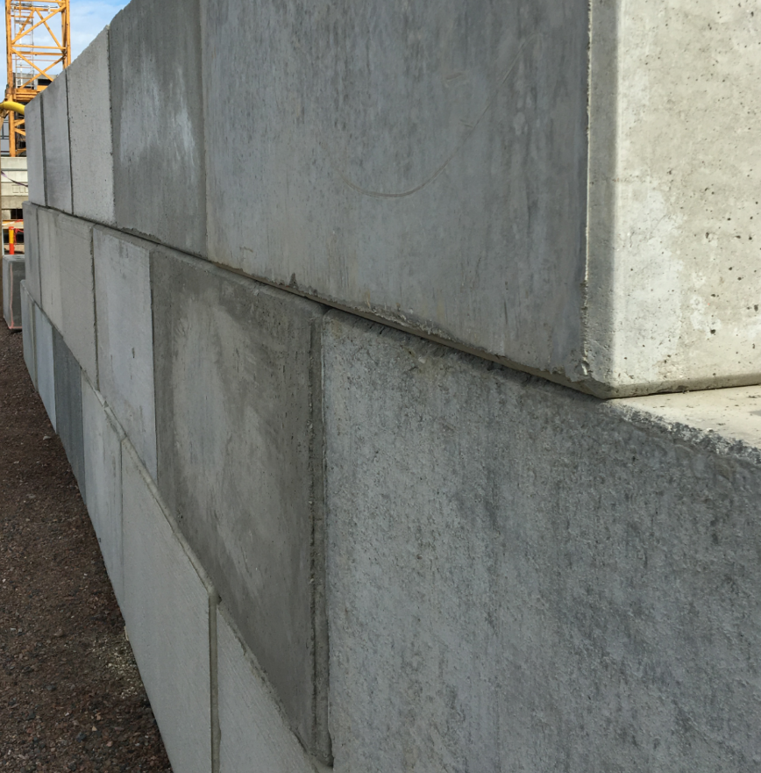
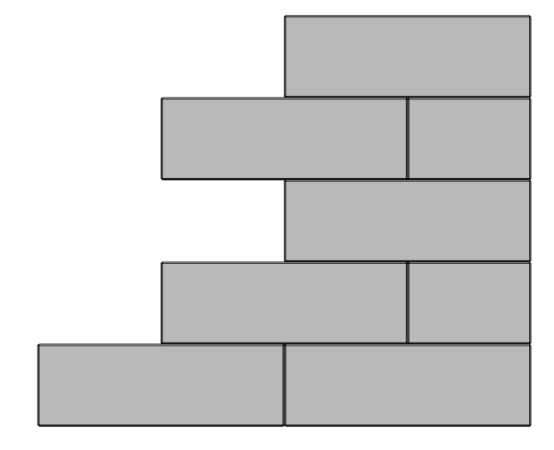
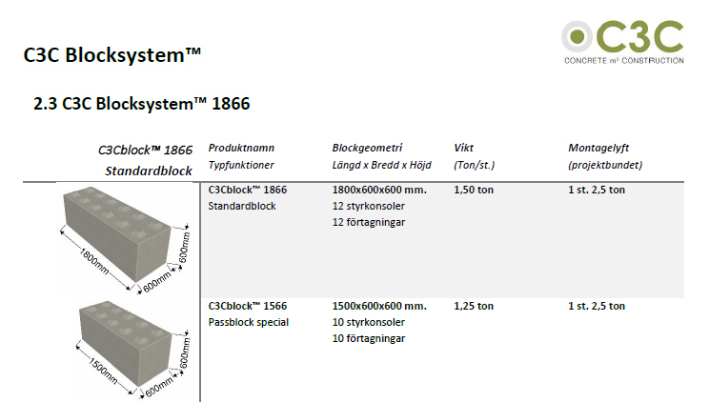
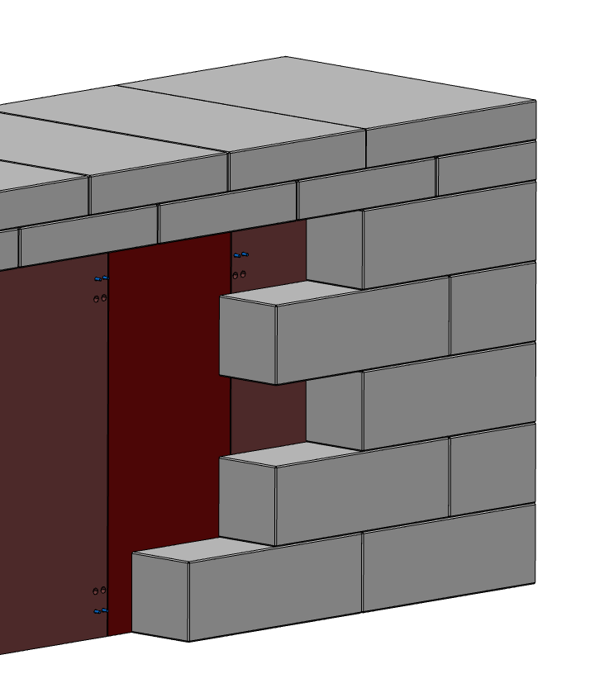
C3C Blocks/E02
Streaming???

Slide 18
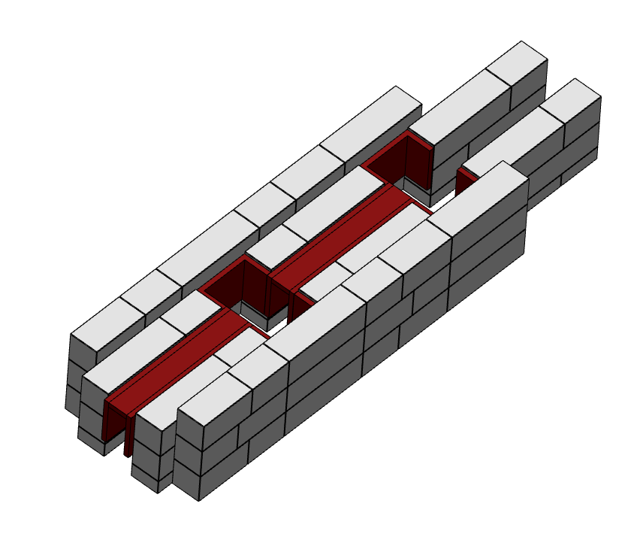
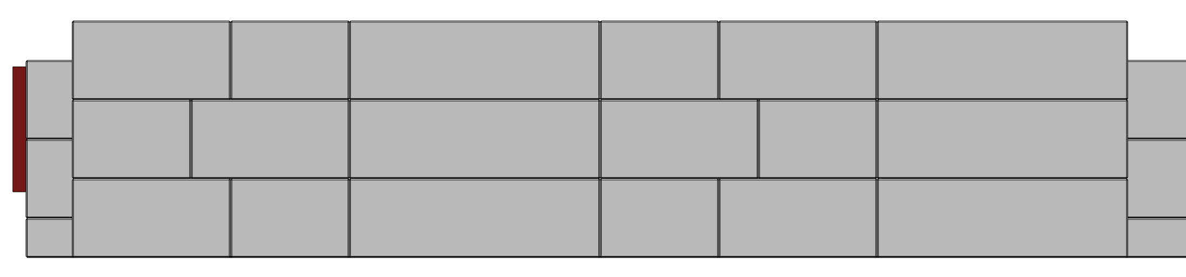
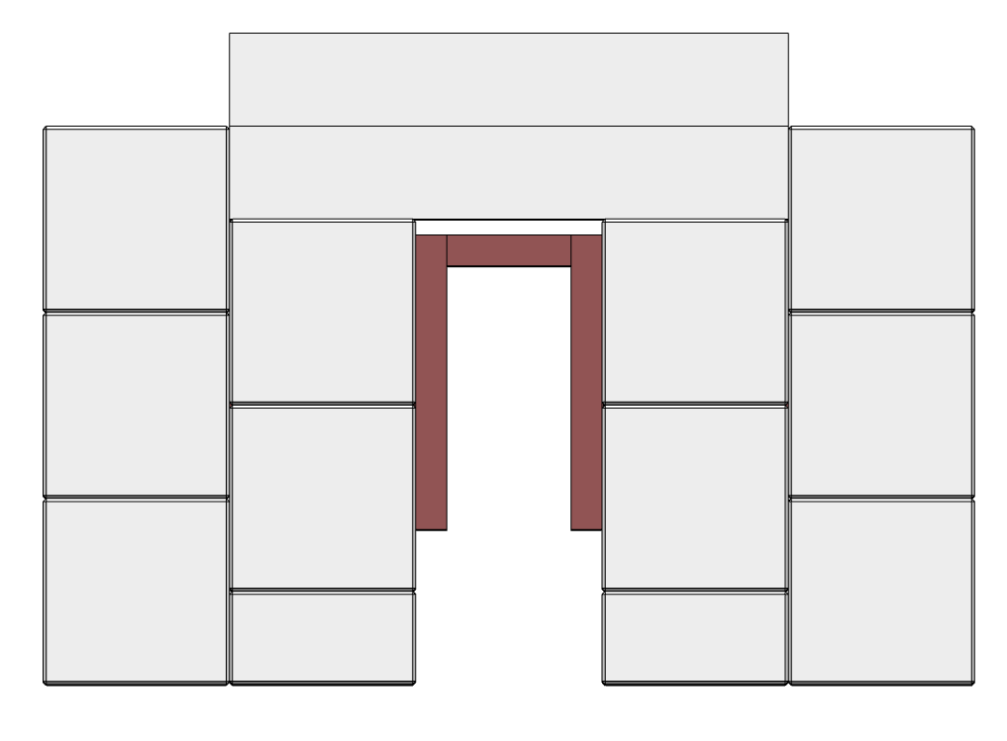
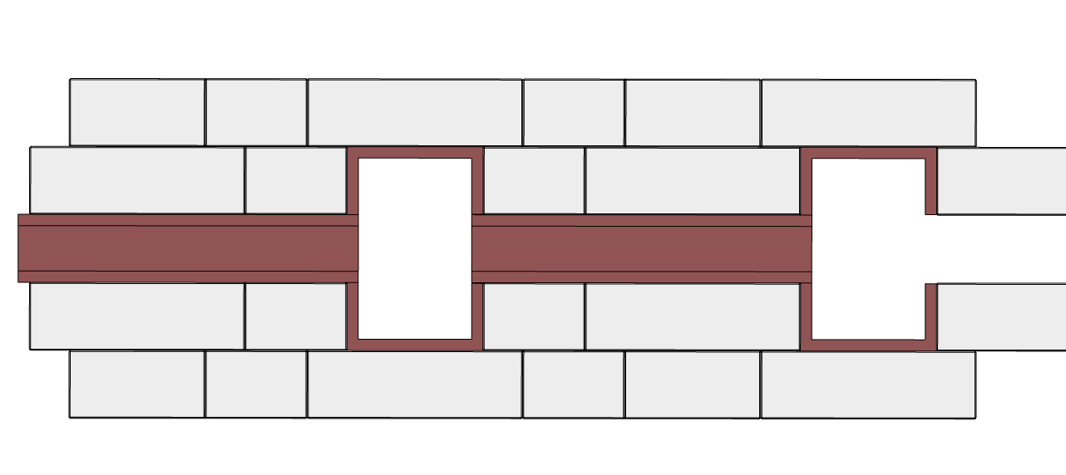
C3C Blocks/E02

Slide 19
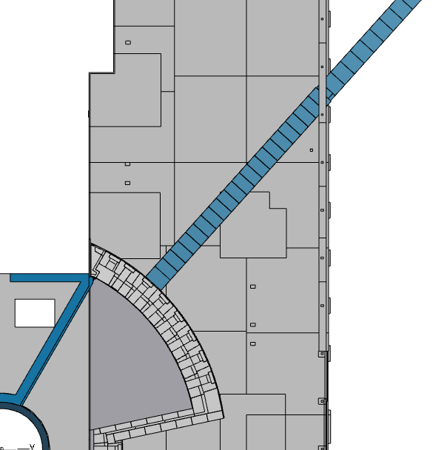
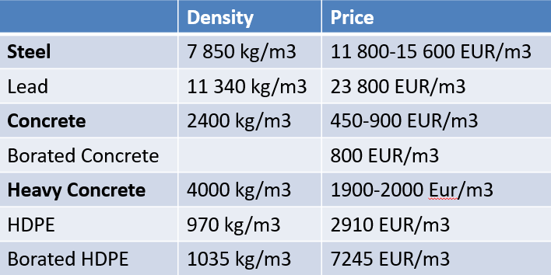
CSPEC example
D03-Concept1 and E02 Concept 3
E02 – aproximate length 100 m
Total mass of steel ≈ 390 t
Total mass of concrete - Walls ≈ 580 t
- Roof ≈ 345 t
D03 – aproximate length 30 m
Total mass of steel ≈ 200 t
Total mass of concrete - Walls ≈ 280 t
- Roof ≈ 130 t

Slide 20
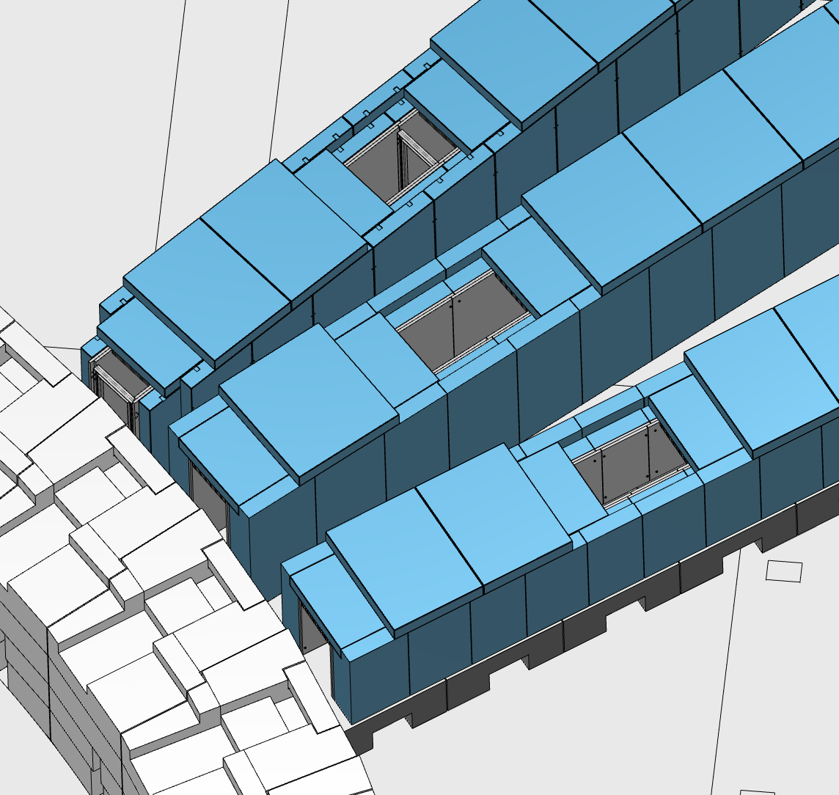
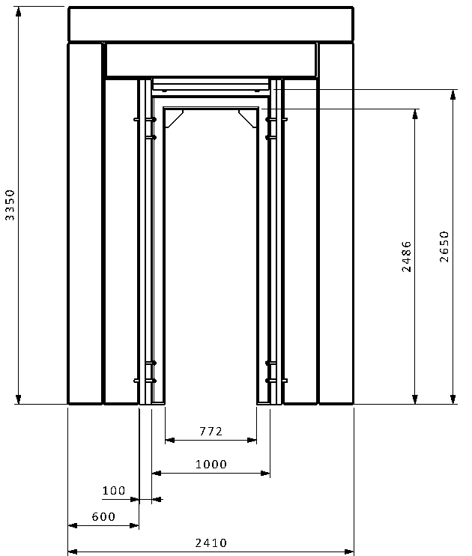
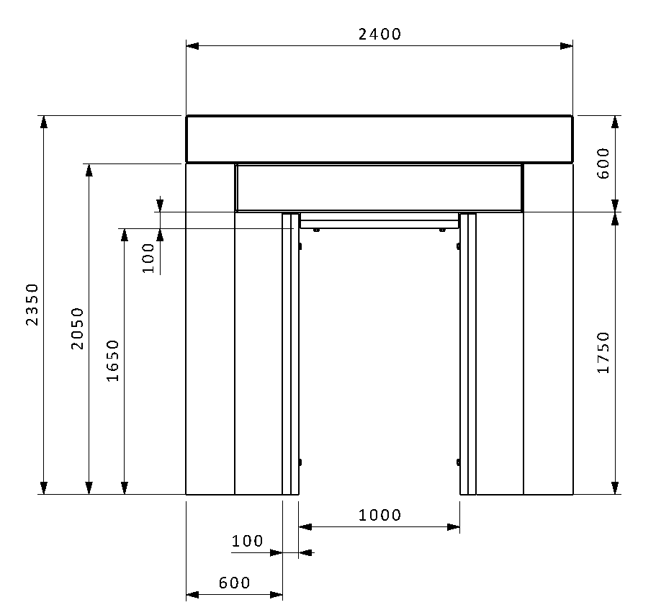
Dimensions

Slide 21
Q/A
Questions ???

