Slide 1
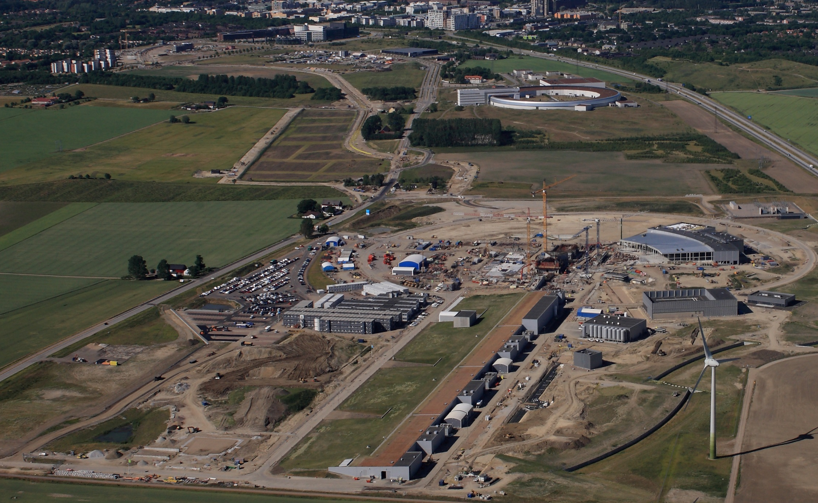

  ESS Project Status
  Roland Garoby – Technical Director
  August 2018

Slide 2
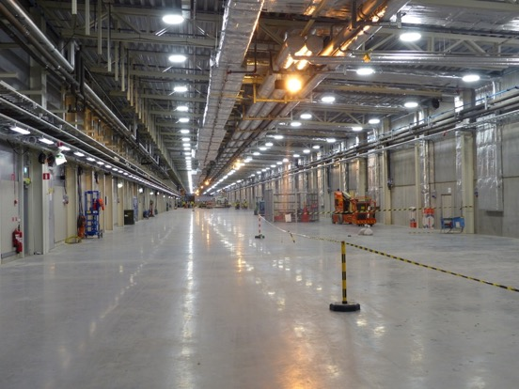
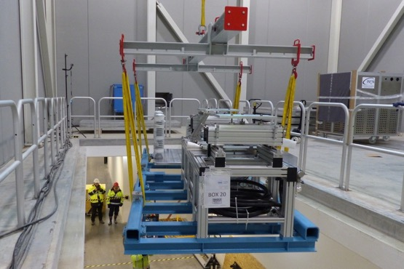
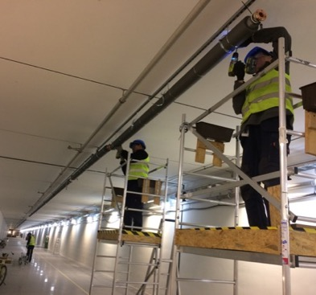
ESS is close to 50% complete
2018 is the peak of construction activity
First buildings have been handed over
In-kind deliveries of high tech equipment arriving
All our staff moved out to site in June this year

Slide 3
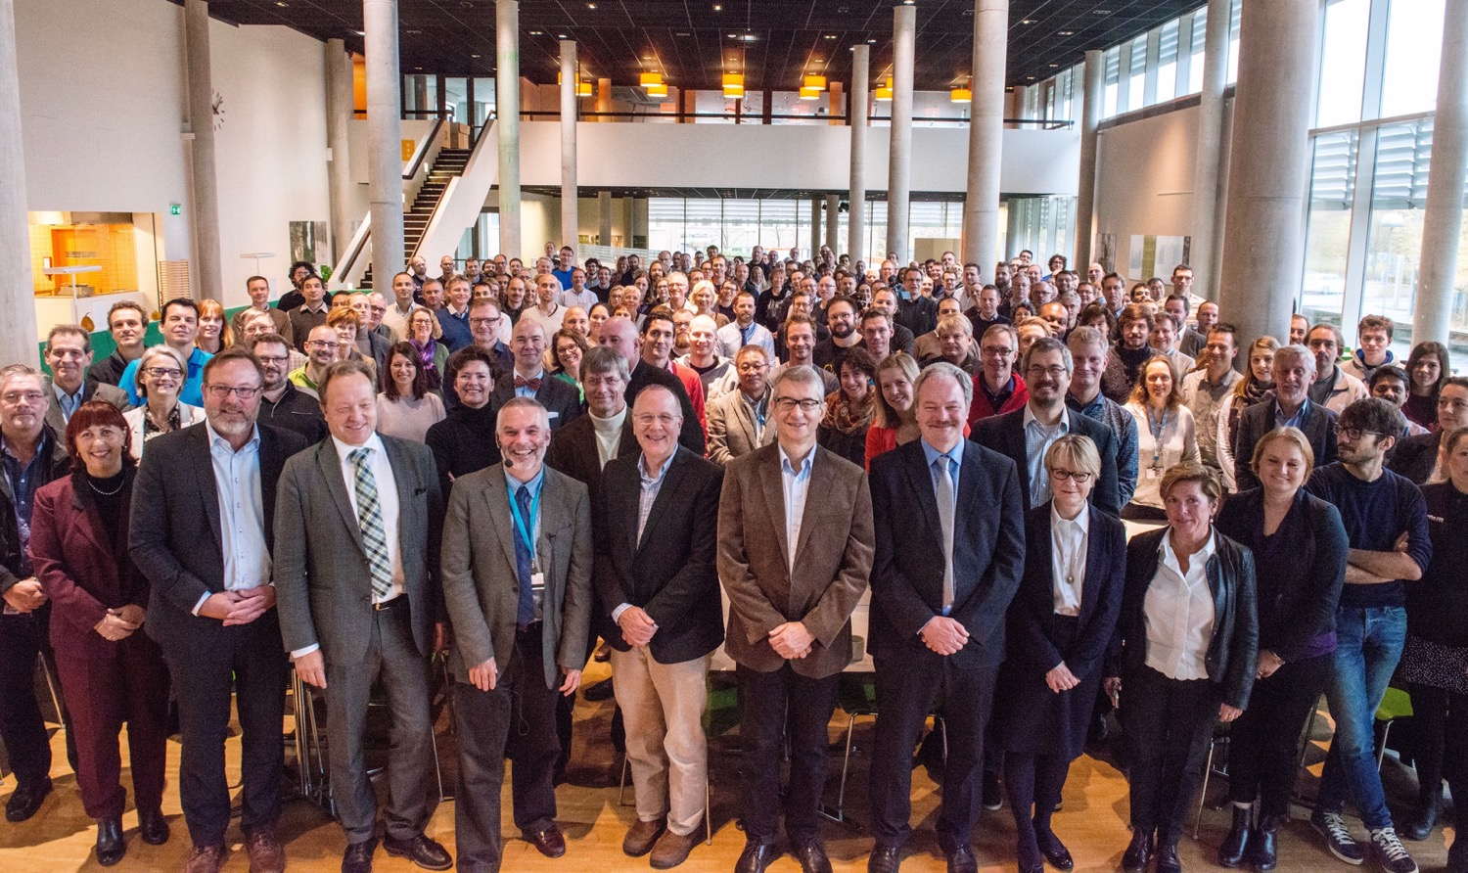


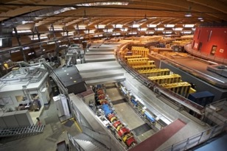
Organisation and People
447
Employees
50
Nationalities
~ 100
Collaborating Institutions
Notes:
Updated September 2017

Slide 4
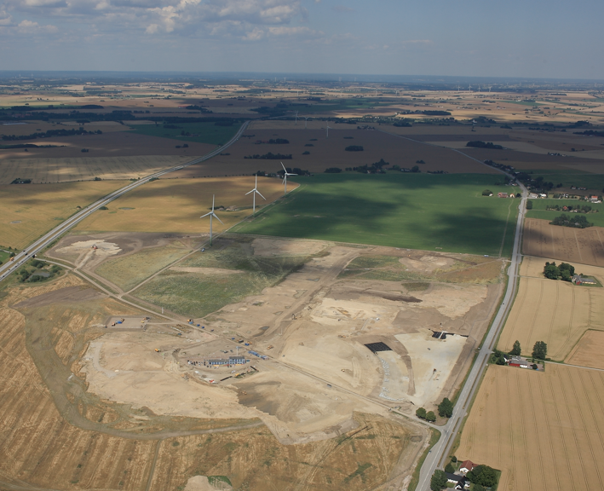
Civil Construction Groundbreaking
September 2014

Slide 5
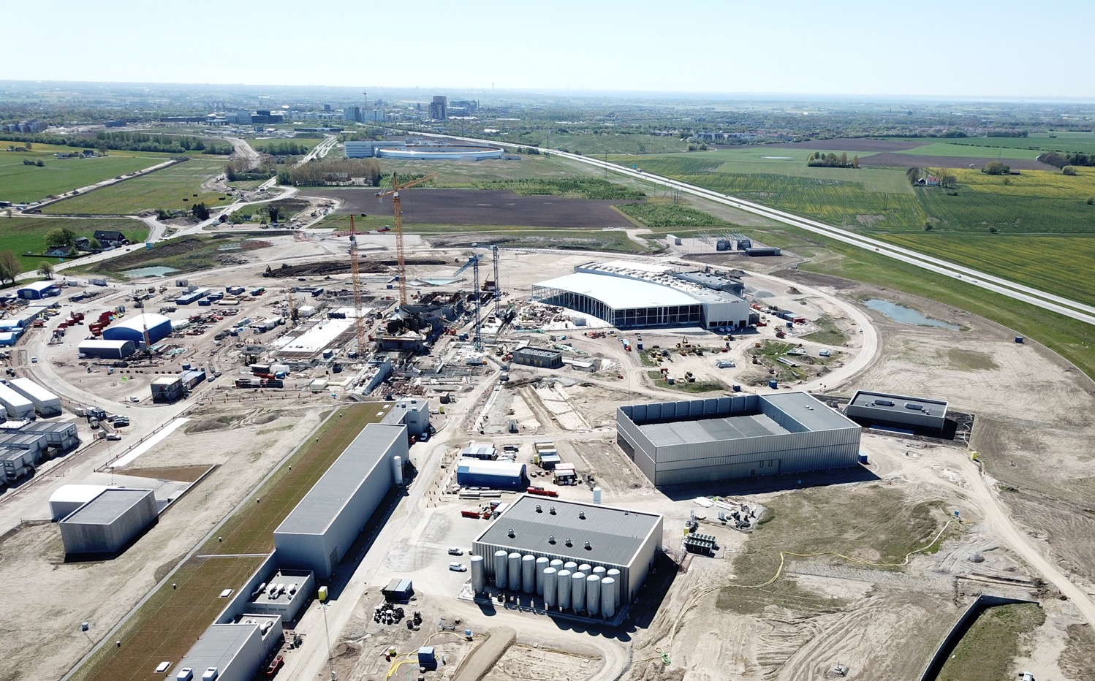

Slide 6
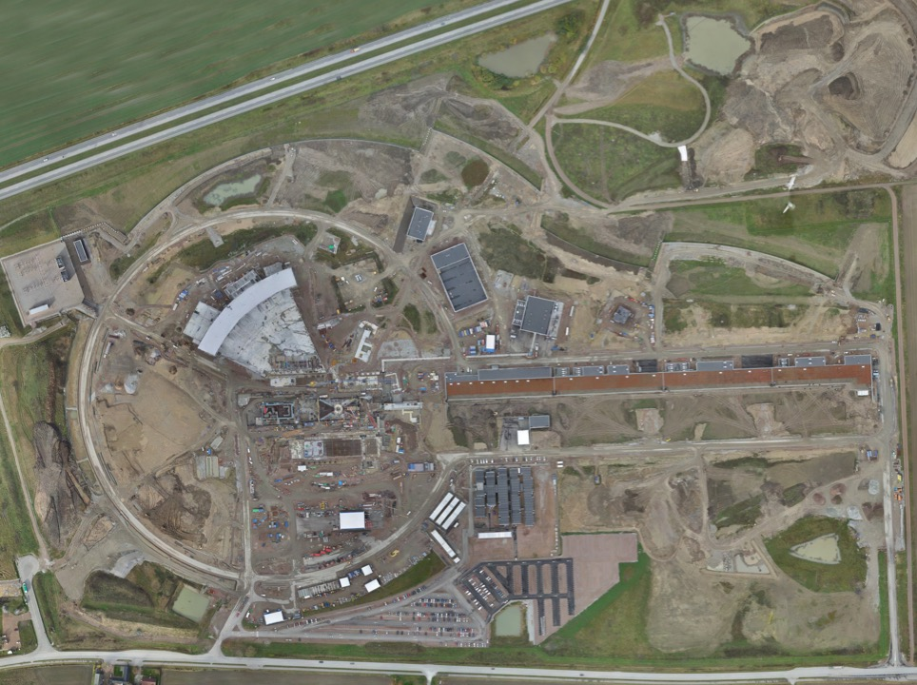
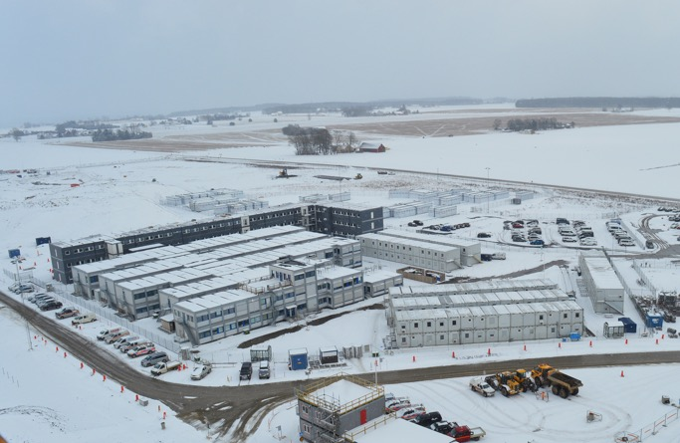
Permanent
Office Campus
2021
New 2018 ESS offices for all staff
New Bus Stop
Lund Tramway Depot

Slide 7
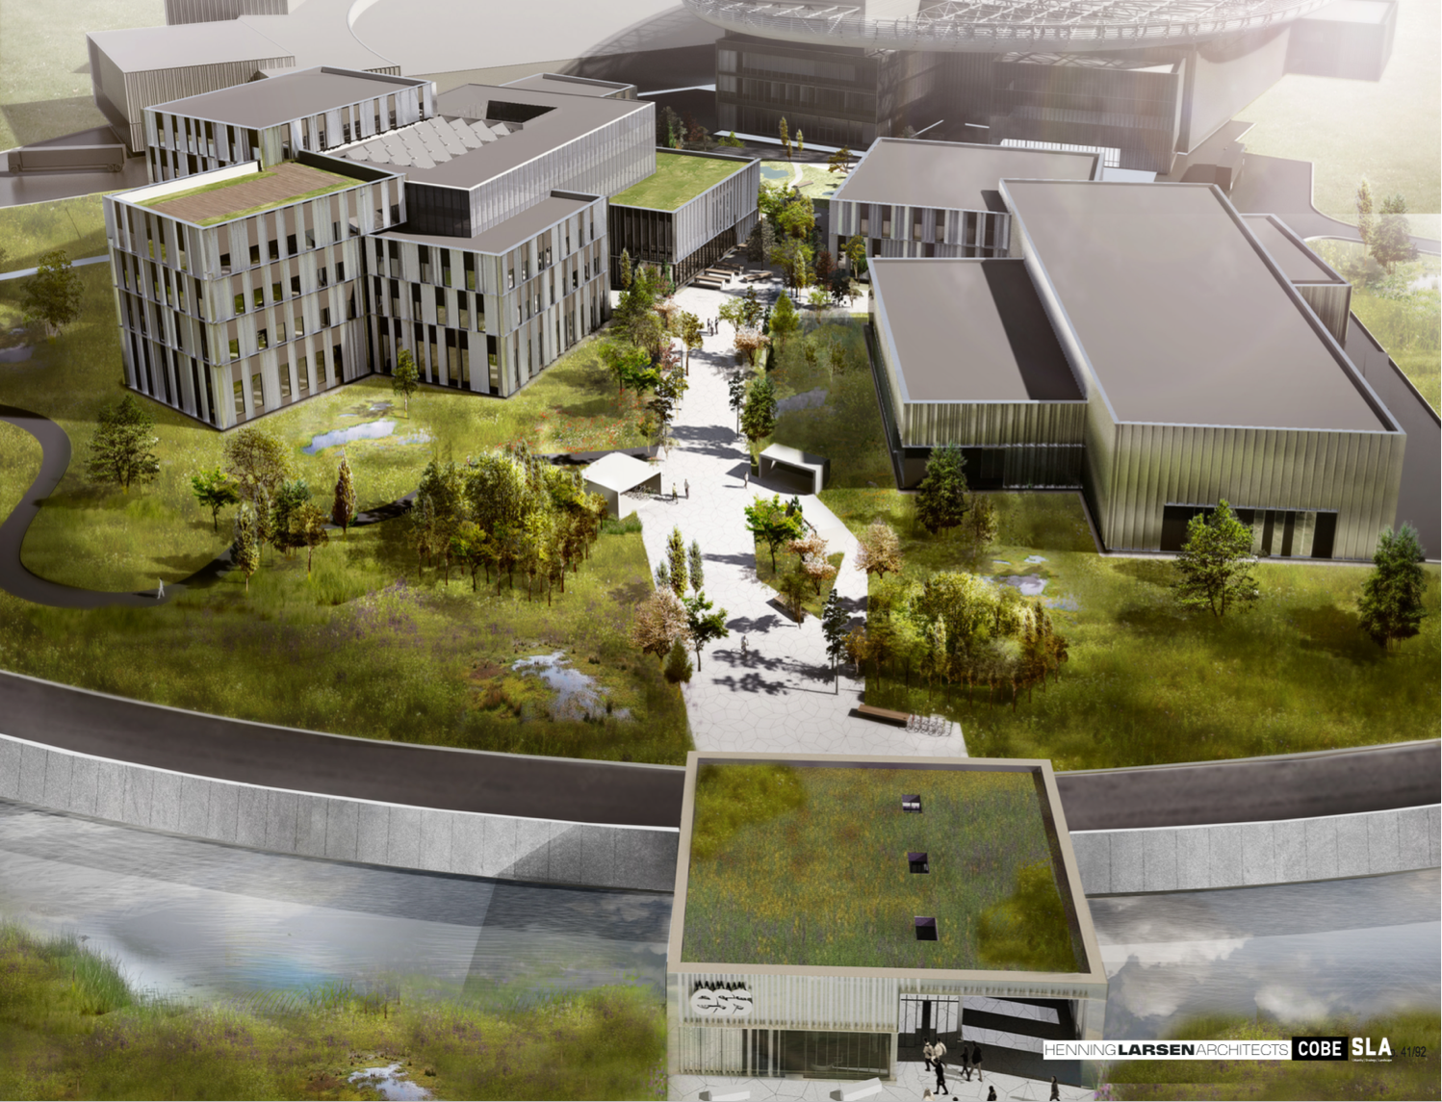
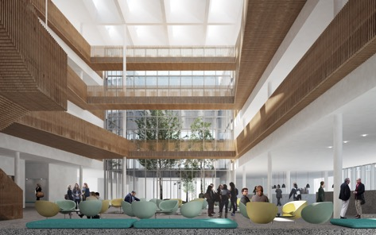
Campus
Offices, auditorium canteen
Labs and Workshops
Signed construction and financing agreements in February
Now in detailed design before target cost is agreed
Cost of the lease is included in the operations costs
Entrance Building

Slide 8
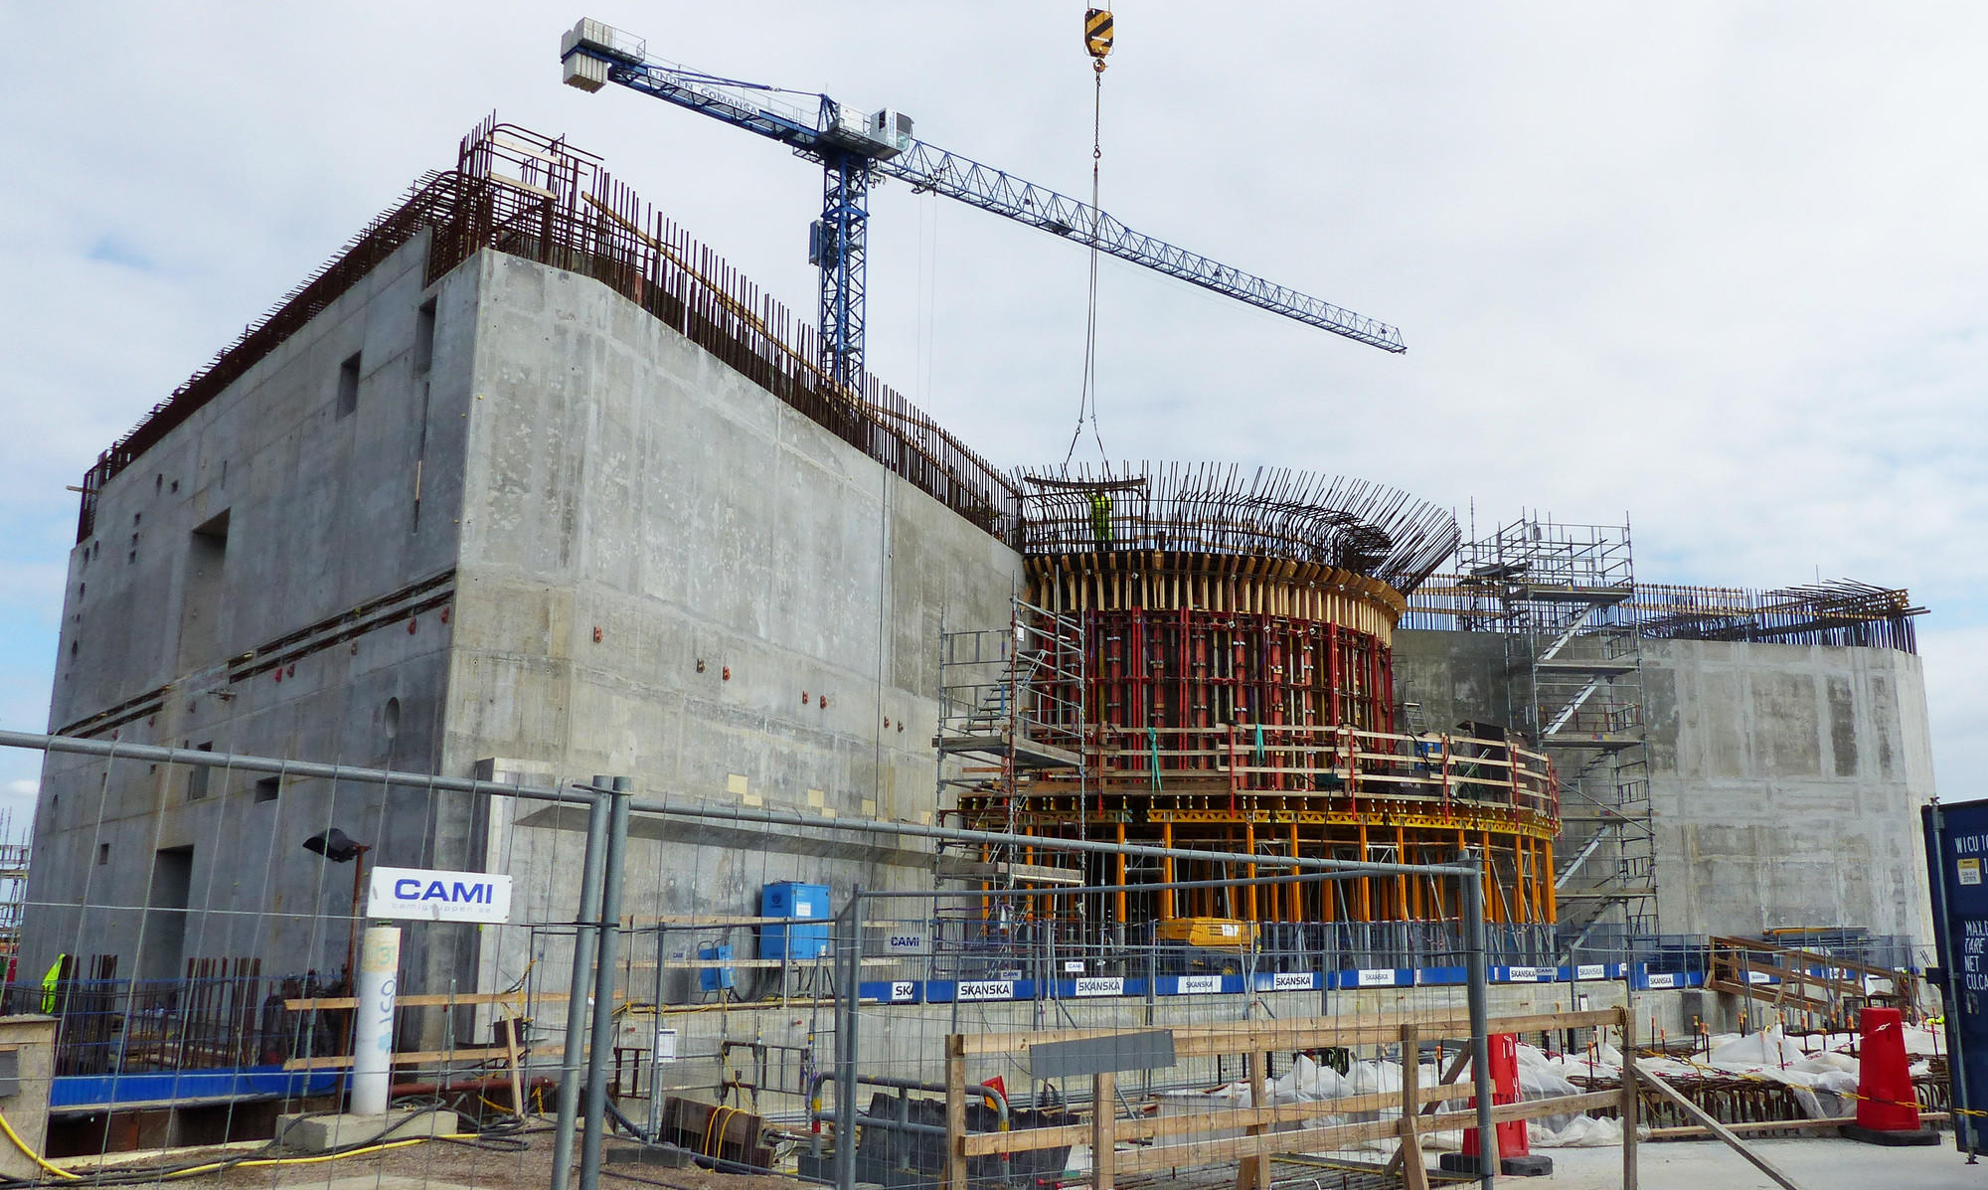
Target building (1/2)

Slide 9
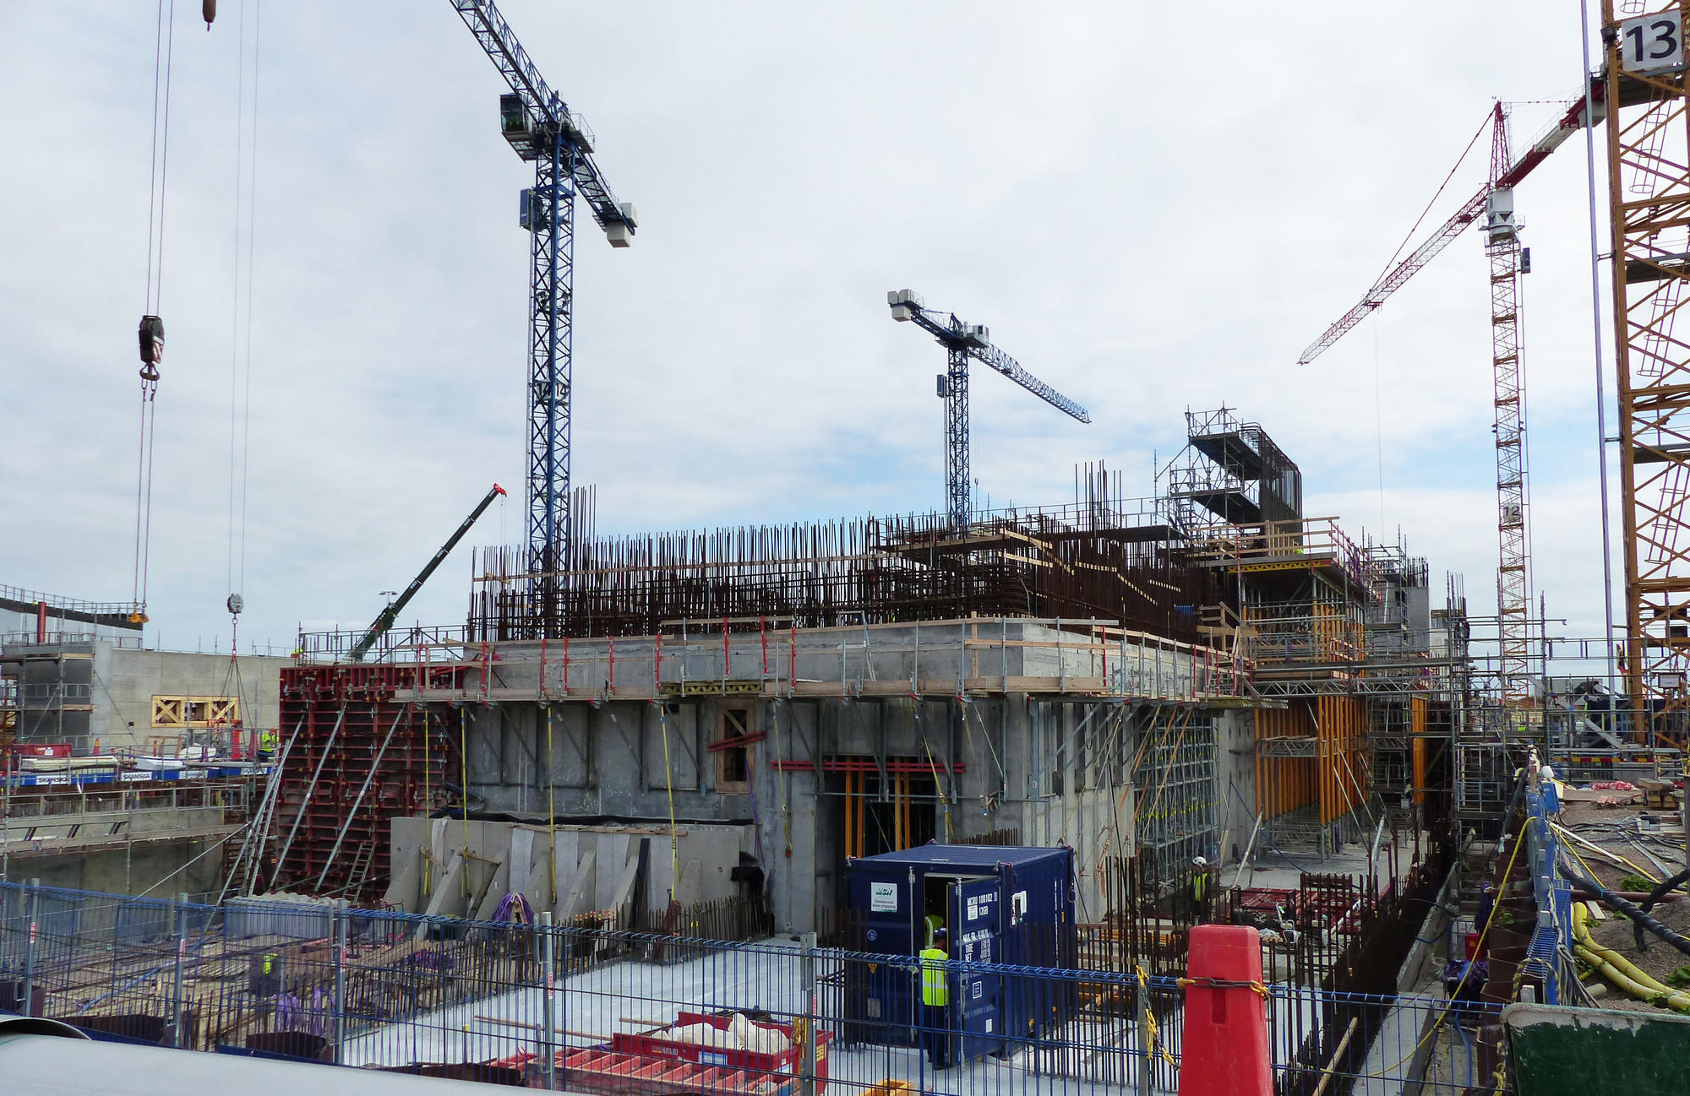
Target building (2/2)

Slide 10
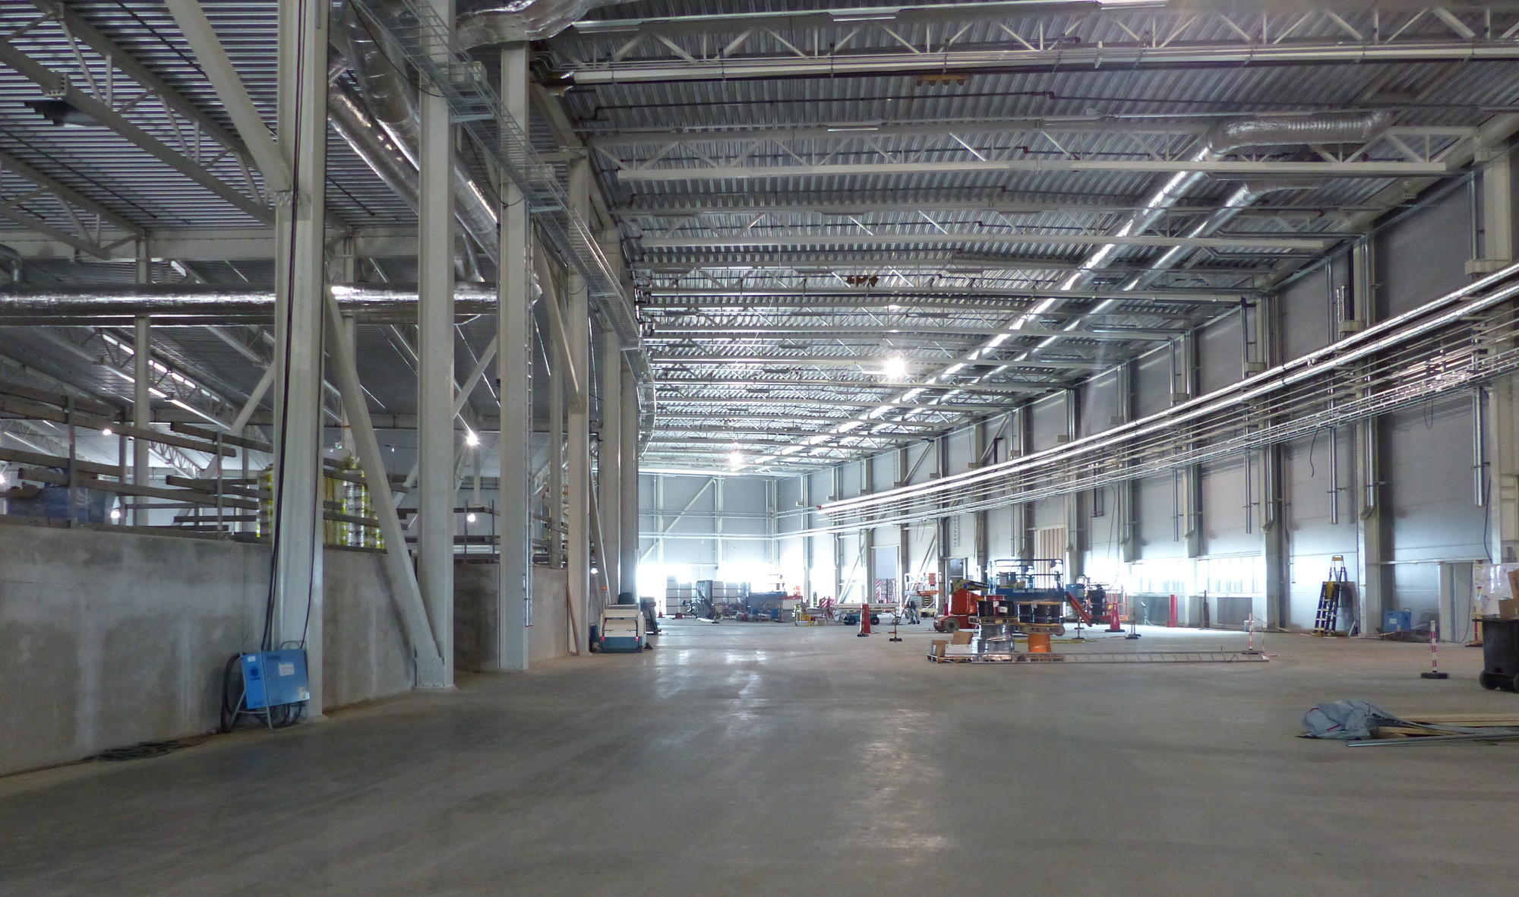
Experimental Hall (E01)

Slide 11
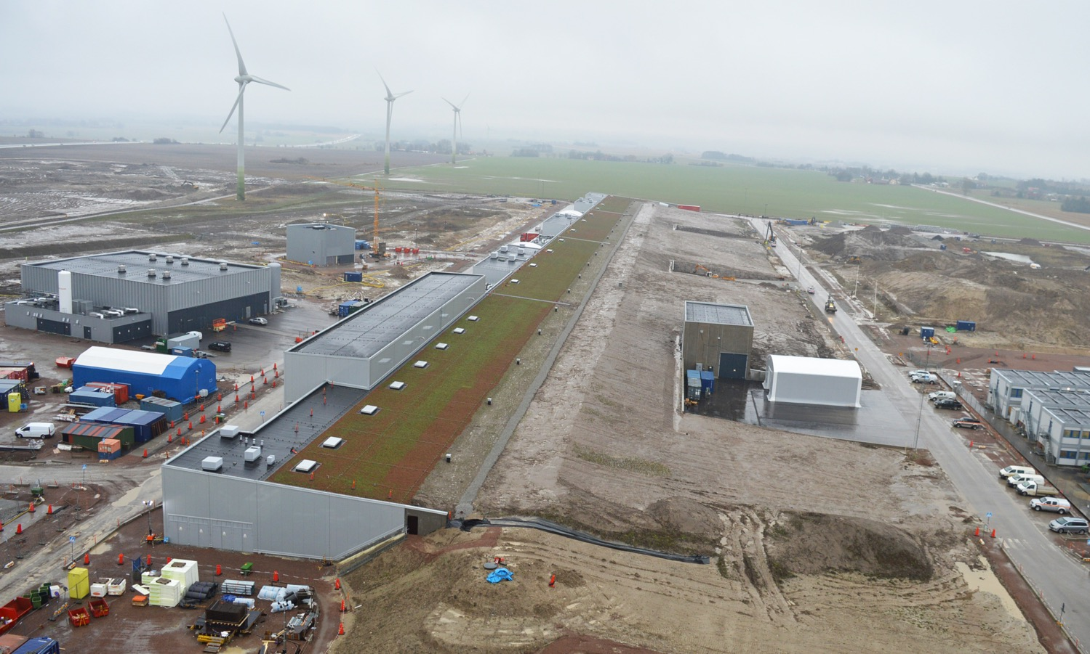
Accelerator & Klystron Gallery

Slide 12
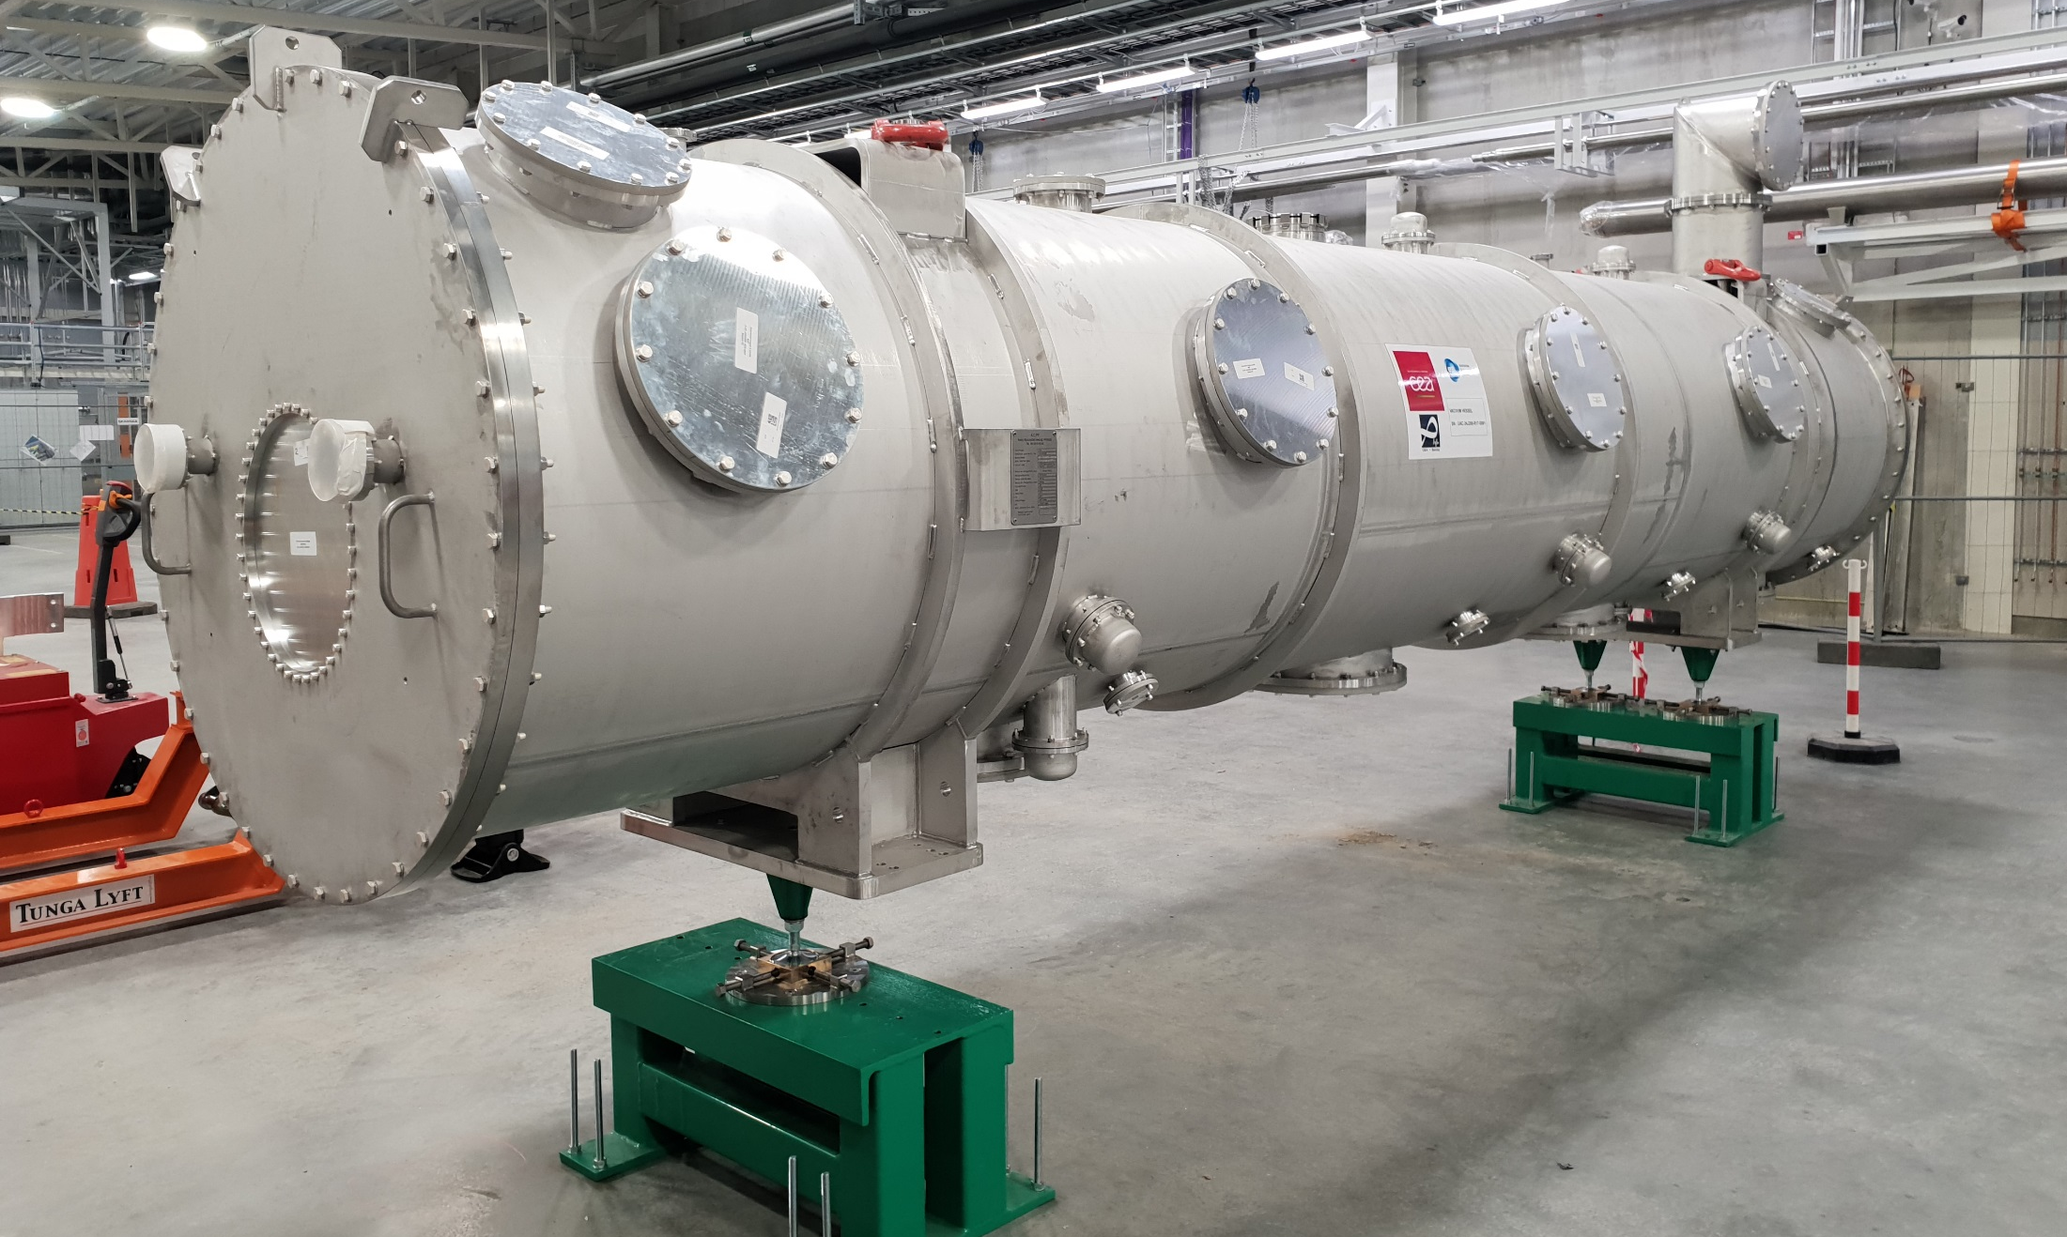
Dummy elliptical cryomodule in TS-2

Slide 13
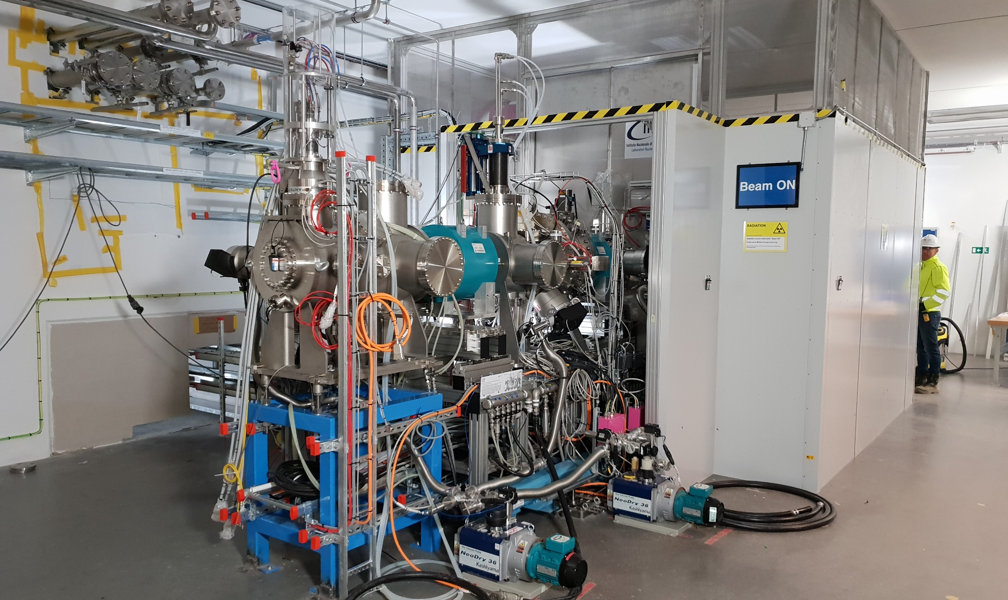
Ion source & LEBT are about to start

Slide 14

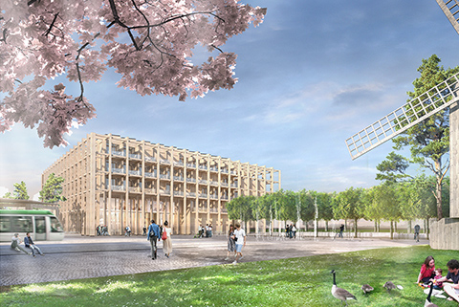
SPACE Building: Reception, exhibition space,
guest house for MAX IV and ESS (~100 rooms),
office and meeting space, restaurant
Modelled on the Harwell Campus
Swedish Government approval
August 2018
Tramway from Lund C station

Slide 16
Rebaselined ESS schedule
2018
2019
2020
2021
2022
2023
2024
2025
BOT
SOUP
Warm LINAC Commissioning Steps
EOC
1.3 GeV Capability Installed
Accelerator + ICS
Hi-Beta Install
Beam on Dump
(570 MeV)
Accelerator RBOT
Accelerator Schedule Float to BOT
CF + Target + NSS (Bunker+TBL) + ICS
Bunker and Test Beam Line RBOT
Access for Monolith Installation
Target RBOT
15th Instrument Complete (Ready for hot commissioning)
NSS Instruments + ICS
Instrument Hall Access for Start of Installation
Start beam commissioning for 1st Instruments
SOUP

Slide 17
Main delays for the Accelerator are due to in-kind partners…
ISrc to RFQ/MEBT/DTL1
ISrc to Beam Dump (BOD)
4 Nov '19
8 Feb '21
ISrc to LEBT
ISrc to DTL4
RBOT
25 Jun '18
27 Apr '20
24 May '21
New Baseline
2019
2020
2021
18.8 months
Beam to RFQ/MEBT Delay
21.8 months
Beam to DTL4 Delay
21.2 months
BOD Delay
23.9 months
RBOT Delay
Old Baseline
2019
2020
2021
5 Jul '18
28 May '19
ISrc to DTL4
RBOT
11 Apr '18
30 Apr '19
ISrc to RFQ/MEBT
ISrc to Beam Dump (BOD)

Slide 18
Main delays for the Target are due to the Target Building, but in-kind contributions are critical…
2018
2019
2020
2021
2022
Monolith Area Superstructure
Monolith and A2T Concrete
High Bay Infrastructure Installation
BOT
Target Building (D02) Access for Monolith Installation
Testing and Readiness Review
Monolith Installation & Testing
Ready for parallel bunker and monolith works
Target Wheel & MR Installed
Target RBOT
CF D01/D03 Build-out to weather tight
3 months float
Parallel Works
Target Integrated Bunker Scope
Final testing and Readiness Review
Bunker Construction and Installation
Monolith inserts & shutters installed
NSS RBOT

Slide 19

Funding decisions in 2018
AFC.07
Budget Plan 19/20 (R)
Indicative Plan 21-25 (I)
Construction Budget 2019 (I)
Political decision-making
Minister level
Schedule Review
8 Feb
10-11 Apr
Focus on re-baselining
Will mostly impact indicative plan 21-25
Council.12
Workshop
Budget plan 19/20 (I)
Indicative plan 21-25 (I)
High-Level Document (D)
Sharing Policy (D)
22-24 May
Council.14
Constr. budget 2019 (A)
Init ops budget 2019 (A)
Indicative plan 2021-2025 (A)
Commitments from Members for 2021-2025
Commitments from Members to completion of construction
Council.13
4-5 June
Budget Plan 19/20 (A)
Indicative Plan 21-25 (I)
Commitments from Members for 2019/20
initial ops funding
AFC.08
Constr. budget 2019 (R)
Init ops budget 2019 (R)
Indicative planning 2021-2025 (R)
Annual Review
Sep
Project review
30-31 Oct
3-4 Dec

Slide 20


