Slide 1
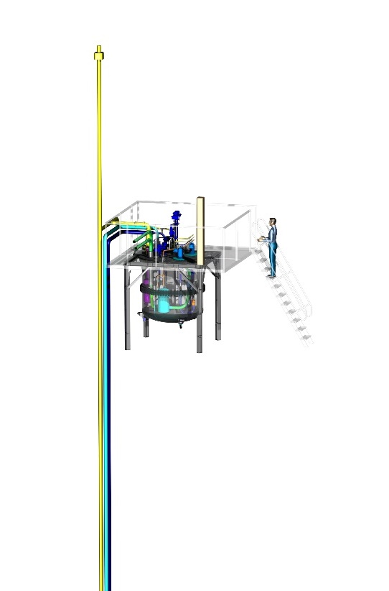
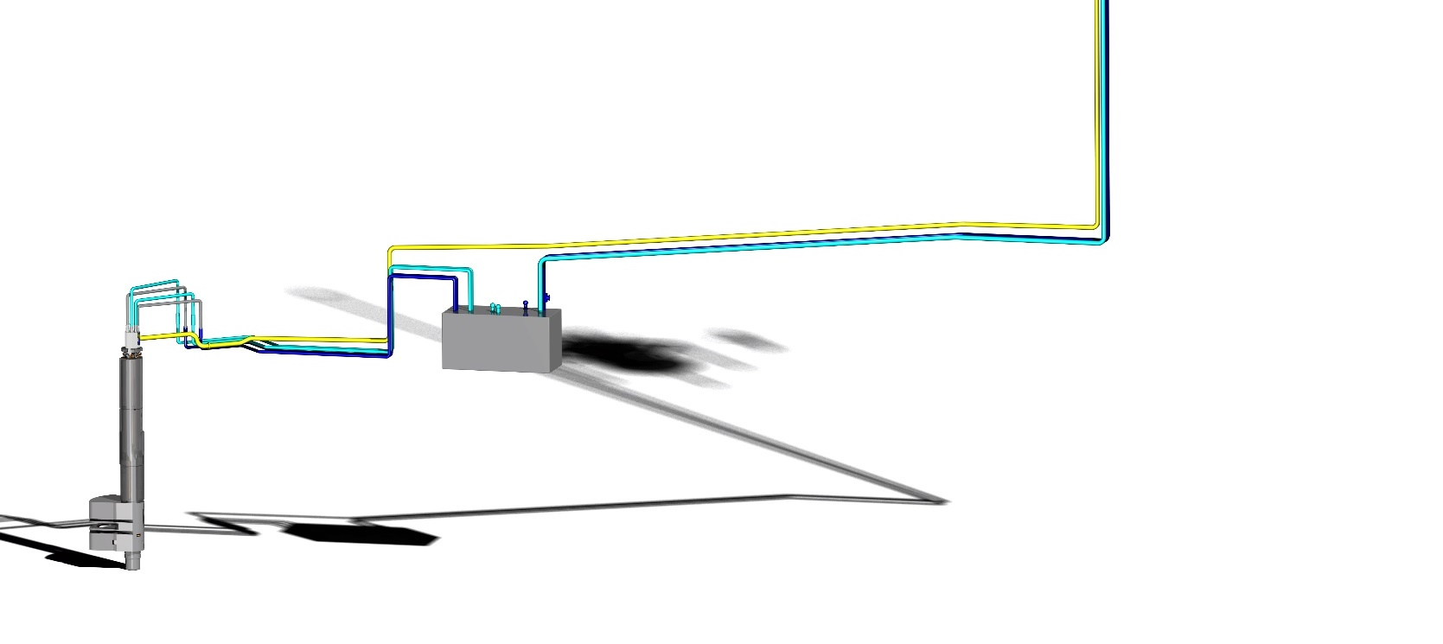
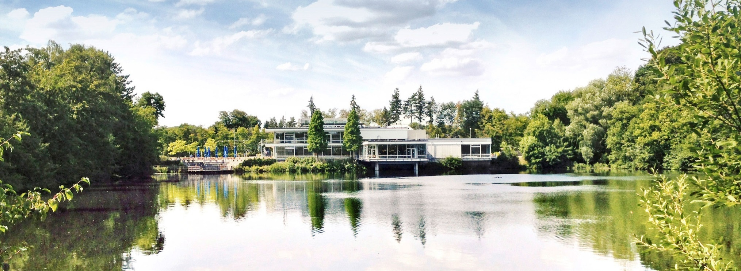
Target collaboratin Board Meeting
7th Meeting / August 2018
2018.08.30 I M. BUTzek

Slide 2
OUTLINE
ESS Projects run and envisioned by FZJ / ZEA-1
Brief technical status
Publication issues and how we tread work of other partners (good scientific practice)

Slide 3
Projects run and envisioned by FZJ
Moderator & Reflector Plug (TIK 3.1) – ongoing / ready in early summer 2019
Cryogenic Moderator System (TIK3.2) – ongoing / ready in early summer 2019
Irradiation Module manufacturing (TIK 3.4) - finished
Moderator (Butterfly 1) engineering feasibility study – ongoing / Mid 2019
Target Monitoring Plug (TIK4.1) - new project / estimated completion mid 2020
Neutron beam extraction system - planned project / phase 1 until April 2019 / phase 2 around end of 2020 (depends on results of phase 1)

Slide 4
Projects run and envisioned by FZJ
Additional small projects
LH2 Pump cooling system (external supplier)
CMS control Cabinet (external supplier)
Optical Retro Reflector Project (no funding yet)
RAMAN view port characterization (master thesis)

Slide 5
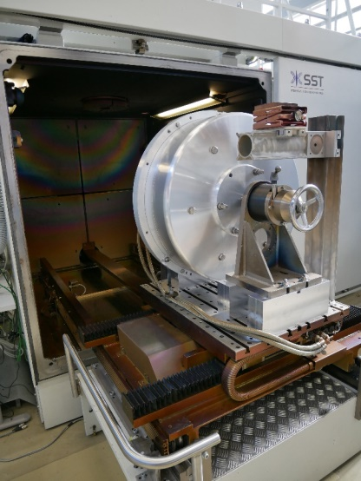
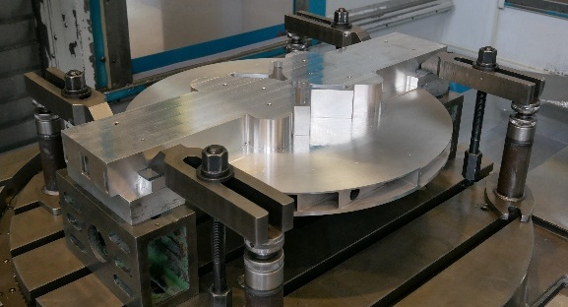
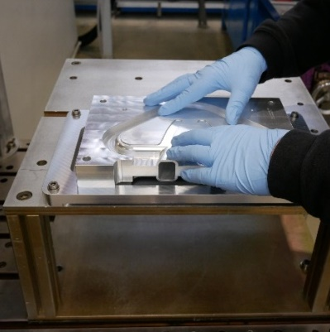
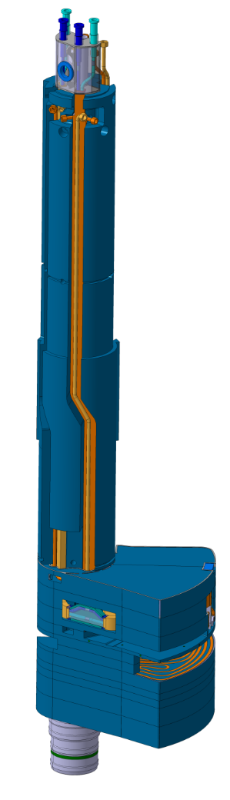
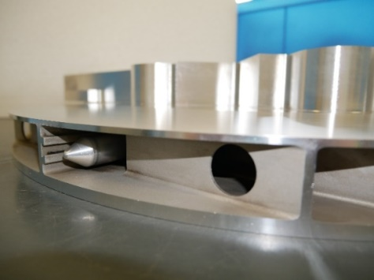
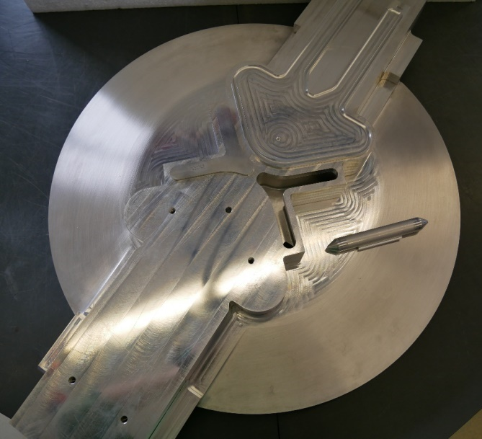
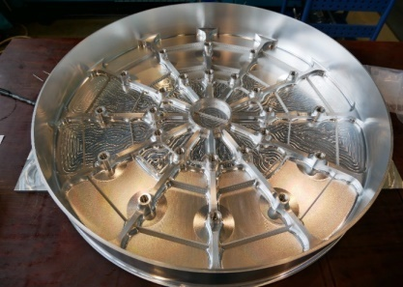
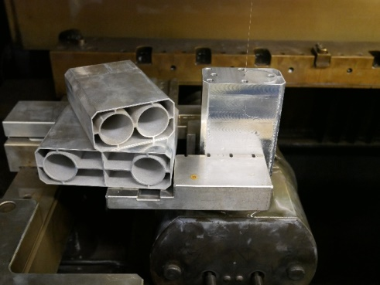
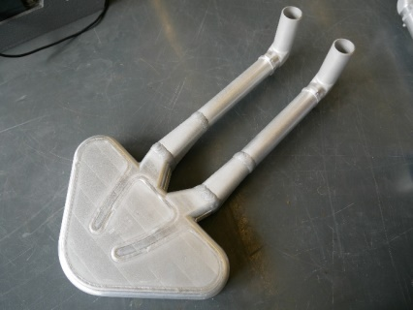
TIK3.1
ebeam welding
Assembling cold moderator
Pre milled thermal Moderator
thM with Irradiation Module
Reflector vessel
Cold
Moderator
Thermal moderator intermediate stage
Twister
Cold Moderator spacers
Cold Moderator

Slide 6
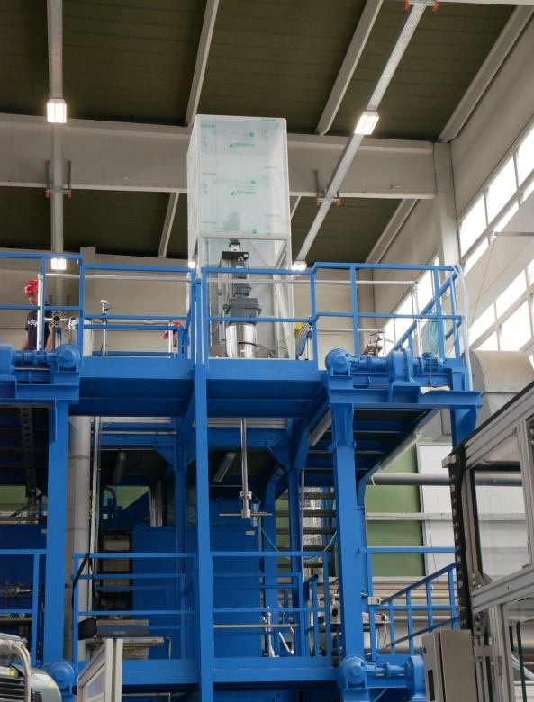
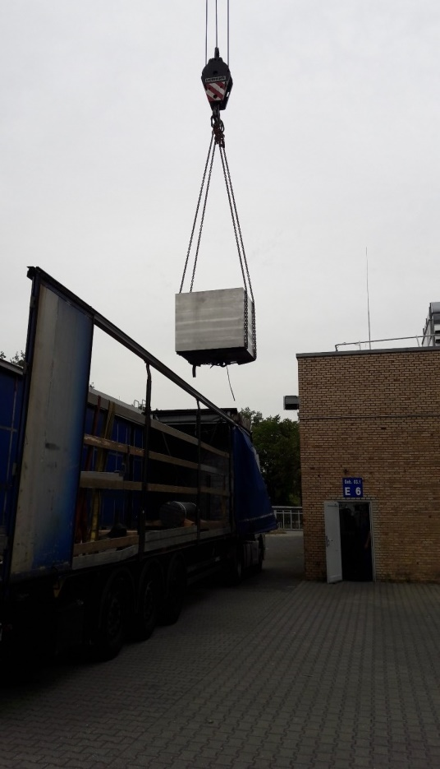
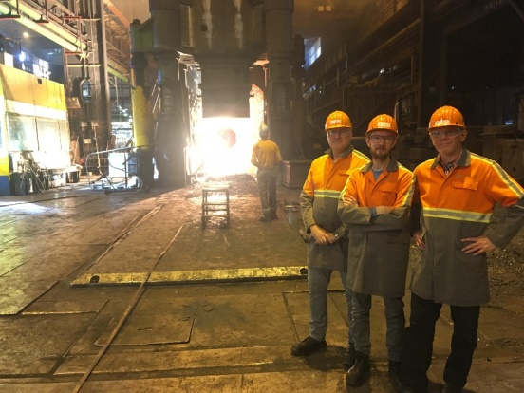
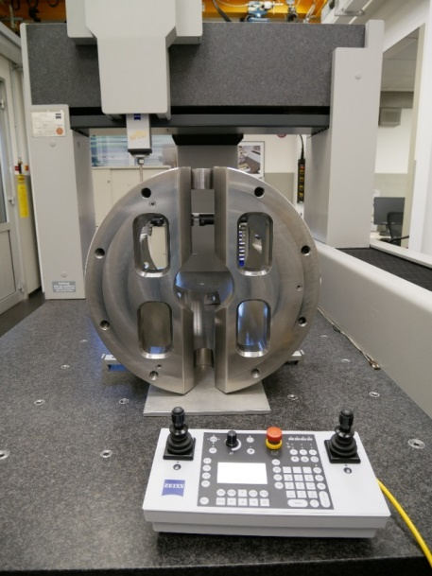
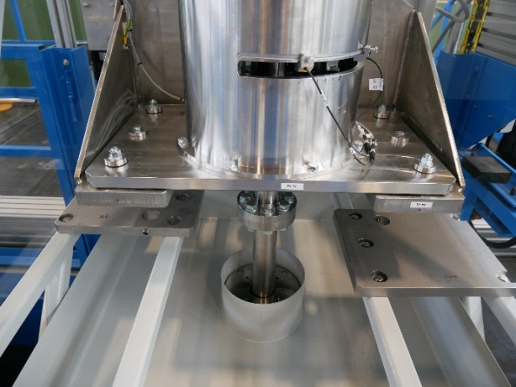
TIK3.1
Final assembly of Rotation Unit at ZEA-1
forge the of Twister shaft
3D dimension check of Crown
Test stand for Twister at ZEA-1
Delivery of 16t block
raw material
Twister
Detail view of rotation mechanism
Cold Moderator

Slide 7
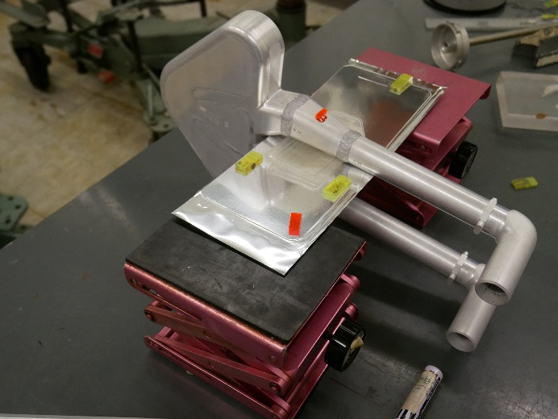
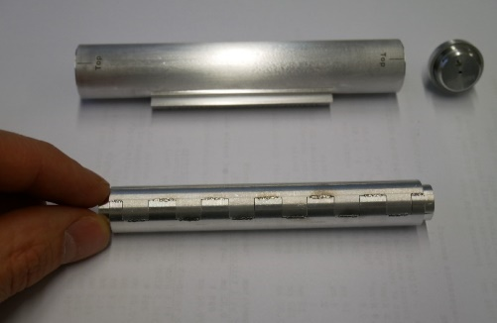
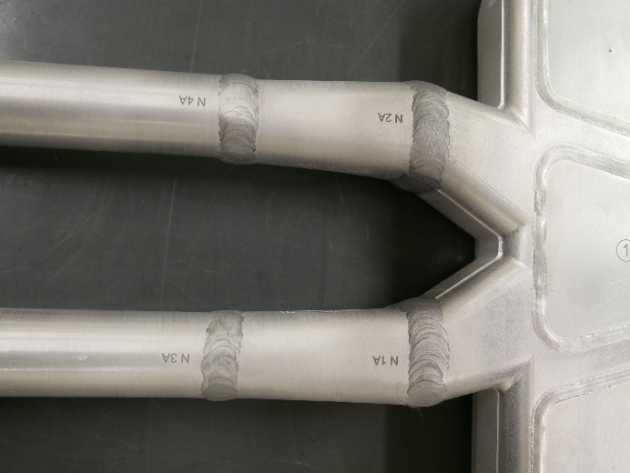
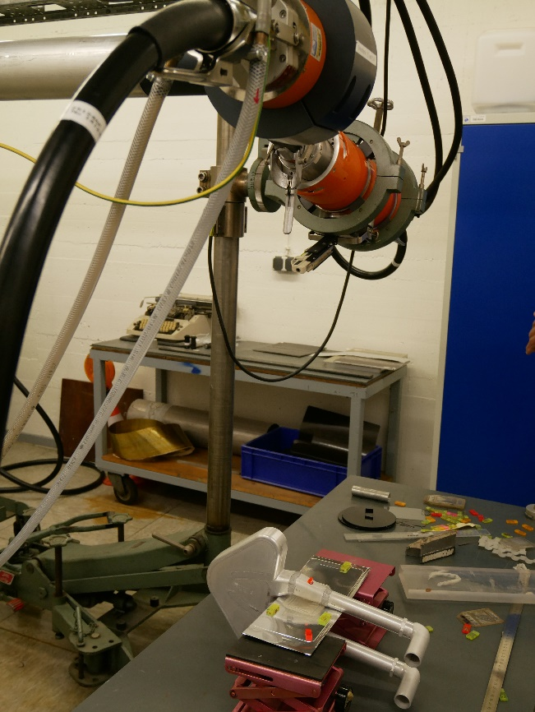
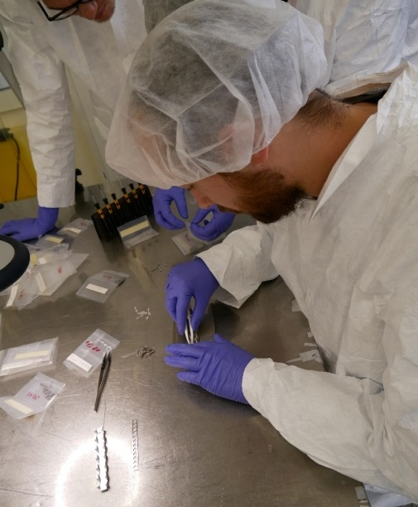
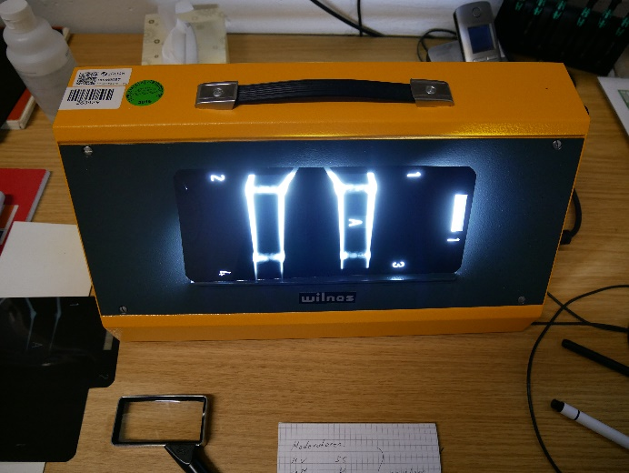
TIK3.1 TIK3.4
Cold Moderators Irradiation Module
non destructive testing (extra project in
Cooperation with Uni Roma / R. Senesi)
Visual inspection
He leak test 10⁻⁹ mbar*l/s
Dry penetration test
X-ray test
Over pressure test 24 bar
Preparation for X-Ray inspection
Assembly of Irradiation Module
Weld identification
x-ray machine
x-ray image

Slide 8
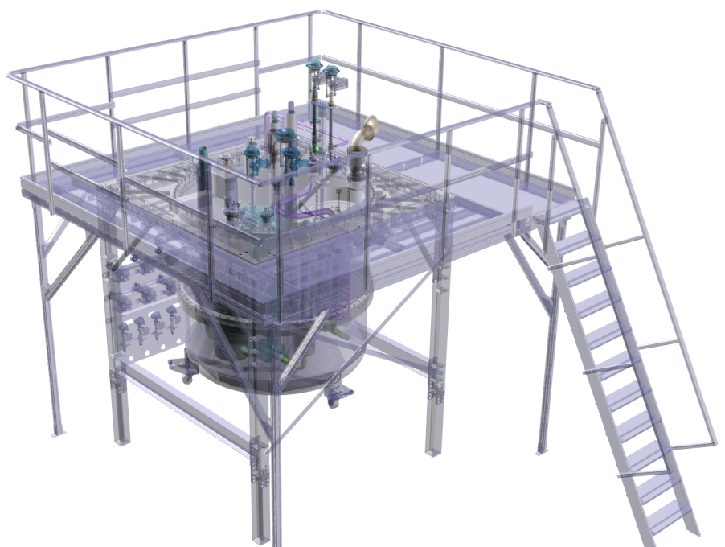
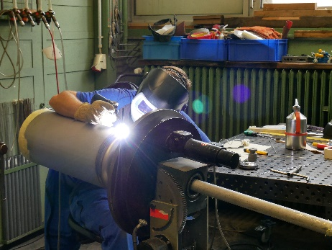
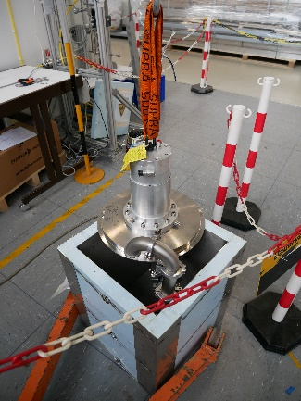
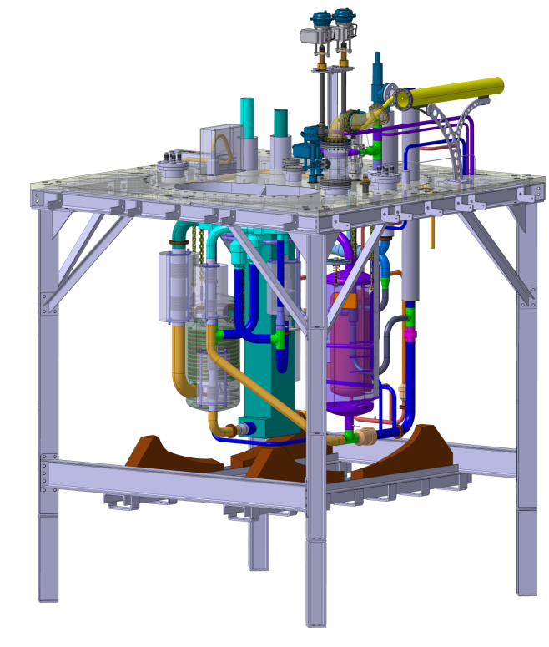
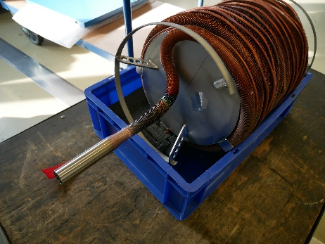
CMS TIK3.2
o-p-converter welding
LH2 pump test
HX 2 inner part

Slide 9
TMP TIK4.1
Kick off just started
Task of Target Monitoring Plug (TMP)
Measure the x/y position of the wheel
Measure the z position of the wheel
Measure the helium coolant outlet temperature from each cassette during operation
Measure shaft vibration during operation
Measure helium borne sound in the helium coolant for acoustic diagnostics of the target cooling system and for acoustic diagnostics
Measure the internal cooling system inlet and outlet temperature
Source: ESS

Slide 10
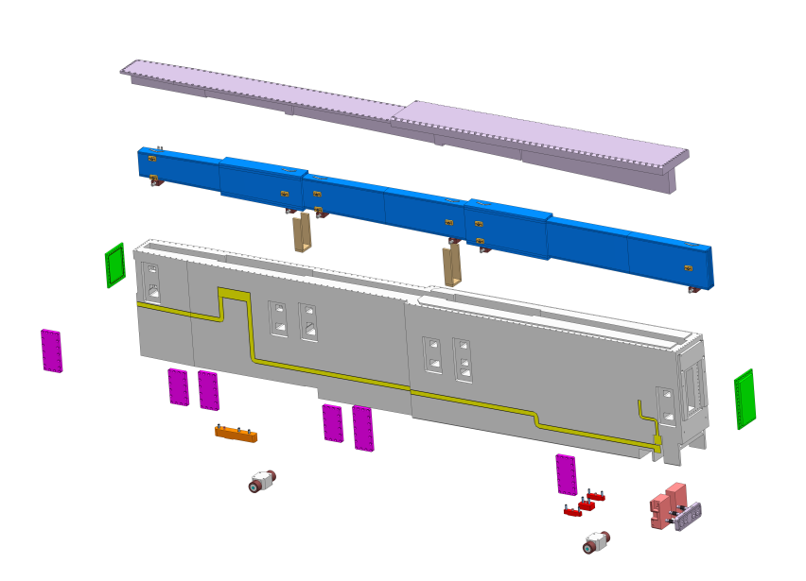
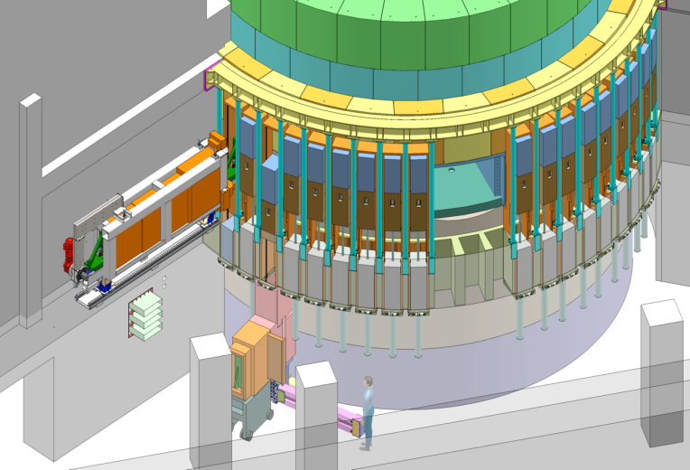
NBEX WBS 12.4.2.4
New project / under evaluation
Phase 1:
Test Stands
Prototype
Phase 2:
Neutron Beam Port Insert
Neutron Beam Port Plug
Neutron Beam Window
Light Shutter System
42 inserts / plugs are needed
Currently under evaluation if Juelich will be able to accept this project
Source: ESS
Source: ESS

Slide 11
Publication issues
Good scientific practice
We do have serious issues with the “culture” recognizing and respecting work performed by partners within the ESS collaboration.
Even if there is no formal “Collaboration Agreement” signed we should follow “Good scientific practice”.
Among others “Good scientific practice” includes:
Naming people/institutions that have provided input as authors/coauthors in publications
Add references/acknowledgment when using figures/photos from others
Correct quoting of text/ figures/photos provided by others
…

Slide 12
Publication issues
Good scientific practice
We talk a lot about “collaboration”, “partnership”, “collaborative effort”, …
But reality often looks different:
Some examples concerning our work:
Drawings (designs) provided by Jülich ended up on printed ESS drawings with “Property of ESS” written in the title block of the drawing frame and no text mentioning the origin of the drawing.
Paper published in „Physica Scripta“ with several pages of text as well as figures provided by Jülich without including the Jülich author nor mentioning Jülichs contribution at all.
ESS Posters (latest seen in Paris during the German /French industry day) using figures provided by Jülich without including the Jülich author nor mentioning Jülichs contribution at all.
….

Slide 13
Publication issues
Good scientific practice
A publication policy will set the details about
Do have partners that were not directly involved into a work package have to be informed prior to publishing work results?
How much time in in advanced a partner has to be informed about a publication?
How do we tread posters and talks?
Does partners have a veto / can prevent publishing something?
….
But before talking about a publication policy we have to discuss:
How can we develop and live a collaborative working spirit within the ESS collaboration?

