Slide 1
In-Kind Status
Håkan Danared
www.europeanspallationsource.se
3 Oct 2018

Slide 2
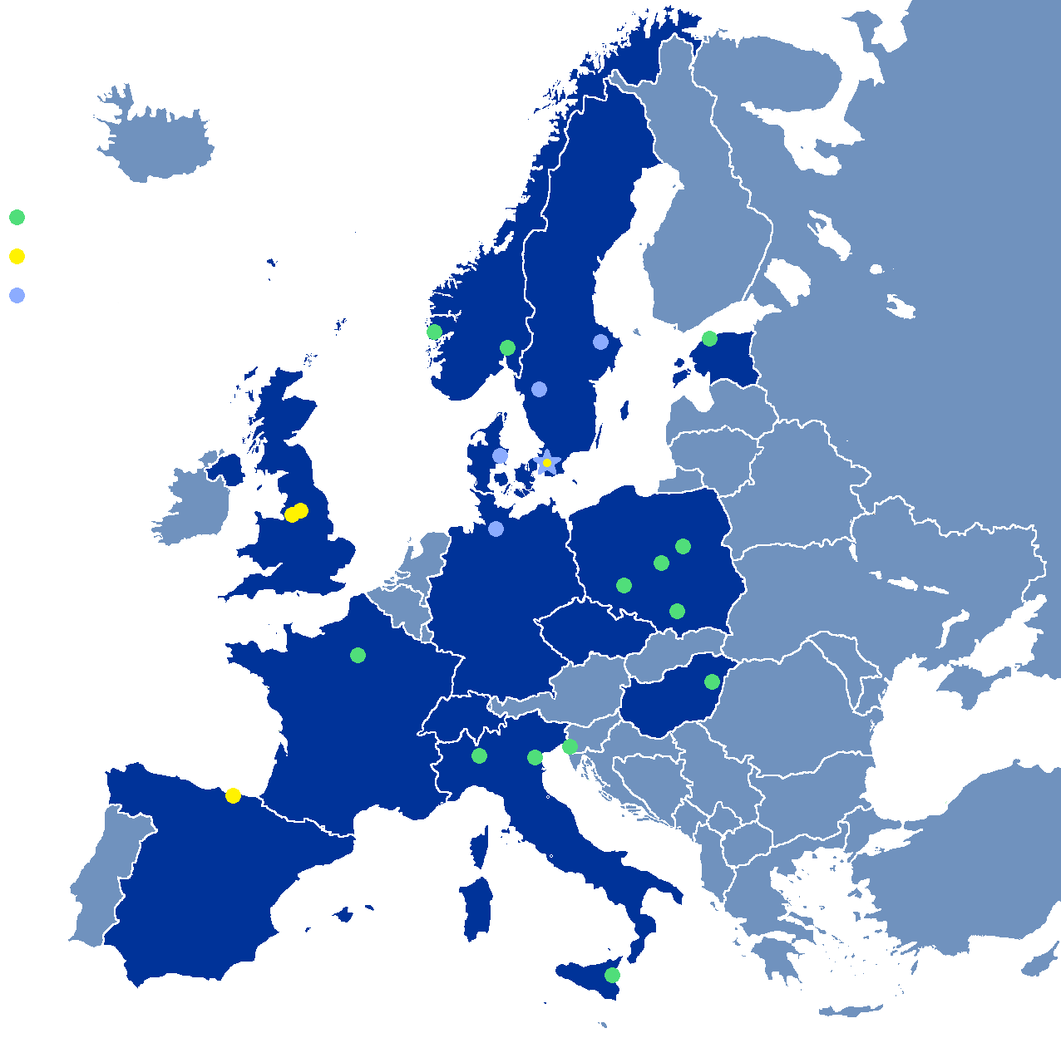
Partner Institutions
In-kind (main contributions)
ATOMKI (RF-LPS)
CEA (RFQ, SRF, Diagn)
CNRS (SRF, Cryo)
Cockcroft Inst (Diagn)
Daresbury Lab (SRF, Vacuum)
Elettra (RF, Magn, PS, Diagn)
ESS-Bilbao (MEBT, RF)
Huddersfield Univ (RF distrib)
IFJ PAN (Installations)
INFN Catania (Source, LEBT)
INFN Legnaro (DTL)
INFN Milan (SRF)
Lodz UT (LLRF)
NCBJ (LLRF, gamma blockers)
Tallinn UT (RF)
Univ Bergen (Seconded staff)
Univ Oslo (Diagn)
Warsaw UT (LLRF)
Wroclaw UT (Cryo)
IK signed
IK endorsed
Collaboration
agreement signed
Collaboration agreements
Aarhus Univ (Beam delivery, diagn)
DESY (Diagn)
Lund Univ (LLRF, RF)
Uppsala Univ (Tests)
University West (Diagn)

Slide 3
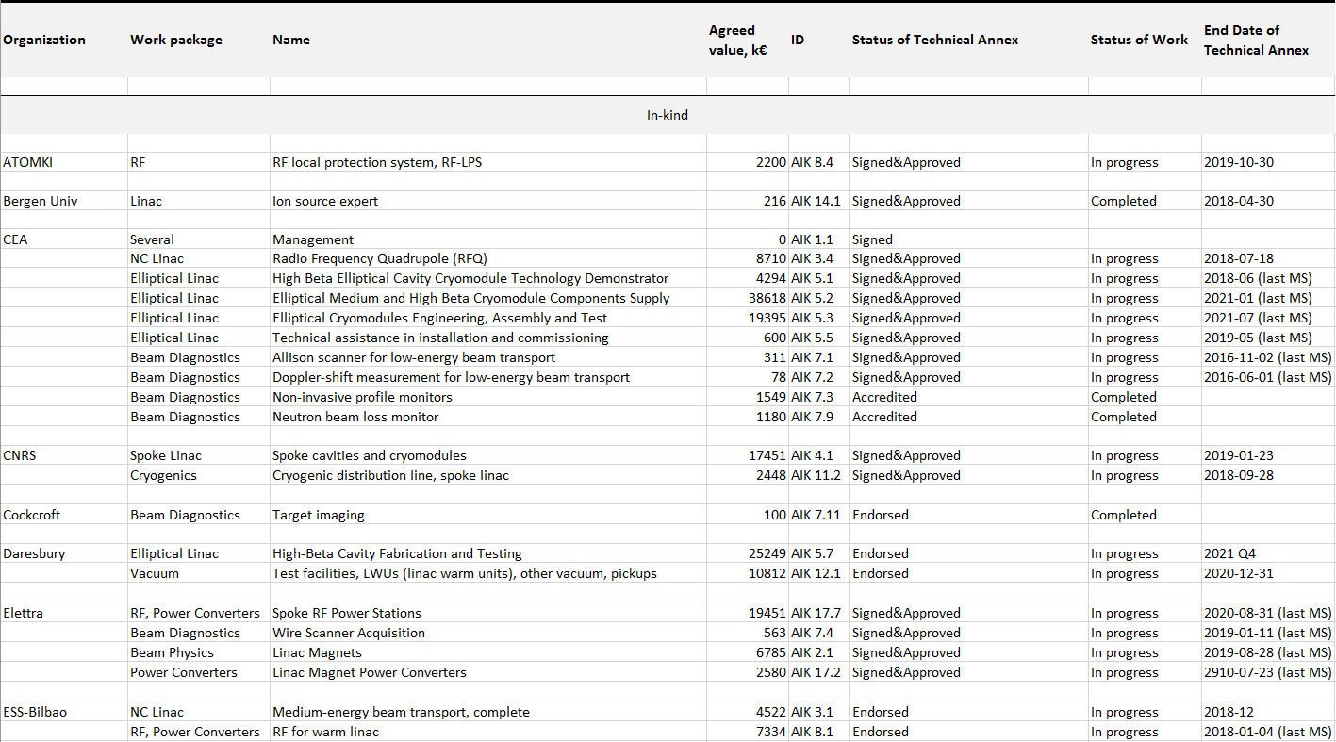
Signed In-Kind Contributions

Slide 4
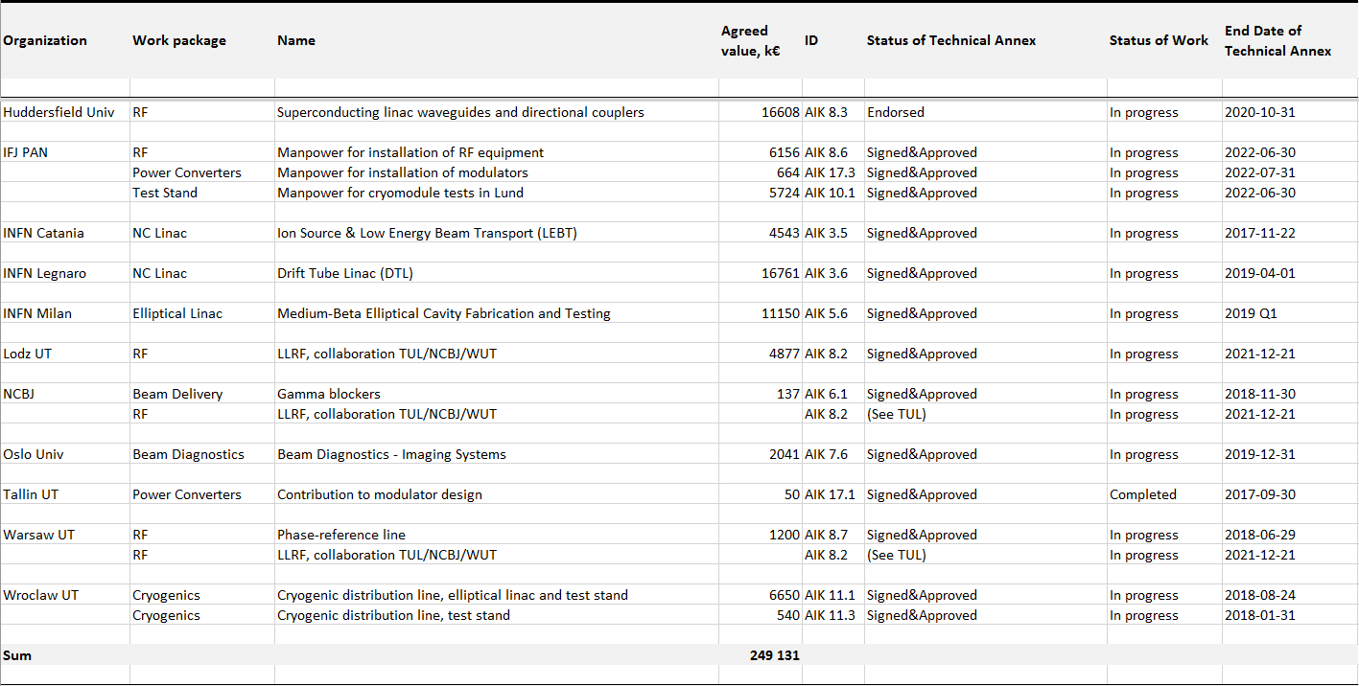
Signed In-Kind Contributions

Slide 5
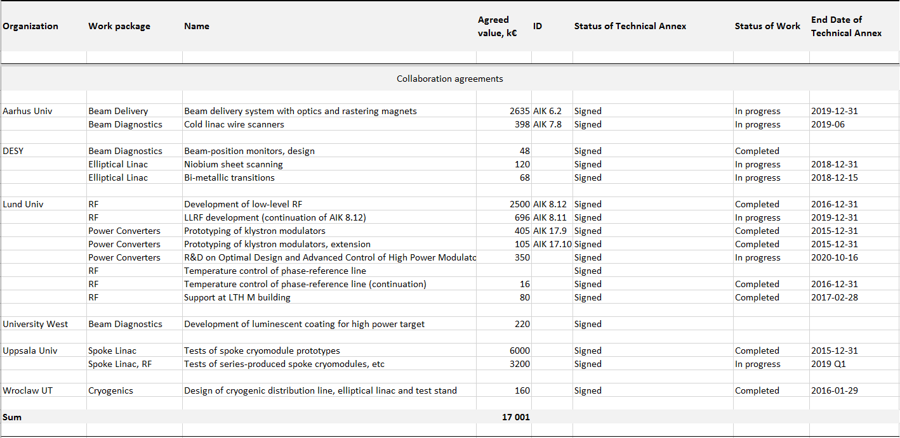
Signed Collaboration Agreements

Slide 6
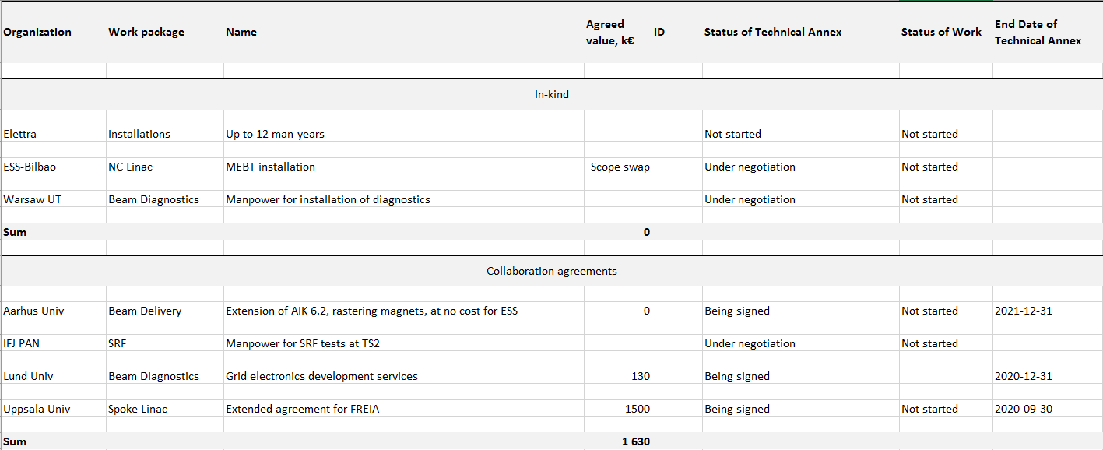
Planned In-Kind and Collaboration Agreements

