Slide 1
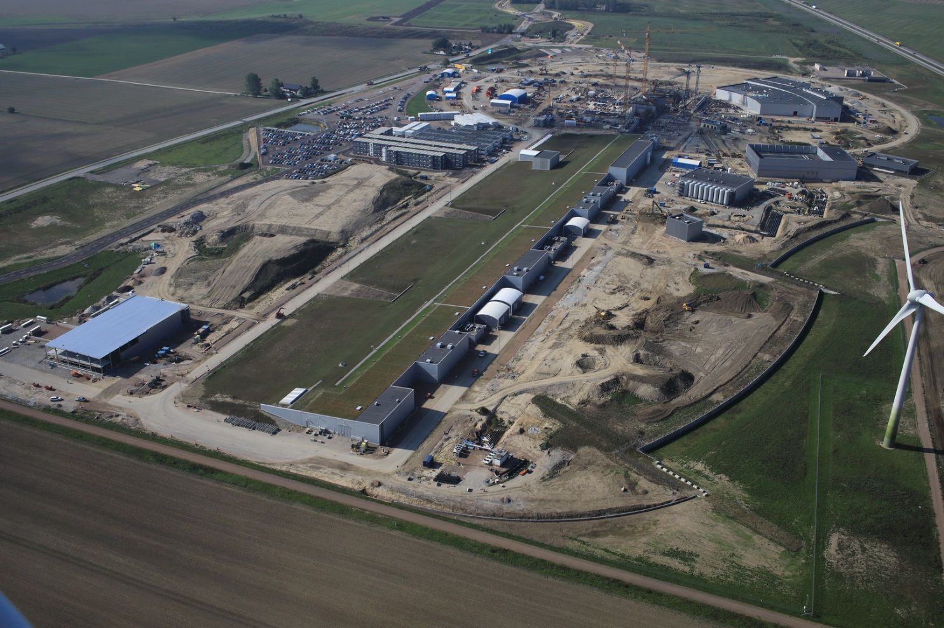

  ESS Project Status
  Roland Garoby – Technical Director
  October 2018

Slide 2
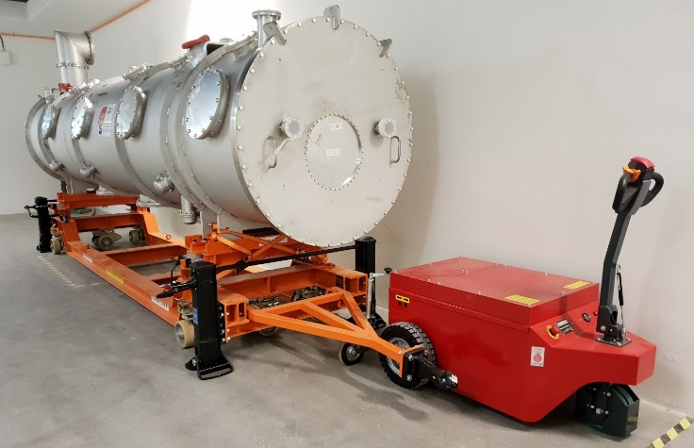
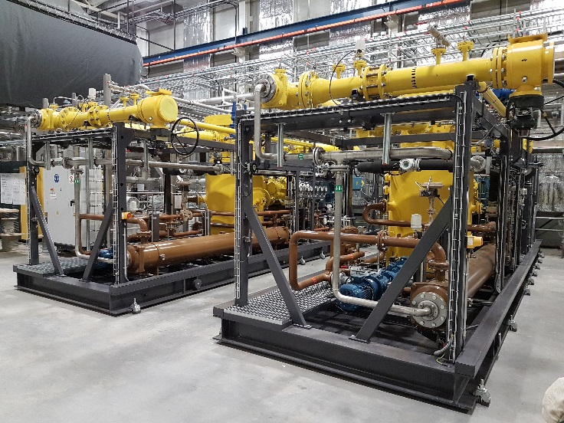
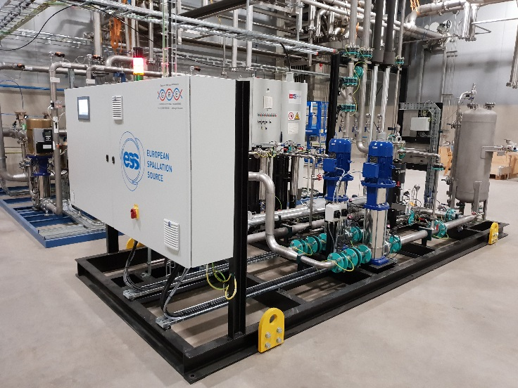
ESS is close to 50% complete
2018 is the peak of construction activity
First buildings have been handed over
In-kind deliveries of high tech equipment arriving
All staff moved out to site in June this year
Ion source skid
Prototype cryomodule
and its transport
vehicle
TMCP compressors

Slide 3
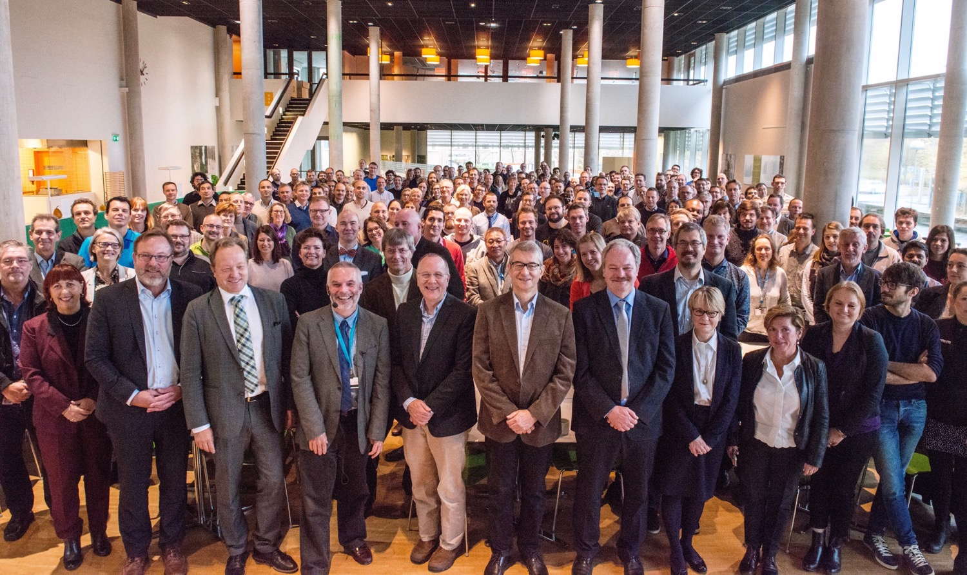


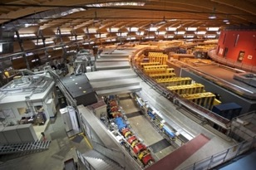
Organisation and People
>480
Employees
50
Nationalities
~ 100
Collaborating Institutions
Notes:
Updated September 2017

Slide 4
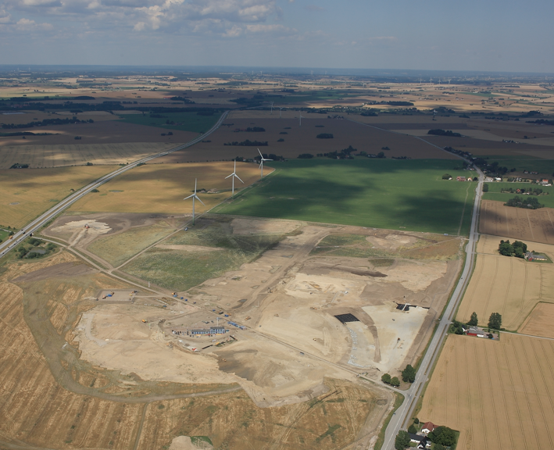
Civil Construction Groundbreaking
September 2014

Slide 5
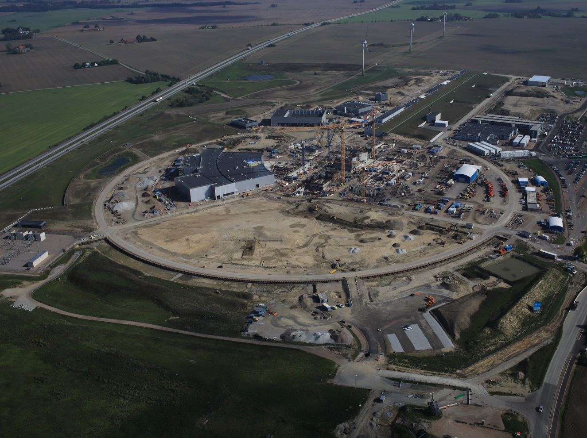
September 2018

Slide 6
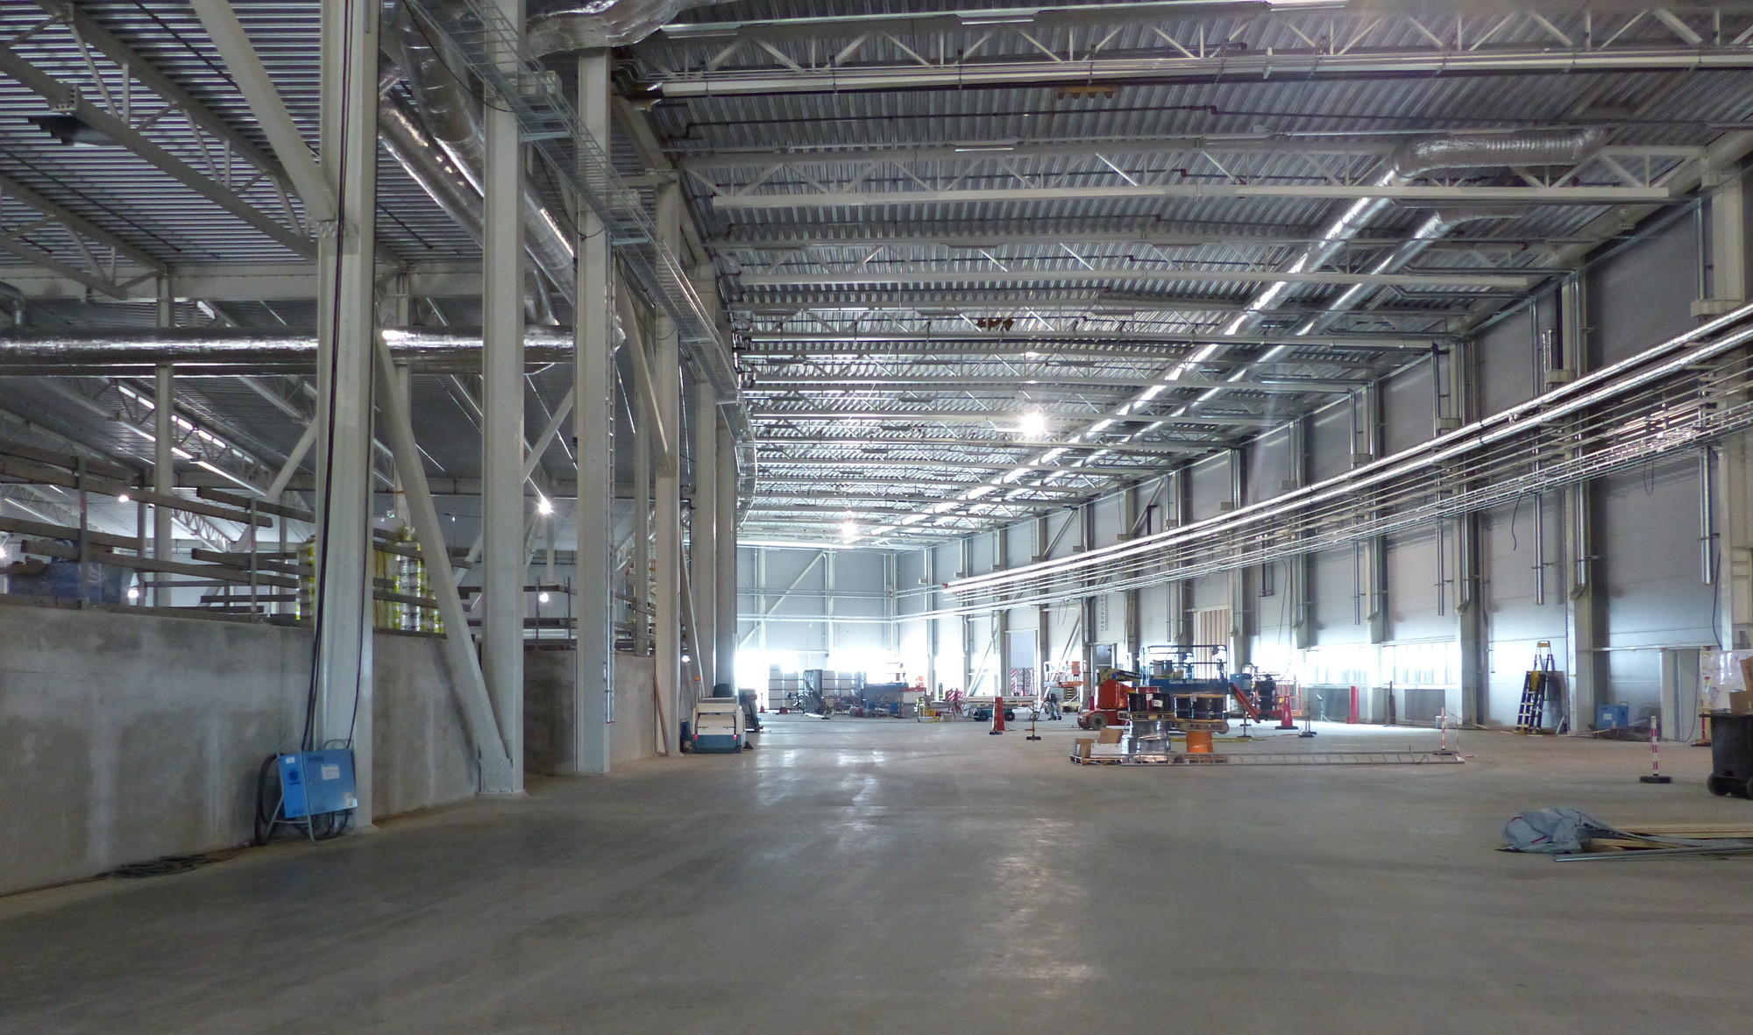
Experimental Hall (E01)

Slide 7
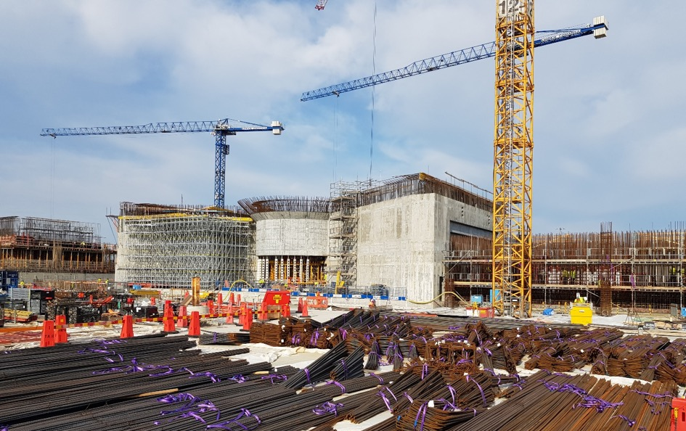
Target building (D02)

Slide 8

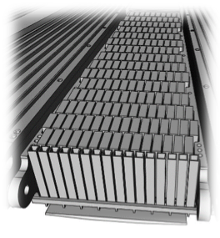



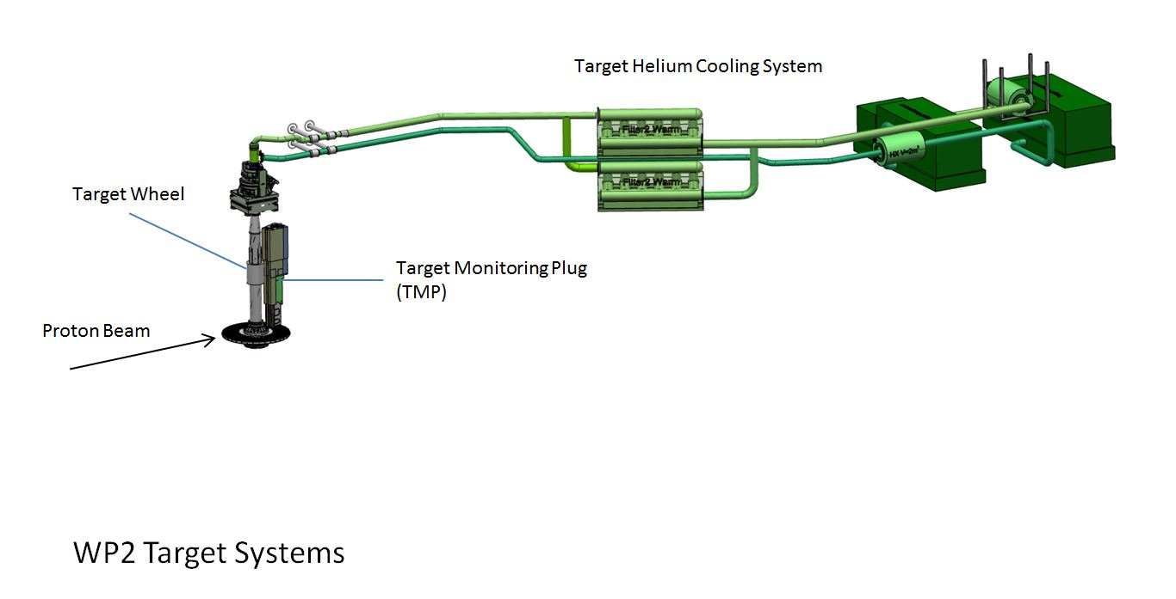
Technical Progress:
WP2 Target Systems 1(2)
Target wheel and drive unit
Manufacturing of cassettes and spallation material in progress
CDR Target Drive Unit held 24 April.
Manufacturing of the target wheel prototype close to be finalized.
Lessons learned to be used for the final Target Wheel
CDR for Target Wheel and Shaft postponed to Sept 2018. However, early procurement of material in progress
Complete Target Wheel Drive & Shaft delivery on site November 2019
Target Helium Cooling System
Manufacturing of the Helium Circulators in progress
CDR Target Helium Cooling System performed. Piping in the Connection Cell needs to be redesigned and remote handling of the helium filters elaborated
Target monitoring
PDR for the Target Monitoring Plug performed.
Contract signed with FZJ to
perform the final design
and manufacturing
Tungsten Bricks in Cassette

Slide 9
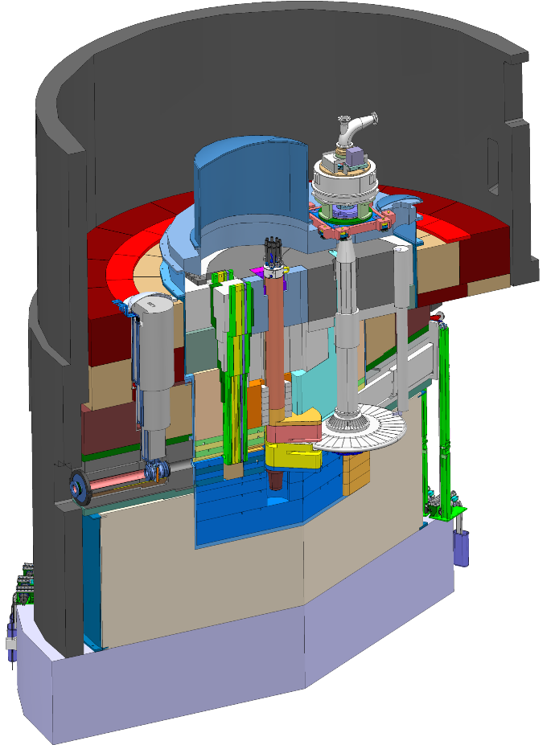
Technical Progress:
WP2 Target Systems 2(2)
Monolith Shielding
  Manufacturing of the Ground Shielding in progress, signed contract May 2018
  Procurement of the Outer Shielding in progress
  CDR for the Inner Shielding performed
  Budget underestimated
Tuning Beam Dump
  CDR for the Tuning Beam Dump Shielding performed
  CDR for the Tuning Beam Dump System performed
  Procurements published, award expected October
Outer Shielding
Inner Shielding
Ground Shielding
Tuning Beam Dump

Slide 10
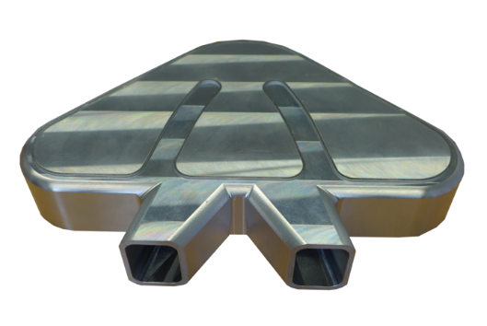
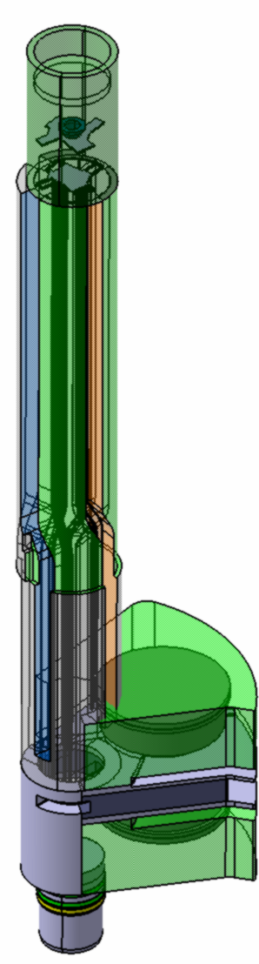

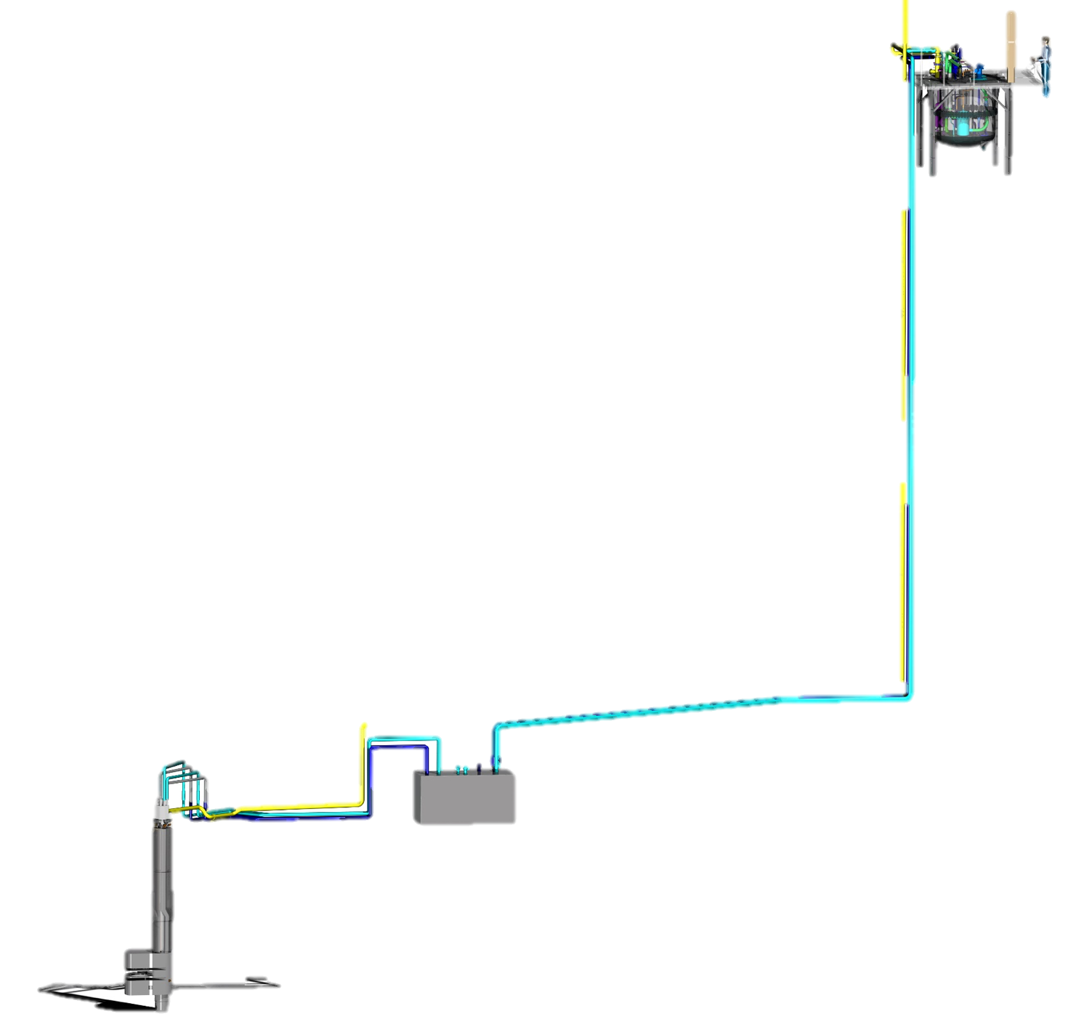

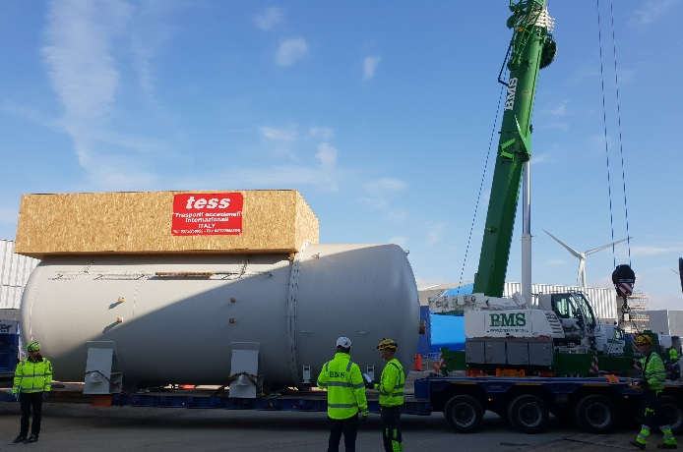
Technical Progress
WP3 Moderator and Reflector Systems,
Moderator & Reflector Plug
  Cold Moderators finished manufactured
  Reflector, Thermal Moderator et al in manufacturing
Cryogenic Hydrogen System
  Manufacturing ongoing
  LH2 pumps delivered
Helium Cryoplant
  Delivery of Compressor Skids 18Q2 and coldbox 18Q3
Irradiation module
  Manufacturing completed
Cryogenic moderator prototype
MR Plug
Part of Reflector Vessel
Helium Coldbox delivery

Slide 11
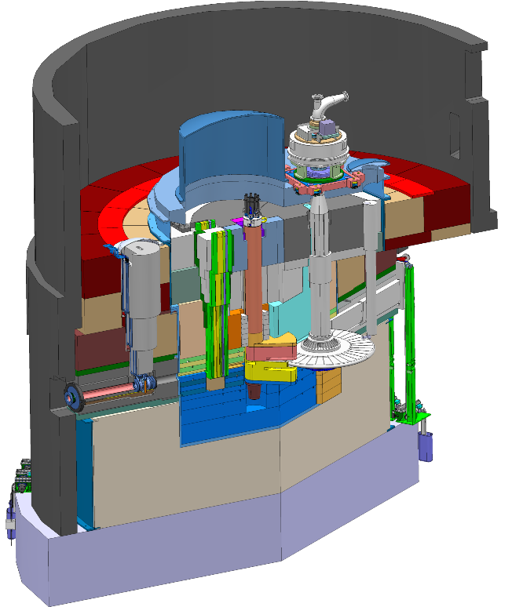
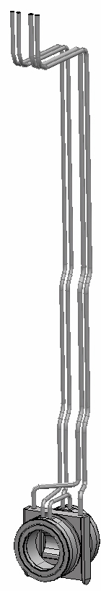
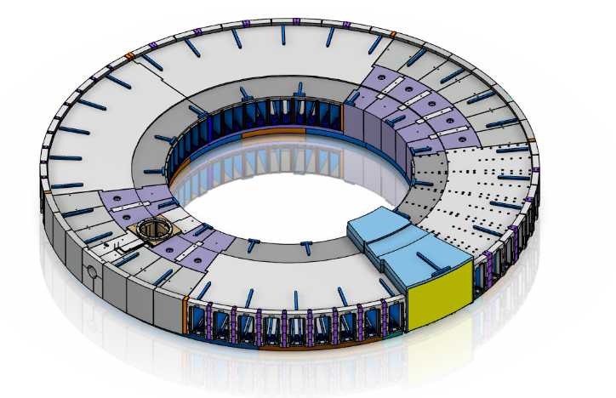
Technical Progress
WP4 Monolith systems
proton beam instrumentation plug
Monolith vessel
  Design finalized for lower parts and contract awarded to AVS/Cadinox for fabrication
  Final design on-going for connection ring and covers
Proton beam window
  Final design on-going
  Tests on PBW and inflatable seals are on-going.
Proton beam instrumentation plug
  Specifications of instrumentation equipment in progress by ACCSYS and their Norwegian in-kind partner
Monolith port block package
  Preliminary design finalized February 2018
  Procurement in progress
  Contract awarded for the monolith base plate
Monolith Atmosphere System
  Decision taken for pursuing rough vacuum (< 100Pa) with PBW in place as primary operation mode.
  Preliminary design performed by Target and then hand-over to ACCSYS for final design
monolith vessel
proton
beam window
Proton Beam Window
Monolith port block package

Slide 12
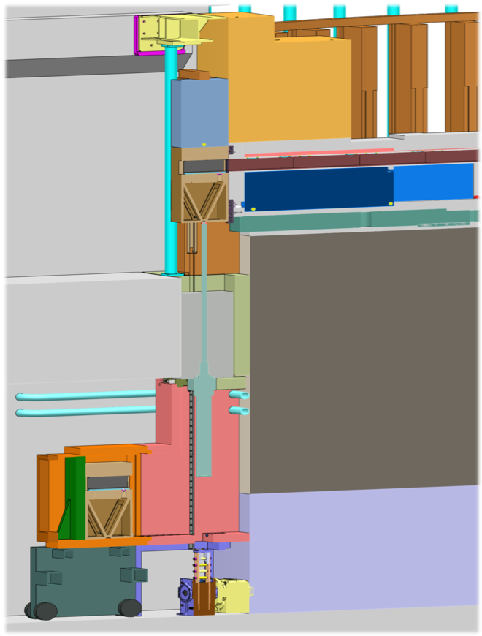
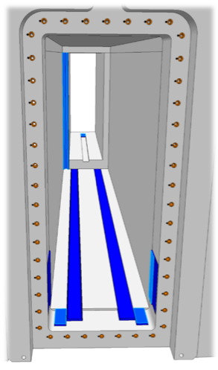
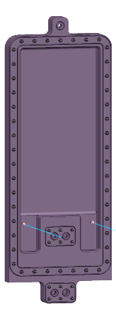
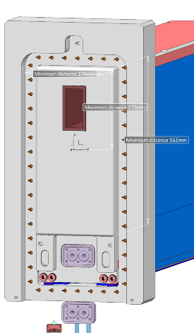
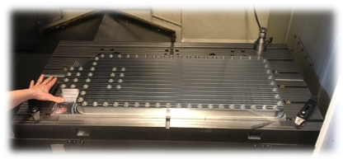
Technical Progress
WP4 Monolith Systems
Neutron beam extraction system
  Detailed design on-going
  Discussions on-going with FZJ to take on parts of the scope
  Material ordered for manufacturing one prototype insert
  System split into several Critical Design Reviews due to complexity. Prototypes ongoing for plugs and planned for Light Shutter System.
Neutron Beam Windows
  Excellent results on vacuum seal tests on prototypes.
GBS
NBW
BBG
NBPI
Instrument position
Target level floor
Handling tooling
12

Slide 13
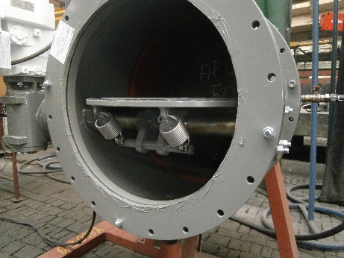
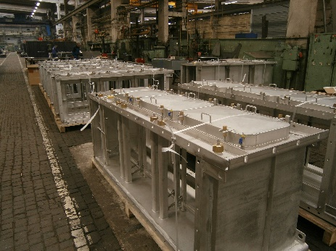

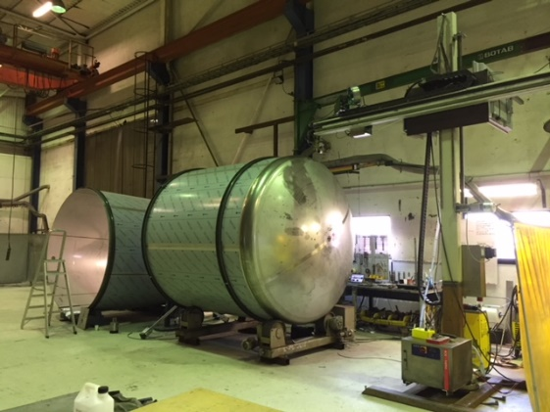
Technical Progress
WP5 Fluid Systems
Primary and intermediate water cooling systems
  Safety classification not ready for primary water cooling systems
    Procurement delayed
  Procurement started for intermediate water cooling systems
Target Station HVAC system
  Detailed design finalized – procurement ongoing
Offgas/monolith vessel relief
  Preliminary design ongoing
Electrical Infrastructure & automation cabinets
  Preliminary design ongoing
All other utility and process systems
  Completion of detailed designs are imminent
  Drain tanks procured and in fabrication
Other
  Procurement preparation of HVAC & Piping installation ongoing
  Turn-key procurement ongoing for Helium purification & Radiolysis Gas Handling systems

Slide 14
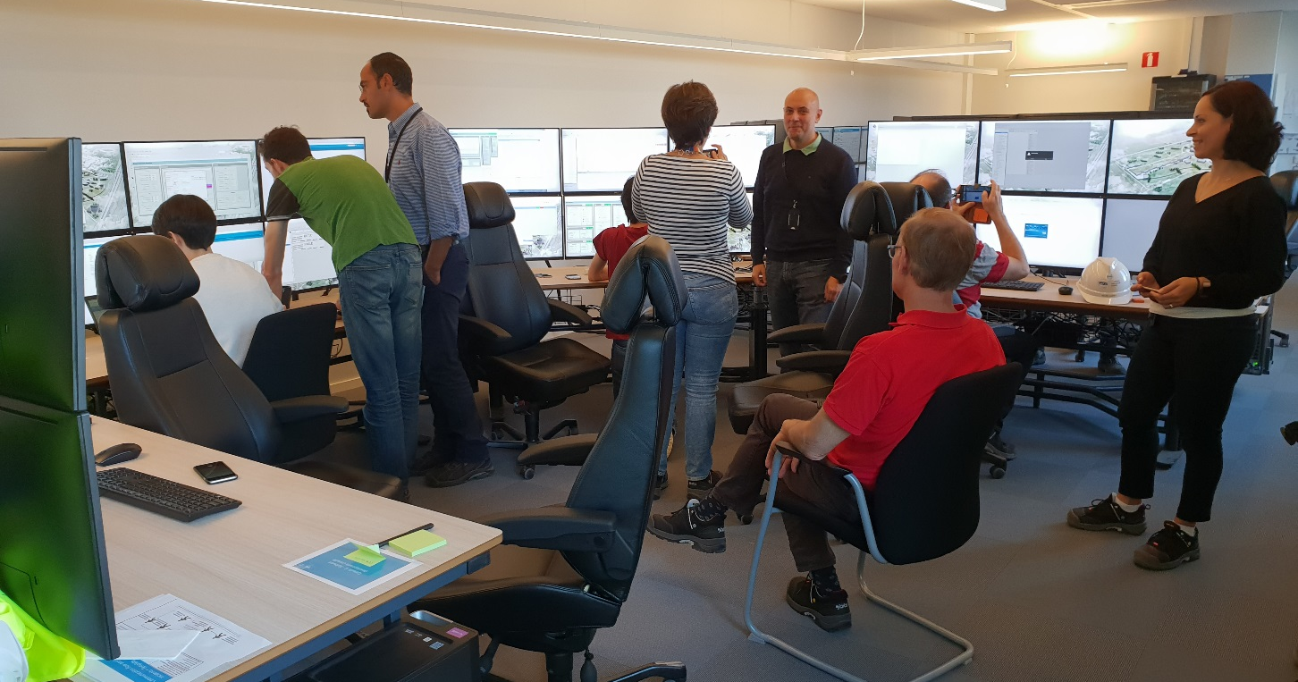
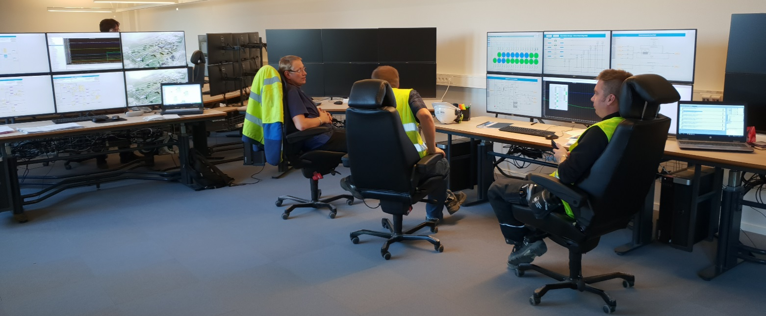
The temporary control room is operational
For commissioning
the ion source…
…and for commissioning
the cryoplants.

Slide 15
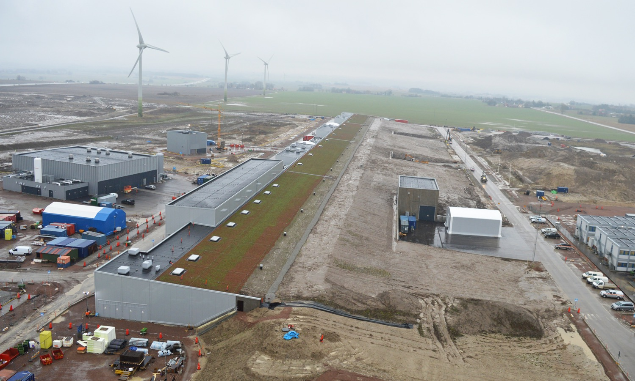
Accelerator & Klystron Gallery (G02)

Slide 16
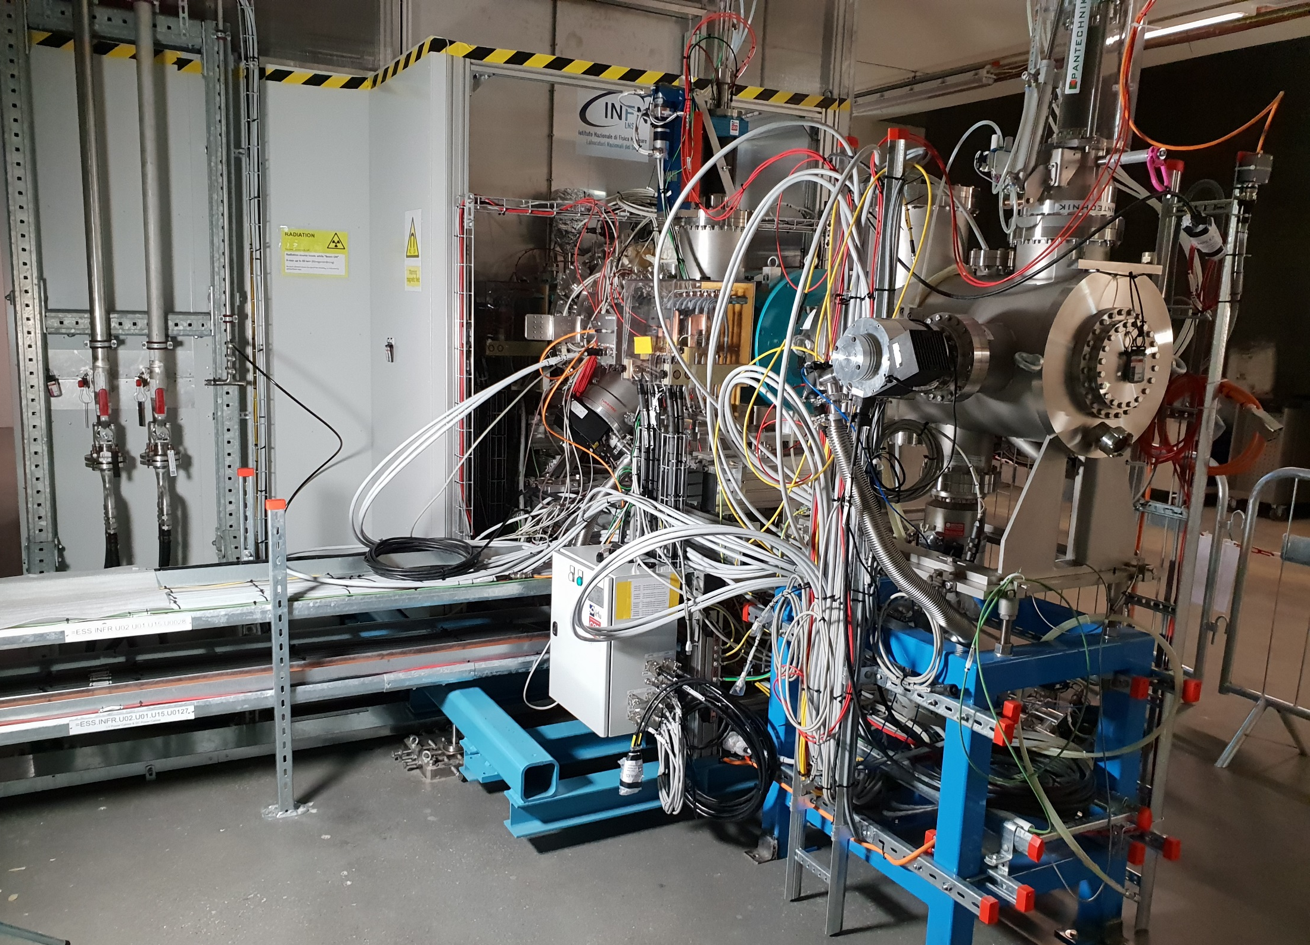
Ion source & LEBT are under commissioning

Slide 17
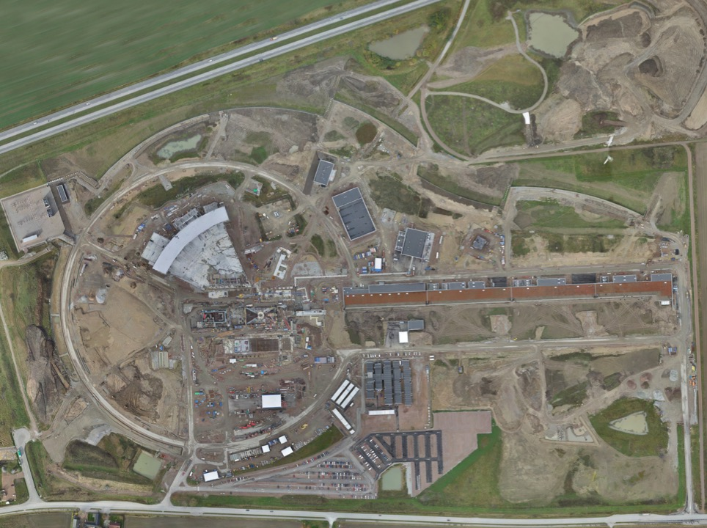
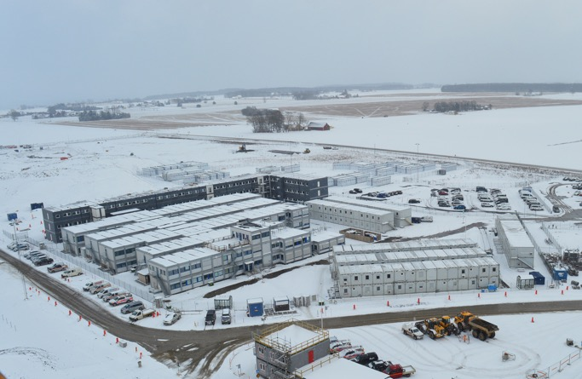
Permanent
Office Campus
2021
New 2018 ESS offices for all staff
New Bus Stop
Lund Tramway Depot

Slide 18
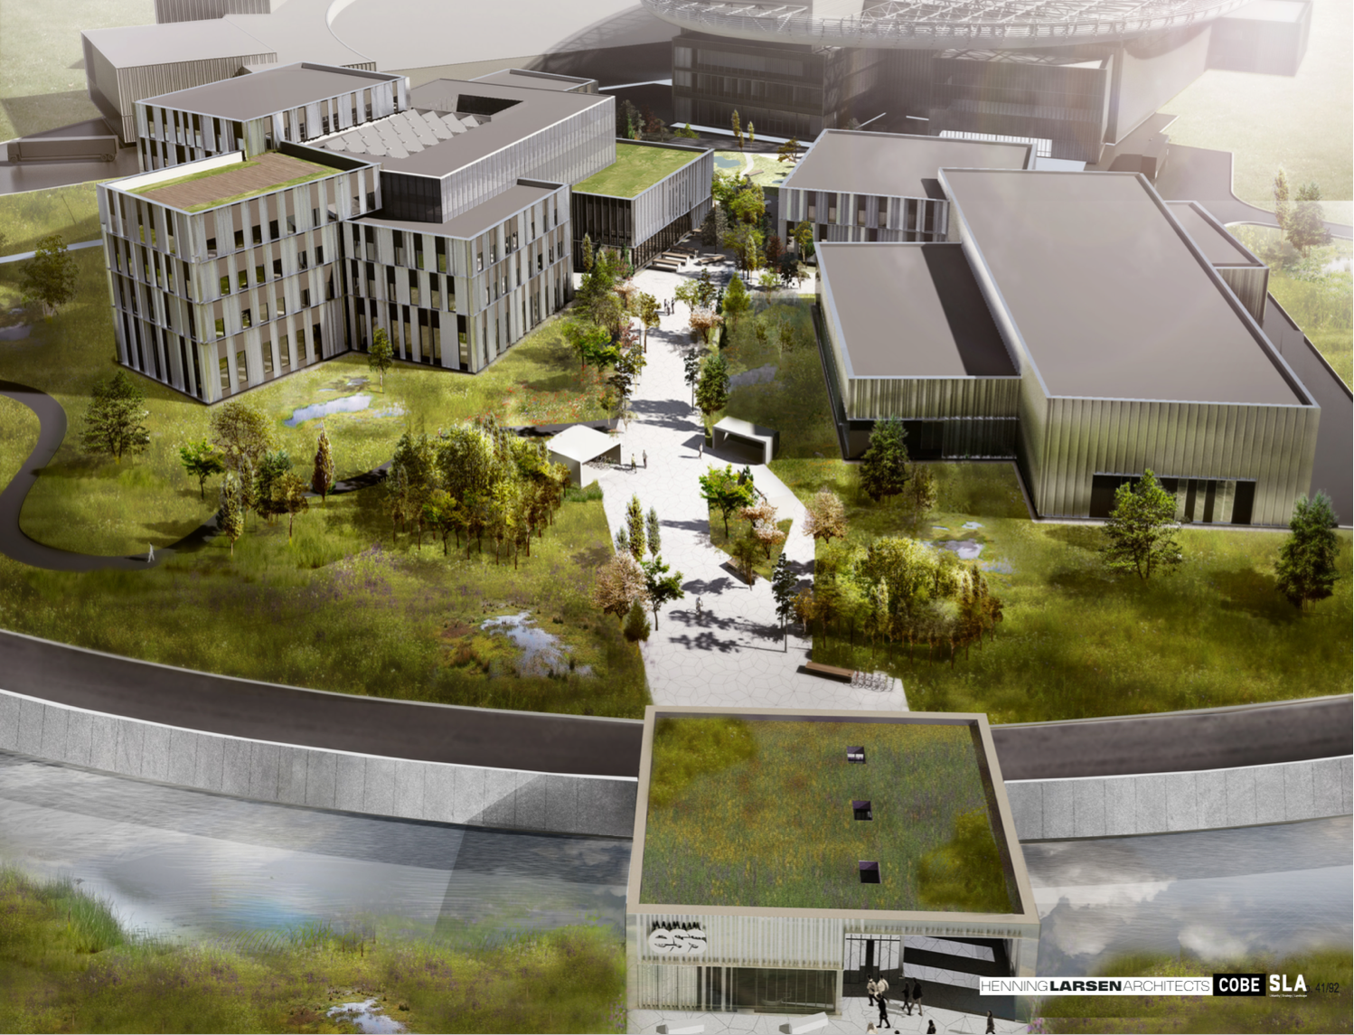
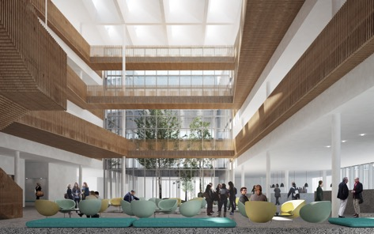
Campus
Offices, auditorium canteen
Labs and Workshops
Signed construction and financing agreements in February
Now in detailed design before target cost is agreed
Cost of the lease is included in the operations costs
Entrance Building

Slide 19
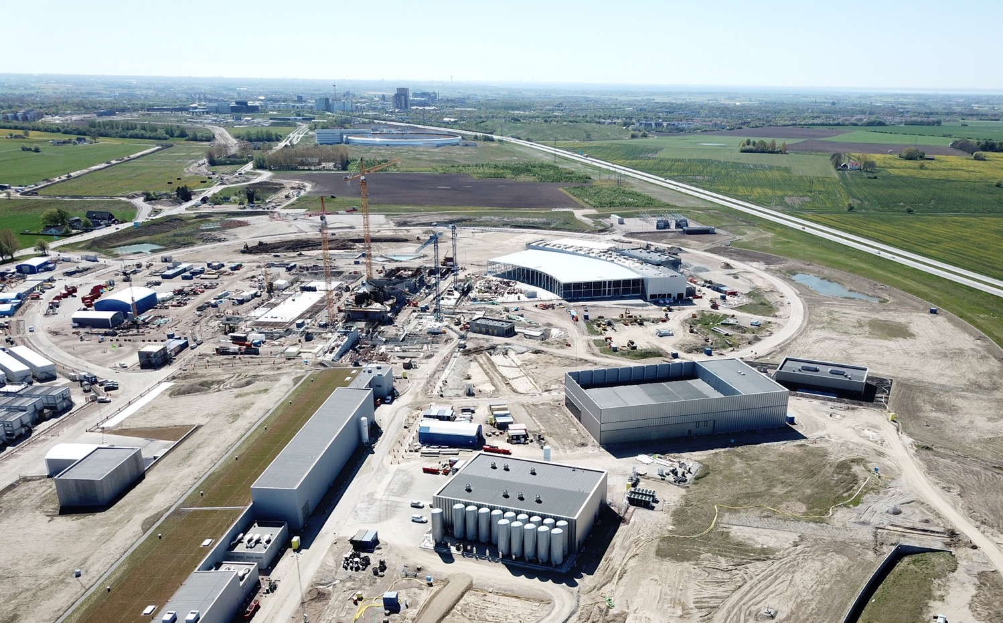


Slide 20
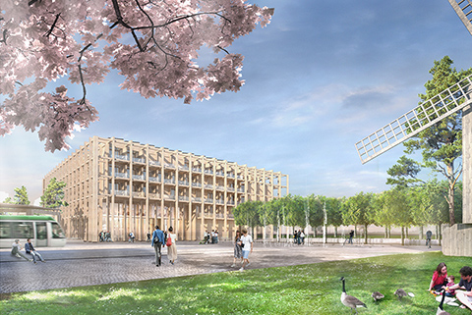
SPACE Building: Reception, exhibition space,
guest house for MAX IV and ESS (~100 rooms),
office and meeting space, restaurant
Modelled on the Harwell Campus
Swedish Government approval
August 2018
Tramway from Lund C station

Slide 21
Rebaselined ESS schedule (as approved by ESS Council in June 2018)
2018
2019
2020
2021
2022
2023
2024
2025
BOT
SOUP
Warm LINAC Commissioning Steps
EOC
1.3 GeV Capability Installed
Accelerator + ICS
Hi-Beta Install
Beam on Dump
(570 MeV)
Accelerator RBOT
Accelerator Schedule Float to BOT
CF + Target + NSS (Bunker+TBL) + ICS
Bunker and Test Beam Line RBOT
Access for Monolith Installation
Target RBOT
15th Instrument Complete (Ready for hot commissioning)
NSS Instruments + ICS
Instrument Hall Access for Start of Installation
Start beam commissioning for 1st Instruments
SOUP

Slide 22
New schedule of Accelerator
ISrc to RFQ/MEBT/DTL1
ISrc to Beam Dump (BOD)
4 Nov '19
8 Feb '21
ISrc to LEBT
ISrc to DTL4
RBOT
25 Jun '18
27 Apr '20
24 May '21
New Baseline
2019
2020
2021
18.8 months
Beam to RFQ/MEBT Delay
21.8 months
Beam to DTL4 Delay
21.2 months
BOD Delay
23.9 months
RBOT Delay
Old Baseline
2019
2020
2021
5 Jul '18
28 May '19
ISrc to DTL4
RBOT
11 Apr '18
30 Apr '19
ISrc to RFQ/MEBT
ISrc to Beam Dump (BOD)

Slide 23
New schedule of Target and Instruments
2018
2019
2020
2021
2022
Monolith Area Superstructure
Monolith and A2T Concrete
High Bay Infrastructure Installation
BOT
Target Building (D02) Access for Monolith Installation
Testing and Readiness Review
Monolith Installation & Testing
Ready for parallel bunker and monolith works
Target Wheel & MR Installed
Target RBOT
CF D01/D03 Build-out to weather tight
3 months float
Parallel Works
Target Integrated Bunker Scope
Final testing and Readiness Review
Bunker Construction and Installation
Monolith inserts & shutters installed
NSS RBOT

Slide 24

Funding decisions in 2018
AFC.07
Budget Plan 19/20 (R)
Indicative Plan 21-25 (I)
Construction Budget 2019 (I)
Political decision-making
Minister level
Schedule Review
8 Feb
10-11 Apr
Focus on re-baselining
Will mostly impact indicative plan 21-25
Council.12
Workshop
Budget plan 19/20 (I)
Indicative plan 21-25 (I)
High-Level Document (D)
Sharing Policy (D)
22-24 May
Council.14
Constr. budget 2019 (A)
Init ops budget 2019 (A)
Indicative plan 2021-2025 (A)
Commitments from Members for 2021-2025
Commitments from Members to completion of construction
Council.13
4-5 June
Budget Plan 19/20 (A)
Indicative Plan 21-25 (I)
Commitments from Members for 2019/20
initial ops funding
AFC.08
Constr. budget 2019 (R)
Init ops budget 2019 (R)
Indicative planning 2021-2025 (R)
Annual Review
Sep
Project review
30-31 Oct
3-4 Dec

Slide 25


