Slide 1
Acc Collaboration board Trieste
181003
Peo Gustavsson

Slide 2
Outline
Infra structure Project
Harmonized ways of working at ESS
  Important roles
  The Installation Readiness Review (IRR)
  The Installation Binder ”Practical Use”
  The WSCP vs RAMS Practical Use
  ESS Work Orders ”Mandatory for all installation work”
CDB and stubs installation road map

Slide 3
Infra structure Project

Slide 4
Take home message
The strategy for infrastructure installation is;
  Use Skanskas org for installation of Mech. Infra structure (Cables comes next)
  Detail design trough ext contractor - for Peiping and raceways, started
  Project Baseline design-hand over to Detail design NCF/ SPOKE, completed
  The work is done in a phased approach to support AD component installation
  The installation will be done in bigger packages, eg. NCF/ SPOKE
Current status;
  Hand over of Data and document inc. 3D DB for Detail design
  Time schedule for Detail design and installation under development
  Workshop to plan and agree target schedule;
    DD design
    Installation
  STUB pipe material and Tooling order placed-Inst start week 40/41
  Next steeps
    Cabling pulling & termination design RFQ/MEBT/DTL
    Baseline M-beta and H-beta Peiping and raceways

Slide 5
FEB (Front End Building) phase 1 and 2
Phase 1
  Cabinets and cooling pipes
Phase 2
  Remaining pipe work
  Installation Cooling skids
  Cables and connectors
  PDUs (power distribution units)
Pipe-work went according to plan
challenges
  Availability of specified cables, Changes to cables and connectors
  Design not fully finalized, reviews of documents not formalized, late changes to design
  Late delivery of PDUs
The inspection documentation handed of 1 week before the SRR (Safety Readiness Review)

Slide 6
”FEB and Tunnel” installations completed today
Process
  All pipes installed
    2000 m
    473 welds
    47 valves
  2 Cooling skid under construction (RFQ & Ion Source)
    To be installed
  Instrument air in the tunnel installed and tested
  28/28 pressure tests completed
Electrical
  3000 m cable trays
  5000 m cables pulled
  300 cables (42 types)
  600 cable terminations/ connectors

Slide 7
Infrastructure project fact and figures ”look ahead”
Process
  10 496 meters of pipes
  App. 6000 welds
  App. 5000 valves
  App. 300 large supports
  App. 1000 small supports
Electrical
  > 10000 m cable trays
  > 900 000 metre cable
  24 902 cable in the DB
  49 804 cable term ends
  > 200 JB
  204 cable types
  40 power distribution busbars
  6 UPS-units with associated sub-distribution
  800 control racks and 100-120 cooling units to be installed
  120 grounding busbars, 3000m of grounding cables

Slide 8
Project planning set up what to do 2019
“installation strategy”
Design for G02;
  Cable trays and pipes
  Cable routing and termination
  All grounding design (not components)
  Power distribution
Install all cable trays and pipes in G02
Cable pulling and termination NCL and SPOK
  RFQ/MEBT/DTL
  SPOK

Slide 9
Implementation strategy (principle schedule layout)
SRR 1 - 5
STUBS inst x 27
(Start 1 Sept)
100 m |  |  |  |  | 500 m
Ion Source | LEBT | RFQ | MEBT | DTL 1 2 3 4 5 | 9 modules | 10 modules | 11 modules (21)
NCF |  |  |  |  | SPOKE | MB | HB
Comp inst. 4 DEC - 18 RFQ
12 DEC - 18 Cryo line
15 April - 19 MEBT
1 June-19 to 1 June- 20 DTL 1-5
BL design - DD - MEC INST
(Start Oct/Nov)
Tray
Pipe
Outline coming work
Cable Pull 1 | Cable Pull 2 | Cable Pull 3 | CABLE PULL
Termi 1 (app 500) | Termi 2 (app 500) | Termi 3 (app 1500) | Termi

Slide 10
Harmonized ways of working at ESS

Slide 11
Introduction
ESS is implementing harmonized ”ways of working”
  Installation Readiness Review (IRR)
  Installation binder (IB)
  The work order process (WO)
Services and support
  Information can be found at ESS Installation web page
https://confluence.esss.lu.se/category/essinst

Slide 12
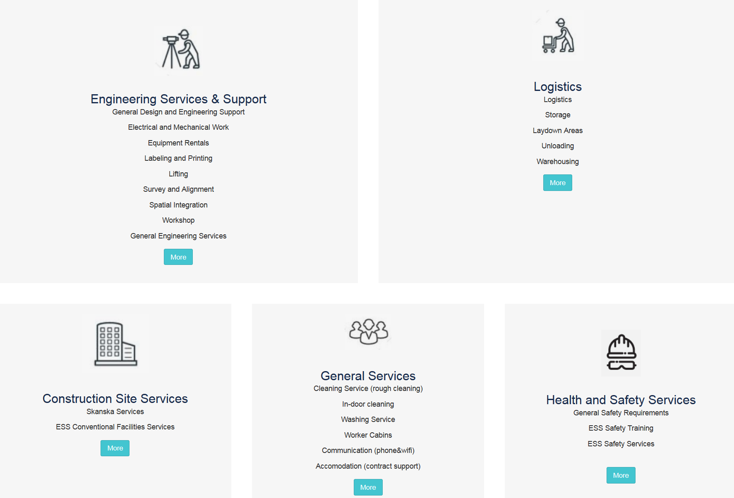
ESS Installation web page

Slide 13
Interface – In Kind – ESS WP to
– Installation Package lead
AD installation coordinator
IK partner
Installation package lead
AD Work package lead
AD Liaison Officers
Responsible for;
Installation binder
IRR
Work order

Slide 14
The Installation Readiness Review (IRR)

Slide 15
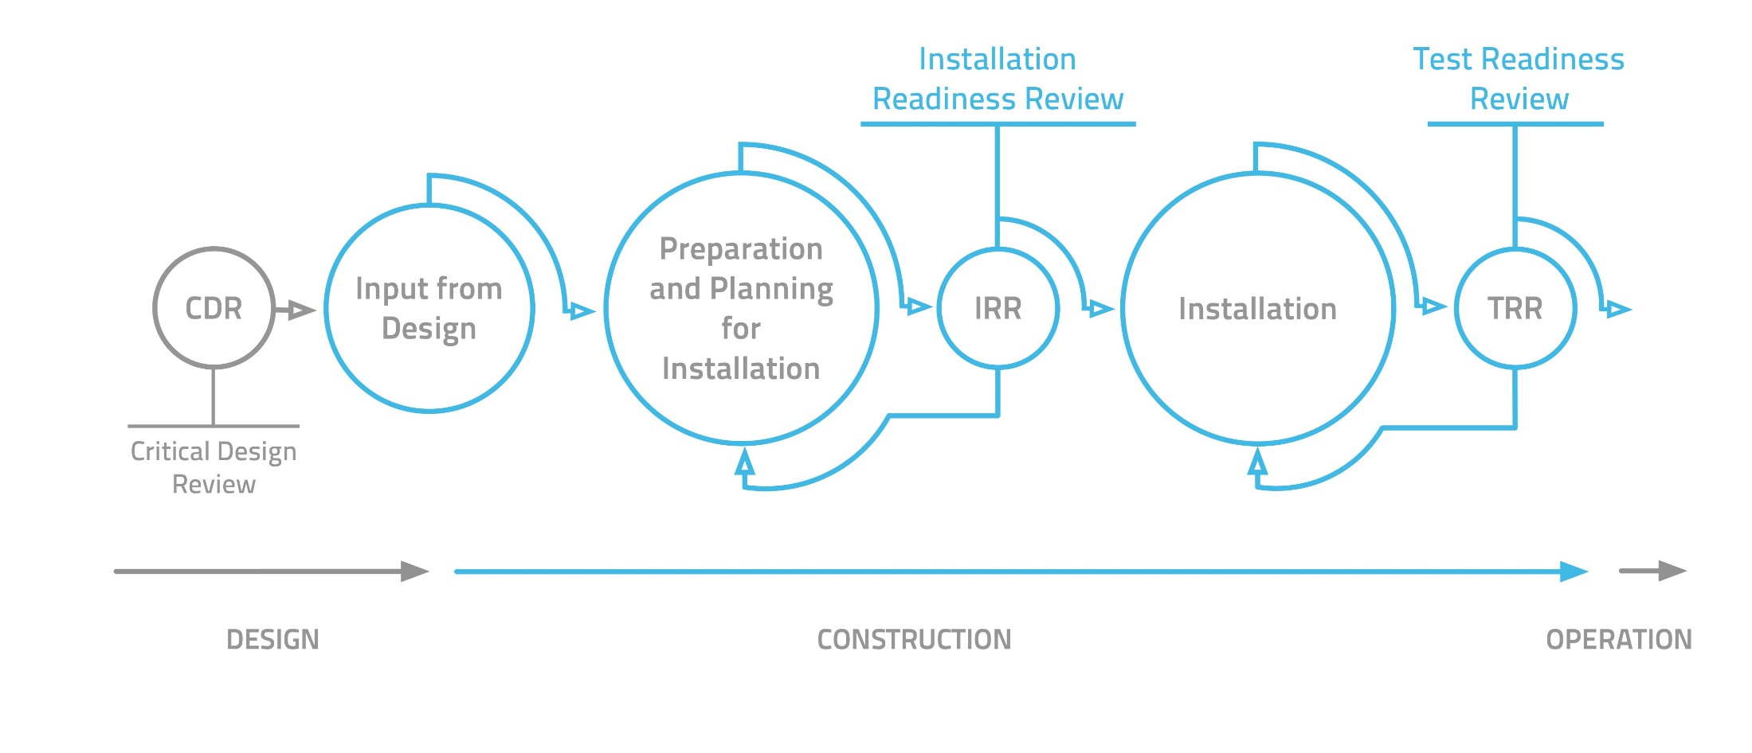
Installation Process & IRR
Installation binder IB

Slide 16
Purpose IRR
The purpose with Installation Readiness Review is;
  to review if the necessary preparations have been performed and
  the supporting documentation are in place for the upcoming installation package.
An installation package is manageable discreet piece of the complete installation
(size of package depending on many factors).
IRR

Slide 17
IRR Documentation
All relevant documentation for the upcoming installation package and IRR is collected in an installation binder.
The scope of an installation package might vary a lot, from small minor works to months of complex, large team installation.
General responsibilities
Installation Package Lead: That an IRR are performed
IRR chair/Installation Coordinator-Go/NoGo for installation
Project QA: Approve the quality plan
Good shape – Proceed
Minor things to fix before start – Keep start date
Major things to fix before start – Reschedule installation
Part of package not ready – Split package

Slide 18
The Installation Binder
Practical Use

Slide 19
The Installation Binder
The binder Is a tool for organizing all documents related to a specific installation work (Installation Package).
  Some of the documents are created during the design phase, e.g. drawings, list of components, quality plans etc.
  Some of the documents are created during preparation of this specific installation work, e.g. schedules, temporary services, RAMS etc.
  Some of the documents are created during the actual installation, e.g. diary, NCRs, Inspection documentation of finalized installation etc.
ESS Installation Binder Library

Slide 20
Formal vs non-Formal
Some documents in the binder are ”formal”,
ie they typically are important and have a long-term importance
for maintenance, operations and licensing
Examples: Drawings, quality plans, NCRs, BOM lists, Inspection reports,
Certificate of compliance etc
Some documents in the binder are ”non-formal”,
ie they are important during the installation,
but once installation complete, they are less relevant.
Examples: Installation schedules, team setup, temporary services,
discussion, action lists etc

Slide 21
The Installation binder (IB)

Slide 22
The WSCP vs RAMS
Practical Use

Slide 23
The RAMS
What does RAMS stand for?
Risk Assessment Method Statement
What’s the purpose with a RAMS?
Identify hazards and associated risks for an activity and determine if sufficient controls are in place (to reduce the risks to an acceptable level)
Who is responsible for preparing the RAMS?
Installation Package Lead for making sure it’s prepared.
What does a RAMS consist of?
The RAMS consists of two parts:
A method statement, i.e. a detailed break down/description of the work to be carried out and material to be used to perform this task
A risk assessment, i.e. identify the risks associated to the work steps detailed in the method statement.

Slide 24
RAMS - Installation Binder & IRR
The RAMS is part of the Installation Binder
There is a template for the RAMS and it should be used when you prepare the Binder
You might have to prepare several RAMS for a binder, depending of the scope of work for that specific installation
When the IRR is performed, review of the RAMS is one of the key activities to determine if method of installation has significant risks associated with it and whether the ‘best / safest’ way has been chosen
If, for some reason, the way of doing the installation is changed, the RAMS needs to be updated (revised)
During the pre-job briefing, all in the installation team should be aware of the RAMS.
The RAMS (in combination with the Installation Binder replaces the WSCP)

Slide 25
(Minor) installation work
Without Binder & IRR
Even if a Binder and an IRR are not used, a RAMS should be created and reviewed.
The RAMS should be attached to the Work Order
Review of RAMS should (minimum) involve Project ES&H and Area Coordinator
Same principle here, all involved in the installation work should be aware of the RAMS.

Slide 26
ESS Work Orders
Mandatory for all installation work
www.europeanspallationsource.se
June 05, 2018

Slide 27
Introduction
Why do we need Work order (WO) ?
  to control the work and work/er safety
  some aspects are ;
    No work shall be executed unless it is planed and organized to avoid misses/ near misses etc. “worker safety=your safety”
    Synchronize the work with other parallel work (same area)
    To control plant conditions and equipment
    To plan for delimitations and tag outs. “becomes more and more important when entering in to the test and commissioning phase!”

Slide 28

What is a work order?
A work order is an ESS internal document.
A Work order will be used to signal the start of an installation process,
  Will be linked to a method statement (RAMS)
  Or an installation binder.
The work order will mainly state:
Installation activity start and end time.
Summary of the activity.
Documents related to this activity.
Any need for delimitations/tag outs

Slide 29
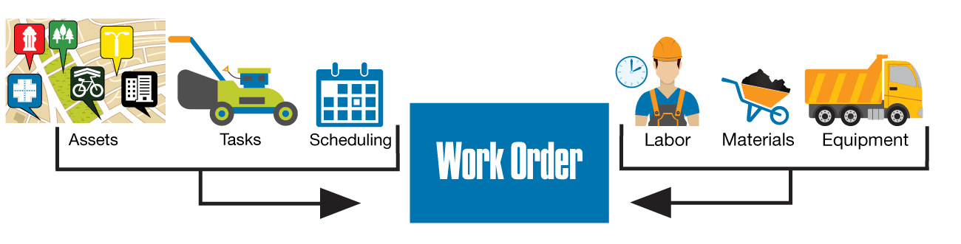
Why do a work order need to be approved?
An approver of a work order need to verify the following before approval:
Installation/safety supporting documents are in place and up to date (RAMS).
Permits are in place and up to date and standards. (Hot work, RAD work)
Time and parallel work does not pose any risks.
Physical Spatial integration requirement are fullfiled.
Other departments and areas coordinators are in Sync with the work order.
On site resources are available

Slide 30
Work Orders – process
-3M
-1d
Preliminary
Approved&
Scheduled
Ongoing
Closed
Registering the work
Installation package lead
Starting the work
Installation Coordinator after coordinating with Area coordinator
Based on coordination
Approving the work
Installation Coordinator (ONLY)
Based on schedule coordination & maturity (documentation status, availability of material etc)
Closing the work
Installation Coordinator based on input from the Installation package lead

Slide 31
How to handle Work Orders
1. Submit your work order
https://jira.esss.lu.se/servicedesk/customer/portal/11/create/129
2. Check status for your WO or what else is ongoing
https://jira.esss.lu.se/secure/Dashboard.jspa#
3. Print out the approval and bring with you
Mailed to you once the WO is approved.
4. Close the work order (will be done by installation coordinator)
Guidelines
Only submit Work Orders for work coming up in 3 months (up to six months)

Slide 32
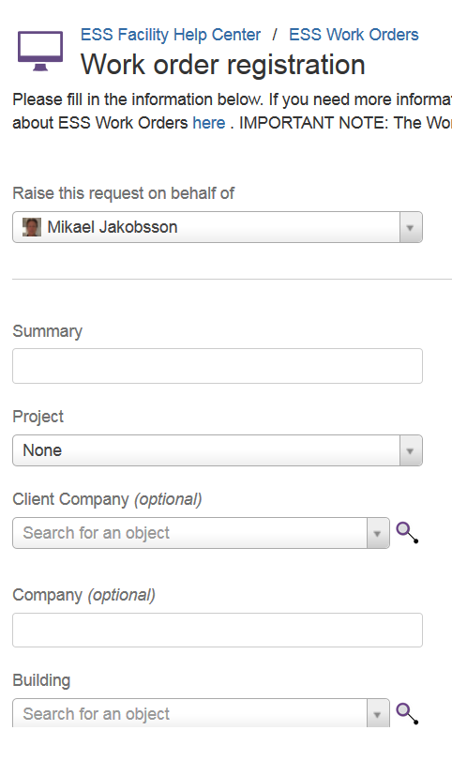
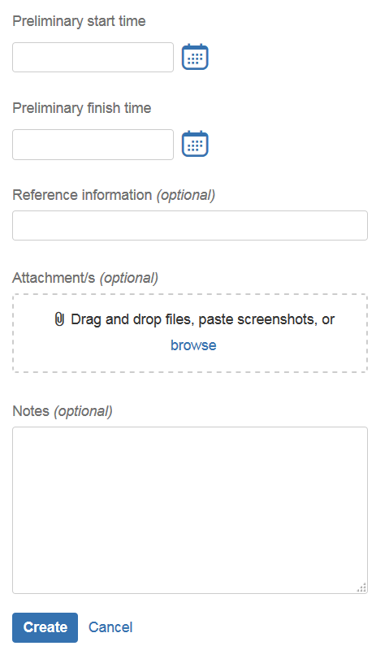
Registering WOs
Minor work
6 fields + RAMS
(attached)
Normal work
6 fields + link to
installation Binder

Slide 33
CDB and stubs installation road map
Nour Akel
www.europeanspallationsource.se
September 06, 2018

Slide 34
Changes since the beginning of the plan till the 6 of September
20 August
14 September
17 September
08 October
18 January
06 September
10,000+ changes to the cable data base including:
6000+ added cables
3000+ existing cables updates and removal
New cable types and connectors added
Setting CDB freezing date and introducing change order system one of the most important objective
Change order system is in place, costs and time impact related shall be well understood
Expected output:
Homogeneous cable types lists with supporting datasheets, supplier can check availability
Cable lengths determined, procurement can proceed

