Slide 1
STATUS
of
INFN contribution
to ESS-accelerator
S. Gammino for INFN
Oct .3rd, 2018

Slide 2
ITALY
I.N.F.N.
LNS-Catania: Ion Source and Low-Energy Beam Transport;
LNL-Legnaro: Drift Tube LINAC;
LASA-Milano: Medium Beta Cavities;
LNL-Legnaro: DTL Control System
Elettra Sincrotrone Linac Magnets;
Wire scanner Acquisition;
Spoke RF Power Stations;
Linac Magnets Power Converters;
C.N.R. T-Rex
VESPA
WP2 Regional Hubs

Slide 3
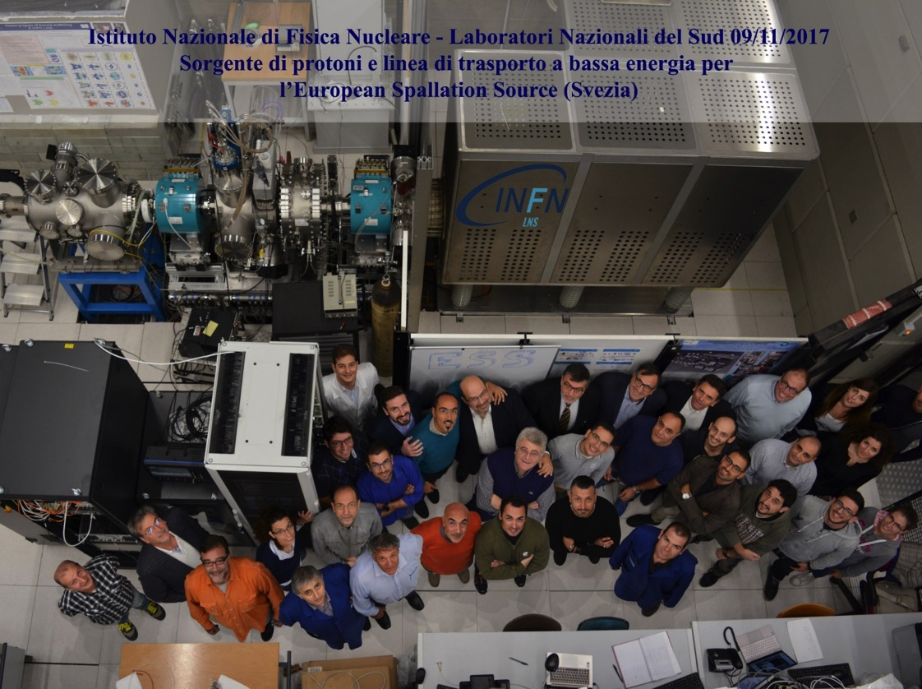
Milestones 1/3
2017-11-09 Source fully commissioned at INFN-LNS

Slide 4
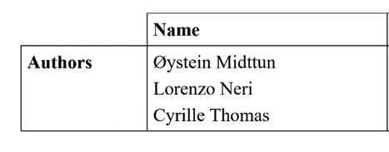
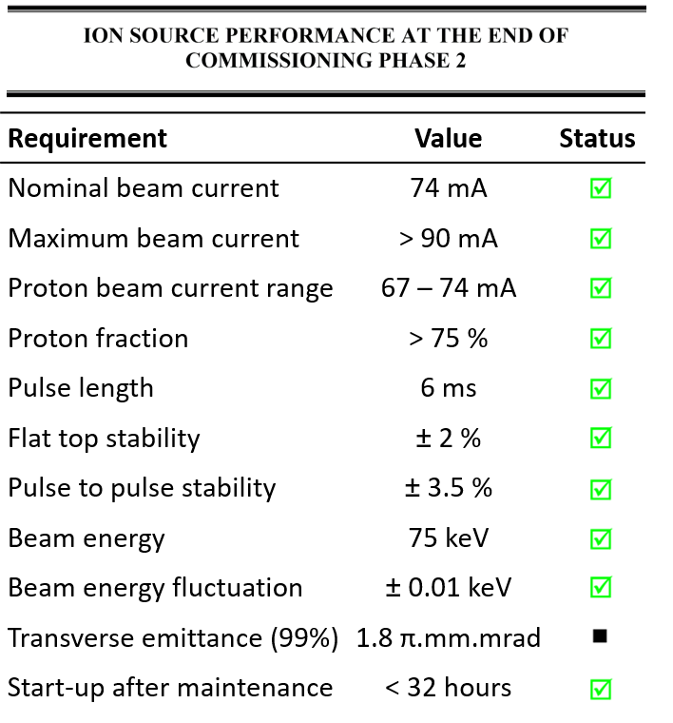
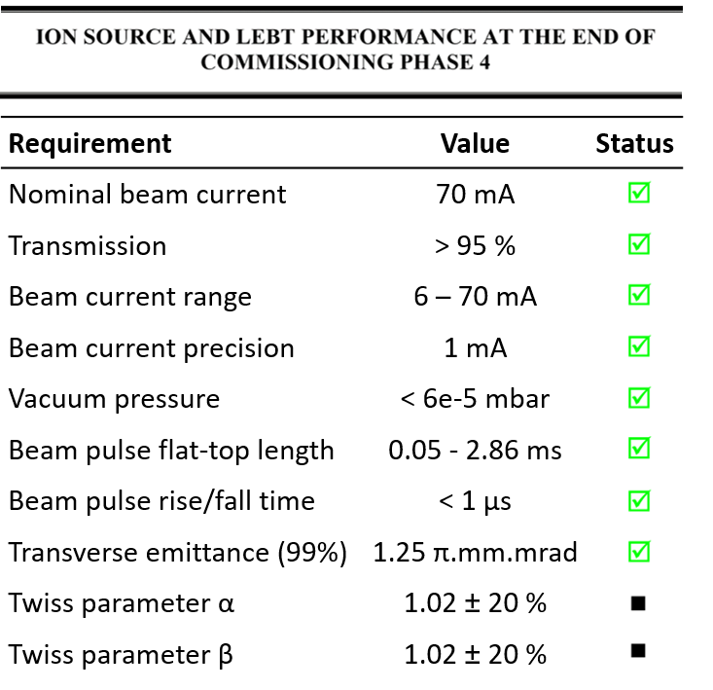
Site Acceptance Review
Back tracing simulation under going
Stable EMU was not provided in time

Slide 5
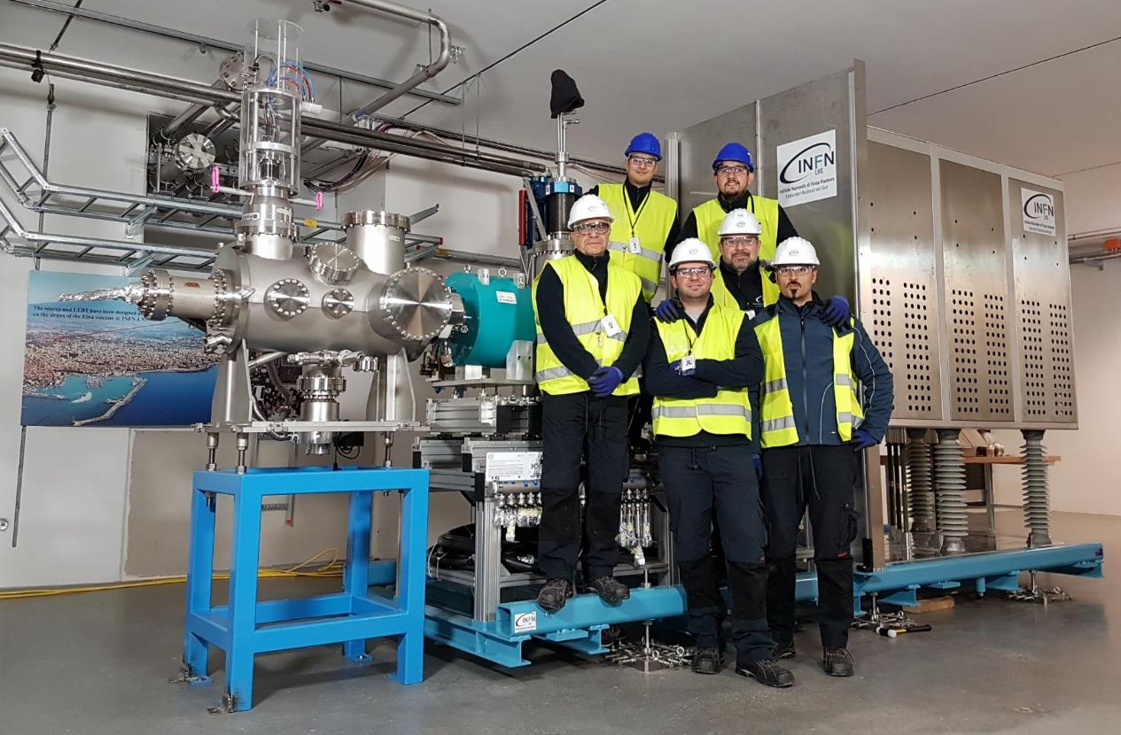
Milestones 2/3
2018-02-01 Source fully assembled in Lund by INFN-LNS team

Slide 6
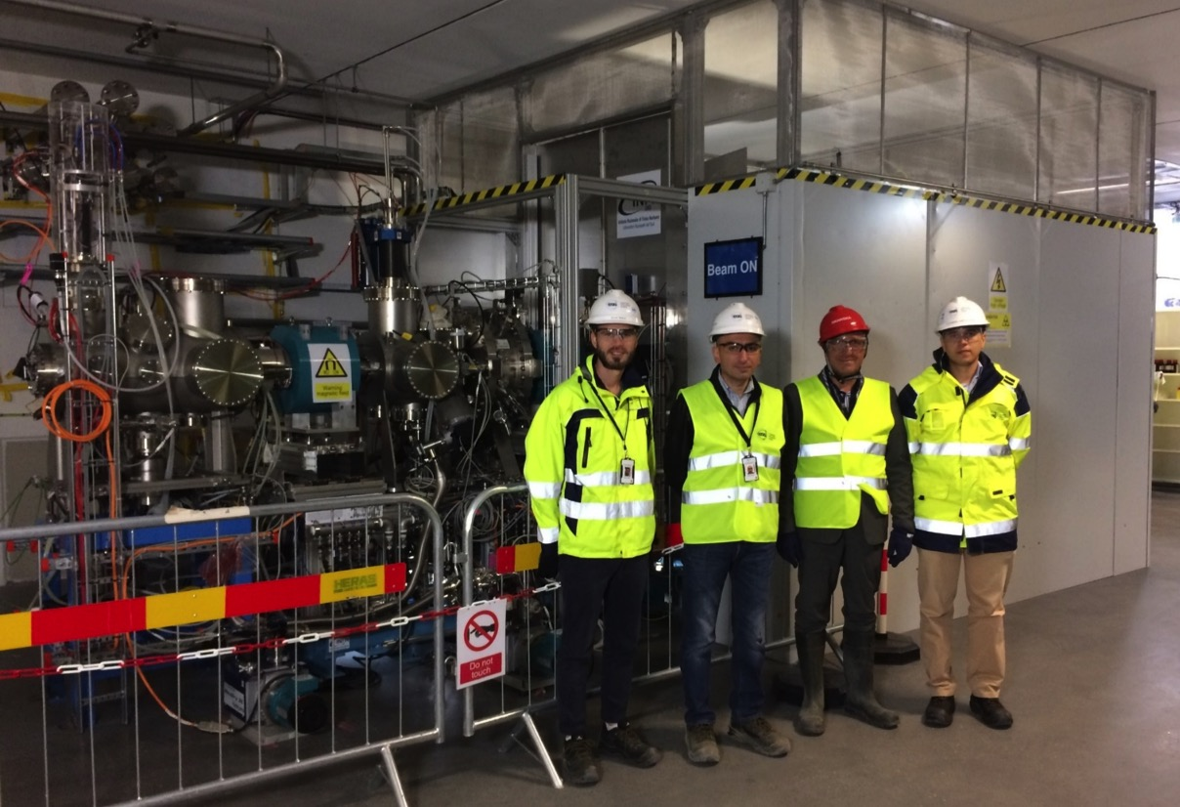
Milestones 3/3
2018-08-03 Source ready for commissioning in Lund

Slide 7
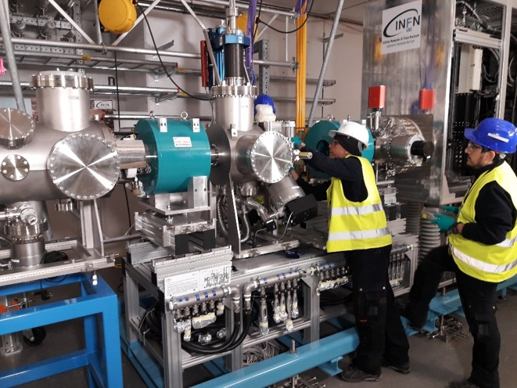
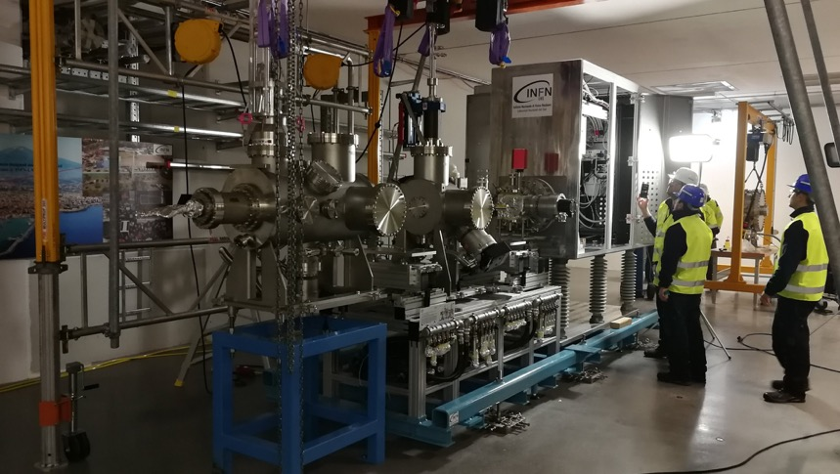
Installation in Lund

Slide 8
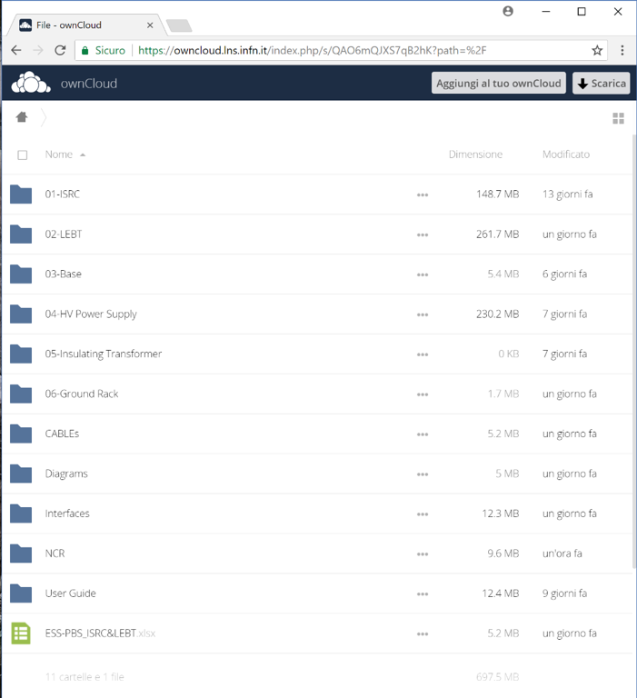
ISRC&LEBT Documentations
INFN is providing a shared folder collecting:
Drawings
Diagrams
Cable specifications
Manuals
Factory acceptance test
Guides
Certification of conformities
Interface drawings
Non conformity reports
The documentation is collected in folders organized following the Product Breackdown Structure.
700 MB of documentations
Notes:
product breackdown structure e visione sito cloud: isrc-estrazione-drawings+ps+certificato rame, insulating column-drawings+certificato vuoto, magneti sorgente con documento completo, magnetron con manuale, lebt solenoidi drawings+ps+fat, chopper+disegni+diagramma blocchi+schematics+signal list, irisdisegni+manuale,supporti-disegni, base-disegni, fug, cavi,
Interfacce documento edgar, cartella interfacce
Standard dentro i disegni, guide, slide andrea+ornella^2

Slide 9
Summer’18 till now
Safety procedures approved
Plasma on
Beam tests under way
Beam commissioning to be completed in mid-November
Long run test in January

Slide 10
DTL IK contribution

Slide 11
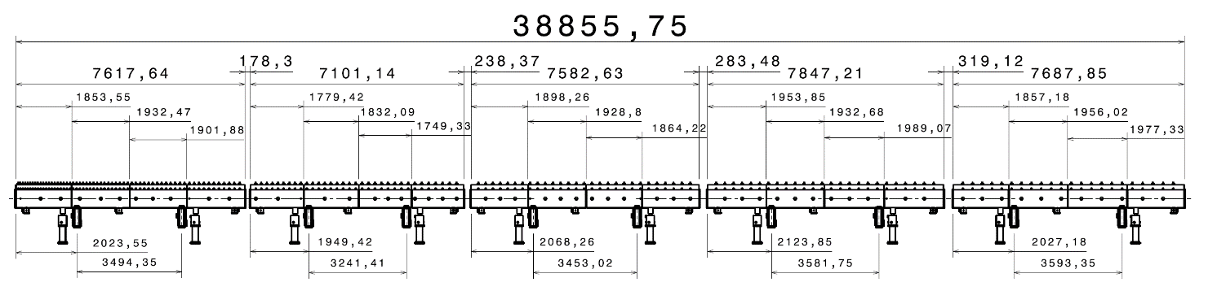
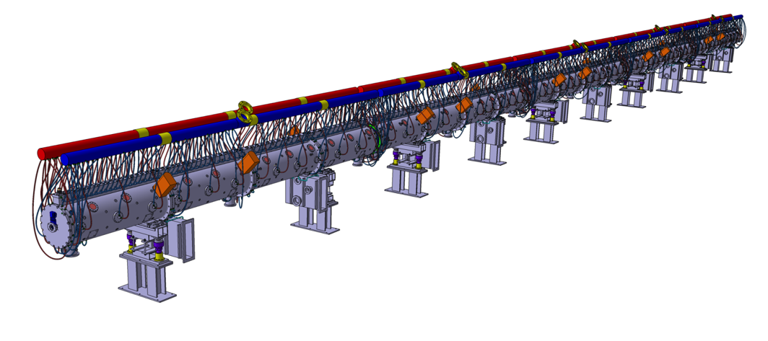
DTL Layout
89 MeV
3.6 MeV

Slide 12
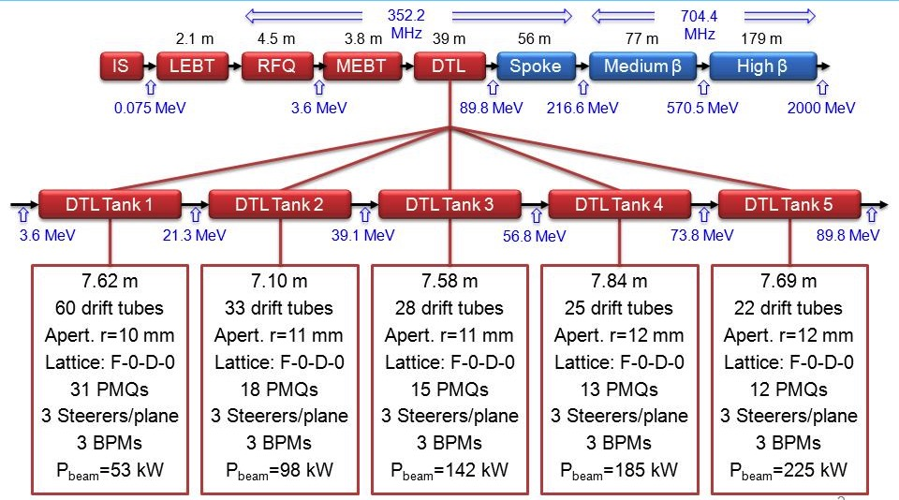
DTL layout
6
2
2
2
6
2
2
2

Slide 13
RFI dates (2018)
Tank | RFI
Tank 4 | 20/03/2019
Tank 1 | 5/06/2019
Tank 3 | 3/10/2019
Tank 2 | 13/01/2020
Tank 5 | 19/03/2020
Note: the tank 4 completion is not critical, since the first tank to see RF will be tank 1

Slide 14
Tank Production
Module | Forged | Deep drilling rough machining | Drilling holes and heat treatment | Final fine machining | Metrology | Delivery | Cu-plating
T4-M1
T4-M2 |  |  |  |  |  |  | @ CERN
T4-M3
T4-M4
T1-M1
T1-M2
T1-M3
T1-M4
T3-M1
T3-M2
T3-M3
T3-M4
T2-M1
T2-M2
T2-M3
T2-M4
T5-M1
T5-M2
T5-M3
T5-M4
Comment:
Delivery Rate from CINEL approx. 1module/month

Slide 15
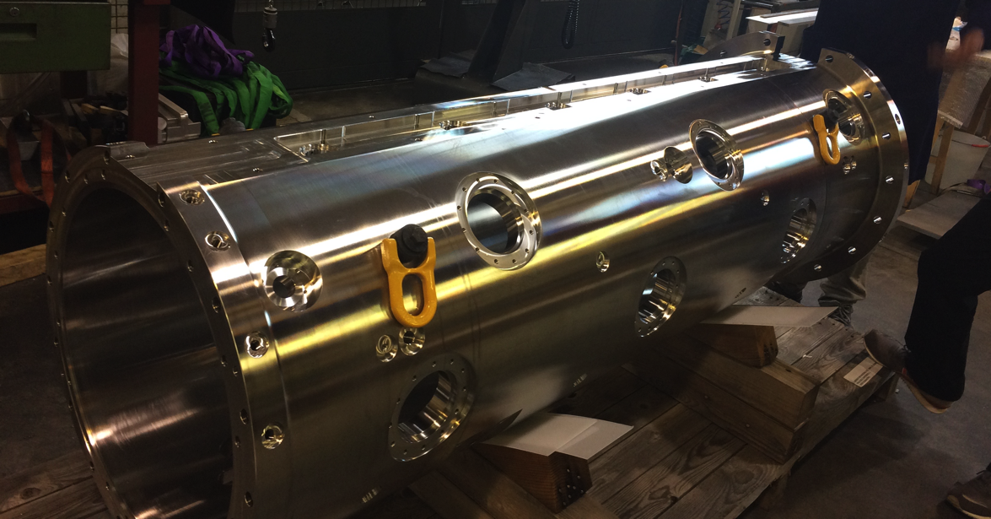

Slide 16
DT production
DT batch | Machinining Copper parts | Machining SS parts | Machining Stems (UMAS) | Cu plating stems (Tobaldini) | Brazing | Test and metrology | Re-machining | EBW (Zanon) | Final Machining, test, Metrology
T4-1 (1-8)
T4-2 (9-16)
T4-3 (17-23)
T1-1 (1-8)
T1-2 (16-24)
T1-3 (25-32)
T1-4 (33-40)
T1-5 (41-48)
T1-6 (49-54)
T3 (26 DTs)
T2 (30 DTs)
T5 (20 DTs)
Comments:
8 DT batches based on brazing oven capability
Machining optimized to 1 part/day
Some delay from Stem cu-plating supplier
Last 5 steps (Brazing→Final test) to be optimized to 3 weeks
DT-BPM outsourced (CINEL)

Slide 17
Main Tenders
 | Done | On-going | To be Done
Forged Tubes
Tank & Girder Machining
Cu-Plating Tank
RF windows
LNL and TO milling machine
Power couplers |  |  | 2018
BPM connectors
BPM cables |  |  | 2018
DT – BPM
DT-EBW
CMM @LNL
Stems |  |  | 2019
Trolley
Skid
Tuners, Posts |  |  | 2019
Movable tuners |  |  | 2019
End Plates |  |  | 2018
Brazing, sealing material |  |  | 2018
Cooling material |  |  | 2019

Slide 18
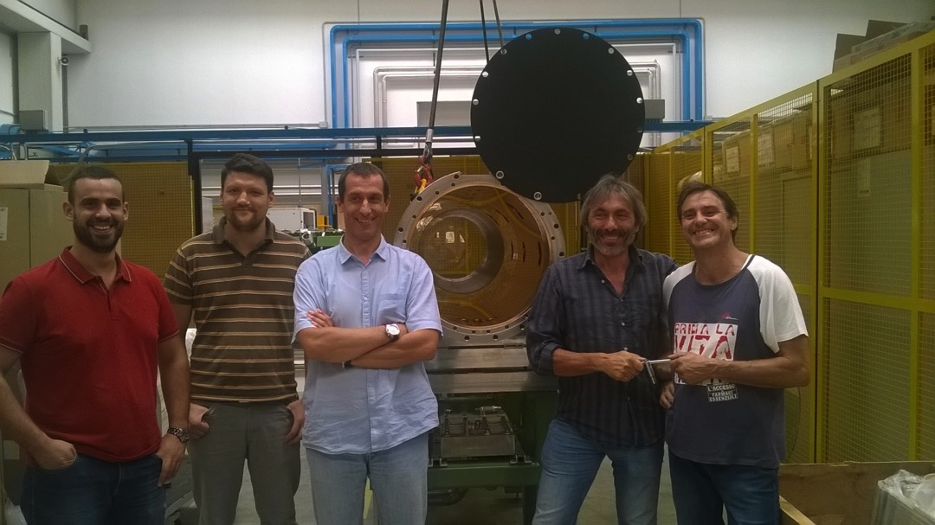
Other activities
Assembly test at LNL
  Sealing
  Alignment
  Mounting procedures

Slide 19
Other activities
Bead pull on full scale DTL model
  Bead pull hardware and procedures
  personnel trained to measurements
  Stabilization and tuning demonstration

Slide 20
Conclusions
The tank 1 RF tests are foreseen in fall 2019. To achieve this
  The high precision tank module and girder machining is proceeding and seems not critical in the schedule.
  The DT production has started, all the main beam elements are delivered, the exact production rate is being consolidated.
  The RF window tender is ongoing (summer 2018 we should have the two windows necessary).
  Concerning power couplers, end plates and other minor components the specs are ready and tenders are programmed within the end of 2018.
  The DTLW has been specified (and ESS is realizing it) while the logistic components (supports, trolley, dummy tuners…….) are under control.
  The tuning procedure was debugged on a low power model of tank2, and the sealing test has been mounted.
  The copper plating of the tanks is critical, since GSI has not accepted the contract.
The production schedule for the other tanks fits with RFI dates (except for copper plating)

Slide 21
DTL MB contribution

Slide 22
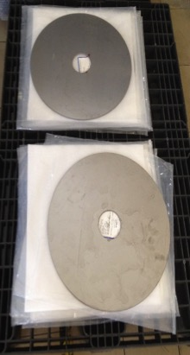
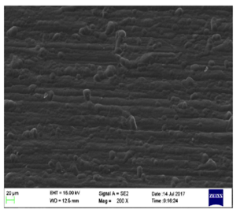
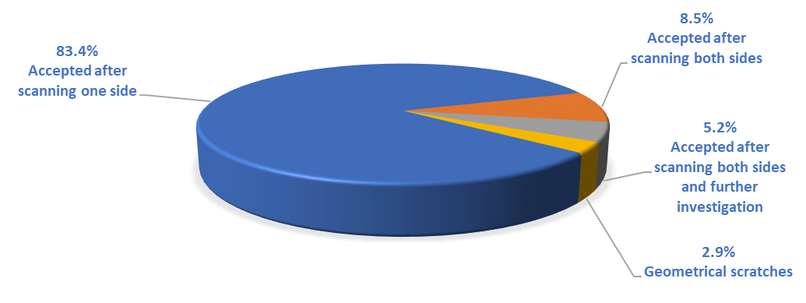
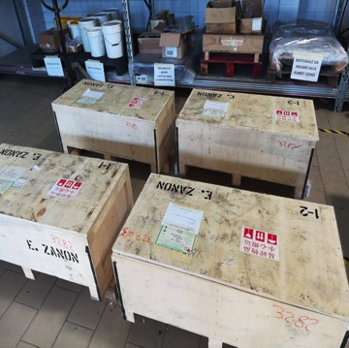
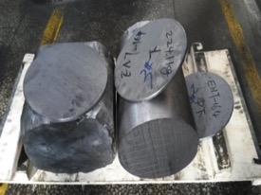
ESS Medium Beta – Niobium Procurement
The Niobium procurement was completed in
September 2018.
All the 482 sheets were scanned at DESY for inclusion of
foreign materials and geometrical defects before delivery
to cavity manufacturing company.
The first batch was
delivered to the company
in January 2018.
The second batch
was delivered
to the company
in April 2018.
Water Cut Sheets
Surface Roughness
Niobium Batch Boxes
Niobium Ingot

Slide 23
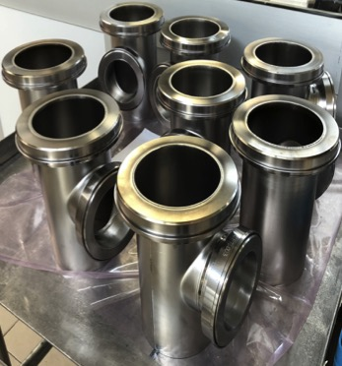
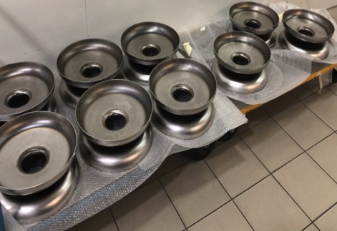
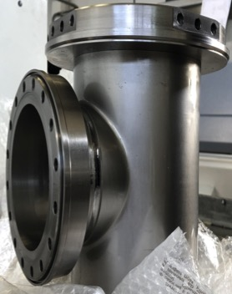
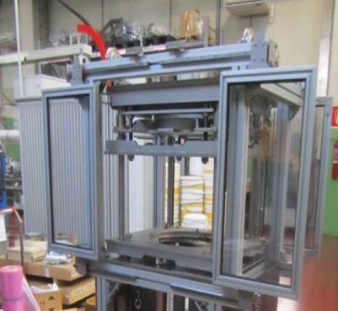
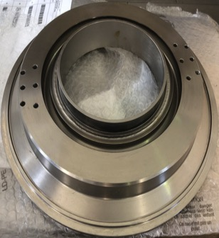
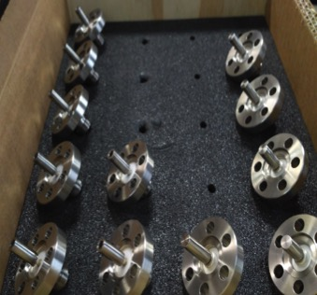
ESS Medium Beta – Cavity fabrication
Subcomponents production in full progress
  Half-Cells: IC, PC, EC
  Dumb-Bell: ID, TD
  End Group: EGP, EGC
First cavities foreseen by
November 2018
Ancilleries all in house
End Group Coupler side
Dumb Bells
Pick Up
Antennas
EGC Details
COmponent COntrol DEvice
EGP Tuner rings

Slide 24
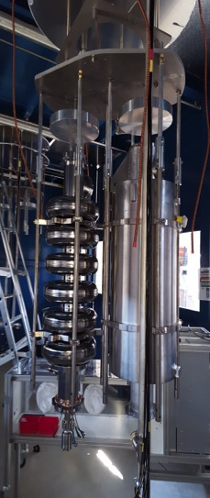
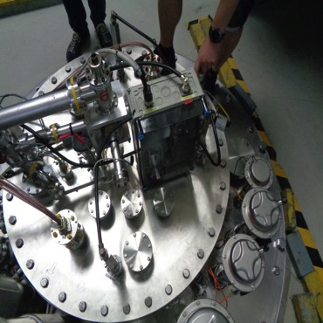
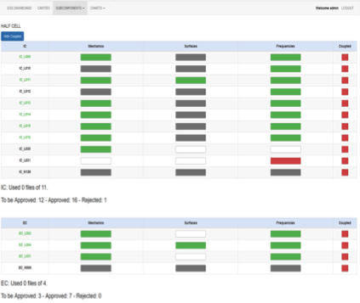
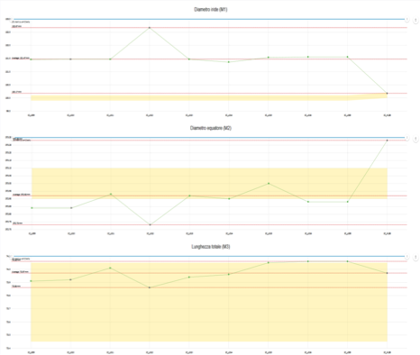
ESS Medium Beta
Preliminary test and documentation
Successful test on MBLG002 cavity (already tested at LASA) done at DESY to test the infrastructure
  Incoming control
  Cold test and related data exchange
  Outgoing control
Successful test of documentation portal and data
display dashboard om first half-cells and dumb-bells
  Document Management System based on
  INFN Alfresco
  ESS Dashboard developed in the framework of
  the European Brightness Program in
  collaboration with LNS colleagues

Slide 25
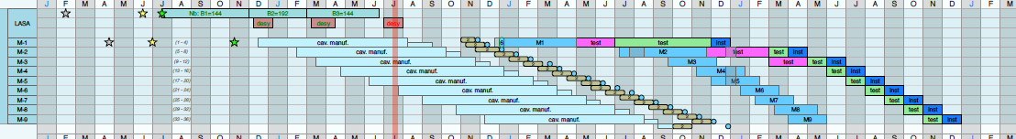
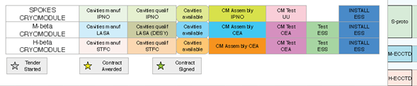
ESS Medium Beta - Planning
First two cavities
available
First six cavities
(for the M-ECCTD)
2017
2018
2019
2020
Cavities manufacturing at the company
First two cavities
test at DESY
Last cavity delivered

