Slide 1
Notes:
Slide 1: Company Logo Full Page
Before you start editing the slides of your talk change to the Master Slide view:
Microsoft Office :Menu: View > Slide Master;
Macintosh – View > Master > Slide Master
Edit the following items:
On the Slide Master (first master slide) – lower area
a) On the left Delete the text and write the title of the event/Conference, Location
b) On the right delete the text and write the name and surname of the speaker and the date (day, month , year)
Close Master View

Slide 2
REPORT FROM
ELETTRA SINCROTRONE TRIESTE
ESS ACCELERATOR COLLABORATION BOARD MEETING
Elettra Sincrotrone Trieste, October 3, 2018
Notes:
Slide 2: Title of the Presentation
Before you start editing the slides of your talk change to the Master Slide view:
Microsoft Office :Menu: View > Slide Master;
Macintosh – View > Master > Slide Master
Edit the following items:
On the Slide Master (first master slide) – lower area
a) On the left Delete the text and write the title of the event/Conference, Location
b) On the right delete the text and write the name and surname of the speaker and the date (day, month , year)
Close Master View
To start adding slides insert a new slide and select a Layout:
For Title & Subtitle
For text with bullet points
For Text
For Picture, graphs, visuals
Two columns
Blank

Slide 3
OVERVIEW
Elettra in-kind contributions for the accelerator:
AIK 2.1 | Magnets for ESS linac | Trilateral IKA signed in April 2017
AIK 7.4 | Beam Diagnostics- Wire Acquisition System for the ESS linac | IKA signed in April 2018
AIK 17.2 | Power Converters for Magnets to the ESS linac | Trilateral IKA signed in July 2017
AIK 17.7 | Spoke RF Power Station | Trilateral IKA signed in October 2017
 | Installations | Under preparation
Note: trilateral agreements involve Elettra, ESS and INFN, the latter being the RE for Italy in European Spallation Source-ERIC
Notes:
Slide 3 – (..) : Content of the presentation
Insert a new slide: Home > “New Slide” and choose a slide Layout:
For Title & Subtitle
For text with bullet points
For Text
For Picture, graphs, visuals
Two columns
Blank
If you want Copy & paste an element from the Clip Board to the particular slide:
1. Click on a box to mark it.
2. Position the mouse pointer on the box frame: Copy!
3. Click on the particular slide: Paste!
How you intend to use the elements is your choice.
You can combine the text block style with the background colour in different manner.

Slide 4
AIK 2.1 - MAGNETS
SCOPE: provide magnets installed in different parts of the linac
352.21 MHz
704.42 MHz
2.4 m
4.5 m
3.6 m
40 m
54 m
75 m
179 m
Target
Source
LEBT
RFQ
MEBT
DTL
Spokes
Medium β
High β
HEBT & Contingency
75 keV
3.6 MeV
90 MeV
220 MeV
571 MeV
2000 MeV
Type | Description | Quantity
Q5 | Quadrupole magnet for A2T | 26
C5 | Dual-plane corrector magnet for SPK | 13
Q6 | Quadrupole magnet for MBL, HBL, HEBT and DmpL | 95
C6 | Dual-plane corrector magnet for MBL, HBL, HEBT, A2Tramp and DmpL | 55
Q7 | Quadrupole magnet for A2T ramp | 12
D1 | Vertical dipole magnet for HEBT and A2T | 2
Q8 | Quadrupole magnet for A2T | 6
C8 | Dual-plane corrector magnet for A2T | 4
Tenders for all magnets issued by INFN according to Elettra technical specifications, concluded and contracts signed.
Notes:
Slide 3 – (..) : Content of the presentation
Insert a new slide: Home > “New Slide” and choose a slide Layout:
For Title & Subtitle
For text with bullet points
For Text
For Picture, graphs, visuals
Two columns
Blank
If you want Copy & paste an element from the Clip Board to the particular slide:
1. Click on a box to mark it.
2. Position the mouse pointer on the box frame: Copy!
3. Click on the particular slide: Paste!
How you intend to use the elements is your choice.
You can combine the text block style with the background colour in different manner.

Slide 5
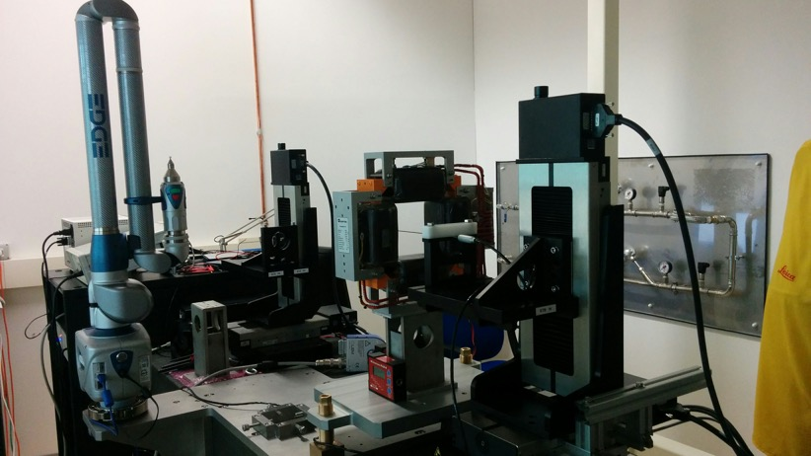
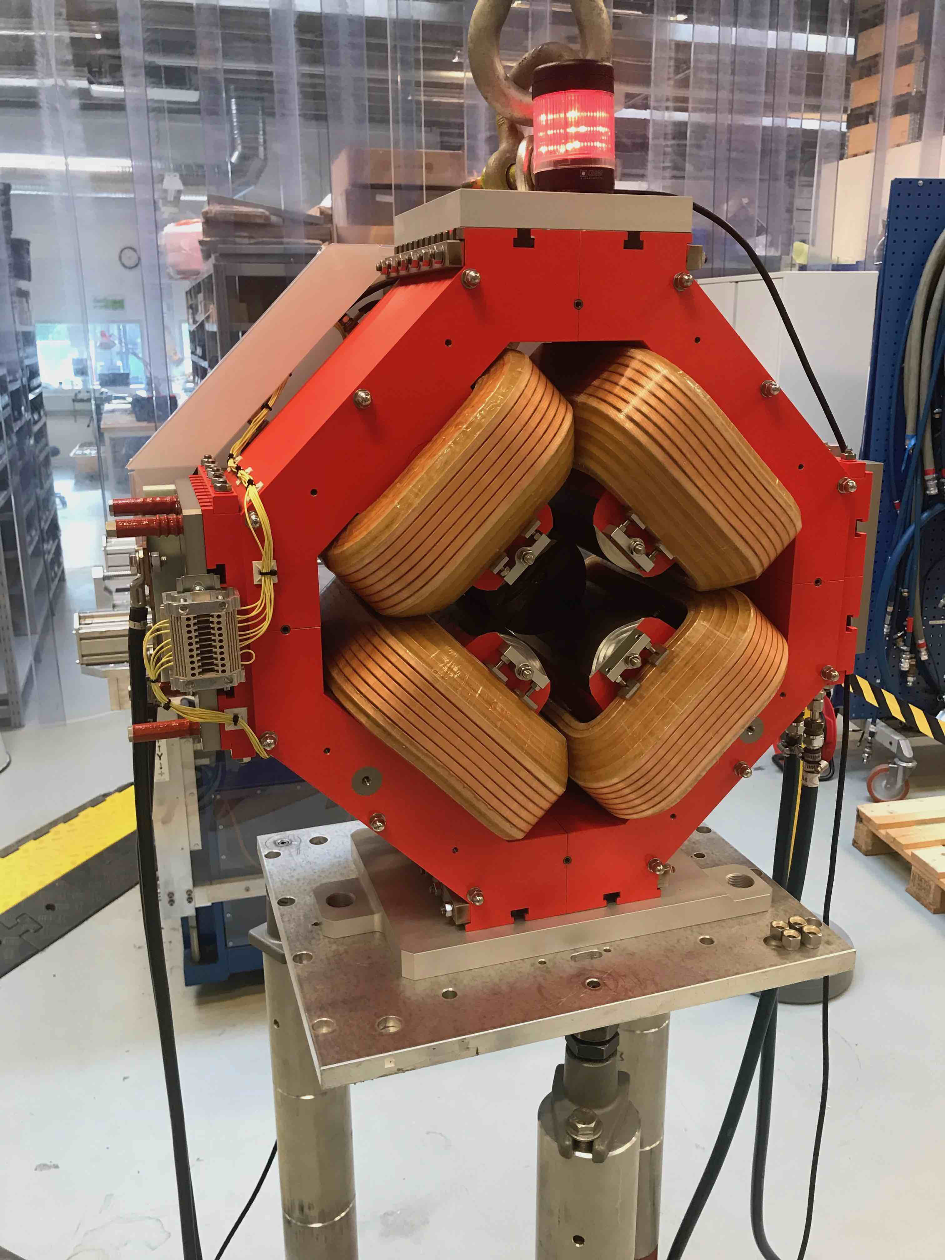
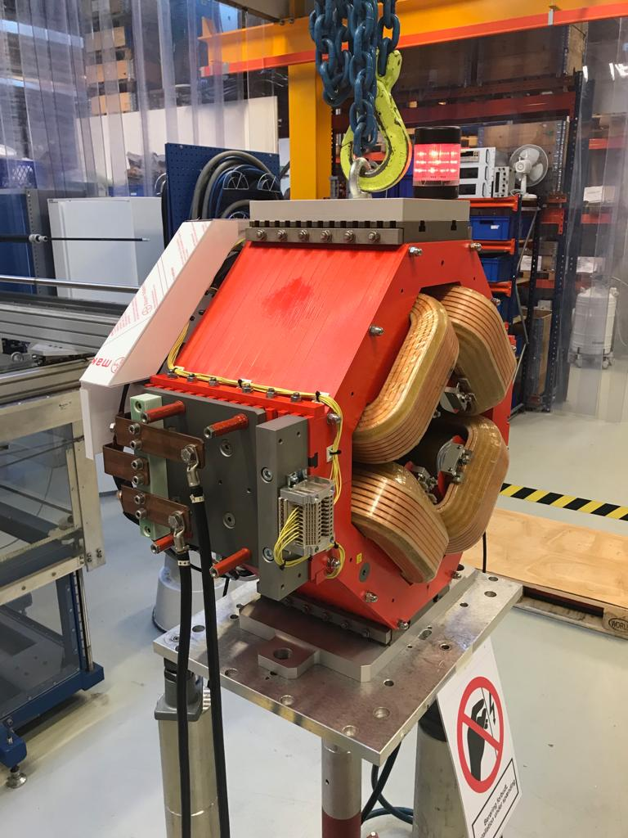
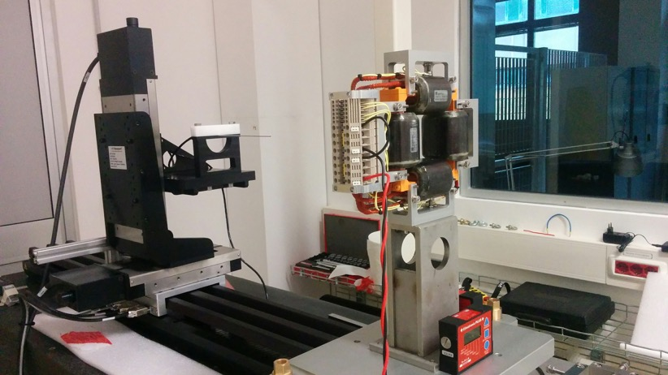
MAGNETS: Q5, Q6, Q7 AND C5, C6
  Magnetic design, mechanical design and magnetic measurements by Elettra.
  Engineering and construction assigned to Danfysik.
  Aug.18: first pre-series corrector magnets C5, C6 magnetic measurements.
  Sept.18: first pre-series Q6 and Q7 quadrupole magnets FAT performed at Danfysik, now being delivered to Elettra for magnetic measurements.
  Oct. 18: first pre-series quadrupole magnet Q5 FAT at Danfysik.
  End Jan. 19: first batch (12 Q7 and 6 C6) delivered to STFC.
  Middle Aug. 19: last batch (9 Q5 and 4 C5): delivered to STFC.
Elettra Magnetic Measurement Lab
Q6
Q7
Notes:
Slide 3 – (..) : Content of the presentation
Insert a new slide: Home > “New Slide” and choose a slide Layout:
For Title & Subtitle
For text with bullet points
For Text
For Picture, graphs, visuals
Two columns
Blank
If you want Copy & paste an element from the Clip Board to the particular slide:
1. Click on a box to mark it.
2. Position the mouse pointer on the box frame: Copy!
3. Click on the particular slide: Paste!
How you intend to use the elements is your choice.
You can combine the text block style with the background colour in different manner.

Slide 6
MAGNETS: D1, Q8 and C8
  Preliminary magnetic design by Elettra.
  Magnetic design finalization, engineering, construction and magnetic measurement assigned to Sigmaphi.
  Middle Dec 18: final design review.
  2nd half October 19: last FAT.
  2nd half November 19: completion of delivery to Lund.
Drawings Courtesy of Sigmaphi
Notes:
Slide 3 – (..) : Content of the presentation
Insert a new slide: Home > “New Slide” and choose a slide Layout:
For Title & Subtitle
For text with bullet points
For Text
For Picture, graphs, visuals
Two columns
Blank
If you want Copy & paste an element from the Clip Board to the particular slide:
1. Click on a box to mark it.
2. Position the mouse pointer on the box frame: Copy!
3. Click on the particular slide: Paste!
How you intend to use the elements is your choice.
You can combine the text block style with the background colour in different manner.

Slide 7
AIK 17.2 - POWER CONVERTERS
SCOPE: provide the power converters for the magnets of the linac
Type | Description | Operating mode-nominal output | Q.ty
PCQ5 | Power converters for the “Q5” quadrupoles | DC - 200A / 50 V | 26
PCQ6 | Power converters for the “Q6” quadrupoles | DC - 200A / 50 V | 95
PCQ7 | Power converters for the “Q7” quadrupoles | DC - 200A / 50 V | 12
PCQ8 | Power converters for the “Q8” quadrupoles | DC - 400A / 50 V | 6
PCD1 | Power converters for the “D1” dipoles | DC - 400A / 100 V | 1
PCC5 | Power converter for the “C5” dual-plane correctors* | 4Q - ± 16 A/ ± 20 V | 26
PCC6 | Power converter for the “C6” dual-plane correctors* | 4Q - ± 16 A/ ± 20 V | 110
PCC8 | Power converter for the “C8” dual-plane correctors* | 4Q - ± 16 A/ ± 20 V | 8
 | *plus COTS Bulk and Aux AC/DC power supplies
Thanks to the parallel development of magnets and power converters design:
  PCQ5, PCQ6, PCQ7, PCQ8 and PD1 specifications developed to allow modularity.
  PCC5, PCC6 and PCC8 standardized to the same power converter.
March 2017:first delivery to ESS ( DC/AC power supplies with redundancy Step Diode)
Tenders for all power converters issued by INFN according to Elettra technical specifications, concluded and contracts signed.
Notes:
Slide 3 – (..) : Content of the presentation
Insert a new slide: Home > “New Slide” and choose a slide Layout:
For Title & Subtitle
For text with bullet points
For Text
For Picture, graphs, visuals
Two columns
Blank
If you want Copy & paste an element from the Clip Board to the particular slide:
1. Click on a box to mark it.
2. Position the mouse pointer on the box frame: Copy!
3. Click on the particular slide: Paste!
How you intend to use the elements is your choice.
You can combine the text block style with the background colour in different manner.

Slide 8
POWER CONVERTERS FOR QUADRUPOLES AND DIPOLES
  Design and construction of the power converters assigned to a consortium made by Energy Technology and CAEN.
  Modular approach;
    PCQ5,PCQ6, PCQ7 and PCQ8: same 200 A/50 V module (directly for PCQ5,PCQ6, and PCQ7 and with parallel connection of two modules for PCQ8).
    PCD1: 100A/100 V modules combined with parallel connection (four modules).
  Based on an industrial product.
  20th Sept. 18: Critical Design Review.
  Middle Nov. 18: first batch FAT.
  End Nov. 18: first batch (5 PCQ5,6,7 + 1 PCQ8 + 1 PCD1) delivered to Lund.
  End May 19: last batch (45 PCQ5,6,7 + 1 PCQ8) delivered to Lund.
Notes:
Slide 3 – (..) : Content of the presentation
Insert a new slide: Home > “New Slide” and choose a slide Layout:
For Title & Subtitle
For text with bullet points
For Text
For Picture, graphs, visuals
Two columns
Blank
If you want Copy & paste an element from the Clip Board to the particular slide:
1. Click on a box to mark it.
2. Position the mouse pointer on the box frame: Copy!
3. Click on the particular slide: Paste!
How you intend to use the elements is your choice.
You can combine the text block style with the background colour in different manner.

Slide 9
POWER CONVERTERS FOR CORRECTORS
  Based on compact Elettra in-house design for FERMI (~ 300 PC installed).
  Construction of the power converters assigned to EEI.
4Q Power converters.
All power converters for correctors standardized to same specifications: ±16 A (± 20 A MAX), ± 20 V.
t₀ + 6 weeks: delivery of pre-series and production test of A2720 System.
t₀ + 18 weeks: delivery to Elettra of the series of the A2720 Systems (units and crates).
Notes:
Slide 3 – (..) : Content of the presentation
Insert a new slide: Home > “New Slide” and choose a slide Layout:
For Title & Subtitle
For text with bullet points
For Text
For Picture, graphs, visuals
Two columns
Blank
If you want Copy & paste an element from the Clip Board to the particular slide:
1. Click on a box to mark it.
2. Position the mouse pointer on the box frame: Copy!
3. Click on the particular slide: Paste!
How you intend to use the elements is your choice.
You can combine the text block style with the background colour in different manner.

Slide 10
AIK 17.7- SPOKE CAVITIES RF POWER STATIONS
SCOPE: build twenty-six pulsed 400 kW@352 MHz RF power stations
Two purchase procedures: RF Power Stations (RFPS ) and tetrodes (sole supplier).
Tender for RFPS issued by INFN according to Elettra technical specifications as well RfQ for the tetrodes (sole suppliers) and procedure results approved by INFN GE.
Appeal of the second bidder for the RFPS to the Court prevented the signature of the contract according to the scheduled plan.
Appeal has been rejected by TAR Lazio following the hearing on September 12, 2018.
This will allow the signature process.
Notes:
Slide 3 – (..) : Content of the presentation
Insert a new slide: Home > “New Slide” and choose a slide Layout:
For Title & Subtitle
For text with bullet points
For Text
For Picture, graphs, visuals
Two columns
Blank
If you want Copy & paste an element from the Clip Board to the particular slide:
1. Click on a box to mark it.
2. Position the mouse pointer on the box frame: Copy!
3. Click on the particular slide: Paste!
How you intend to use the elements is your choice.
You can combine the text block style with the background colour in different manner.

Slide 11
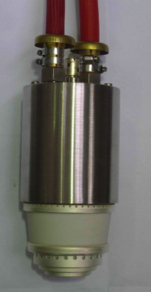
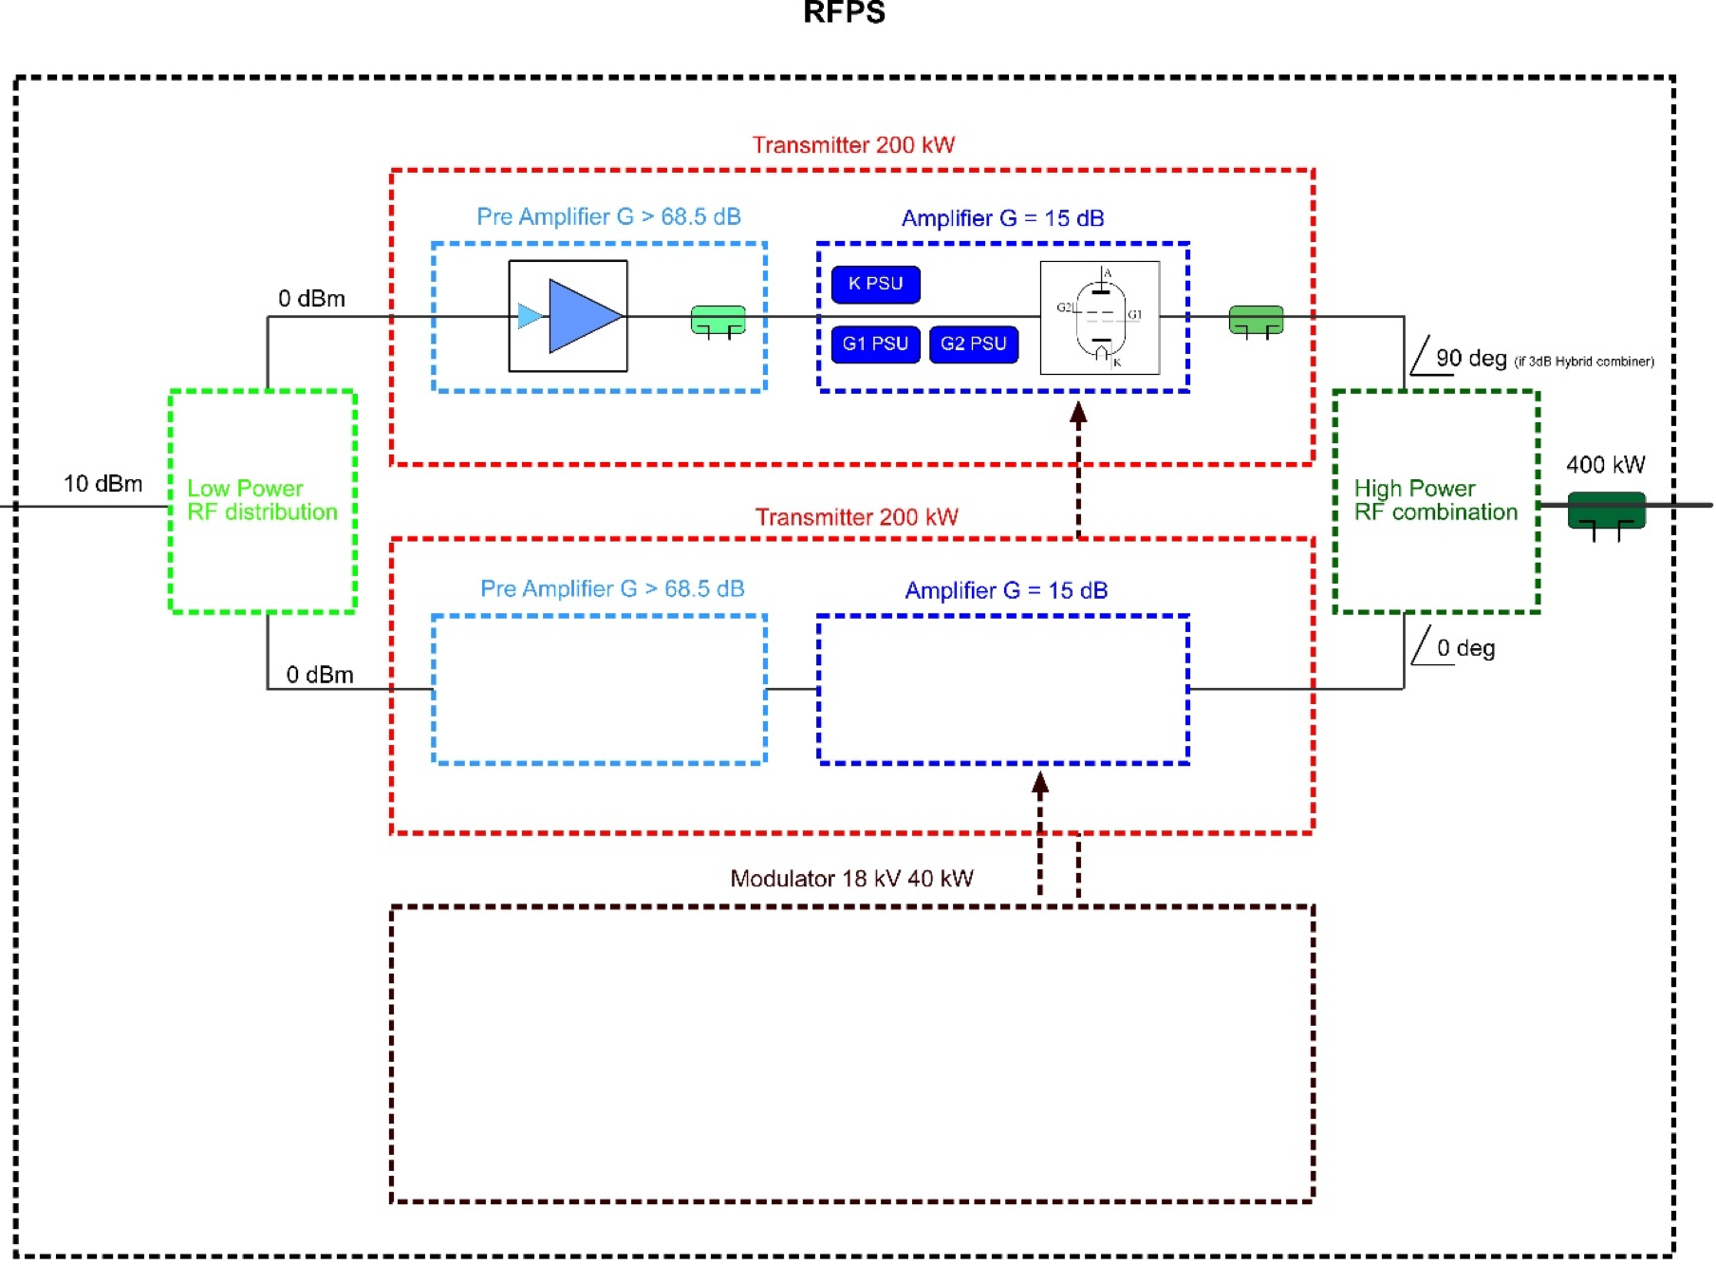
RF POWER STATIONS
Each RFPS consists of:
    two equivalent transmitters with amplification chain composed by solid state preamplifier and a 200 kW tetrode amplifier;
    one Modulator to supply both tetrodes.
  Detailed design specifications for the station as a whole and for each of the subsystem.
  Studies on improved grid power supply and tetrodes modulator designs developed in collaboration between ESS and Elettra.
Notes:
Slide 3 – (..) : Content of the presentation
Insert a new slide: Home > “New Slide” and choose a slide Layout:
For Title & Subtitle
For text with bullet points
For Text
For Picture, graphs, visuals
Two columns
Blank
If you want Copy & paste an element from the Clip Board to the particular slide:
1. Click on a box to mark it.
2. Position the mouse pointer on the box frame: Copy!
3. Click on the particular slide: Paste!
How you intend to use the elements is your choice.
You can combine the text block style with the background colour in different manner.

Slide 12
AIK 7.4 - WIRE SCANNER ACQUISITION SYSTEM
SCOPE: provide the Wire Scanner acquisition system (custom developed HW modules and integrated COTS modules, including control and processing software running under EPICS)
Design validated at CERN Linac 4 with real beam.
CDR successfully held in April 2018.
Successful vertical integration test end August in Lund.
System under construction.
Notes:
Slide 3 – (..) : Content of the presentation
Insert a new slide: Home > “New Slide” and choose a slide Layout:
For Title & Subtitle
For text with bullet points
For Text
For Picture, graphs, visuals
Two columns
Blank
If you want Copy & paste an element from the Clip Board to the particular slide:
1. Click on a box to mark it.
2. Position the mouse pointer on the box frame: Copy!
3. Click on the particular slide: Paste!
How you intend to use the elements is your choice.
You can combine the text block style with the background colour in different manner.

Slide 13
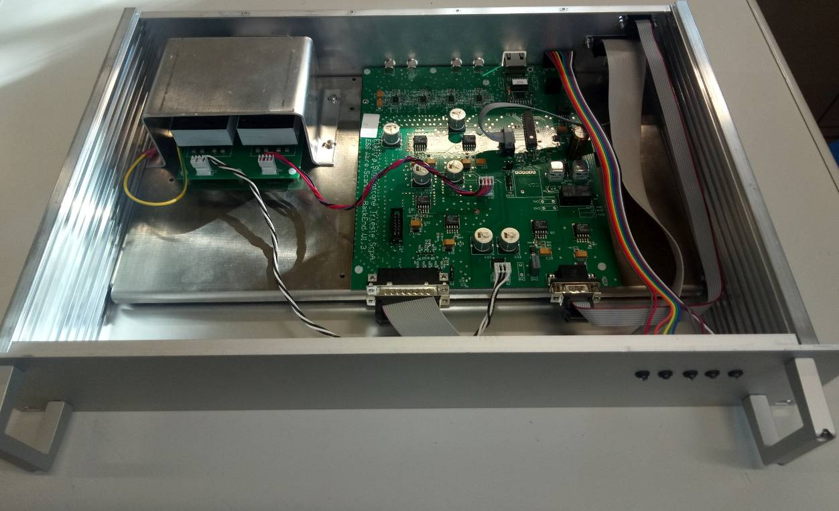
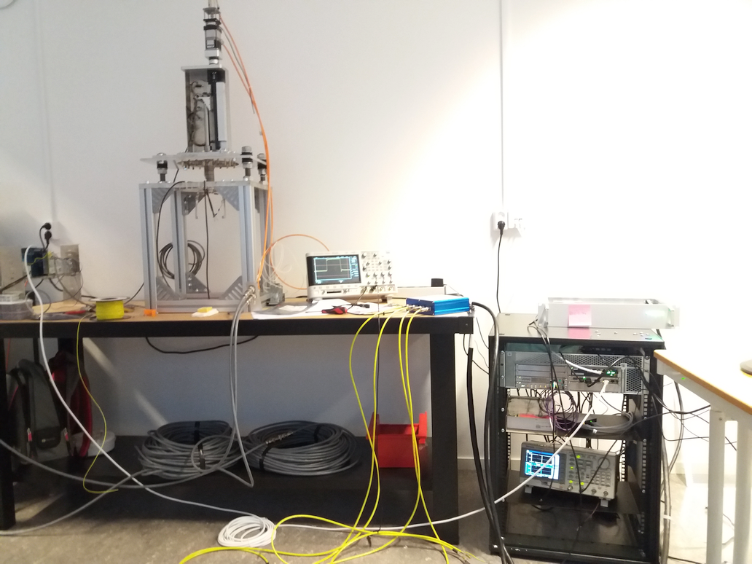
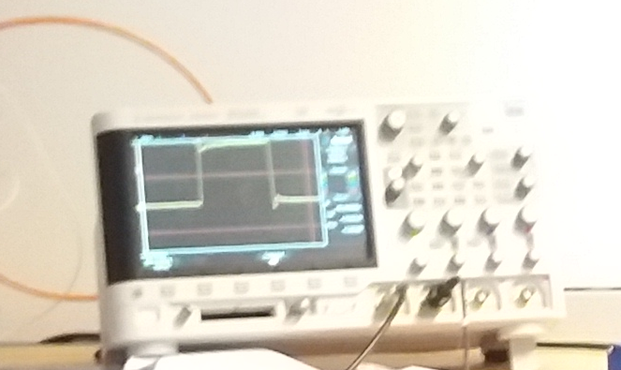
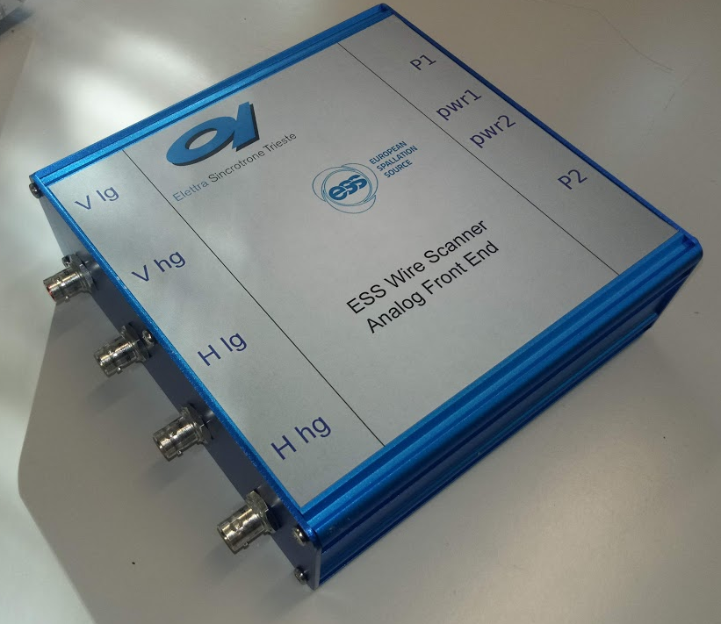
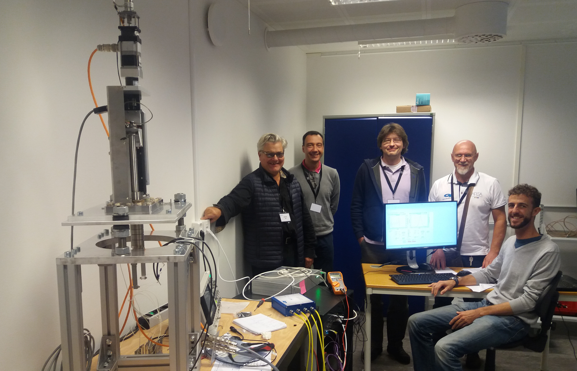
WIRE SCANNER ACQUISITION SYSTEM
System composed of custom developed HW modules and of integrated COTS units, linked together by means of an EPICS control and processing software.
A total number of 11 WS station will be acquired.
A total number of 13 AFE modules, 9 OFE modules and a total of 22 BEs will be produced.
Vertical Test in Lund
Notes:
Slide 3 – (..) : Content of the presentation
Insert a new slide: Home > “New Slide” and choose a slide Layout:
For Title & Subtitle
For text with bullet points
For Text
For Picture, graphs, visuals
Two columns
Blank
If you want Copy & paste an element from the Clip Board to the particular slide:
1. Click on a box to mark it.
2. Position the mouse pointer on the box frame: Copy!
3. Click on the particular slide: Paste!
How you intend to use the elements is your choice.
You can combine the text block style with the background colour in different manner.

Slide 14
Notes:
Last Slide 1: Thanks to the audience

Slide 15
Notes:
Last Slide 2: Aerial Photo of Elettra

