Slide 1

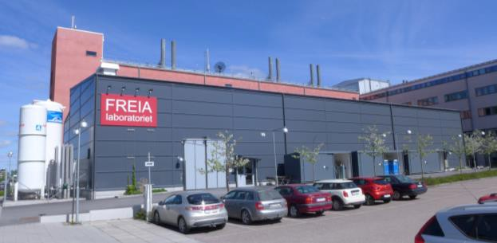
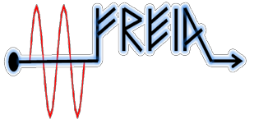







Status
of tests for ESS
Tord Ekelof
Trieste 3 October 2018
FREIA Laboratory
Facility for Research Instrumentation and Accelerator Development

Slide 2

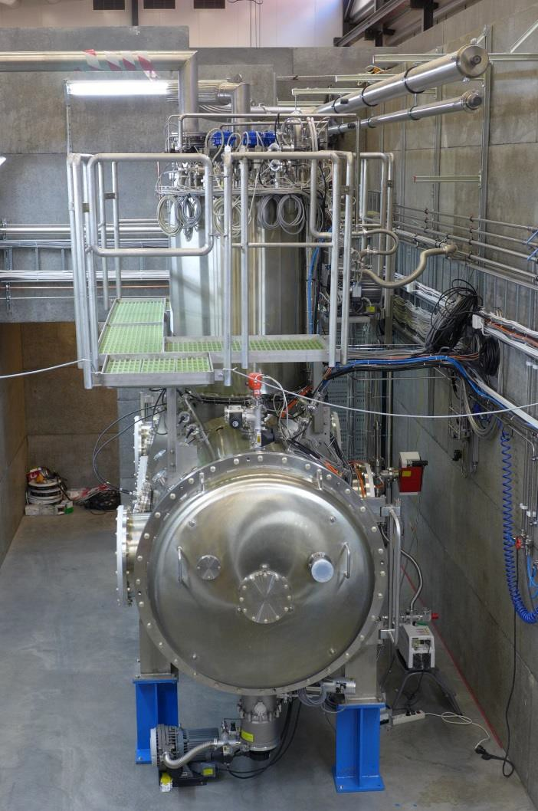
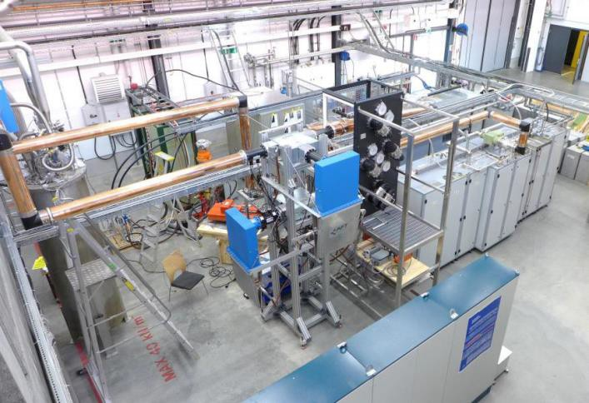
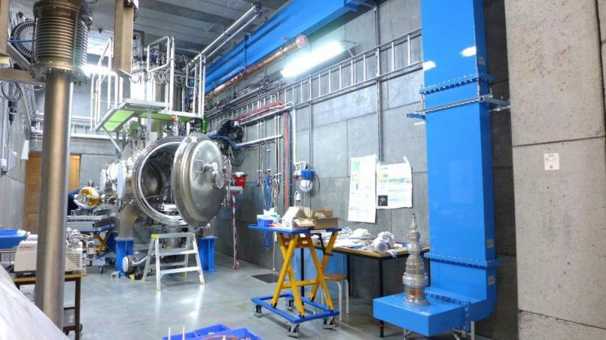

“HNOSS” Horizontal Cryostat
HNOSS = Horizontal Nugget for Operation of Superconducting Systems
Test of superconducting cavities/devices
  3240 x ø1200mm inner volume
  up to two cavities simultaneously,
  each equipped with helium tank,
Low or High power RF testing
  fundamental power coupler (top, bottom, side)
  (cold) tuning system
Operation in the range 1.8 to 4.5K.

Slide 3
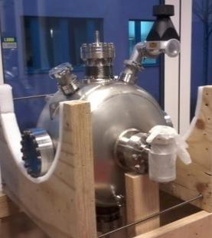
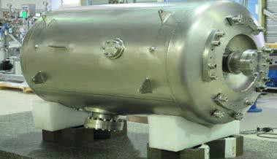
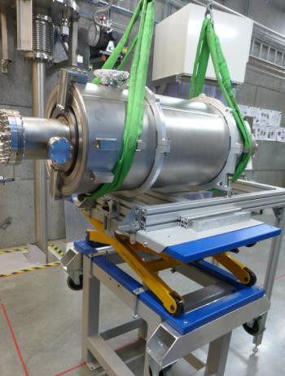
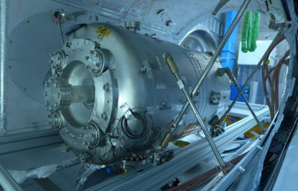
SRF Test Activities
Hélène single spoke cavity (IPNO)
  antenna, low power
  self-excited loop (SEL)
  RF calibration procedures
Germaine double spoke (IPNO)
  antenna and cold tuner, low power
  cryogenics: cooling, heat load
  LLRF, SEL
  Q₀, gradient, microphonics
Romea cavity package (IPNO)
  power coupler and tuner, nominal gradient
  Q₀ and gradient, microphonics, fill time,
Lorentz force detuning (LFD)
  tuner operation
RF Station 352 MHz (2x)
  acceptance and functional test
    including RF distribution components
  soak test
  pulsed and CW operation on cavity
RF Station 704 MHz
  acceptance & operation of modulator
High-β elliptical cavity package (CEA)
  power coupler, tuner
  Q₀ and gradient, micro- phonics, fill time, LFD
  LLRF/tuner operation
ESS Cryomodules
  prototype,
arrived August 2018

