Slide 1
Wire Scanner
EtherCAT Integration
Julen Etxeberria
Entry-level Controls Engineer
www.europeanspallationsource.se
September 11, 2018

Slide 2
Common Hardware Infrastructure (EtherCAT)
EtherCAT is the technology chosen by ICS and MCAG
to meet real-time requirements (kHz DAQ system and Motion Control)
open protocol with an available Linux open source master.
high performance and it is faster that the most other fieldbuses.
It is a real-time Ethernet-based fieldbus
flexible topology
high synchronization between nodes

Slide 3
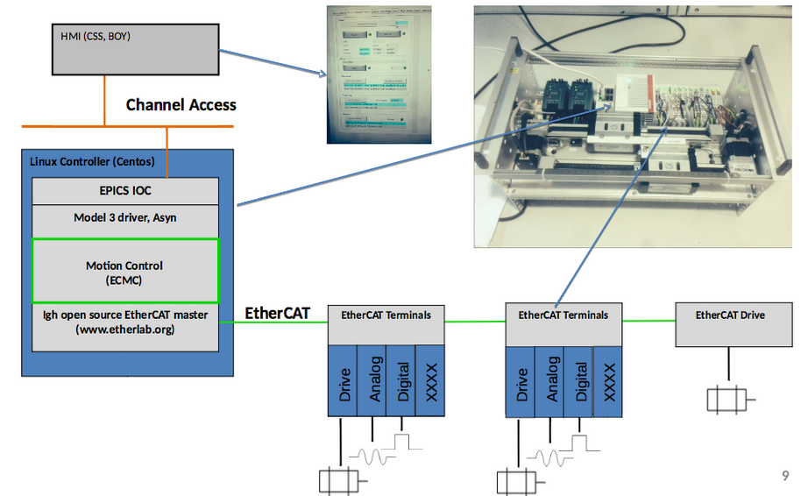
EtherCAT Motion Control Architecture

Slide 4
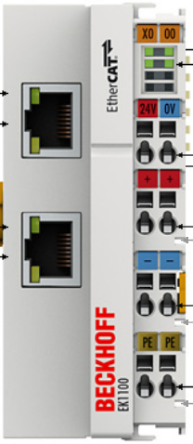

Coupler and EtherCAT station
  EtherCAT Coupler EK1100
The EK1100 coupler connects EtherCAT cables with the EtherCAT terminals.
  Bus end cap EL9011
This is a cap to cover the E-bus contacts. Each assembly must be terminated at the right-hand end with an EL9011 bus end cap.

Slide 5


Input Output terminlas
    HD 16-channel DI 24V DC EL1809
The EtherCAT terminal contains 16 channels for input signals of 24V
DC. For the EL1809 EtherCAT terminal, the reference ground for all
inputs is the 0 V power contact. A 16-channel terminal digital input is included for every four axes. Inputs 1 to 4 for one axis, 5 to 8 for the another and so on. The
inputs are used for the limit switches and the home sensor, leaving one in put
free in case it is needed.
    HD 16-channel DO 24V DC/0.5A EL2819
The EL2819 EtherCAT terminal has 16 digital output channels for the switching
of 24 V loads up to 0.5 A. Each digital output channel is supervised and the
diagnostics are available cyclically over EtherCAT
and via diagnostic LEDs on the terminal. The diagnostics include:
Over temperature
Open load
Over current
Short circuit to 24V

Slide 6

Resolver
    Resolver EL7201
In case of a resolver there is not a specific
resolver terminal. However, the EL7201
servomotor EtherCAT terminal, with integrated resolver interface. This terminal will be used as
the resolver terminal, regardless if the motor is
a stepper or servo.

Slide 7
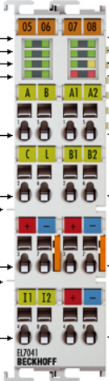
Stepper Control
    Stepper motor 8…50V/3.5A_{rms} EL7041-0052
The EL7041-0052 EtherCAT terminal is intended for stepper motors. The PWM output stages cover a wide range of voltages and currents. The voltage range of this terminal goes from 8 to 50V with a max. output current of 5A_{peak}.
The digital inputs included in the
terminal are only used in special
cases for local machine protection
purposes.

Slide 8
More functionalities for the Wire Scanner
Collision interlock.
Only one axis at the time are allowed to move from the low limit switch. 3 layers of safety is implemented in order to avoid collision.
The extra switches (mounted together with low limit switches) can be wired to a relay that break power to the other drive (the relay can be wired in many configuration, terminals on the back).
Soft interlock (called external hw interlock below). Each axis not allowed to move if the other axis is not at the lower limit switch. The power will be removed from the terminal by software if needed.
Each EL7037 terminal has two inputs. These inputs can be configured to enable/disable the amplifier in the terminal (by sdo). This configuration is made for input 1 of the EL7037 terminals. The switch supervising the "other" axis needs to be connected to input 1 of the EL7037 drive.
2. Latching and storing of axes actual position.
An event is configured to trigger on rising edge of input 1 of the terminal EL1252-0050 (NOTE 5V I/O).
Two data storages (currently 1000 elements) are configured to hold data.
Two data recorders are configured to record actual position of each axis into a data storage when the event is triggered.

Slide 9
Questions?

