Slide 2
CDR2&3 Time Schedule
Roberto Visintini
Elettra Sincrotrone Trieste

Slide 3
References
Schedule AIK 17.2 - Power Converters for magnets to the ESS Linac (version 2) to the Trilateral In-Kind Contribution Agreement signed between ESS ERIC, INFN, Elettra – ESS-0053408_2017.07.14
Deliverables and Milestones (Table 3)
Preliminary Project Schedule (Table 4)
Technical specification of the DC Power Converters for Quadrupole Magnets Q5, Q6, Q7, Q8, and Dipole Magnets D1 (PCQ5, PCQ6, PCQ7, PCQ8, and PCD1) – E-ST ESS PC TSD 001, rev. 1.6, dated 13-09-2017
Contract Deadlines (Section 12 – Appendix 2)
Contract between INFN and Energy Technology with CAEN, signed on August 3rd, 2018”
“Art. 4 Duration of the Contract and Delivery Dates
…according to the time deadlines reported in Art. 12 – Appendix 2 of the Technical Specifications”
Production Schedule Document (PSD), according to the Technical Specifications Art. 3.3.2, sent by Energy Technology – CAEN on August 17th, 2018
“UT-PL-0007_Production_Schedule_Document_for_ESS_Quadrupoles-Dipoles” (pdf and Microsoft Project format).

Slide 4
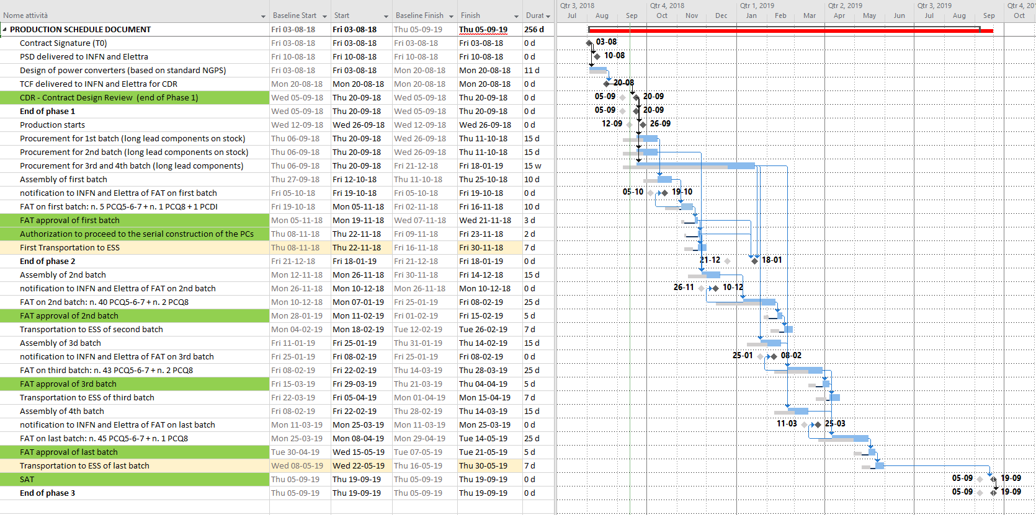
Time Schedule – Gantt (PSD*)
*The only change to the original PSD is the shifting of CDR from September 5 to 20, highlighted as Baseline (light grey).

Slide 5
Time Schedule - Comparison
Schedule AIK 17.2 (Table 3) |  | Deadlines in TechSpec | PSD from Contractor | Actual date
WBS 2.7 & WBS 3.5 – Contract signed | 2 July 2018 | t₀ = 2.07.2018 | 3 Aug 2018 | 3 Aug 2018
WBS 2.8 – CDR-2 & WBS 3.7 – CDR-3 | 31 Aug 2018 | t₀ + 8 wks = 24.08.2018 | 5 Sept 2018 | 20 Sept 2018
WBS 2.11 – First Transportation to ESS | 18 Feb 2019 | t₀ + 33 wks = 15.02.2019 | 16 Nov 2018 | 30 Nov 2018
WBS 2.12 – Final Transportation to ESS (PCQ5, PCQ6, PCQ7) | 5 Aug 2019 | t₀ + 57 wks = 2.08.2019 | 22 May 2019 | 30 May 2019
WBS 3.10 – Final Transportation to ESS (PCQ8, PCD1) | 15 Apr 2019 | t₀ + 57 wks = 2.08.2019 (actually “hidden” by the PCQ5, PCQ6, and PCQ7) | 22 May 2019 | 30 May 2019*
WBS 2.16 – SAR-2 completed | 27 Nov 2019 | t₀ + 73 wks = 22.11.2019 | 5 Sept 2019 | 19 Sept 2019
WBS 3.14 – SAR-2 completed | 23 July 2019 | t₀ + 73 wks = 22.11.2019 (actually “hidden” by the PCQ5, PCQ6, and PCQ7) | 5 Sept 2019 | 19 Sept 2019
*Could the last PCQ8 be anticipated to 15 Apr 2019?

Slide 6
Time Schedule – Summing Up
The actual time t₀ (Contract Signed) is one month behind referred to the Schedule AIK17.2
The Production Schedule Document (PSD) by Energy Technology – CAEN is ahead of relevant WBS deadlines
The only exception (delivery of last PCQ8) could be recovered with minimal re-schedule of the production
The SAT (Site Acceptance Tests) and the following SAR (Site Acceptance Review) dates depend on the status of installation at ESS

Slide 7
Notes:
Last Slide 1: Thanks to the audience

