Slide 1
General overview of ACCSYS 11.11.6.5 Work Unit: Safety Helium Collectors (SHC)
Jaroslaw Fydrych
SHC Lead Engineer
Critical Design Review 2018-10-04, ESS, Lund, Sweden

Slide 2
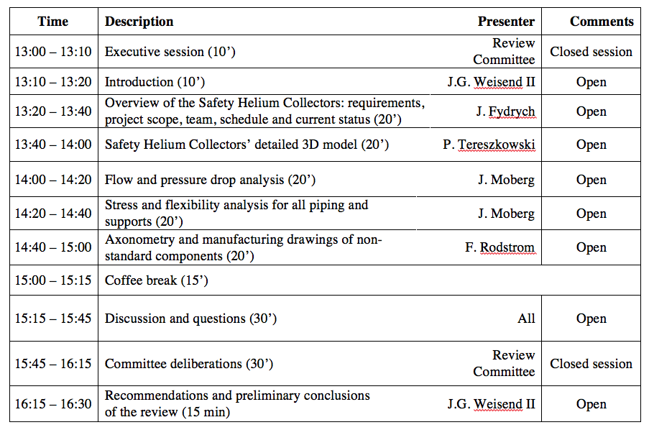
SHC CDR agenda

Slide 3
SHC project backgrounds (1/3)
In 2015 AD Safety Group with help of EIS Division investigated possible cold helium releases and propagations in the tunnel. The study revealed that during personnel access to the tunnel the most critical risk regarding ODH and cold barns is the rapid loss of the 2K helium from 1 elliptical cryomodule. The numerical analyses showed that if the CM RDs were open to the tunnel the oxygen concentration and temperature might drop to 6 % and -160°C, respectively.
Oxygen concentration and temperature distribution in the linac tunnel after
a discharge of 28.4 kg of 5K helium within 1.9 seconds from the 2 RDs of a HBL Cryomdule

Slide 4









SHC project backgrounds (2/3)
ESS Cryogenic Safety Workshop – Feb. 2016
“Technical solutions to vent the helium coming out from the burst disks of the 2K helium vessel to a safe place should be investigated. Facilities like XFEL, Fermilab and ORNL only vent the vacuum vessel of cryogenic systems in the tunnel.”
ESS Cryomodules Safety Review – June 2016
“Integrating in the tunnel a helium collector in order to discharge helium outside the tunnel is a very interesting solution in order to cope with the risk of ODH and cold burns to personnel in the vicinity of the cryomodules. The committee supports the continuation of this work with high priority, as well as the evaluation of the impact of this system on the cryomodule design and integration aspects in the tunnel. “

Slide 5
SHC project backgrounds (3/3)
ESS Change Control Board meeting – Sep. 2017
Change Request CR0163/11.00145.1 Safety Helium Collectors in the Tunnel was presented to the Board on Sept 21st, 2017
CHANGE ANALYSIS
Reason for change | Cold helium vapour coming out from the bursting disks of the 2K helium vessels in cryomodules should be evacuated outside the tunnel in order to cope with the risks of oxygen deficiency hazards (ODH) and cold burns to personnel in the vicinity of the cryomodules. The evacuation of cold helium vapour outside the tunnel has been recognized as a valuable solution by the committees of the ESS Safety Workshop 2016 (ESS-0061987) and the Safety Review of the Spoke and Elliptical Cryomodules 2016 (ESS-0063620)
CHANGE IMPACT
Schedule impact for affected projects | No schedule impact for the affected projects.
Scope impact for projects | The scope of the ACCSYS project will be increased by designing two helium collectors (preparation of built-to-print design documentation), and procuring and following-up the manufacturing and installation of the collectors in the cold linac section (SPK, MBL and HBL), CTL gallery and Cold Box Hall.
Safety Impact | Helium collectors will considerably increase the safety of works on cryomodules in the tunnel by eliminating the risks of oxygen deficiency hazards (ODH) and cold burns to personnel due to sudden and rapid cold helium discharges from the cryomodule bursting disks.
The change request was approved by CCB Chair Roland Garoby on Sep 21st, 2017
and authorized by Director General John Womerslay on Sep 28th, 2017

Slide 6
SHC function and main requirements
Function
Safety Helium Collectors are intended to collect the helium released by the rupture disks of the 2 K helium vessel of the cryomodules and vent it outside the tunnel in order to prevent exposure of the personnel to helium releases during access to the tunnel (Beam OFF mode).
Design requirements
Safety Helium Collectors shall be designed in such a way that the impact on the cryomodules design and operation is very limited:
  Maximum allowable pressure of 1.9 bar(a) at the outlet of the cryomodules’ burst disks.
  The collectors shall “behave” as if there were no collectors during Beam ON mode to limit back-pressure effects.
  Limit as much as possible the pressure drops in the connection line between the burst disks and the collectors.

Slide 7
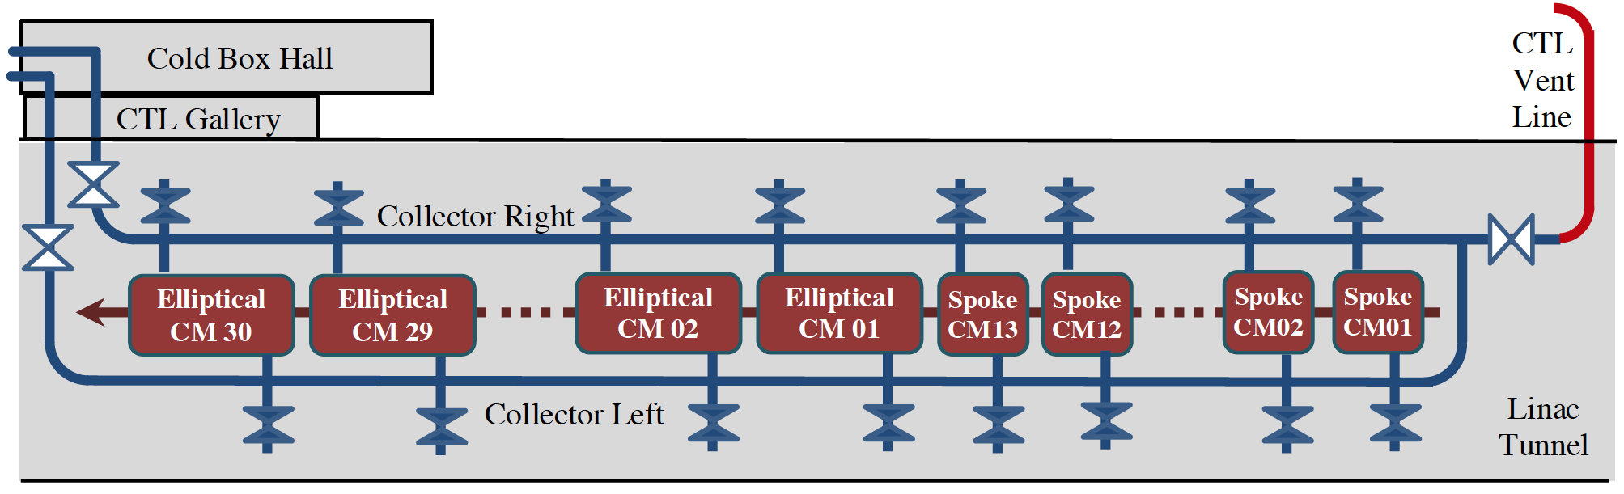
SHC conceptual layout
SHC main components
- DN300 stainless-steel welded pipes (734 m) - 73 flexible hoses DN100
500mm x 250mm ducts (20 m) - 13 lateral compensators DN100
89 shut-off valves: - 79 fixed supports
  86 VAT Series 121 gate valves DN250 - 79 sliding supports
  3 VAT Series 121 gate valves DN320 - 6 vertical supports
- 75 axial compensators DN300 - Support beam HEA120 (1260 m)
6 EN1092 flanges DN300 - 86 ISO-F flanges DN250
253 EN1092 flanges DN100 - 5 EN1092 flanges (DN80, 2xDN50, DN40, DN25)

Slide 8
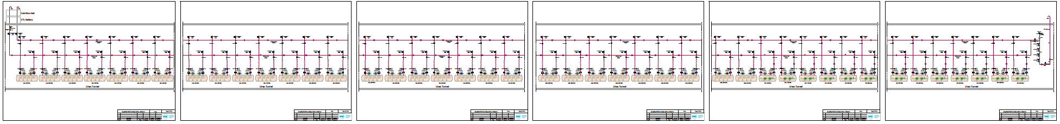
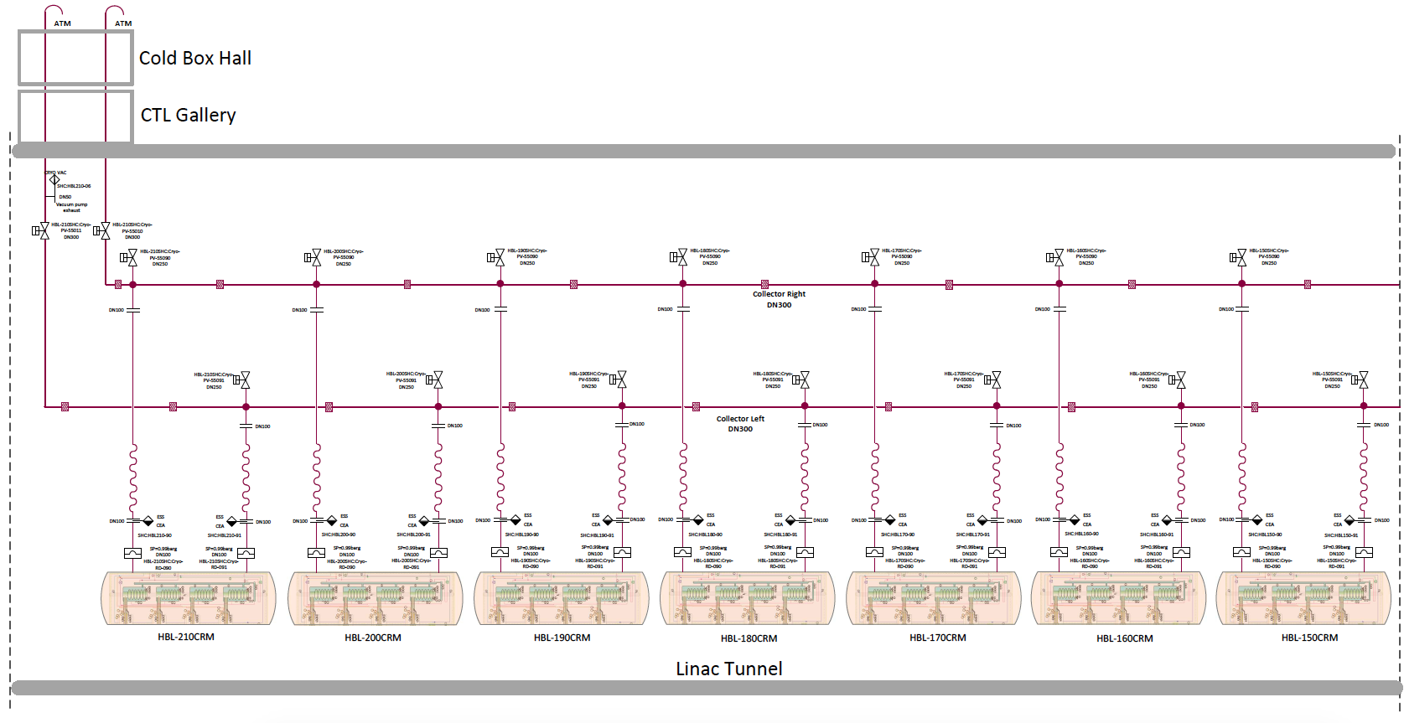
SHC Process and Instrumentation Diagram

Slide 9
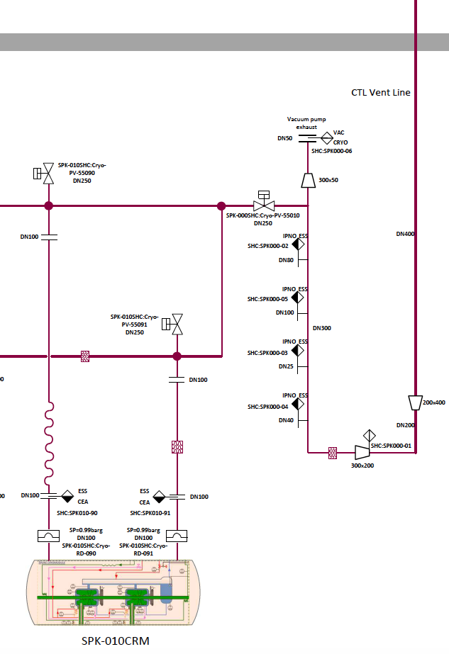
SHC Interfaces
SHC interfaces:
26 interfaces to SPK CRM RDs
18 interfaces to MBL CRM RDs
42 interfaces to HBL CRM RDs
2 interfaces to VAC pump exhausts
1 interface to the CDS Vent Line
89 Interfaces to ICS
(under discussion with Philippe Rabis)
89 interfaces to Instrument Air
(under discussion with Anthon Lundmark)
IPNO
IPNO
Interfaces are listed in ESS-0414416

Slide 10
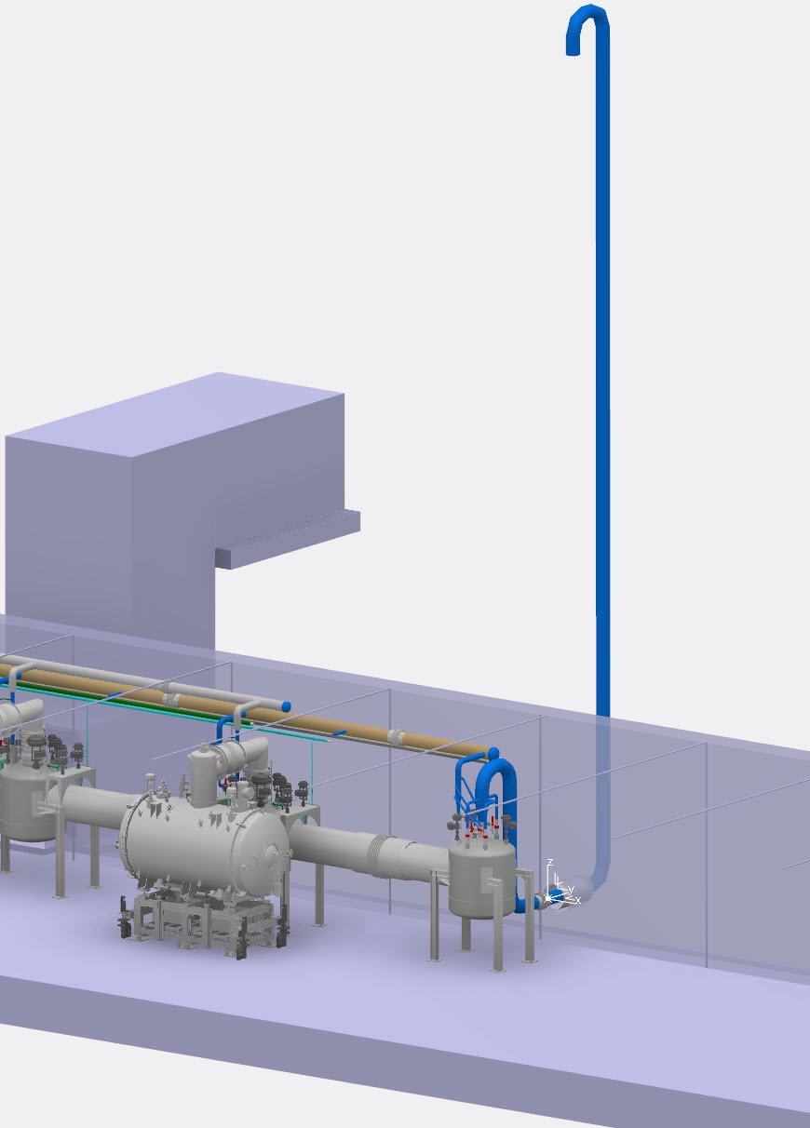
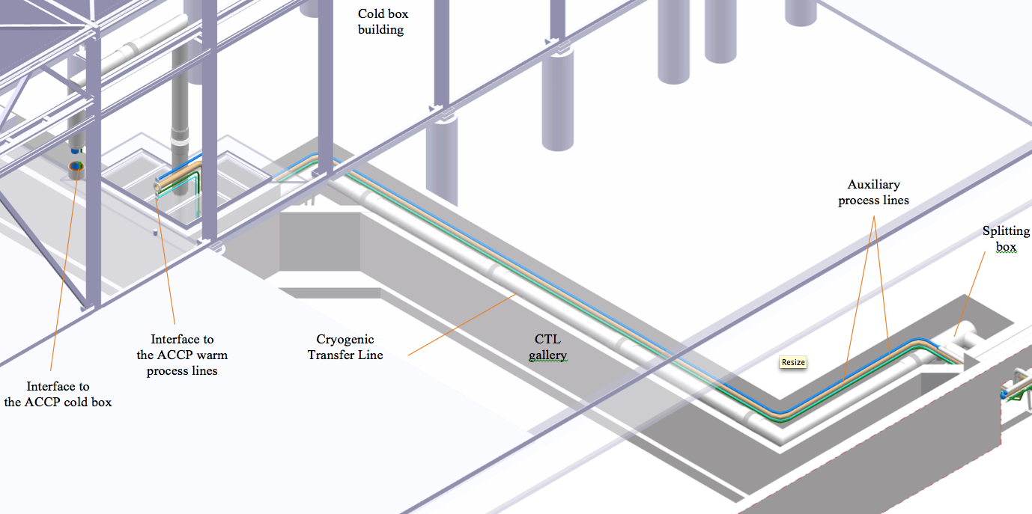
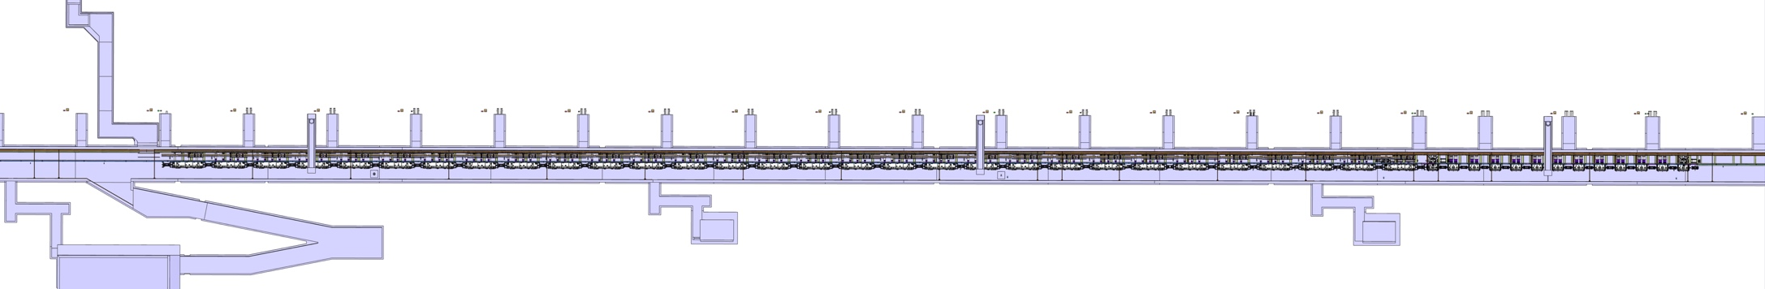
SHC location
Cold box room
L = 10 m
CDS vent line
L = 12 m, DN400
CTL gallery
L = 55 m
Linac tunnel
HEBT
HBL
MBL
Spk
DTL
315 m

Slide 11
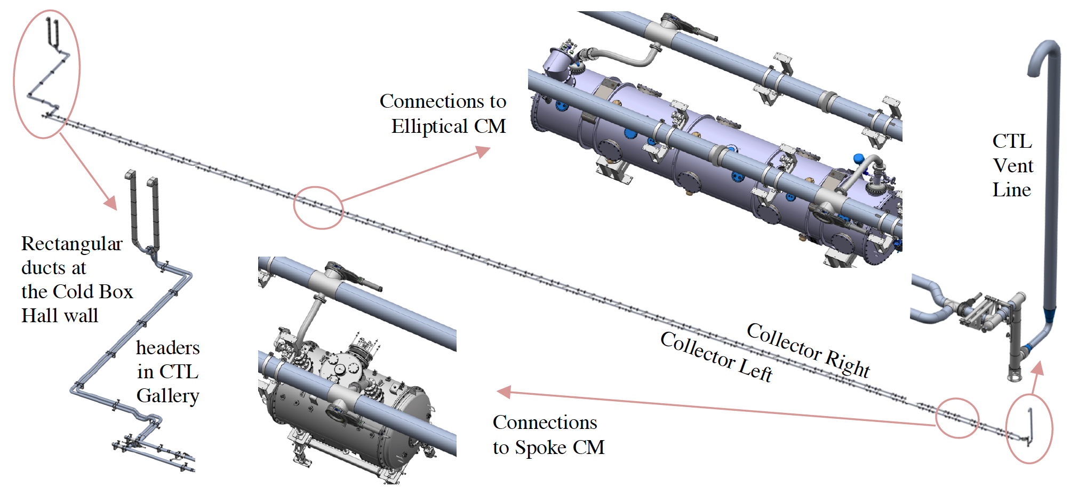
SHC 3D model
Details in Piotr’s presentation
in ESS Virtual Reality Room

Slide 12
SHC project scope
Detailed 3D model - ESS/CRYO
As-build documentation including:
    CFD analysis - ESS/EISD
    stress and flexibility analysis - ESS/EISD
    selection of flexible hoses and bellows - ESS/EISD
    selection of valves - ESS/CRYO and VAC
    2D manufacturing drawings – ESS/CRYO
Procurement of gate valves - ESS/VAC
Procurement of manufacturing and installation in the tunnel – ESS/Procurement Department
Manufacturing of the SHC pipes and supports sub-assemblies – contractor
Installation of the SHC pipes, supports and valves in the tunnel – contractor
Controls for SHC gate valves – ESS/ICS
Cabling the valves – ESS/ICS
Connections to the instrument air – contractor or ESS/UTS
Tests – contractor and ESS/CRYO

Slide 13
SHC project scope
Detailed 3D model - ESS/CRYO
As-built documentation including:
    CFD analysis - ESS/EISD
    stress and flexibility analysis - ESS/EISD
    selection of flexible hoses and bellows - ESS/EISD
    selection of valves - ESS/CRYO and VAC
    2D manufacturing drawings – ESS/CRYO
Procurement of gate valves - ESS/VAC
Procurement of manufacturing and installation in the tunnel – ESS/Procurement Department
Manufacturing of the SHC pipes and supports sub-assemblies – contractor
Installation of the SHC pipes, supports and valves in the tunnel – contractor
Controls for SHC gate valves – ESS/ICS
Cabling the valves – ESS/ICS
Connections to the instrument air – contractor or ESS/UTS
Tests – contractor and ESS/CRYO
complete
under preparation

Slide 14
SHC project team
Team member | Affiliation and position | Role in the SHC project
Jaroslaw Fydrych | AD Cryogenics Engineer | Coordination
Piotr Tereszkowski | AD Design Engineer | 3D modeling (CATIA) Preparation of 2D drawings of non-standard components
Jonathan Moberg | EISD Mechanical Engineer | CFD and mechanical calculations (ANSYS)
Frans Rodstrom | AD Design Engineer | Preparation of 2D drawings of standar components (E3D)
Xiaotao Su | AD Cryogenics Engineer | Preparation of P&ID (Visio)
tbd by CW43 | ICS Controls Engineer | Developing Controls for the SHC valves Cabling the valves

Slide 15
SHC project schedule

Slide 16
SHC installation plan

Slide 17
Thank you for your attention!
Questions?

Slide 18
SHC CDR agenda

