Slide 1
Helium collector CFD analysis
Jonathan Moberg
Notes:
Jarek, Piotr, Emil, Per

Slide 2
Outline
Main function
Modes of operation
DN300 Collector header
CDS vent line connection
Pressure calculation

Slide 3
Accelerator tunnel 15.2 kg/s during 2 s
ESS Threshold
From: Phan D. and Lundh E.:ESS ODH concept and on-going safety study presented during “Cryogenic Safety Workshop at ESS” on2016.02.10
Notes:
Filmerna visar Elliptical CM. Kör och stanna vid ca 4 s då det har tagit sig över till “Accessible side”, sedan till slutet på 10 s och berätta att det spridit sig över 30-40 m
The planes shown are just for visualization.

Slide 4
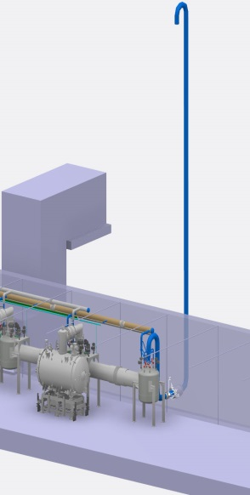
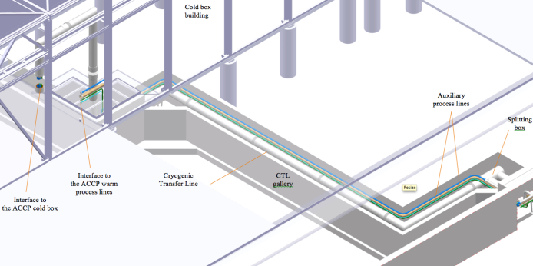
Routing of the collector
Cold box room vent line
Total length of the collector < 400 m
CDS vent line
L = 12 m, DN400
CTL gallery
L = 55 m
Elliptical and Spoke Linac tunnel
310 m
Notes:
Target left, source right

Slide 5
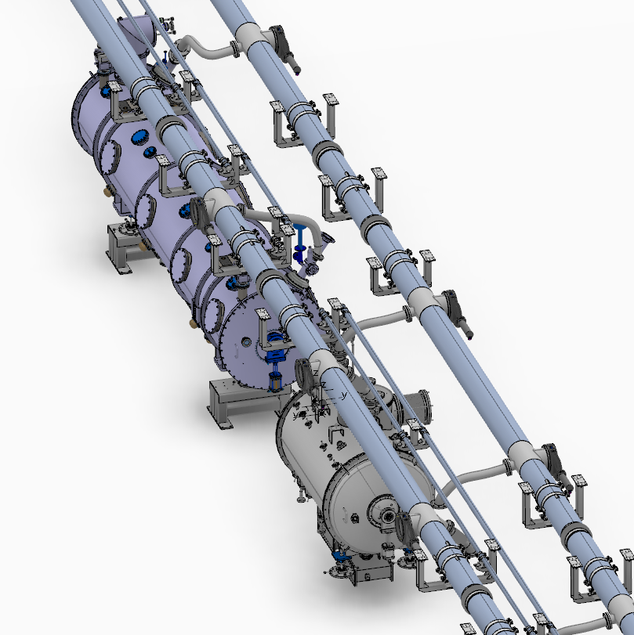
Connections to the collector header
Notes:
Overwiev collector

Slide 6
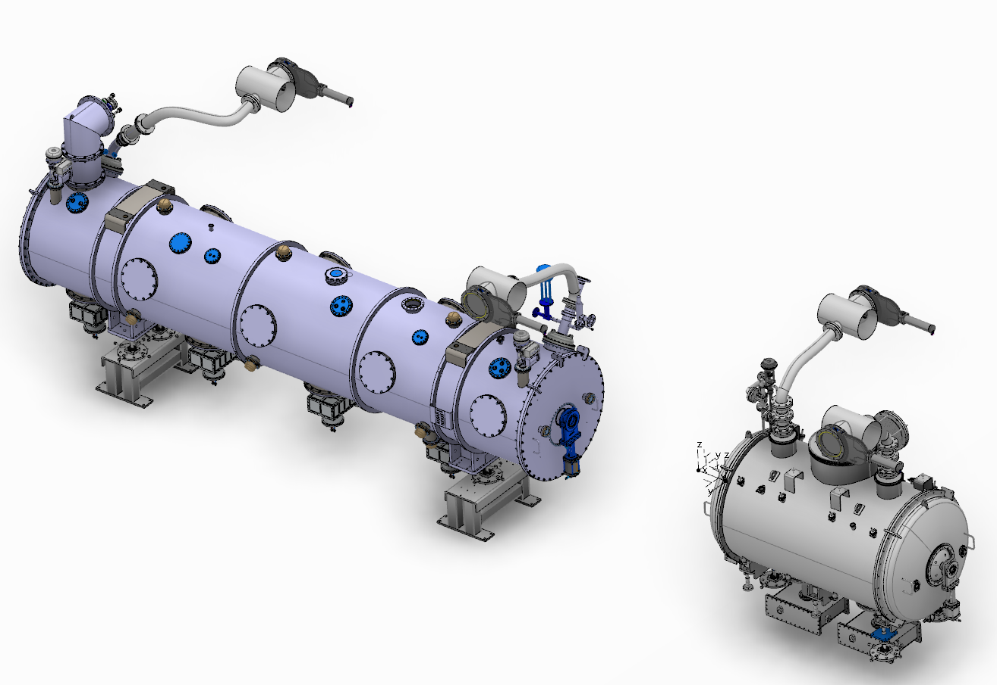
Connections to the collector header
Notes:
Clearer picture of the collector

Slide 7
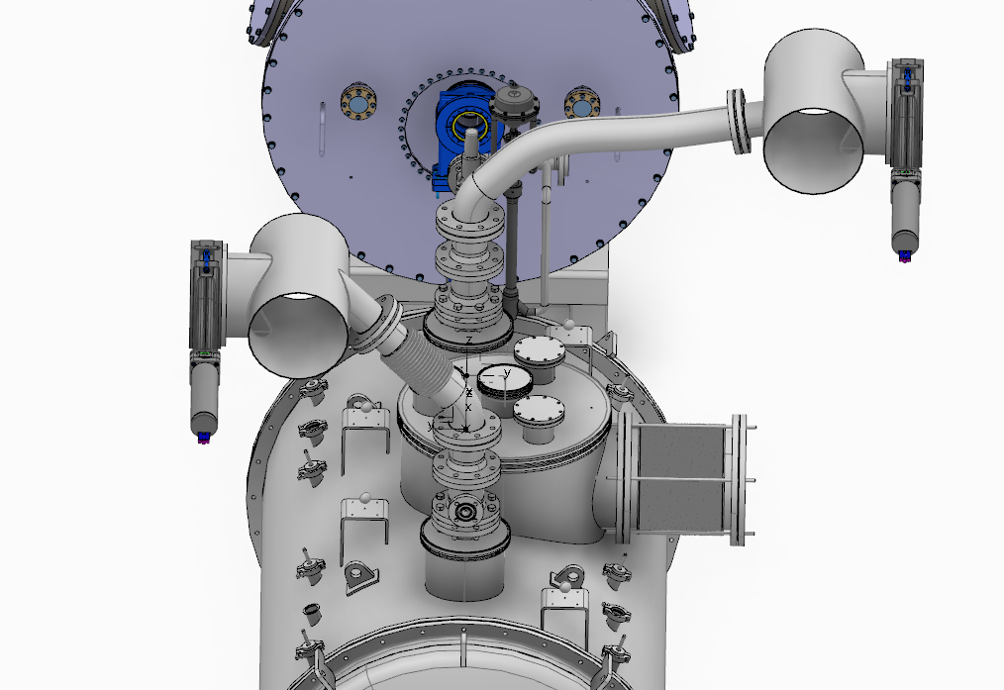
Spoke connections to the collector header
Notes:
Flexible hose and bellow on Spoke

Slide 8
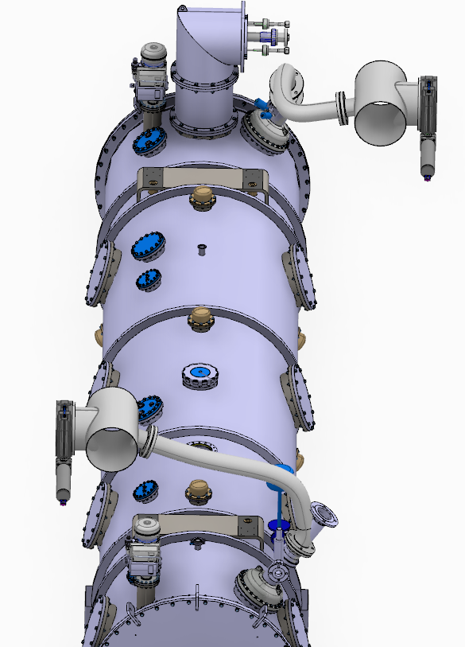
Elliptical connections to the collector header
Notes:
Flexible hoses on elliptical

Slide 9
Modes of operation
Beam on | Beam off
No people in the tunnel | People in the tunnel
Failure scenario: 6 cryomodules | Failure scenario: 1 cryomodule
All valves are open | All valves are closed
The collector is inactive | The collector is active
Requirement: Behaviour as if no collector is installed | Requirement: Evacuate Helium with a maximum pressure of 1.9 bara at the burst disc

Slide 10
Collector concept
Beam on
Notes:
Let’s talk about the three main header valves. The idea is that when the beam is ON the collector valves are open. This would create a direct link to the outside atmosphere. To avoid this we need shut off vales to close of the collector.

Slide 11
Collector concept
Beam off
Notes:
When the beam is OFF however the collector should be active. This means closing all the collector valves and opening the three shut off valves to alow the helium to flow outside

Slide 12
Calculation assumptions
Diameter of the helium collector: 2 x DN 300
Type of cryomodules: Elliptical, Spoke
Temperature at the outlet of the burst disk: 5.06 K (corresponding to the saturation pressure of the fluid)
Mass flow rate of one Spoke/Elliptical cryomodule: 4 kg/s, 7.2 kg/s
Duration of the release: 1.9 seconds
Maximum allowable pressure in the collector: 1.9 bar(a)

Slide 13
Collector concept
Notes:
Special attention needs to e paid to this region. Since the two collector join to form one singular header the pressure is due to increase. Furthermore the diameter is reduced for a stretch of the pipe further increasing the pressure drop.

Slide 14
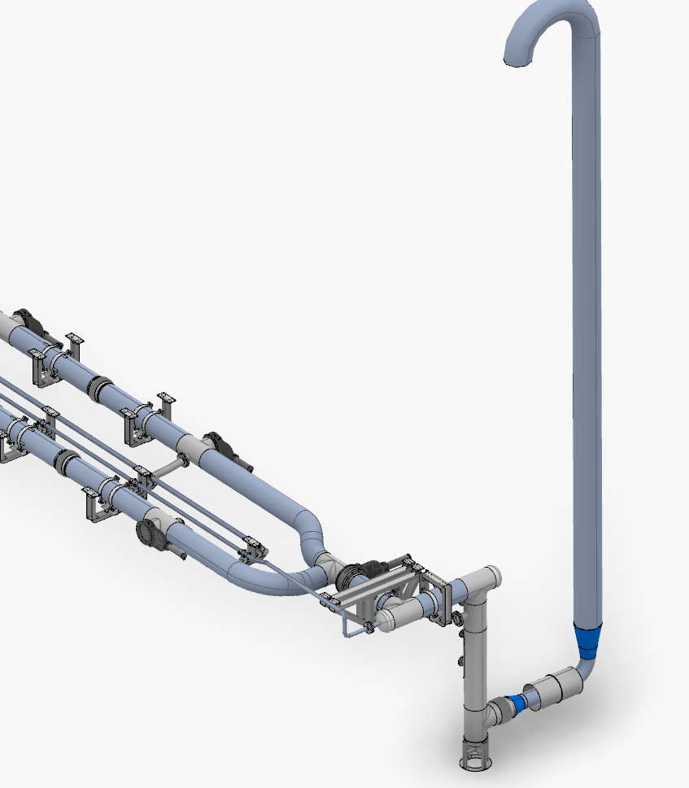
CDS vent line connection

Slide 15
Hydraulic midpoint
Notes:
To determine the ”worst case” CM to burst a hydraulic midpoint was calculated. The high pressure drop in the CDS vent line moves the midpoint towards the right in the picture. The larger flow from the elliptical crymodules makes them ”worse” then the spokes. The conclusion is that the first Elliptical is the worst case CM to burst.

Slide 16
Routing of the collector
Cold box room vent line
Total length of the collector < 400 m
CDS vent line
L = 12 m, DN400
CTL gallery
L = 55 m
Elliptical and Spoke Linac tunnel
310 m
Notes:
Target left, source right.
Here it is clear how close the CM chosen is to the CDS vent line.

Slide 17
Mesh
CDS Vent line
Tetrahedron | 577051
Prisms | 913860
Tot | 1490911
Cold box
Tetrahedron | 679913
Prisms | 1471910
Tot | 2151823
Notes:
The mesh shows the importance of the heat transfer from the walls. The walls are 25C while the helium is 5K as it leaves the CM.

Slide 18
Mesh
CDS Vent line
Tetrahedra | 577051
Prisms | 913860
Tot | 1490911

Slide 19
Mesh
Cold box
Tetrahedra | 679913
Prisms | 1471910
Tot | 2151823

Slide 20
Inlet pressure
1.61
Notes:
BLUE = CDS VENT LINE
RED = COLD BOX
Difference due to the assumption about the hydraulic midpoint.

Slide 21
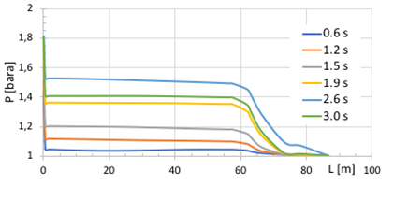
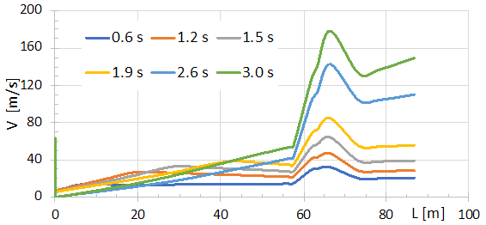
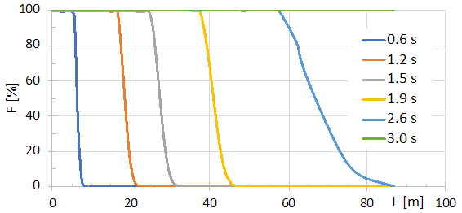
Collector CFD results – CDS vent line direction
Pressure
Velocity
Temperature
Helium fraction
Notes:
Pressure increases. Point ot 1.9s. Then decreases from 2.6 -> 3 s
Velocity increases as helium displaces air.
Temperature follows the helium concentration.
Helium concentration smothens out then at 3s all helium.

Slide 22
Validation

Slide 23
Summary
With 2xDN300 collectors the pressure stays below 1.9 bara in the event of a cryomodule venting its helium. Thereby protecting any possible personnel in the tunnel at the time without damaging the cryomodules.
Notes:
All good!

