Slide 1
Helium collector structural analysis
Jonathan Moberg

Slide 2
Outline
Overview
Bellows
Pipes
Supports

Slide 3
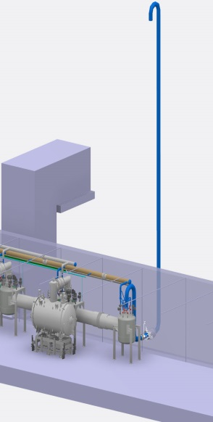
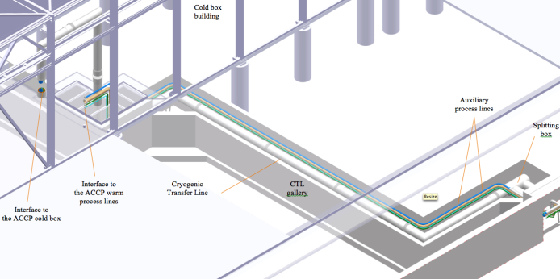
Routing of the collector
Cold box room vent line
Total length of the collector < 400 m
CDS vent line
L = 12 m, DN400
CTL gallery
L = 55 m
Elliptical and Spoke Linac tunnel
310 m
Notes:
Target left, source right

Slide 4
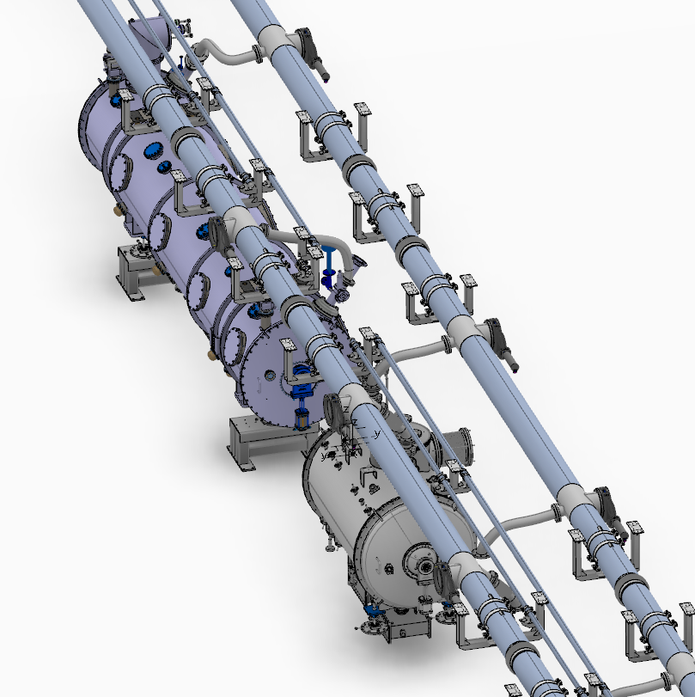
Connections to the collector header

Slide 6
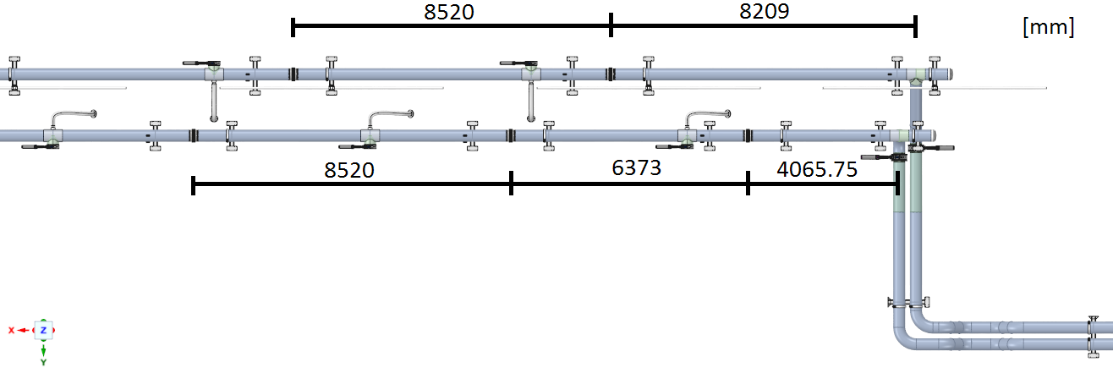
Bellows

Slide 7
Highest stress in the system

Slide 8
Deformation

Slide 9
SHC [L/R] | Cryomodule | Deformation 1 [mm] | Deformation 2 [mm] | Total Deformation [mm]
L | Spoke | 21.84 | 2.64 | 24
L | Spoke transition | 22.48 | 2.64 | 25
L | elliptical transition | 9.19 | 21.8 | 31
L | elliptical | 2.65 | 21.74 | 24
R | Spoke | 21.83 | 2.61 | 24
R | Spoke transition | 21.79 | 2.65 | 24
R | elliptical transition | 2.58 | 17.09 | 20
R | elliptical | 2.62 | 21.78 | 24

Slide 10
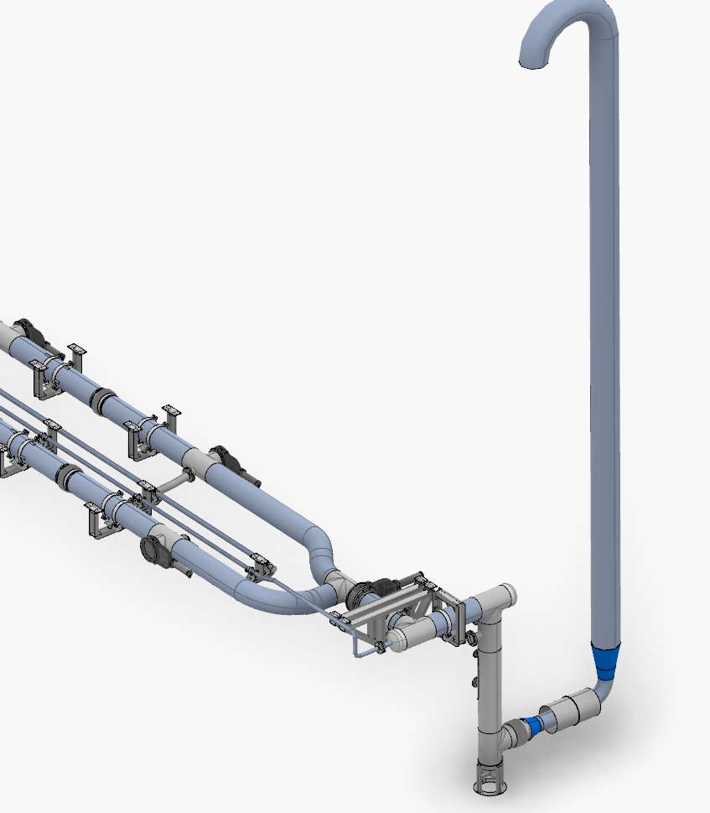
CDS vent line connection

Slide 12
Stub loads
 |  |  |  |  |  | Static pressure in the flexible inlet hose
Safety device | Type | Interface DN | Interface PN | Fz due to mass [N] | valve opening [kN] | Fx [kN] | Fy [kN] | Fz [kN]
SV91 | DIN EN 1092-1 Form B1 (DIN 2526 Form C) | 80 | 16 | -0.30 | 1.3 | -1.4 | -1.4 | -1.4
SV92 | DIN EN 1092-1 Form B1 (DIN 2526 Form C) | 40 | 16 | -0.20
SV93 | DIN EN 1092-1 Form B1 (DIN 2526 Form C) | 25 | 40 | -0.15 | 0.8 | -4.5 | -4.5 | -4.5
SV94 | DIN EN 1092-1 Form B1 (DIN 2526 Form C) | 40 | 40 | -0.20 | 2 | -4.5 | -4.5 | 4.5
RD92 | DIN EN 1092-1 Type 11 Form B | 100 | 16 | -0.20 | 5.6 | NA | NA | NA

Slide 13
Load cases
Load case | DN25 [N] | dir | DN40 [N] | dir | DN80 [N] | dir | DN100 [N] | dir
1 | -4500 | z | 4500 | z | -1400 | z | 5600 | y
2 | -4500 | y | -4500 | y | -1400 | y | 5600 | y
3 | -4500 | x | -4500 | x | -1400 | x | 5600 | y
4 | -4500 | x | 4500 | z | -1400 | x | 5600 | y
5 | -4500 | y | 4500 | z | -1400 | y | 5600 | y
6 | -4500 | z | 0 | z | -1400 | z | 5600 | y

Slide 14
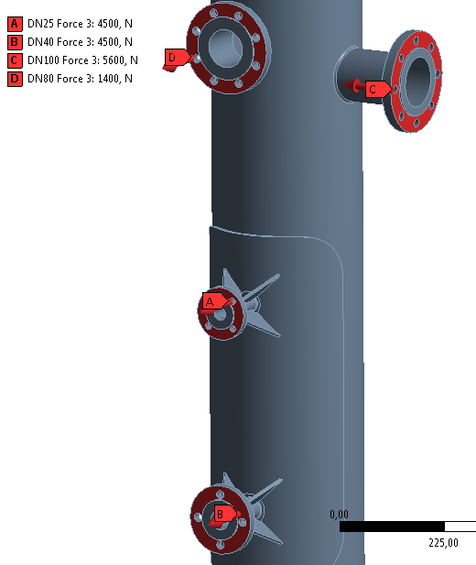
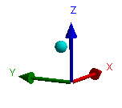
Load case 3
1.4404 |  | 1.4307
Time step | Plastic deformation [m/m] | Time step | Plastic deformation [m/m]
1 | 6.19E-03 | 1 | 6.34E-03
3 | 6.44E-03 | 3 | 6.60E-03
5 | 6.62E-03 | 5 | 6.79E-03
7 | 6.75E-03 | 7 | 6.94E-03
9 | 6.84E-03 | 9 | 7.04E-03
11 | 6.90E-03 | 11 | 7.11E-03
13 | 6.94E-03 | 13 | 7.15E-03
15 | 6.96E-03 | 15 | 7.17E-03
17 | 6.97E-03 | 17 | 7.18E-03
n_allowed | 6328 | n_allowed | 4654
Notes:
Load case 3 was identified as the worst case. Therefore another three load cycles were simulated the hardening of the material was thereby increased and the increment in plastic deformations was reduced between time step 9 and 11 compared to the increment between 3 and 5. By extrapolating the plastic deformations the structure can then withstand at least 1229 cycles.

Slide 16
Floor mounted support

Slide 17
Floor mounted support

Slide 18
F_5,5316e+005

Slide 19
F_5,5316e+005

Slide 20
Ceiling beam

Slide 21
Ceiling beam

Slide 22
Ceiling beam

Slide 23
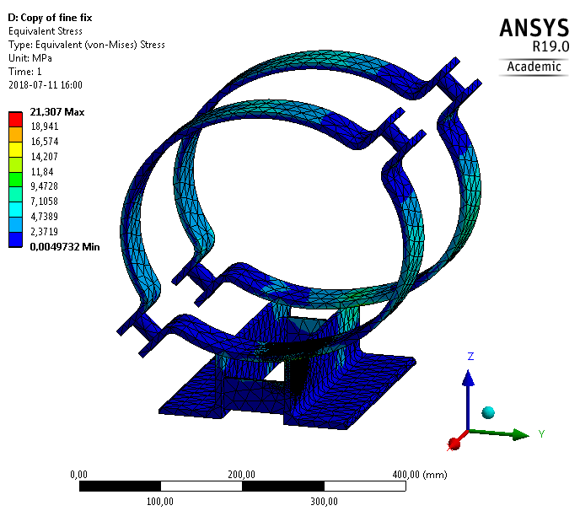
Primary supports

Slide 24
Anchors

Slide 25
Supports in the corridor to the cold box

Slide 26
Supports in the corridor to the cold box

Slide 27
Fix after the L-shaped hole

