Slide 1
CDR -presentation
Scope of design work
3D-model
Piping and isometric drawing
Pipe support drawings
Detail drawings of components
Remaining work

Slide 2
Scope of design work
3D-model
Isometric drawings
Pipe support drawings
Drawings of special components special support designs

Slide 3
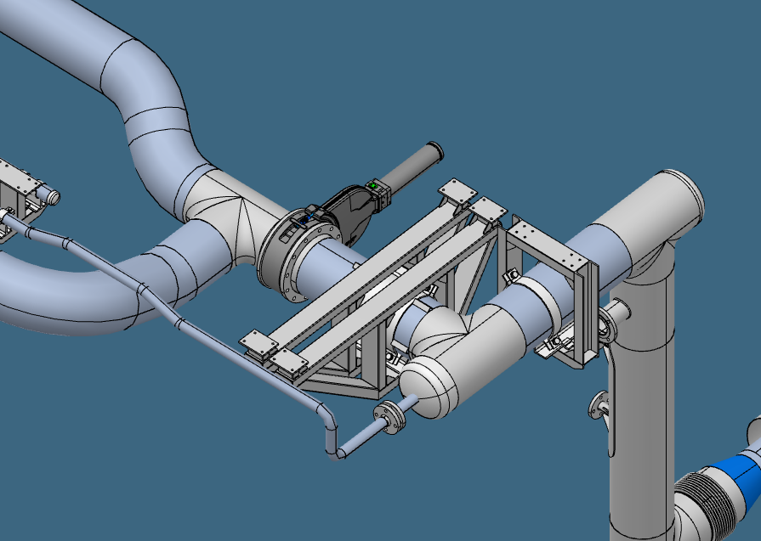
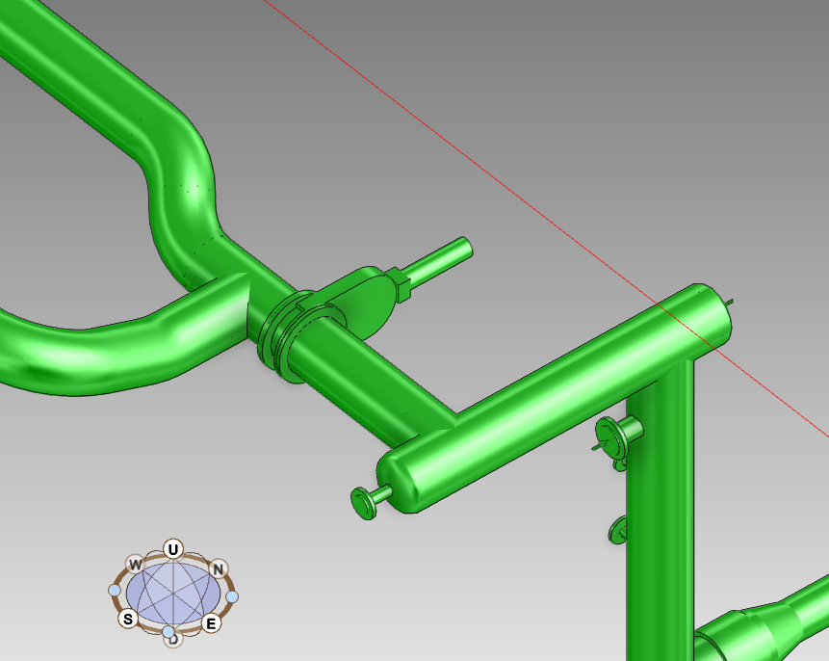
3D model – Catia and E3D
Original design made in Catia.
Design in E3D carbon copy of Catia model.
Isometrics to be made using E3D.
2D Drawings of supports and special components to be made in Catia.

Slide 4
Pipe routing through 5 different Areas
HBLG
HBL
MBL
SPK
NCL

Slide 5
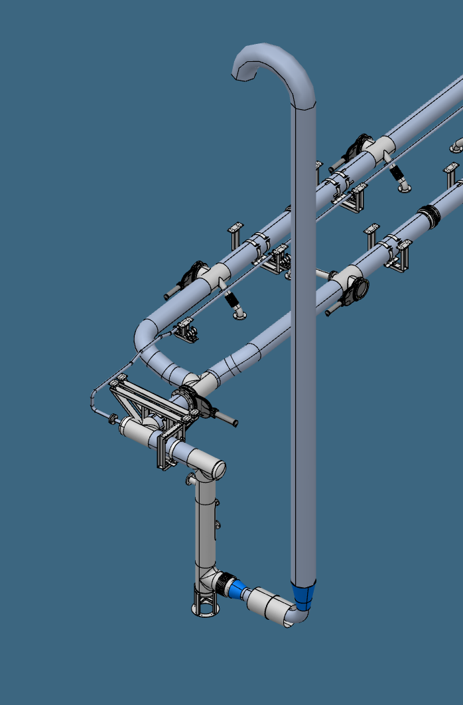
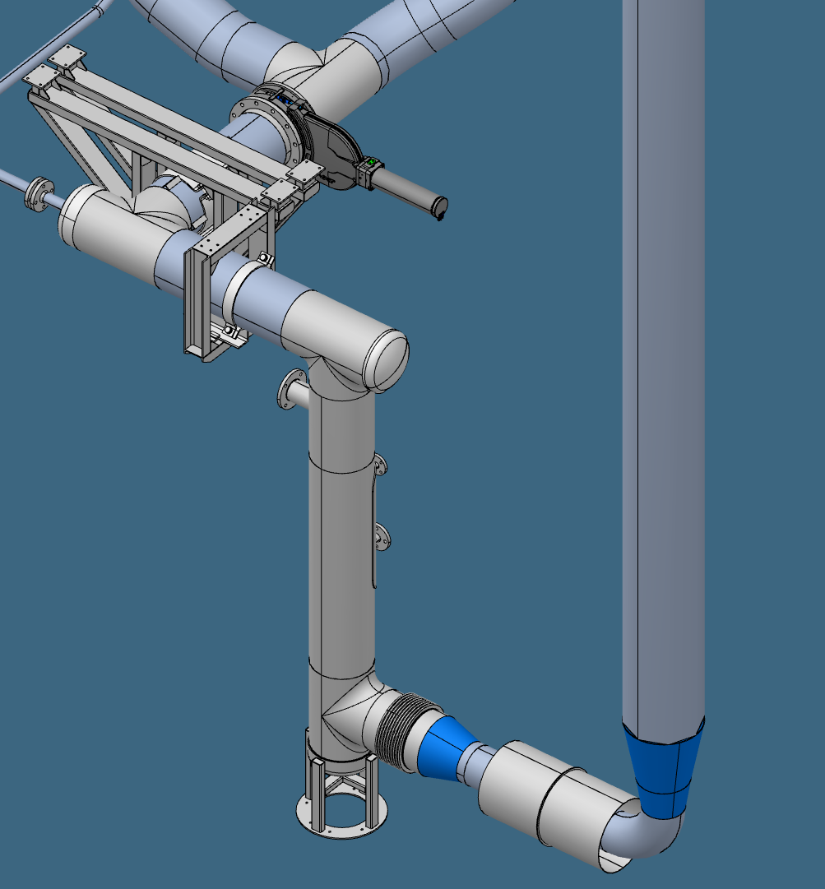
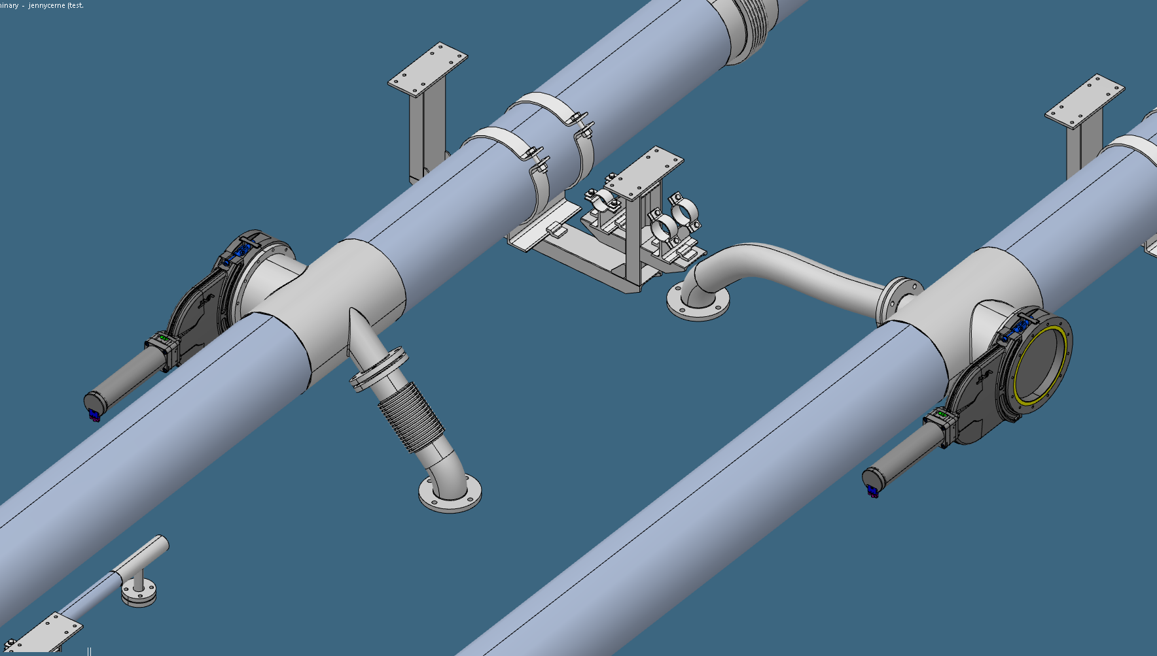
3D-model
1
3
2

Slide 6
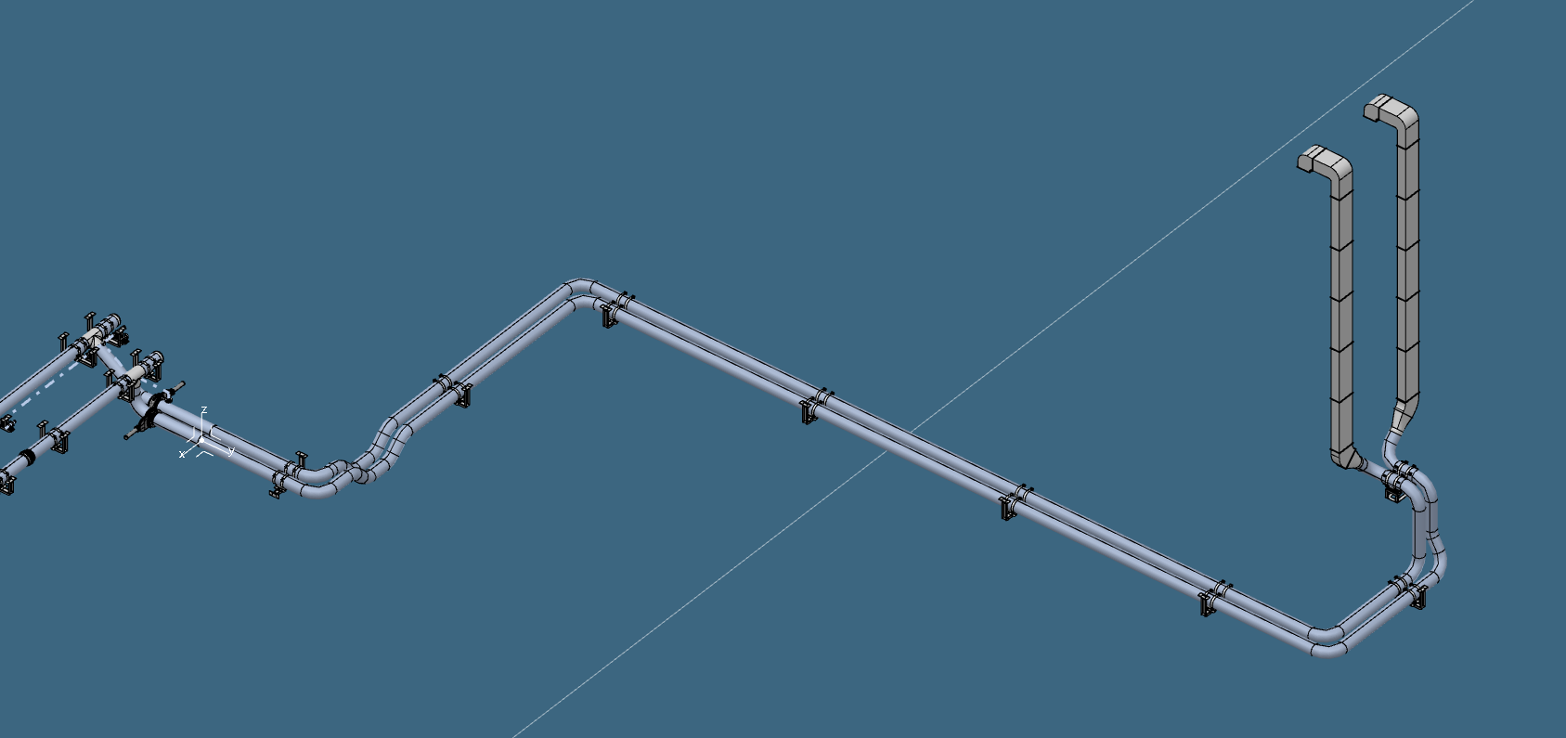
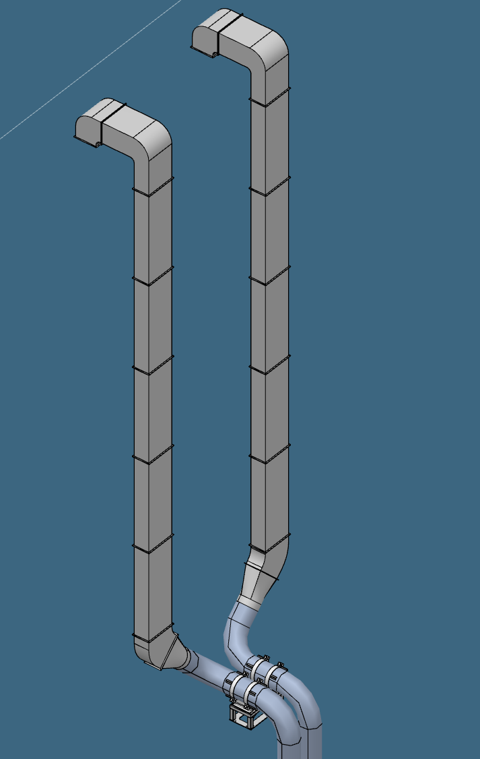
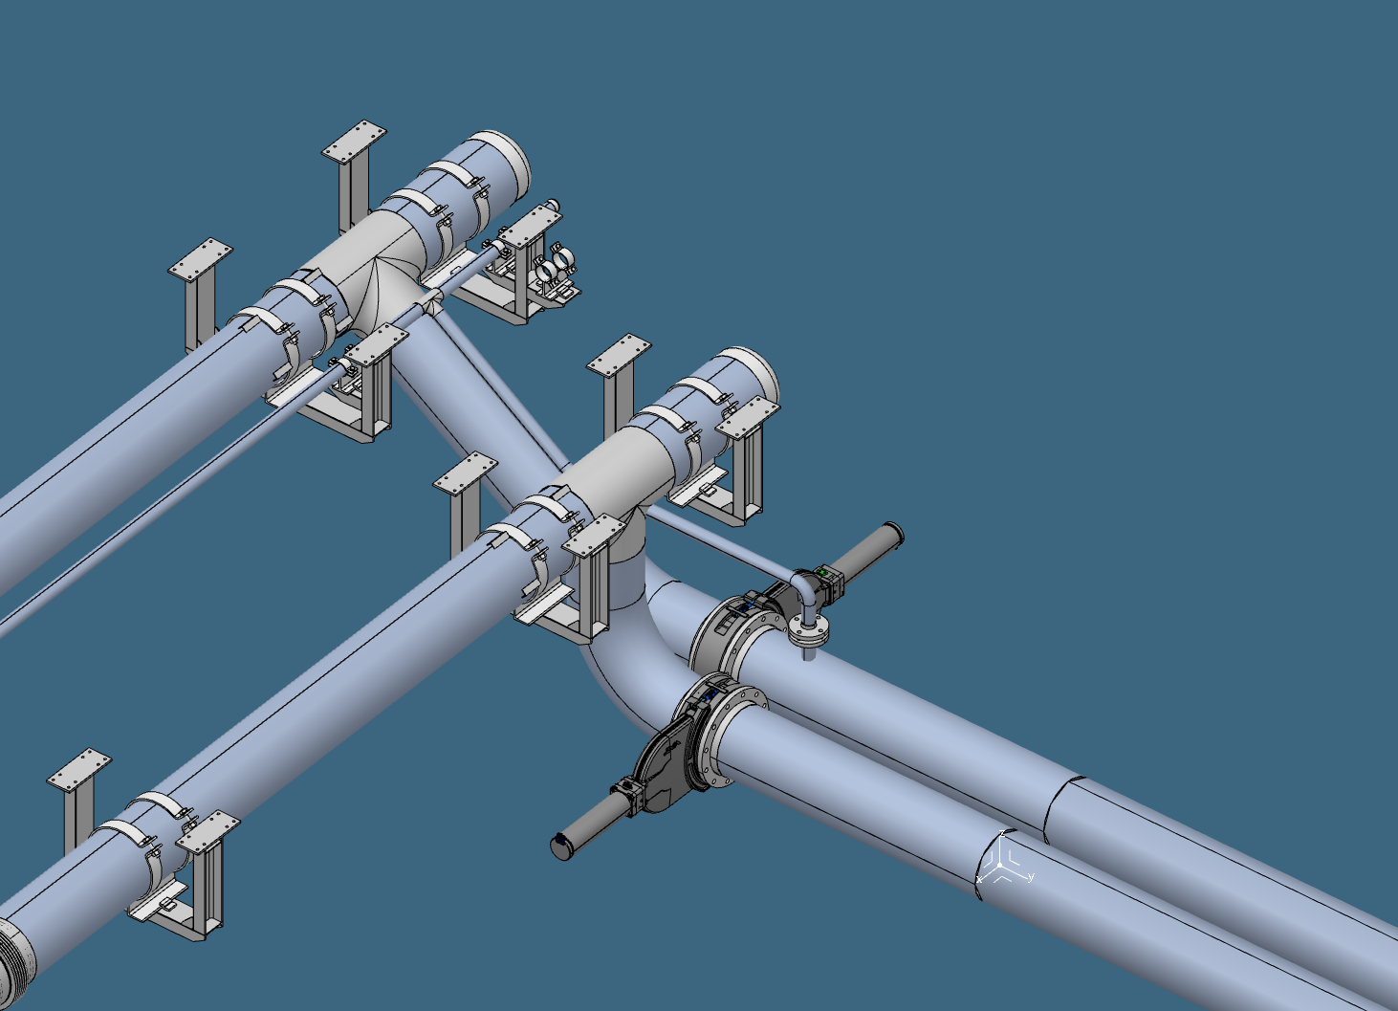
4
6
5

Slide 7
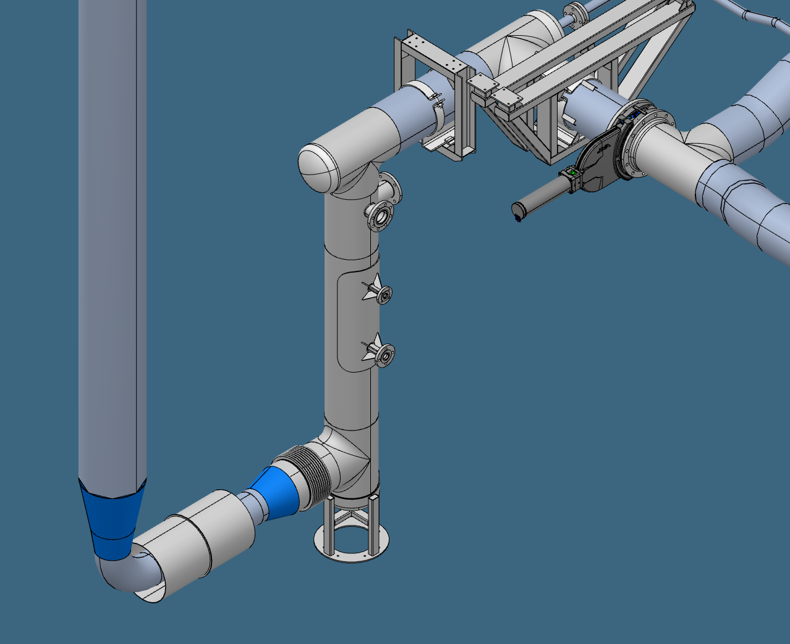

Slide 8
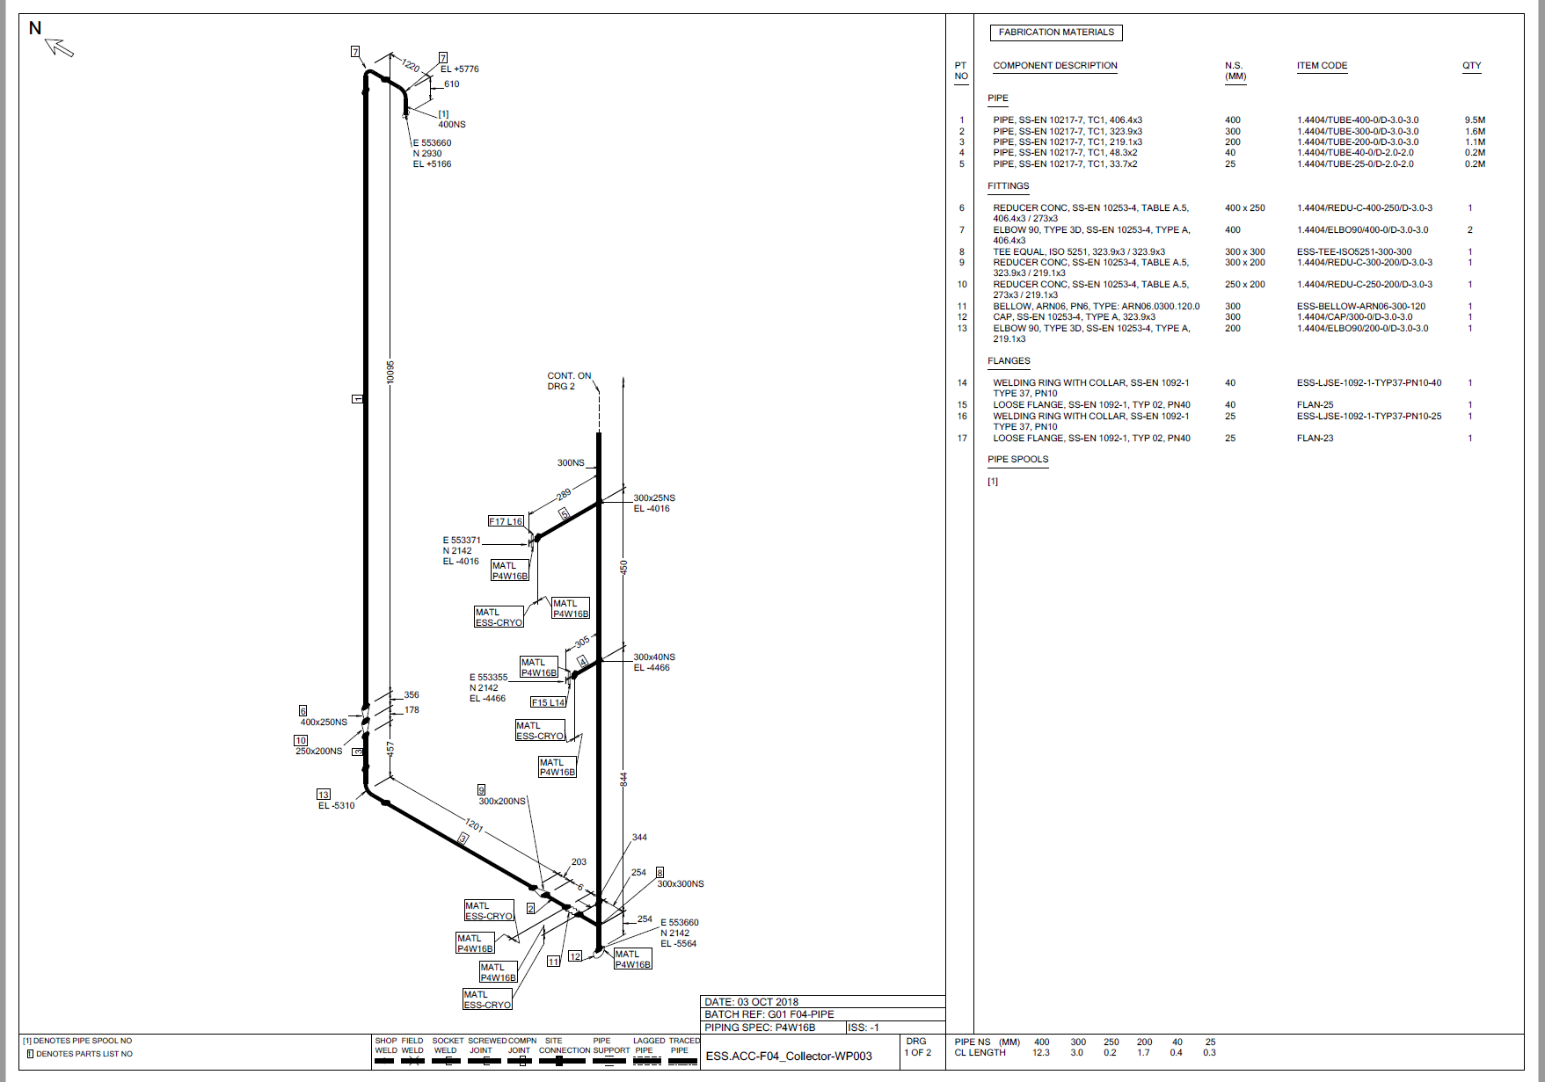
Isometric drawing

Slide 9
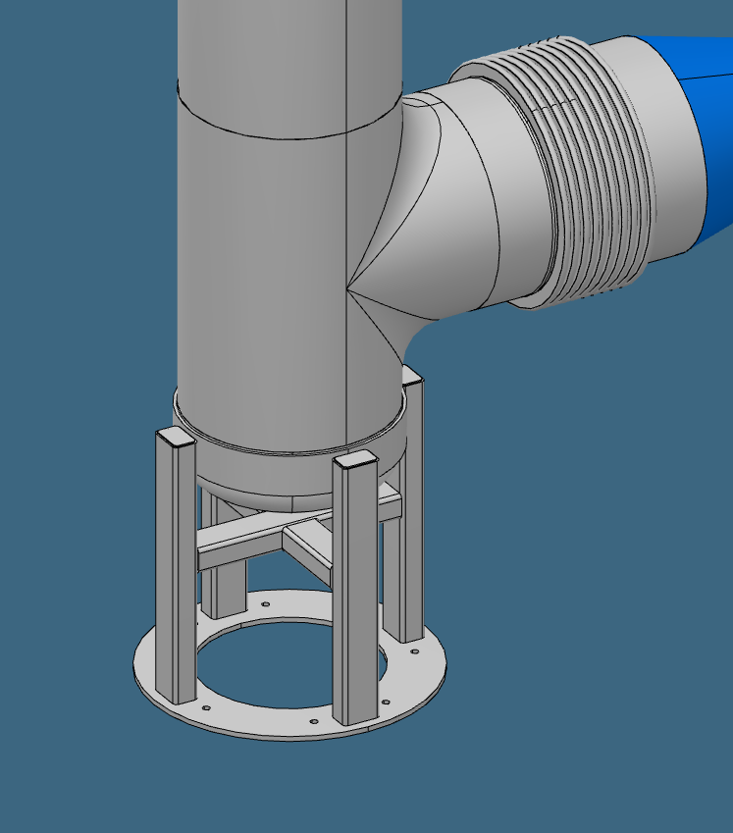
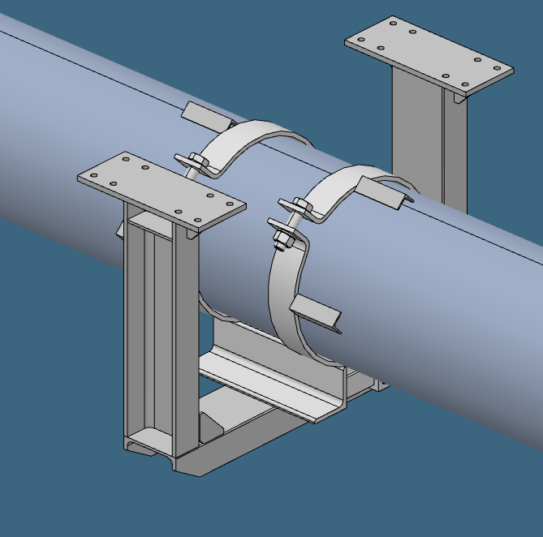
Support drawings

Slide 10
Detail drawings of special components
Components which are acc. to EN-standards do not need detail drawings.
Components which are original design or modificated EN-components do need detail drawings.
Non-standard components:
Reinforced weldolets and weldplates
4-way tees
Special reinforced SSG – Support shoe

Slide 11
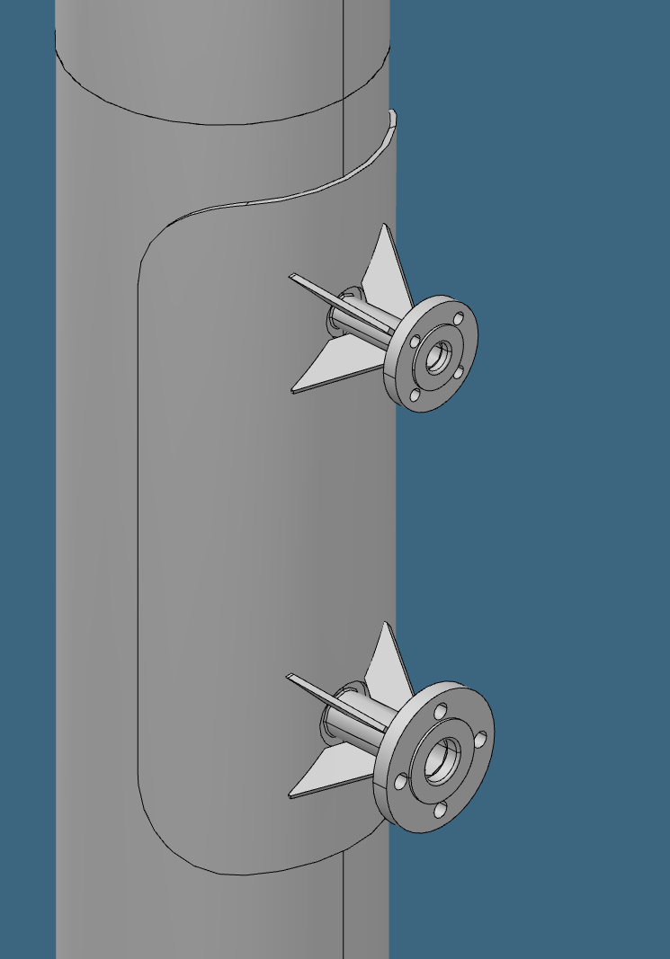
Reinforced weldolets and weldplates

Slide 12
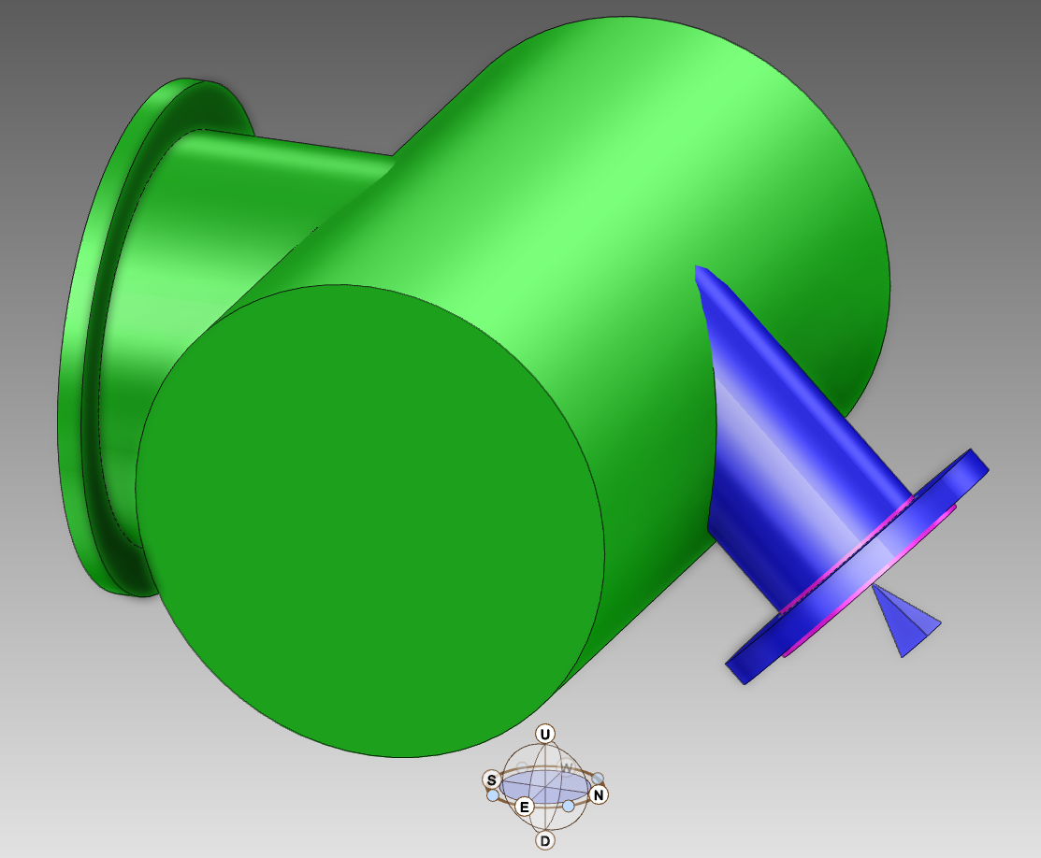
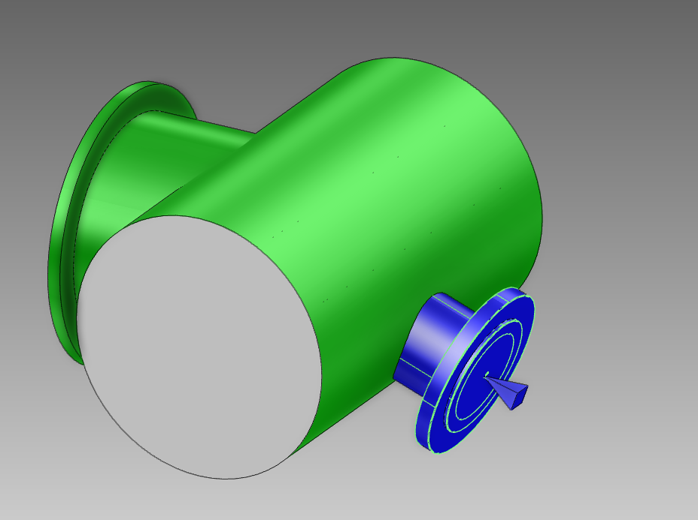
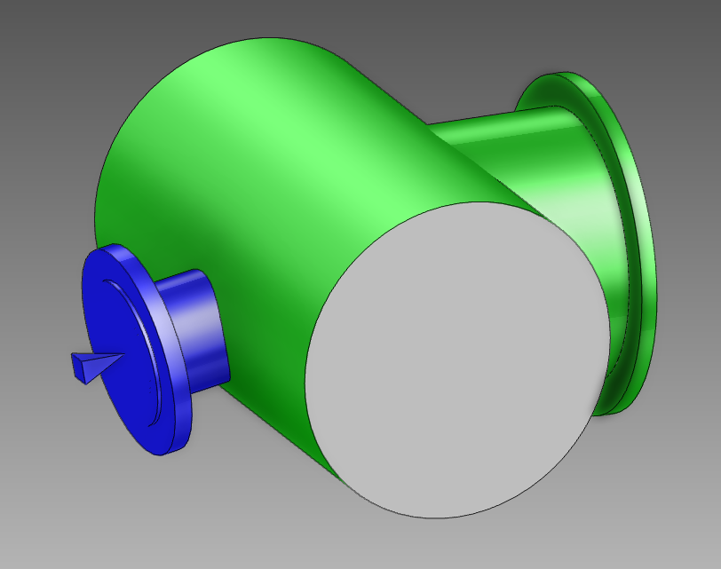
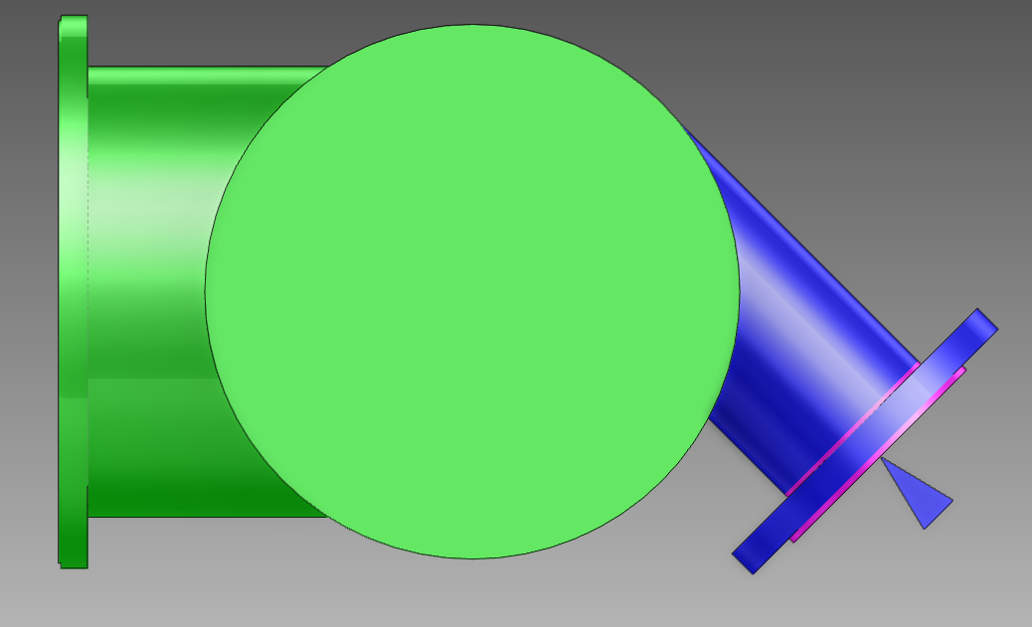
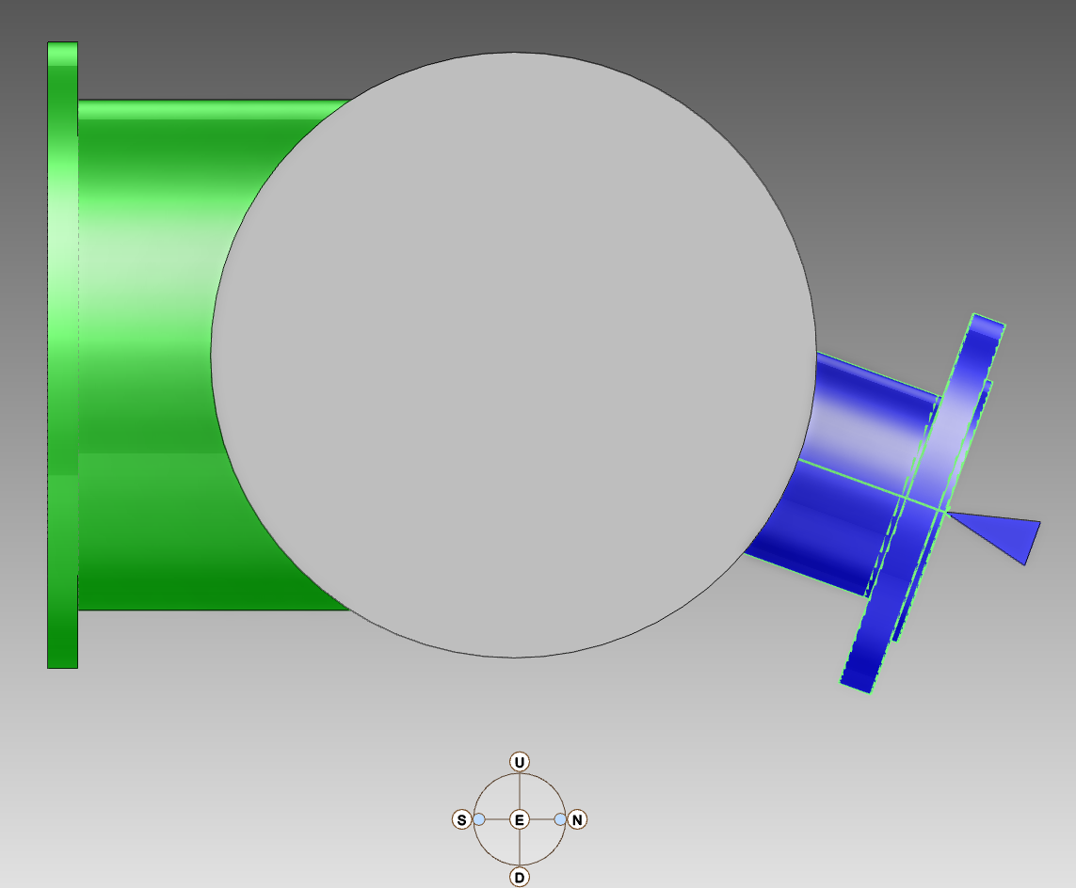
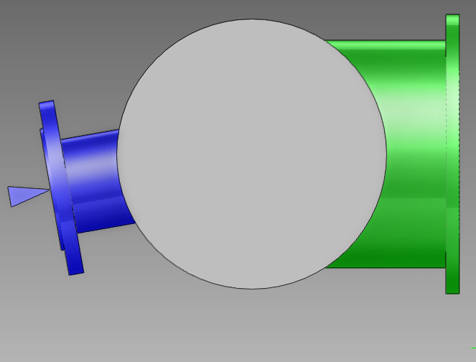
4-way tees
EN 1092-1 Tees modified with additional weld on tee

Slide 13
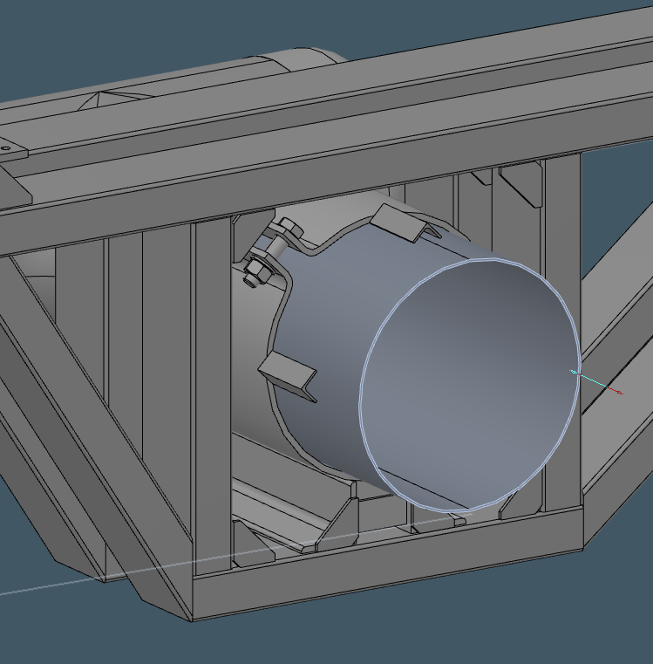
Special reinforced SSG Support shoe

Slide 14
Design work remaining:
Produce Isometrics:
Book drawing numbers
Split up pipe acc. to AREAs
Change spec on a few components
Modell SSG-support shoes
Cross-reference to support drawings and detail drawings.
Correct pipe naming and TAG acc. To FBS and P&ID.
Cross check with P&ID
Produce supports and detail drawings:
Book drawing numbers
2D-drawing production
Cross-reference to isometric drawing.

