Slide 1
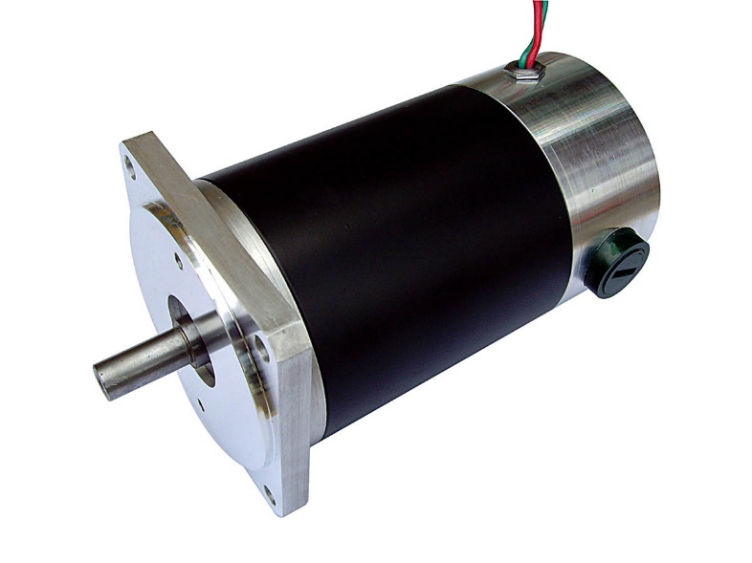
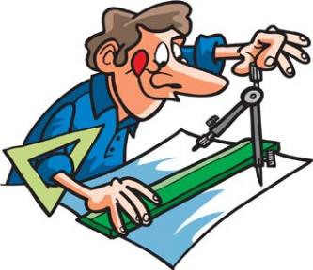
The wonderful world of motors from a mechanical engineers perspective.
Nick Webb

Slide 2
Motion control team ISIS
Steve
Nick
Simon
Ben
Kyle
Jon

Slide 3
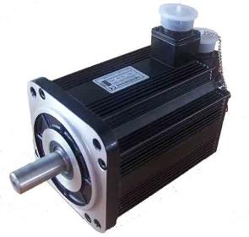
Summary
Different types of motor and the applications you might use these in
What do we need to know to spec a motor
Motor calculations worked example

Slide 4
Different types of motor and the applications you might use these in

Slide 5
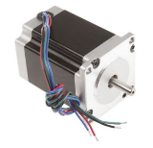
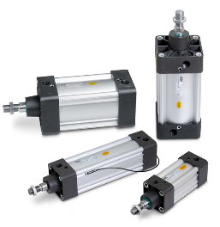
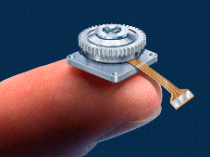
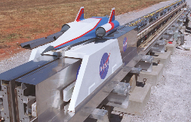
Choice of motor
Pneumatic
Hydraulic
Linear motor
piezo
Electric rotary
Stepper
Servo

Slide 6
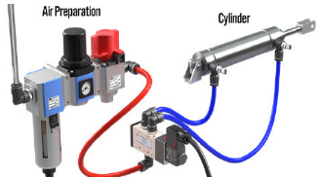
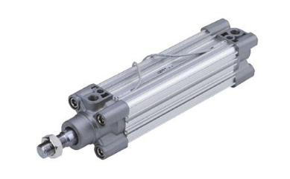
Pneumatic
PRO’S
Air is free and everywhere
Control and mechanics are basic
Can be fast acting
Good for in – out of the beam type operations
Air wont become active the same way a oil will
Clean (no hydraulic oil to leak)
Can be designed to fail safe if air is lost
CON’s
Noisy
Control is basic
Accuracy defined as dead stop

Slide 7
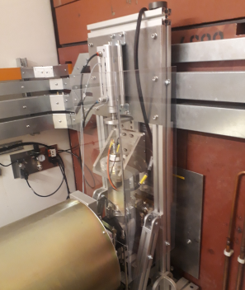
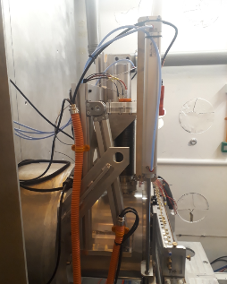
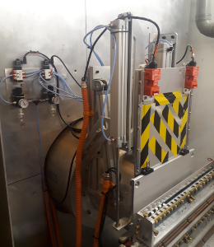
Pneumatic application
ISIS use Pneumatics for safety shutters on vacuum tanks,
Neutron monitors in and out the beam

Slide 8
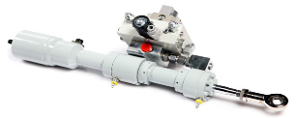
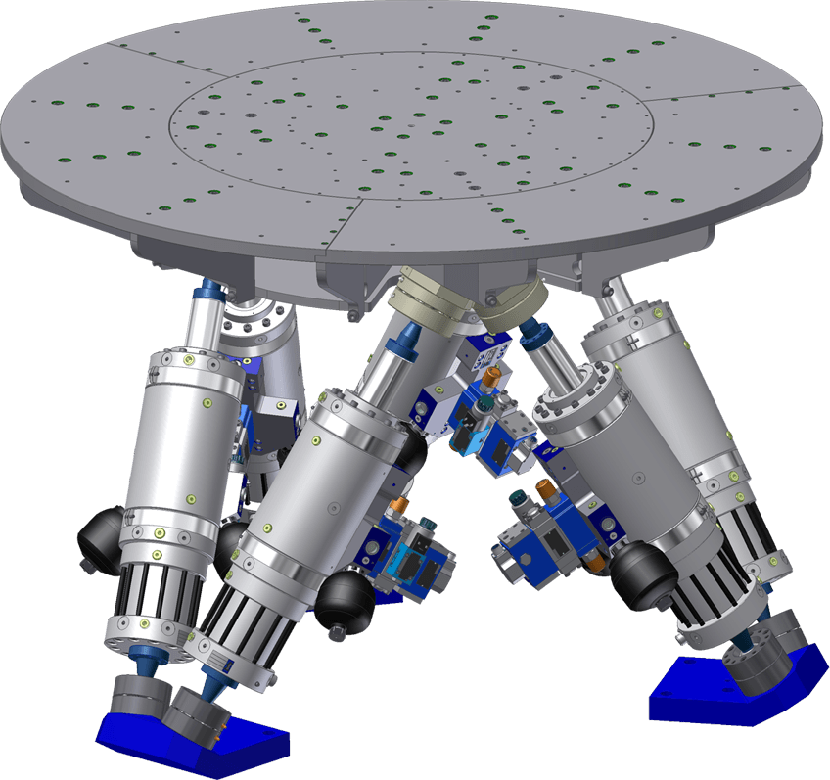
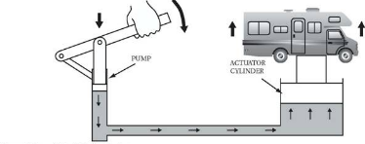
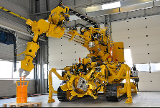
Hydraulics
PRO’S
Very high force output can be available
Smooth operation/motion profile
System has some natural damping to it and can be designed to withstand shock loading
Can be position/velocity controlled with similar methods to motors
Very suited to linear motion applications
Compact installation as pump can be located away from where force/motion is required
Possible to run many actuators of different sizes off a single pump
CON’S
Hydraulic fluid (different fluids are available) can become active when used with neutrons
Different design skill-set to electrical systems
Requires maintenance staff trained in risks of hydraulic systems
Can be messy.
Users around hydraulics must be aware of the health hazards associated with hydraulic fluid and high pressure systems or the area must be controlled to prevent their access

Slide 9
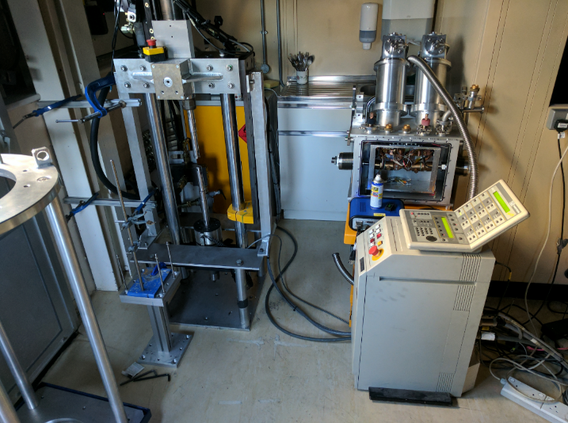
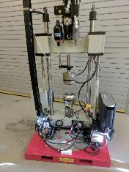
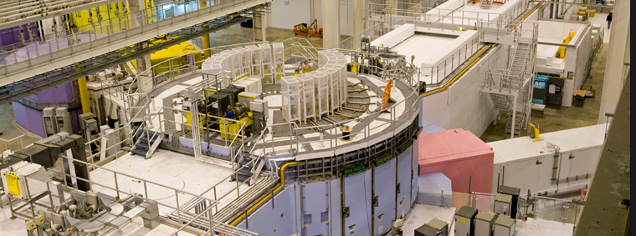
Hydraulic applications
At ISIS we use hydraulics to run the shutter on the TS2 due to fail safe properties
Engineering beamlines, stress rigs

Slide 10
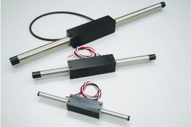
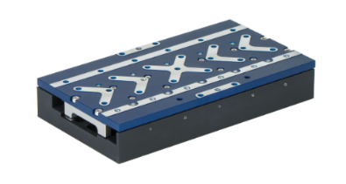
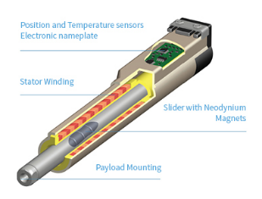
Linear motor
PRO’S
Fast motion
Compact design
Less parts in the design
CON’S
Holding force when used vertically
Not suitable for some applications
Less control over accuracy of motion

Slide 11
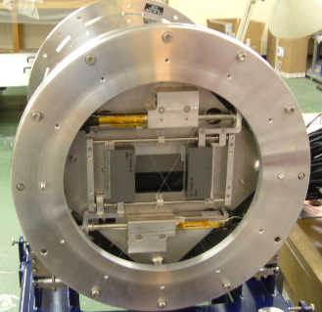
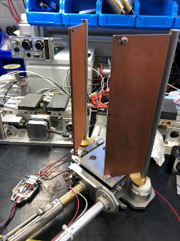
Linear motor application
Commonly used on early slit designs
Vaccum chamber slits

Slide 12
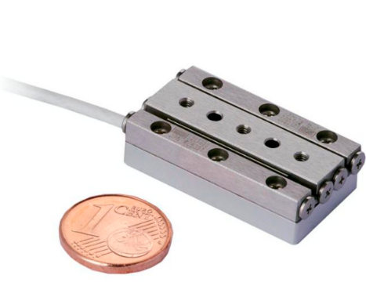
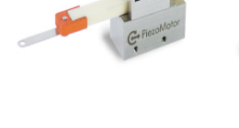
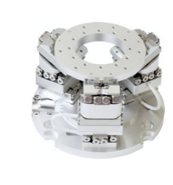
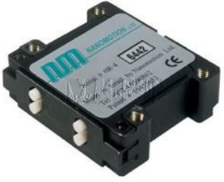
Piezo
PRO’S
High resolution
Non magnetic (polarised beamlines)
Compact assembly
Work well in vacuum
CON’S
More difficult to control
Cable length, tuning
Cable size, fragile
Maintenance
Extra controller needed
cost

Slide 13
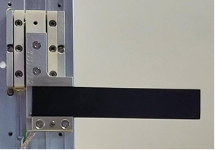
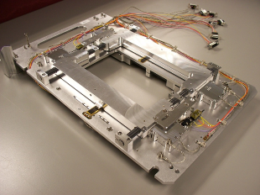
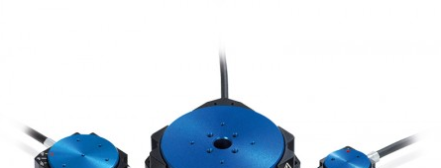
Piezo applications
ISIS use piezo motors mainly non magnetic slit assembly.

Slide 14
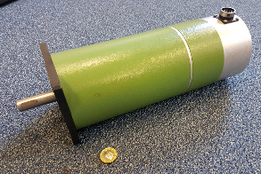
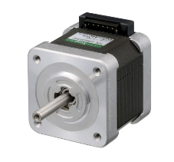
Open loop stepper motor
PRO’S
Add feedback to create a ‘Servo Stepper’ system
Now seen as a cheap option by industrial users
Inherent repeatability (step angles of 1.8° or 0.72°)
Highest torque at low speeds
Holding ‘detent’ torque
Stepper motors exist for high radiation environments
CON’S
Speed limitation (Useful speed 300 rpm
Low resolution (200 to 500 magnetic steps)

Slide 15
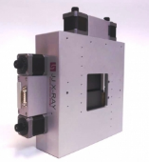
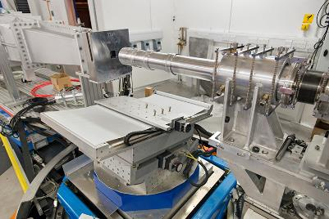
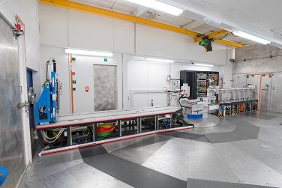
Stepper application
85% of motors at ISIS are stepper

Slide 16
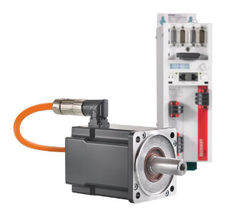
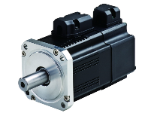
Servo Any motor with closed-loop feedback becomes a Servo system. (BLDC) Brush less DC waveform excited synchronous motor (PMSS) AC waveform excited synchronous motor with permanent magnets. Feedback can be resolver, hall sensors or encoders
PRO’S
Higher speed applications (1000 rpm or above)
Allows larger gearbox ratios to be used due to higher speed,
More torque at higher speed, useful for moving large loads
Fast response times - Useful for ‘tracking’ motion
fast error correction
BLDC motors exist for high radiation environments (Space use or ESS)
CON’S
Needs tuning and feedback to work reliably
Setup time is high compared to steppers
Can go unstable on a loss of feedback
Higher costs likely

Slide 17
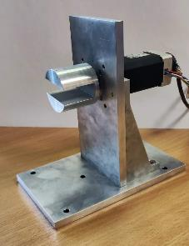
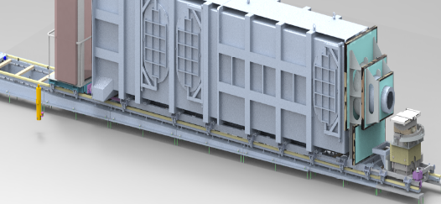
Servo applications
We use servo’s for high torque high speed applications, often stepper has torque but not speed
Freia blocker project that needed smother rotation

Slide 18
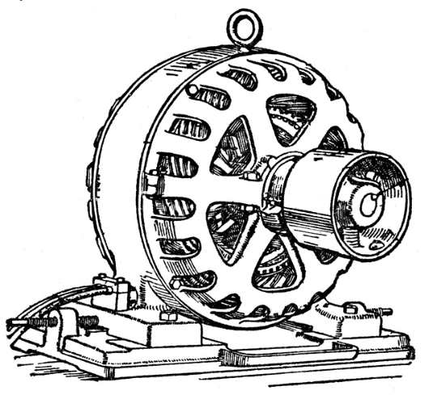
What do we need to know to spec a motor
Load
Accuracy
Speed / duty cycle
Speed vs accuracy vs load
Acceleration
Environment

Slide 19
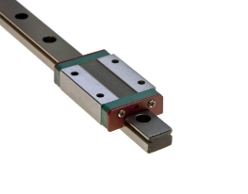
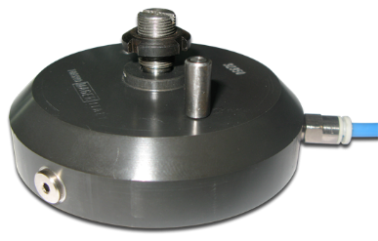
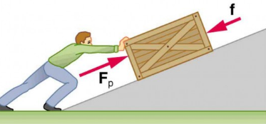
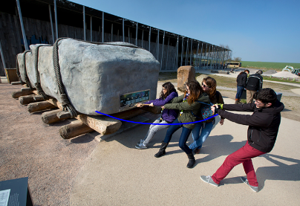
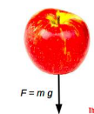
Load
Horizontal
Vertical
Gravity
Friction
Braked

Slide 20
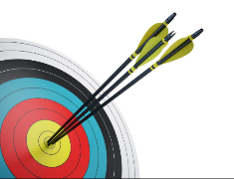
Accuracy
Calculate resolution by smallest step size
Resolution should be 10 times smaller than accuracy.
High accuracy stepper
Use full step for calculations (motion stop, power off conditions)

Slide 21
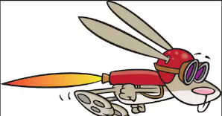
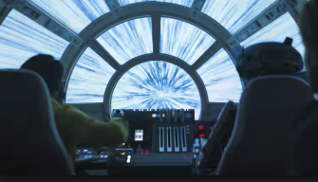
Speed
How fast do you want to move?
10mm/s vs 100mm/s
Calculate real world numbers
Safety / momentum
Sample environment
Large rotations
Stepper torque 300rpm

Slide 22
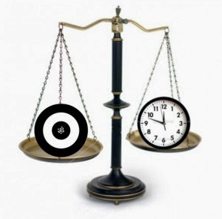
Speed vs accuracy vs torque
Motor can limit all 3 of these
Stepper 300rpm 200 steps/rotation
Can gearbox help

Slide 23
Gearboxes
Adding 10/1 gearbox
High accuracy
Low speed
Small amount extra backlash
Extra heat
Bigger assembly
Encoder, where do you put it ?

Slide 24
Gearboxes
Adding 1/10 gearbox
lower accuracy
Higher speed
Backlash is amplified
Extra heat
Bigger assembly
Encoder where do you put it ?

Slide 25
Types of gearbox
Bevel
90˚rotation change
Can drive 2 axes from 1 motor
Low friction
Multiple ratio choices
Choice of gear mesh
Spiral
Straight

Slide 26
Choice of gear mesh
Straight
+ Less Friction
+ Cheaper
+ force in all one direction
+ Needs lower spec bearings
+ less heat
Needs bigger gear to transmit force
Noise
Back lash
Spiral (Helical)
+ Lower noise
+ High contact area
+ Transmit more force
More friction
Expensive
Thrust force
Run hotter

Slide 27
Planetary or Harmonic
PRO’S
No backlash
compactness and light weight
High gear ratios 30:1 up to 320:1
Good resolution and excellent repeatability
High torque capability
CON’S
Torsional stiffness
Back winding
Cost
Efficiency can be difficult to calculate
Blue (outer circle): circular spline (fixed) Red (middle flexible circle): flex spline (attached to output shaft, which is not shown) Green (inner oval): wave generator (attached to input shaft; inner ball bearing and shaft are not shown)

Slide 28
Worm and wheel
PRO’S
High speed reduction
Silent operation
Self locking due efficiency
Compact geartrain
Can be high precision
CON’S
Manufacturing costs
Extra force needed to drive
Forces created in box
Heat
Heavy casing

Slide 29
Acceleration
How fast do you need to get up to top speed
Faster accelerations = more torque

Slide 30
What do we need to know about the environment to spec a motor
Environment
Frame size
Magnetic environment
Vacuum environment
Hot , cold
Radiation levels

Slide 31
Motor calculations worked examples

Slide 32
Calculating force needed for a motion system (Basics vertical)
Newton’s 2nd law
Force = Mass x Acceleration
Force = Mass x Gravity
N = Kg x m/s²
98.1N = 10Kg x 9.81m/s²
In an inertial frame of reference, the vector sum of the forces F on an object is equal to the mass m of that object multiplied by the acceleration a of the object: F = ma

Slide 33
Calculating force needed for a motion system (Basics vertical)
Newton 3rd law
Force = Mass x acceleration (Gravity)
Greater apposing force will create upwards motion and acceleration
When one body exerts a force on a second body, the second body simultaneously exerts a force equal in magnitude and opposite in direction on the first body.

Slide 34
Calculating force needed for a motion system (Basics Horizontal)
Friction resistive force = Input Force x coefficient of friction
Moving an aluminium block on mild steel = 0.61
Use the 10kg box
98.1N = 10Kg x 9.81m/s²
59N = 98.1N x 0.61

Slide 35
Calculating force needed for a motion system (Friction Basics Horizontal)
On roller bearings friction is 0.01
Use the 10kg box
98.1N = 10Kg x 9.81m/s²
1N = 98.1N x 0.01

Slide 36
Calculating force needed for a motion system (Friction Basics Horizontal)
On roller bearings friction is 0.01
Use the 10kg box
98.1N = 10Kg x 9.81m/s²
1N = 98.1N x 0.01
Miss alignment of rail and drive couplings will increase friction massively. This will cause the force to rise.

Slide 37
Calculating the torque needed to drive a leadscrew
Axial force, Gravity?
Lead or Pitch (distance travelled by 1 rotation of screw )
Screw Efficiency
Leadscrews: 20% - 80% Ballscrews: 90%
Efficiency of 50% or greater will back drive.
Screw lead’s less than 1/3 of leadscrew diameter do not back wind
10mm dimeter screw with 2mm lead = 41% Efficiency (< 50% will not back drive)
10mm diameter screw with 25mm lead = 83% Efficiency (> 50% will back drive)

Slide 38
Calculating the torque needed to drive a leadscrew
Torque (Nm) =
10 kg
98.1N
Torque (Nm) =
= 0.05(Nm)
Less than 50%
Wont back wind

Slide 39
Loki collimator
Specification
Maximum mass: 6,000 kg
Travel distance: 475 mm
Travel between guides: 250mm
Linear rails : f 0.01
Time to travel distance
Accuracy needed: +-0.01mm
In Vacuum
Constraints
Motor RPM : stepper useable RPM 300- 600
System Resolution (full step): 0.001mm
System lead = 1mm or 0.25mm
Screw jack constraints:
1mm lead with 200 step / rev 1 step = 0.005mm
Speed = 600 x 1 =600mm per minute
0.25mm lead with 200 step / rev 1 step =0.00125mm
Speed = 600 x 0.25 =150mm per minute
Which screwjack neither are correct ?
What about a gearbox?

Slide 40
Loki collimator Adding a gearbox
Type of gearbox?
Planetary
Ratio ?
3:1
3/1 gearbox= 600step per mm
Resolution = 0.0016mm

Slide 41
Loki collimator
Load:
Mass x Gravity x Friction
6000kg x 9.81m/s x 0.01
= 589 N = 0.6KN
Screw jack: 4mm pitch
Screw jack reduction 4:1
Load
Pitch
Idling torque
Efficiency
Efficiency
0.42 Nm =
$$\frac{0.6kN x 4mm}{2 x π x 0.65 x0.56 x 4}$$
+ 0.16 Nm
Drive torque= 0.42Nm

Slide 42
Loki collimator Torque calculation
Drive Torque M_{G}: 0.42Nm
What is Inertia??

Slide 43
Calculating Inertia ? What is inertia? I=mr²
Inertia is an object’s resistance to a change in speed.
Controlled by mass of object and distance of mass from axis of rotation
Solid diesel engine flywheel
Ultralight race engine flywheel
A figure skater on the ice. When she spins with her arms close to her body, her mass is close to her axis of rotation and her rate of spin is fast. But when she extends her arms, the distance of her mass from the axis of rotation is increased, making her inertia larger and causing her to spin at a slower rate.

Slide 44
Loki collimator Inertia
drive torque 0.42Nm
Select motor, vacuum, need to add 3:1 gearbox
Phytron vacuum steppers
350mNm torque x 3 = 1Nm (roughly)
Rotor inertia = 0.15 kg cm²
Screw jack inertia = 0.21kg cm²
To calculate load inertia =
$m. \left(\frac{p}{2π}\right)$² x 10⁻⁶
0.6 $x \left(\frac{1}{2π}\right)$² x 10⁻⁶ =1.519 x 10⁻¹² kg/cm²
Total Inertia J = 0.36Kg cm²
Inertia ratio = $\frac{inertia of load reflected to motor}{inertia of motor }$ =$\frac{0.21}{0.15}$ =$\frac{1.4}{1}$

Slide 45
Loki collimator Inertia (adding 3:1 gearbox)
Gearbox inertia = 0.03 kg cm²
J = $\frac{previous inertia }{{gear ratio }^{2}}$ + gearbox inertia
J = $\frac{0.36}{3^{2}}$ + 0.03 = 0.07 kg cm2
Inertia ratio = $\frac{inertia of load reflected to motor}{inertia of motor }$ =$\frac{0.07}{0.15}$ =$\frac{1}{2}$

Slide 46
Loki Collimator Angular Acceleration
ω’ = angular acceleration (rad/s²)
N = angular velocity (rpm)
t = acceleration time (s)
$\text{ω}\text{’}$ = $\frac{2π . N}{60.t}$
$\text{ω}\text{’}$ = $\frac{2π x 600 \left(rpm\right)}{60 x 3 (s)}$
= 21 rad/s²
$\text{ω}\text{’}$ = $\frac{2π x 600 (rpm)}{60 x 0.1 (s)}$
= 628 rad/s²

Slide 47
Loki Collimator Total acceleration torque
T_{acc} = torque due to acceleration (Nm)
J = inertia of the system (kgm²)
ω’ = angular acceleration (rad/s²)
T_{acc}=J. ω’
T_{acc}= 1.47 Nm
T_{acc}= 43 Nm
Will this work ??
Motor + gearbox torque = 1Nm
J = 0.07(kgm²)
ω’ = 21(rad/s²)
ω’ = 628(rad/s²)

Slide 48
Loki Collimator Total acceleration torque
Lower the acceleration to 6s
$\text{ω}\text{’}$ = $\frac{2π x 600 \left(rpm\right)}{60 x 6 (s)}$ = 10.5 rad/s²
T_{acc}=J. ω’ = 0.07 x 10.5 = 0.735 Nm
Torque total = acceleration torque + drive torque
0.735Nm + 0.42Nm = 1.155 Nm
Still not enough motor torque ☹

Slide 49
Loki Collimator try a bigger motor
J = $\frac{0.46}{3^{2}}$ + 0.03 = 0.08 kg cm2
T_{acc}=J. ω’
0.08 x 10.5 = 0.84Nm
0.84Nm + 0.42Nm = 1.26 Nm
Motor torque with gearbox= 2.52Nm
Factor of safety of 2
What about Accuracy? Can we achieve 0.01mm
3/1 gearbox= 600step per mm
Resolution = 0.0016mm

Slide 50
Loki Collimator speed calculation
Takes 6s to reach max velocity 200mm /minute
0.2 metres ÷ 60 seconds = 0.0033m/s
Acceleration = $\frac{change in velocity (metre per second)}{time taken }$
Acceleration = $\frac{0.0033}{6}$ =0.00055m/s²

Slide 51
Loki Collimator speed calculation
Acceleration: 0.00055m/s²
Time taken: 6s
$Distance traveled during acceleration=\frac{1}{2}$ at²
= $\frac{1}{2}$ x 0.00055 x 6²
^{0.0099m = 9.9mm}

Slide 52
Loki Collimator speed calculation
Time taken to travel between 250mm guide centres
Guide moves 10mm during acceleration and deceleration
How long does it take to travel 230mm
200 ÷ 60 = 3.33
230 ÷ 3.33 = 69s + 12s (accel +decel) = 81s

Slide 53
Loki collimator Conclusion
Torque needed to move system = 1.26 Nm
Motor and gearbox torque = 2.52 Nm
Motor and gearbox FoS = 2:1
System Resolution = 0.001mm
Time taken to travel 250mm = 81s
Could we up the RPM ?
Could we fit a larger motor ?
Check with scientist if speed is ok ?

Slide 54
Questions ??? (No difficult maths questions please)
Thankyou for you attention

