Slide 1
ESS MCAG TwinCAT
Federico Rojas Givaudan
ESS Motion Control and Automation Group
www.europeanspallationsource.se
5 November, 2018

Slide 2
Agenda
Monday Afternoon
Introduction
Presentation of TwinCAT usage
  ISIS
  FZJ
  ESS
EPICS
Current ESS MCAG software package
  Changes in the current structure and FB (proposal, discussion)
  Things missing in the structure
  Basic function blocks req. (proposal)
  Envisioned development work distribution

Slide 3
Agenda
Tuesday morning
Hands-on session
  Confluence commissioning workflows
Feedback of the workflows
  Commissioning documentation feedback
MCAG ESS TwinCAT for instruments
Wrap up

Slide 4

Round the table
Who are we?
Where do we come from?
What are we doing?

Slide 5
Objectives
Share the TwinCAT knowledge
ESS MCAG software distribution
Agree on a base structure and functions
Agree on a TwinCAT work flow between ESS and In-Kind
Action list of changes and improvements

Slide 6
TwinCAT at ESS MCAG
Federico Rojas Givaudan
ESS Motion Control and Automation Group
www.europeanspallationsource.se
5 November, 2018

Slide 7
Outline
Bitbucket and Git
TwinCAT solution structure
tc_mca_std_lib
tc_epicscommodule
MAIN
AXES( )
ERROR( )
PROG( )
Commissioning workflow

Slide 8
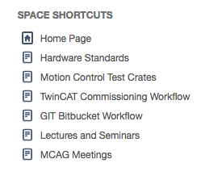
Useful links
Confluence home page of MCAG
https://confluence.esss.lu.se/display/MCAG

Slide 9
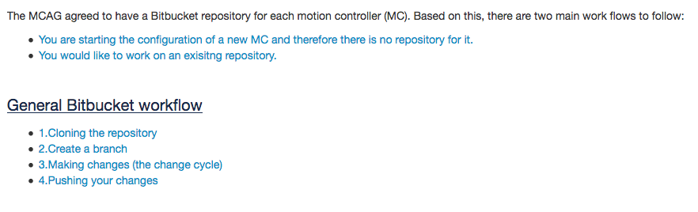
Git in the workflow
One MC (CPU), one Bitbucket repository.
https://confluence.esss.lu.se/display/MCAG/GIT+Bitbucket+Workflow

Slide 10
Git workflow
Cloning the repository
Work on a branch
  Create a new branch
  Or check out and existing branch
Making changes (the change cycle)
  Checking the changes (git status)
  Adding the changes (git add)
  Committing the changes (git commit)
Pushing your branch

Slide 11
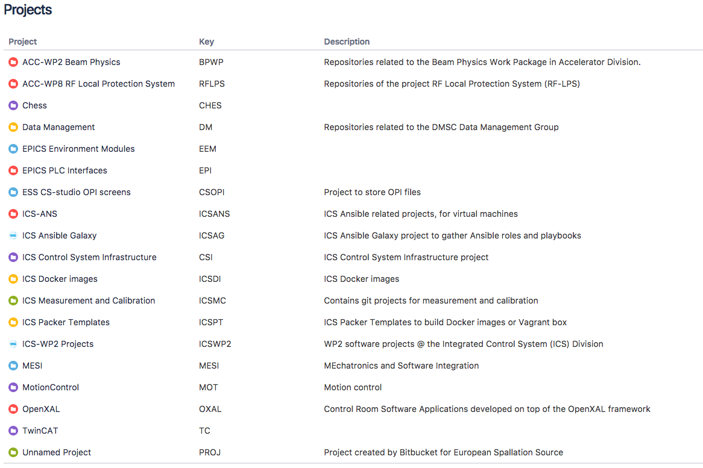
Bitbucket

Slide 12
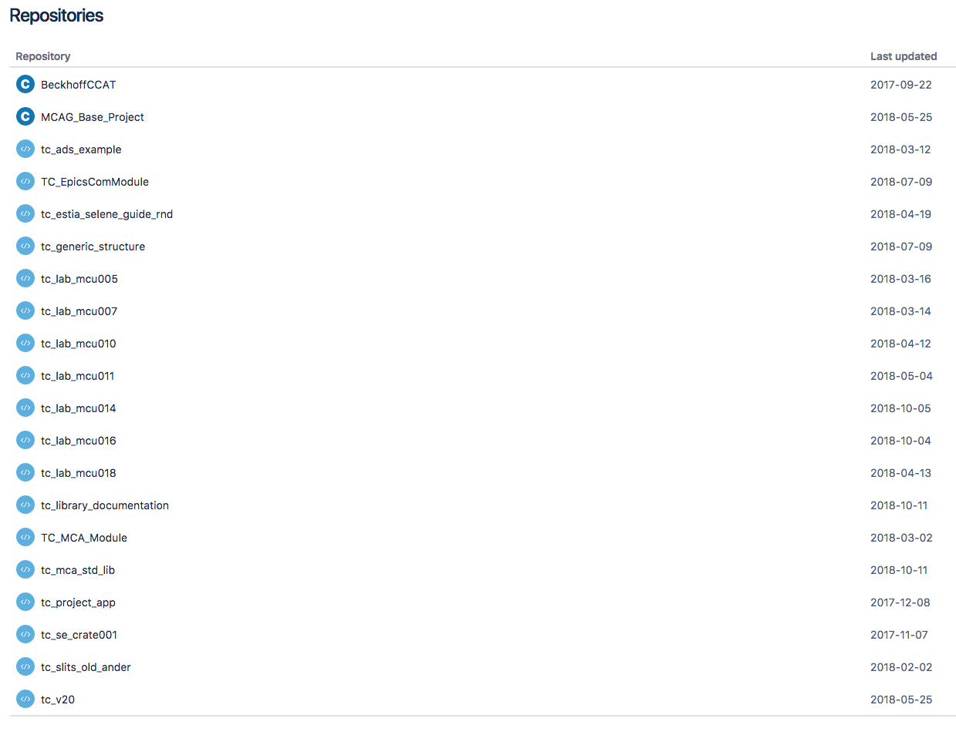
TwinCAT repositories

Slide 13
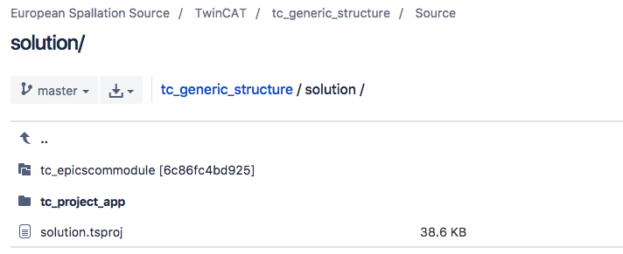
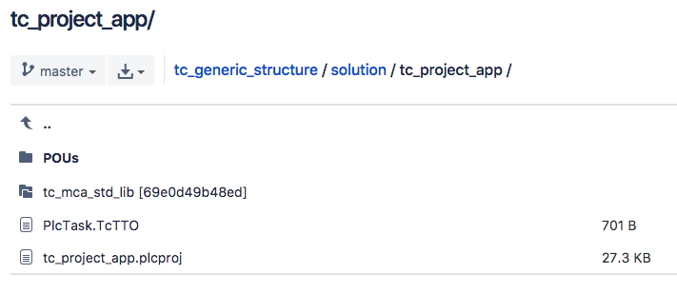
tc_generic_struct
Two submodules for easier update and maintenance
  tc_epicscommodule
  tc_mca_std_lib

Slide 14
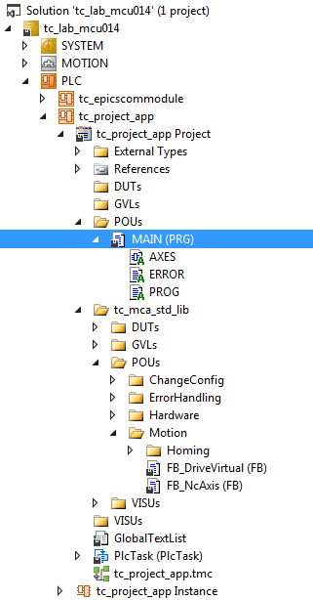
Our folder structure
tc_epicssommodule
MAIN
  AXES
  ERROR
  PROG
tc_mca_std_lib
  ChangeConfig
  ErrorHandling
  Hardware
  Motion
    Homing
  VISUs

Slide 15
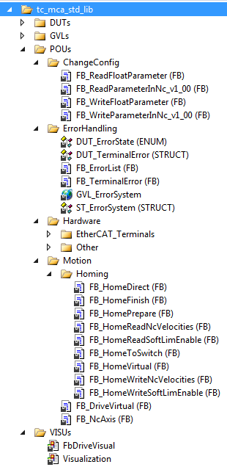
FB’s of tc_mca_std_lib
Motion
  FB_DriveVirtual
  FB_NcAxis
Hardware
  EtherCAT_Terminals
  Other

Slide 16
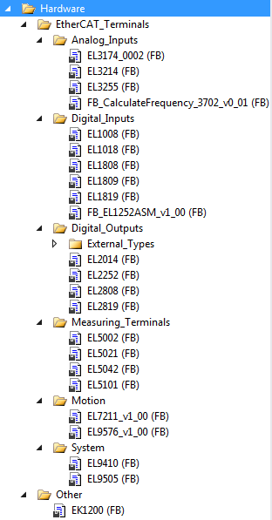
Hardware folder
All supported terminals
Easy to create new FB if necessary

Slide 17
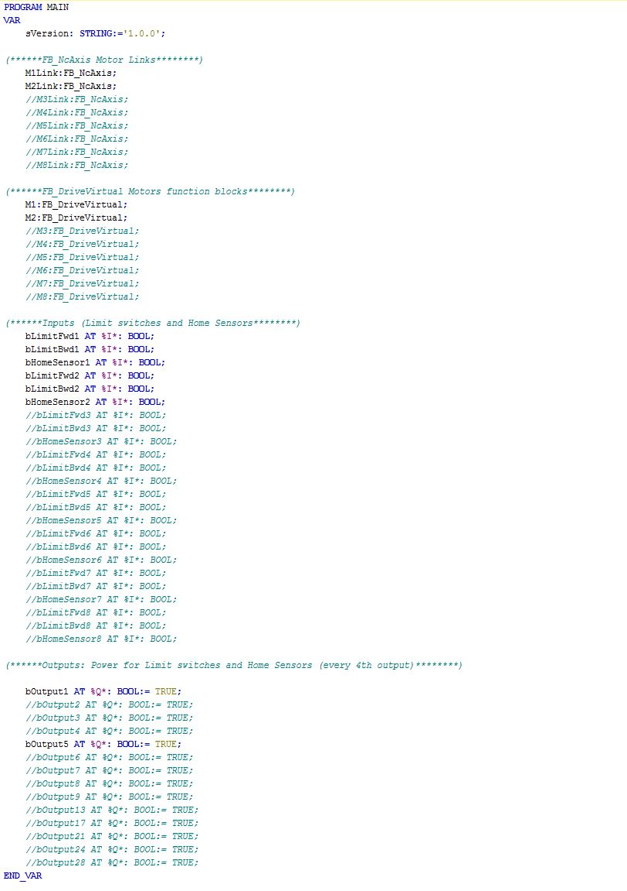
MAIN variables
Motion variables
I/O’s variables

Slide 18
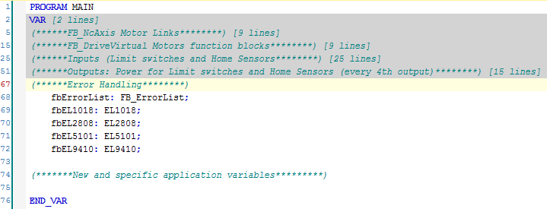
MAIN variables
Error Handling

Slide 19
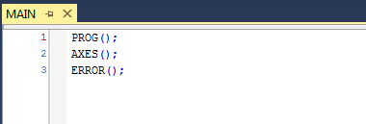
MAIN program
Calls of 3 Actions
  AXES( )
  ERROR( )
  PROG( )

Slide 20
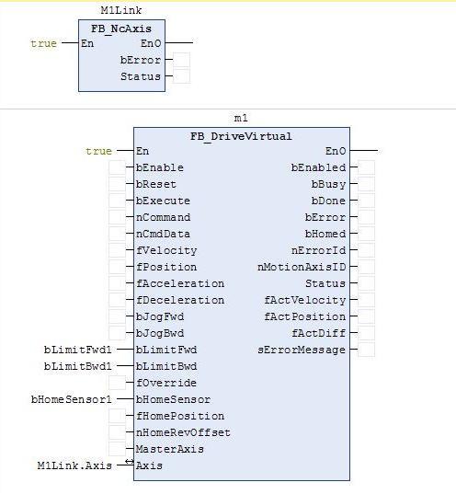
AXES( )
In FBD language
NC communication
FB for driving an axis

Slide 21
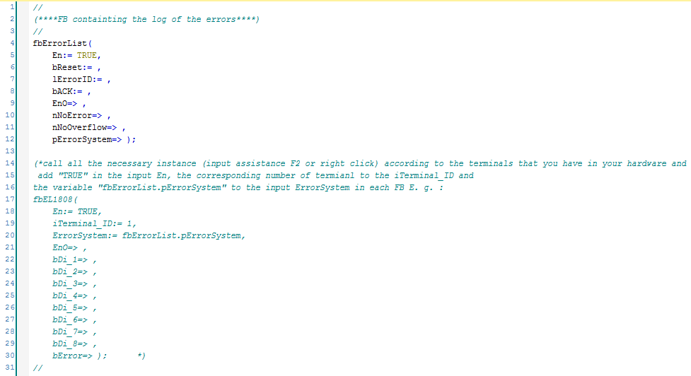
ERROR( )
In ST language

Slide 22
PROG( )
In ST language
Space for “free” programming
  MP
  Sequencing
  Etc.

Slide 23
Thank you!
Questions?

Slide 24
ESS MCAG software package
Federico Rojas Givaudan
ESS Motion Control and Automation Group
www.europeanspallationsource.se
5 November, 2018

Slide 25
Software package
TwinCAT base project in Git
https://confluence.esss.lu.se/display/MCAG/GIT+Bitbucket+Workflow
  Bitbucket (Git) used as distribution, version control and support platform
  Generic structure for all instruments
  Library containing all needed motion FB’s
  Updated and maintain by MCAG regularly
  Training provided by ESS MCAG if needed (by request or MC workshops)

Slide 26
Improvement in-kind discussion
What can be improved, what is missing?
  Improvements in the current structure and FB
  Things missing in the structure
  Basic function blocks requirements
  Envisioned development work distribution

Slide 27
TwinCAT feedback

Slide 28
Hands-on FYI
Meet in the Lab
Teams of 3
Material and datasheets in INDICO

Slide 29
Thank you!
Questions?

Slide 30
Hands-on feedback

Slide 31
ESS TwinCAT for instruments
Federico Rojas Givaudan
ESS Motion Control and Automation Group
www.europeanspallationsource.se
5 November, 2018

Slide 32
What is missing and how to continue?
Soft limit value 0

Slide 33
Wrap up
Git and Bitbucket feedback
TwinCAT structure feedback
FB’s feedback
Commissioning workflow feedback
AOB?

Slide 34
TwinCAT feedback

Slide 35
Thank you!
Questions?

